Slide 1
ISAD253SL DATABASES
Lanka Tours Database
Group Members :- 10602218
10602194
10601949
10601950
10602203

Slide 2
CONTENT
Introduction
EER Diagram
Relational Mapping
Data Normalization
Create Table SQL Statements
Database Diagram
Triggers
Function statements
View statements
Procedure statements
Critical Appraisal and Comments on future implementation

Slide 3
Introduction
This database develop for Tour Management system to maintain of customer , employee , reservation , payment , tour , vehicles and itinery conduct by lanka tours company.
We want some assumptions when we design this enhanced Entity Relationship diagram. After design EER diagram we sketch the relational mapping. After that we normalized all the tables. When we develop this database we use MYSQL server. Using MYSQL we create Tables, Constraints , Views , Triggers , Stored Procedures , User Define Functions. Some assumptions are taken for make easier to work with system, flexible users friendly.

Slide 4
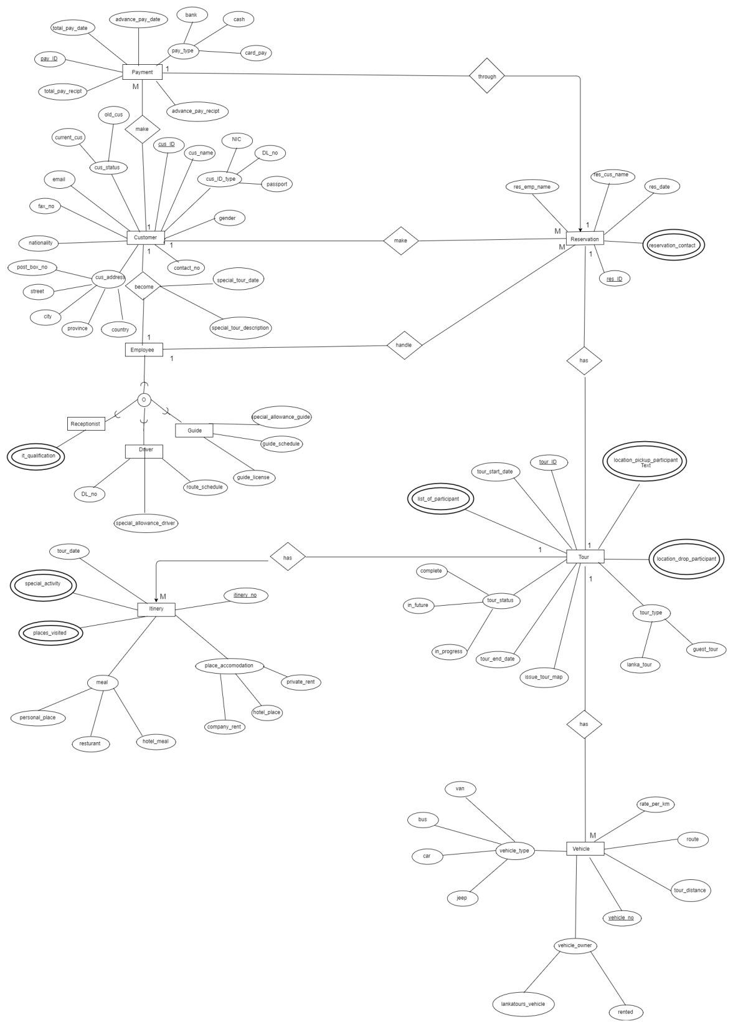
EER-Diagram

Slide 5
Relational Mapping
Relational mapping in computer science is a programming technique for converting data between incompatible type systems using object-oriented programming languages. This creates, in effect, a "virtual object database" that can be used from within the programming language.

Slide 6
Data Normalization
Normalization is also the process of simplifying the design of a database so that it achieves the optimal structure composed of atomic elements.
Normalization involves arranging attributes in relations based on dependencies between attributes, ensuring that the dependencies are properly enforced by database integrity constraints.

Slide 7
Create Table SQL Statements
Customer Table
create table CUSTOMER(
cus_ID bigint not null,
cus_name varchar(255),
gender varchar(1),
nationality varchar(45),
email varchar(250),
fax_no int,
contact_no int);
Cus_Address Table
create table CUS_ADDRESS(
cus_ID bigint not null,
post_box_no int,
street varchar(45),
city varchar(50),
state varchar(50),
country varchar(50));

Slide 8
Triggers
Used to specify automatic actions to be taken that the database system will perform when certain events and conditions occur.
• Provide an alternative way to check the integrity of data and also to run scheduled tasks.
• It is a stored program that executesautomaticallyin response to a specific event associated with a table like:
–Insert
–update
–delete

Slide 9
User Defined Functions Statements
In-built functions in SQL Server are not enough to use in applications with different business logics, complex algorithms, calculations and custom actions.
UDFs were introduced with SQL Server 2000, to create own routines, which can accept parameters, perform custom actions and return results.
UDFs allow modular programming and faster execution.
–Can create the function once, store it in the database, and call it any number of times in the program.

Slide 10
View Statements
A virtual table which contains data derived from other tables based on a result-set of an SQL statement.
A way of specifying a table that is referred frequently, even though it may not exist physically.
Can join multiple tables together and use the view to present the data as if the data is coming from a single table.
views simplify complex queries.
–Hide the complexity of SQL statements with many
joins.

Slide 11
Stored Procedure Statements
A database program module that are stored and executed by the DBMS at the database server.
A segment of SQL codes that can save and reuse over and over again instead of writing that query each time.
Help to save a SQL query which is frequently executed as a prepared SQL code and just execute it when needed.
Once created, stored procedures are compiled and stored in the database.

Slide 12
Conclusion
Lanka Tours management system simplifies the management process in tour and travelling.
Fast processing and immediate results with high security.
Minimizing human efforts cost efficient database.

Slide 13


