Slide 1
AI FOR BUSINESS DECISION
MGMT 678
GROUP 20
MUSKAN AGGARWAL
NAVYA KONDAVEETI
KAUSHALYA NAIDU

Slide 2
Dunnhumby Dataset
Introduction:
The Dunnhumby dataset, titled "The Complete Journey," offers a comprehensive view into the shopping habits and preferences of 2,500 households over a two-year period, capturing every transaction at a detailed level across a multitude of product categories.
Dataset Description:
Household Transactions: Records detail each purchase, mirroring lines found on a store receipt, including product IDs, quantities, sales values, and associated discounts.
Demographic Data: Available for a subset of households, providing insights into demographics segmented across several classifications that impact shopping patterns.
Campaign Data: Chronicles the direct marketing efforts, tracking various campaigns received by households and their responses.
Product Details: Includes comprehensive descriptions from high-level categories to specific product attributes such as type, brand, and size.
Features and Utility:
Rich Transactional Data: Captures every purchase, facilitating a granular analysis of buying behavior and product popularity.
Integrated Marketing Analysis: Allows for the study of marketing campaign effectiveness on consumer buying behavior and engagement levels.
Demographic Insights: Demographic data enables segmentation and personalized marketing strategy formulations.
Academic and Business Research: Ideal for in-depth academic research and advanced analytical applications in business settings.

Slide 3
Executive Summary
Market Analysis:
Manufacturer 69 exhibits a commanding presence in the market with robust dominance in transactions and sales across key departments such as DRUG GM, DELI, and MEAT-PCKGD, primarily driven by aggressive coupon distribution and effective campaign strategies.
Competitive Landscape:
Manufacturer 693 emerges as a key competitor in the DRUG GM sector, closely matching Manufacturer 69 in transactions but lagging in sales, suggesting potential areas for strategic improvement and market capture.
Strategic Initiatives:
Utilization of data-driven insights has enabled targeted campaigns and pricing strategies, enhancing Manufacturer 69’s market penetration and customer retention.

Slide 4
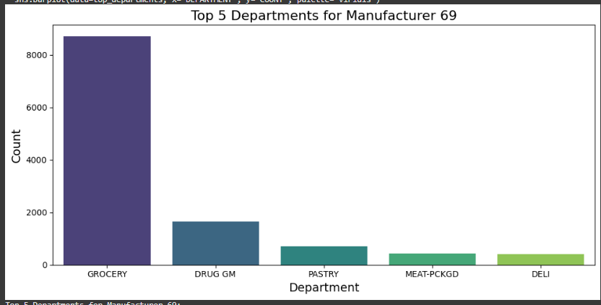
Focal Brand Selection - Manufacturer 69
Initial Aggregation:
Metrics from the product table identified Manufacturer 69 as having the most comprehensive data.
Top Departments:
Focused analysis on four key departments: DELI, MEAT-PCKGD, PASTRY, DRUG GM, where 69 had a dominant presence.
Selected DRUG GM due to strong competition and data availability.
Rationale for Selection:
Manufacturer 69 exhibited clear dominance in transactions and sales across multiple departments.
Comprehensive availability of demographic, transaction, and campaign data made it a robust candidate for focal analysis.
69

Slide 5
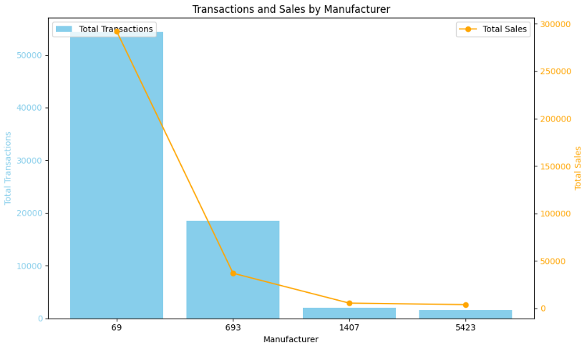
Competitor Selection - Manufacturer 693
Looked at top manufacturers in DRUG GM, Pastry, Meat-Pckgd, Deli departments
Manufacturer 693:
Identified as the strongest competitor in DRUG GM.
Virtually matched Manufacturer 69 in transactions and household reach but significantly lagged in sales, indicating opportunities for 69 to leverage better pricing and campaigns.
Manufacturer 5423:
Broad presence across DELI, MEAT-PCKGD, and Pastry.
Limited competition overall but showed potential in Pastry department
Manufacturer 1407:
Minimal competition in DRUG GM due to lower transactions, sales, and household reach
Serves as a niche player with negligible impact on Manufacturer 69's dominance.
693

Slide 6
Competitor Analysis 69 vs 693
Transaction, Demographic and Campaign Data Analysis

Slide 7
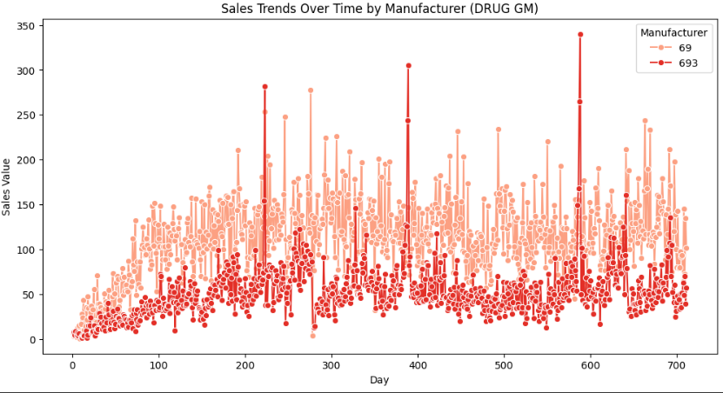
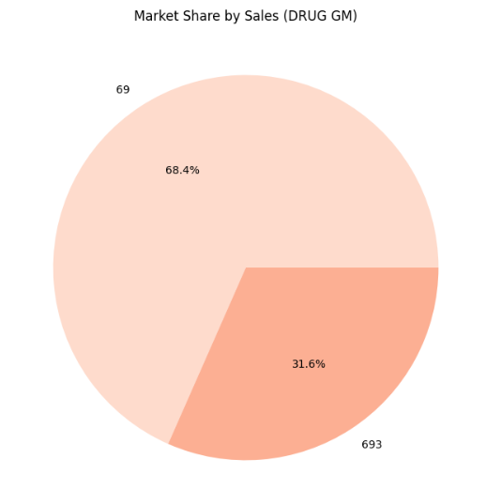
Competitor Analysis between Manufacturers 69 and 693
Transaction Data
Title One
Title Two
Manufacturer 69:
Shows consistent dominance with higher peaks and larger seasonal spikes.
Manufacturer 693:
Maintains a steady sales presence over time with moderate peaks.
Manufacturer 693 captures 31.6% of the total sales market share, which is a significant portion of the DRUG GM department and demonstrates that despite being smaller in revenue, 693 has a strong foothold and the potential to grow further.

Slide 8
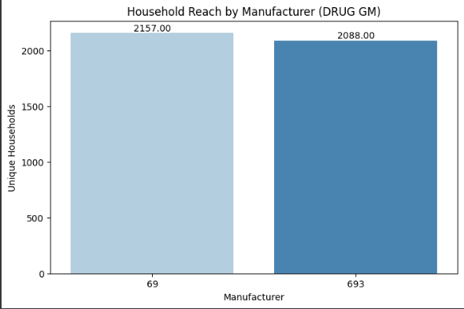
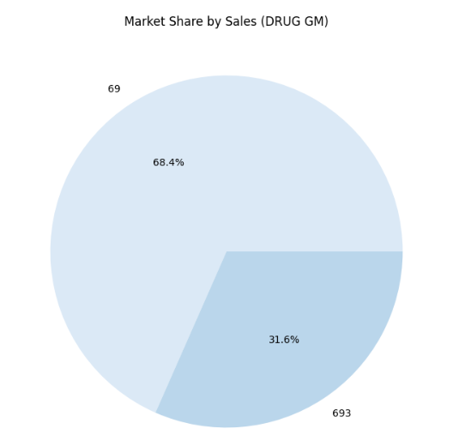
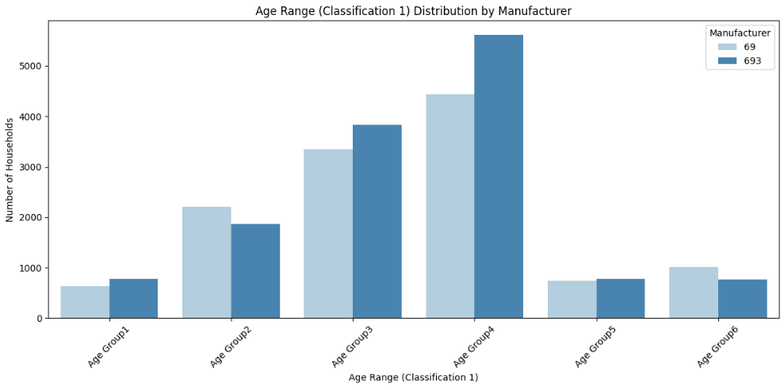
Competitor Analysis between Manufacturers 69 and 693
Demographic Data
Title One
Title Two
Household Reach:
Comparable Reach: 693 engages 2,088 households vs. 2,157 for 69.
Interpretation: Strong engagement despite lower sales volume.
Age Range:
Manufacturer 69 appeals more to younger and middle-aged households (Age Groups 2 and 3) while Manufacturer 693 dominates in older households (Age Group 4), aligning products with older age preferences.

Slide 9
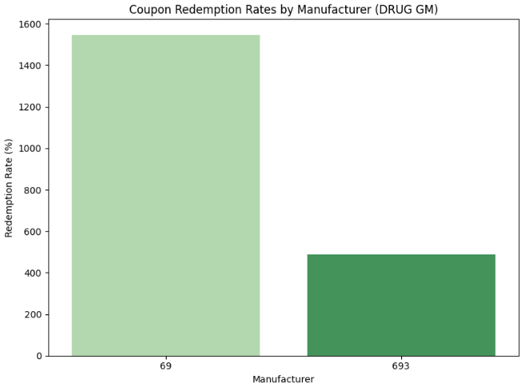
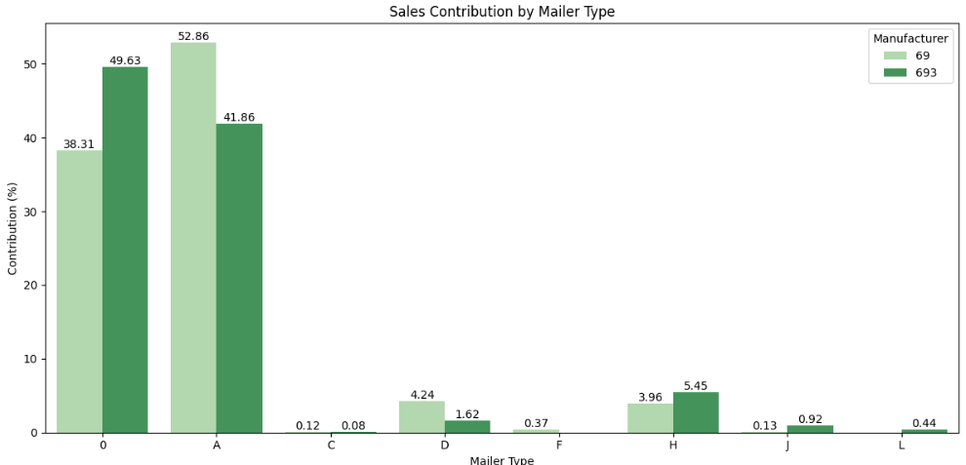
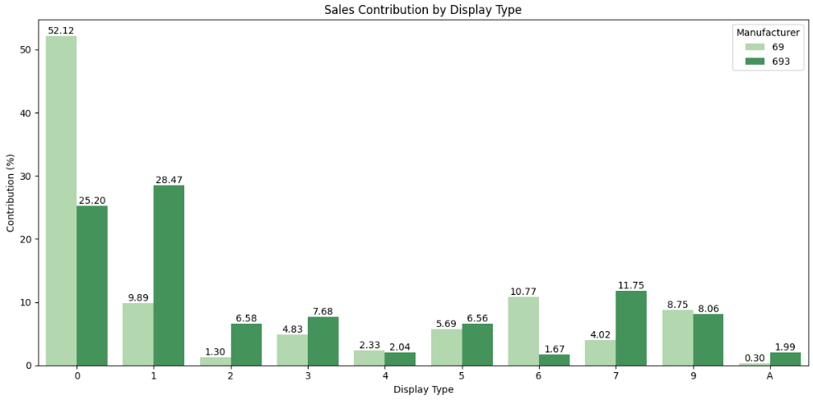
Competitor Analysis between Manufacturers 69 and 693
Campaign Data
Title One
Title Two
Coupon Redemption Rates:
Manufacturer 69 leads in coupon redemption rates, indicating more effective targeting and appealing offers compared to Manufacturer 693
Mailer Contribution: Manufacturer 693 outperforms 69 in Mailer A, showcasing stronger customer engagement strategies, while 69 leads in Mailer 0, indicating untapped potential for optimized mailer usage.
Display Contribution: manufacturer 69 outperforms 693 in Display 0, while 693 excels in display 1

Slide 10
Which Displays/Mailers boost sales for Manufacturer 69

Slide 11
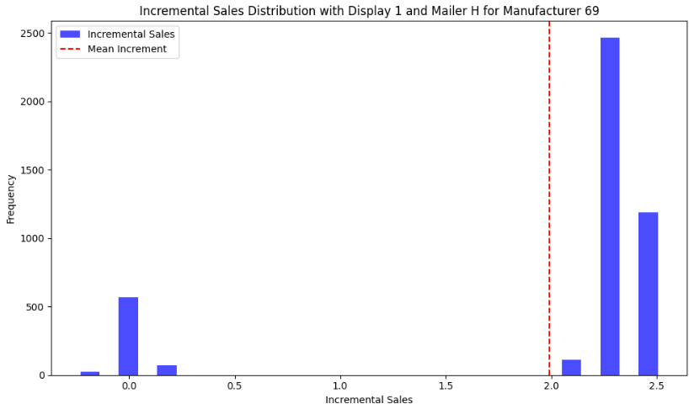
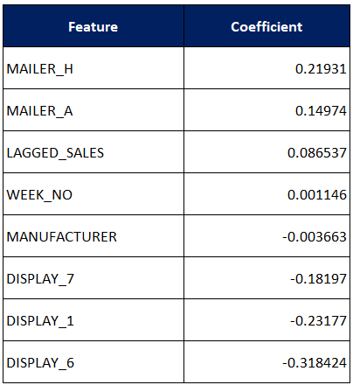
Model Used:
Linear Regression
Adopting 693’s Mailer/Display Strategies
R-squared:0.9068
Campaign Effectiveness for Manufacturer 693:
Opportunity for Manufacturer 69:
Regression Model Analysis:
Results:
By implementing Display Type 1 and Mailer H for Manufacturer 69, the incremental sales distribution shows that most incremental sales are small, clustered around 0.0–0.5 units, indicating limited effectiveness.
Manufacturer 693 has achieved positive sales outcomes by effectively leveraging Display 1 and Mailer H in their campaigns.
These methods remain underutilized by Manufacturer 69, presenting an opportunity to improve their campaign strategies.
To assess the potential impact, a regression model was developed to predict how sales for Manufacturer 69 would respond to adopting Display 1 and Mailer H.

Slide 12
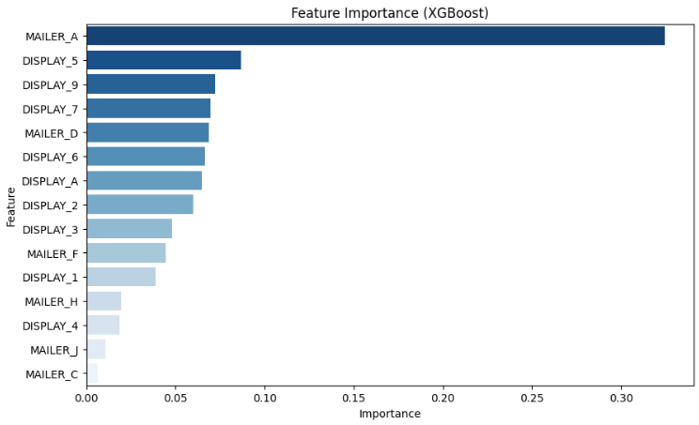
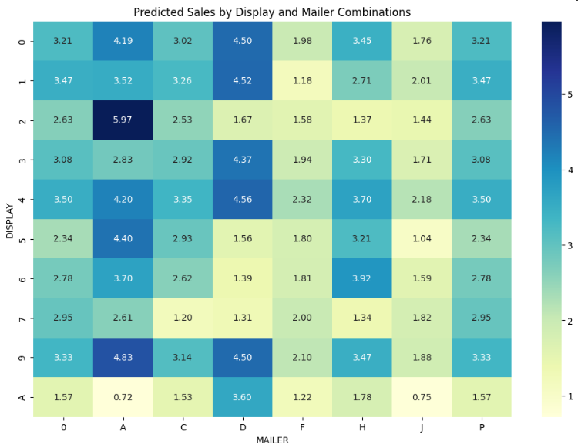
Model Used:
Gradient Boosting
Ideal Mailer/Display Strategies for 69
R-squared:0.8835
W
Most Influential Features:
MAILER_A is the top contributor to sales.
DISPLAY_5, DISPLAY_9, and DISPLAY_2 is most impactful display types.
Less Impactful Features:
MAILER_C, MAILER_J, and MAILER_H have minimal or no influence on sales
Predicted Sales by Display and Mailer Combinations:
Best Combinations:DISPLAY_2 with MAILER_D: Highest predicted sales (5.97).
DISPLAY_4 with MAILER_D and DISPLAY_9 with MAILER_D are also effective
Poor Combinations: Combinations involving MAILER_H, MAILER_C, and MAILER_J show low predicted sales..

Slide 13
Causal Data Conclusion
Objective:
The goal was to identify effective mailer and display strategies for Manufacturer 69, leveraging insights from their own performance and learning from Manufacturer 693's successful campaigns.
Approach:
Conducted a feature importance analysis using Gradient Boosting to rank the impact of various mailers and displays on sales.
Identified MAILER_A and DISPLAY_5 as the most influential features for Manufacturer 69, while MAILER_C, MAILER_J, and MAILER_H had minimal impact.
Explored mailer-display combinations, with DISPLAY_2 and MAILER_D achieving the highest predicted sales for Manufacturer 69.
Competitor Insights:
Manufacturer 693 effectively utilized Display 1 and Mailer H, achieving positive sales outcomes that remain underutilized by Manufacturer 69.
A regression model predicted that adopting these strategies would result in small incremental sales for Manufacturer 69, indicating limited effectiveness in their current setup.
Findings:
Effective combinations like DISPLAY_4 and MAILER_D or DISPLAY_9 and MAILER_D provide actionable insights for Manufacturer 69 to focus on impactful strategies.
Conclusion:
Manufacturer 69 can improve its campaign performance by focusing on high-impact strategies such as MAILER_A and impactful displays like DISPLAY_5. Learning from Manufacturer 693’s success is valuable but should be complemented with data-driven optimization of mailer-display combinations tailored to their specific audience.

Slide 14
Which Coupons boost sales for Manufacturer 69

Slide 15
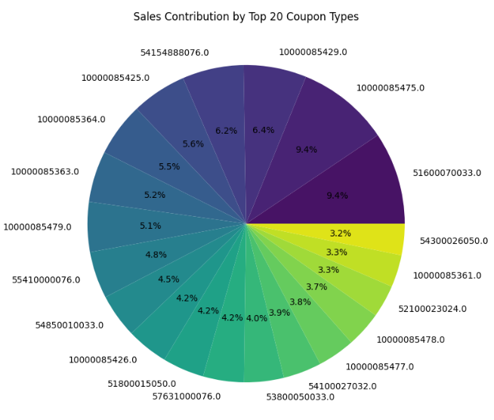
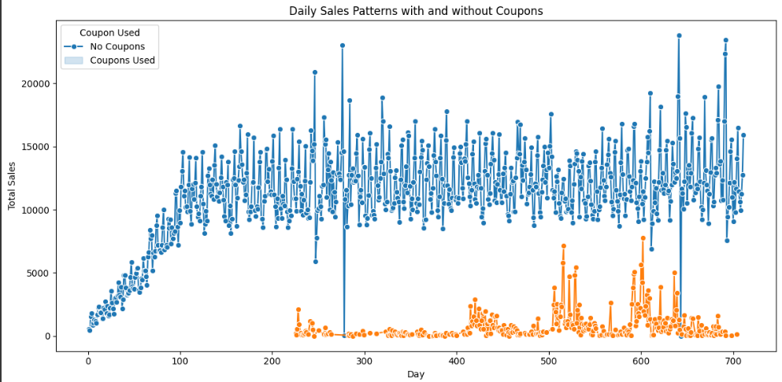
Current Coupon Analysis for 69
Daily Coupon Sale Trends
Identifying Top 20 Coupons
Merged transaction data with coupon redemption data to analyze sales with and without coupons. Plotted daily trends to identify sales spikes driven by coupon usage.
Insights: Coupons significantly contribute to daily sales, with consistent usage patterns across time.
Aggregated metrics like total sales, transaction count, and average sales per coupon. Ranked coupons based on total sales and filtered the Top 20 coupons.
Insights: These 20 coupons collectively accounted for a significant portion of total sales, showcasing their influence.

Slide 16
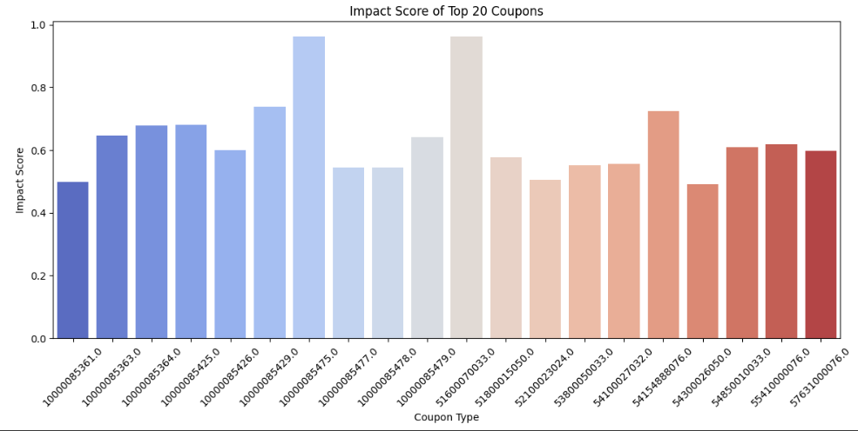
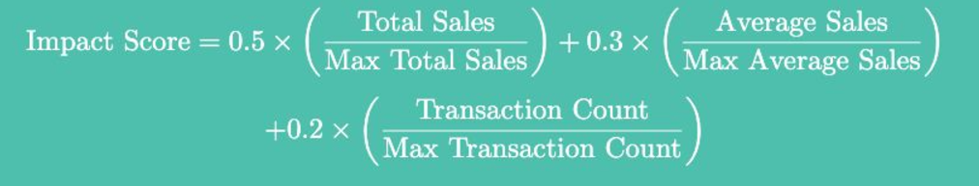
Model Used:
Gradient Boosting
Coupon Analysis by Impact Scores
R-squared:0.8623
W
Refined analysis to focus on the most effective coupons:
Introduced an Impact Score Formula:
Sorted the Top 20 coupons by Impact Score and selected the Top 5 coupons for further analysis
Gradient Boosting Regression:
Predict total sales and simulate scaling effects for the Top 5 coupons
Gradient Boosting captured non-linear relationships between features like transaction count, average sales, and impact score.

Slide 17
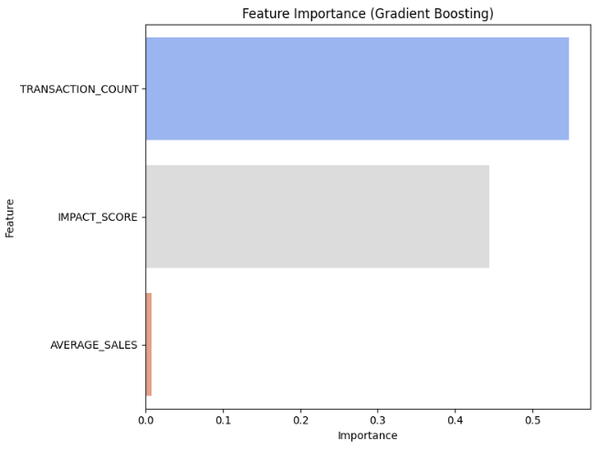
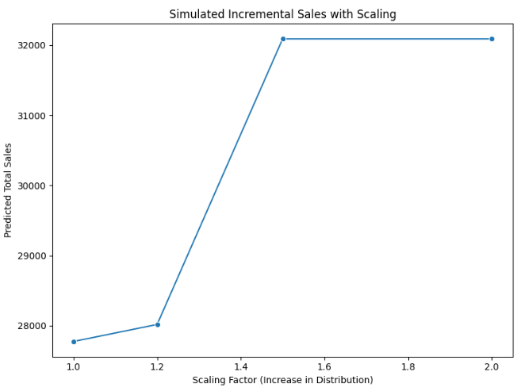
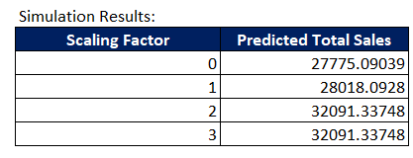
Model Used:
Gradient Boosting
(cont.)
Coupon Analysis by Impact Scores
W
Feature importance insights:
Transaction Count was the most influential feature, followed by Impact Score
Scaling Analysis Objective:
Sales increased significantly with scaling factors 1.2 and 1.5.Plateau Effect: Beyond 50% scaling, sales plateaued, indicating diminishing returns
Key Insight:
Increasing distribution by 50% results in a 15% sales boost, but further scaling yields no additional benefit. The plateau suggests an optimal scaling limit for distribution efficiency.

Slide 18
Coupon Data Conclusion
Comprehensive Coupon Analysis:
Daily Coupon Trends: Coupons play a crucial role in driving daily sales, with consistent spikes observed during coupon usage.
Top Coupon Identification: By ranking coupons based on total sales and implementing an Impact Score formula, we narrowed down to the Top 20 high-performing coupons, further refining to the Top 5 for detailed analysis.
Gradient Boosting Analysis:
Leveraged Gradient Boosting to predict sales performance and evaluate the impact of scaling distribution.
Identified Transaction Count as the most significant contributor to sales, followed by the Impact Score.
Scaling Analysis:
Simulated sales growth under different scaling scenarios. A 50% increase in transaction counts resulted in a 15% boost in sales, showcasing the potential for strategic scaling
Beyond 50%, a plateau effect indicated diminishing returns, emphasizing the importance of optimizing distribution efforts
Conclusion:
Optimal Scaling Strategy: Increasing distribution by 50% offers a significant growth opportunity for efficiency without oversaturating resources.
Actionable Insights: Focus on promoting top-performing coupons and scaling transaction counts strategically to maximize revenue growth within operational limitations

Slide 19
Household level analysis

Slide 20
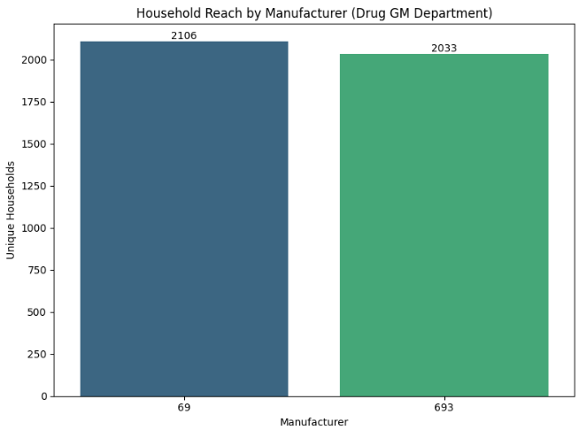
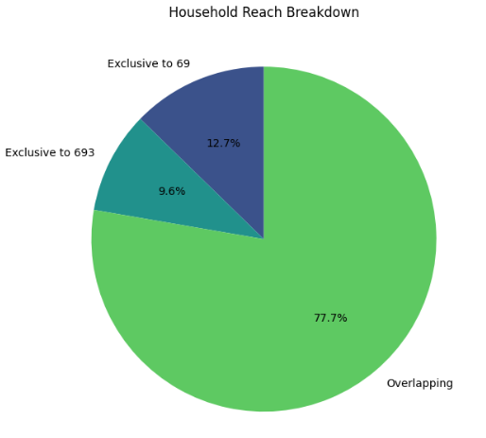
Household Reach – Manufacturer 69 vs 693
W
Manufacturer 69 has slightly more unique households (2157) compared to Manufacturer 693 (2088) in the Drug GM department, suggesting a competitive reach in household penetration.
Household Overlap Analysis:
Overlapping Households: 1810
Overlap Percentage for 69: 85.94%
Overlap Percentage for 693: 89.03%
Exclusive Households for 69: 14.06%
Exclusive Households for 693: 10.97%

Slide 21
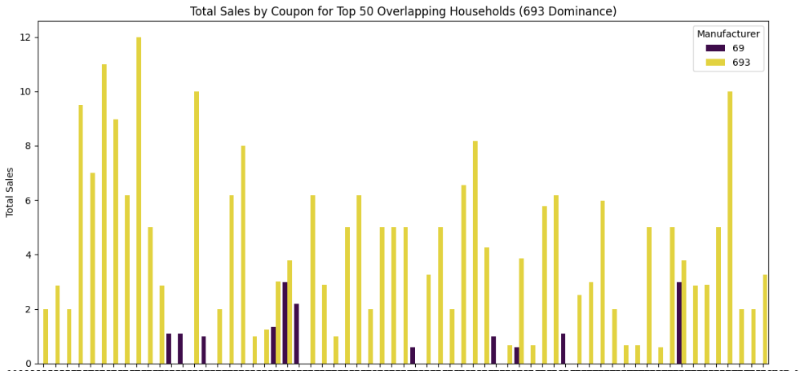
Sales by coupons for overlapping Households
W
Total sales have been aggregated for overlapping households by manufacturer.
Identified the top 50 households where Manufacturer 693 dominates in sales contribution over Manufacturer 69.
Merges coupon data with these transactions to analyze coupon usage by these top households.
Calculated total sales for each coupon used by the top 50 households for both manufacturers.

Slide 22
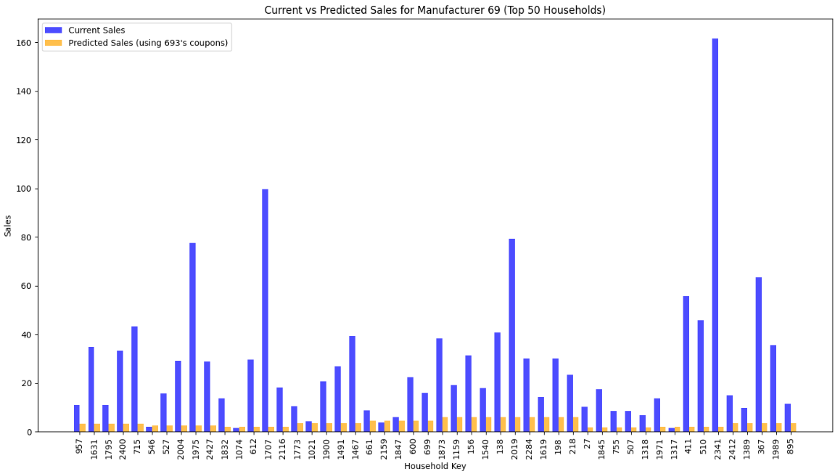
Model Used:
Random Forest
Manufacturer 69’s sales by using 693’s coupons in top 50 households
R-squared:0.9641
W
A simulation was conducted using Random Forest using 693's coupons, and the predicted sales for Manufacturer 69 were compared to their current sales.
Current sales (blue bars) for Manufacturer 69 significantly outperform the predicted sales (orange bars) when adopting Manufacturer 693’s coupon strategies for these 50 households

Slide 23
Coupon Data Conclusion
Household Level Analysis:
693 and 69 have comparable household reach for DRUG GM department.
The objective is to find out how 69 can capture 693’s households to boost their sales
Approach:
Analyzed sales data for Manufacturers 69 and 693 within overlapping households to understand the sales dynamics.
Identified top 50 households where Manufacturer 693 had a higher sales contribution than Manufacturer 69.
Simulated the impact of applying Manufacturer 693's top-performing coupons for Manufacturer 69 using Random Forest Regression.
Conclusion:
Effectiveness of 693's Coupons for Manufacturer 69: Simulation results reveal that Manufacturer 693's top-performing coupons have limited impact in boosting sales for Manufacturer 69. While these coupons are effective for 693, they fail to provide significant traction for 69 in overlapping households.
The sales difference in favor of Manufacturer 693 highlights the need for a tailored coupon strategy. Replicating 693's approach alone is insufficient to capture these households effectively.

Slide 24
Strategic Recommendations and Future Directions
Focus on High-Impact Campaigns:
Manufacturer 69 should intensify focus on proven high-impact mailer and display combinations, such as DISPLAY_2 with MAILER_D, to maximize sales and market reach.
Leverage Data-Driven Pricing:
Implement dynamic pricing strategies to further exploit competitive gaps, particularly against Manufacturer 693’s pricing and discounting tactics.
Expand Target Demographics:
Adapt product and marketing strategies to better cater to older and larger households where Manufacturer 693 holds sway, potentially increasing market share in these segments.
Optimize Coupon Strategy:
Increase distribution efficiency by scaling top-performing coupons up to 50%, beyond which diminishing returns are observed. This strategy ensures efficient resource use while maximizing sales impact.
Tailored Customer Engagement:
Enhance personalized marketing efforts to deepen customer relationships and loyalty, particularly among overlapping households, leveraging data analytics for targeted promotions and offers.

Slide 25
THANK YOU

Slide 26
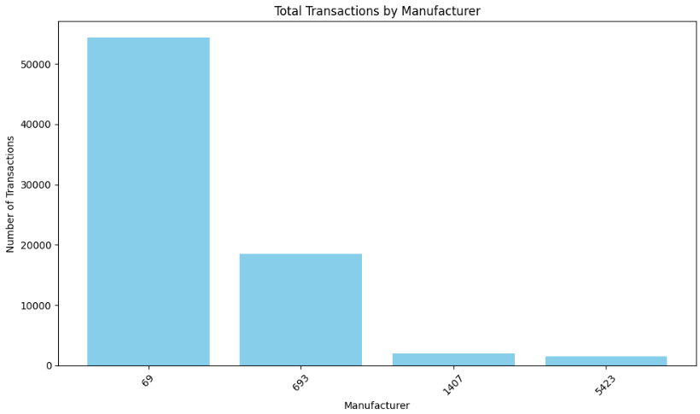
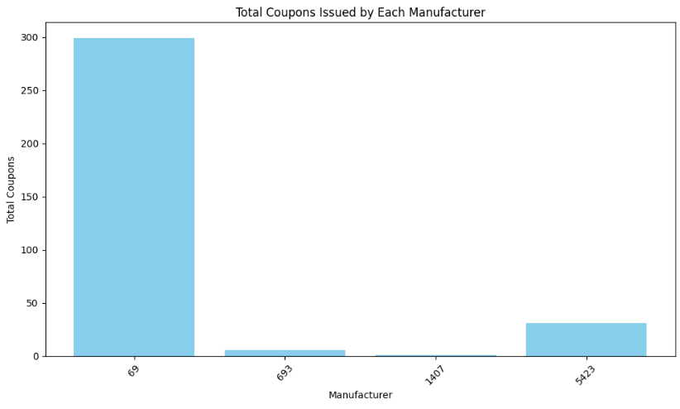
Competitor Selection – data availability exploration
Total Transactions by Manufacturer:
Manufacturer 69 dominates in terms of total transactions, showcasing its strong presence in the market.
Manufacturer 693 follows as the second-highest, indicating a significant, yet smaller, market share compared to 69.
Manufacturers 1407 and 5423 have relatively fewer transactions, reflecting their niche presence.
This disparity in transaction data highlights why Manufacturer 69 and 693 were selected for detailed analysis.
Total Coupons Issued by Each Manufacturer:
Manufacturer 69 leads in issuing coupons, with a significantly higher count compared to the rest.
Manufacturer 693 has issued a moderate number of coupons, ranking second but far below 69.
Manufacturers 1407 and 5423 have a minimal coupon presence, reflecting limited campaign activity.
The higher coupon data availability for 69 and 693 makes them ideal for analysis.

Slide 27
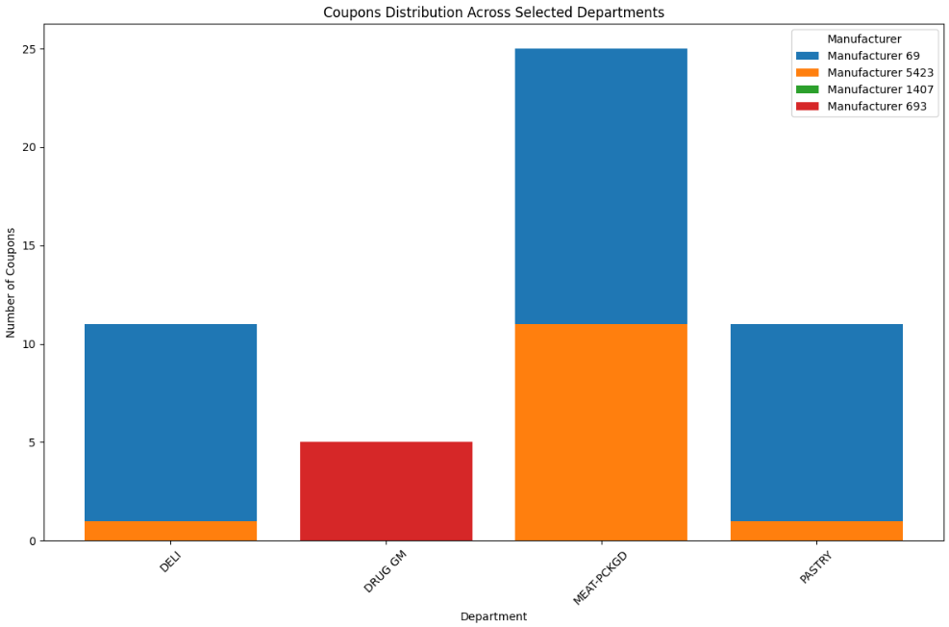
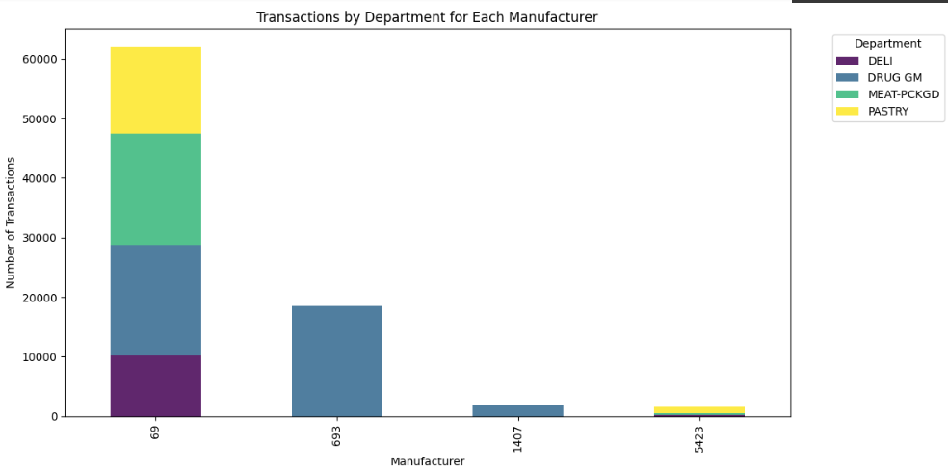
Competitor Selection – data availability exploration
Coupons Distribution Across Selected Departments:
Manufacturer 69 has substantial coupon distribution across all selected departments, particularly DRUG GM.
Manufacturer 693 shows strong coupon usage in DRUG GM, aligning with its competitive strength in this category.
Manufacturers 1407 and 5423 have niche coupon activity, primarily in MEAT-PCKGD and DELI.
The wide distribution of coupons in DRUG GM for 69 and 693 reinforced their selection for analysis.
Transactions by Department for Each Manufacturer:
Manufacturer 69 has the highest transaction volumes across DELI, DRUG GM, and MEAT-PCKGD, showcasing broad engagement.
Manufacturer 693's transactions are heavily concentrated in DRUG GM, indicating a focused competitive strategy.
Manufacturers 1407 and 5423 show activity concentrated in niche departments like MEAT-PCKGD and DELI.
The strong presence of 69 and 693 in DRUG GM guided their selection for detailed competitor analysis.

Slide 28
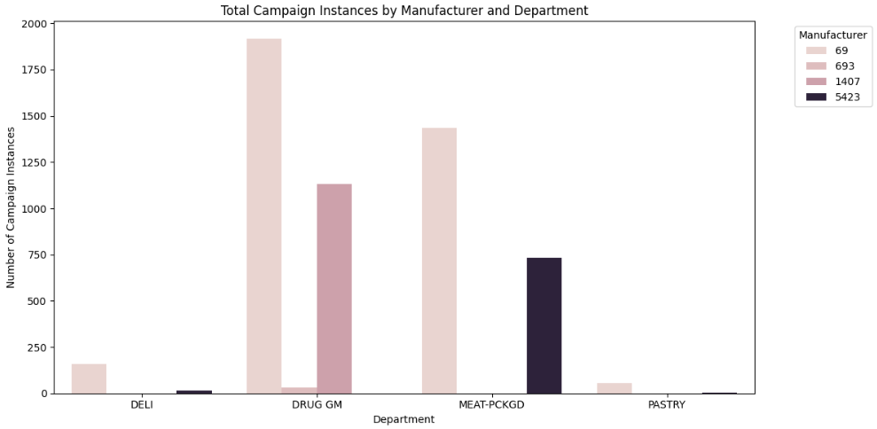
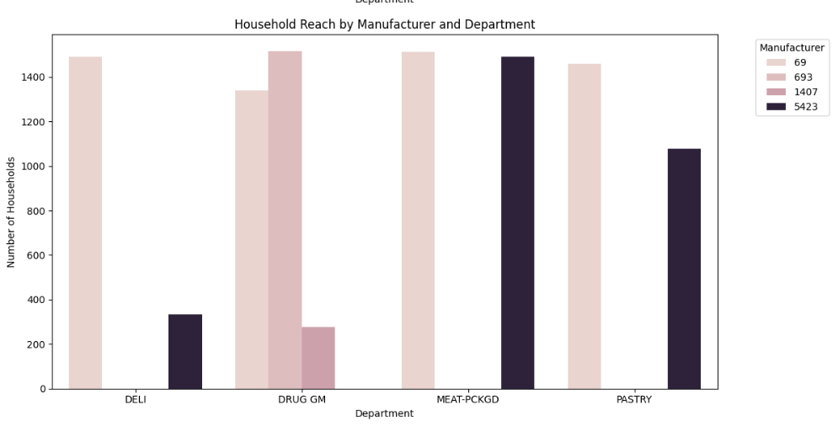
Competitor Selection – data availability exploration
Total Campaign Instances by Manufacturer and Department:
Manufacturer 69 runs the highest number of campaigns across all departments, with a strong focus on DRUG GM.
Manufacturer 693 conducts significant campaigns in DRUG GM but has fewer campaigns overall compared to 69.
Manufacturers 1407 and 5423 show limited campaign activity, concentrated in MEAT-PCKGD and DELI.
The campaign data richness for 69 and 693 in DRUG GM was a key factor in focusing on these manufacturers.
Household Reach by Manufacturer and Department:
Manufacturer 69 reaches the largest number of households across all departments, indicating strong market penetration.
Manufacturer 693 has a substantial household reach in DRUG GM, highlighting its competitive position in this department.
Manufacturers 1407 and 5423 have lower household reach, emphasizing their smaller scale.
The large household data for 69 and 693 provided a robust foundation for competitor and customer engagement analysis.

Slide 29
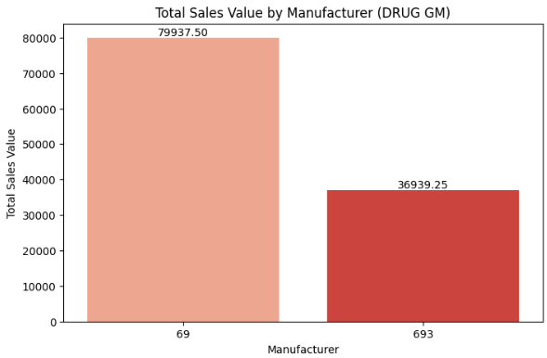
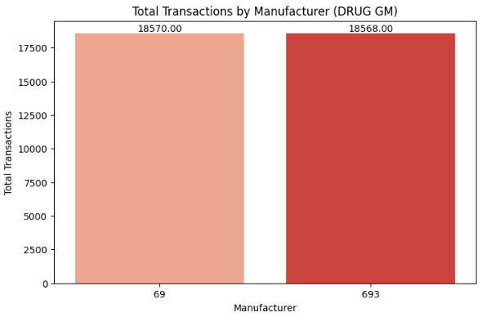
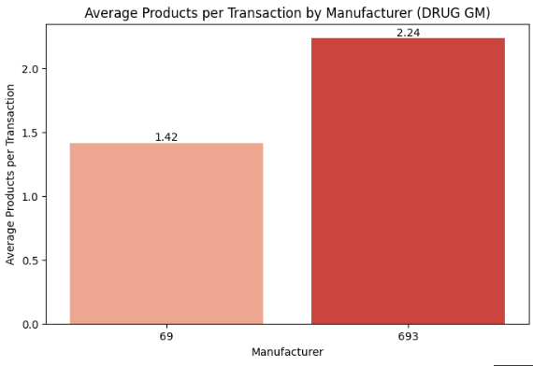
Transaction Data Analysis between Manufacturers 69 and 693
Manufacturer 69 leads with $79,937.50 in sales compared to $36,939.25 for 693. Overall, 69 captures 68.4% market share in terms of sales
Equal Market Share in terms of transactions: 693 matches 69 with 50% of total transactions. Interpretation: Demonstrates customer loyalty and competitive presence.
Basket Composition: Higher Products per Transaction: 2.24 for 693 vs. 1.42 for 69. Might be due to effective bundling and cross-selling opportunities.

Slide 30
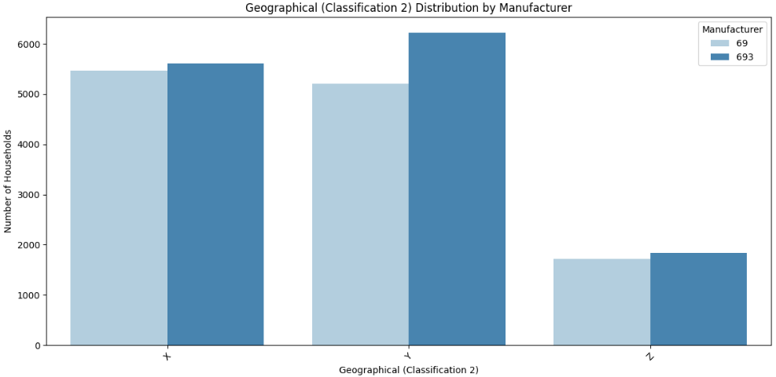
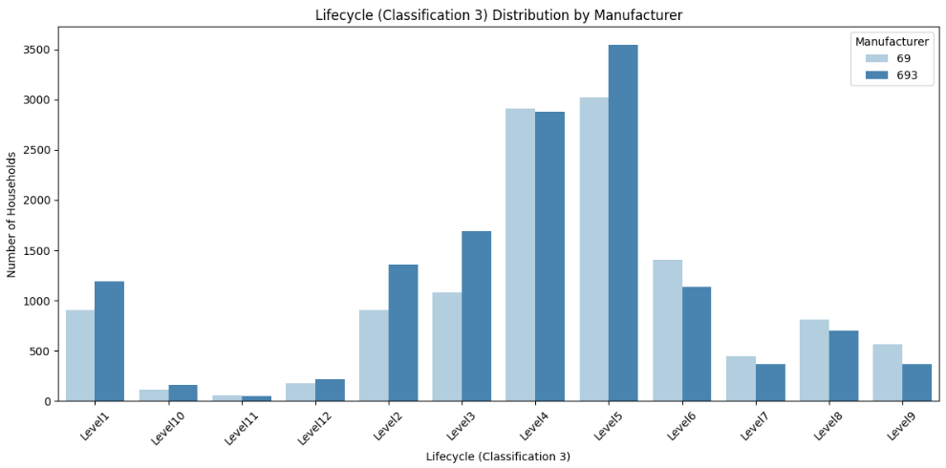
Demographic Data Analysis between Manufacturers 69 and 693
Demographic Data Analysis between Manufacturers 69 and 693
Assumptions: Classifications 1-5 have been categorized based on our assumption of the demographic data
Age Range (Classification 1):
Manufacturer 69: Strong in middle-aged groups (Age 2 & 3).
Manufacturer 693: Dominates older households (Age 4).
Geography(Classification 2):
Manufacturer 693 consistently outperforms 69 across all regions.
Lifecycle (Classification 3):
Manufacturer 69: Broad appeal across families (Levels 3–5).
Manufacturer 693: Strong focus on early and mature lifecycles (Levels 1 & 5).

Slide 31
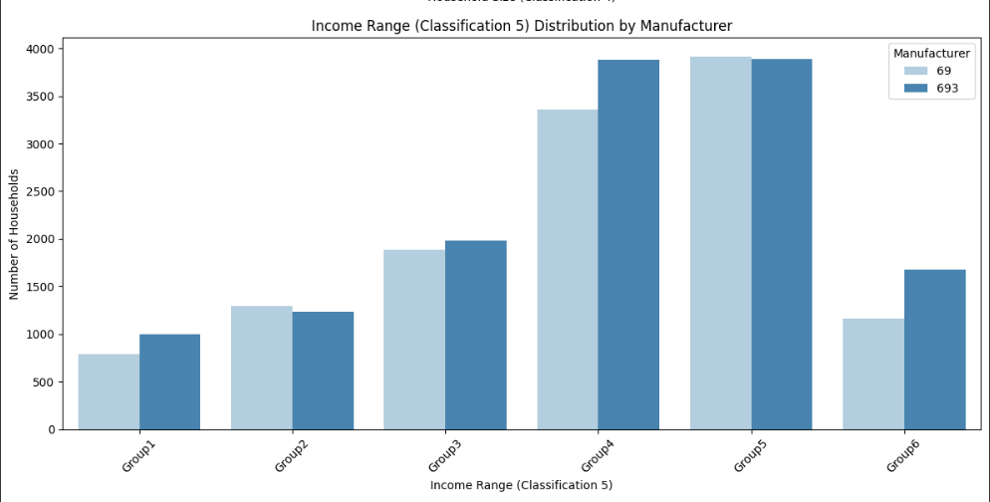
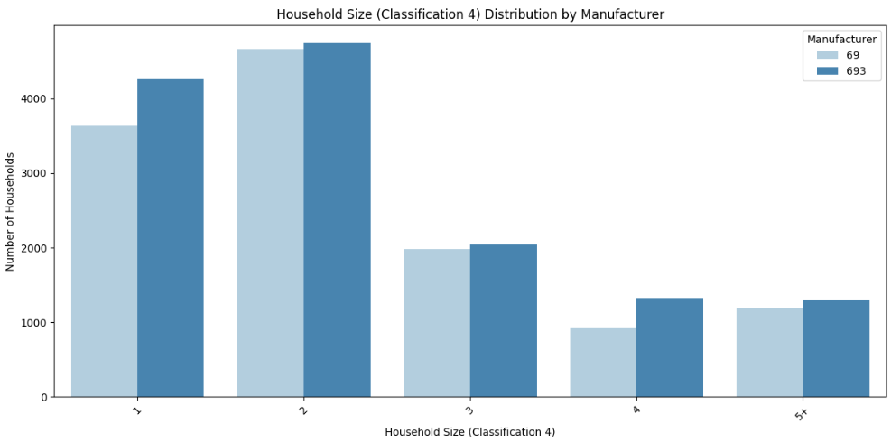
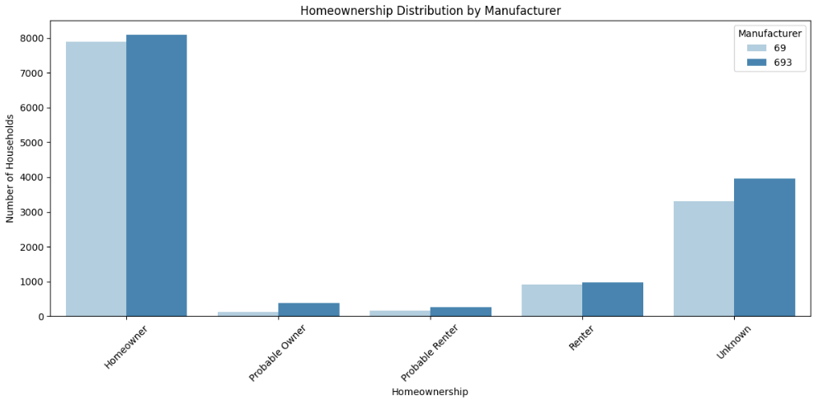
Demographic Data Analysis between Manufacturers 69 and 693
Household Size (Classification 4):
Manufacturer 69: Preferred by small households (1–2 members).
Manufacturer 693: Appeals to larger households (3+ members).
Income (Classification 5):
Manufacturer 69: Mid-to-high-income focus (Groups 4 & 5).
Manufacturer 693: Slight edge in the highest-income group (Group 6).
Homeownership Distribution:
Manufacturer 69 focuses on homeowners, with less unknown demographic data.
Manufacturer 693 potentially targets renters or has incomplete demographic data.

Slide 32
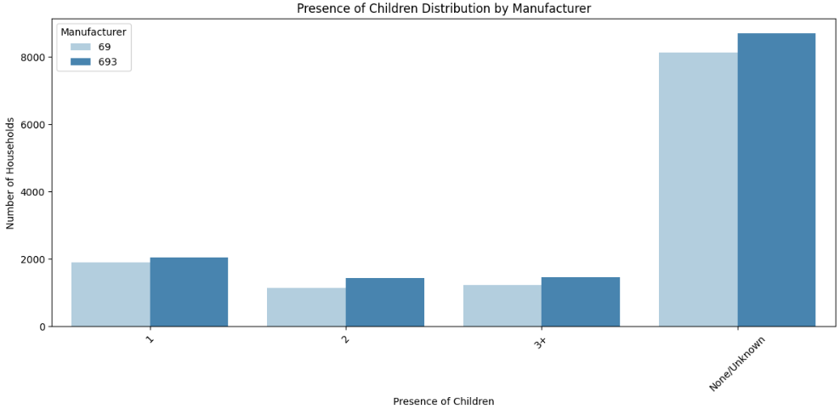
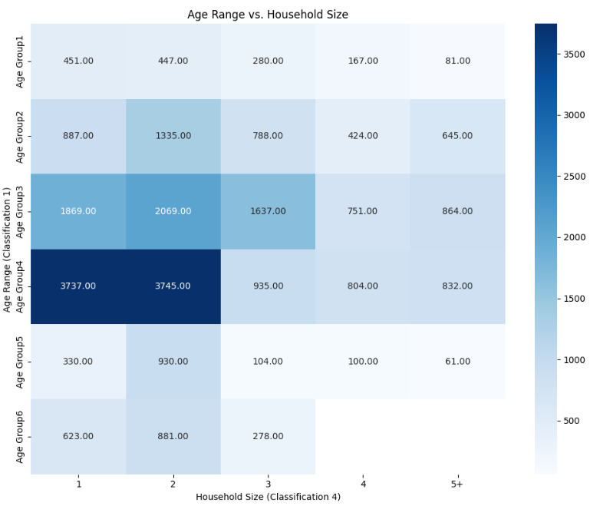
Demographic Data Analysis between Manufacturers 69 and 693
Presence of children:
Manufacturer 69 shows a stronger presence among households with 1 or 2 children.
Manufacturer 693 has a higher share in households with 3+ children or unknown child status.
Age range vs Household size:
For Manufacturer 69: Strong concentration in Age Group 3 and 4 across 1-2 member households. Moderate spread across other combinations.
For Manufacturer 693: Dominant presence in Age Group 4 across 3+ member households. Significant representation in older age groups (e.g., Age Group 4) combined with larger households.
Manufacturer 69 caters to smaller, younger-to-middle-aged households, possibly urban or single/couple-oriented.
Manufacturer 693 focuses on older, larger households, which aligns with family-oriented or multi-person household products.

Slide 33
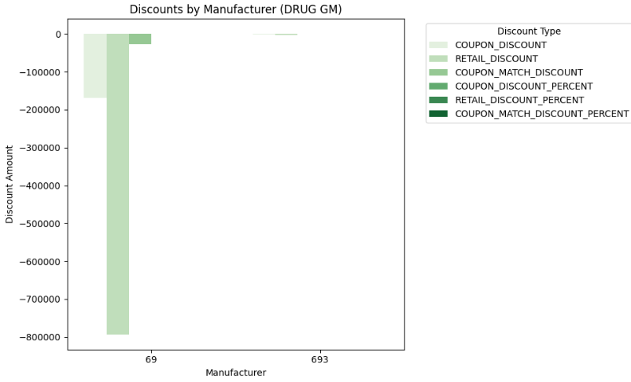
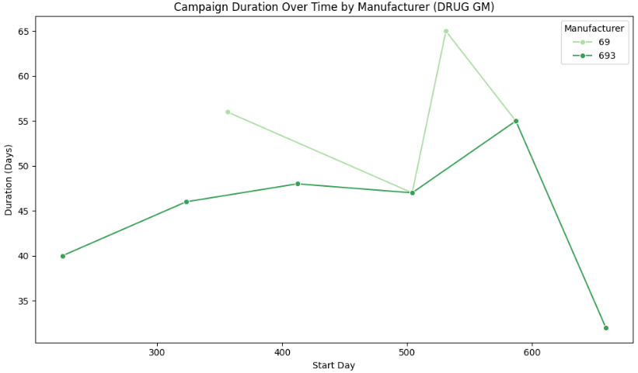
Campaign Data Analysis between Manufacturers 69 and 693
Discounts by Manufacturer:
Manufacturer 69 provides significantly higher discounts compared to Manufacturer 693, indicating aggressive pricing strategies to attract customers
The focus on higher coupon and retail discounts highlights 69's reliance on promotions to drive sales
Manufacturer 693 offers minimal discounts, suggesting a different strategy that avoids heavy reliance on price reductions
This disparity in discount levels may indicate differing market positioning, with 693 likely targeting value-oriented segments without frequent promotions.
Campaign Duration Over Time:
Manufacturer 69 consistently runs longer campaigns, maintaining market visibility and engagement over extended periods
A sudden peak in campaign duration for Manufacturer 693 suggests a focused effort to compete during specific periods. The declining trend for 693's campaign duration indicates possible resource constraints or a strategic shift
Manufacturer 69's sustained campaign activity reflects a commitment to brand visibility and customer retention, while 693's sporadic efforts suggest targeted strategies in an effort to maximize customer base

Slide 34
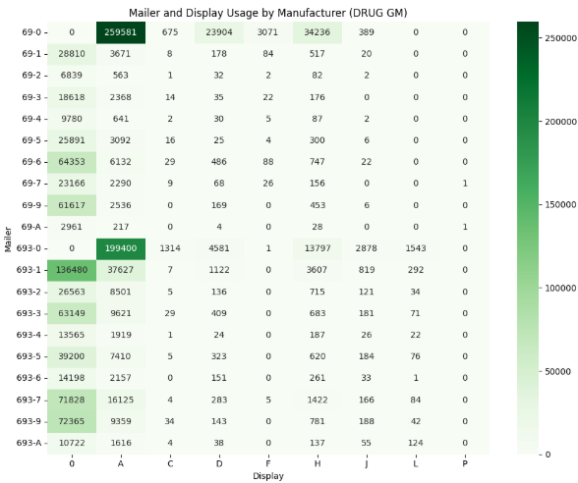
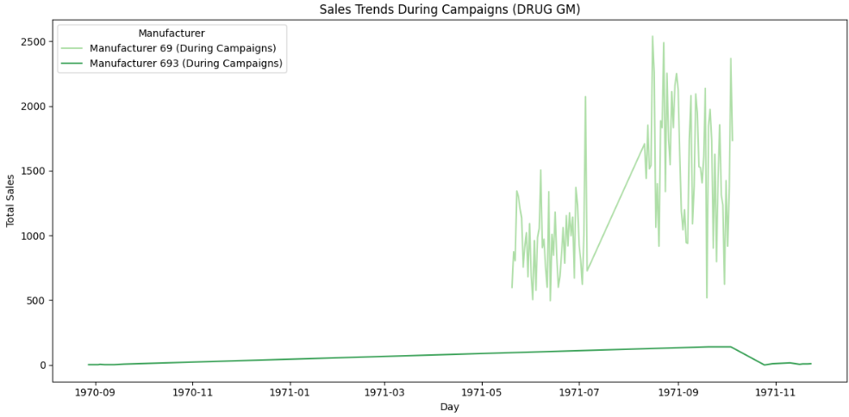
Campaign Data Analysis between Manufacturers 69 and 693
Mailer and Display Usage by Manufacturer:
Manufacturer 69 heavily utilizes mailers and displays, with a significant contribution from "Display 0" and "Mailer 0," indicating a broad, general approach to promotions
Manufacturer 693, while using fewer mailers and displays overall, leverages selective strategies like "Mailer A" and "Display 2" for targeted engagement
The high usage of certain displays by 69 suggests a more aggressive, volume-driven strategy, compared to 693's more focused promotional efforts
Manufacturer 693's selective use of mailers and displays may reflect resource optimization or niche targeting compared to 69's comprehensive deployment.
Sales Trends During Campaigns:
Manufacturer 69 exhibits consistent and sharp sales spikes during campaigns, indicating effective engagement and promotional activities
Manufacturer 693 shows a relatively flat sales trend, reflecting limited impact or smaller-scale campaigns during the observed period
The sustained peaks for 69 highlight its ability to capitalize on campaign periods for substantial revenue generation.

Slide 35
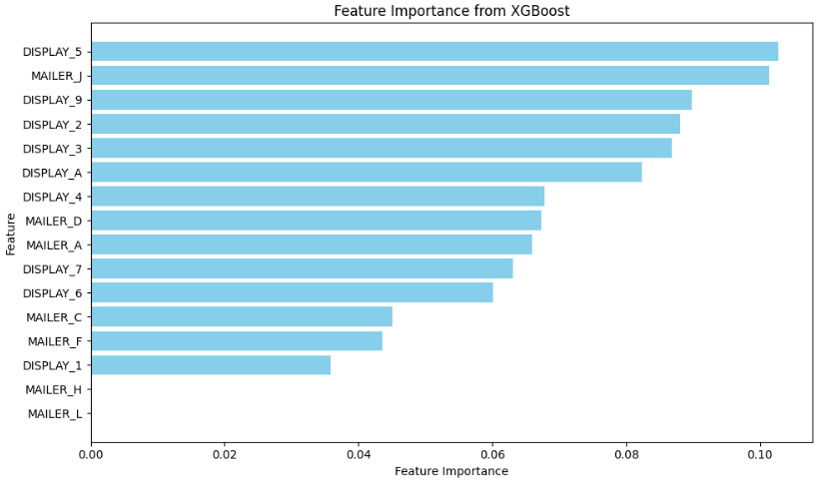
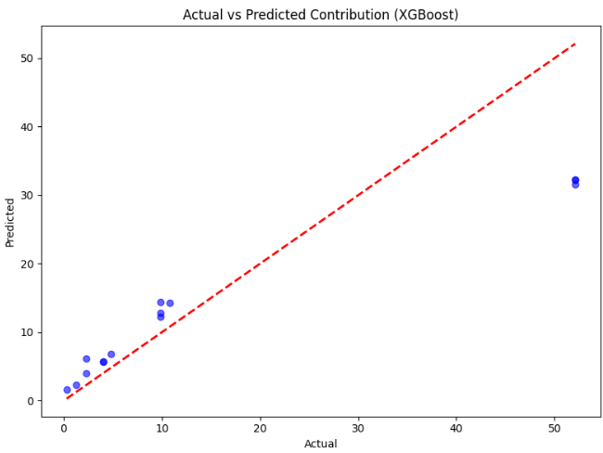
Causal Data Analysis – Other Models Tested
Purpose of the Model:
The model was built to analyze the contribution of various display and mailer combinations to sales, focusing specifically on Manufacturer 69. The goal was to derive actionable insights on which strategies are most effective.
Model Performance Concerns:
Mean Squared Error (MSE): The high value of 92.01 indicates significant errors between the predicted and actual contributions, which suggests that the model's predictive accuracy is limited.
R-squared Value (R²): The R² of 0.76 is moderate but not exceptional. While it indicates that 76% of the variance in contributions is explained by the model, the remaining 24% is unexplained, highlighting possible gaps in the model's ability to generalize.
Feature Importance Analysis:
The feature importance ranking is led by Display_5 and Mailer_J, but the weights of the remaining features show relatively low variation. This lack of distinctiveness among features suggests that the model struggles to effectively differentiate the impact of different combinations.
Several features, such as Mailer_H and Mailer_L, have zero importance, indicating they did not contribute at all to the model's predictions, which may signal redundant or irrelevant input variables.
Relevance to the Business Objective:
The model does not provide actionable insights or clear recommendations. Many of the combinations identified as impactful (e.g., Display_5 or Mailer_J) are not validated with strong business significance or alignment with scaling strategies previously analyzed.
The plateauing effects of certain features, such as Mailer_H and Mailer_L, further diminish the model's usefulness in practical decision-making.
Decision to Reject:
The predictive performance, coupled with unclear or marginally useful insights, does not justify using this model for operational strategy. Instead, alternative approach was implemented

Slide 36
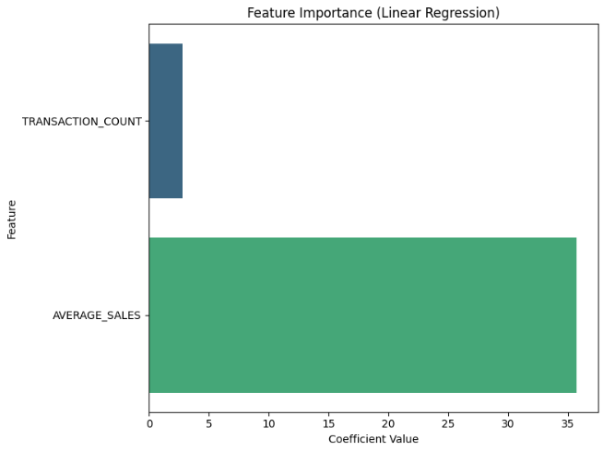
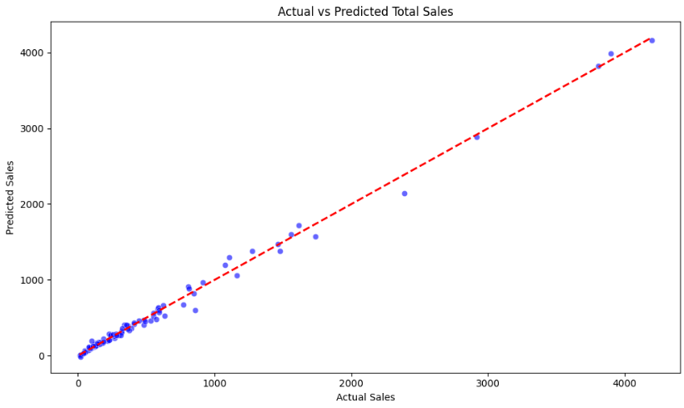
Coupon Data Analysis – Other Models Tested
Purpose of the Model:
The linear regression model aimed to predict total sales using two key features: transaction_count and average_sales
It was designed to evaluate the relationship between these predictors and their impact on total sales, providing a simple, interpretable approach to analyze coupon performance.
Model Performance Concerns:
High R² (0.994): The model showed near-perfect performance on the dataset, which is a red flag for overfitting, suggesting it may fail to generalize well to unseen data.
High MSE (3356.69): Despite the high R2R^2R2, the error magnitude is notable, indicating inconsistencies between the actual and predicted values for certain data points
Feature Importance Analysis:
AVERAGE_SALES dominated the model, with a coefficient of 35.72, heavily influencing predictions.
TRANSACTION_COUNT had a much smaller coefficient (2.83), indicating an imbalanced contribution between the features.
This imbalance suggests the model failed to capture the true dynamics of coupon-driven sales, potentially overlooking critical interactions.
Relevance to the Business Objective:
The model's linear assumptions limit its ability to capture non-linear relationships inherent in sales influenced by coupons.
Business scenarios often involve complex feature interactions (e.g., synergy between transaction counts and average sales), which linear regression cannot adequately handle.
The model lacked flexibility for simulating scaling effects or evaluating dynamic relations
Decision to Reject:
The model was rejected due to its inability to capture non-linear interactions and reliance on a single dominant feature
An alternative model, Gradient Boosting Regression, was chosen as it better aligned with the complexity of the data, provided richer insights into feature importance, and allowed for scaling simulations critical for evaluating campaign effectiveness.

Slide 37
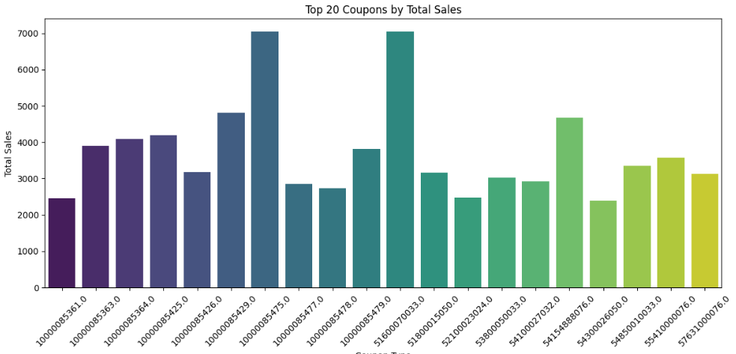



Coupon Data Analysis – Model Results
Additional Visuals
Additional visualizations and descriptive statistics for the gradient boost model in coupon impact analysis

