Slide 1
LIVE-COVID covid-19 cases tracker and death prediction
B KAUSHIC ARAVIND

Slide 2
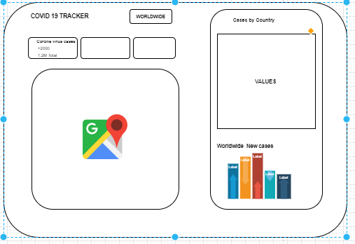
WHAT EXACTLY IS GOING TO HAPPEN HERE?
A USER FRIENDLY APPLICATION WHICH PROVIDES PIN-POINT INFORMATION REGARDING THE CASES WORLDWIDE AND COUNTRY WISE
WIREFRAME OF THE APP

Slide 3
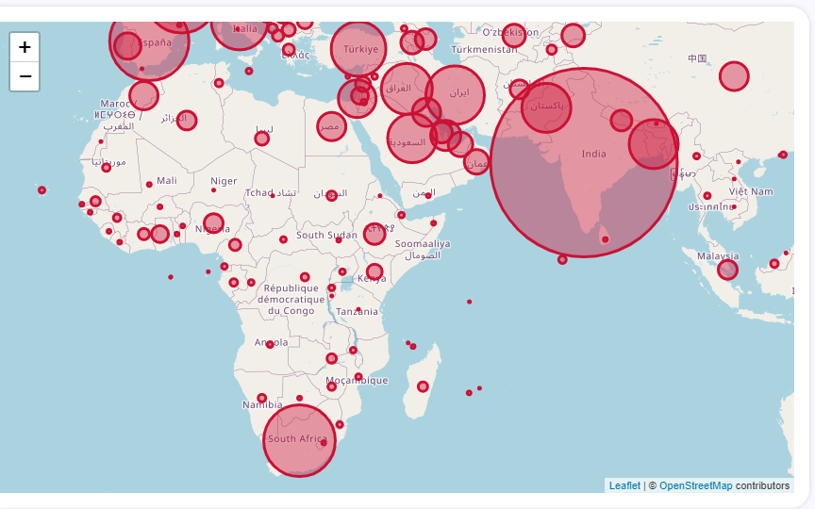
HOW WILL THIS APP BE USEFUL
A CLEAR REPRESENTATION OF MAGNITUDES OF CASES HELPS US FRAME AN IDEA OF HOW WE ARE PROGRESSING IN THIS PANDEMIC.
A TABLE OF COUNTRIES WITH THEIR CASES AND A DYNAMIC GRAPH TO ANALYSE THE BEHAVIOURAL PATTERNS OF THE CHANGES IN CASES IN A DEEP WAY

Slide 4
TIMESERIES MODEL
USING SIR MODEL AS THE BACKBONE, TIMESERIES ANALYSIS IS CARRY FORWARDED TO PREDICT THE DEATHS IN THE PANDEMIC
MACHINE LEARNING MODEL UNDER TIMESERIES ANALYSIS

Slide 5
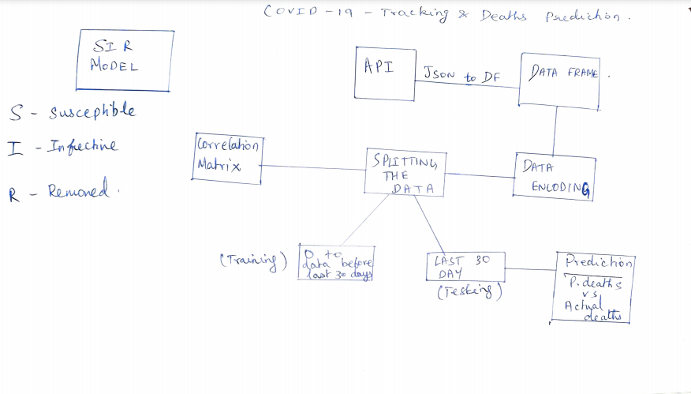
ARCHITECTURE

