Slide 1

SSN COLLEGE OF ENGINEERING
PARCEL SERVICE MANAGEMENT

Slide 2
TEAM MEMBERS AND ROLES:
-KARTHICK V -SCRUM MASTER
-KARUNAGARAN R -DEVELOPER
-KAUSHIK A -DEVELOPER
-HEMASRI K V -OWNER AND DEVELOPER
-KAVIN V -DEVELOPER
-KAVIYAPRIYA K -TESTER AND DEVELOPER
-KAYATHRI R -DEVELOPER

Slide 3
PROBLEM STATEMENT
A parcel service office wants to develop a system to manage their dispatch service. The parcel should be assigned a unique tracking number using which the status of the parcel can be tracked
The sender and the receiver address, and contact details have to be maintained in the system
Once the parcel has reached the destination office, the sender and the receiver should be notified
It should be possible to fetch a location and date-wise list of deliveries from the system
Even after completion of the delivery, the system should be able fetch the relevant details using the tracking number.

Slide 4
OBJECTIVE OF THE PROJECT:
The main objective of the project is to manage details of courier ,notification,tracking,customer
The purpose of the project is to build an application to reduce the manual handling of details of the parcel
It tracks all the details about the parcel
The project is mainly focused at administrative end but both the customer and mainly the administrator are guaranteed the access
IT FACILITATE THE USER TO COMMUNICATE IN FASTER MANNER .THROUGH THE SYSTEM THE STATUS OF THE PARCEL CAN BE EASILY FETCHED

Slide 5
REQUIREMENT ANALYSIS:
1.Unique tracking number is the main requirement to find out any details.
2.Login management also plays a crucial role to store sender and receivers address and login details.
3.Tracking management helps to find the status of package.
4.Notification management notifies both sender and receiver once the parcel.
5.Date wise parcel management gives the details of date wise deliveries.

Slide 6
DESIGN DIAGRAM:
PARCEL SERVICE MANAGEMENT
PARCEL_BOOKING
PINCODE_UPDATES
ADMIN
PARCEL_DETAILS MANAGEMENT
CUSTOMER
STATUS_TRACKING

Slide 7
Class parcel_booking:
Size, details_array, trackno._array
Push(),resize()
Class status_tracking:
Head, size, tail
Push(),check(),track(), trackno(), gethead(),getfront(),getdest(),getend()

Slide 8
Class pincode_updates:
Size,head,tail
Screen_3(),find(),treeview()
Class parcel_detail management:
Size,capacity,array
Admin_login(),proceeding_admin(),getitem(),fetch_details(),getend()

Slide 9
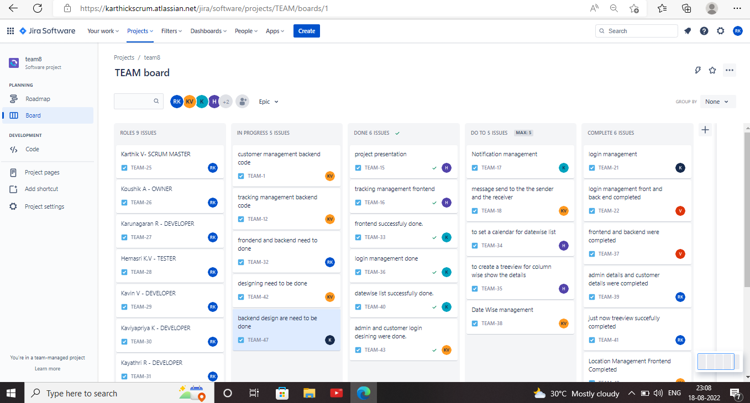
JIRA TASK

Slide 10
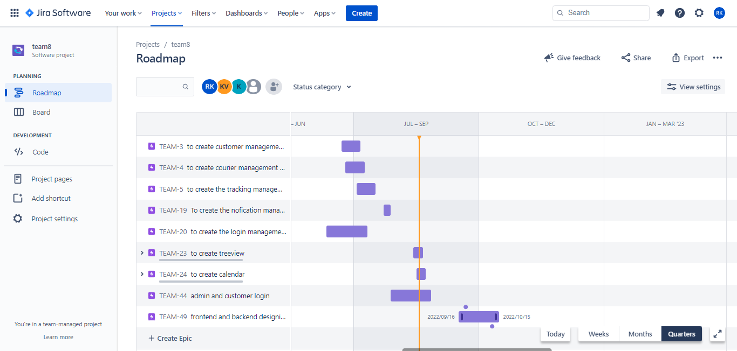

Slide 11
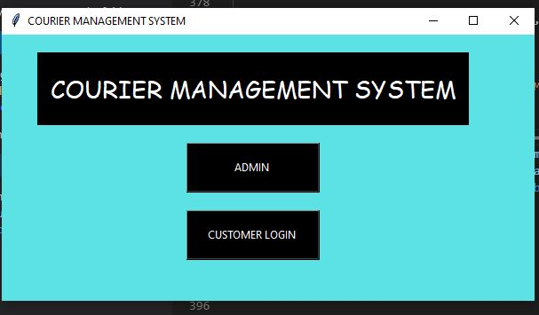
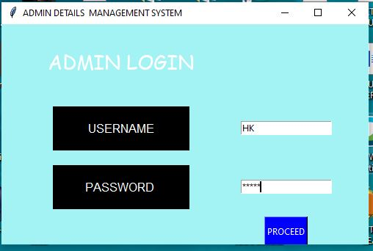
INTERFACE

Slide 12
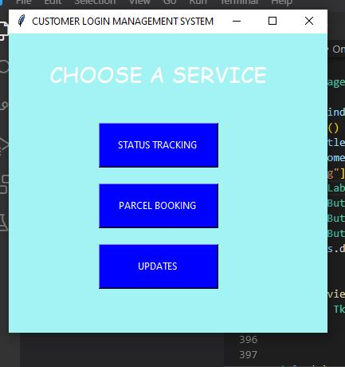
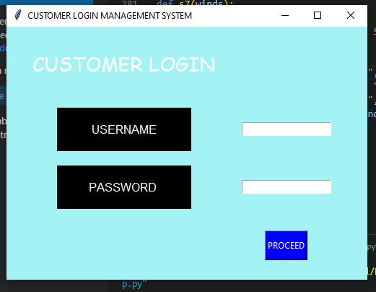

Slide 13
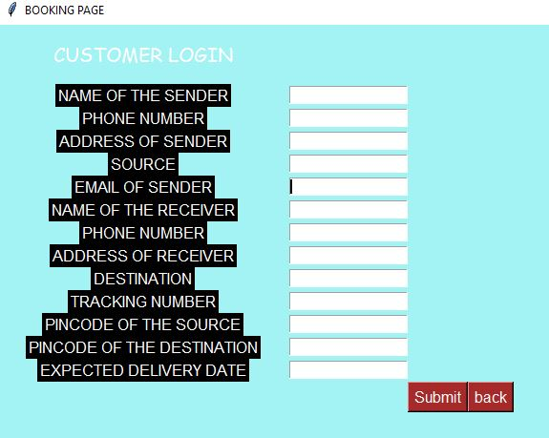
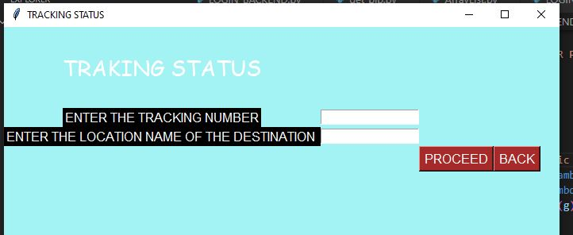

Slide 14
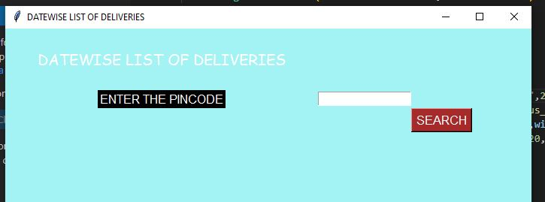
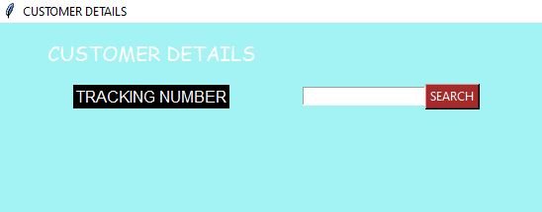

Slide 15
SPRINT | Epic | User Story # | Requirement / User Story | Essential or Desirable | Description of the Requirement | Remar ks
ADMIN LOGIN | Admin_login | To fetch details of parcel | Customers cannot login to admin side to fetch all the details of the customer | essential | By entering the password the admin can login and fetch the details | The details of each parcel is displayed using treeview by entering tracking number
CUSTOMER LOGIN | Password_login | To register as a new customer or to login to their accounts | It is provided with parcel booking ,tracking status of the parcel and can see the pincode wise deliveries of parcel | essential | The customer can login to their account and the can access the facilities of the courier management system | The login will be succesfull by entering the correct password
PARCEL BOOKING | Parcel_booking | The customer can book parcels | The customer can book their order by entering their corresponding contact and delivery details | essential | The customers are asked for their address pincode, contact details and a unique tracking number is generated | The parcel will be stored in a array and booking will be placed
STATUS TRACKING | Status_tracking | The customer can track the status of the parcel | The customer can enter their tracking number and destination and the status of the parcel | essentials | Asked for the tracking number and destination the parcel status will be displayed | The status of the parcel is displayed as message box using linked list
UPDATES | Pincode_tracking | The number of parcels delivered to the pincode can be fetched | By entering the pincode the parcels will be displayed | desirable | Asked for the pincode and the parcels delivered to that location will be displayed in a treeview | Parcels delivered to the particular location will be delivered by using linked list

Slide 16
CONCLUSION
Our software is user friendly to both admin and customer.
Using this software the admin can easily store contact details of both sender and receiver.
The customer also can easily access this software to know their status of the parcel.
The system also maintains their location with date wise deliveries accessable to customers.
Finally we can say our software is easily accessable and user friendly.

Slide 17
THANK YOU

