Slide 1

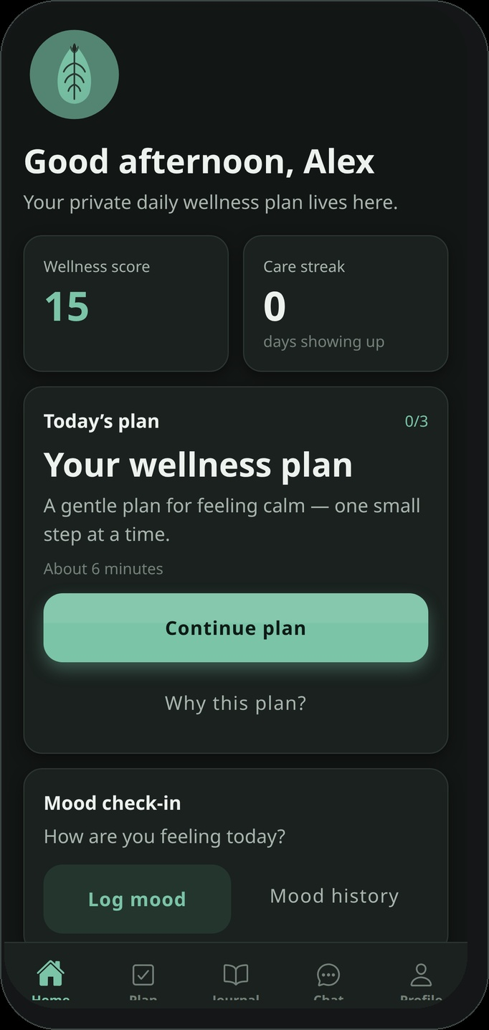
Oppuna
Private AI for your thoughts.
Offline, multilingual and CBT-informed emotional wellness on Android
Kaushik I B · Founder & Product/AI Architect
https://oppuna.com
Notes:
SPEAKER (~40s) Open with the live product: Oppuna is a privacy-first, offline, multilingual and voice-enabled CBT-informed emotional-wellness application on Android. Investment thesis preview: consumer proof point for a privacy-first on-device CBT-informed wellness engine; Plus and institutional programs for early revenue; longer-term SDK for platform leverage. Boundary: supports everyday self-reflection—does not diagnose, treat or replace professional or emergency care. SOURCES - https://oppuna.com - Google Play: https://play.google.com/store/apps/details?id=com.oppuna.care - Cover screenshot: captured from the current Oppuna application UI (running build), Aug 2026.

Slide 2
Dignity and privacy are not premium features.
“I built Oppuna around a simple belief: receiving emotional-wellness support should not require an account, constant connectivity or surrendering private thoughts.”
Oppuna is a coined, Koraga-inspired name. The documented Koraga verb root “oppu” means “to be agreeable” or “to be in accord.” The complete word “Oppuna” is not presented as a literal dictionary translation. The name honours the language and cultural presence of the Koraga indigenous community of coastal Karnataka. The product is dedicated to the spirit of inclusion represented by that heritage—and designed for a broad audience. Interpretation: meeting a person where they are—with agreement, dignity and without judgement.
Living-leaf mark
Oppuna · Confidential
02
Notes:
SPEAKER (~40s) Keep cultural explanation respectful and brief. No costume imagery. Singular founder voice. SOURCES - D. N. Shankara Bhat, The Koraga Language — documents Koraga verb root oppu (“to be agreeable / to be in accord”): https://dnshankarabhat.net/wp-content/uploads/2014/11/Koraga_Language.pdf

Slide 3
Sensitive thoughts are still being asked to trust the cloud.
1 Privacy
2 Access
3 Trust
Emotional content may pass through accounts, cloud servers and third-party AI systems.
Many products require connectivity, subscriptions or English-first interaction.
People may hesitate to open up when they cannot control where their information goes.
India context (need ≠ Oppuna customers): • NMHS 2015–16: about 10.6% of Indian adults had a current mental disorder; treatment gaps commonly reported near 70–92%. • IAMAI–Kantar 2025: 958 million active internet users in India. • Statcounter (India mobile OS, Mar 2025 snapshot): Android about 94.8% of mobile OS traffic share. Oppuna’s wedge is general CBT-informed emotional wellness and self-reflection—not clinical treatment populations.
Oppuna · Confidential
03
Notes:
SPEAKER (~50s) Separate prevalence statistics from the commercial wedge. Do not imply every person with a mental disorder is a customer. SOURCES - NIMHANS National Mental Health Survey of India 2015–16 (current morbidity ~10.6%; treatment gap often cited 70–92%): WHO SEARO summary https://cdn.who.int/media/docs/default-source/searo/india/health-topic-pdf/summary.pdf ; PIB https://www.pib.gov.in/PressReleasePage.aspx?PRID=2188003 - IAMAI–Kantar Internet in India Report 2025: 958M AIU — https://www.indiadigitalsummit.in/wp-content/uploads/2026/01/Internet-in-India-2025-Press-Release-Final.pdf - Statcounter Mobile OS India: https://gs.statcounter.com/os-market-share/mobile/india/ - Product boundary: https://oppuna.com

Slide 4
Private, structured wellness support can now run on the phone.
What Oppuna delivers
• No account required
• Emotional content remains local
• On-device intelligence
• Offline and airplane-mode operation
• Voice and multilingual accessibility
• No advertising in vulnerable moments
• Local export and delete controls
Why now
• On-device AI capability is improving on mainstream Android devices
• Android has large reach across India
• AI-assisted self-help is becoming familiar
• Privacy concerns create a differentiated opening for local-first design
Oppuna · Confidential
04
Notes:
SPEAKER (~45s) Position as architecture opportunity, not hype. Do not invent a multiplied TAM from AIU × Android share. SOURCES - Product capabilities: https://oppuna.com ; https://oppuna.com/privacy/ - India AIU and Android OS share: IAMAI–Kantar 2025; Statcounter India mobile OS (cited on slide 3 notes).

Slide 5
CBT turns overwhelming thoughts into manageable actions.
1
2
3
4
5
6
Recognise the emotion
Capture the automatic thought
Examine the evidence
Build a balanced reframe
Choose one manageable action
Reflect and observe patterns
Connected Oppuna practices
Mood check-ins
Guided thought records
Thought-reframing exercises
Guided journaling
Behavioural / wellness goals
Grounding and breathing
Daily plan
Progress summaries
CBT-informed self-help for everyday wellness—not therapy or diagnosis. Oppuna helps people recognise thoughts and emotions, examine patterns, reframe unhelpful thinking, practise grounding and breathing, choose manageable actions and observe progress—privately on Android.
Oppuna · Confidential
05
Notes:
SPEAKER (~50s) This is the differentiation slide: structured CBT-informed mechanism, not a generic chatbot or meditation library. Repeat boundary language. SOURCES - Product feature set: https://oppuna.com - Positioning: CBT-informed emotional wellness (founder product brief, Aug 2026).

Slide 6
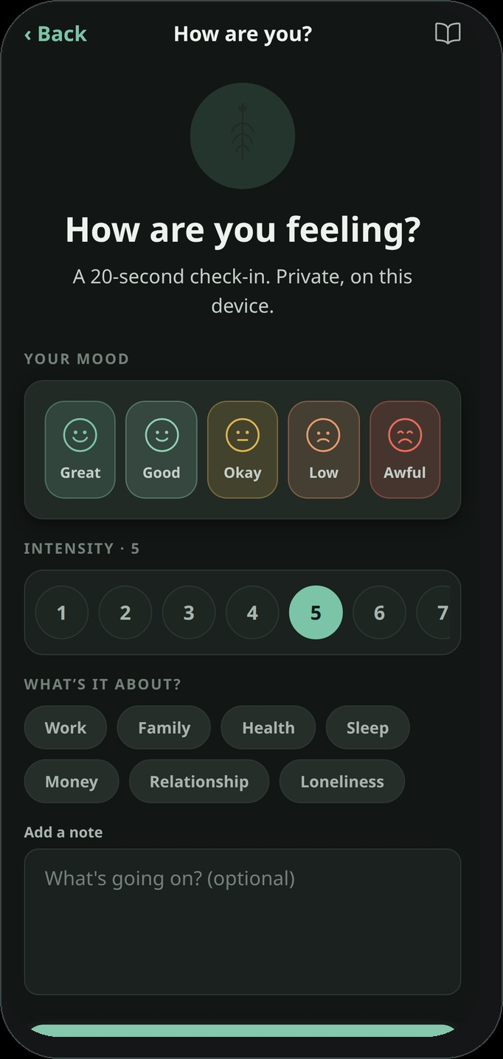
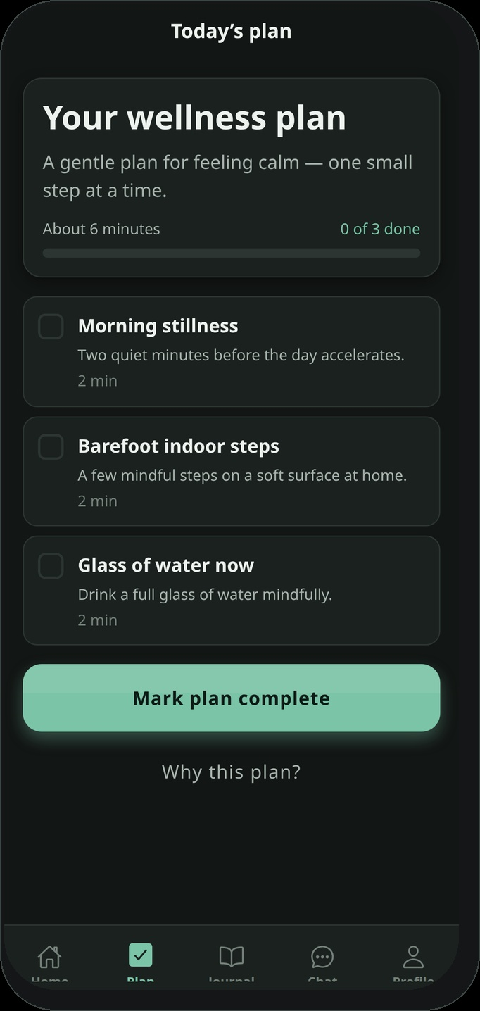
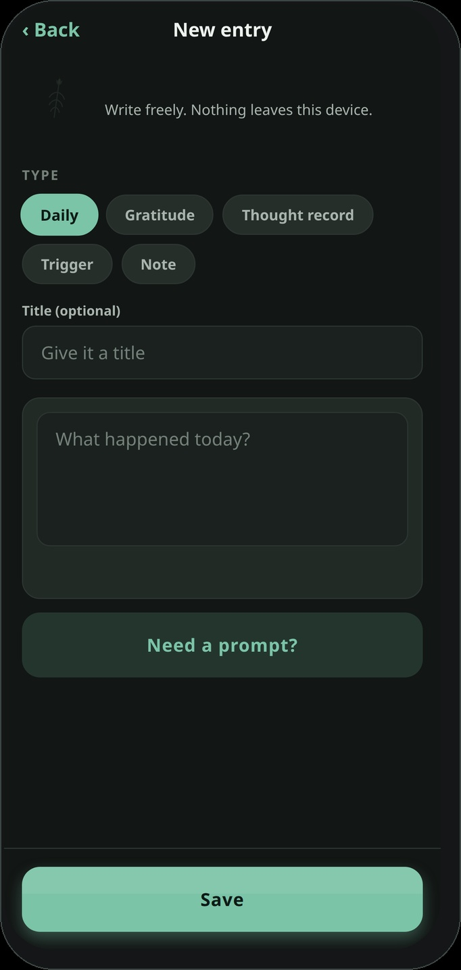
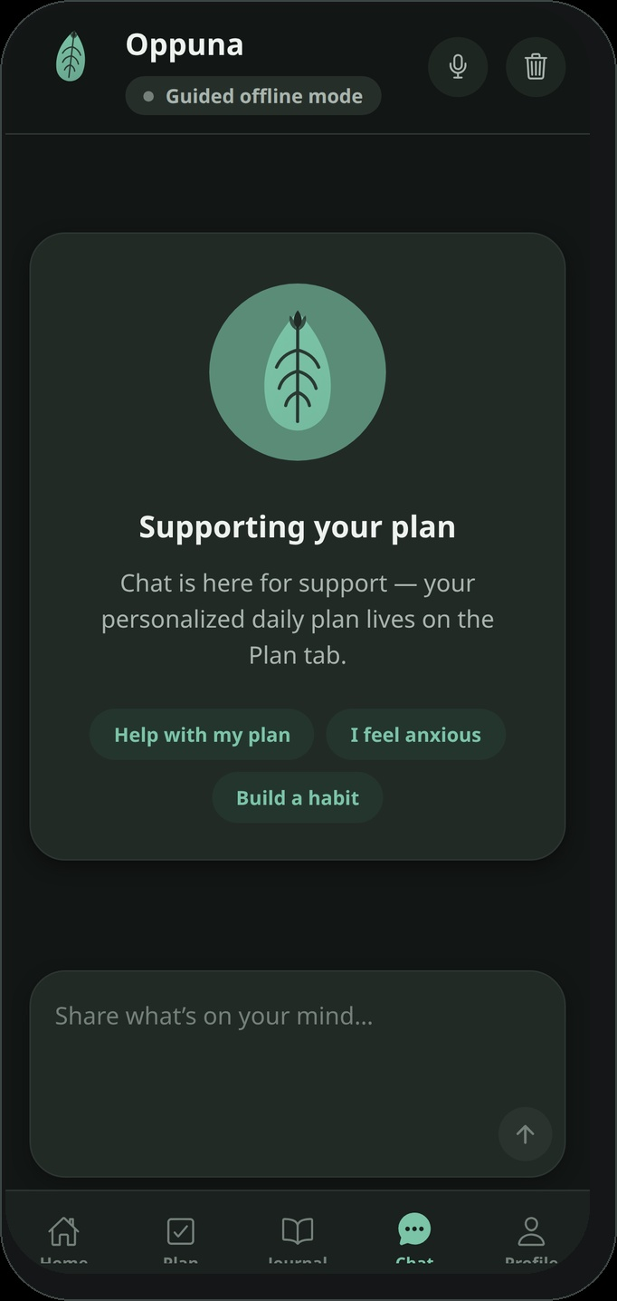
One private space for the practices that build consistency.
1. Check in
2. Daily plan
3. Journal
4. Talk
5. Return home
Mood on this device
Small structured steps
Thoughts stay local
On-device companion
Observe patterns
Oppuna · Confidential
06
Notes:
SPEAKER (~40s) Walk the realistic journey with current in-app screenshots: mood check-in → daily plan → journal / thought record → talk with companion → return home to observe patterns. SOURCES - Screenshots: captured from the current Oppuna application UI (running build), Aug 2026 - Journey capabilities: https://oppuna.com

Slide 7
Privacy and safety are product architecture—not policy promises.
User
→
Android app
→
Local storage
→
On-device AI + local safety
• Journals, moods, thought records, voice notes and conversations remain on the device.
• On-device intelligence supports CBT-informed and general-wellness workflows.
• Local safety logic can present appropriate crisis resources; Oppuna is not an emergency service.
• Export and delete controls provide user control; offline operation is first-class.
• Optional device biometric / PIN app lock is available; SQLCipher-class database encryption is a funded improvement—not a current claim.
Shipped now vs funded
Shipped: local storage, offline companion, CBT-informed workflows, crisis-resource presentation, export/delete, optional app lock. Funded: stronger on-device models, encryption hardening, broader device validation, professional CBT review, multilingual voice depth.
Oppuna · Confidential
07
Notes:
SPEAKER (~45s) Do not claim perfect safety, certifications or clinical validation. Separate shipped from funded. SOURCES - Privacy and architecture: https://oppuna.com/privacy/ ; docs/DATA_PROTECTION.md in product repo (SQLite not SQLCipher-encrypted today) - App lock implementation present in application code (expo-local-authentication / SecureStore) - Crisis resources on site: 112, Tele-MANAS, KIRAN via official government pages linked from oppuna.com

Slide 8
Early users are returning to a private, structured experience.
80–100
~90%
Early users
Returned during the current observation period
Live on Google Play · Production website at oppuna.com Approximately 90% of tracked early users returned during the current observation period.
Founder-reported early-user tracking across approximately 80–100 users. The current return measure is directional and is not yet equivalent to standard D7 or D30 cohort retention.
Oppuna · Confidential
08
Notes:
SPEAKER (~35s) Present as early signal, not product-market fit proof. Methodology detail is in Appendix 1. SOURCES - Founder-reported early-user tracking (Aug 2026) - https://play.google.com/store/apps/details?id=com.oppuna.care - https://oppuna.com

Slide 9
India is the starting point for private, accessible CBT-informed wellness.
Initial customer wedge
Market framing
• Android-first adults in India
• Privacy-conscious users
• People with inconsistent connectivity
• Users seeking structured self-reflection rather than clinical treatment
• Regional-language and voice-first users
Enabling market 958M active internet users in India (IAMAI–Kantar 2025). Android dominates India mobile OS traffic (~94.8%, Statcounter Mar 2025). Initial segment Privacy-seeking Android adults who want structured CBT-informed self-help that works offline. 18-month target 5,000 monthly active users with defined retention and early paid conversion. Expansion Institutional pilots → embeddable SDK for partners.
These figures are enabling-context statistics, not a multiplied TAM. Oppuna does not treat clinical prevalence as its addressable customer count. The near-term job is to prove retention and willingness to pay inside a focused wedge.
Oppuna · Confidential
09
Notes:
SPEAKER (~45s) Do not multiply AIU × Android share into a validated TAM. Keep segment qualitative + 18-month target quantitative. SOURCES - IAMAI–Kantar Internet in India 2025 (958M AIU) - Statcounter India mobile OS (Android ~94.8%, Mar 2025 snapshot) - NMHS for clinical context only (slide 3) - 18-month targets aligned with raise plan (slide 14)

Slide 10
The core remains free; revenue comes from depth and distribution.
Investment thesis: Oppuna is the consumer proof point for a privacy-first, on-device CBT-informed wellness engine. Consumer adoption validates the product; Oppuna Plus and institutional programs provide early revenue; the longer-term SDK creates platform leverage.
1 Now
2 Near-term
3 After retention
4 Longer-term
Free core
Oppuna Plus
Institutional
SDK / platform
Trust, access and daily engagement
Depth, voice and personalisation
Employer, NGO, CSR pilots
License the privacy-first engine
Free core includes: basic CBT-informed exercises · mood check-ins · thought records · journaling · breathing and grounding · basic daily plan · crisis resources · local export and delete. Future Oppuna Plus: stronger on-device models · natural low-latency voice · advanced personalised CBT-informed journeys · deeper insights · longitudinal summaries · user-controlled encrypted backup and migration.
Pricing hypothesis
₹99–₹199 / month
Not final pricing · no ads · no data sale · no per-message fees
Oppuna · Confidential
10
Notes:
SPEAKER (~50s) Sequence matters: free core first; Plus and institutional after proof; SDK is longer-term leverage—not four equal immediate businesses. SOURCES - Business sequence and pricing hypothesis: founder strategy brief, Aug 2026 - Free-core capabilities: https://oppuna.com

Slide 11
Trust-led distribution begins with focused, measurable channels.
Phase 1 — Validation
Early checkpoint
• Google Play and app-store optimisation
• Founder-led community adoption
• Privacy, CBT self-help and regional-language educational content
• User referrals
1,000
active users as an early validation step—not the final milestone of the ₹1 crore round.
Phase 2 — After retention is established
• NGO and community partnerships
• Employer or CSR-sponsored pilots
• Selected public-wellness programs
Oppuna · Confidential
11
Notes:
SPEAKER (~40s) Do not invent signed partnerships. Phase 2 follows retention proof. SOURCES - GTM phasing and 1,000-user checkpoint: founder strategy brief, Aug 2026 - Current channel: Google Play listing for com.oppuna.care

Slide 12
Oppuna competes through architecture and structured engagement.
Dimension
Oppuna
Wysa
Calm / Headspace
Where content is processed
On device
Cloud / AWS servers
Cloud + content CDN
Interactive support offline
Yes (core)
Requires connectivity
Downloaded content may work offline; interactive cloud features do not
Structured CBT-informed workflows
Yes
Yes (care library)
Mindfulness / sleep content focus
Account required
No
Anonymous options; still server-based
Account typical
Voice + multilingual
Voice roadmap; EN · HI · ES
Chat-led; multilingual options
Content libraries; account ecosystems
Local data control
Local-first
Server-stored (transit/at-rest encryption)
Cloud sync / accounts
Business model
Free → Plus → institutional → SDK
Consumer + enterprise wellbeing
Subscription content platforms
Emerging moat: on-device CBT-informed workflow engine · local-model optimisation · safety-aware offline workflows · voice and multilingual UX · privacy-led brand · future embeddable SDK.
Oppuna · Confidential
12
Notes:
SPEAKER (~50s) Correct prior overclaims: Calm/Headspace can offer offline playback of downloaded content; do not claim they have ads as a core model. Wysa offers anonymous usage but processes conversations on cloud servers (AWS) per its privacy policy. SOURCES - Wysa Privacy Policy (cloud/AWS storage; AI/LLM processing): https://legal.wysa.io/privacy-policy - Wysa FAQ (anonymous usage; connectivity/service model): https://www.wysa.com/faq - Calm Premium / content platform: https://support.calm.com/hc/en-us/articles/360008536834-Calm-Premium-vs-Free-Features-Content-List-Benefits - Headspace account/subscription model: https://www.headspace.com/ - Calm/Headspace offline downloads commonly documented in vendor help centres (downloaded sessions may work offline) - Oppuna local-first claims: https://oppuna.com/privacy/

Slide 13
Built by a founder who takes complex systems to production.
Kaushik I B
Founder & Product/AI Architect
• 12+ years across software architecture, cloud and AI
• Enterprise systems across banking, FinTech and AI platforms
• TOGAF certified; Microsoft Teams ecosystem experience
• Currently building enterprise AI and agentic systems
• Built Oppuna end-to-end—from architecture and on-device workflows to Google Play launch
Kaushik combines enterprise architecture experience with the ability to build and ship privacy-sensitive AI products independently.
Oppuna · Confidential
13
Notes:
SPEAKER (~40s) Solo founder. Do not invent additional founders, advisors or clinical staff. Emphasise capital-efficient execution and enterprise-grade systems experience applied to privacy-sensitive consumer AI. SOURCES - Founder credentials and narrative: founder brief, Aug 2026 - Execution evidence: live Android app on Google Play; website https://oppuna.com

Slide 14

₹1 crore takes Oppuna from early usage to validated, revenue-generating wellness infrastructure.
Raising
Runway
₹1 crore pre-seed
18 months
Product & safety
Engagement
Commercial
• Professionally reviewed CBT journeys
• On-device AI + multilingual voice upgrade
• Local-data protection & safety testing
• Broader Android device validation
• 5,000 monthly active users
• Defined D30 retention of 25%+
• 1,000 users completing ≥4 structured CBT-informed exercises
• 500 Oppuna Plus subscribers or ₹1 lakh MRR
• 2–3 paid institutional pilots
Use of funds
40% Product, Android and on-device AI engineering · 15% CBT content and professional review · 15% Privacy, safety, security and testing · 20% User research, community distribution and growth · 10% Institutional pilots, legal and operations
Oppuna is building a future where structured emotional-wellness support does not require surrendering privacy.
https://oppuna.com
support@oppuna.com
Google Play
Oppuna · Confidential
14
Notes:
SPEAKER (~55s) Close on the ₹1 crore pre-seed ask and 18-month milestones. No equity % or valuation. CTA: fundraising conversation. SOURCES - Raise plan and milestones: founder fundraising brief, Aug 2026 - Contact: https://oppuna.com ; mailto:support@oppuna.com - Play: https://play.google.com/store/apps/details?id=com.oppuna.care

Slide 15
Retention methodology
Appendix 1
• Current claim: approximately 90% of tracked early users returned during the observation period.
• Population: approximately 80–100 early users.
• Source: founder-reported internal tracking.
• Limitation: not yet a frozen D1, D7 or D30 install cohort with a pre-declared return definition.
• Prospective framework: cohort start date · observation window · qualifying return event · exclusions · D1/D7/D30 · monthly active users.
• Purpose of the upgrade: make retention comparable for diligence and milestone tracking against the 25%+ D30 target.
Oppuna · Confidential
A1
Notes:
SPEAKER (optional) Investor diligence detail for the early return measure. SOURCES - Founder-reported early-user tracking, Aug 2026 - Future source of truth: Google Play Console retention / cohort reports

Slide 16
Current architecture and funded improvements
Appendix 2
Current product
Funded improvements
• Android application
• Local data storage
• On-device / offline companion
• CBT-informed wellness workflows
• Mood, journal and thought records
• Local crisis-resource presentation
• Export / delete controls
• Offline operation
• Optional biometric / PIN app lock
• Stronger on-device models
• Encryption hardening
• Biometric / PIN protection hardening
• Broader device validation
• Professional CBT-content review
• Expanded safety testing
• Multilingual voice improvement
• User-controlled backup and migration
Oppuna · Confidential
A2
Notes:
SPEAKER (optional) Clear separation of shipped vs funded. Database encryption is funded, not shipped. SOURCES - https://oppuna.com/privacy/ - Product data-protection notes: SQLite currently not SQLCipher-encrypted; app lock exists via device authentication APIs

Slide 17
Product and revenue roadmap
Appendix 3
Free core
Oppuna Plus
Institutional
SDK / platform
Shipped now
In development / hypothesis
Future
Longer-term
• CBT-informed basics
• Mood + thought records
• Journaling
• Breath / ground / sleep
• Daily plan
• Crisis resources
• Export / delete
• Stronger on-device models
• Natural voice
• Personalised journeys
• Deeper insights
• Longitudinal summaries
• Encrypted backup*
• Device migration*
• Sponsored access
• Employer pilots
• NGO / CSR programs
• Public-wellness pilots
• No sale of user data
• Privacy-first engine
• White-label path
• Partner integrations
• Local-model packaging
• Safety workflows
* Future / hypothesis — not shipped. Roadmap items are not existing features.
Oppuna · Confidential
A3
Notes:
SPEAKER (optional) Status labels matter for diligence: shipped vs in development vs future vs hypothesis. SOURCES - Shipped capabilities: https://oppuna.com - Roadmap sequencing: founder strategy brief, Aug 2026

Slide 18
Sources
Appendix 4
• Koraga verb root “oppu”: D. N. Shankara Bhat, The Koraga Language — https://dnshankarabhat.net/wp-content/uploads/2014/11/Koraga_Language.pdf
• India mental-health context: NIMHANS National Mental Health Survey 2015–16 — WHO SEARO summary; PIB releases citing NMHS.
• India internet users: IAMAI–Kantar Internet in India Report 2025 (958M active internet users).
• Android share (India mobile OS traffic): Statcounter Global Stats — https://gs.statcounter.com/os-market-share/mobile/india/
• Oppuna product, privacy and positioning: https://oppuna.com · https://oppuna.com/privacy/
• Google Play listing: https://play.google.com/store/apps/details?id=com.oppuna.care
• Wysa cloud/server processing and privacy: https://legal.wysa.io/privacy-policy · https://www.wysa.com/faq
• Calm / Headspace: subscription content platforms; vendor help centres document offline playback of downloaded content.
• Traction (80–100 users; ~90% return during observation): founder-reported early-user tracking, Aug 2026.
• Raise plan (₹1 crore / 18 months / milestones): founder fundraising brief, Aug 2026.
Oppuna · Confidential
A4
Notes:
SPEAKER (optional) Point investors to primary sources. Prefer official pages over secondary blogs. Additional references - WHO SEARO NMHS summary PDF - IAMAI–Kantar press PDF (India Digital Summit, Jan 2026) - Calm Premium help article; Headspace site for account/subscription model

