Slide 1
Movie Rental Analytics Dashboard
Power BI Business Performance Analysis
Prepared by: Mayank Kaushik
Date: August 2025

Slide 2
Introduction
The dashboard provides insights into customer behavior, film inventory, staff efficiency, and store performance.
It uses the MECE framework to structure the analysis and ensure comprehensive coverage of business questions.

Slide 3
Methodology – MECE Framework
A. Time-based Analysis (When?)
B. Customer Analysis (Who?)
C. Product/Inventory Analysis (What?)
D. Staff/Store Analysis (Where/By Whom?)

Slide 4
Data Model
Fact Tables:
- fact_rentals (rental transactions)
- fact_sales (payment transactions)
Dimension Tables:
- dim_customer (customer demographics)
- dim_staff (staff details)
- dim_store (store details)
- dim_film (film details)
- dim_date (calendar)
Built as a star schema for optimized querying.

Slide 5
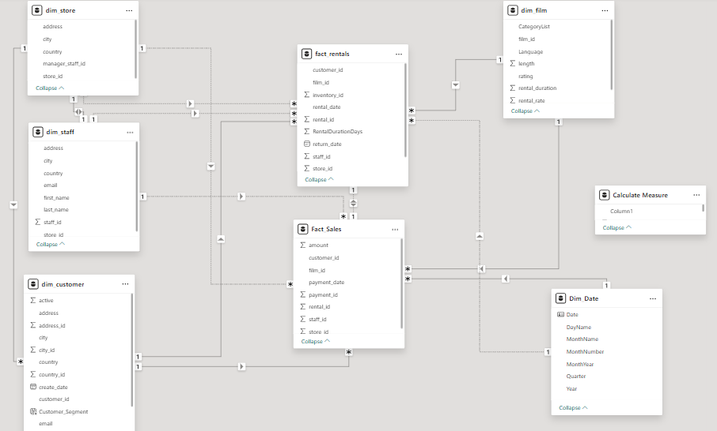

Slide 6
Page 1: Executive Overview
KPIs: Revenue, Rentals, Customers, On-time %
Visuals: Revenue by Month, Store, Country
Purpose: Provide high-level business performance snapshot.

Slide 7
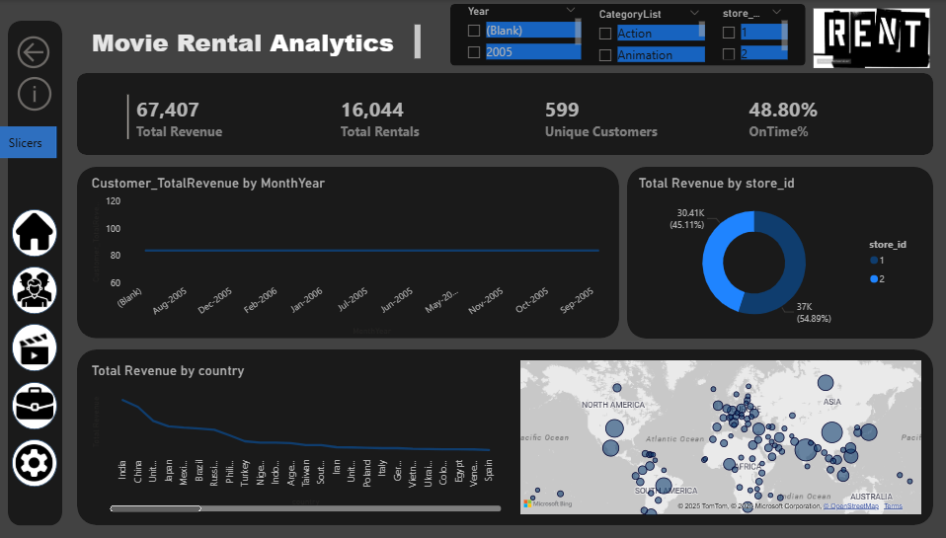

Slide 8
Page 2: Customers & Segments
KPIs: Active Customers, Avg Revenue/Customer, Top Customer
Visuals: Segmentation, City Distribution, Top Customers Table
Purpose: Identify valuable customers and retention opportunities.

Slide 9
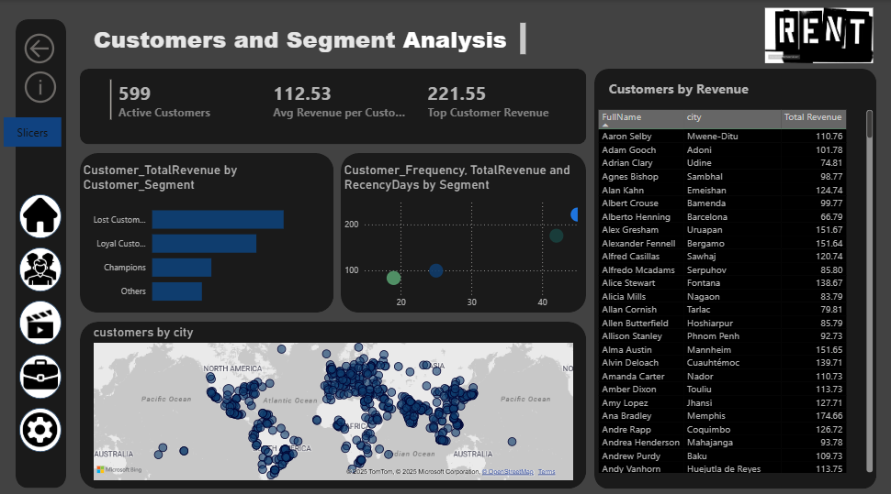

Slide 10
Page 3: Films & Inventory
KPIs: Films in Catalog, Copies in Stock, Rentals per Copy
Visuals: Rentals by Category, Film × Store Matrix, Rental Duration Histogram
Purpose: Optimize film stock and category demand.

Slide 11
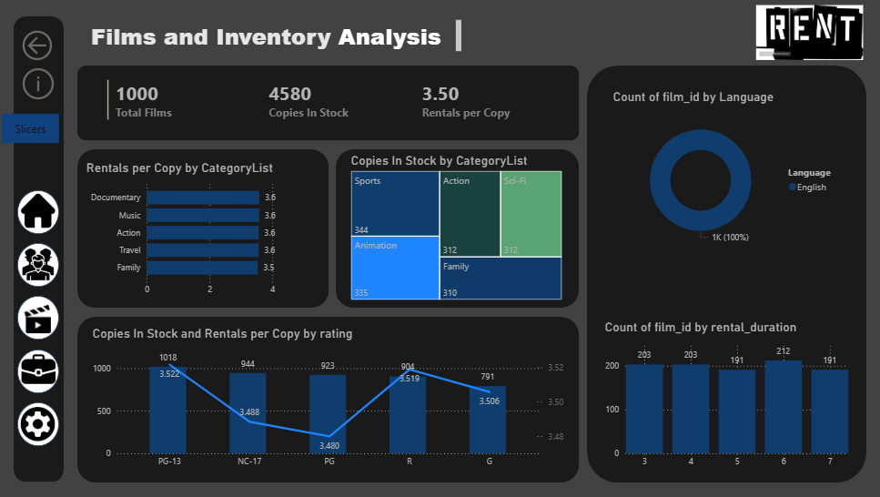

Slide 12
Page 4: Staff & Store Operations
KPIs: Revenue per Store, Avg Rentals per Staff, On-time % by Store
Visuals: Store Comparison, Staff Performance Table
Purpose: Benchmark stores and staff efficiency.

Slide 13
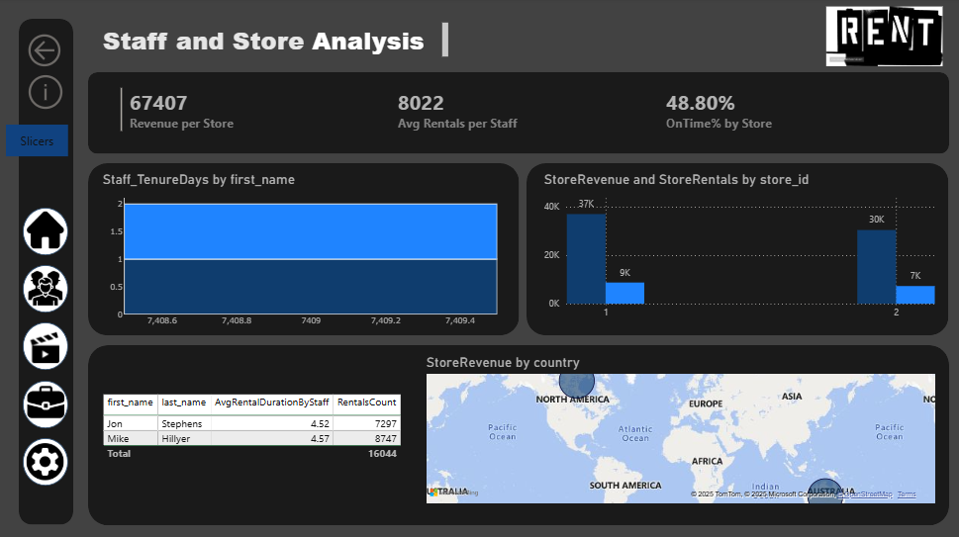

Slide 14
Recommendations
- Improve customer retention by targeting 'Lost customers'
- Restock high-demand categories (Sports, Action, Animation)
- Train staff for on-time returns
- Balance inventory across stores

Slide 15
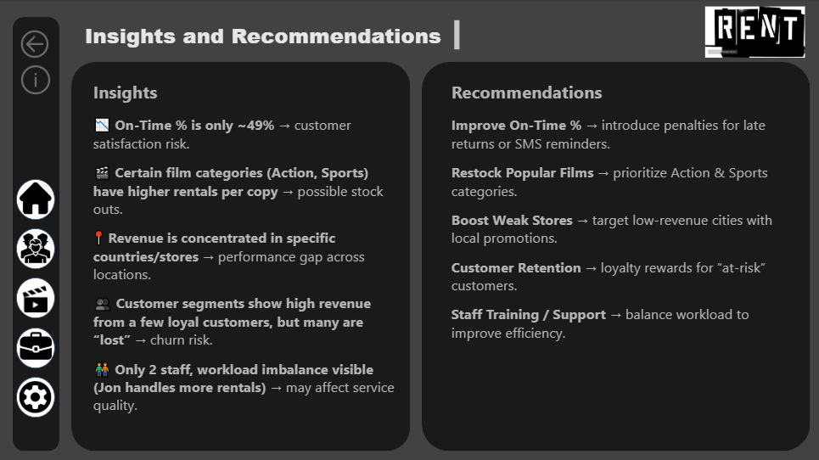

Slide 16
Conclusion
• Star schema ensures clean and optimized data modeling.
• MECE framework ensures structured analysis without overlap.
• Dashboard answers key business questions.
• Helps improve retention, inventory, staff efficiency, and profitability.

