Slide 1

Exploratory Data Analysis & Dashboard Report
By Mayank Kaushik

Slide 2
Agenda
1. Project Overview
2. EDA Findings
3. Dashboards & Insights
4. Key KPIs
5. Recommendations

Slide 3
Project Overview
- Data cleaning, transformation, and EDA performed in Excel & SQL
- Interactive dashboards created in Power BI
- Insights generated across Customers, Products, Employees, and Suppliers

Slide 4
EDA Findings
- Avg. orders per customer calculated
- High-value repeat customers identified
- Customer order patterns analyzed by city/country
- Product category contributions measured
- Seasonal demand patterns observed
- Correlations between location, product category, and orders checked

Slide 5
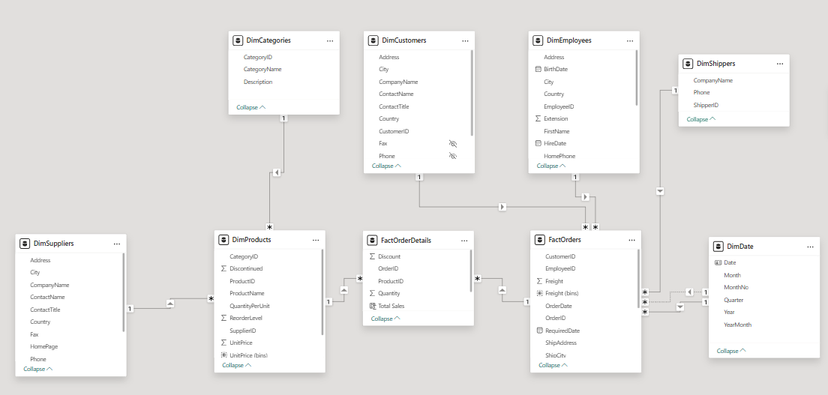

Slide 6
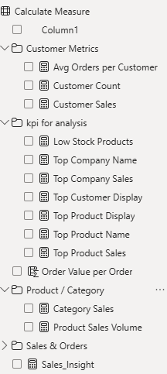
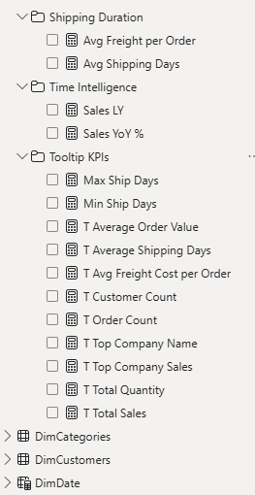

Slide 7
Dashboards & Insights
- Customer Dashboard: Orders, spending, repeat customers
- Product Dashboard: Sales, pricing, demand trends
- Employee Dashboard: Geographic & title-wise distribution
- Supplier Dashboard: Regional presence, pricing & categories

Slide 8
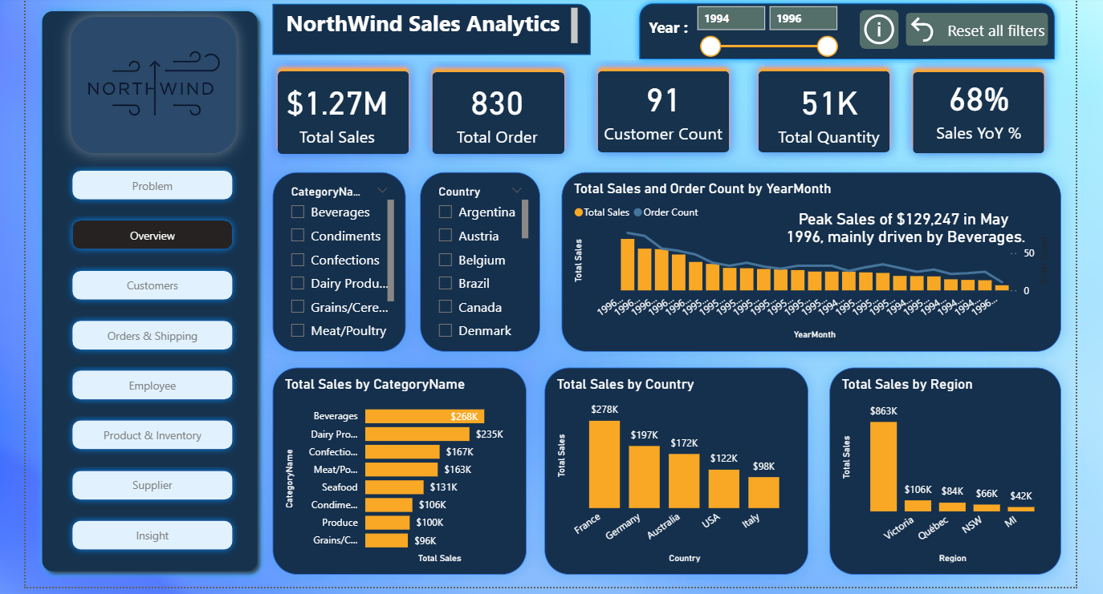

Slide 9
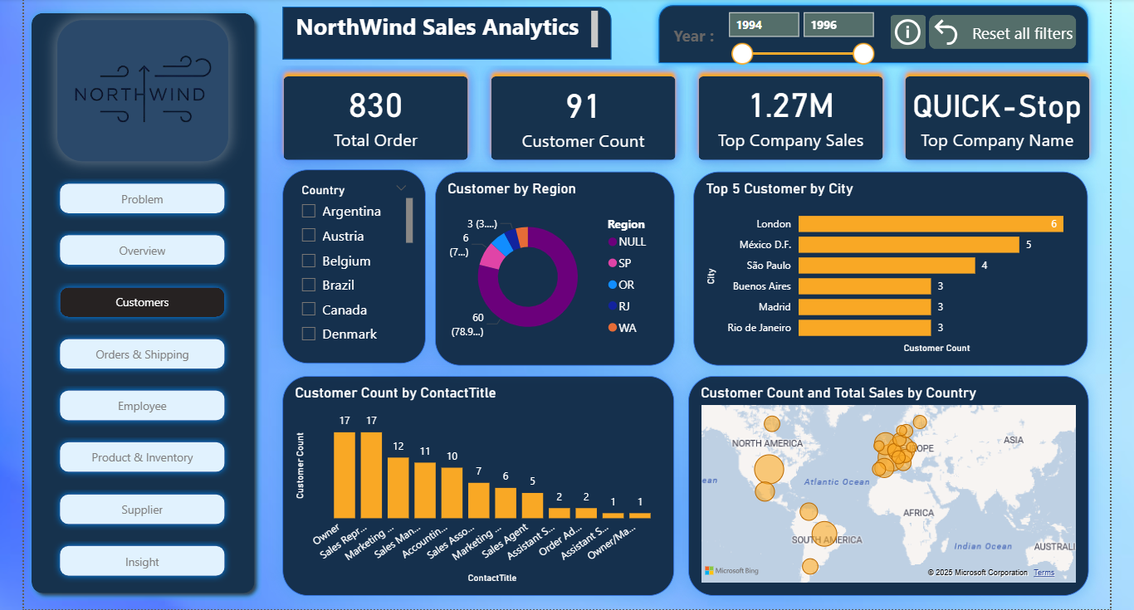

Slide 10
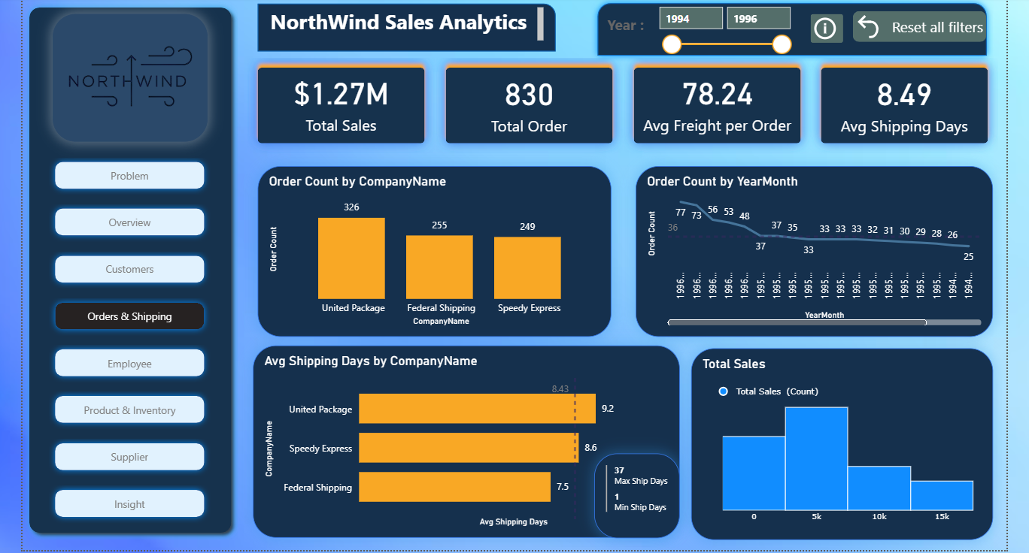

Slide 11
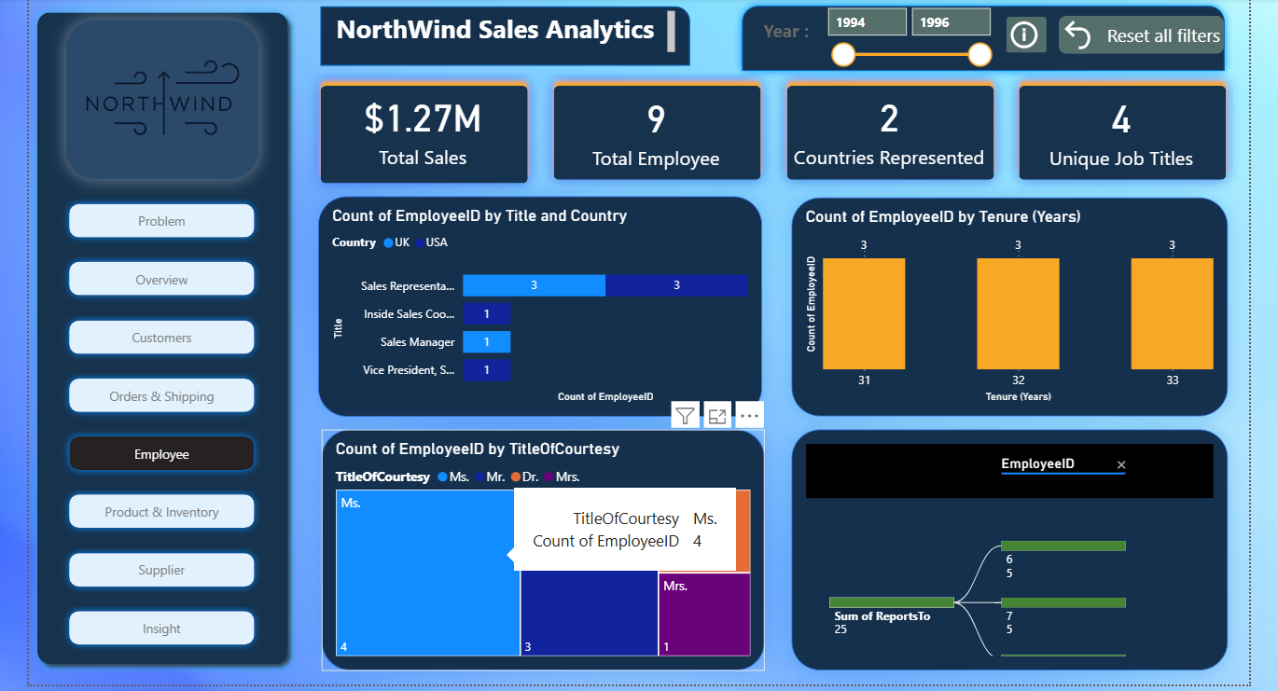

Slide 12
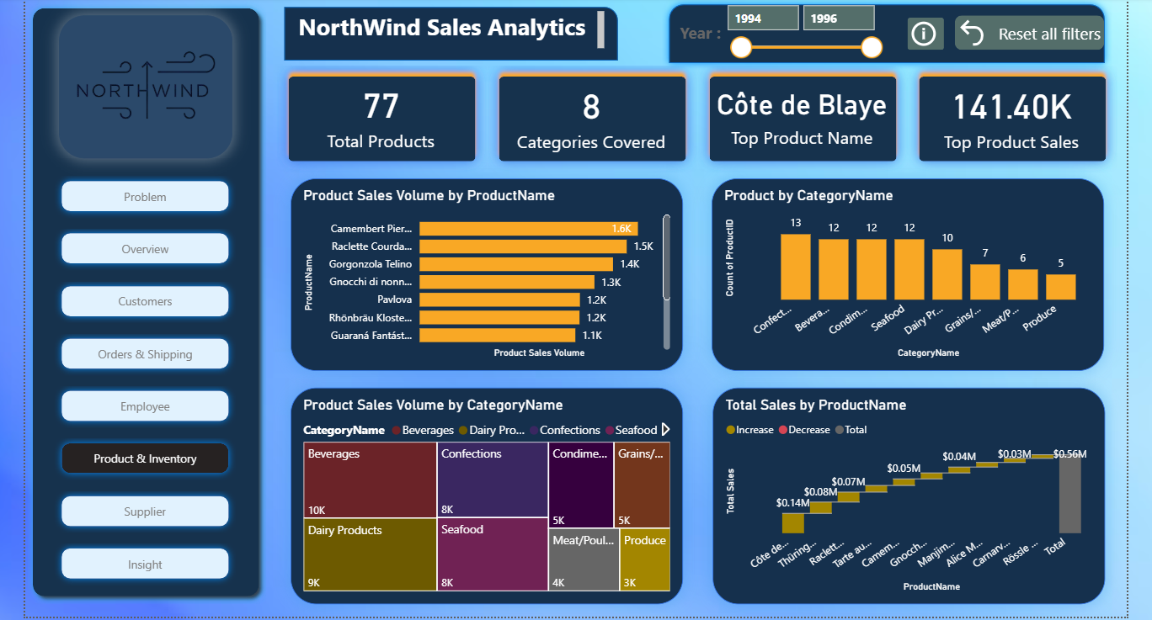

Slide 13
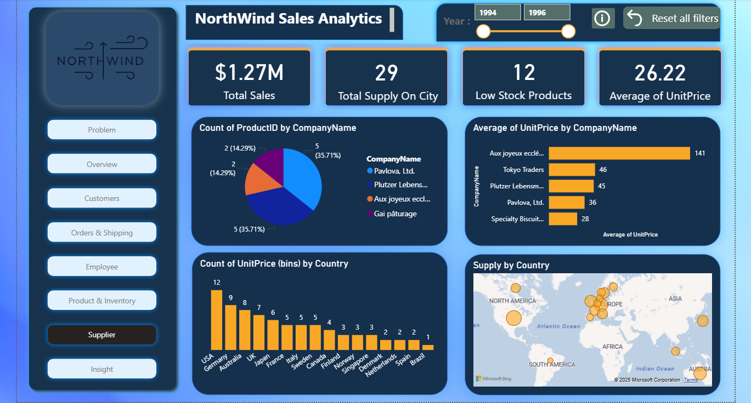

Slide 14
Key KPIs
- Total Sales (by supplier & product)
- Top-Selling Products
- Low Stock Products
- Average Unit Price
- Customer Retention & Repeat Purchase Rates

Slide 15
Recommendations
- Focus on high-value customers for retention programs
- Optimize inventory for low-stock, high-demand items
- Expand in regions with high supplier & customer activity
- Improve employee training in high-demand regions
- Seasonal demand planning to boost sales & reduce stockouts

Slide 16
Conclusion
The analysis provides valuable insights into customer behavior, product performance, employee distribution, and supplier trends.
Dashboards and KPIs support strategic decision-making for growth and efficiency.

