Slide 1

Note: The data and information in this document is reflective of a hypothetical situation and client. This document is to be used for KPMG Virtual Internship purposes only.
Sprocket Central Pty Ltd
Data analytics approach
Kaushik Prasad Dey
KPMG Data Analyst Virtual Intern

Slide 2
Note: The data and information in this document is reflective of a hypothetical situation and client. This document is to be used for KPMG Virtual Internship purposes only.
Agenda
Introduction
Data Exploration
Model Development
Interpretation

Slide 3
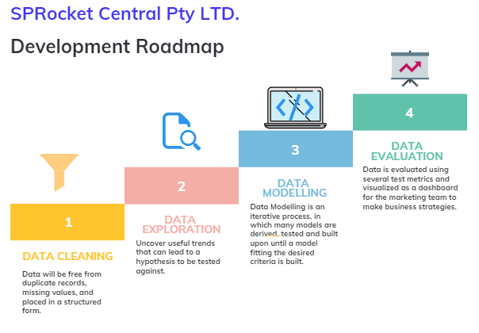
Note: The data and information in this document is reflective of a hypothetical situation and client. This document is to be used for KPMG Virtual Internship purposes only.
Introduction

Slide 4
Note: The data and information in this document is reflective of a hypothetical situation and client. This document is to be used for KPMG Virtual Internship purposes only.
Introduction
New Customer Analysis
After Analysing the Existing Datasets (Transactions, CustomerDemographic, CustomerAddress) and Exploring Relationship within them, following are the features recommended for New Customers:
Gender distribution
Comparison old gender vs new gender distribution
Past 3 years Bike Purchase history
Job Industry
No. of Car Owns
Wealth Segment

Slide 5
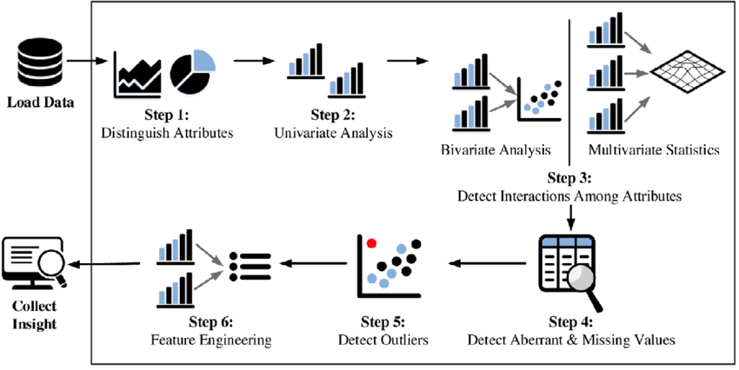
Data Exploration
Data exploration is the first step of data analysis used to explore and visualize data to uncover insights from the start or patterns to dig deeper.
Significance of performing an EDA:
Reduces the risk of imbalance distribution of the dataset by checking the skewness of a particular field.
High Correlation between multiple variables can lead to overfitting problem which can be checked using correlation analysis.
To Infer better variables/predictors out of the existing variables that can turn out to be a good predictor if it correlates with the output variable.
Removes the redundant values from the dataset by treating missing values and outliers.
fig. Steps for Data Exploration.

Slide 6
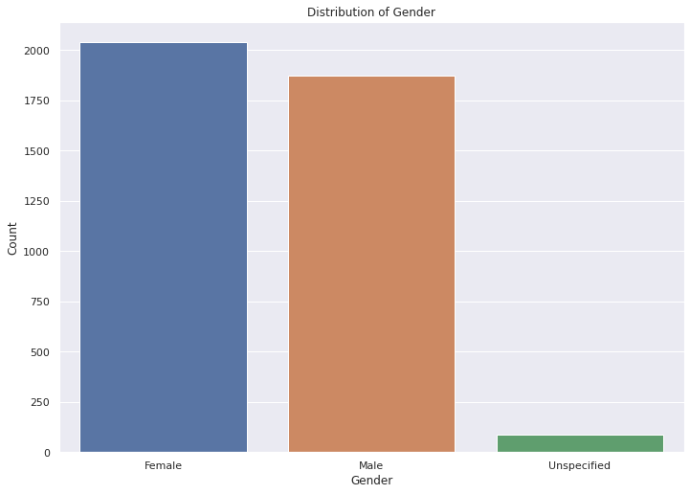
Note: The data and information in this document is reflective of a hypothetical situation and client. This document is to be used for KPMG Virtual Internship purposes only.
Data Exploration
Gender distribution
Female customer count was 2039 , Male customer count was 1873 & unspecified count was 88.
﻿﻿so, we can say that Female customer was more interested over male customer.

Slide 7
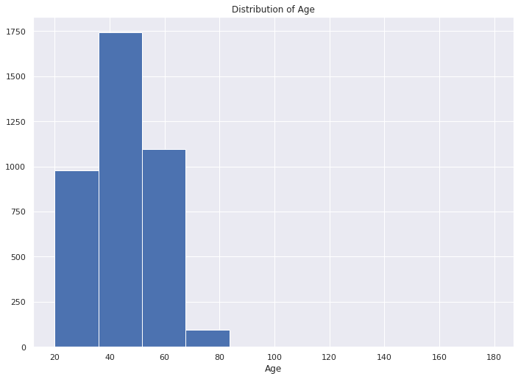
Note: The data and information in this document is reflective of a hypothetical situation and client. This document is to be used for KPMG Virtual Internship purposes only.
Data Exploration
Age Distribution
Most of the customers are falling under the age bin 40 to 60.

Slide 8
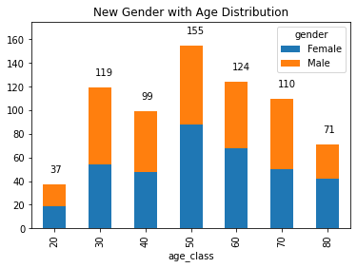
Note: The data and information in this document is reflective of a hypothetical situation and client. This document is to be used for KPMG Virtual Internship purposes only.
Data Exploration
Gender with Age Distribution
At the age of 50 we can state that female customer count was 100. And Male customer count was 55.
﻿﻿ At the age of 20 we can state that female customer count was 20 and male customer was 17.
﻿﻿﻿In a comparison we can say that female customer was higher ratio than male customer.
﻿﻿At the age of 50 more customer was interested to purchase bike.

Slide 9
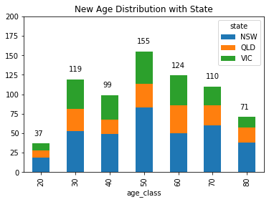
Note: The data and information in this document is reflective of a hypothetical situation and client. This document is to be used for KPMG Virtual Internship purposes only.
Data Exploration
Age distribution with State
We can say that 3 state are more comparitively higher than other state. ( NSW, QLD & VLC )
﻿﻿75 customers are from NSW state, 25 customers are from QLD state and 55 customers are from VLC.
﻿﻿﻿So from that NSW state and at the age of 50 more customer was interested to purchase bike.

Slide 10
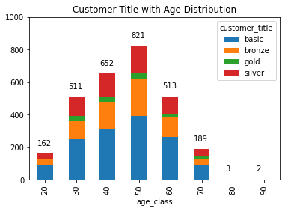
Note: The data and information in this document is reflective of a hypothetical situation and client. This document is to be used for KPMG Virtual Internship purposes only.
Data Exploration
Age distribution with State
We can say that 3 state are more comparitively higher than other state. ( NSW, QLD & VLC )
﻿﻿75 customers are from NSW state, 25 customers are from QLD state and 55 customers are from VLC.
﻿﻿﻿So from that NSW state and at the age of 50 more customer was interested to purchase bike.

Slide 11
Note: The data and information in this document is reflective of a hypothetical situation and client. This document is to be used for KPMG Virtual Internship purposes only.
Data Exploration
Age distribution with State
We can say that 3 state are more comparitively higher than other state. ( NSW, QLD & VLC )
﻿﻿75 customers are from NSW state, 25 customers are from QLD state and 55 customers are from VLC.
﻿﻿﻿So from that NSW state and at the age of 50 more customer was interested to purchase bike.

Slide 12
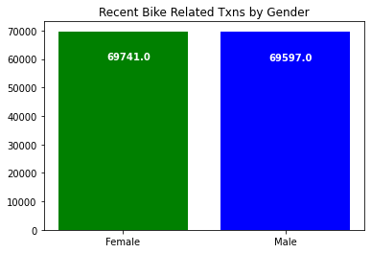
Note: The data and information in this document is reflective of a hypothetical situation and client. This document is to be used for KPMG Virtual Internship purposes only.
Data Exploration
Bike Related Txns By Gender
We can say Female customer are more purchased from Male customer.
﻿﻿Graph shows that Female (69741.0) and male (69597.0) .

Slide 13
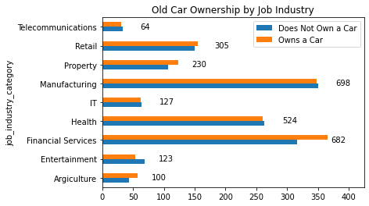
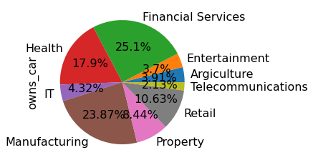
Note: The data and information in this document is reflective of a hypothetical situation and client. This document is to be used for KPMG Virtual Internship purposes only.
Data Exploration
Old car Ownership by Job Industry
Manufacturing and Financial Services are taken more ownership.
Manufacturing ( 698 ) and Financial Services ( 682 )
And from the pie chart we also state that 25.1% from Financial Services and 23.87% from Manufacturing Industry.

Slide 14
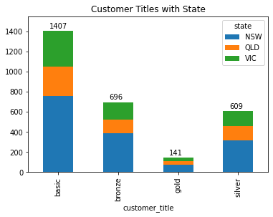
Note: The data and information in this document is reflective of a hypothetical situation and client. This document is to be used for KPMG Virtual Internship purposes only.
Data Exploration
Customer title with State
From that analysis we can say that 4 types of customer we have. ( Basic, Bronze, Gold & Silver ).
And we have 3 states ( NSW, QLD and VLC).
We can conclude that in that NSW state we have Basic ( 800 ) customer , QLD ( 200 and VLC ( 207 ) .

Slide 15
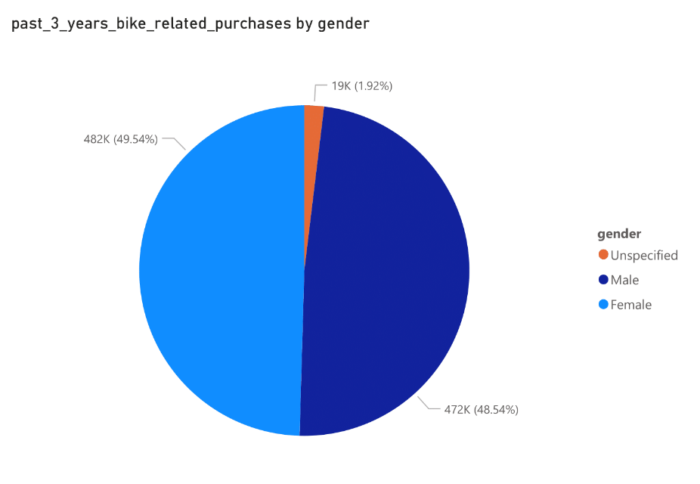
Note: The data and information in this document is reflective of a hypothetical situation and client. This document is to be used for KPMG Virtual Internship purposes only.
Data Exploration
Bike purchases within the last 3 years by Gender for Existing Customer
Female had the highest past_3_years_bike_related_purchases at 482083, followed by Male at 472297 and Unspecified at 18677.﻿﻿
﻿﻿Female accounted for 49.54% of past_3_years_bike_related_purchases.﻿﻿

Slide 16
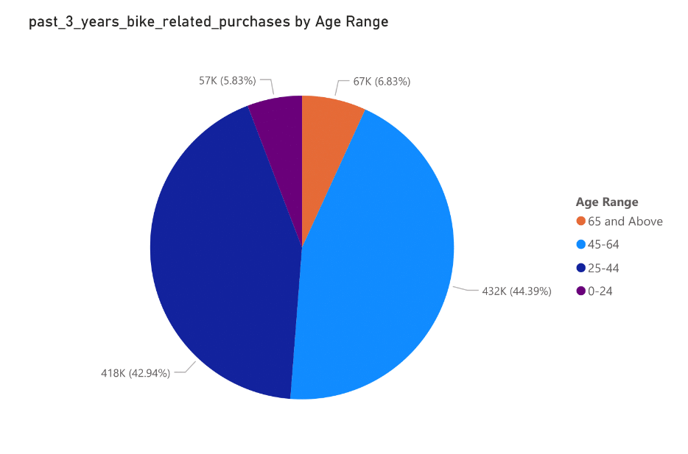
Note: The data and information in this document is reflective of a hypothetical situation and client. This document is to be used for KPMG Virtual Internship purposes only.
Data Exploration
Bike purchases within the last 3 years by Age for Existing Customer
45-64 had the highest past_3_years_bike_related_purchases at 431982, followed by 25-44, 65 and Above, and 0-24.﻿﻿
﻿﻿45-64 accounted for 44.39% of past_3_years_bike_related_purchases.﻿﻿

Slide 17
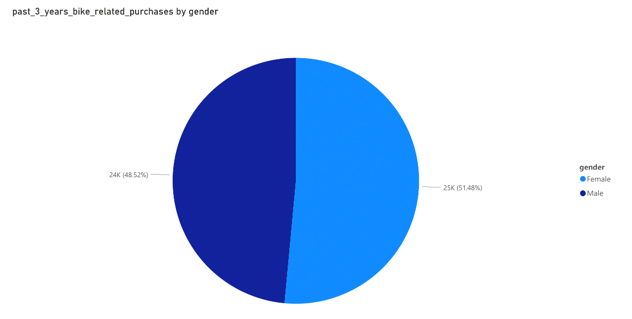
Note: The data and information in this document is reflective of a hypothetical situation and client. This document is to be used for KPMG Virtual Internship purposes only.
Data Exploration
Bike purchases within the last 3 years by Gender for New Customer
﻿past_3_years_bike_related_purchases for Female (25212) was higher than Male (23765).﻿﻿
﻿﻿Female accounted for 51.48% of past_3_years_bike_related_purchases.﻿﻿

Slide 18
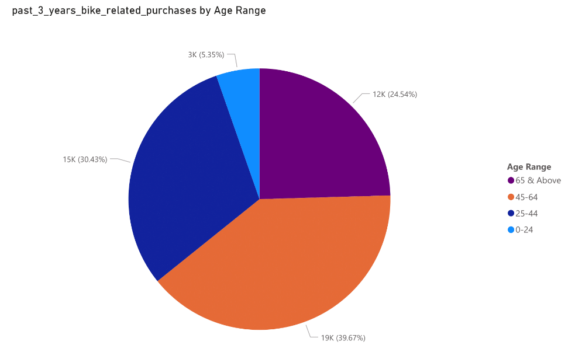
Note: The data and information in this document is reflective of a hypothetical situation and client. This document is to be used for KPMG Virtual Internship purposes only.
Data Exploration
Bike purchases within the last 3 years by Age for New Customer
﻿At 19429, 45-64 had the highest past_3_years_bike_related_purchases and was 641.00% higher than 0-24, which had the lowest past_3_years_bike_related_purchases at 2622.﻿﻿
﻿﻿45-64 had the highest past_3_years_bike_related_purchases at 19429, followed by 25-44, 65 & Above, and 0-24.﻿﻿
﻿﻿45-64 accounted for 39.67% of past_3_years_bike_related_purchases.﻿﻿
﻿﻿Across all 4 Age Range, past_3_years_bike_related_purchases ranged from 2622 to 19429.﻿﻿
The distribution of the two groups is somewhat comparable, therefore depending on your marketing plan, you may strive to increase the number of male customers or concentrate on increasing the retention of female customers.

Slide 19
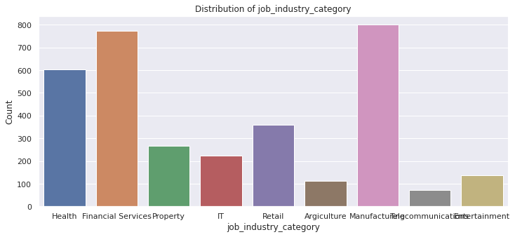
Note: The data and information in this document is reflective of a hypothetical situation and client. This document is to be used for KPMG Virtual Internship purposes only.
Data Exploration
Job industry
8 different industry we can identify.
﻿﻿out of them Financial Services and Manufacturing industry are highest pick.

Slide 20
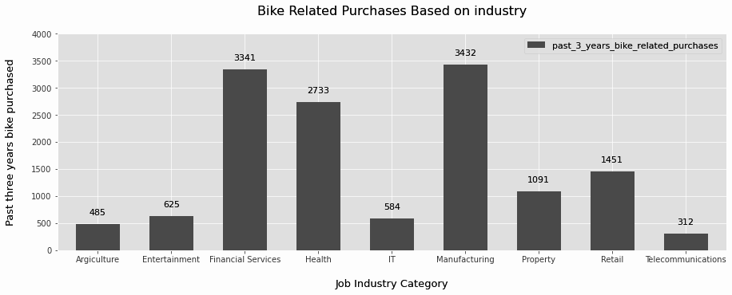
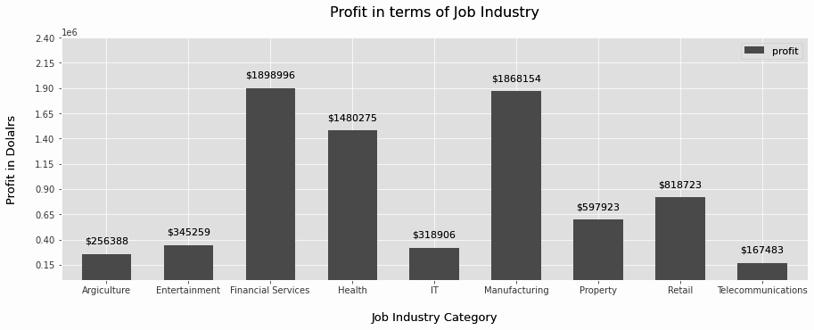
Data Exploration : Job Industry
Financial Services, Manufacturing, and Health are the top three profit-generating industries, followed by retail and property.
The highest profits are also Financial Services, Manufacturing, and Health as seen in the second chart.

Slide 21
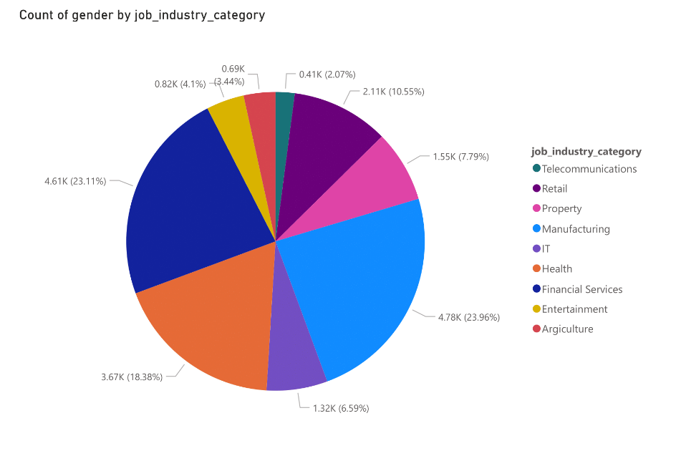
Note: The data and information in this document is reflective of a hypothetical situation and client. This document is to be used for KPMG Virtual Internship purposes only.
Data Exploration
Job industry category for Existing Customer
﻿At 4,783, Manufacturing had the highest Count of gender and was 1,058.11% higher than Telecommunications, which had the lowest Count of gender at 413.﻿﻿
﻿﻿Manufacturing accounted for 23.96% of Count of gender.﻿﻿
﻿﻿Across all 9 job_industry_category, Count of gender ranged from 413 to 4,783.﻿﻿

Slide 22
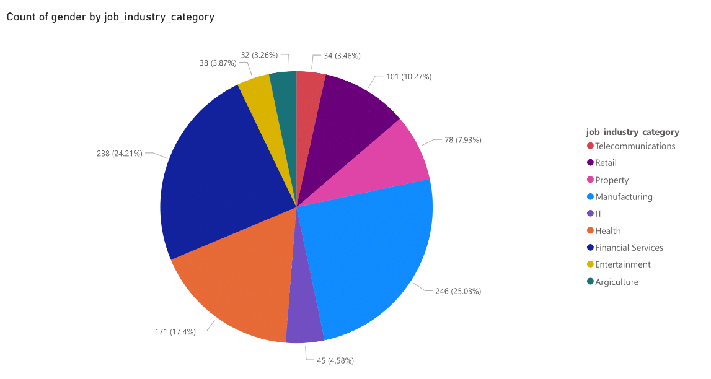
Note: The data and information in this document is reflective of a hypothetical situation and client. This document is to be used for KPMG Virtual Internship purposes only.
Data Exploration
Job industry category for New Customer
﻿﻿At 246, Manufacturing had the highest Count of gender and was 668.75% higher than Agriculture, which had the lowest Count of gender at 32.﻿﻿
﻿﻿Manufacturing accounted for 25.03% of Count of gender.﻿﻿
﻿﻿Across all 9 job_industry_category, Count of gender ranged from 32 to 246.﻿﻿

Slide 23
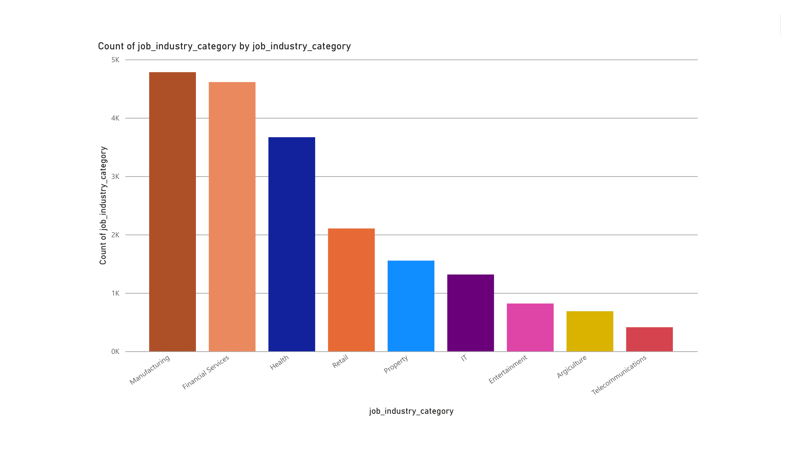
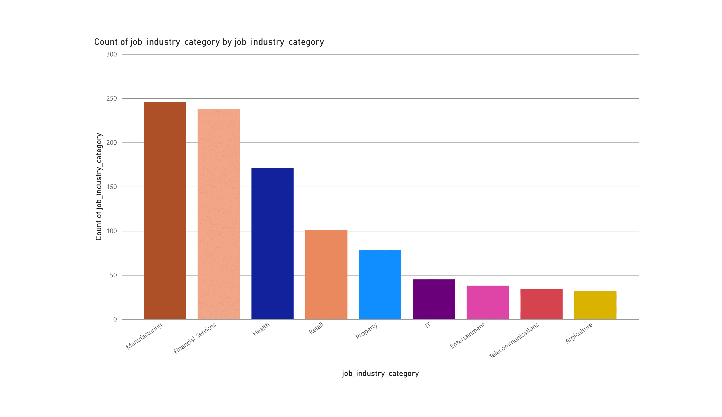
Note: The data and information in this document is reflective of a hypothetical situation and client. This document is to be used for KPMG Virtual Internship purposes only.
Data Exploration
﻿﻿The new customers' industrial profile and that of the existing ones are rather comparable. For the original group, financial services, manufacturing, and health are the top three industries (respectively).For the new group, manufacturing, financial services, and health are the top three industries (respectively).

Slide 24
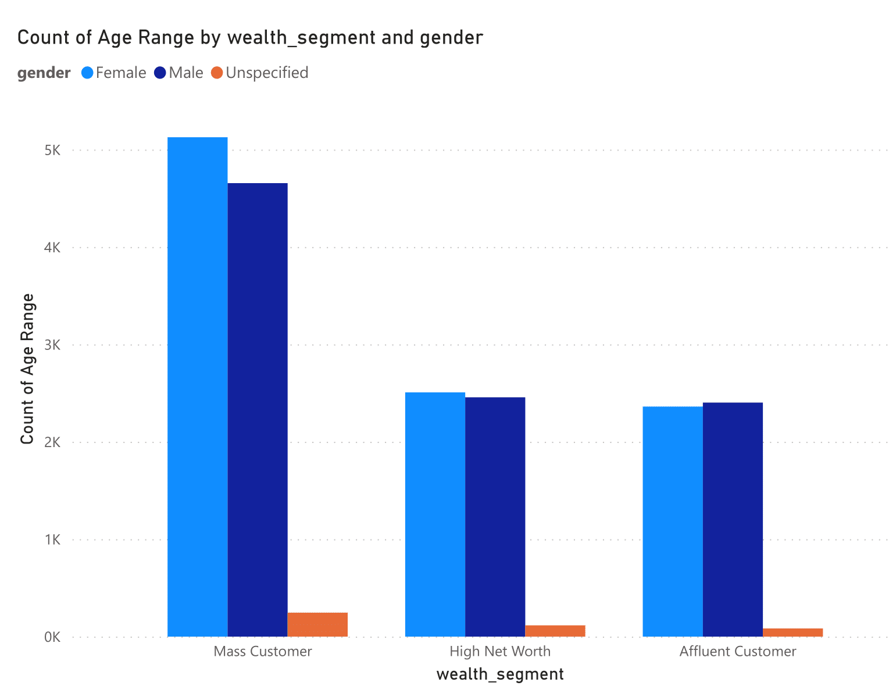
Note: The data and information in this document is reflective of a hypothetical situation and client. This document is to be used for KPMG Virtual Internship purposes only.
Data Exploration
Wealth segments for Existing Customer
﻿﻿﻿Female had the highest total Count of Age Range at 9,997, followed by Male at 9516 and Unspecified at 446.﻿﻿
﻿﻿Mass Customer in gender made up 25.69% of Count of Age Range.﻿﻿﻿
﻿﻿Female had the highest average Count of Age Range at 3,332.33, followed by Male at 3172 and Unspecified at 148.67.﻿﻿

Slide 25
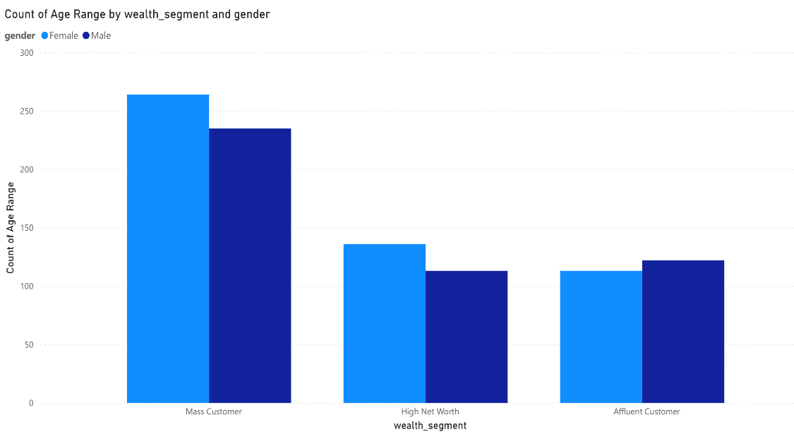
Note: The data and information in this document is reflective of a hypothetical situation and client. This document is to be used for KPMG Virtual Internship purposes only.
Data Exploration
Wealth segments for New Customer
﻿﻿﻿﻿Total Count of Age Range was higher for Female (513) than Male (470).﻿﻿
﻿﻿Mass Customer in gender made up 26.86% of Count of Age Range.﻿﻿
﻿﻿Average Count of Age Range was higher for Female (171) than Male (156.67).﻿﻿
﻿﻿Count of Age Range for Female and Male diverged the most when the wealth segment was Mass Customer, when Female were 29 higher than Male.﻿﻿
The average and median age of the new group is older. The largest demographic of clients is Mass Customers, which is safe for all ages. Compared to "High Net" and "Affluent" clients, the share of "Mass" customers is relatively lower in the new groups. The two aforementioned groups should be our primary emphasis.

Slide 26
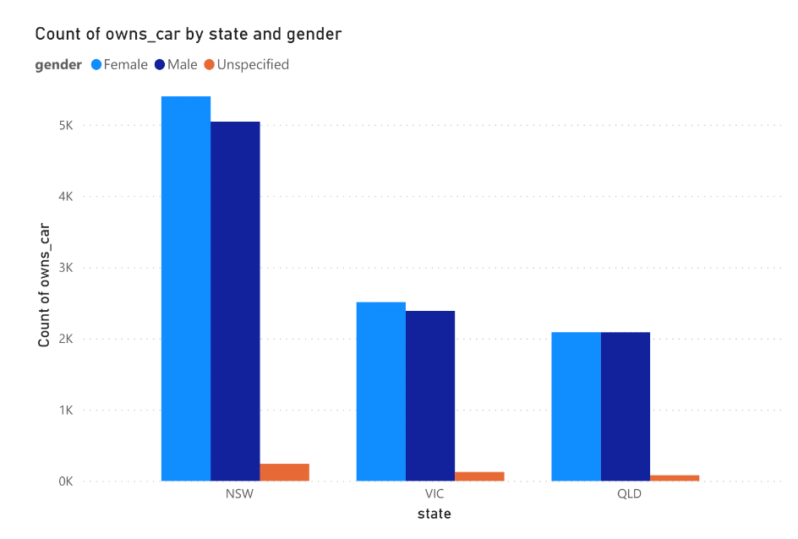
Note: The data and information in this document is reflective of a hypothetical situation and client. This document is to be used for KPMG Virtual Internship purposes only.
Data Exploration
Numbers of cars owned in each state for Existing Customer
﻿﻿Female had the highest total Count of owns car at 9,997, followed by Male at 9516 and Unspecified at 446.﻿﻿
﻿﻿NSW in gender made up 27.06% of Count of owns car.﻿﻿
﻿﻿Female had the highest average Count of owns car at 3,332.33, followed by Male at 3172 and Unspecified at 148.67.﻿﻿

Slide 27
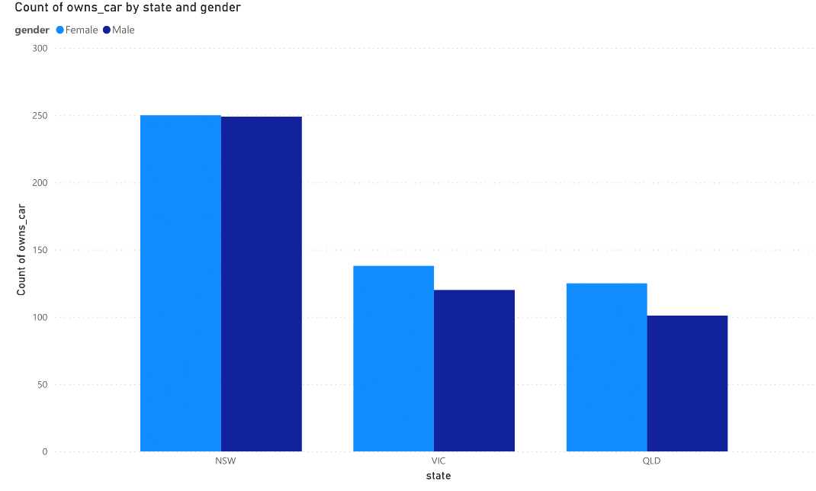
Note: The data and information in this document is reflective of a hypothetical situation and client. This document is to be used for KPMG Virtual Internship purposes only.
Data Exploration
Numbers of cars owned in each state for New Customer
﻿﻿﻿﻿﻿Total Count of gender was higher for Female (513) than Male (470).﻿﻿
﻿﻿NSW in gender made up 25.43% of Count of gender.﻿﻿
﻿﻿Average Count of gender was higher for Female (171) than Male (156.67).﻿﻿
﻿﻿Count of gender for Female and Male diverged the most when the state was QLD, when Female were 24 higher than Male.﻿﻿

Slide 28
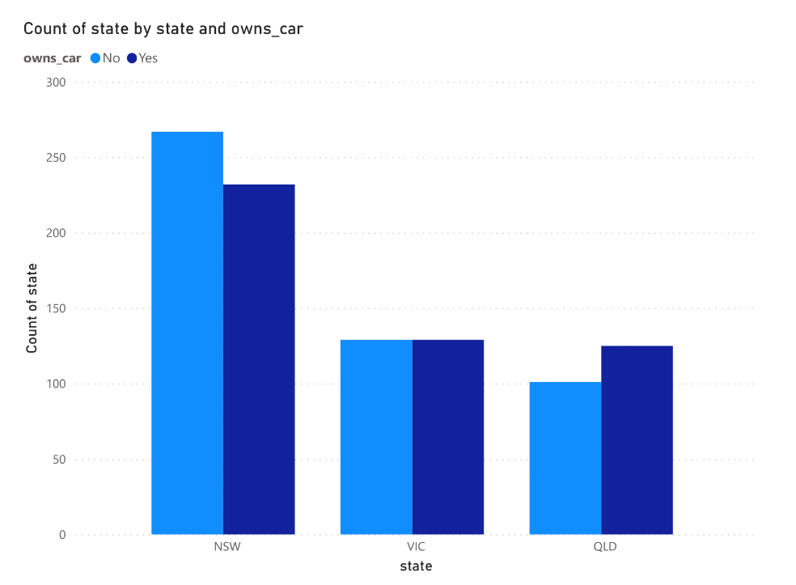
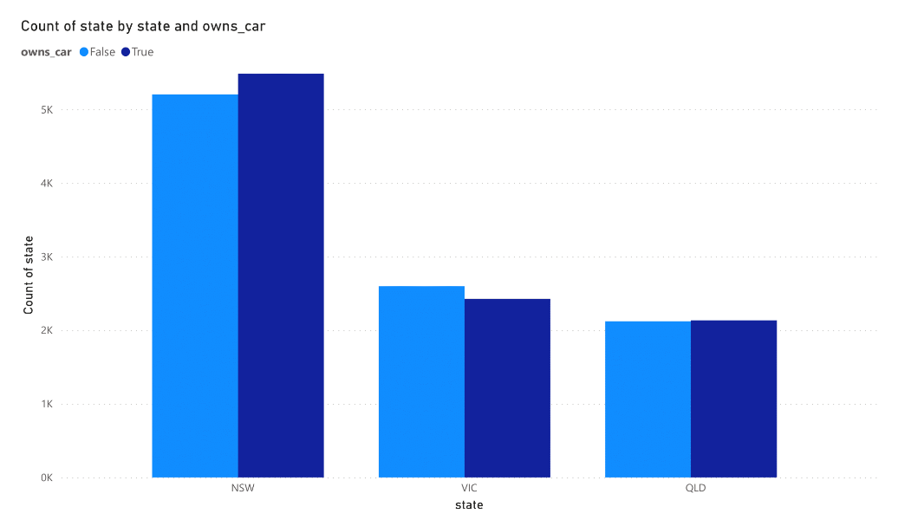
Note: The data and information in this document is reflective of a hypothetical situation and client. This document is to be used for KPMG Virtual Internship purposes only.
Data Exploration
The highest percentage of automobiles are owned in NSW, although the proportion of non-car owners is also higher. The number of cars owned is next greatest in VIC, while the percentage of non-owners is roughly equal. Since QLD has the fewest automobile owners, we may concentrate our efforts there.

Slide 29
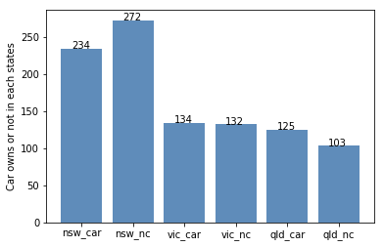
Note: The data and information in this document is reflective of a hypothetical situation and client. This document is to be used for KPMG Virtual Internship purposes only.
Interpretation
Wealth segment
VIC and QLD cars seem to have more customers that own car, so NSW should be considered.
NSW cars category should be prioritized the most for now, since numbers of customers that don’t own a car is significantly larger than the number of customers who own one.

Slide 30
Note: The data and information in this document is reflective of a hypothetical situation and client. This document is to be used for KPMG Virtual Internship purposes only.
Model Development
RFM Analysis
Recency
The last day on which a customer performed a transaction was taken as the recency parameter.
Customers were divided into 4 quartiles and given a R_Score.
Frequency
The frequency of transactions done by a particular customer was taken as the frequency parameter.
Customers were divided into 4 quartiles and given a F_Score.
Monetary Value
The average profit per customer was taken as the monetary value parameter.
Customers were divided into 4 quartiles and given a M_Score

Slide 31
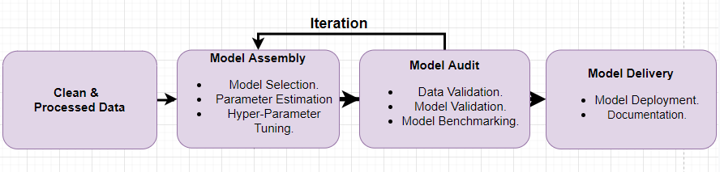
Model Development
Model development is an iterative process, in which many models are derived, tested and built upon until a model fitting the desired criteria is built.
Fig. Model Development Steps.
The Initial step is to determine a hypothesis questioning the problem statement and then perform statistical testing to determine if the hypothesis is valid or not.
Evaluate the performance of the models using factors such as ROC Curves, Precision, Recall, AUC Curve, Accuracy, F1-score etc.
Finally, deploy and document the best model’s performance, assumptions and certain limitations.

Slide 32
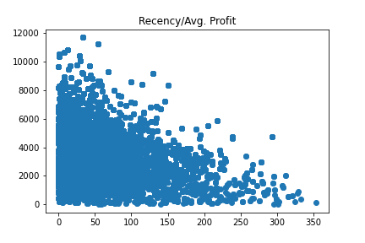
Note: The data and information in this document is reflective of a hypothetical situation and client. This document is to be used for KPMG Virtual Internship purposes only.
Model Development
RFM Analysis

Slide 33
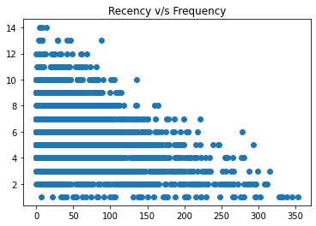
Note: The data and information in this document is reflective of a hypothetical situation and client. This document is to be used for KPMG Virtual Internship purposes only.
Model Development
RFM Analysis

Slide 34
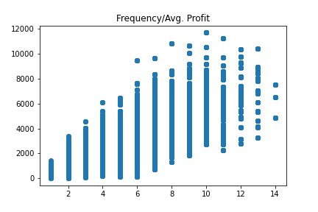
Note: The data and information in this document is reflective of a hypothetical situation and client. This document is to be used for KPMG Virtual Internship purposes only.
Model Development
RFM Analysis

Slide 35
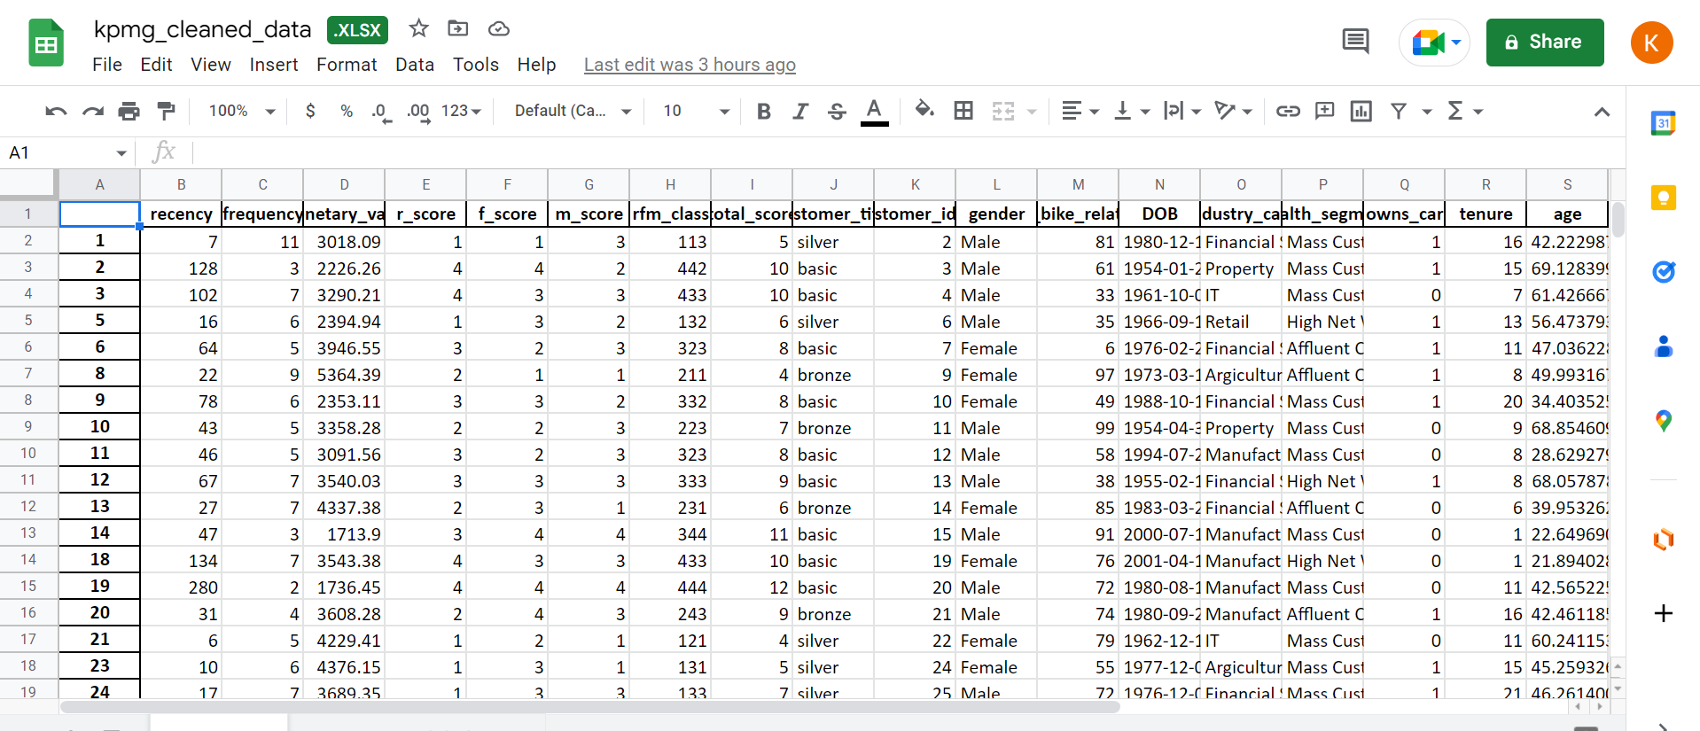
Note: The data and information in this document is reflective of a hypothetical situation and client. This document is to be used for KPMG Virtual Internship purposes only.
Model Export

Slide 36
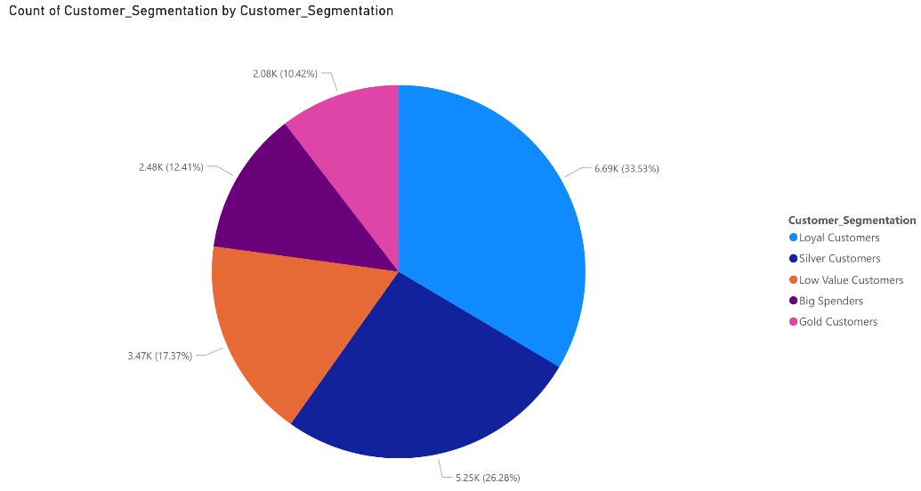
Note: The data and information in this document is reflective of a hypothetical situation and client. This document is to be used for KPMG Virtual Internship purposes only.
Model Development
RFM Analysis
Based on the RFM Class, five customer tiers were identified:
Big Spenders: These customers have recently made a purchase, are frequent and are most profitable.
Loyal Customers
Gold Customers
Silver Customers
Low Level Customers: These customers have not made any recent purchase, are not frequent and do not contribute majorly.

Slide 37
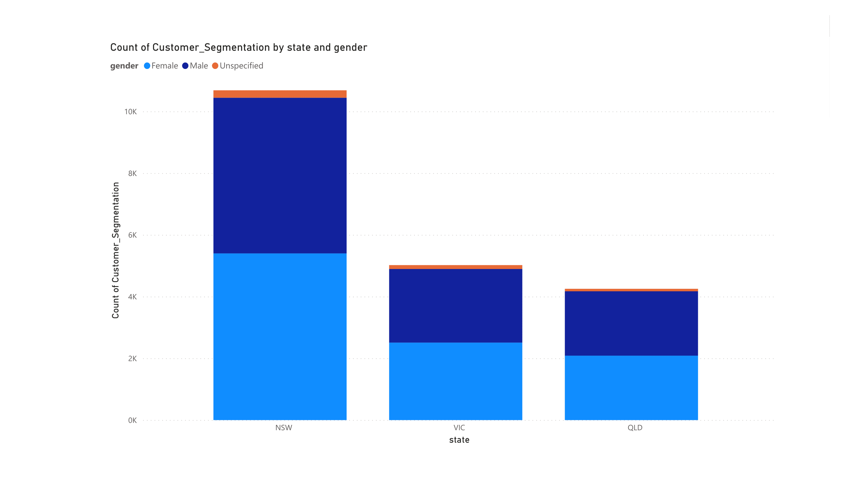
Note: The data and information in this document is reflective of a hypothetical situation and client. This document is to be used for KPMG Virtual Internship purposes only.
Interpretation
RFM Analysis

Slide 38
Interpretation
HIGH-VALUE CUSTOMER SUMMARY TABLE
Customer ID | Bike Related Purchases for the last 3 years | Age | Job Industry | Wealth Segment | Owns Cars | State
1842 | 445 | 44 | Financial Services | Mass Customer | No | New South Wales
2001 | 168 | 44 | Manufacturing | Mass Customer | Yes | New South Wales
650 | 486 | 44 | Health | Mass Customer | No | New South Wales
3297 | 234 | 46 | Manufacturing | Mass Customer | No | Victoria
50 | 266 | 41 | Manufacturing | Mass Customer | Yes | New South Wales

Slide 39
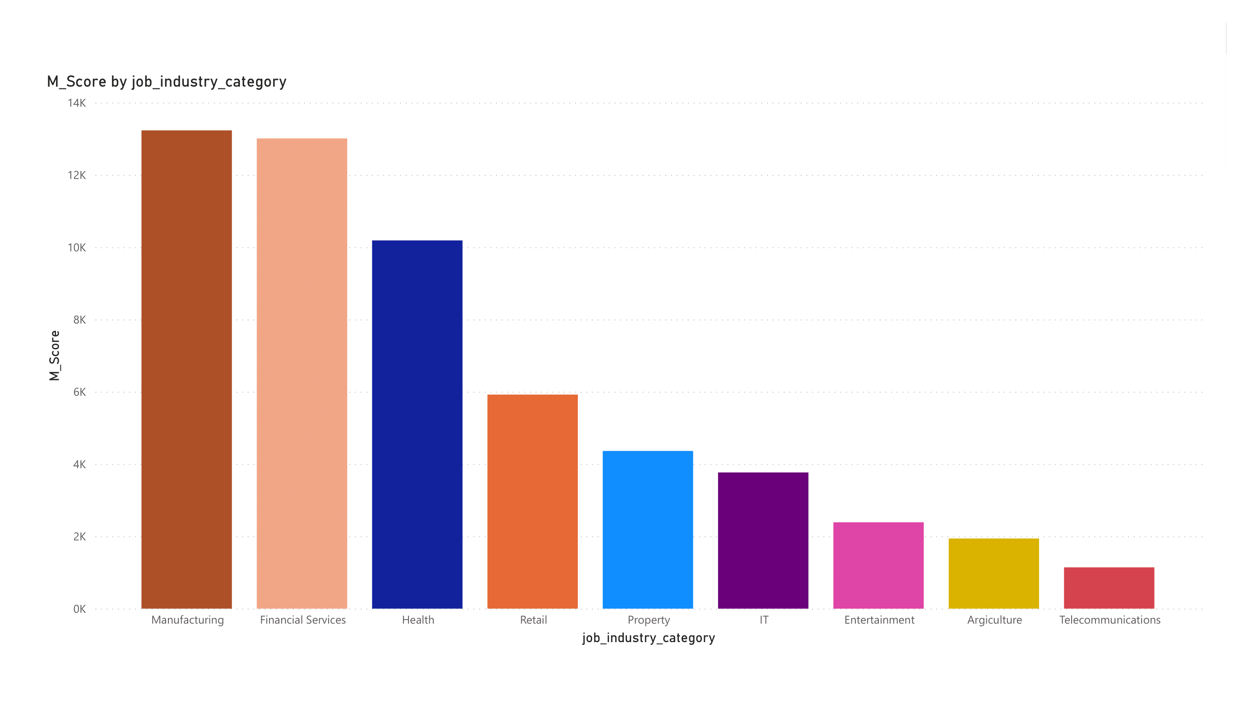
Note: The data and information in this document is reflective of a hypothetical situation and client. This document is to be used for KPMG Virtual Internship purposes only.
Interpretation
RFM Analysis

Slide 40
Note: The data and information in this document is reflective of a hypothetical situation and client. This document is to be used for KPMG Virtual Internship purposes only.
Interpretation
Targeting Methodology
Customers having high RFM Scores can be filtered and targeted.
The customers have made recent purchases, are frequent, and drive the most profits.

Slide 41
Note: The data and information in this document is reflective of a hypothetical situation and client. This document is to be used for KPMG Virtual Internship purposes only.
Appendix

