Slide 1
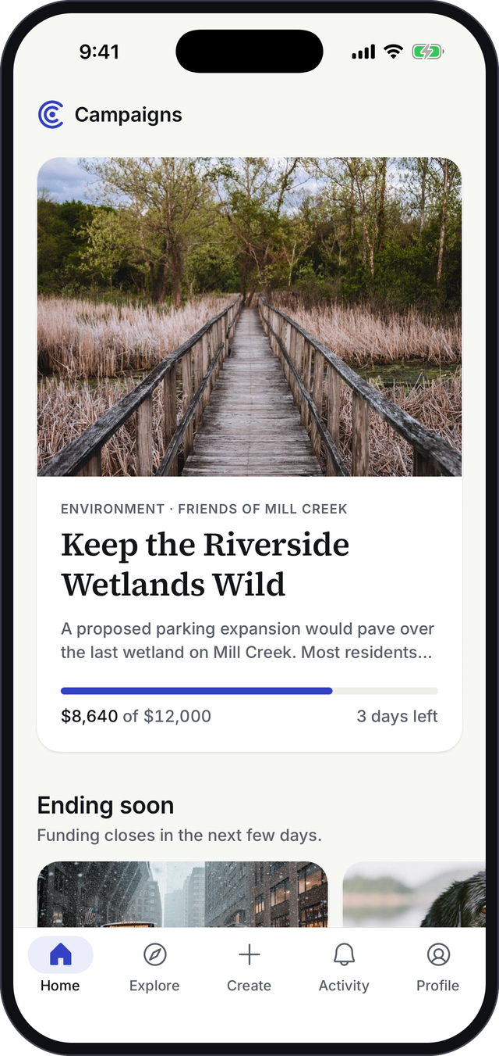

Campaigns
Help important messages reach the people who need to hear them.
Product overview · iPhone and Android
Notes:
Campaigns is a mobile app that helps important messages travel further. Think of a free tutoring program, a heat-safety tip, a public comment deadline: useful information that stays stuck inside the creator’s own circle. Today I’ll show you the problem, how the app works, and where we are.

Slide 2



Good messages rarely travel past their creator’s followers
“Free tutoring exists. Families don’t know.”
The people who need to hear it
A program can be free, proven and nearby, and still go unused because the people it’s for never hear about it.
Ads cost money and know-how
Small organizations rarely have an ad budget or someone who can run one.
Who already follows the creator
Sharing stays in the same circles
Supporters repost to people who already agree.
Giving feels opaque
People can’t see what their money actually achieved.
Notes:
The problem is reach, not the message. Organizations already have something worth saying. What they lack is a way to get it in front of people outside their bubble. Supporters want to help, but their shares stay inside the same circles, and when they give money they rarely see what it achieved.

Slide 3





The idea: backers fund the reach, not the cause
Create
Review
Back
Promote
Report
A creator writes the message, adds sources and designs the ads.
Our team checks the facts, visuals and targeting before anything goes live.
Backers pool money toward a goal. It pays for ads, not the cause.
Ads carry the message to new people who match the target audience.
Everyone sees a public report: money spent and people reached.
Not a donation platform. Contributions buy ad placements for a message. They never go to the creator or the cause directly.
Notes:
This is the core idea. Backers don’t donate to a cause; they pay for the message to be seen. That distinction matters: it makes small amounts meaningful, because ten dollars buys real reach, and it keeps the promise simple: your money buys ads, and you’ll see how many people they reached.

Slide 4


Two sides, one goal: more of the right people see it
Creators
Backers
Nonprofits, community groups, local businesses and individuals with something worth saying.
People who care about a message and want more people to see it.
Reach people outside their own followers
No ad expertise or upfront budget needed
A guided builder, review and a final report
Back from $1, with reach shown before paying
Clear fees and refund rules, up front
Follow progress and see the results
Ten categories
Environment
Health
Science
Education
Public Policy
Economic Policy
Community
Arts & Culture
Business
Other
Notes:
Two audiences. Creators bring the message: nonprofits, community groups, small businesses, even individuals. Backers bring the reach. Both need to trust the process, which is why review, sources and reporting are built into every step you’re about to see.

Slide 5
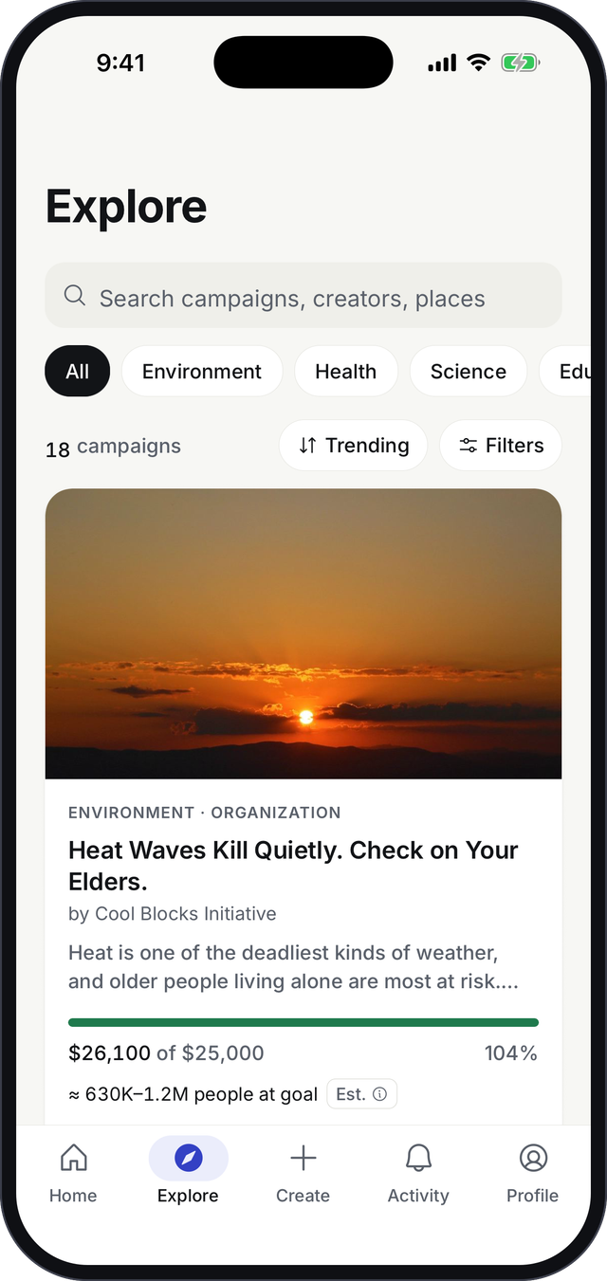



Discover messages worth spreading
A curated home
A featured story, campaigns ending soon, and the ones already reaching new people.
Search and filter
By keyword, creator, place or category; sort by trending, newest or closest to goal.
Progress at a glance
Every card shows money raised, time left and the estimated reach.
Notes:
The app opens on a curated home: one featured story, then campaigns closing soon and campaigns whose ads are already running. Explore lets you search and filter across ten categories. Every card shows the same three things: how much is raised, how long is left, and roughly how many people the ads will reach.

Slide 6
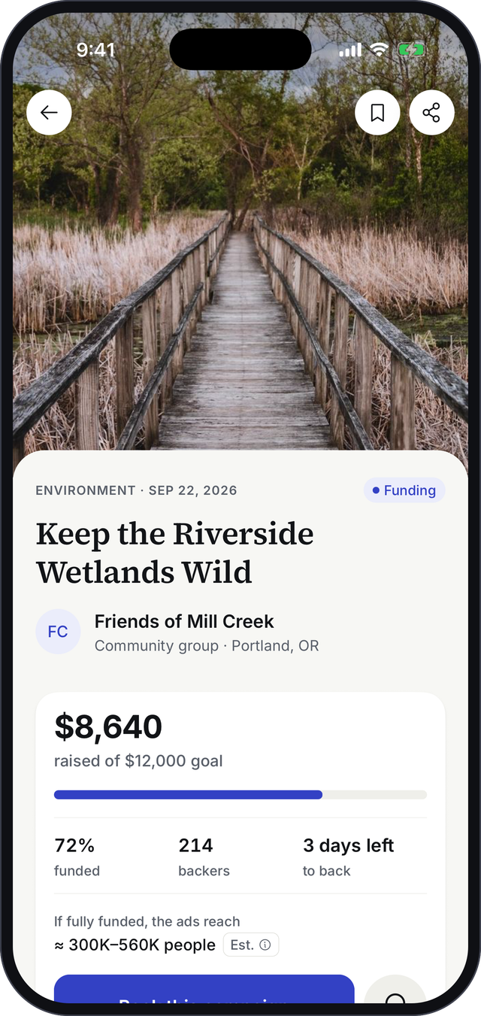




Every campaign makes its case, with evidence
Funding, in plain numbers
Reach you can picture
Raised, goal, backers and days left, right below the story’s title.
“If fully funded, the ads reach ≈ 300K–560K people.” Always labeled as an estimate.
A story with sources
Where every dollar goes
Statistics link to the source behind them, so readers can check the claims.
90% buys ads, 10% covers review, ad setup and reporting, shown before anyone pays.
Notes:
A campaign page is designed to earn trust quickly. The numbers are right at the top. Reach is shown as a range and always marked as an estimate. Claims in the story link to their sources. And the split of every dollar is visible before anyone decides to back.

Slide 7
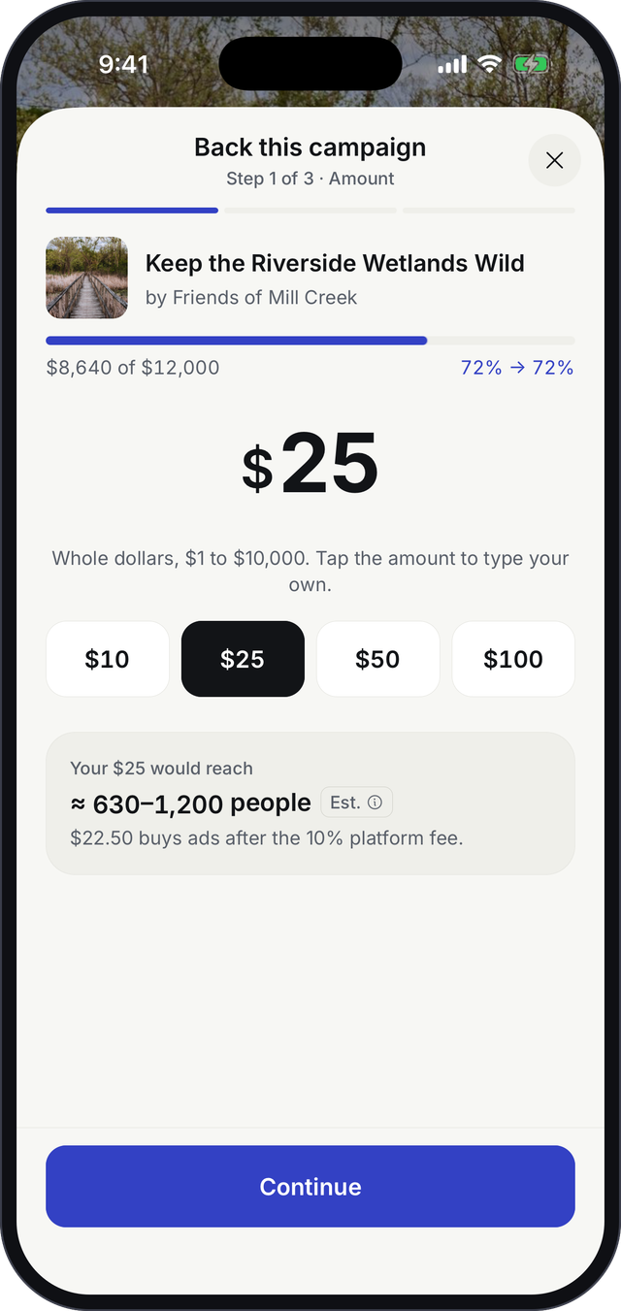
Backing takes three steps and under a minute
1
Choose an amount
Pick $10, $25, $50, $100 or your own. The reach estimate updates as you choose.
$25
2
Review
reaches about 630 to 1,200 people
See the fees, the refund rules, and choose to show your name or stay anonymous.
$22.50 buys ads after the 10% fee
3
Pay
No account needed: an email for the receipt is enough. Then see the campaign move.
Notes:
Backing is three short steps. The key moment is the first one: as you pick an amount, the app shows how many people it will reach. Twenty-five dollars reaches roughly six hundred to twelve hundred people. Fees and refund rules are shown before payment, and guests can back without creating an account.

Slide 8




Trust is built into every step
Reviewed before launch
Sources on every claim
Money only buys ads
Facts, visuals and targeting are checked before backing opens. Nothing runs without approval.
Readers can open the source behind each statistic.
It never goes to the creator. The split is shown up front.
Refunds when it can’t run
Honest estimates
Private by default
Under $250 raised, every backer is refunded. Unspent budget is refunded too.
Reach is always a range and labeled “Est.”, with the assumptions one tap away.
Backer names are hidden unless they choose otherwise. Ads are labeled as sponsored.
Notes:
Trust is the product. Six commitments run through the whole experience: review before anyone can back, sources for every claim, money that only buys ads, automatic refunds when a campaign can’t run, honest estimates, and privacy by default. These are also the strongest messages for marketing.

Slide 9
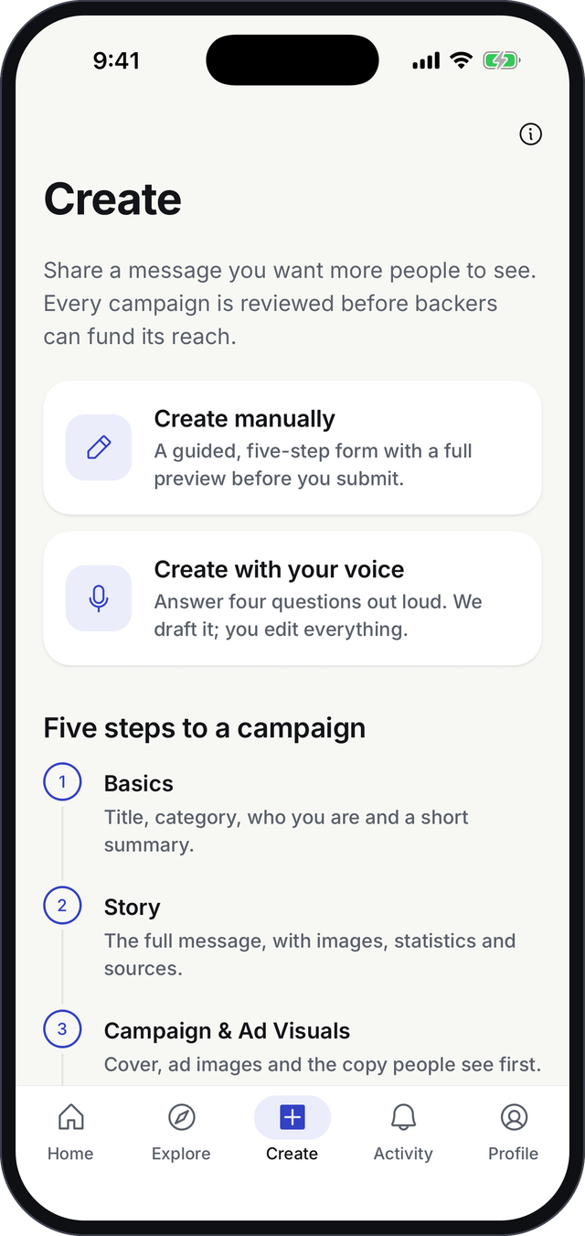
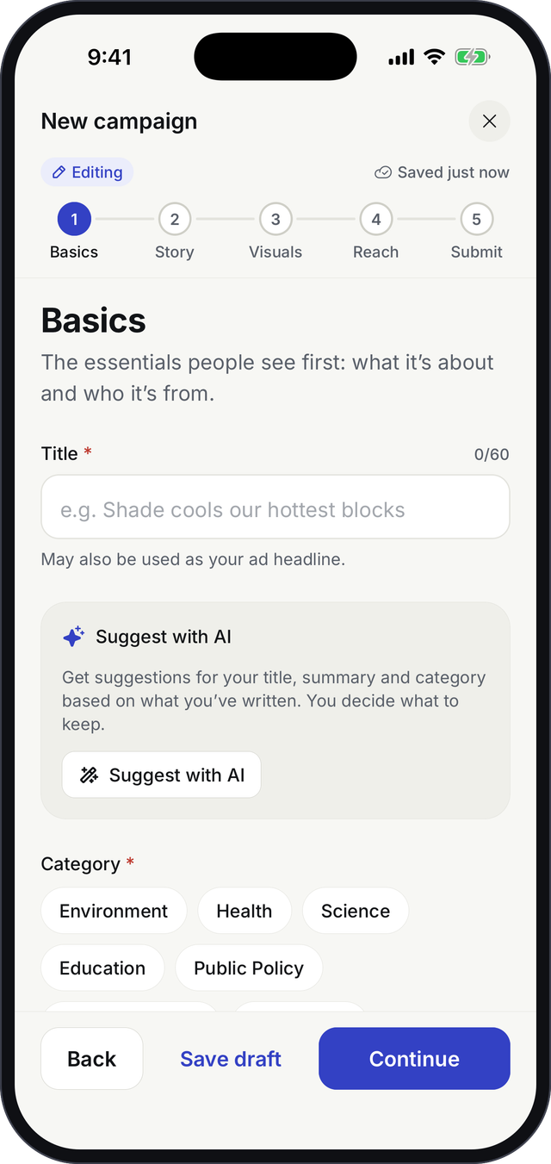




Creating a campaign is guided from start to finish
Five clear steps
Basics, Story, Visuals, Reach and Submit, with a full preview before sending it for review.
AI suggestions you control
Ideas for the title, summary and ad copy. Nothing changes until the creator accepts it.
Never lose work
Every change saves automatically; pick up any draft where you left off.
See the ads before they run
Previews show how the campaign will look in feeds and stories.
Notes:
Most creators are not marketers, so creation is a guided, five-step flow. AI can suggest a title, summary or ad copy, but the creator stays in control and accepts or ignores each suggestion. Work saves automatically, and creators see exactly how their ads will look before submitting.

Slide 10
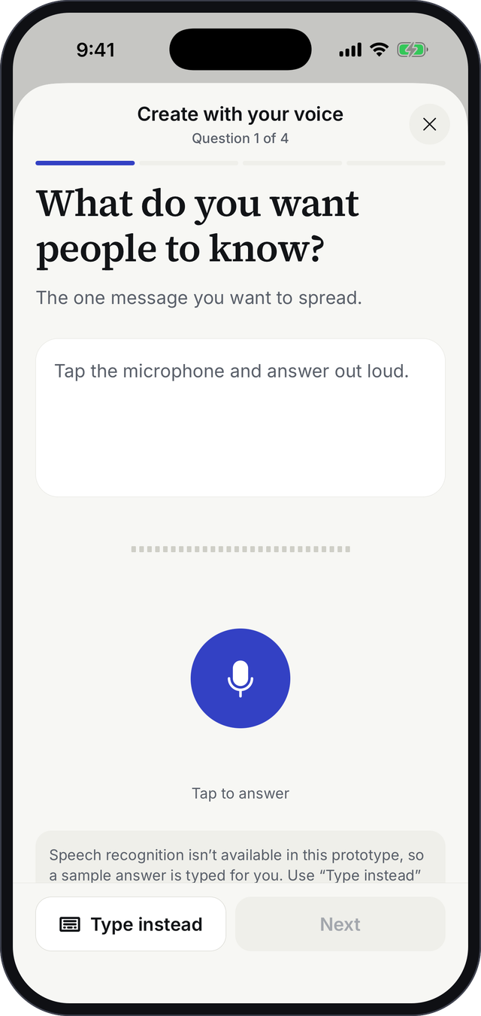
Or simply say it out loud
Answer four questions with your voice. The app drafts the campaign; you edit everything before it goes anywhere.
1
What do you want people to know?
2
Why does it matter now?
3
Who most needs to hear it?
4
What should they do next?
The funding goal is always set by the creator, never by AI.
Notes:
For people who would rather talk than type, there is a voice path. Four simple questions, answered out loud, become a first draft that the creator then edits. In the prototype a sample answer is typed out to show the experience; real speech recognition comes later.

Slide 11
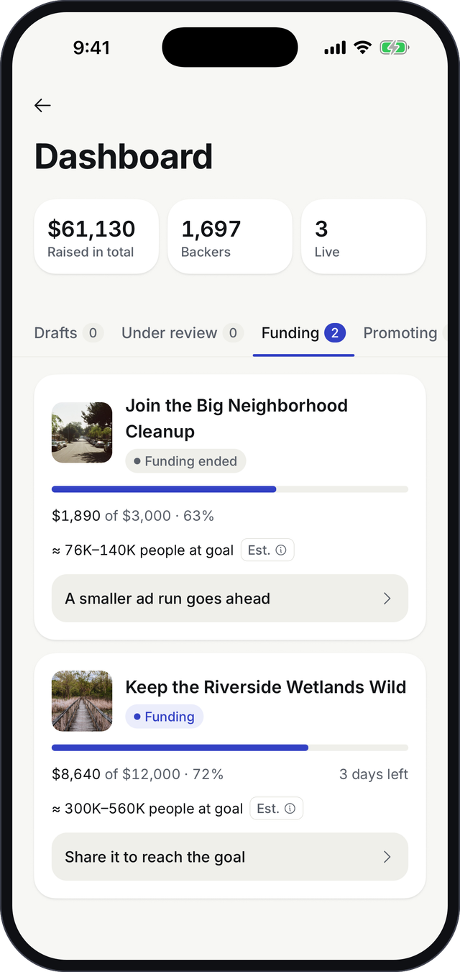
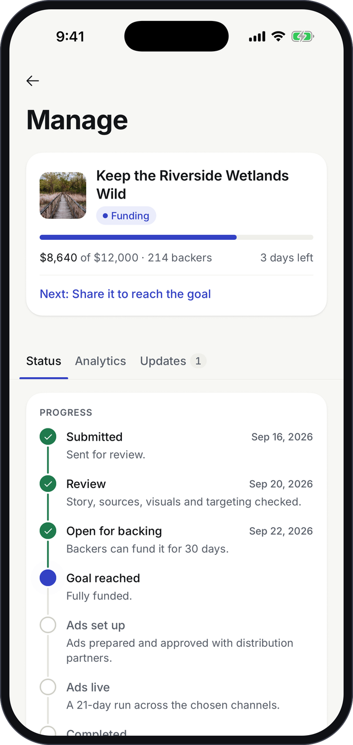




Creators always know what to do next
One dashboard
Total raised, backers and live campaigns, sorted by stage: drafts, review, funding, promoting, completed.
A clear next step
Each campaign says what to do now, like “Share it to reach the goal”.
The full journey
A timeline from submission to final report, with dates for each step.
Updates for backers
Creators post news that reaches everyone who backed or follows the campaign.
Notes:
Once a campaign is submitted, creators get a dashboard that groups everything by stage and always says what to do next. Each campaign has a timeline from submission to final report, and creators can post updates that reach their backers and followers.

Slide 12
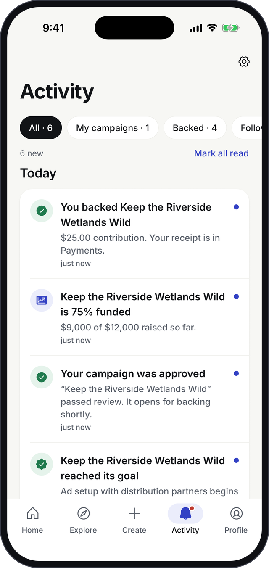



Everyone stays in the loop
Activity is one place for everything that happens to the campaigns you back, follow or created.
Payments
Milestones
Confirmations, receipts and refunds
25%, 50%, 75% funded, and goal reached
Review decisions
Ads and reports
Approved, or changes requested with the reviewer’s note
Ads live, creator updates, final report ready
People choose which kinds they get in Settings.
Notes:
Activity keeps backers and creators engaged after the first tap: payment confirmations, funding milestones, review decisions, ads going live and final reports. It is filtered by your relationship to the campaign, and every notification type can be switched off.

Slide 13
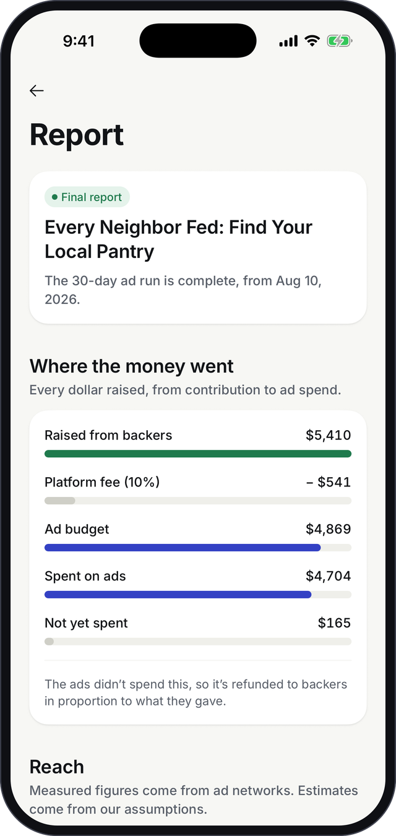
Proof, not promises: every campaign ends with a report
A public report shows backers and creators exactly what their money did.
$5,410
$4,704
$165
raised from backers
spent on ads
unspent, refunded to backers
Measured and estimated side by side. People reached, impressions and spend by channel, clearly separated from projections.
Shareable proof for creators to show funders, boards and their community.
A reason to back again. Backers see the outcome, not just a thank-you.
Notes:
This is the slide I’d lead with in marketing. Every campaign ends with a public report: what was raised, the fee, what was spent on ads, what was refunded, and how many people were reached. Figures shown are from a completed sample campaign in the app.

Slide 14
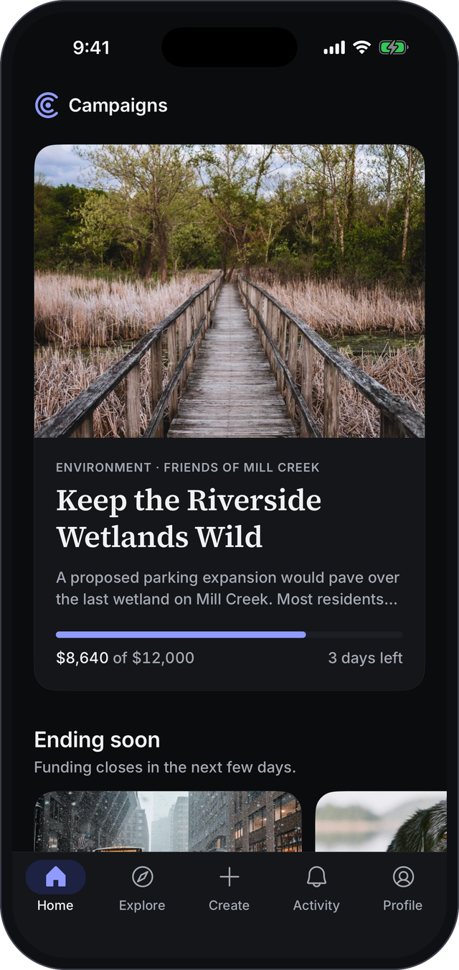
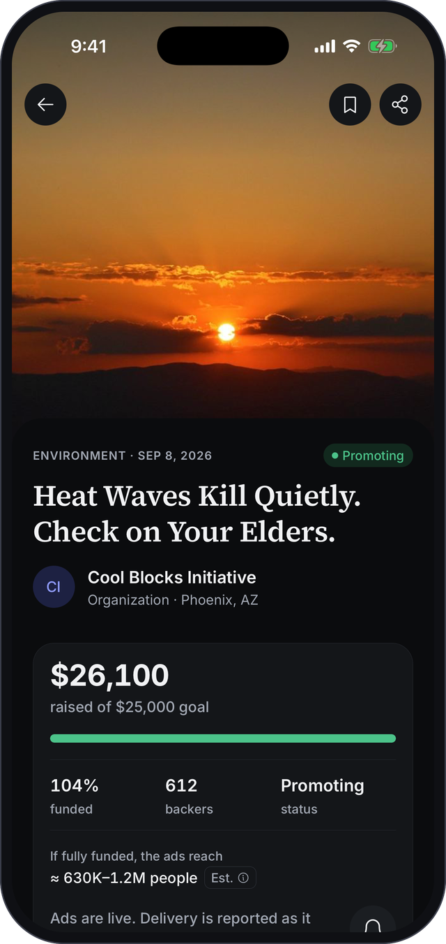




Designed to feel calm, clear and premium
Light and dark
Follows the phone’s setting, tuned for both.
Smooth, purposeful motion
Covers glide open, progress fills, confetti when you back.
Feels physical
Subtle haptics confirm taps, payments and milestones.
Respects accessibility
Honors Reduce Motion; screens are labeled for screen readers.
Notes:
Quality matters for trust. The app has an editorial look, works in light and dark mode, uses motion and haptics to make actions feel confirmed, and respects accessibility settings such as Reduce Motion. It runs on both iPhone and Android.

Slide 15

How the money works: a $100 contribution
$103.20
$100
$10
$90
≈3,600
Backer pays
Into the pool
Platform fee
Buys ads
Est. reach
Card processing (2.9% + 30¢) is added at checkout
The full contribution counts toward the goal
Pays for review, ad setup and reporting
Placed with ad networks for this message
People reached: about 2,500 to 4,700
Revenue model: a 10% platform fee on funds raised. If a campaign raises less than $250, nothing runs and every backer is refunded in full.
Notes:
Here is the money in one example. A backer contributes 100 dollars; card processing is added on top, so the campaign receives the full 100. Ten percent is our platform fee, covering review, ad setup and reporting. Ninety dollars buys ads, which at our current assumptions reaches about 3,600 people. Reach assumptions: an average of 10 dollars per thousand ad views and 2.5 views per person.

Slide 16

Where we are today: a working prototype
Working today
Simulated in the prototype
The full app on iPhone and Android
Real accounts: sign up, sign in, password reset
Every flow end to end: discover, back, create, review, report
Notifications, creator dashboard and public reports
Light and dark mode, accessibility settings
Payments use a test card: no real money moves
Review decisions happen automatically on a timer
Ad delivery and reach figures are sample data
Campaigns and activity are stored on the device
Voice answers are typed out from a sample
Notes:
To be clear about status: the app is real and complete as an experience, and accounts are real. Everything that involves money or outside partners is simulated, so we can show the full journey safely. Moving each simulated piece to the real thing is the next phase of work.

Slide 17


From prototype to pilot
1
Get pilot-ready
2
Run a pilot
3
Launch
Real payments and refunds
Shared data across devices
Review tools for our team
A handful of local organizations
One city, a few categories
Measure reach and repeat backing
Ad network partnerships
Push notifications
App Store and Google Play
How you can help
Product
Marketing
Everyone
Choose pilot categories and the success measures that matter.
Test the message “fund the reach, not the cause” and recruit pilot creators.
Try the app and tell us where it confuses or delights you.
Notes:
The path forward has three stages. First, make the simulated parts real: payments, shared data and review tools. Then a small pilot with a handful of local organizations in one city, measuring reach and whether backers come back. Then launch. We need product help choosing the pilot and its measures, and marketing help testing the core message and recruiting creators.

Slide 18
Help important messages travel further.
Questions and feedback welcome.
Notes:
Thank you. Happy to take questions, and I can do a live walkthrough of any part of the app.

