Slide 1

Travel Insurance Hackathon Team Name – TryHackMe Submitted By – Ajay Kaushik

Slide 2
Problem Statement
Insurance companies take risks over customers. Risk management is a very important aspect of the insurance industry. Insurers consider every quantifiable factor to develop profiles of high and low insurance risks. Insurers collect vast amounts of information about policyholders and analyze the data.
As a Data scientist in an insurance company, need to analyze the available data and predict whether to sanction the insurance or not.
Wrongly denying a genuine claim could lead to lawsuits against the company and approving the wrong claim would lead to a loss.
Notes:
Can we include some examples here?

Slide 3
Why solve this problem?
Risk management is becoming increasingly important to protect both customers and business in travel industry. We should be prepared to deal with potential crises. Identify possible risks for your destination, and determine your risk management strategy to set up a plan. Train your staff and team up with stakeholders
Stakeholders - CEO, CFO, Marketing, Sales of SafeTravel Inc.

Slide 4
Data Science in Insurance
Data science has brought new marvellous opportunities to many industries. Along with these possibilities it has also brought constant changes and challenges. Travel and tourism industry is no exception here.
Travel is on its rise nowadays. This may be explained by the fact that it has become affordable to a broader audience. Thus, the target market has changed dramatically by getting more extensive than ever before. It is no more a privilege of the rich and noble. Moreover, travel and tourism have become a worldwide trend.
To satisfy all the needs of the growing number of consumers and process enormous data chunks the data science algorithms are vital. Big data becomes a critical tool as far as airlines, hotels, reservation and booking websites and many others are striving to improve their services every day. Let’s consider several of widespread and efficient data science use cases in the travel industry.

Slide 5
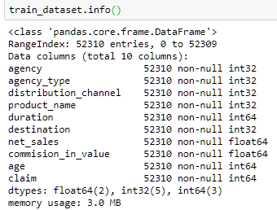
Available Data
Typically Data is related to travel agency or consultancy which are playing a role to sanction the claim or not for the consumers.
To increase the consumers, business should invest on Online distribution rather than Offline.
Need to identify least valuable products so that travel industry will have more insight on such products and change the strategy to get more attraction from customer perspective.
Need to add additional columns like loss due to their product’s duration/ destination to get more insights about the current business so that our company can grow in future,

Slide 6
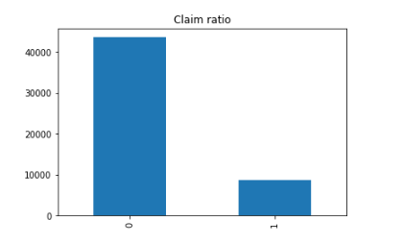
Exploratory Data Analysis
Try to find out insight on available data from travel insurance company –
Categorical and Continuous variable ?
Does distribution channel/age play an important role ?
Which products are valuable for business value ?
What are the destinations on which business should focus to get profit ?
What are important features in given dataset ?
Is there any external impact on data (outlier) ?
Relationship between features (Dependent or Independent)
is available data imbalanced ?

Slide 7
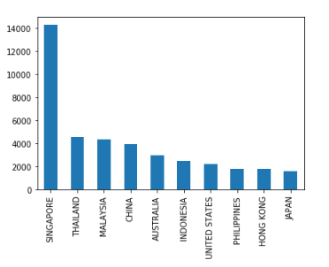
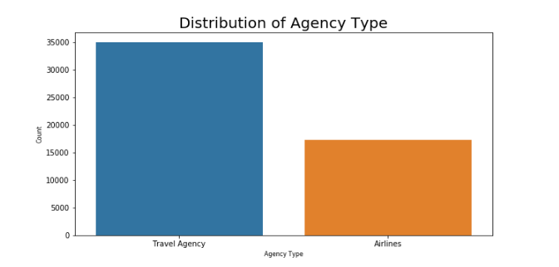
Favorite Destination
Singapore is most favorite place for consumers
It might be happened that consumers have their
Connecting flight.

Slide 8
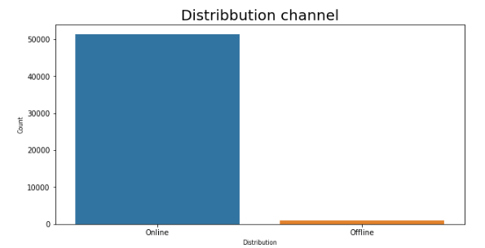
Online mode is preferable channel for travel insurance so business keep their plans on internet or portal and try to train their staff to help the consumers on calls.

Slide 9
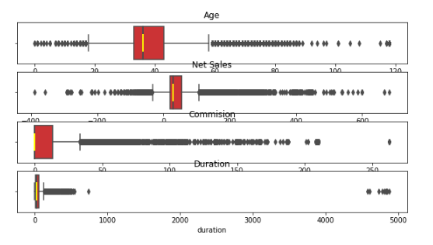
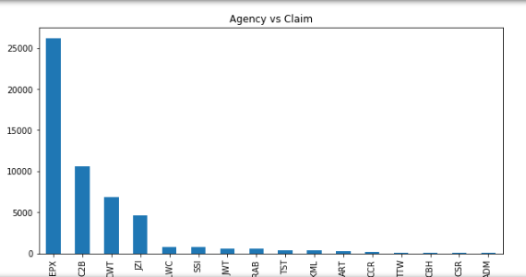
Top agencies
Outlier detection

Slide 10
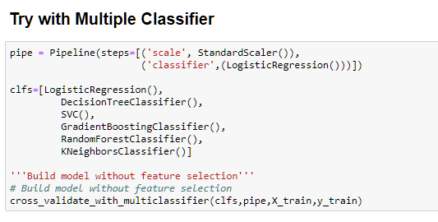
Pipeline

Slide 11
Models and Approaches
I tried following models to fit on training data set using cross validation technique –
Logistic Regression
Decision Tree
KNN
Gradient Descent Boosting
Support Vector Classifier
Random Forest Classifier
I found that RFC gave high score on it so I chose it due to following reasons –
Robust model -Does not have impact due to outlier then don’t need to remove extreme values from data
Handle over fitting (High variance)
Feature importance
Random forests are built on decision trees, and decision trees are sensitive to class imbalance. Each tree is built on a bag, and each bag is a uniform random sample from the data (with replacement). Therefore each tree will be biased in the same direction and magnitude (on average) by class imbalance.

Slide 12
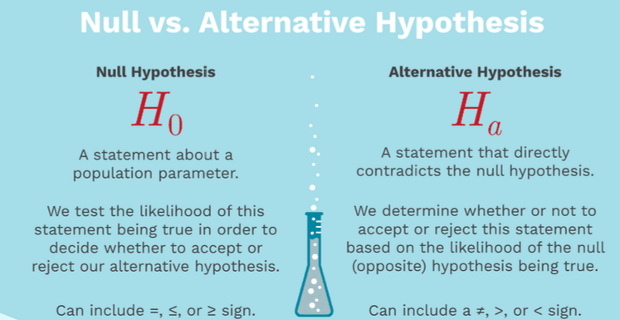
Chi2 Test Independence
NULL hypothesis is that there are independent features available in given dataset.
I found that all categorical variables are dependent so we reject H0.

Slide 13
Model Tuning
Feature Engineering – As we have two type of data – Categorical & Continous so I used f-classify ANOVA test to get importance features –
Random Search Estimator – This algorithm is used to extract best combination of featuures based on ranking score which could be precision,recall or AUC.

Slide 14
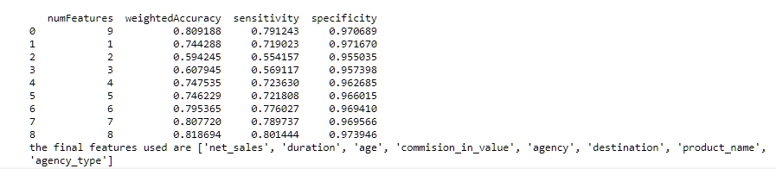
RFE

Slide 15
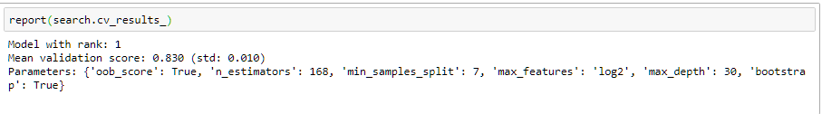
Hyper Tuning using RandomForestClassifier – I used hyper parameter like log2 transformation on max_features as shown below to penalized the algorithm after finding the best parameters using RandomForestClassifier

Slide 16
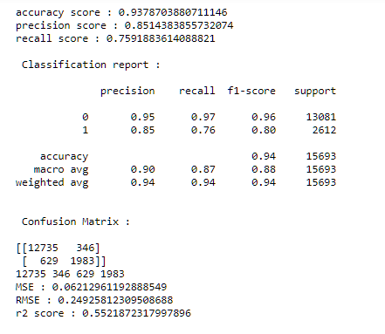
Precision and Recall
Our focus is to maximize the True Negative Rate called specificity.
TNR= it means that our model is able to correctly identify the claims (like loss of begs, flight delayed etc.) with negative means no claim.
TPR – Sensitivity is the ability to correctly identify those with claim (TRUE POSTIVE RATE).

Slide 17
Final Results
Model score is 85% after submission the predictions.

Slide 18
Insights & Decisions
Focus on Online distribution only
Need to work on product planning strategy
Need to work on why Singapore has come in first , still have assumptions ?
Need to work on Travel agency from which we are not getting comission why ?

