Slide 1
Real Time Location tracking technique for smartphone when switched off
UNDER THE GUIDANCE OF
PROF.R.ASHWINI MAM

Slide 2
Introduction
Object tracking plays an important role in many applications.
The main aim of our project is to track a mobile phone’s location even
the phone is switched off.
Our project will enhance the facility for tracking our device in any
case(Switched off).

Slide 3
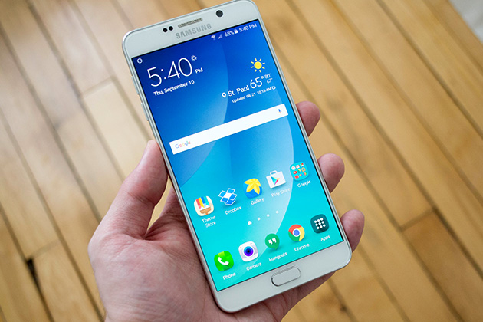
Reasons to track our mobile phone
Precious
Personal

Slide 4
Literature review
Smart searching of wireless devices using device location information- intel
corporation(2016).
RFID-based tracking system was used to tracking location. RFID reader turns on
the module kit via RF communication which is GPS and GSM – “described by
N.Sriskanthan and Tan Karand”.“Bluetooth Based Home Automation System”[2].
System based on inertial sensors for behavioral monitoring of wildlife[12]-
“described by R.Tapiador -Morales et al”.
Tracking Information-Stealing Smartphone Applications IMEI Number-Beresford,
A.R.,Rice, A., Skehin, N., Sohan, R.: MockDroid.

Slide 5
GPS,GSM,RFID are used to track location wildlife animals accurately – “described
by Ajinkya C Bapat,Sonali U Nimbhorkar”,object have been tracked by auto
generative location tracking and movement patterns implemented using GPS
with the accelerometer and the WiFi shield. GPS, GSM and RFID were combined
onto a single platform to make the monitoring system[13].
Mobile and web based monitoring of patient’s physiological parameters –“described by
Agham, N.D., Thool, V.R., Thool, R.C”.Here data can be used to monitor the health of the
patient.The acquired data is then sent to a website server by ESP (connected to external
wifi )from which the doctors can check the patient’s vital signs.
Jung, J.Y. , Lee, J.W. (2014). ‘ZigBee/bluetooth device access control and reliable data
transmission in ZigBee based health monitoring system’.

Slide 6
Problems on Existing System
We could not trace the location of mobile phones during shut down
The existing system had an software oriented approach that
tracks the mobile phones using IMEI number and GPS but mobile
phone should be turned on.

Slide 7
Proposed System
To overcome this drawback of the existing system we proposed
system of integrating a new hardware component and thus tracking the
mobile phone even when switched off.

Slide 8
Flow chart
Smart phone
If OFF
Start
External battery power up
Arduino Execute
Data update on cloud
Connected to wifi
Fetch location from GPS
View on site
STOP

Slide 9
Step by Track phone
When smart phone is switched on, Bluetooth sends signal to
the other end simultaneously.
If these signal breaks, External components are activated.
The Hardware components run by External power source.
Arduino fetches the current location of the smart phone.
Connect the Network to ESP.
By this way Data is updated on cloud by giving specfic
IP address.
We can able to see the current location of the smart phone by
using our developed website.

Slide 10
Key components
Smart phone
OTG(On To Go)
Bluetooth
Arduino
GPS(Global Positioning System)
External battery
ESP8266
Arduino IDE(software)

Slide 11
Block diagram
Bluetooth
Arduino
ESP
Smart phone
OTG
Bluetooth
Battery
GPS

Slide 12

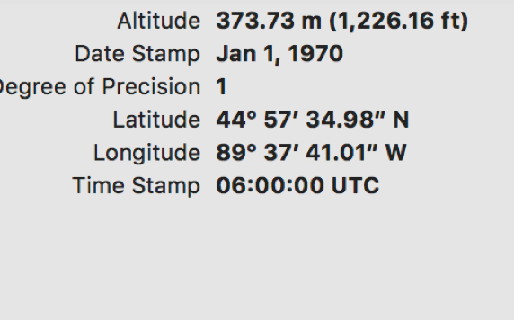

Working principle
INTERNET
ESP 8266/
ESP-01
GPS information
(using IP address)
link

Slide 13
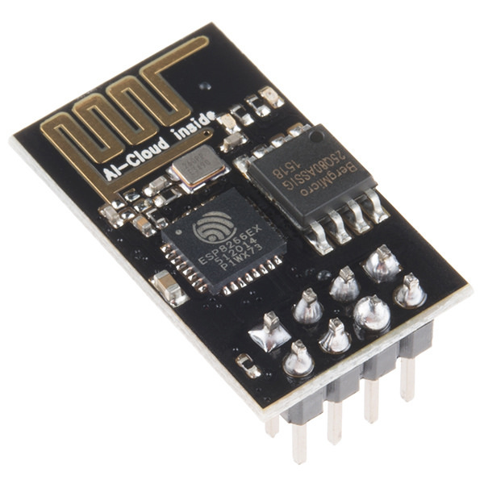
Role of ESP-8266
Access Internet
Connects to Wi-Fi network

Slide 14
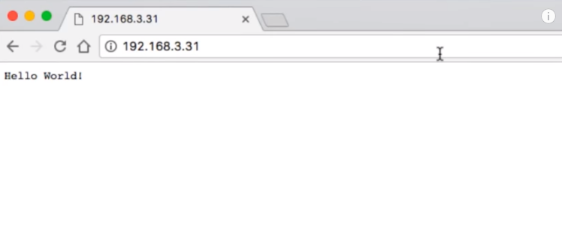
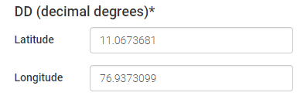
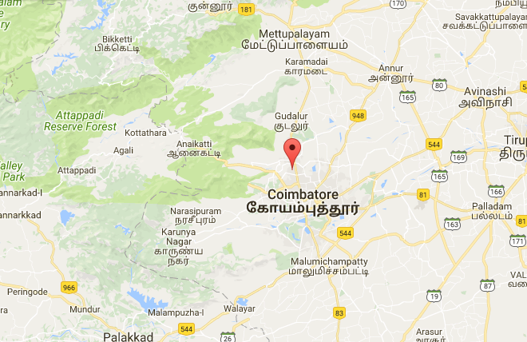
Track Location

Slide 15
Conclusion
This project has introduced a monitoring technique that promotes
real time sensing and detection of mobile phones.
Due to rise in usage of mobile phones among this generation
widely, so we have to protect it.
Our proposed system would eliminate the loss of mobile phones.
This System would not only provide us with safe and accurate
monitoring but also guarantees location independency.

Slide 16
Reference
GATA: GPS-Arduino based Tracking and Alarm system for protection of wildlife animals
M Gor , J Vora , S Tanwar , S Tyagi 2017.
GPS,GSM,RFID are used to track location wildlife animals accurately – “described
by Ajinkya C Bapat , Sonali U Nimbhorkar.
Khatal Sachin Sahebrao, GPS/GSM based animal tracking and health monitoring
system, International Journal Of Engineering, Education And Technology
(ARDIJEET),pp 1-10, 2015.
Ajinkya C Bapat, Sonali U Nimbhorkar, Designing RFID Based Object Tracking
System by Applying Multilevel Security, In International Conference on Wireless
Communications, Signal Processing and Networking (WiSPNET), pp. 22-26, 2016.
Jung, J.Y. , Lee, J.W. (2008). ‘ZigBee/bluetooth device access control and reliable data
transmission in ZigBee based health monitoring system’.

Slide 17
An early application of pervasive computing was the active badge location
system, ”described by Want et al”, in which users and objects were tagged
with an "active" badge which could locate and identify them.
Designing RFID Based Object Tracking System by Applying Multilevel
Security[13].
GPS/GSM based animal tracking and health monitoring system
“described Khatal Sachin Sahebrao”.
“A. R. Krishna, G. S. Bala, A. Sastry, B. B. Sarma and G. S. Alia”,"Design
And Implementation of a object tracking Based On Arduino
Technology”.
“J. Hou, C. Wu, Z. Yuan, J. Tan, Q. Wang and Y. Zhou”, "Research of
Intelligent Home Security Surveillance System Based on ESP“.
This tracking system suffered from security issues due to presence of air interface
. between GSM and RFID.
GPS location for mobile phones using the internet

