Slide 1
ML CLASSIFICATION PROJECT
Student Performance
Prediction & Classification
A comprehensive Random Forest ML pipeline to predict student letter grades (A–F)
~16,000
75.77%
RF + Grid
6 Grades
Dataset Size
Test Accuracy
Algorithm
Output Classes
Student records
RandomForestClassifier
GridSearchCV tuned
A B C D E F
AI Tech Gen • Student Performance ML • 2026

Slide 2
PROJECT OVERVIEW
What We Built & Why
🎯 Objective
🔬 Approach
Transition from predicting continuous numerical scores to a full multi-class classification problem. The goal is to map six student features directly to a final letter grade (A–F) using machine learning.
▶ Full EDA & feature visualisation
▶ Data cleaning & One-Hot Encoding
▶ Stratified 80/20 train-test split
▶ RandomForestClassifier training
▶ GridSearchCV hyperparameter tuning
📋 Input Features
▶ Multi-class evaluation & confusion matrix
Age
Student demographic
⚙️ Tech Stack
Study Hours / Week
Behavioural signal
Attendance %
Engagement metric
Python + Pandas + NumPy
Data processing & manipulation
Math Score
Academic baseline
Matplotlib + Seaborn
Visualisation & EDA
Science Score
Academic baseline
Scikit-Learn
ML model, GridSearchCV, metrics
English Score
Academic baseline
HTML5 + JS + Tailwind
Interactive prediction web app
Slide 2 of 8

Slide 3
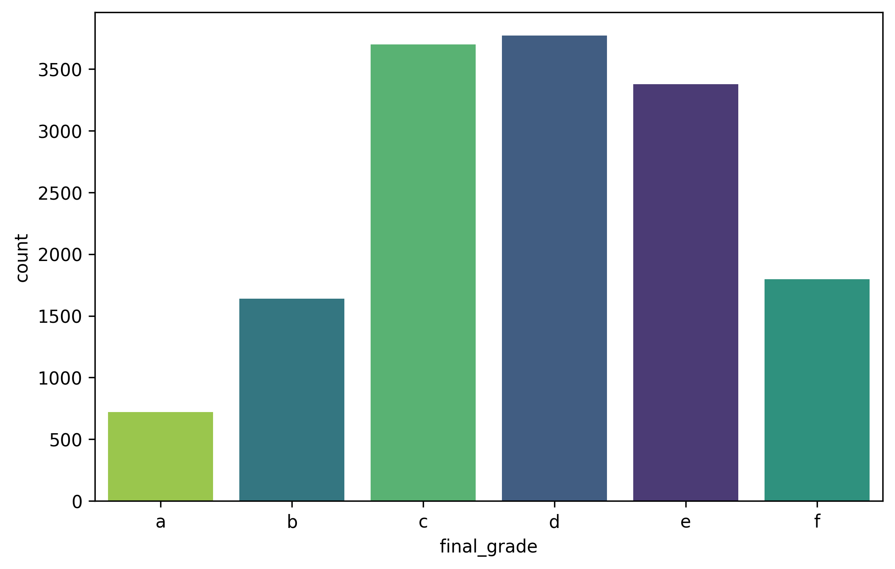
DATASET & EXPLORATORY DATA ANALYSIS
Understanding the Data Before Modelling
~16,000
6 Classes
80 / 20
Imputed
Total Records
Target Variable
Split Strategy
Missing Values
Student entries
A / B / C / D / E / F
Stratified split
Median / Mode fill
📊 Grade Distribution
🔍 Key EDA Findings
Grade Imbalance
Grades C & D dominate (~3,700 each). Grade A is rarest (~750). Required stratified splitting.
Study Hours → Scores
Strong correlation (0.80) between study_hours and all subject scores. A primary driver.
Attendance Impact
Moderate correlation (0.25–0.29) with academic scores. Acts as an amplifier.
Age is Irrelevant
Age shows near-zero correlations (≈ 0.00–0.01) with all other features.
Subject Scores Co-vary
Math, Science, English correlate tightly with each other (~0.79) and overall score (~0.88–0.89).
Leakage Removed
overall_score dropped to avoid data leakage — model must predict from raw inputs only.
Slide 3 of 8

Slide 4
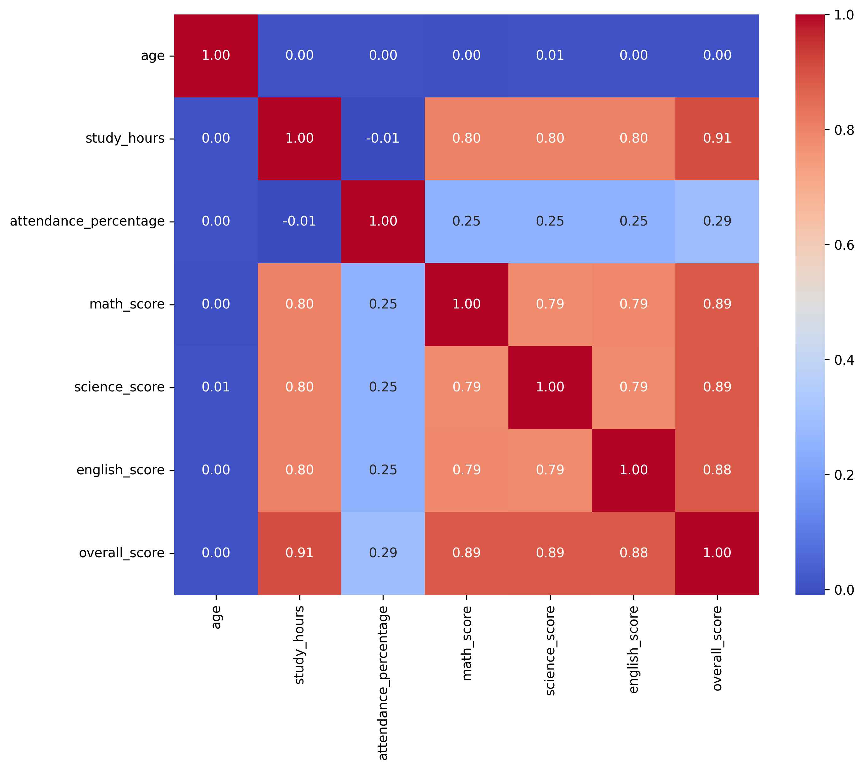
FEATURE CORRELATION ANALYSIS
Correlation Heatmap — Understanding Feature Relationships
📌 Interpretation
Study Hours ↔ Scores
r = 0.80
Strongest predictor. More study time strongly linked to higher subject scores.
Scores ↔ Each Other
r = ~0.79
Math, Science & English are tightly linked — students tend to be uniformly strong/weak.
Attendance ↔ Scores
r = 0.25
Moderate effect. Consistent attendance helps but is not the sole driver.
Age ↔ Everything
r = ≈0.00
Age carries virtually no predictive signal — correctly excluded as noise.
Overall Score (Dropped)
r = 0.91
overall_score correlates 0.91 with study_hours — excluded to prevent data leakage.
Slide 4 of 8

Slide 5
DATA PREPROCESSING & FEATURE ENGINEERING
Cleaning, Encoding & Preparing the Pipeline
1
Noise Removal
2
Data Leakage Prevention
Dropped student_id — a meaningless unique identifier that would cause the model to overfit to individual records rather than learn generalizable patterns.
Removed the overall_score column. This column is a direct derivative of subject scores and would trivially reveal the answer, making the model useless in real-world inference.
3
Missing Value Imputation
4
One-Hot Encoding
Numerical columns → filled with median (robust to outliers). Categorical columns → filled with mode (most-frequent value). Ensured zero null values before training.
Applied pd.get_dummies() to convert all text-based categorical features into binary (0/1) machine-readable columns. Prevents ordinal bias in the classifier.
5
Stratified Train/Test Split
6
Feature Matrix (X) & Labels (y)
80% training / 20% testing. Stratified by final_grade ensures rare classes like 'A' and 'F' appear proportionately in both sets — critical for unbiased evaluation.
Final feature set: age, study_hours, attendance_percentage, math_score, science_score, english_score + any encoded categoricals. Target: final_grade (A–F).
Slide 5 of 8

Slide 6
MODEL TRAINING & HYPERPARAMETER TUNING
Random Forest + GridSearchCV Optimization
🌲 Why RandomForestClassifier?
🔧 GridSearchCV Configuration
▶ Handles non-linear, complex feature relationships
Param Grid Tested:
▶ Resistant to overfitting via ensemble averaging
n_estimators
[50, 100, 150]
Number of trees in the forest
▶ Handles correlated features (study_hours ↔ scores)
max_depth
[None, 10, 20]
Maximum depth of each tree
▶ Built-in feature importance ranking
▶ Works well on multi-class problems out-of-the-box
CV Folds
5-fold
Cross-validation strategy
▶ No need to scale/normalize features
Scoring
accuracy
Metric used for selection
🏆 Best Parameters Found by GridSearchCV
max_depth
n_estimators
Best CV Score
None
50
~75.77%
Trees are allowed to grow to full depth — the data is complex enough to benefit from deep splits.
50 trees gave optimal accuracy without the overhead of larger ensembles.
Achieved on the held-out 20% test set after fitting on stratified 80% training data.
Slide 6 of 8

Slide 7
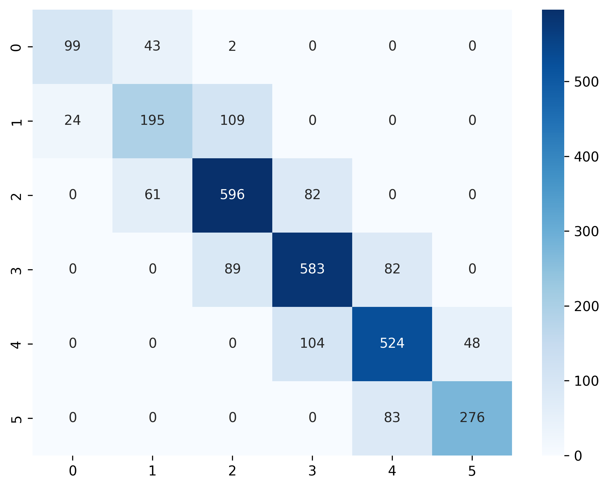
MODEL EVALUATION & RESULTS
Performance Metrics & Confusion Matrix
75.77%
Adjacent
Zero
C & D
Test Accuracy
Primary Errors
Cross-Grade Err
Best Predicted
Held-out 20% test set
Misclassifications only between neighboring grades
No A predicted as F or vice versa
Largest class → most training data
📊 Confusion Matrix (Test Set)
📋 Matrix Interpretation
Grade A (Class 0)
99 correctly classified. 43 confused with B — borderline A/B overlap is expected.
Grade B (Class 1)
195 correct. Some confusion with A (24) and C (109) — middle grades are hardest to separate.
Grade C (Class 2)
596 correct (largest correct bucket). 82 confused with D — adjacent grade issue.
Grade D (Class 3)
583 correct. 89 confused with C, 82 with E — symmetric neighbour confusion.
Grade E (Class 4)
524 correct. 104 confused with D, 48 with F.
Grade F (Class 5)
276 correct. 83 confused with E — model still can detect failing students.
Slide 7 of 8

Slide 8
WEB APPLICATION & CONCLUSIONS
EduPredict AI — Interactive App & Key Takeaways
💻 EduPredict AI Web App
✅ Key Conclusions
A fully interactive front-end simulation that brings the Random Forest's inference logic to life — no backend or Python installation required.
✓ 75.77% accuracy on unseen data is solid for a 6-class problem
✓ Misclassifications are exclusively between adjacent grade boundaries
✓ Study Hours is the single most influential feature
Input Form
Accepts Age, Study Hours, Attendance %, Math, Science, English scores
✓ Stratified splitting was essential to handle class imbalance
Live Inference
Simulates Random Forest logic: baseScore + behaviourBoost + noise
✓ Random Forest outperforms simpler models on this non-linear dataset
Grade Badge
Displays A–F prediction with colour-coded animated badge
🚀 Future Improvements
Confidence Meter
Animated progress bar showing model confidence (82–98% range)
→ Deploy with a Flask/FastAPI backend for real ML inference
Feature Importance
Shows top 3 drivers: Academic Avg · Attendance · Study Hours
→ Add SHAP explainability for per-prediction feature insights
Zero Dependencies
Pure HTML5 + Tailwind CSS + Vanilla JS — open-and-run
→ Experiment with XGBoost or Neural Networks for higher accuracy
→ Include socio-economic and extracurricular features
→ Add real-time model retraining as new student data arrives
Slide 8 of 8

