Slide 1
VR MALL
A Virtual Reality based approach to make shopping experience better

Slide 2
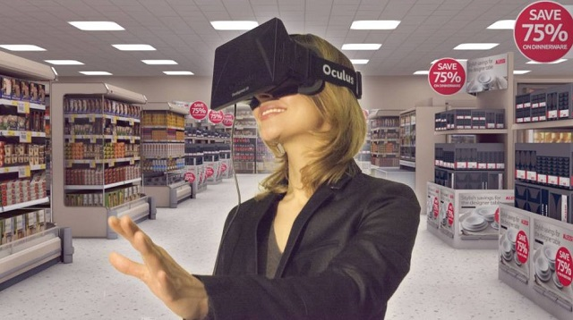
What is VR Mall
A Unique 3-D Virtual Mall that allows you to engage and interact with the E-commerce products.
Mall consists of different products with their complete details.
Customer can view and add products into cart.

Slide 3
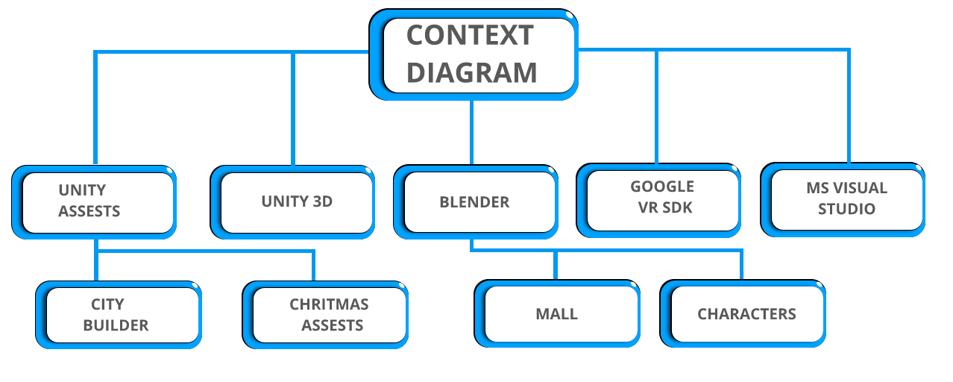

Slide 4
Value And Benefit
Future Scope
See every product in more detailed way.
Organise products, payment gateway etc.
Deploy more optimised application for IOS and ANDROID.
Create own wish list of up to 100 products.
Better graphical products and live characters.
Virtual reality represents the next step in selling & buying E-commerce products, than walking into a shopping mall.
Better Visualization 3D visualization of Products and best shopping experience in E-commerce.
Commercial tool Can be used as tool for better understanding of E-commerce market and their products.
Simple to use Easy install and Easy Shopping

Slide 5
THANK YOU

