Slide 1


M.Tech/MCA Program
Advanced Industry Integrated Programs
Jointly offered by University and LTIMindTree
Review II
Project Title
An Intelligent Framework for Prediction and Avoidance of Cyberattack with Digital Evidence Analysis
Team Member
VARSHA
Knowledge partner | Implementation partner

Slide 2
FAPT-Guard: Cyberattack Prediction & Avoidance
Introduction
Modern cyberattacks are multi-stage campaigns: initial access → execution → credential theft → lateral movement → impact.
IDS, SIEM, EDR and provenance-based systems such as KAIROS (IEEE S&P 2024) detect and reconstruct an attack, but only after the system is compromised.
Common responses (kill process, shut down, reimage) stop the attacker but destroy volatile evidence, and attackers also delete or fake logs.
FAPT-Guard predicts the attacker’s next stage, checks how far the evidence can be trusted, and selects a response that stops the attack while preserving forensic evidence.
Reconnaissance
Initial Access
Execution
Credential Access
Lateral Movement
Impact
Existing detectors (KAIROS, UNICORN): alert and investigate after compromise
FAPT-Guard: predict next stage → preserve evidence → prevent

Slide 3
FAPT-Guard: Cyberattack Prediction & Avoidance
Objective
Collect evidence: system, Sysmon, process and authentication logs, network flows, memory and file artefacts.
Build temporal provenance graphs and map every event to MITRE ATT&CK tactics and techniques.
Predict the next attack stage, the next ATT&CK technique and the attacker’s final intent, with a confidence score.
Evaluate evidence trust (DETS) and detect tampering: deleted, modified, fake or reordered events.
Measure evidence value and preservation using CDFU, ERS, ELC and the graph integrity score EGIS.
Select containment actions that stop the attack, preserve evidence and minimise business impact (U-EPPC).
Generate explainable forensic reports with a hash-verified audit trail (chain of custody).

Slide 4
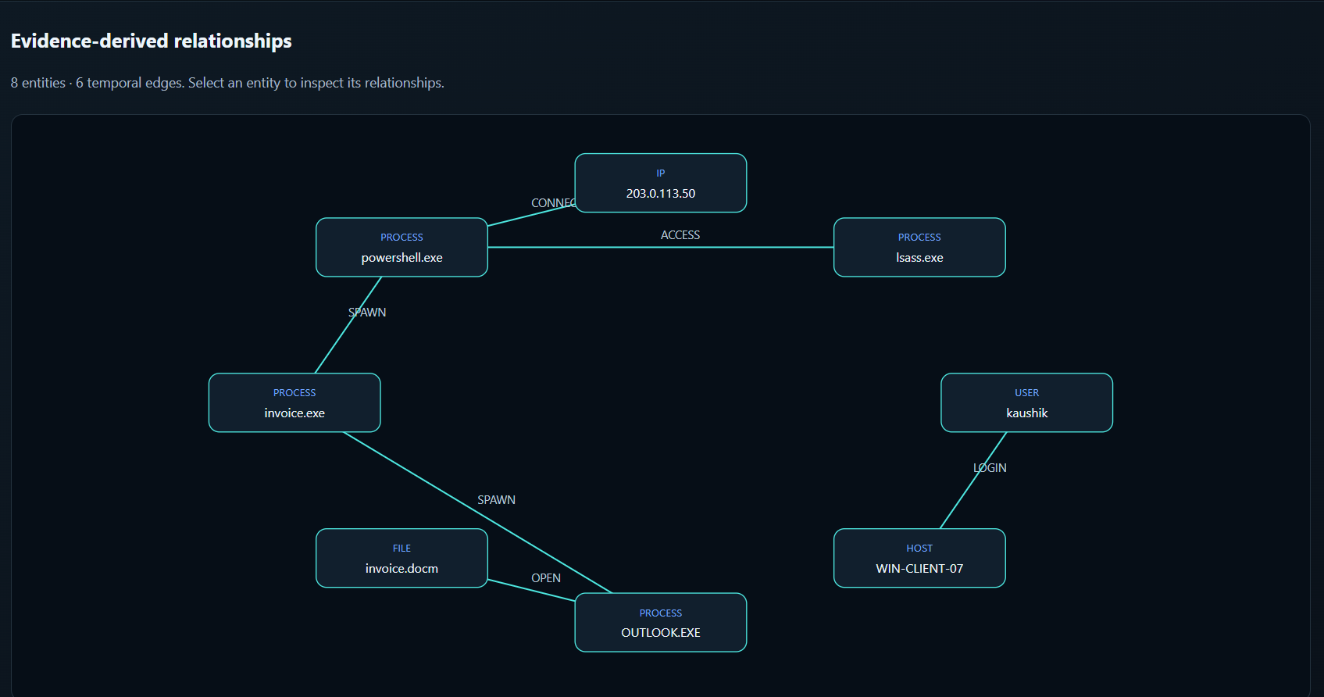
FAPT-Guard: Cyberattack Prediction & Avoidance
Module 1 – Evidence Collection & Provenance Graph
Evidence → graph → ATT&CK mapping
Inputs: authentication, process, Sysmon and network logs (loaders for DARPA CDM/eCAR and CIC-IDS2018).
Each event is parsed into subject → action → object with a timestamp.
Entities (user, host, process, file, IP) become nodes; actions become time-stamped edges.
Rules map events to ATT&CK v19.2, e.g. PowerShell → T1059.001, LSASS access → T1003.001.
Output: temporal provenance graph – demo incident INC-00001 has 8 entities and 6 edges.
Provenance graph of demo incident INC-00001 (FAPT-Guard UI)

Slide 5
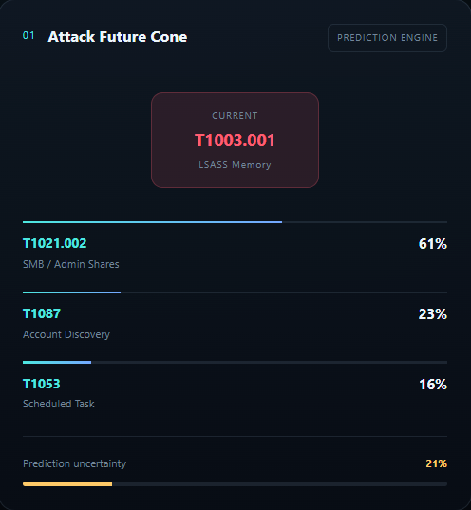
FAPT-Guard: Cyberattack Prediction & Avoidance
Module 2 – Attack Prediction & Anti-Forensic Intent
FAPN next stage + AFIP anti-forensic intent
FAPN: GRU sequence model over ATT&CK technique sequences, with two heads for next tactic and next technique.
Shown in the UI as the Attack Future Cone: T1021.002 61%, T1087 23%, T1053 16%; uncertainty 21%.
AFIP predicts anti-forensic moves (disable Sysmon, delete PowerShell history, fake events) and links each to a preservation step.
FAPN top-1 accuracy 0.951 vs Markov 0.711 vs frequency 0.133 (leave-one-campaign-out, 3 seeds).
UI: Attack Future Cone

Slide 6
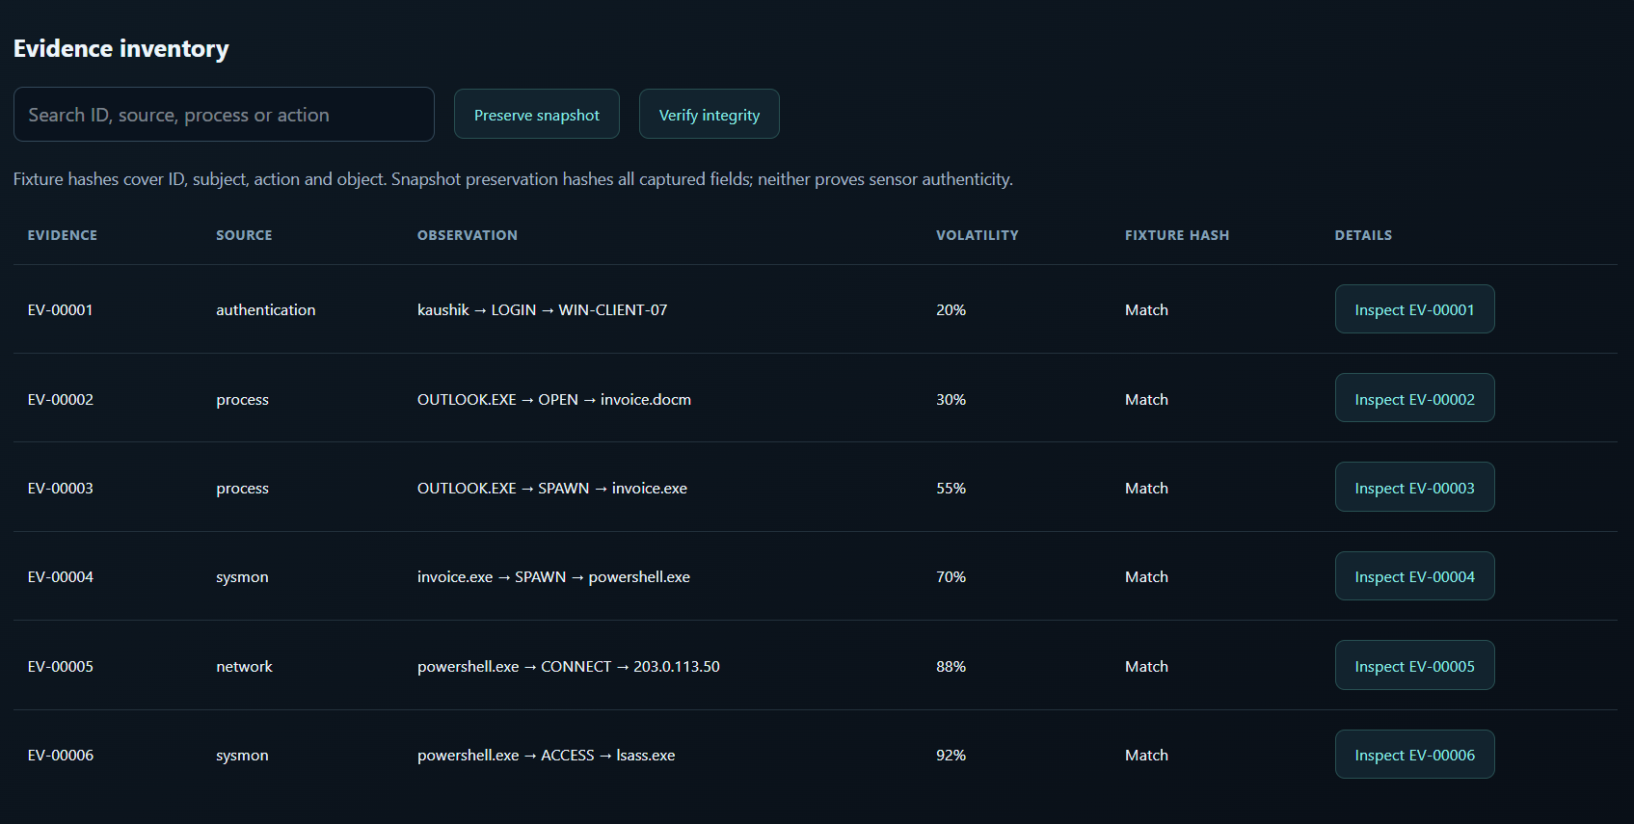
FAPT-Guard: Cyberattack Prediction & Avoidance
Module 3 – Evidence Trust & Integrity Analysis
DETS trust score, volatility, EGIS, SHA-256
DETS = source × temporal × structural × anomaly; one strong red flag pulls trust down.
Volatility sets collection order: LSASS access 92%, network 88%, login 20%.
Preserve snapshot hashes all fields with SHA-256; Verify integrity re-hashes (“Match”).
EGIS combines completeness, consistency and authenticity of the whole graph.
Clean detection F1 0.889, AUC 0.939, EGIS 0.961. Tamper-detection F1: fake events 0.79, attribute modification 0.71, timeline manipulation 0.61.
Evidence inventory with volatility and hash verification

Slide 7
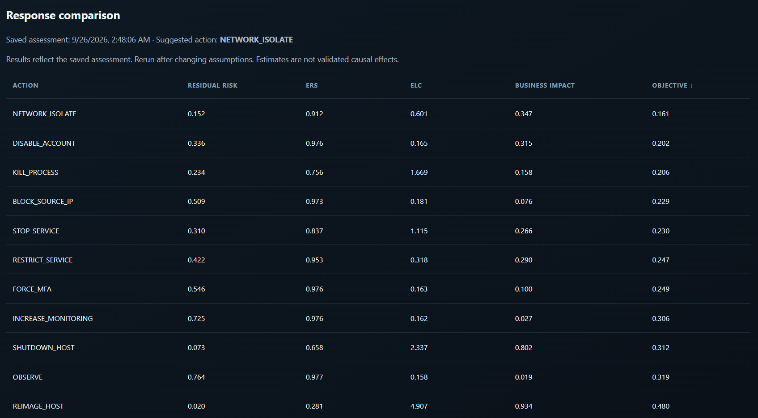
FAPT-Guard: Cyberattack Prediction & Avoidance
Module 4 – Evidence-Preserving Prevention Decision
JCFE counterfactual comparison + U-EPPC optimiser
JCFE scores 11 candidate actions before any is executed.
Each action: residual risk, Evidence Retention Score (ERS), Evidence Loss Cost (ELC), business impact.
U-EPPC picks the lowest objective: NETWORK_ISOLATE (risk 0.152, ERS 0.912); REIMAGE_HOST ranks last (ELC 4.907).
Trust gate (τ = 0.5) blocks destructive actions on low-trust evidence: 32.7% → 0%.
Response comparison of 11 actions for INC-00001

Slide 8
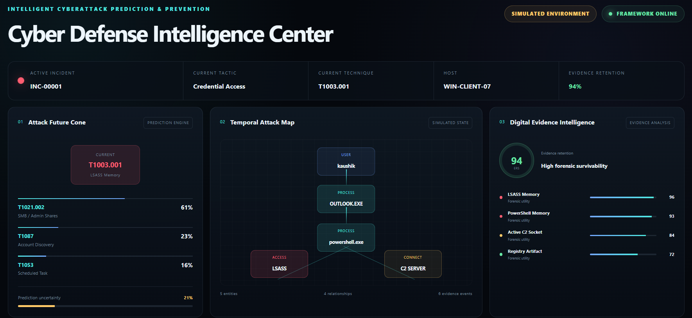
FAPT-Guard: Cyberattack Prediction & Avoidance
Module 5 – Dashboard, Forensic Report & Evaluation
Web dashboard + evaluation suite
7 pages: Dataset research, Command Center, Incidents, Attack Graph, Evidence, Prevention, Reports.
Workflow: investigate → trace graph → preserve & verify → compare responses → export report.
Audit trail logs every ASSESSMENT, SIMULATION and PRESERVATION with SHA-256 (chain of custody).
Evaluation: 7 experiments (E1–E7) over 3 seeds; holdout on FAPT datasets 10–12; dataset 13 (FAPT-Bench) kept for robustness.
Command Center: future cone, attack map, evidence intelligence

Slide 9
FAPT-Guard: Cyberattack Prediction & Avoidance
Methodology / Modeling Plan
1 Data collection
FAPT datasets 10–13, demo incident, ATT&CK v19.2, OpTC loader
Task | Model / method | Metric
Next-stage prediction | FAPN (GRU) vs Markov, frequency | Top-1 / Top-3 accuracy
Anti-forensic intent | AFIP classifier | Accuracy, macro-F1
Pre-intrusion blocking | Histogram Gradient Boosting | Block rate, false-block rate
Provenance anomaly | Isolation Forest + ATT&CK hits | F1, AUC
Evidence trust / tamper | DETS product score + EGIS | Tamper-detection F1
Exploit probability | Beta-Bernoulli update of CVSS/EPSS | MAE, Brier score
Response selection | U-EPPC weighted objective | Residual risk, ERS, ELC
2 Preprocessing & graph
parse, clean, map to ATT&CK, build provenance graph
3 Prediction models
FAPN next stage, AFIP intent, anomaly detector
4 Evidence modelling
DETS trust, volatility, EGIS, SHA-256 snapshots
5 Decision optimisation
JCFE what-if scoring, U-EPPC + trust gate
6 Evaluation
holdout + 3 seeds, FAPT-Bench robustness
Decision objective: a* = argmin [ Risk + λ1·ELC + λ2·Business impact + λ3·Uncertainty ]
Destructive actions allowed only when evidence trust ≥ τ (0.5)

Slide 10
FAPT-Guard: Cyberattack Prediction & Avoidance
Data Preprocessing & EDA
Dataset | Rows | Use | Modules
10 – Cyber-Forensic Response | 7,700 | development | CDFU, ACES, ERS, ELC, JCFE, U-EPPC
11 – Anti-Forensic | 5,000 | development | AFIP, predictive preservation
12 – Evidence Trust | 8,000 | development | DETP, P3R, EGIS, FAPN robustness
13 – FAPT-Bench 2.0 | 1,890 | evaluation only | final robustness test
MITRE ATT&CK v19.2 | – | reference | technique mapping
DARPA OpTC | 0 (not imported) | planned | real-data evaluation
Preprocessing steps and EDA findings
Parse: raw events → subject–action–object with timestamps; drop malformed rows, fill missing fields.
Map & normalise: ATT&CK technique per event; scores scaled to 0–1; event counts log-scaled per host window.
Split: 80/20 train/holdout per development dataset; dataset 13 never seen in training.
Finding 1: AFIP labels are imbalanced – 61.3% accuracy but macro-F1 0.088 → class weighting needed.
Finding 2: poisoning inputs contain corruption indicators (label leakage → 100%) – being removed.

Slide 11
FAPT-Guard: Cyberattack Prediction & Avoidance
Approach / Algorithms / Tools
Component | Algorithm / approach | Tools
Evidence parsing & provenance graph | Subject–action–object parsing; temporal graph construction | Python, pandas, NetworkX
ATT&CK mapping | Rule-based technique matching | MITRE ATT&CK v19.2
Next-stage prediction (FAPN) | GRU sequence model trained with Adam; Markov and frequency baselines | NumPy
Anti-forensic intent (AFIP) | Supervised multi-class classifier on FAPT dataset 11 | scikit-learn
Pre-intrusion blocking | Histogram Gradient Boosting flow classifier | scikit-learn
Provenance anomaly detection | Isolation Forest fused with ATT&CK-hit signal | scikit-learn
Evidence trust & integrity | DETS product score, EGIS, SHA-256 snapshots | Python, hashlib
Hardening & exploit model | Attack graph + Monte Carlo attacker; Beta-Bernoulli learning | NetworkX, SciPy
Decision engine (JCFE, U-EPPC) | Counterfactual scoring + weighted multi-objective + trust gate | Python
Visualisation & reporting | Dashboard, charts, audit trail, report export | Web UI, Matplotlib
Planned for the real-data phase: PyTorch Geometric GNN encoder for FAPN, Sysmon / Wazuh evidence collection, DARPA OpTC import and direct comparison with KAIROS.

Slide 12
FAPT-Guard: Cyberattack Prediction & Avoidance
Project Plan / Milestones Progress
# | Milestone | Status
1 | Literature survey, base paper (KAIROS) and research gap | Completed
2 | Framework design and novelty definition (FAPT-Guard) | Completed
3 | Synthetic data generators and FAPT datasets 10–13 | Completed
4 | Modules: provenance graph, FAPN, DETS / EGIS, decision engine | Completed
5 | Experiments E1–E7 (3 seeds) and IEEE paper draft | Completed
6 | FAPT-Guard dashboard prototype | Completed
7 | DARPA OpTC import and real-data evaluation vs KAIROS | In progress
8 | Fix poisoning label leakage; improve AFIP (class weighting) | In progress
9 | GNN encoder, FAPT-Bench final benchmark, Review III and thesis | Planned
6 of 9
milestones completed
Review I
Completed
Review II
Current
Review III
Planned

Slide 13
FAPT-Guard: Cyberattack Prediction & Avoidance
Pipeline Structure
Digital evidence
logs, Sysmon, network,
memory, files
Acquisition &
preprocessing
parse, clean, timestamp
Temporal
provenance graph
entities + time-stamped
edges
ATT&CK mapping
technique per event
FAPN prediction
next stage, technique,
intent + confidence
Stage A – understand & predict
Preserve evidence
→ act → report
SHA-256 snapshot,
audit trail
Containment
decision (U-EPPC)
risk + ELC + impact,
trust gate
Counterfactual
simulator (JCFE)
what-if for
11 actions
Graph integrity
(EGIS)
completeness,
consistency
Evidence trust (DETS)
& tamper detection
AFIP anti-forensic
intent
Stage B – trust, decide, preserve, prevent
Outputs to the dashboard: current & predicted stage, attacker intent, evidence trust, ERS / ELC, EGIS, recommended action, counterfactual risk and the forensic report.

