Slide 1


Rescue-x iot-based smart ACCIDENT detection and emergency dispatch system
PANIMALAR ENGINEERING COLLEGE
Department of Electronics and Communication Engineering
Batch No: D8
Batch Members:
KAUSHIK B (211421106130)
MAHENDHAR M (211421106163)
JAGANNATH A (211421106105)
PRITHIVIRAJ E (211421106333)
Internal Guide:
Ms. R. MARY VICTORIA , M.E.,
Assistant Professor,
Department of ECE,
Panimalar Engineering College.

Slide 2
INDEX
Abstract
Introduction
Objective of the Project
Literature Survey
Hardware and Software Requirement
Existing System
Proposed Work
Pros & Cons
Block Diagram and Architecture Diagram
Conclusion and References

Slide 3
ABSTRACT
This project aims to develop a real-time accident detection system that utilizes sensors for accident detection and GSM technology for communication.
The system receives data from an accident detection controller and sends notifications to nearby ambulance drivers through a web interface.
The nearest available ambulance driver is then able to accept the emergency request, while ensuring that the same ambulance does not appear as available to multiple drivers simultaneously. After accepting the request, the ambulance driver enters the nearby hospital’s name, and the system dynamically updates the route via IoT-enabled GPS.
This integration allows the ambulance to be rerouted in real-time for the quickest possible response, ensuring that critical accident victims receive timely medical assistance.
The system incorporates advanced sensor technologies, GSM communication, and IoT-based route management to create a comprehensive and efficient emergency response solution, enhancing public safety and emergency medical services.

Slide 4
INTRODUCTION
Road accidents are a major cause of fatalities worldwide, often due to delayed emergency response and lack of immediate medical assistance. In critical situations, timely intervention can significantly increase survival rates. To address this issue, we propose an IoT-based Accident Detection and Ambulance Rescue System that automatically detects accidents, sends real-time alerts, and helps emergency services reach the accident location faster.This system is built using an ESP32 microcontroller, which continuously monitors data from MEMS and vibration sensors to detect collisions. When an accident occurs, the system retrieves the exact location using a GPS module and sends an SMS alert via a GSM module to emergency contacts, including ambulance services. Additionally, a web application is developed to allow ambulance drivers to log in and check accident locations in real-time. The system integrates the Google Maps API, enabling drivers to navigate efficiently to the accident site.By leveraging IoT technology, the system ensures real-time data transmission, cloud storage, and improved accessibility for emergency responders. This project provides an automated, efficient, and life-saving solution to reduce response time, minimize fatalities, and improve road safety.

Slide 5
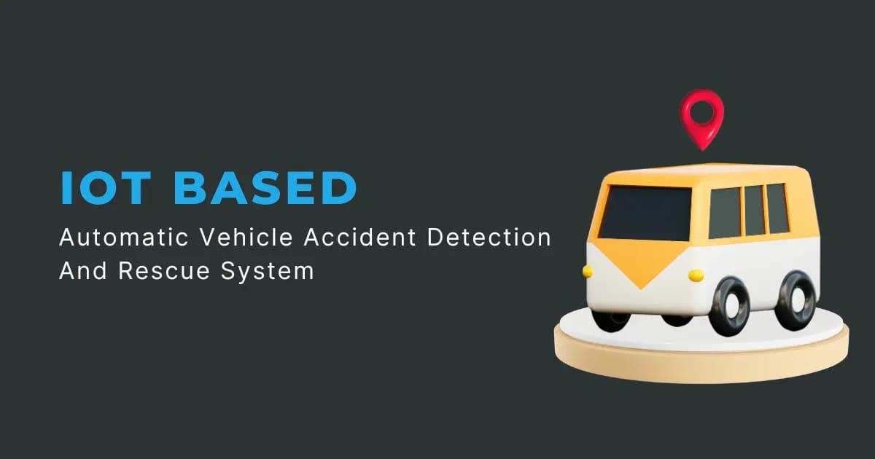
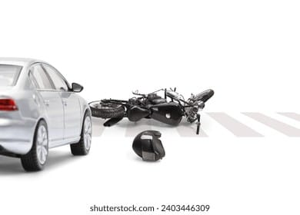
OBJECTIVE OF THE PROJECT
The objective of this project is to create a real-time accident detection and emergency response system that integrates an ESP32 controller, MEM sensors, and GSM technology to enhance the efficiency and timeliness of emergency services.
The system aims to detect accidents instantly using MEM sensors, which identify sudden impacts or changes in vehicle dynamics.
Once an accident is detected, the system communicates with nearby ambulance drivers via GSM, notifying them of the emergency.
The project ensures that only one ambulance is notified to avoid duplication of response, thereby optimizing the use of available resources.

Slide 6
LITERATURE SURVEY
1. Fall Detection With Wrist-Worn Watch by Observations in Statistics of Acceleration
Author: S. Li Year: 2023 Description: This study focuses on fall detection using wrist-worn devices, leveraging statistical observations of acceleration. It highlights the effectiveness of motion sensors in detecting sudden impacts, which is relevant for accident detection in vehicles. Our project applies a similar concept by using MEMS and vibration sensors to identify vehicle collisions in real time.
2. A Real-Time Vision Transformers-Based System for Enhanced Driver Drowsiness Detection and Vehicle Safety
Authors: A. Jarndal, H. Tawfik, A. I. Siam, I. Alsyouf, A. Cheaitou Year: 2025 Description: This research introduces an AI-based real-time drowsiness detection system using Vision Transformers. It emphasizes the role of real-time monitoring in preventing accidents. Our system complements this by detecting accidents when preventive measures fail, ensuring immediate rescue response and location tracking.

Slide 7
LITERATURE SURVEY
3. A Comprehensive Study on IoT-Based Accident Detection Systems for Smart Vehicles
Authors: U. Alvi, M. A. K. Khattak, B. Shabir, A. W. Malik, S. R. Muhammad Year: 2020 Description: This study reviews various IoT-based accident detection mechanisms and their applications in smart vehicles. It highlights the importance of real-time data transmission and cloud integration, which our project incorporates using ESP32, GSM, GPS, and IoT connectivity to ensure instant accident alerts and ambulance coordination.
4. Smart System to Avoid Car Accidents
Authors: M. Saffarini, R. Saffarini, I. Ishaq Year: 2020 Description: This paper presents an AI-driven system for accident prevention using proximity sensors and decision-making algorithms. Unlike our project, which focuses on post-accident detection and emergency response, this study aims at preventing accidents. Our system bridges this gap by ensuring automatic accident detection and real-time emergency alert.

Slide 8
SYSTEM CONFIGURATION:
HARDWARE AND SOFTWARE REQUIREMENT
HARDWARE COMPONENTS:
ESP32 MICRO CONTROLLER
POWER SUPPLY
LCD
IOT
UART
MEM SENSOR
GSM
SOFTWARE COMPONENTS:
EMBEDDED C
ARDUINO UNO
HTML AND CSS
PYTHON
H/W SYSTEM CONFIGURATION:
Processor – I3, i5,i7
RAM - 8 Gb
Hard Disk - 500 GB
S/W SYSTEM CONFIGURATION:
Operating System – Above Windows 8
Scripts – Python (3.10.8)
Tool – IDLE (Python)

Slide 9
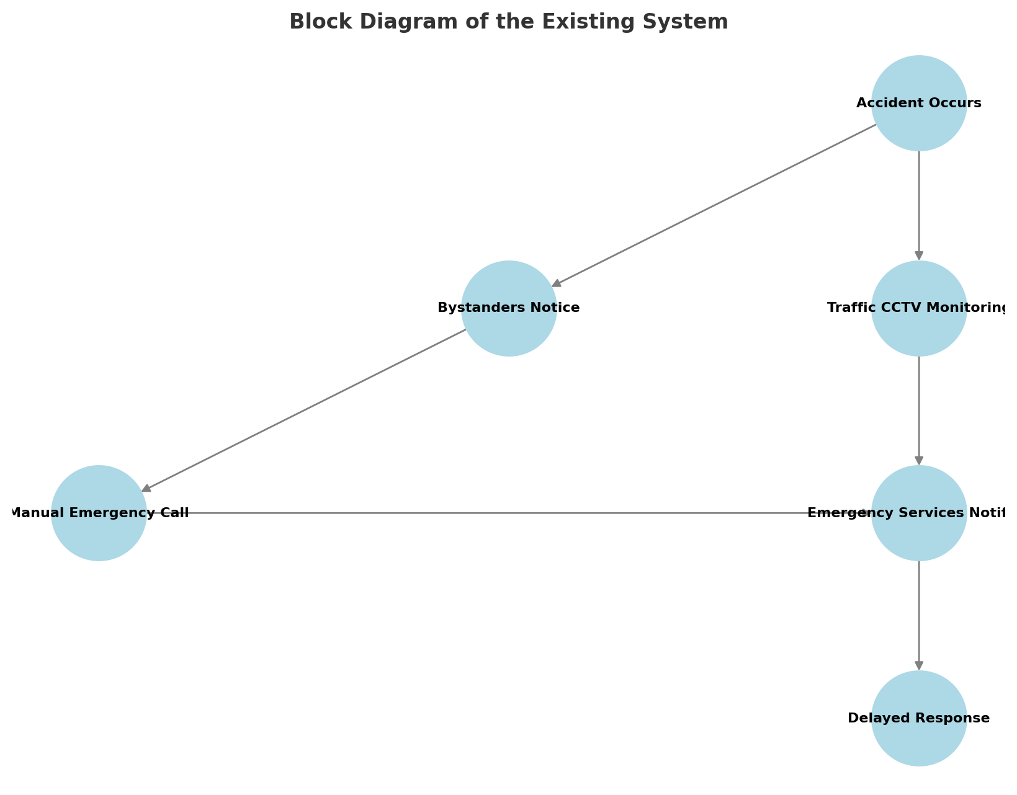
EXISTING SYSTEM
In the current scenario, accident detection and emergency response rely on manual reporting by bystanders or passengers. This often leads to delays in emergency services, increasing the risk of fatalities. Some vehicles are equipped with airbag deployment sensors, which can detect collisions, but these do not automatically send alerts to rescue teams. Traditional accident reporting systems include:
Manual Emergency Calls: Victims or witnesses must dial emergency services, which may not be possible if the victim is unconscious.
CCTV-Based Monitoring: Traffic control centers use CCTV cameras to detect accidents, but this method is limited by camera coverage and response delays.

Slide 10
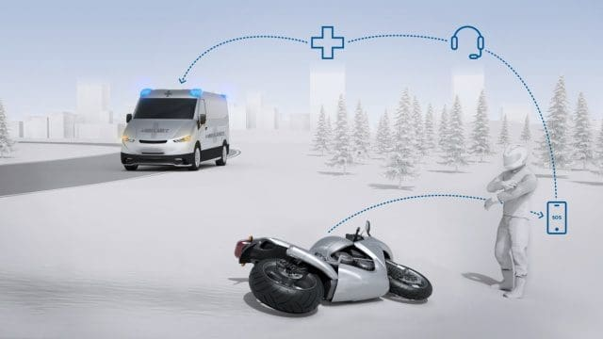

PROPOSED SYSTEM
The proposed system aims to address the limitations of existing accident detection and emergency response frameworks by integrating advanced technologies such as ESP32 controllers, MEM sensors, GSM communication, and IoT for real-time accident detection, efficient ambulance dispatch, and dynamic route optimization.
In this system, MEM sensors embedded in vehicles detect sudden changes in velocity or impact, instantly triggering an alert to the nearest available ambulance via GSM.
This ensures that emergency responders are notified without delay, reducing response times significantly. Once the ambulance driver accepts the notification, they can input the nearest hospital name, and the system automatically updates the optimal route using IoT-enabled GPS technology.

Slide 11
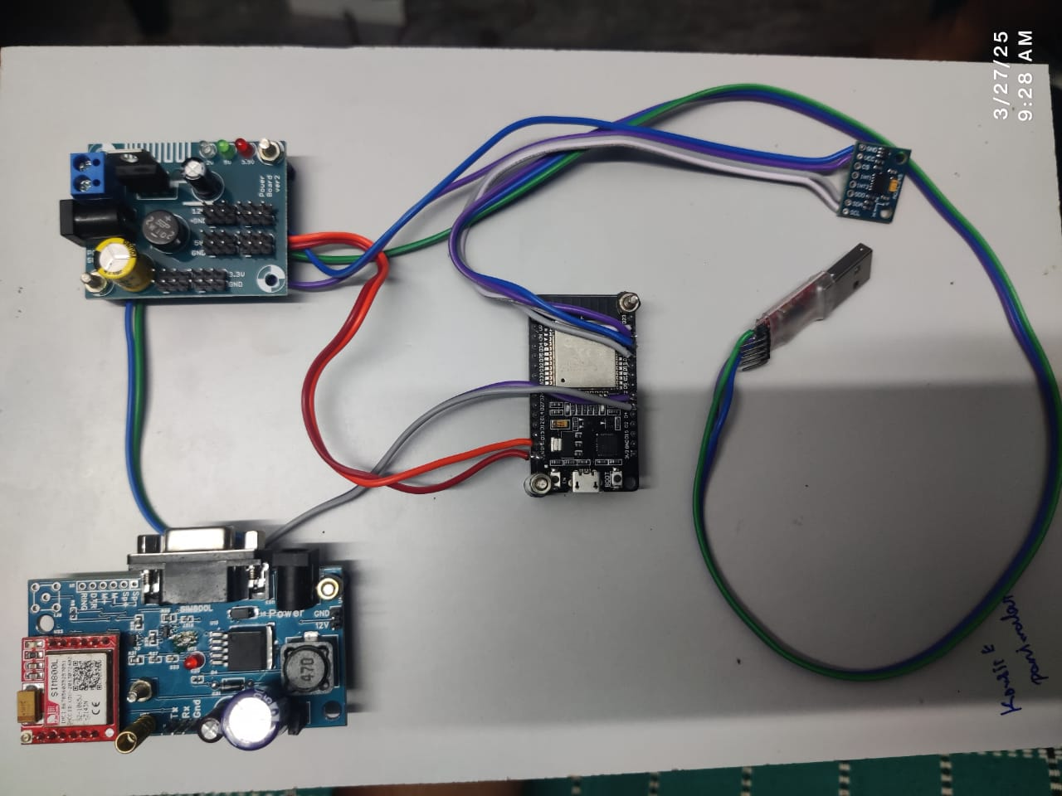
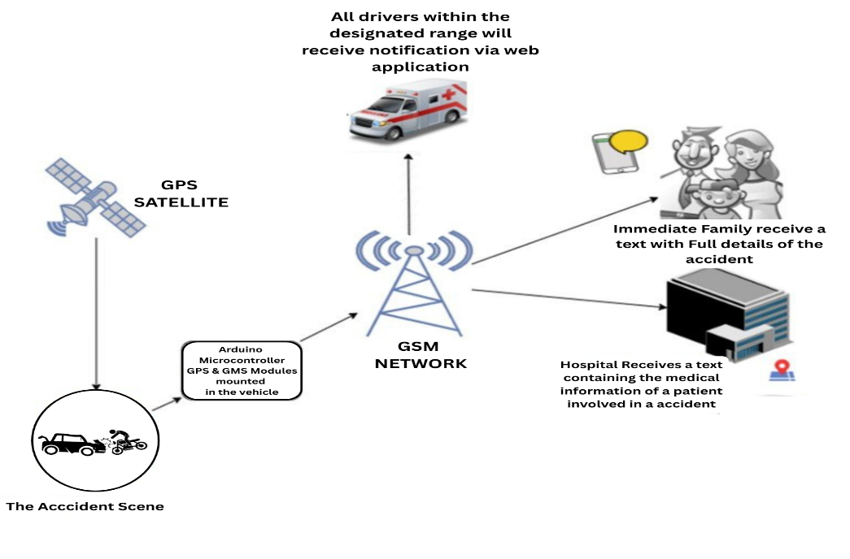
PROPOSED SYSTEM
This real-time route optimization takes into account live traffic data, road conditions, and distance, ensuring the is ambulance reaches the hospital in shortest possible time.
The system also includes a web-based interface where ambulance drivers can view accident notifications, monitor their progress, and the Interact with the system in real time

Slide 12
PROS
PROS AND CONS
CONS
• By notifying the nearest ambulance instantly through GSM, the system significantly reduces response times, ensuring quicker assistance for accident victims.
• The web interface enables ambulance drivers and emergency services to monitor accident data, track ambulances, and manage responses in real time.
• The system provides real-time updates to hospitals, allowing them to prepare for incoming patients, ensuring that medical staff is ready for immediate intervention.
• In remote or rural areas, existing systems may not be able to reach ambulance drivers or may suffer from communication failures due to lack of mobile network coverage.
• Existing systems generally do not provide continuous tracking of ambulances, making it harder to monitor progress and ensure efficient routing.
• Ambulances are often dispatched without real-time traffic data, leading to longer travel times, especially in congested or remote areas.

Slide 13
BLOCK DIAGRAM
PYTHON
POWER SUPPLY
UART
ESP32 MICRO CONTROLLER
IOT
GSM
MEM SENSOR

Slide 14
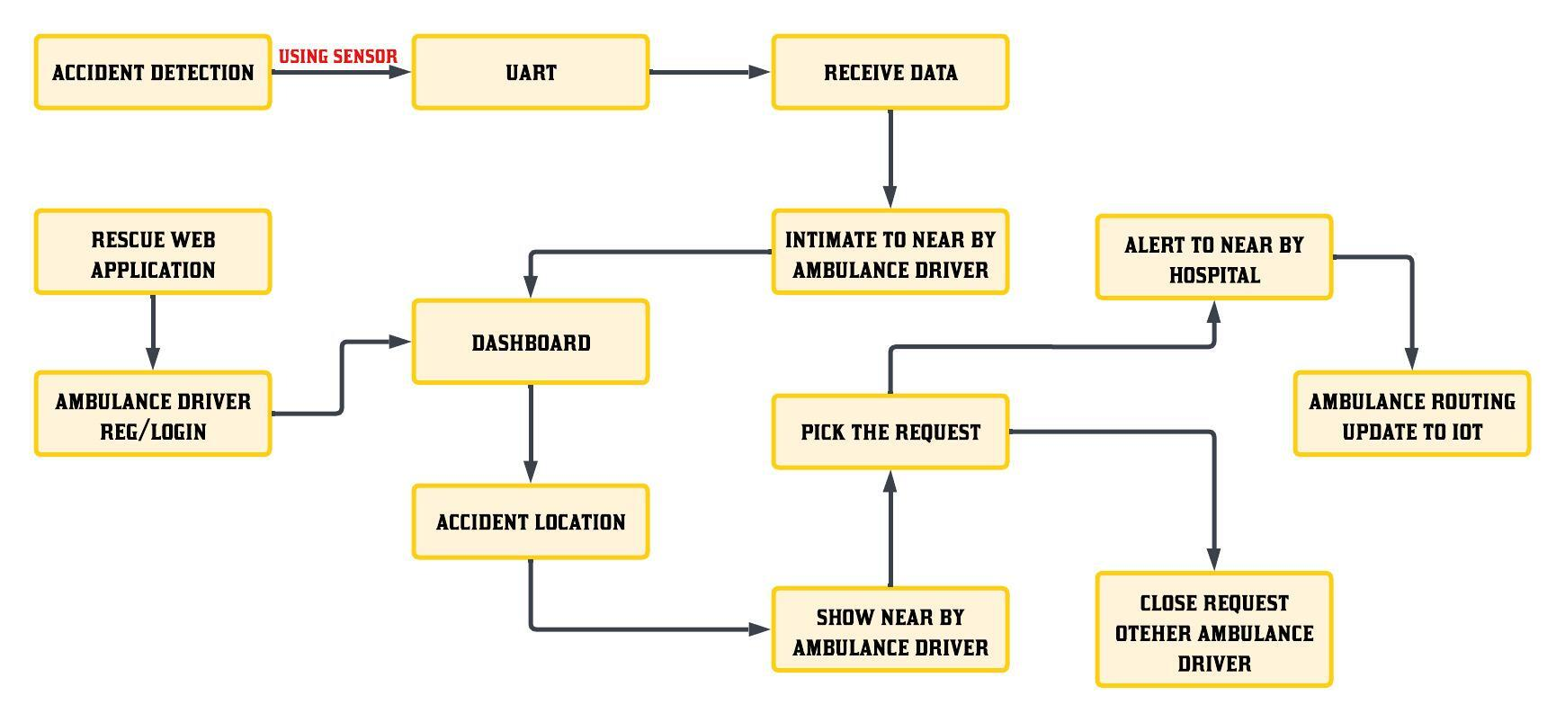
ARCHITECTURE DIAGRAM

Slide 15
MODULE DESCRIPTION
ACCIDENT DETECTION MODULE:
An accident detection module uses sensors and algorithms to identify and alert for vehicle collisions or accidents in real-time.
GSM COMMUNICATION MODULE:
A GSM communication module enables devices to send and receive data via mobile networks, typically for text messaging or remote control applications.
AMBULANCE DISPATCH AND NOTIFICATION MODULE:
An ambulance dispatch and notification module automatically alerts and coordinates with emergency services to dispatch ambulances quickly in response to an emergency.

Slide 16
CONCLUSION
The project serves as a valuable tool in revolutionizing emergency response systems, offering significant improvements in accident detection, ambulance dispatch, and medical assistance.
Its primary use lies in saving lives by ensuring faster response times through automated accident detection using MEM sensors and optimized route planning with real-time traffic data.
By integrating GSM communication, IoT, and GPS technologies, the system enhances coordination between ambulance drivers, hospitals, and emergency response teams, ensuring a more efficient and streamlined process.
Furthermore, the project has potential applications in broader contexts, such as disaster management, public health monitoring, and integration with smart city infrastructure, where it can contribute to quicker responses during emergencies.
Its scalability and adaptability make it a valuable solution not only for road accident management but also for other critical situations requiring timely intervention.

Slide 17
REFERENCE
[1]. S. Li, "Fall Detection With Wrist-Worn Watch by Observations in Statistics of Acceleration," in IEEE Access, vol. 11, pp. 19567-19578, 2023, doi: 10.1109/ACCESS.2023.3249191.
[2]. A. Jarndal, H. Tawfik, A. I. Siam, I. Alsyouf and A. Cheaitou, "A Real-Time Vision Transformers-Based System for Enhanced Driver Drowsiness Detection and Vehicle Safety," in IEEE Access, vol. 13, pp. 1790-1803, 2025, doi: 10.1109/ACCESS.2024.3522111.
[3]. J.-W. Hu, B.-Y. Zheng, C. Wang, C.-H. Zhao, X.-L. Hou, Q. Pan, and Z. Xu, ‘‘A survey on multi-sensor fusion based obstacle detection for intelligent ground vehicles in off-road environments,’’ Frontiers Inf. Technol. Electron. Eng., vol. 21, no. 5, pp. 675–692, May 2020
[4]. M. Saffarini, R. Saffarini and I. Ishaq, "Smart System to Avoid Car Accidents," 2020 International Conference on Promising Electronic Technologies (ICPET), Jerusalem, Palestine, 2020, pp. 22-27, doi: 10.1109/ICPET51420.2020.00013.
[5]. W. Rahman, M. R. Ruman, K. Roushan Jahan, M. J. Roni, M. Foyjur Rahman and M. A. Hasnat Shahriar, "Vehicle Speed Control and Accident Avoidance System Based on Arm M4 Microprocessor," 2020 International Conference on Industry 4.0 Technology (I4Tech), Pune, India, 2020, pp. 154-158, doi: 10.1109/I4Tech48345.2020.9102693.

