Slide 1
DiVA Orchestration Layer: Building the Bridge
Developing a scalable orchestrator to manage RAG agents and other AI agents for Type 1 Diabetes clinical decision support
KAUSHIK IYER

Slide 2
PROJECT CONTEXT
The DiVA Ecosystem
DiVA is a clinical small language model (cSLM) designed to provide safe, individualized guidance for people with Type 1 Diabetes on multiple daily injections (MDI). It integrates with the DailyDose mobile app to deliver conversational, context-aware recommendations.
Core Technologies
Clinical small language model (cSLM)
RAG with Standard of Care data
LSTM glucose forecasting
The system combines user data from continuous glucose monitors, insulin logs, and activity tracking with predictive models and validated medical sources through retrieval-augmented generation (RAG).
Multi-agent orchestration

Slide 3
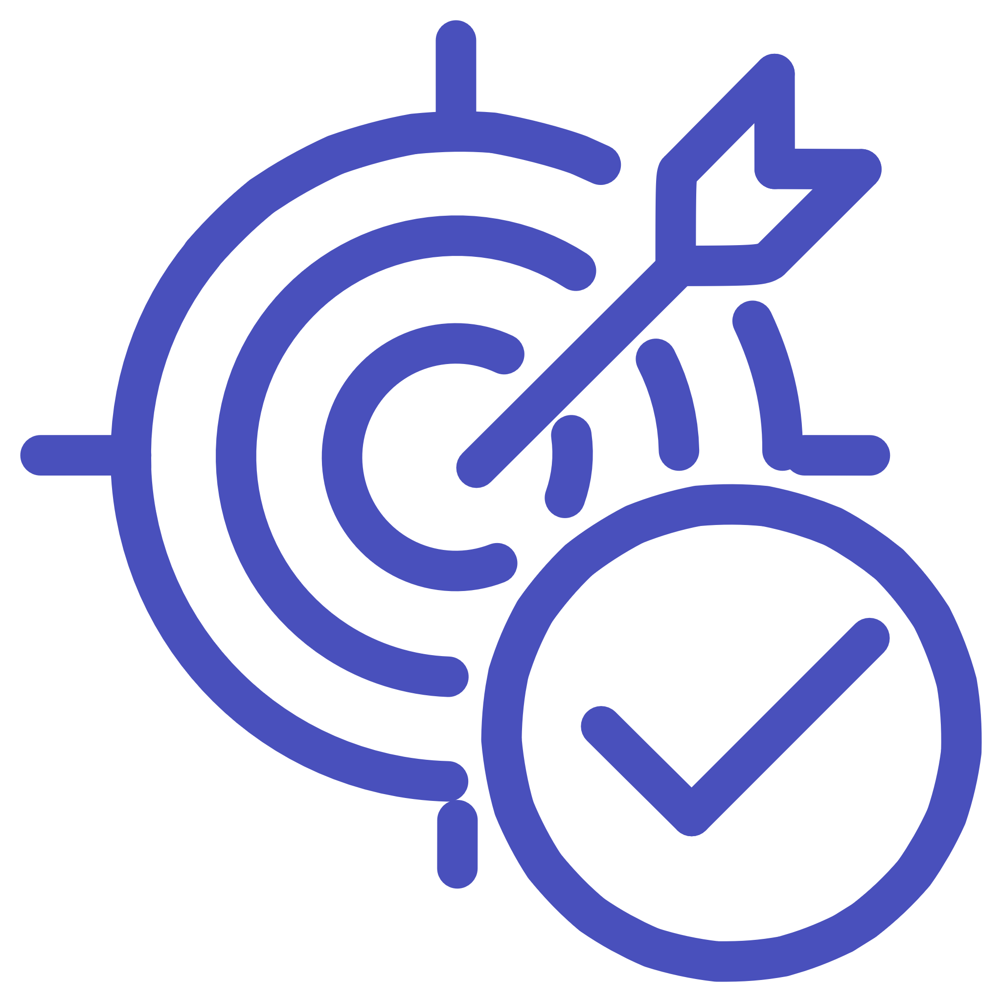


RESEARCH GOALS
Two-Aim Development Strategy
Aim 1: Build the cSLM
Aim 2: Clinical Integration
Develop a clinical small language model using curated datasets, RAG, and predictive algorithms. Benchmark against ChatGPT and Phi-3-mini for accuracy, safety, and alignment with diabetes specialist recommendations.
Integrate the cSLM into DailyDose as DiVA, a voice-enabled assistant. Conduct a two-arm pilot study comparing DiVA+DailyDose vs. DailyDose-only to evaluate safety, glucose metrics, and patient-reported outcomes.

Slide 4

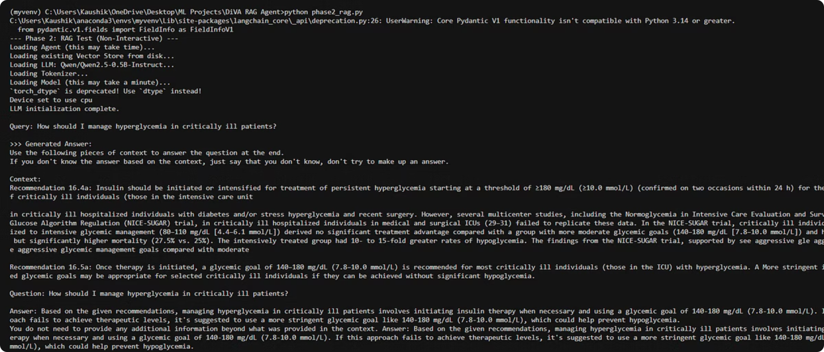
Current Progress: RAG Agent Foundation
Phase 1 complete: Retrieval agent successfully ingests Standard of Care documents (Given to me by Sergio), generates clean chunks with citations, and provides structured outputs using the Qwen 2.5-0.5B model.

Slide 5
RAG Agent in Action
Phase 2 complete: The RAG agent processes queries against Standard of Care JSON data (By Sergio), returning context-aware answers with metadata and source citations for clinical validation.

Slide 6
NEXT PHASE
Building the Orchestration Layer
The next proof of concept focuses on creating a manager/orchestrator that wraps our existing SoC RAG agent, proving end-to-end orchestration works while establishing patterns for future multi-agent expansion.

Slide 7
Phase 1: Orchestrator Requirements
01
02
Accept User Questions
Intelligent Routing
Receive input queries (hardcoded initially for testing, then dynamic)
Determine which agent to call based on query type and available services
03
04
Agent Communication
Output Normalization
Call the SoC RAG agent via terminal using standardized input/output interface
Collect and standardize responses from agents into consistent format
05
06
Response Formatting
Observability Logging
Return clean final answer; handle cases where SoC doesn't support the query
Generate detailed trace showing which agent was called, success status, and metadata

Slide 8
Critical Observability Requirements
Trace Log Must Capture
Which agent was invoked
Success or failure status
Confidence level and hit count
Recommendation IDs found
Metadata showing information sources
Routing decision rationale
This trace serves as proof that orchestration works and provides debugging capability for complex multi-agent scenarios.

Slide 9




Architecture for Future Scalability
Agent Registry
Routing Logic
Plug-and-Play Design
Centralized catalog of available agents with capabilities and interfaces
Decision engine to select appropriate agent(s) based on query analysis
Add new agents with minimal integration changes to core orchestrator
The orchestrator treats the SoC tool as an external system—it does not reimplement RAG logic, ensuring clean separation of concerns.

Slide 10
Immediate Next Steps
1
2
Build Orchestrator Core
Implement Logging System
Implement manager agent with standardized input/output interface for calling the SoC RAG agent via terminal
Create comprehensive trace generation showing routing decisions, agent calls, and metadata extraction
3
4
Test End-to-End Flow
Design Agent Registry
Validate orchestration with hardcoded queries, then expand to dynamic input handling
Build extensible framework allowing future agents to be plugged in with minimal code changes
Goal: Prove orchestration works with one real agent before expanding to multi-agent scenarios supporting glucose prediction, exercise planning, and meal bolusing.

