Slide 1
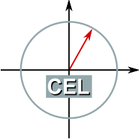
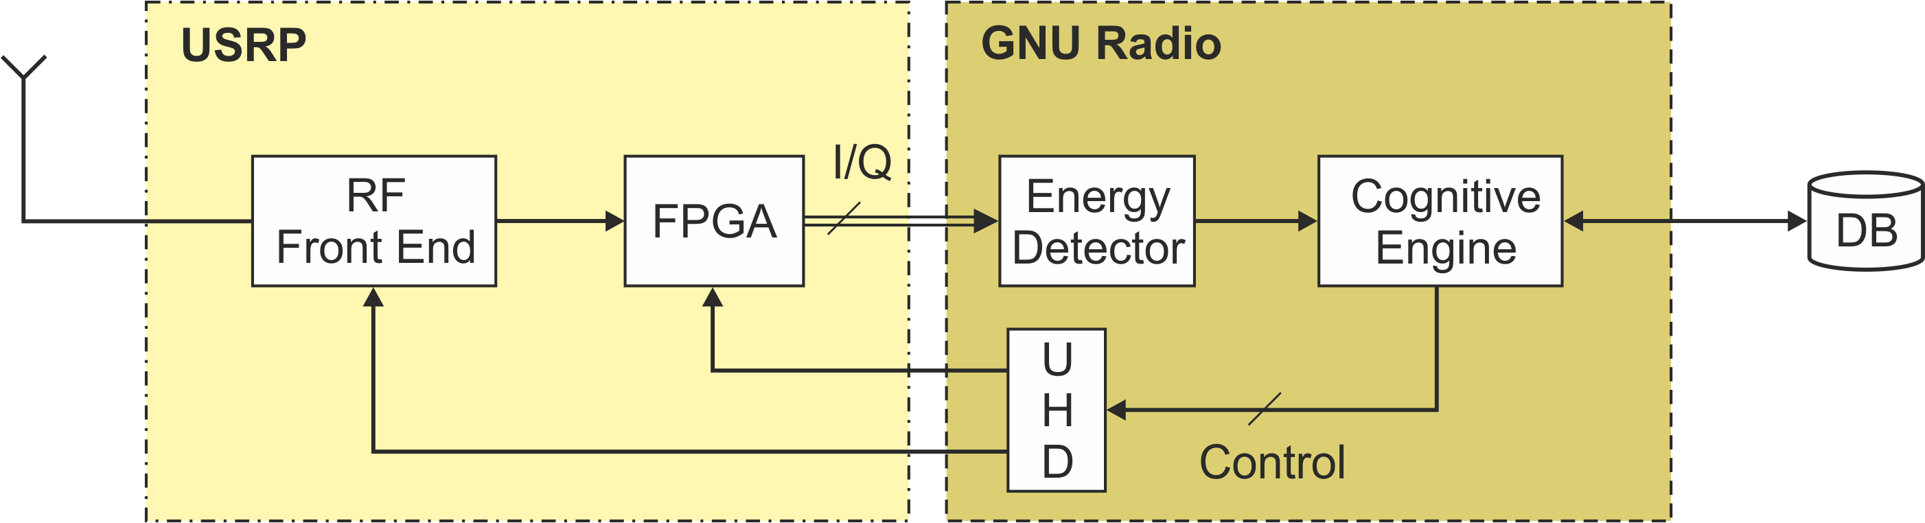
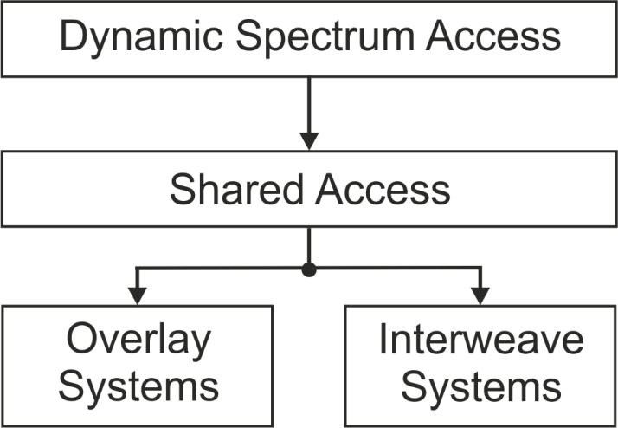
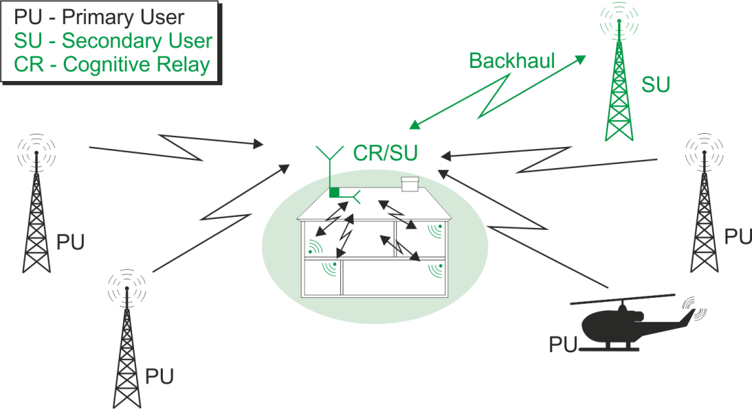

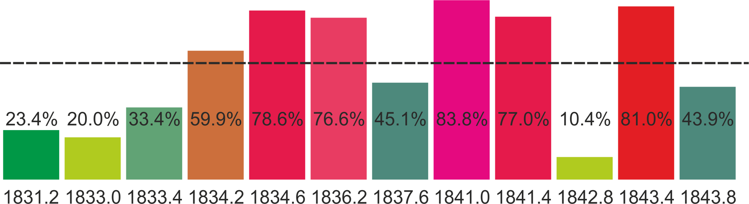

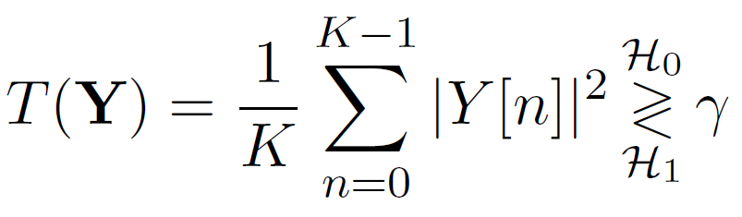
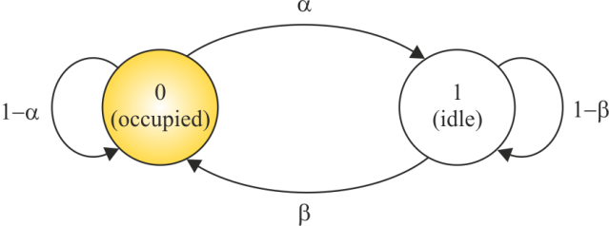
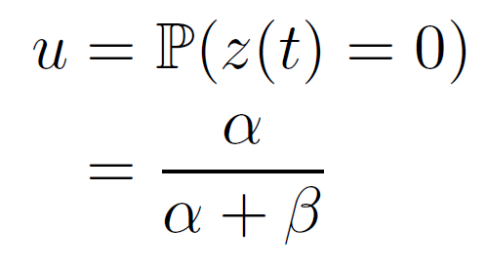
Cognitive Relay: Detecting Spectrum Holes in a Dynamic Scenario
Karlsruhe Institute of Technology
Communications Engineering Lab
Ankit Kaushik, Marcus Müller and Friedrich K. Jondral
{ankit.kaushik, friedrich.jondral}@kit.edu, {marcus.mueller@student.kit.edu}
Introduction and Motivation
Dynamic Spectrum Access (DSA) is one of the many applications of cognitive radio.
Main tasks for a DSA operating as Secondary User (SU):
Sensing (Learning) and intelligent access (Act)
Avoid interference to the Primary User (PU)
Purpose of this work:
Realize the cognitive concepts over the hardware
Use sophisticated algorithms to reduce the time constraints and computational complexity
Demonstrate the radio in a real scenario
Implementation and User Interactions
Demonstrator Setup
Analysis
Test scenario | GSM channels at 1800 MHz
Shared Access | Interweave
Hardware | USRP N210
Multiband sensing Software defined architecture | GNU Radio
Scenario
Cognitive Relay (CR) is a network element of the SU system
Supports wireless services for devices operating indoor
Enables dynamic access to increase spectral efficiency
time/s
PHY Layer
System Model
Cross layer optimization
Receiver model
Energy detection
Learning
Modelling channel access
as discrete time
discrete state Markov process
PU subchannels N
Multiband sensing through
scanning
State transition probabilities (α , β )
Utilization probability u
u
Channels /MHz
MAC Layer
T (Y) test statistics
K number of samples
Y [n] received waveform
X [n] transmitted waveform
W [n] noise waveform
γ threshold, determined using constant false alarm
Channels /MHz
Detection of spectral holes | Time slots
Estimation of model parameters (α, β ) | Maximum likelihood estimation
Channel ranking | u = [u¹, u², ..., u^{N} ]
^
^
Conclusion and Future Work
Cognitive radio implementation in a dynamic scenario
Potential to sense non-contiguous multiple band simultaneously over low cost hardware
Capable to learn and interact with its environment
Considering other scenarios such as Overlay Systems
– Spatial separation of the PU and SU systems (transmission power control)
Cooperation with other the CRs

