Slide 1
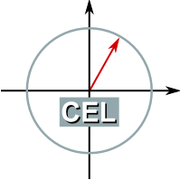
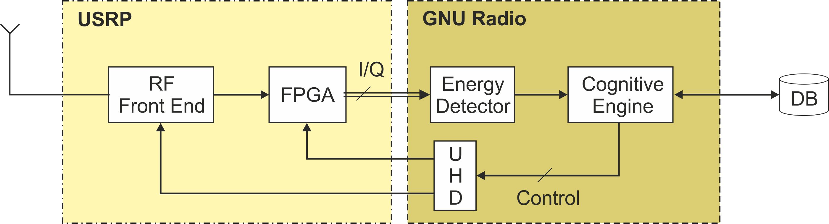
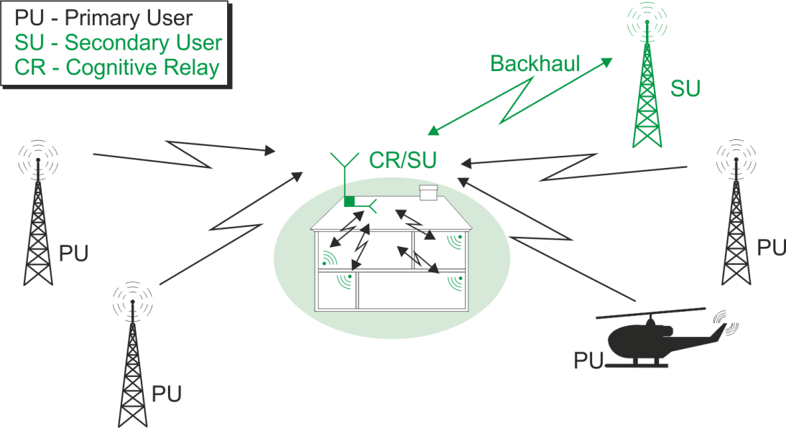


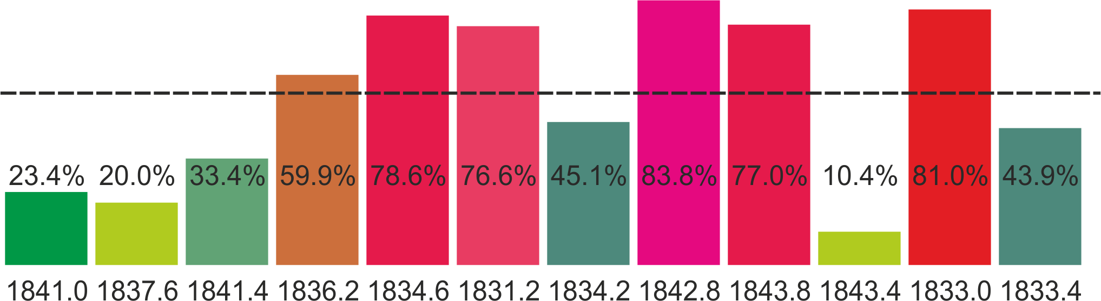

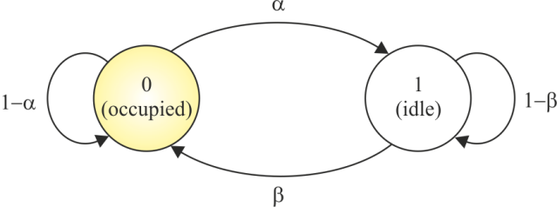
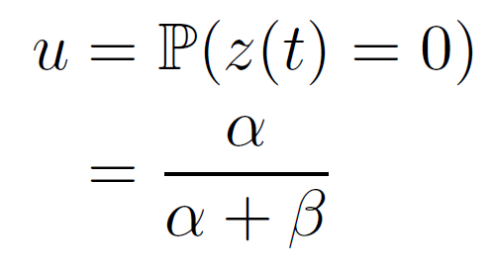
Cognitive Relay: Detecting Spectrum Holes in a Dynamic Scenario
Karlsruhe Institute of Technology
Communications Engineering Lab
Ankit Kaushik, Marcus Mueller and Friedrich K. Jondral
{ankit.kaushik, friedrich.jondral}@kit.edu, {marcus.mueller@kit.edu}
Introduction and Motivation
Cognitive radio illustrates a dynamic model that provides human intervention to the
underlying radio hardware.
Dynamic spectrum access (DSA) is one of the many applications of cognitive radio.
Main tasks for a DSA operating as secondary user (SU):
Realizes secondary access to the primary user (PU) spectrum.
Gathers information sensing and use it for intelligent access to the spectrum learning.
Avoid interference to the PU
Purpose of this work:
Realize the cognitive concepts over the hardware.
Implement simple algorithm to reduce the time and computational constraints
Test it in a real scenario
Implementation and User Interactions
Demonstrator Setup
Test scenario ➔→ GSM Channels at 1800MHz
Hardware ➔→ USRP N210
Implementing multiband sensing through scanning using a Software dened architecture ➔→ GnuRadioPerpendicular illumination
Analysis
Determination of spectral holes
Estimation of parameters (b; c )
Channel Ranking based on the u
System model
Cognitive Relay (CR) is network element of the SU system
Supports wireless services for devices operating indoor
Enables dynamic access to increase spectral eciency
Cross layer optimization
Receiver model
Energy detection
Learning
Modelling channel access model as discrete time discrete state Markov Process
PU subchannels N
Multiband Sensing through
subchannel scanning
Transitional Probability (a; b)
Channel ranking is decided
based on Utilization Probability
Scenario
T(Y) Test Statistics,
K Number of Samples,
Y [n] Received Waveform,
X[n] Transmitted Waveform,
W[n] Noise Waveform
^
^
Conclusion and Future Work
Cognitive radio implementation in a dynamic scenario
Potential to sense non-contiguous multiple band simultaneous over low cost hardware
Capable to learn and interact with its environment
Realizing other scenarios such as spatial separation of the PU and SU system through transmit power control
Utilization Probability

