Slide 1
Introduction

Slide 2
Serial
Peripheral
Interface

Slide 3

SCLK
SCLK
Slave
MOSI
MOSI
Master
( Sensor, EEPROM,
SDCARD,
Display,
Bluetooth,etc )
MISO
MISO
gpio1
$$\overline{ss}$$

Slide 4



SCLK
SCLK
MOSI
MOSI
Slave1
MISO
MISO
Master
gpio1
$$\overline{ss}$$
gpio2
gpio3
SCLK
MOSI
Slave2
MISO
$$\overline{ss}$$
SCLK
MOSI
Slave3
MISO
$$\overline{ss}$$
Notes:
Spi is an interface bus commonly used to send data between microcontrollers and small peripherals such as sensors, memory chips like sd cards,etc
It uses separate clock and data lines, along with a select line to choose the device you wish to talk to.
The side that generates the clock is called the “master”, and the other side is called the “slave”.
There is always only one master (which is almost always your microcontroller), but there can be multiple slaves.

Slide 5
Understanding SPI Pins and Protocol

Slide 6
SCLK
SCLK
MOSI
MOSI
Slave1
Master
MISO
MISO
$$\overline{ss}$$
gpio1
SCLK
gpio2
MOSI
Slave2
MISO
$$\overline{ss}$$
gpio3
SCLK
MOSI
Slave3
MISO
$$\overline{ss}$$
Notes:
SPI is a single-master communication protocol. This means that one central device initiates all the communications with the slaves,
generally SPI is restricted to one master, driving couple of slaves using corresponding slave select line.
– A clock signal named SCLK, sent from the bus master to all slaves;
A slave select signal for each slave, used to select the slave the master communicates with – A data line from the master to the slaves, named MOSI (Master Out-Slave In)
– A data line from the slaves to the master, named MISO (Master In-Slave Out).

Slide 7

SCLK
Master
SCLK
MOSI
Send
MOSI
Receive
MISO
MISO
gpio
$$\overline{ss}$$

Slide 8

Master to slave
Slave to Master
SCLK
1
1
0
0
1
1
0
0
0
0
0
0
0
0
0
0
MOSI
0
1
1
0
0
1
1
0
MISO
0
0
0
0
0
0
0
0
$$\overline{ss}$$
Notes:
SPI is a synchronous protocol, or you can say it uses a synchronous bus,
That means it uses separate lines for data and clock, and the design keeps both side I.e clock and data in a perfect sync.
The clock is an oscillating signal, that is always generated by master, which tells the receiver exactly when to sample the bits on the data line.

Slide 9
Master must know in advance when the slave needs to send the data back and how much data That slave wants to send, so that it can keep generating the clock for that many bytes of data.

Slide 10
SPI Hardware :Behind the scenes
Notes:
One reason that SPI is so popular is that the transmitting as well as the receiving hardware can be a simple shift register.

Slide 11
SPI Hardware :Behind the scenes
SCLK
Shift Register
Shift Register
MOSI
A7
A6
A5
A4
A3
A2
A1
A0
B7
B6
B5
B4
B3
B2
B1
B0
SCLK
Master
Slave
MISO

Slide 12
SPI Hardware :Behind the scenes
1
SCLK
Shift Register
Shift Register
MOSI
B0
A7
A6
A5
A4
A3
A2
A1
A0
B7
B6
B5
B4
B3
B2
B1
SCLK
Slave
Master
Slave
MISO

Slide 13
SPI Hardware :Behind the scenes
1
2
SCLK
Shift Register
Shift Register
MOSI
B1
B0
A7
A6
A5
A4
A3
A2
A1
A0
B7
B6
B5
B4
B3
B2
SCLK
Master
Slave
MISO

Slide 14
SPI Hardware :Behind the scenes
1
2
3
SCLK
Shift Register
Shift Register
MOSI
B2
B1
B0
A7
A6
A5
A4
A3
A2
A1
A0
B7
B6
B5
B4
B3
SCLK
Slave
Master
Slave
MISO

Slide 15
SPI Hardware :Behind the scenes
1
2
3
4
SCLK
Shift Register
Shift Register
MOSI
B3
B2
B1
B0
A7
A6
A5
A4
A3
A2
A1
A0
B7
B6
B5
B4
SCLK
Slave
Master
Slave
MISO

Slide 16
SPI Hardware :Behind the scenes
1
2
3
4
5
SCLK
Shift Register
Shift Register
MOSI
B4
B3
B2
B1
B0
A7
A6
A5
A4
A3
A2
A1
A0
B7
B6
B5
SCLK
Master
Slave
MISO

Slide 17
SPI Hardware :Behind the scenes
1
2
3
4
5
6
SCLK
Shift Register
Shift Register
MOSI
B5
B4
B3
B2
B1
B0
A7
A6
A5
A4
A3
A2
A1
A0
B7
B6
SCLK
Slave
Master
Slave
MISO

Slide 18
SPI Hardware :Behind the scenes
1
2
3
4
5
6
7
SCLK
Shift Register
Shift Register
MOSI
B6
B5
B4
B3
B2
B1
B0
A7
A6
A5
A4
A3
A2
A1
A0
B7
SCLK
Master
Slave
MISO

Slide 19
SPI Hardware :Behind the scenes
1
2
3
4
5
6
7
8
SCLK
Shift Register
Shift Register
MOSI
B7
B6
B5
B4
B3
B2
B1
B0
A7
A6
A5
A4
A3
A2
A1
A0
SCLK
Master
Slave
MISO

Slide 20
Significance of Clock Phase and Polarity

Slide 21
Clock Polarity(CPOL)

Slide 22
CPOL =0
CPOL =1
Notes:
CPOL parameter decides clock format to be used by the SPI bus,
there are 2 clock formats are permitted one is inverted and another one is non-inverted.
, the leading edge of the clock is rising, that means the first edge of the clock is rising in this case, and the trailing edge is falling. When the cplo is zero
, the leading edge of the clock is falling and the trailing edge is rising when the cpol is 1

Slide 23
Clock Phase(CPHASE)

Slide 24
CPHASE defines, When the data has to be toggled and when the adata has to be sampled on the data lines of the SPI !

Slide 25
Data toggling means, data transition to the next bit.
Data line
1
0
1
Data sampling means, sampling the data line to capture the data.
Clock
Data line
1
0
1

Slide 26
CPOL =1 CPHASE=1
MOSI
MISO
Notes:
“Data is always sampled on the trailing edge of the clock “.
So phase determines at which edge the data has to be sampled and at which edge the data has to be toggled. If it is 1 then data will be sampled on the trailing edge of the clock.

Slide 27
If CPHASE=1
Data will be sampled on the trailing edge of the clock.
If CPHASE=0
Data will be sampled on the leading edge of the clock.

Slide 28
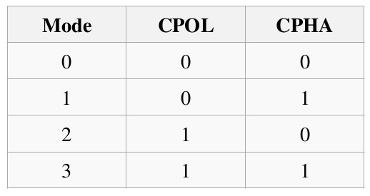
Different SPI Modes
Notes:
Put mode table picture

Slide 29
Different SPI Modes and Timing diagram

Slide 30
CPOL =0
PHASE =0
SCLK
MOSI
Hi-Z
Hi-Z
MISO
Hi-Z
Hi-Z
nSS
Sample

Slide 31
If CPHASE=1
Data will be sampled on the trailing edge of the clock.
If CPHASE=0
Data will be sampled on the leading edge of the clock.

Slide 32
CPOL =0
PHASE =1
SCLK
MOSI
Hi-Z
Hi-Z
MISO
Hi-Z
Hi-Z
nSS
Sample

Slide 33
CPOL =1
PHASE =0
SCLK
MOSI
Hi-Z
Hi-Z
MISO
Hi-Z
Hi-Z
nSS
Sample

Slide 34
CPOL =1
PHASE =1
SCLK
MOSI
Hi-Z
Hi-Z
MISO
Hi-Z
Hi-Z
nSS
Sample

Slide 35
Uni and Bi-Directional SPI
Notes:
This is just a different vendor’s customization on spi bus.
You know that typically spi has 4 pins, in which 2 lines are used to transmit and receive data.
So basically spi is a full duplex unidirectional bus.
But we can also use it bidirectional mode

Slide 36

Unidirectional: TX-RX
SCLK
SCLK
MOSI
MOSI
Slave
Master
MISO
MISO
gpio1
$$\overline{ss}$$
Notes:
these 2 lines are unidirectional with full duplex capability.

Slide 37


Unidirectional: TX Only
SCLK
SCLK
Slave
Master
MOSI
MOSI
MISO
MISO
$$\overline{ss}$$
$$\overline{ss}$$
Notes:
so you can save 1 pin which you can use for some other purpose.
Putting spi to tx only mode, actually disables the rcv functionality of the spi peripheral and makes that pin free so that it can be used for other purposes safely.
You microcontroller datasheet will tell you how you can put the spi in to tx only mode

Slide 38


Unidirectional: RX Only
SCLK
SCLK
Slave
Master
MOSI
MOSI
MISO
MISO
$$\overline{ss}$$
$$\overline{ss}$$
Notes:
Putting in to the rx only mode, actually disables the spi output function and frees the transmit I/O PIN ,

Slide 39


Unidirectional: TX-RX
SCLK
SCLK
MOSI
MOSI
Slave
Master
MISO
MISO
$$\overline{ss}$$
$$\overline{ss}$$
Notes:
Slave1

Slide 40


Bidirectional SPI
SCLK
SCLK
Slave
Master
MOSI/MISO
MOSI/MISO
$$\overline{ss}$$
$$\overline{ss}$$
Notes:
single line for both tx and rxing the data.
So this is basically half duplex, bidirectional mode.

Slide 41
Bidirectional SPI
SCLK
MISO/MOSI
SS
MOSI Phase
Bus
Direction
Swap
MISO Phase
Notes:
bus direction swap will occur at both master as well as slave side.

Slide 42
SPI Functional Block
Notes:
To transmit the data, the data has to be written to the tx buffer
When the shift register receives 1 complete byte it will transfer it to the rx buffer so that you can read it.

Slide 43
SPI Peripheral clock & Serial clock

Slide 44
So, Let’s find out what is the maximum Peripheral clock frequency at which our SPI peripheral can run if we use the internal RC(HIS) oscillator of 16Mhz as our system core clock.

Slide 45
HSI
16Mhz
HSE
PLL
/
APB 1 bus ( 42 Mhz Max)
f_{pclk = 16MHz}
Min Prescalar
= 2
SPI2/SPI3
8Mhz
/
SCLK
Notes:
Here HSI stands for High speed internal, which is nothing but our internal RC oscillator of 16 megahtz
HSE stands for HIGH speed external, which is external crystal based oscillator of 8 mega htz.
And PLL stands for Phase locked loop, which is clock boosting cirutitary present inside the MCU.
But by default, HIS, that is internal rc oscillator of 16megh htz will be selected

Slide 46
HSI
16Mhz
HSE
PLL
/
16mhz
APB 2 bus ( 84 Mhz Max)
f_{pclk = 16MHz}
Min Prescalar
= 2
SPI1
8Mhz
/
SCLK
Notes:
the maximum frequency at which spi1 peripheral can run is maximum apb2 clock divided by 2 which is 42mhz.

Slide 47
So, if we use the internal RC oscillator of 16Mhz as our system clock then SPI1/SPI2/SPI3 peripherals can able to produce the serial clock of maximum 8Mhz.

Slide 48
SPI Master TX/RX

Slide 49
SCK
MOSI
TXE
Low
TX Buffer
BSY flag
Low
MISO
RXNE flag
Low
RX
buffer

Slide 50
SCK
MOSI
HIGH
TXE
TX Buffer
BSY flag
Low
MISO
RXNE flag
Low
RX
buffer

Slide 51
SCK
MOSI
TXE
TX Buffer
BSY flag
Low
MISO
RXNE flag
Low
RX
buffer
Notes:
d1

Slide 52
SCK
MOSI
B0 b1 b2 b3 b4 b5 b6 b7
TXE
TX Buffer
BSY flag
MISO
B0 b1 b2 b3 b4 b5 b6 b7
RXNE flag
RX
buffer

Slide 53
SCK
MOSI
B0 b1 b2 b3 b4 b5 b6 b7
TXE
TX Buffer
BSY flag
MISO
B0 b1 b2 b3 b4 b5 b6 b7
RXNE flag
RX
buffer

Slide 54
SCK
MOSI
B0 b1 b2 b3 b4 b5 b6 b7
TXE
TX Buffer
BSY flag
MISO
B0 b1 b2 b3 b4 b5 b6 b7
RXNE flag
RX
buffer

Slide 55
SCK
MOSI
B0 b1 b2 b3 b4 b5 b6 b7
TXE
TX Buffer
BSY flag
MISO
B0 b1 b2 b3 b4 b5 b6 b7
RXNE flag
RX
buffer

Slide 56
SCK
MOSI
B0 b1 b2 b3 b4 b5 b6 b7
B0 b1 b2 b3 b4 b5 b6 b7
TXE
TX Buffer
BSY flag
MISO
B0 b1 b2 b3 b4 b5 b6 b7
b0 b1 b2 b3 b4 b5 b6 b7
RXNE flag
RX
buffer

Slide 57
SCK
MOSI
B0 b1 b2 b3 b4 b5 b6 b7
B0 b1 b2 b3 b4 b5 b6 b7
TXE
TX Buffer
BSY flag
MISO
B0 b1 b2 b3 b4 b5 b6 b7
b0 b1 b2 b3 b4 b5 b6 b7
RXNE flag
RX
buffer

Slide 58
SCK
MOSI
B0 b1 b2 b3 b4 b5 b6 b7
B0 b1 b2 b3 b4 b5 b6 b7
TXE
TX Buffer
BSY flag
MISO
B0 b1 b2 b3 b4 b5 b6 b7
b0 b1 b2 b3 b4 b5 b6 b7
RXNE flag
RX
buffer

Slide 59
SCK
MOSI
B0 b1 b2 b3 b4 b5 b6 b7
B0 b1 b2 b3 b4 b5 b6 b7
b0 b1b2 b3 b4 b5 b6 b7
TXE
TX Buffer
BSY flag
MISO
B0 b1 b2 b3 b4 b5 b6 b7
b0 b1 b2 b3 b4 b5 b6 b7
b0 b1b2 b3 b4 b5 b6 b7
RXNE flag
RX
buffer

Slide 60
SCK
MOSI
B0 b1 b2 b3 b4 b5 b6 b7
B0 b1 b2 b3 b4 b5 b6 b7
b0 b1b2 b3 b4 b5 b6 b7
TXE
TX Buffer
BSY flag
MISO
B0 b1 b2 b3 b4 b5 b6 b7
b0 b1 b2 b3 b4 b5 b6 b7
b0 b1b2 b3 b4 b5 b6 b7
RXNE flag
RX
buffer

Slide 61
SPI Slave TX/RX

Slide 62
SCK
MOSI
TXE
Low
TX Buffer
BSY flag
Low
MISO
RXNE flag
Low
RX
buffer

Slide 63
SCK
MOSI
HIGH
TXE
TX Buffer
BSY flag
Low
MISO
RXNE flag
Low
RX
buffer

Slide 64
SCK
MOSI
b0 b1 b2 b3 b4 b5 b6 b7
TXE
TX Buffer
BSY flag
MISO
b0 b1 b2 b3 b4 b5 b6 b7
RXNE flag
RX
buffer

Slide 65
SCK
MOSI
b0 b1 b2 b3 b4 b5 b6 b7
b0 b1 b2 b3 b4 b5 b6 b7
TXE
TX Buffer
BSY flag
MISO
b0 b1 b2 b3 b4 b5 b6 b7
b0 b1 b2 b3 b4 b5 b6 b7
RXNE flag
RX
buffer

Slide 66
SCK
MOSI
b0 b1 b2 b3 b4 b5 b6 b7
b0 b1 b2 b3 b4 b5 b6 b7
b0 b1 b2 b3 b4 b5 b6 b7
TXE
TX Buffer
BSY flag
MISO
b0 b1 b2 b3 b4 b5 b6 b7
b0 b1 b2 b3 b4 b5 b6 b7
b0 b1 b2 b3 b4 b5 b6 b7
RXNE flag
RX
buffer

Slide 67
SPI Driver Development: Introduction

Slide 68
Overview

Slide 69
Sample Applications
SPI Driver
Startup & CMSIS APIs
SPI1
SPI2
SPI3
SPIx
STM32F4xx Microcontroller

Slide 70
Understanding Driver API Requirements

Slide 71
APIs
SPI Initialization
SPI Master TX(non-blocking)
SPI Master RX(non-blocking)
SPI Driver
SPI Slave TX(non-blocking)
SPI Slave RX(non-blocking)
SPI Interrupt handling

Slide 72
Exploring different SPI Peripherals and pins of the MCU

Slide 73
SPIx | Pin Pack 1 |  |  | Pin pack 2 |  |  | Pin pack 3 |  |  | Bus
 | MOSI | MISO | SCK | MOSI | MISO | SCK | MOSI | MISO | SCK
SPI1 | PA7 | PA6 | PA5 | PB5 | PB4 | PB3 |  |  |  | APB2
SPI2 | PC3 | PC2 | PB10 | PB15 | PB14 | PB13 | PI3 | PI2 | PI0 | APB1
SPI3 | PB5 | PB4 | PB3 | PC12 | PC11 | PC10 |  |  |  | APB1

Slide 74
Firmware Write
0xAB
Data Register
APB1/APB2
Read
Rx buffer
Shift Register
TX buffer
Write

Slide 75
Firmware Write
0xAB
Data Register
APB1/APB2
Read
Rx buffer
Shift Register
TX buffer
Write

Slide 76
Firmware Read
Data Register
APB1/APB2
Read
Rx buffer
0xAB
Shift Register
TX buffer
Write

Slide 77
Configuring NSS

Slide 78

SCLK
SCLK
MOSI
MOSI
MISO
MISO
Master
Slave
gpio1
$$\overline{Nss}$$
Notes:
these 2 lines are unidirectional with full duplex capability.

Slide 79
In STM32F4xx based microcontroller, the NSS pin can be handled by 2 ways
Software Slave Management
Hardware Slave Management
Notes:
Software Slave Management
H

Slide 80

Software Slave Management
NSS Pin state is handled by ‘SSI’ bit in the CR1 register
SCLK
MOSI
If SSI bit = 1 , then NSS goes HIGH
+VCC
MISO
SSI=1
Slave
$$\overline{Nss}$$

Slide 81
Software Slave Management
NSS state is handled by ‘SSI’ bit in the CR1 register
SCLK
MOSI
If SSI bit = 1 , then NSS goes HIGH
If SSI bit = 0, then NSS goes LOW
MISO
SSI=0
Slave
$$\overline{Nss}$$

Slide 82
Software Slave Management
NSS state is handled by ‘SSI’ bit in the CR1 register
SCLK
MOSI
If SSI bit = 1 , then NSS goes HIGH
If SSI bit = 0, then NSS goes LOW
MISO
SSI bit is the handle for the software to control the NSS pin !
Slave
$$\overline{Nss}$$

Slide 83
So, What is the advantage of using Software Slave Management(SSM) ?

Slide 84

Saves PIN
SCLK
SCLK
MOSI
MOSI
MISO
MISO
Master
Slave
gpio1
$$\overline{Nss}$$
Master need not use its another pin to drive the NSS pin low, that saves one pin for master.
NSS pin is handled by SSI bit
of Control register by software

Slide 85
What is Hardware slave Management?

Slide 86



SCLK
SCLK
MOSI
MOSI
Slave1
MISO
MISO
Master
gpio1
$$\overline{Nss}$$
gpio2
gpio3
SCLK
MOSI
Slave2
MISO
$$\overline{Nss}$$
SCLK
MOSI
Slave3
MISO
$$\overline{Nss}$$
Notes:
SPI is a single-master communication protocol. This means that one central device initiates all the communications with the slaves,
generally SPI is restricted to one master, driving couple of slaves using corresponding slave select line.
– A clock signal named SCLK, sent from the bus master to all slaves;
A slave select signal for each slave, used to select the slave the master communicates with – A data line from the master to the slaves, named MOSI (Master Out-Slave In)
– A data line from the slaves to the master, named MISO (Master In-Slave Out).

Slide 87
Implementing Master rx API
If master wants read something form the slave, it has to produce clock , and to produce clock Master has to place some data in to the tx buffer by writing some dummy bytes.

Slide 88
Implementing slave tx api
Slave can not do Tx, until master produces clock
Whenever you are in SPI slave mode and want to send some data, then slave must be ready with the data before master produces the clock.

Slide 89
SPI Interrupting the Processor
SPI_1
NVIC
Processor Core
SPI_2
SPI_3
ARM Cortex M4
MCU
Notes:
SPI interrupting the Processor

Slide 90
Handling SPI interrupt in the Code
Got interrupt from SPI
Decode the interrupt using Status register
Interrupt is due to setting of RXNE flag
Interrupt is due to setting of TXE flag
Interrupt is due Setting of ERROR flag
Handle RXNE interrupt
Handle TXE interrupt
Handle Error

Slide 91
Handling TXE interrupt
Handle TXE interrupt
8 bit or 16 bit mode?
8bit
16bit
Write one byte to SPI Data register(DR)
Write 2 byte to SPI Data register(DR)
Tx Count--
Tx Count --
Tx Count --
Count = 0 ?
No
Yes
Close the SPI TX
Wait till another TXE interrupt

Slide 92
Master Sending Write CMD and Data Stream to Slave
Master
Slave
Master Send Write CMD
Master gets ACK bytes
Verify ACK
Master Sends Data Stream
Pass
Fail
Blink RED LED
Verify Data Stream
Blink BlueLED
Pass
Blink RED LED
Fail

Slide 93
Master Sending Read CMD and Receiving Data Stream From Slave
Master
Slave
Send Read CMD
Master gets ACK bytes from slave
Verify ACK
Master gets data stream from slave
Pass
Fail
Blink RED LED
Verify Data Stream
Pass
Blink BlueLED
Fail
Blink RED LED
Notes:
Receiving

Slide 94
Master Write CMD Execution
Master sends out the Write CMD
Slave ACK back for the command
If ACK is valid, then Master sends out the Data stream of known length
Master Read CMD Execution
Master sends out the Read CMD
Slave ACK back for the command
If ACK is valid , then Master gets the data stream from the slave of known length.

Slide 95
We selected spi2 device,
The clock will run at 500KHz
Data format is 8bit MSbfirst
Spi mode is 0, because CPOL and CPHASE are 0
The peripheral acts as master device.

Slide 96
SPI Master Initialization
We selected SPI2 device.
SPI serial line clock will run at 500KHz
Data format is 8bit msb first
SPI mode is 1, because CPO=0 and CPHASE=1
The peripheral acts as master device
SPI peripheral clock is 16Mhz, because we are running MCU at 16Mhz Internal RC Oscillator

Slide 97

Common Debugging Steps
Master mode bit must be enabled in the configuration register if you are making peripheral to work in MASTER mode.
SPI peripheral enable bit must be enabled
SPI peripheral clock must be enabled

Slide 98

Common Problems in SPI and
Debugging Tips

Slide 99
Case 1
Master Can not able to produce clock and data

Slide 100
Case 1: Master cannot able to produce
clock and data
Reason-1:
Non-Proper Configuration of I/O lines for Alternate functionality
Debug Tip:
Recheck the GPIO Configuration registers to see what values they have

Slide 101
Case 1: Master cannot able to produce
clock and data
Reason-2:
Configuration Overriding
Debug Tip:
Dump out all the required register contents just before you begin the transmission
Notes:
Non-Proper Configuration of I/O lines for alternate functionality

Slide 102
Case 2
Master is sending data, but slave is not receiving data !

Slide 103
Case 2: Master is sending data but
slave is not receiving data !
Reason-1:
Not pulling down the slave select pin to ground before sending data to the slave
Debug Tip:
Probe through the logic analyzer to confirm slave select line is really low during data communication

Slide 104
Case 2: Master is sending data but
slave is not receiving data !
Reason-2 :
Non-Proper Configuration of I/O lines for Alternate functionality
Debug Tip:
Probe the alternate function register

Slide 105
Case 2: Master is sending data but
slave is not receiving data !
Reason-3 :
Non enabling the peripheral IRQ number in the NVIC
Debug Tip:
Probe the NVIC Interrupt Mask register to see whether the bit position corresponding to the IRQ number is set or not

Slide 106
Case 3
SPI interrupts are not getting triggered

Slide 107
Case 3: SPI interrupts are not getting triggered
Reason-1 :
Not enabling the TXE or RXNE interrupt in the SPI configuration register
Debug Tip:
Check the SPI configuration register to see TXEIE and RXNEIE bits are really set to enable the interrupt !

Slide 108
Case 3: SPI interrupts are not getting triggered
Reason-2:
Non enabling the peripheral IRQ number in the NVIC
Debug Tip:
Probe the NVIC Interrupt Mask Register to see whether the bit position corresponding to the IRQ number is set or not

Slide 109
Case 4
Master is producing right data but slave is receiving the different data

Slide 110
Case 4: Master is producing right data
but slave is receiving the different data
Reason-1 :
Using Long Wires in high frequency communication
Debug Tip:
use shorter wires or reduce the SPI serial frequency to 500KHz to check things work well

Slide 111
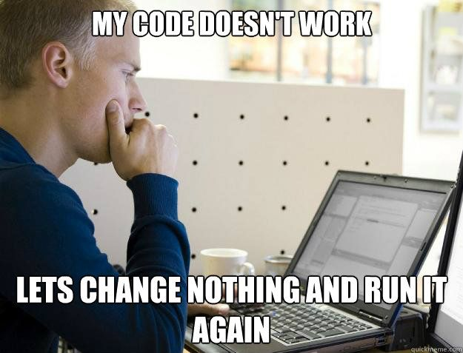
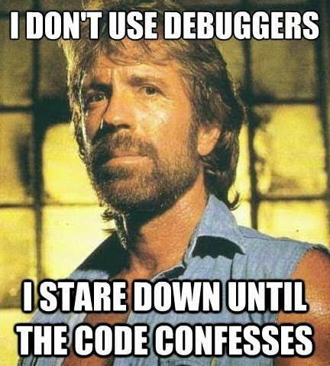

Slide 112
SCLK
SCLK
MOSI
MOSI
Slave1
Master
MISO
MISO
gpio1
$$\overline{Nss}$$
gpio2
gpio3
SCLK
MOSI
Slave2
MISO
$$\overline{Nss}$$
SCLK
MOSI
Slave3
MISO
$$\overline{Nss}$$

Slide 113
Cross Check These Settings
Master mode bit must be enabled in the configuration register if you are configuring the peripheral as master
SPI peripheral enable bit must be enabled .
SPI peripheral clock must be enabled. By default clocks to almost all peripheral in the microcontroller will be disabled to save power.

Slide 114
Clock Sources in the MCU
High Speed Internal (HSI) oscillator
High Speed External (HSE) oscillator
Phase Locked Loop (PLL)
Low Speed Internal (LSI) clock
Low Speed External (LSE) clock

Slide 115
Clock Sources in the MCU
HSI
PLLN
X
SysClk
AHB
16MHz
PLLM
PLLP
AHB
/
/
VCO
/
HSE
APB1
/
8 – 26 MHz
PLLQ
/
APB2
PLL
/
USB OTG,SDIO,etc

Slide 116
The HSI RC oscillator which is inside the MCU has the advantage of providing a clock source at low cost . Because there is no external components required to use this clock. It also has a faster start-up time than the external crystal oscillator however, the frequency is less accurate than an external crystal oscillator.

Slide 117
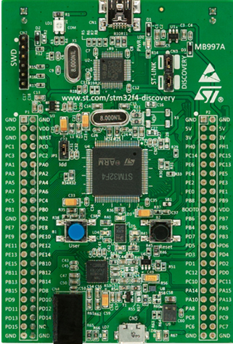
STM32F4xx Discovery board

Slide 118
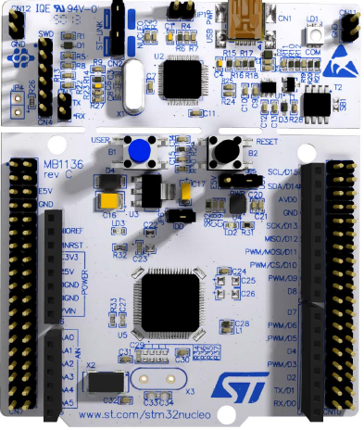
STM32F411RE Nucleo-64

Slide 119
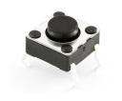
Connection Diagram
SPI2
SPI2
SCLK(PB13)
SCLK(PB13)
MISO(PB14)
MISO(PB14)
MOSI(PB15)
MOSI(PB15)
NSS
USER button
STM32F4 discovery
GND
GND
STM32F4 discovery
Master
Slave

Slide 120
How to enable the High Speed External Crystal Oscillator and use it as System Clock ?

Slide 121
Let’s measure the frequency of different clock sources like HSI,HSE,PLL by using USB logic Analyzer !

Slide 122
Connection between USB Logic Analyzer and Discovery board

Slide 123
Understanding Connection Diagram

Slide 124
USB Logic analyzer
To PC
GND
CH2
CH1
CH0
SPI2
SPI2
SCLK(PB13)
SCLK(PB13)
MISO(PB14)
MISO(PB14)
MOSI(PB15)
MOSI(PB15)
USER button
STM32F4 discovery
GND
GND
STM32F4 discovery
Master
Slave

