Slide 1
GPIO Must Know Concepts !

Slide 2
Section Takeaways !
This section has totally 7 lectures
You will learn about behind the scene implementation about GPIO pin and GPIO port
GPIO Input mode configurations like HIGH-Z , pull-up,pull-down state
You will learn about different GPIO output Configurations like Open drain, pushpull , etc.
You will learn about I/O power optimization

Slide 3
GPIO Pin and GPIO Port

Slide 4
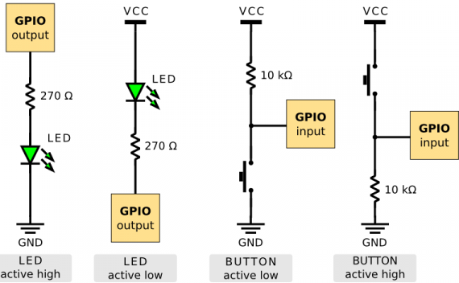
General Purpose Input
Output

Slide 5
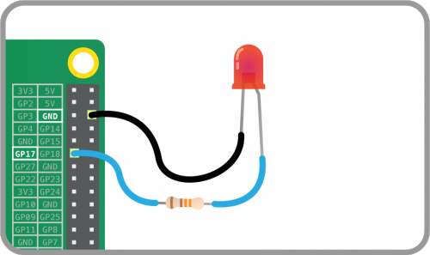

Slide 6



GPIOs typically used for

Slide 7
Let’s begin with some of the must know concepts in GPIO. These concepts are generic and can be applied to any microcontroller you have !

Slide 8

PA.0
GPIO Port A
PA.1
PA.15
Port ‘A’ having many pins
Port ‘Soller Town’ having many boats

Slide 9

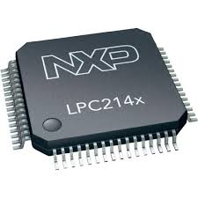
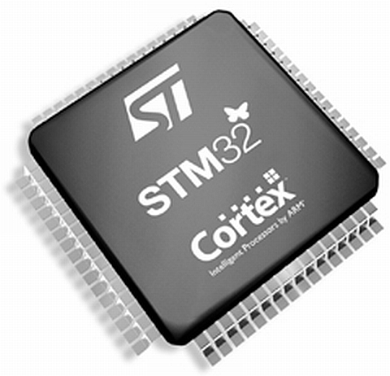
Each port have
8 i/o pins
Each port have
32 i/o pins
Each port have
16 i/o pins

Slide 10
GPIO Pin Behind the Scene

Slide 11
How does a GPIO pin is actually implemented inside the MCU?

Slide 12
Enable Line
Pin
Output buffer
Input buffer
YOUR MCU

Slide 13
+VCC
Enable Line
source
Output buffer
gate
T1
Pin
PMOS
Pin
drain
T2
Input buffer
NMOS
gate
source
MCU
GND

Slide 14
Enable Line
Output buffer
+VCC
Pin
S
T1
P
Pin
G
Input buffer
D
T2
N
S
MCU

Slide 15
Enable Line
+VCC
Output buffer
+VCC
Pin
S
T1
P
Pin
G
Input buffer
D
T2
N
S
MCU

Slide 16
Enable Line
Output buffer
+VCC
Pin
S
T1
P
Pin
G
Input buffer
D
T2
N
S
MCU

Slide 17
GPIO INPUT MODE High Impedance(HI-Z) State

Slide 18
Let’s understand, what exactly is this High Impedance state, that people talk about when the pin is in input mode ??
High impedance is also called as HI-Z state

Slide 19
+VCC
S
T1
P
Floating=Hi-Z
Pin
D
G
T2
N
Input Not Fixed
S
GND
GND

Slide 20
GPIO INPUT MODE Pull-Up/Pull-Down State

Slide 21
+Vcc
Input Buffer
Pin
Input Buffer
R_{i}
Pin
R_{e}
GND

Slide 22
GPIO OUTPUT MODE Open-drain State

Slide 23
+VCC
S
T1
P
Pin
G
D
T2
N
S
GND

Slide 24
+VCC
S
T1
P
Pin
G
D
T2
N
S
GND

Slide 25
GPIO OUTPUT MODE Open drain with Pull-Up

Slide 26
+VCC
+VCC
R_{i}
R_{e}
Pin
Pin
D
D
G
P
G
P
S
S
GND
GND
Open drain with internal pull up
Open drain with External pull up

Slide 27
Practical Usage -1
How to drive a LED from
Open drain GPIO Pin ??

Slide 28
Driving LED’s
+VCC
+VCC
R
R
Pin
Pin
D
D
LED
LED
G
N
G
N
S
S
GND
GND
GND
GND
Using Internal Pull-up
Using External Pull-up

Slide 29
Practical Usage -2
Driving I2C bus

Slide 30
+Vcc
I2C Bus
SDA
Pull-Up
SCL
Pull-Up
Serial Data Line(SDA)
Pin
Serial Clock line(SCL)
Pin
MCU
SCL Rx
SDA Rx
SCL Tx
D
SDA Tx
D
G
N
G
N
S
S
GND
GND

Slide 31
GPIO OUTPUT MODE Push-Pull State

Slide 32
Output Mode with Push-Pull Configuration
+VCC
S
P
T1
Pin
G
D
N
T2
S
GND

Slide 33
+VCC
+VCC
R_{i}
R_{e}
Pin
Pin
D
D
G
P
G
P
S
S
GND
GND
Open drain with internal pull up
Open drain with External pull up

Slide 34
How to drive a LED from Push-Pull GPIO Pin ??

Slide 35
+VCC
S
P
T1
Pin
G
D
N
T2
S
R
GND
LED
GND

Slide 36
Discovery Board LED Connection
+VCC
S
P
T1
PD12
G
D
Pin
N
T2
S
R
GND
LED_GREEN

Slide 37
Optimizing IO Power Consumption
Leakage Mechanism By Input Pin Floating

Slide 38
Fixed to High
MCU
+VCC
+VCC
MCU
+VCC
S
S
T1
P
T1
Pin
P
Pin
D
G
D
G
T2
N
T2
GND
N
S
S
Fixed to Low
GND
GND

Slide 39
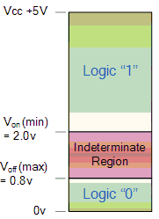
Voltage of input
is not fixed
MCU
+VCC
May be 0.5Vcc
or 0.3Vcc
Input Logic Level
S
T1
P
Pin
D
G
T2
N
S
GND
GND

Slide 40


Valve opened
partially
Valve Closed
No water flows
Water Tickles out

Slide 41
GPIO Programming Structure

Slide 42
BUS
Port Direction(Mode) register
I/O
PORT
Port Speed Register
Port output type Register
MCU
I/0 Pins
Some other configuration Register
Port OutPut Data Register
Port Input Data Register

Slide 43
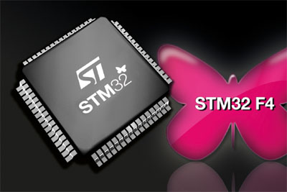
In STM32F4xx series of microcontrollers, each GPIO port is governed by many configuration registers.

Slide 44
Exploring GPIO Port and Pins On the Discovery board

Slide 45
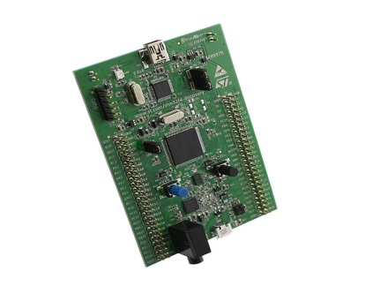
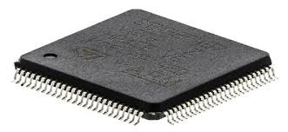
STM32F407VG
GPIOA
GPIOA
GPIOB
GPIOB
GPIOC
Each port will have its
Own set of configuration
registers
GPIOC
GPIOD
GPIOD
GPIOE
GPIOE
GPIOF
GPIOG
GPIOH
GPIOI

Slide 46
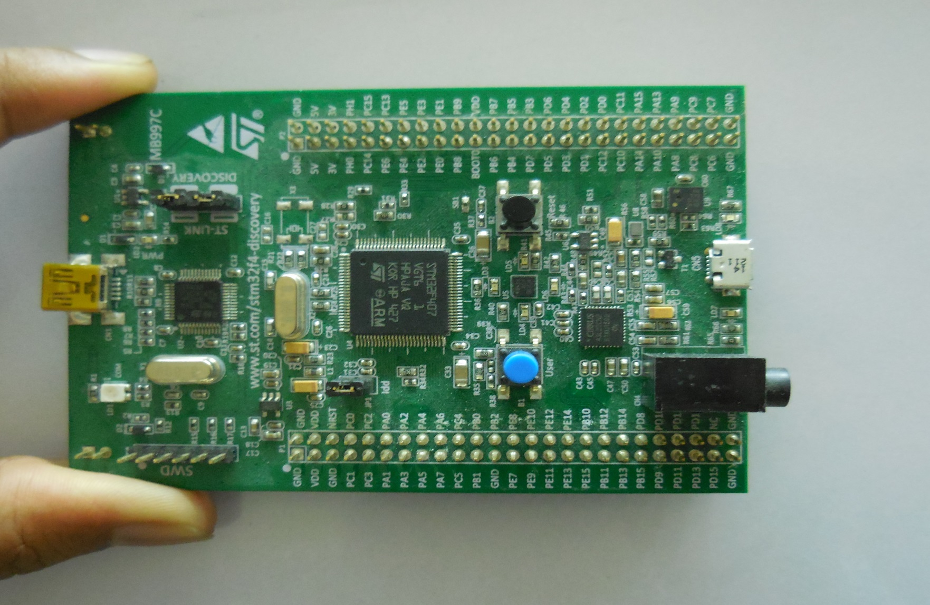

Slide 47
GPIO Port MODE Register

Slide 48
Before using any GPIO, you must decide its MODE. Whether you want to use it as Input, Output or for any analog purposes

Slide 49
GPIO Port Output Type Register

Slide 50
When a GPIO pin is in the output mode, this register is used to choose the output type

Slide 51
GPIO Port Speed Register

Slide 52
Why do we have a speed
setting for an I/O pin?
To save Power

Slide 53
By using speed register you can configure “how quick the GPIO transition”

Slide 54
Lets Assume:
Main system clock of MCU = 48MHz, Then
fastest toggle speed for the GPIO on this MCU = 24MHz
12Mhz

Slide 56
To be able to work with any peripheral in a MCU , first you have to make sure that its peripheral Clock (f_{pclk)} is enabled

Slide 57
In STM32F4xx MCU, there is a RCC block which manages clocks for almost all peripheral, RCC stands for Reset and Clock Control

Slide 58
GPIO Port Pull-Up/Pull-Down Register
Notes:
The internal pull-up and pull down resistors can be configured on GPIO pins which are in input or output mode.
No pull-up, pull-down, it means, internal pull-up resistor or pull down resistor are deactivated
Pull up: it means, pull up resistor is activated
Pull down: it means, only pull down resistor is activated

Slide 59
GPIO Port Input Data Register
Notes:
reading this register gives the, voltage levels of all the I/O pins of a GPIO port

Slide 60
GPIO Port Output Data Register

Slide 61
GPIO Port Alternate Function Register

Slide 62
What are those 16 different
alternate functionalities a I/O
Pin can have ??

Slide 63
Enabling /Disabling GPIO Port Peripheral Clock
Notes:
To be able to work with GPIO or any other peripheral, you have to first enable the peripheral clock for the gpio port in the RCC register which stands for (Reset and Clock Control).
GPIO PORT is also a peripheral and it is connected to AHB1 bus.
the peripheral clock of the GPIO port is derived from the AHB1 BUS clock
By default the peripheral clock of almost all peripherals are disabled to save power, so it’s important to enable the clock before configuring and using any peripheral.

Slide 64
GPIO Driver Development: Getting Started !!!

Slide 65
Overview of the Driver Development Task

Slide 66
Overview of the Driver Development Task
Sample Applications
GPIO Driver
Startup & CMSIS APIs
GPIOA
GPIOB
GPIOC
GPIOx
STM32F4xx Microcontroller

Slide 67
Understanding Driver API Requirements

Slide 68
Driver API Requirements
APIs
GPIO initialization
Enable/Disable GPIO port clock
GPIO Driver
Read From a GPIO Pin
Write to GPIO Pin
Configure alternate functionality
Interrupt Handling

Slide 69
GPIO Driver Development: Explore MCU Specific Header File !!!

Slide 70
Preparing/Organizing Project files in KEIL

Slide 71
Locating MCU Specific Header File

Slide 72
Exploring MCU Specific Header File

Slide 73
GPIO Driver Development: Driver Header File !!!

Slide 74
Implementing
Driver Header file

Slide 75
Note:
Remember, it is always encouraged to write header file first, before attempting to write a source file.

Slide 76
GPIO Driver Development: Implementing Init API !

Slide 77
Code to Configure the MODE

Slide 78
Code to Configure GPIO Speed and Output Type

Slide 79
Writing Init function to configure the LED

Slide 80
Implementing GPIO read API

Slide 81
Code Implementation to Turn On/Off/Toggle LED

Slide 82
Testing the Sample Application
on development board

Slide 83
Testing LED behaviour on logic analyser Software

Slide 84
Exploring How peripherals Interrupts the processor via NVIC

Slide 85
Test Interrupt Handling APIs by using button

Slide 86
Implementing APIs to Configure and Enable External Interrupts

Slide 87
Adding Interrupt Handling APIs to our driver

Slide 88
Vector table and IRQ handlers

Slide 89
Clearing External Interrupt

Slide 90
Implementing GPIO Write API

Slide 91
Code to Configure Alternate function for GPIO

Slide 92
Code to configure GPIO pull-up/pull down Resistor

Slide 93
Setting the Alternate Functionality to GPIO pin lets you to use GPIO pin for different peripheral operations such as SPI, I2C, UART, etc.
Remember every GPIO pin can be set to 16 different alternate functions

Slide 94
We Completed:
GPIO Init API
GPIO Read API
GPIO Write API
To-do:
GPIO Interrupt Handling

Slide 95
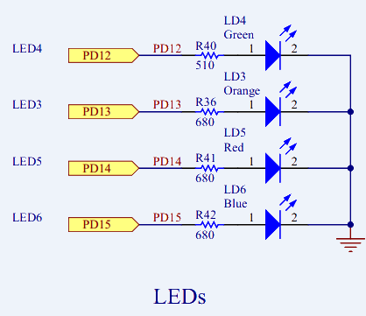
Discovery Board LEDs

Slide 96
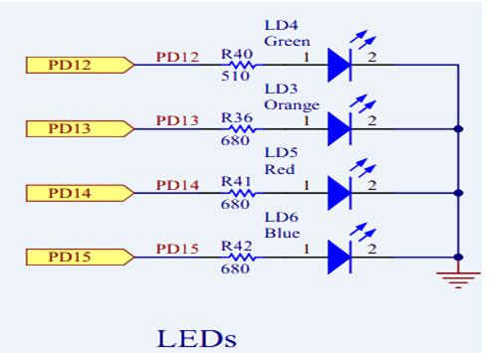
USB Logic
Analyzer
CH3
CH1
CH2
CH0
GND
GND

Slide 97
How GPIO Peripheral
Interrupts the Processor !!! ?

Slide 98
Exception #16 is ext Interrupt #0
Various external peripherals like
(Timers
ADC
Watchdog
SPI
I2C
Etc)
Interrupt #0
N
V
I
C
Exception Number
16
17
18
19
.
.
.
255
Interrupt#1
NVIC lines
Interrupt #2
Processor core
Interrupt #3
System
Exception
Interrupt #239
ARM cortex-M4
Notes:
nvic block of the processor supports up to 255 exceptions
Out of which 15 are internal system exceptions
and 240 are external exceptions. External exceptions are also called as extenrla interrupts.

Slide 99
N
V
I
C
Some Peripherals including GPIO
External Interrupt Controller Block
(exti)
Processor core
ARM Cortex M4
MCU

Slide 100
External Interrupt Controller Block
(exti)
exti0
N
V
I
C
exti1
Processor core
exti2
exti21
exti22
ARM Cortex M4
EXTI Register sets
Notes:
, NVIC and exit controller are connected over 23 lines and each line carries interrupt for one particular peripheral.
out of 23 lines of 16 lines are for gpio ports for issuing the interrupt to the processor core via NVIC.

Slide 101
GPIO,
RTC Alarm,
USB OTG FS Wakeup, Ethernet Wakeup event
External Interrupt Controller Block
(exti)
N
V
I
C
23
23
EXTI Register sets
I2C, SPI,USART,DMA,USB,etc
SPI
I2C
USART
Etc…..
Notes:
, NVIC and exit controller are connected over 23 lines and each line carries interrupt for one particular peripheral.
out of 23 lines of 16 lines are for gpio ports for issuing the interrupt to the processor core via NVIC.

Slide 102

Button
Interrupt #0
EXTI interrupt mask register
PA0
PB0
PC0
PD0
PE0
PF0
PG0
PH0
PI0
N
V
I
C
16
17
22
.
.
.
.
Interrupt #1
EXTI0
EXTI interrupt pending register
EXTI0
Processor
core
Multiplexer
EXTI interrupt edge selection register
Interrupt #239
EXTI[3:0] bits in the
SYSCFG_EXTICR1 register
EXTI Controller
ARM Cortex M4
Notes:
To find out the irq numbers, you have to refer to the vector table given by your MCU vendor.
exit line 0 is connected to the NVIC at position 6, in other words, IRQ number of the ext line 0 is 6.
Similarly, exti1 is connected to nvic line number or position 7, so its IRQ number is 7

Slide 103
Button
Interrupt #0
EXTI interrupt mask register
PA0
PB0
PC0
PD0
PE0
PF0
PG0
PH0
PI0
N
V
I
C
16
17
22
.
.
.
.
Interrupt #1
EXTI0
EXTI interrupt pending register
EXTI0
Interrupt #6
Processor
core
Multiplexer
EXTI interrupt edge selection register
Interrupt #239
EXTI[3:0] bits in the
SYSCFG_EXTICR1 register
EXTI Controller
ARM Cortex M4
Notes:
To find out the irq numbers, you have to refer to the vector table given by your MCU vendor.
exit line 0 is connected to the NVIC at position 6, in other words, IRQ number of the ext line 0 is 6.
Similarly, exti1 is connected to nvic line number or position 7, so its IRQ number is 7

Slide 104

Button
Interrupt #0
N
V
I
C
16
17
.
22
.
.
255
PA0
PB0
PC0
PD0
PE0
PF0
PG0
PH0
PI0
Interrupt #1
EXTI0
Processor
Multiplexer
Interrupt #239
EXTI[3:0] bits in the
SYSCFG_EXTICR1 register
ARM Cortex M4
Exti Controller
STM32F4xx MCU
Notes:
To find out the irq numbers, you have to refer to the vector table given by your MCU vendor.
exit line 0 is connected to the NVIC at position 6, in other words, IRQ number of the ext line 0 is 6.
Similarly, exti1 is connected to nvic line number or position 7, so its IRQ number is 7

Slide 105
Button
Interrupt #0
N
V
I
C
16
17
.
22
.
.
255
PA0
PB0
PC0
PD0
PE0
PF0
PG0
PH0
PI0
Interrupt #1
EXTI0
Interrupt #6
Processor
Multiplexer
Interrupt #239
EXTI[3:0] bits in the
SYSCFG_EXTICR1 register
ARM Cortex M4
Exti Controller
STM32F4xx MCU
Notes:
To find out the irq numbers, you have to refer to the vector table given by your MCU vendor.
exit line 0 is connected to the NVIC at position 6, in other words, IRQ number of the ext line 0 is 6.
Similarly, exti1 is connected to nvic line number or position 7, so its IRQ number is 7

Slide 106
Vector table and irq handlers
Notes:
when the interrupt occurs on a particular IRQ number, the processor just picks up the address of IRQ handler by the corresponding vector address.

Slide 107
GPIO IRQ Numbers

Slide 108

Button
EXTI interrupt mask register
Interrupt #0
PA0
PB0
PC0
PD0
PE0
PF0
PG0
PH0
PI0
N
V
I
C
16
17
.
22
.
.
.
.
.
Interrupt #1
EXTI0
EXTI interrupt pending register
EXTI0
Interrupt #6
Processor
core
Multiplexer
EXTI interrupt edge selection register
Interrupt #239
EXTI Controller
ARM Cortex M4
EXTI[3:0] bits in the
SYSCFG_EXTICR1 register
Notes:
To find out the irq numbers, you have to refer to the vector table given by your MCU vendor.
exit line 0 is connected to the NVIC at position 6, in other words, IRQ number of the ext line 0 is 6.
Similarly, exti1 is connected to nvic line number or position 7, so its IRQ number is 7

Slide 109
0
EXTI0
0
EXTI1
0
0
0
0
EXTI
Controller
EXTI Interrupt Pending Register
NVIC
Processor
Core
0
0
0
EXTI23
EXTI Controller

Slide 110
1
EXTI0
0
EXTI1
0
0
Button interrupt on EXTI0
0
0
EXTI Interrupt Pending Register
NVIC
Processor
Core
0
0
ISR of EXTIx
0
EXTI23
Clear the pending bit
EXTI Controller

Slide 111
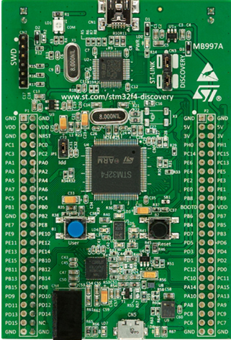
STM32F4xx Discovery board

Slide 112
Probing LED Toggling using USB Logic Analyzer
USB Logic analyzer
To PC
GND
CH1
CH0

