Slide 1
Introduction to I2C

Slide 2
Inter–Integrated Circuit(I2C) Protocol
Pronounced As
“I squared C “ or “ I two C “

Slide 3
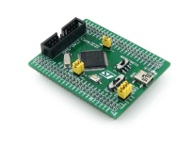
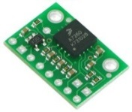
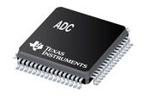
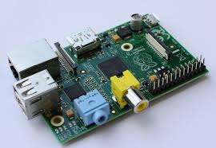
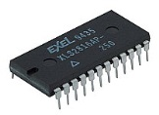
+vcc
R1
R2
SCL
SDA
Master-1
Slave
Slave
Slave
Master-2
STM32
Accelerometer
ADC
EEPROM
Rasp PI

Slide 4
How different than SPI ?

Slide 5


How different than SPI ?
Multi-Master Capability
I2C protocol is multi-master capable ,
whereas SPI is not.

Slide 6
How different than SPI ?
Hardware ACK
I2C supports hardware ACK
SPI is not.

Slide 7
How different than SPI ?
Complexity
Physical implementation of I2C is more complex than SPI

Slide 8
How different than SPI ?
Pin Requirement
I2C requires only 2 lines , Whereas SPI requires 4 lines for communication.

Slide 9
How different than SPI ?
Addressing
I 2C master talk to slaves based on slave addresses, whereas in SPI dedicated line is used called slave select

Slide 10
How different than SPI ?
Communication
I2C is half duplex, where is SPI is full duplex

Slide 11
How different than SPI ?
Speed
I2C transfers fewer bytes per second than SPI.
Not more than 2 to 3 MHz
Max up to MCU system clock/2

Slide 12
I2C is limited to 1Mbps in Fast Mode+ and to 3.4 Mbps in High-Speed Mode
If your microcontroller is running at say 50Mhz , then SPI can work at maximum of 25Mhz of speed. That’s really fast.

Slide 13

How different than SPI ?
Slave’s Control Over Clock
Notes:
In I2C slave can make master wait by holding the clock down if it's busy , what we call clock stretching.
But in SPI, slave has no control over clock, if it's busy then it has to indicate to the master in other ways.

Slide 14
I2C:Hardware Setup

Slide 15
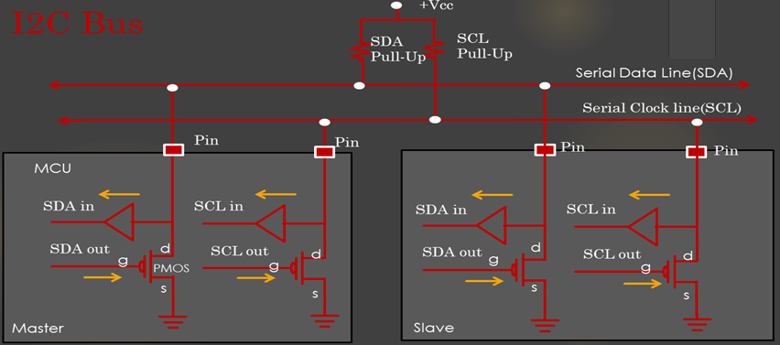

Slide 16
I2C Bus
+Vcc
SDA
Pull-Up
SCL
Pull-Up
Serial Data Line(SDA)
Serial Clock line(SCL)
Pin
Pin
Pin
Pin
MCU
SDA in
SCL in
SDA in
SCL in
SDA out
d
SCL out
d
SDA out
d
SCL out
g
g
d
PMOS
g
g
s
s
s
s
Master
Slave

Slide 17
I2C PROTOCOL IN DETAIL !

Slide 18
Basics

Slide 19

A7
A6
A5
A4
A3
A2
A1
R/$\overline{W}$
ACK
D7
D6
D5
D4
D3
D2
D1
D0
ACK
Notes:
The master always triggers the data communication first with the start condition.
After that master sends out the 7-bit address of the slave along with 1 bit read or write bit, which we call as address phase.
If this bit 1 , that means master is expecting data from the slave
if this bit is zero, then master will send out the data to the slave
, for each data byte the slave receives, the slave will send out the ack,
After that, if at any time master wishes to terminate the communication then it raises the stop condition

Slide 20
I2C Protocol: Start Condition

Slide 21
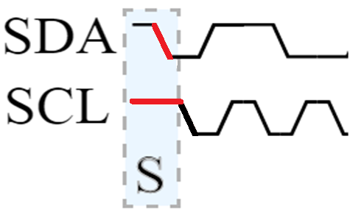
I2C Protocol: Start Condition
Notes:
if the sda line goes low, when the clock is high, then it is interpreted as start condition in i2c.

Slide 22
I2C Protocol: Address Phase

Slide 23
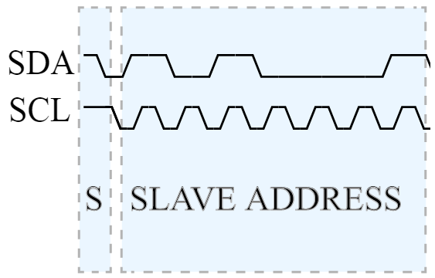
I2C Protocol: Address Phase
Notes:
You can see it takes seven clock cycle to send out 7 bit of slave address
after that master sends out read or write bit in the 8th clock cycle

Slide 24
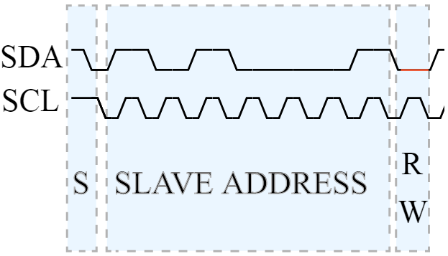
I2C Protocol: Address Phase
Notes:
At 8th clock cycle if the sda is low, then it is interpreted as write and if it high then it is interpreted as read bit.

Slide 25
I2C Protocol: ACK/NACK

Slide 26
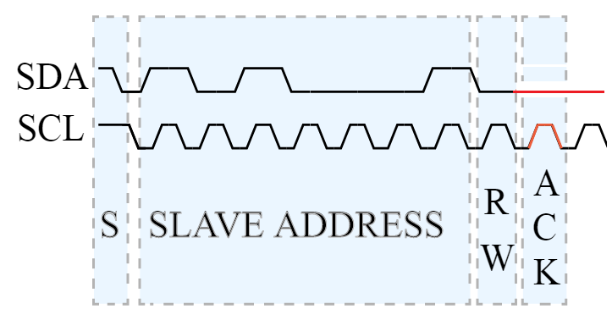
I2C Protocol: ACK
Notes:
, at the 9th clock, if the sda line goes low, then it is interpreted as an ack from the slave
. If the sda remains high at the 9th clock cycle then, it is interpreted as NAck .

Slide 27
I2C Protocol: NACK

Slide 28
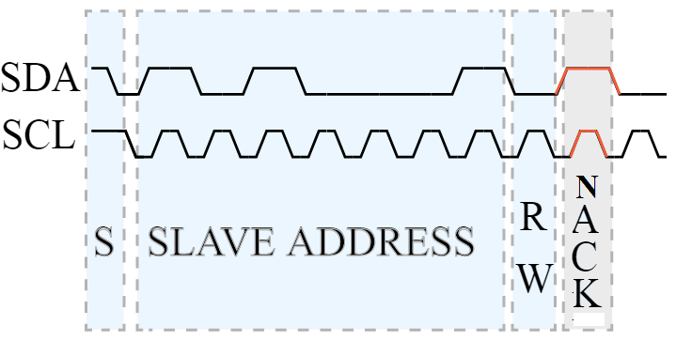
I2C Protocol: NACK

Slide 29
I2C Protocol: Stop Condition

Slide 30
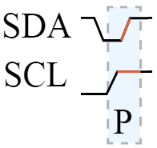
I2C Protocol: Stop Condition
Notes:
When the clock is high, if the sda makes a low to high transition, then it is interpreted as stop condition by the i2c engine
After the stop condition, you can see that, both the sda and clock line are high, that means the bus is released and can be used by other masters.

Slide 31
Master Read/Write data phase

Slide 32
Master Writing data to slave

Slide 33
SCL
SDA
Notes:
first master generates start condition, that is sda going low, when the clock is high,

Slide 34
SCL
1
2
3
4
5
6
7
SDA
A7 A6 A5 A4 A3 A2 A1
Notes:
then master sends out the address of 7 bits

Slide 35
SCL
1
2
3
4
5
6
7
8
SDA
A7 A6 A5 A4 A3 A2 A1
Notes:
then master sends out the write bit, which is low at the 8th clock cycle

Slide 36
SCL
1
2
3
4
5
6
7
8
9
SDA
A7 A6 A5 A4 A3 A2 A1
Notes:
after that slave sends out the ack at the 9th clock,.

Slide 37
SCL
1
2
3
4
5
6
7
8
9
1
2
3
4
5
6
7
8
SDA
A7 A6 A5 A4 A3 A2 A1
D7 D6 D5 D4 D3 D2 D1 D0
Notes:
After that master sends out the first data byte which is 8 bits

Slide 38
SCL
1
2
3
4
5
6
7
8
9
1
2
3
4
5
6
7
8
9
SDA
A7 A6 A5 A4 A3 A2 A1
D7 D6 D5 D4 D3 D2 D1 D0
Notes:
, for that, slave sends back the ack

Slide 39
1
2
3
4
5
6
7
8
9
1
2
3
4
5
6
7
8
9
D7 D6 D5 D4 D3 D2 D1 D0
D7 D6 D5 D4 D3 D2 D1 D0
Notes:
then master again sends out the next byte and again slave sends back the ack.

Slide 40
1
2
3
4
5
6
7
8
9
1
2
3
4
5
6
7
8
9
D7 D6 D5 D4 D3 D2 D1 D0
D7 D6 D5 D4 D3 D2 D1 D0
Notes:
And then, if there is no more data to send, master just ends the communication by generating the stop condition

Slide 41
Master Reading data from slave

Slide 42
SCL
SDA

Slide 43
SCL
1
2
3
4
5
6
7
SDA
A7 A6 A5 A4 A3 A2 A1

Slide 44
SCL
1
2
3
4
5
6
7
8
SDA
A7 A6 A5 A4 A3 A2 A1
Notes:
then since master wants to read, it sends out read bit which is high at the 8th clock cycle.

Slide 45
SCL
1
2
3
4
5
6
7
8
9
SDA
A7 A6 A5 A4 A3 A2 A1

Slide 46
SCL
1
2
3
4
5
6
7
8
9
1
2
3
4
5
6
7
8
SDA
A7 A6 A5 A4 A3 A2 A1
D7 D6 D5 D4 D3 D2 D1 D0
Notes:
After that slave will start sending out the data byte to the master,

Slide 47
SCL
1
2
3
4
5
6
7
8
9
1
2
3
4
5
6
7
8
9
SDA
A7 A6 A5 A4 A3 A2 A1
D7 D6 D5 D4 D3 D2 D1 D0
Notes:
and for each data byte received, the master will send back the ack to the slave.

Slide 48
SCL
1
2
3
4
5
6
7
8
9
1
2
3
4
5
6
7
8
9
SDA
D7 D6 D5 D4 D3 D2 D1 D0
D7 D6 D5 D4 D3 D2 D1 D0
Notes:
And at some point of time, when the master decides, it no longer needs any data bytes from the slave then, after receiving the last data byte , it won't ack

Slide 49
SCL
1
2
3
4
5
6
7
8
9
1
2
3
4
5
6
7
8
9
SDA
D7 D6 D5 D4 D3 D2 D1 D0
D7 D6 D5 D4 D3 D2 D1 D0
Notes:
And at some point of time, when the master decides, it no longer needs any data bytes from the slave then, after receiving the last data byte , it won't ack

Slide 50
Repeated Start
(Start without Stop)

Slide 51
MCU
EEPROM
I2C
0x45

Slide 52
without repeated start.

Slide 53
SCL
1
2
3
4
5
6
7
8
9
1
2
3
4
5
6
7
8
9
SDA
A7 A6 A5 A4 A3 A2 A1
D7 D6 D5 D4 D3 D2 D1 D0
1
2
3
4
5
6
7
8
9
1
2
3
4
5
6
7
8
9
A7 A6 A5 A4 A3 A2 A1
D7 D6 D5 D4 D3 D2 D1 D0
Notes:
slave will never send out any data, because it’s a write phase of the master.
you are allowing other masters to take over the bus.
So you have to keep both these, write phase and read phase atomic

Slide 54
With repeated start.

Slide 55
SCL
1
2
3
4
5
6
7
8
9
1
2
3
4
5
6
7
8
9
SDA
A7 A6 A5 A4 A3 A2 A1
D7 D6 D5 D4 D3 D2 D1 D0
1
2
3
4
5
6
7
8
9
1
2
3
4
5
6
7
8
9
A7 A6 A5 A4 A3 A2 A1
D7 D6 D5 D4 D3 D2 D1 D0
Notes:
Instead of generating a stop here, generate another start condition, which we call repeated start.

Slide 56
I2C MODES
Teacher name | SECTION-3

Slide 57
Fast Mode/Standard Mode

Slide 58
Fast Mode
Fast mode is a mode in i2c protocol, where devices can receive and transmit data up to 400 kbits/s.
Fast-mode devices are downward-compatible and can communicate with Standard-mode devices in a 0 to 100 kbit/s I2C-bus system
to achieve data transfer rate up to 400kbits/sec, you must put the i2c device in to fast mode

Slide 59
Standard Mode
In standard mode communication data transfer rate can reach up to maximum of 100kbits/sec.
stand mode was the very first mode, introduced when first i2c spec was released.
Standard-mode devices, however, are not upward compatible;

Slide 60
I2C Duty Cycle

Slide 61
Most of the modern microcontrollers like LPC1768, STM32f4xx you will find their I2C peripheral allow varying the duty cycle of I2C clock .
The duty cycle is significant, and different I2C modes have the slightly different duty cycle.

Slide 62
I2C Duty Cycle
t_{high}
t_{low}
2t_{high}
t_{high}
t_{low}
1.7t_{high}
t_{high}
t_{low}
Notes:
i2c peripheral allow varying the duty cycle of i2c clock
The duty cycle is significant, and different i2c modes have the slightly different duty cycle
in stm32f4xx, there are two options to tune duty cycle in fast mode, one is 1:2 ratio of duty cycle

Slide 63
I2C Duty Cycle
So in order to achieve 100Khz in standard mode, you can keep T_{low} =T_{high} = 5μs. Which will surely pass I2C Specification recommendation

Slide 64
I2C Duty Cycle
If you want to reach 400KHz in fast mode, then
SCL_{f} = 400KHz
SCL_{T}=T_{high}+T_{low} = 2.5 μs
if you choose 1:2 ratio, then
T_{high} = 2.5/3 = 0.83μs

Slide 65
I2C Duty Cycle
t_{high}
t_{low}
2t_{high}
t_{high}
t_{low}
1.7t_{high}
t_{high}
t_{low}
Notes:
i2c peripheral allow varying the duty cycle of i2c clock
The duty cycle is significant, and different i2c modes have the slightly different duty cycle
in stm32f4xx, there are two options to tune duty cycle in fast mode, one is 1:2 ratio of duty cycle

Slide 66
I2C Addressing MODES

Slide 67
I2C Addressing MODES
In i2c protocol, there are 2 addressing modes
7 bit addressing
10 bit addressing
Now a days almost all microcontrollers I2C peripheral support both the addressing modes. But there are still some microcontrollers which do not support 10-bit addressing, so you have to check the reference manual of your microcontroller.

Slide 68
7-bit Addressing

Slide 69

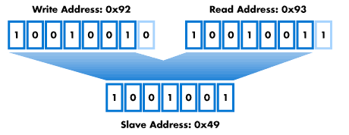
7-bit Addressing
Notes:
each slave is addressed by 7bit address.

Slide 70
10-bit Addressing

Slide 71

10-bit Addressing
bit 9
msb
bit 0
lsb
1
1
1
1
0
A9
A8
R/$\overline{W}$
ACK
A7
A6
A5
A4
A3
A2
A1
A0
ACK
10 bit Address
A9
A8
A7
A6
A5
A4
A3
A2
A1
A0
Notes:
After the start condition, a leading ‘11110’ pattern introduces the 10-bit addressing scheme
. Slaves which only use 7 bit addressing simply ignore messages with the leading bit pattern ‘11110’(4 ones followed by 0).
If the address phase begins with this bit pattern, slave will interrupt it as the 10-bit addressing mode
7bit slave address should not contain this bit pattern in the initial bits of the address.

Slide 72
I2C Functional block and Peripheral Clock
Notes:
there is one shift register and there is only one associated data register,
since i2c is a half-duplex one data register is sufficient

Slide 73
I2C Functional Block

Slide 74
I2C Peripheral clock and Serial line clock
Notes:
This microcontroller has up to 3 i2c peripherals,
And all the i2c peripherals are connected to apb1 system bus

Slide 75
HSI
16Mhz
HSE
MAX I2C1 frequency when
system core clock is 168Mhz
= APB1 MAX
= 42Mhz
PLL
/
16Mhz
APB 1 bus ( 42 Mhz Max)
16Mhz
/
I2C1
Up to 100KHz in SM
Up to 400Khz in FM
SCL

Slide 76
N/A
N/A
2MHz
HSI
3MHz
168Mhz
HSE
/
I2C1
Up to 100KHz in SM
Up to 400Khz in FM
4
Multiplexer
42Mhz
APB 1 bus ( 42 Mhz Max)
PLL
42Mhz
40MHz
41MHz
42MHz
Control bits

Slide 77
N/A
N/A
2MHz
HSI
3MHz
16Mhz
HSE
/
Multiplexer
I2C1
Up to 100KHz in SM
Up to 400Khz in FM
16Mhz
APB 1 bus ( 42 Mhz Max)
16Mhz
PLL
14MHz
15MHz
16MHz
Control bits

Slide 78
f_{pclk} (Peripheral Clock Frequency ) must be at least 2MHz to achieve standard mode I2c frequencies that are up to 100khz
f_{pclk} must be at least 4Mhz to achieve FM mode i2c frequencies. that is above 100khz but below 400Khz
f_{pclk} must be a multiple of 10Mhz to reach the 400khz max i2c fm mode clock frequency

Slide 79
I2C Interrupts

Slide 80
I2C IRQs and Interrupt mapping
Notes:
i2c has separate IRQ line interrupting the processor in case of errors.

Slide 81
Bus Error
This error happens when the interface detects an SDA rising or falling edge while SCL is high,occurring in a non-valid position during a byte transfer
Arbitration Loss Error
This error can happen when the interface loses the arbitration of the bus to another master

Slide 82
ACK Failure Error
This error happens when no ACK is returned for the byte sent
Overrun Error
Happens during reception, when a new byte is received and the data register has not been read yet and the New received byte is lost.

Slide 83
Under-run Error
Happens when In transmission when a new byte should be sent and the data register has not been written yet and the same byte is sent twice
PEC Error
Happens when there is CRC mismatch, if you have enabled the CRC feature

Slide 84
Time-Out Error
Happens when master or slave stretches the clock , by holding it low more than recommended amount of time.

Slide 85
I2C IRQ numbers

Slide 86
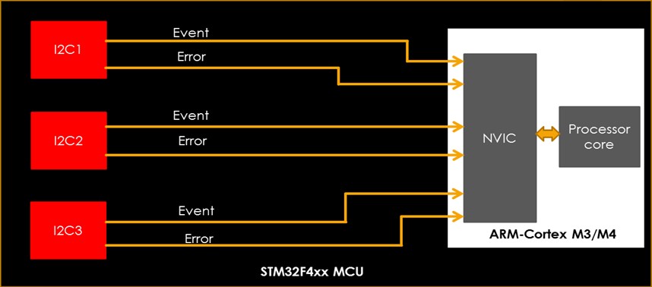
I2C Interrupting the Processor

Slide 87
I2C Driver Development: Overview

Slide 88
Sample Applications
I2C Driver
Startup & CMSIS APIs
I2C1
I2C2
I2C3
I2Cx
STM32F4xx Microcontroller

Slide 89
Understanding the Requirements

Slide 90
APIs
I2C Initialization
I2C Master TX
I2C Driver
I2C Master RX
I2C Slave TX
I2C Slave RX
I2C Error Interrupt handling
I2C Event Interrupt handling

Slide 91
Exploring different I2C Peripherals and Pins of the MCU

Slide 92
I2Cx | Pin Pack 1 |  | Pin pack 2 |  | Pin pack 3 |  | Bus
 | SCL | SDA | SCL | SDA | SCL | SDA
I2C1 | PB6 | PB7 | PB8 | PB9 | PB6 | PB9 | APB1
I2C2 | PB10 | PB11 | PF1 | PF0 | PH4 | PH5 | APB1
I2C3 | PA8 | PC9 | PH7 | PH8 |  |  | APB1

Slide 93
Exploring I2C control register
Notes:
This bit is used only for the slave to enable or disable the clock stretching
clock stretching is so much important for the slave to prevent underrun or overrun errors by stretching clock low.

Slide 94
Exploring I2C Address Registers
Notes:
There are 2 i2c address registers to set the i2c device address,
By using this one , you can mention both 7bit as well as 10-bit address.

Slide 95
Exploring I2C Data Register
Notes:
data register is used to transmit and receive data bytes over any serial protocol
In i2c, you can only have 8bit data frame unlike spi, where you can either have 8bit data format for 16bit
for every txe interrupt generated, that is the indication to put the next data byte to continue the data transmission
whenever the firmware gets the rxne interrupt, then it is clear that data register has new data byte to be read, so firmware should act immediately to read out the data register.

Slide 96
Exploring I2C Status Register
Notes:
status register contains the flags which hold the status of the various events happened during I2C communication
This bit is only valid for the master; if start condition is successfully generated then this bit will be set to 1,
For the master if this bit is set , then that means, the address is successfully sent, and for slave if this bit is set, then address is successfully matched.
These flags will be set by the hardware automatically but needs to clear by the firmware
This is a very important flag which makes sense only when the clock stretching is enabled, that means, no_clockstretch=0.
If this bit is set to 1, then there is some data waiting for the firmware to read out.
If this bit is set to 1 , then data register is empty and software has to write to it in order to continue data transmission .

Slide 97
Exploring I2C Clock Control
Register
Notes:
status register contains the flags which hold the status of the various events happened during I2C communication
This bit is only valid for the master; if start condition is successfully generated then this bit will be set to 1,
For the master if this bit is set , then that means, the address is successfully sent, and for slave if this bit is set, then address is successfully matched.
These flags will be set by the hardware automatically but needs to clear by the firmware
This is a very important flag which makes sense only when the clock stretching is enabled, that means, no_clockstretch=0.
If this bit is set to 1, then there is some data waiting for the firmware to read out.
If this bit is set to 1 , then data register is empty and software has to write to it in order to continue data transmission .

Slide 98
BTF flag in TX
During Txing of a data byte, if TXE=1, then that means data register is empty.
And if the firmware has not written any byte to data register before shift register becomes empty(previous byte transmission), then BTF flag will be set and clock will be stretched to prevent the under run.

Slide 99
BTF flag in RX
If RXNE =1, Then it means new data is waiting in the data register, and the firmware has not read the data byte yet before Shit register is filled with another new data, then also the BTF flag will be set and clock will be stretched to prevent the overrun.

Slide 100
if the btf flag is set for the master or slave, then you should understand that the I2C communication is momentarily paused or in wait state by stretching or holding the clock low until btf is cleared out by writing to or reading from the data register.

Slide 101
I2C clock control register

Slide 102
CCR =??
I2C Serial Clock Frequency( f_{scl}) = 100KHZ
Lets assume I2C Peripheral Clock Freqeuncy(f_{pclk}) = 10MHZ

Slide 103

CCR Standard mode Calculation
If $f$_{pclk} = 10Mhz, then T_{pclk} = 0.1 μs
We want to generate $f$_{scl} = 100KHz, that is
T_{scl} = T_{high}+T_{low} = 10
For Standard mode duty cycle = 1:1
So, T_{high} = T_{scl}/2 = 5 μs
Substituting in the equation : T_{high} = CCR * T_{pclk}
CCR = 5/0.1
CCR = 50 = 0x32

Slide 104
Clock Stretching

Slide 105
1
2
3
4
5
6
7
8
9
1
SCL
SDA
1
2
3
4
5
6
7
8
9
1
SCL
SDA
The slave is not ready for more data, so it buys time by holding the clock low.
The master will wait for the clock line to be released before proceeding to the next frame

Slide 106
I2C Master TX

Slide 107
S
Address
A
data1
A
data2
A
data n
A
P
EV1
EV2
EV3
EV
3
EV
3
EV
3
EV
3

Slide 108
S
Address
A
Data1
A
Data2
A
Data3
A
P
EV1
EV2
EV3
EV3
EV
3
EV
3
EV
4
SB
ADDR
TXE
TXE
TXE
TXE
TXE
BTF
1st byte
2nd byte
3rd byte
Nothing
To write
Wait till
3rd byte TX
Complete
Count=2
Count=1
Count=0
Disable TXEIE
Count=0
Generate
Stop
Notes:
the firmware has to wait until the sb event is set in the status flag.
the master here again waits until the addr flag is set, addr flag will be set once the ack is received from the slave for this address space.
. Until the firmware clears this flag, the clock will be stretched low, and the interface will be in wait state

Slide 109
Master mode
Got int?
TXE
TXE/BTF?
BTF
Xfer Count =0 ?
Send 1 byte
Xfercount--
Xfer Count =0 ?
Disable all interrupts
Send 1 byte
Wait for another interrupt
Disable buff interrupt
Generate stop
Wait for another interrupt
Wait for BTF Interrupt
Tx done

Slide 110
S
Address
A
Data1
A
Data2
A
DataN
NA
P
EV1
EV2
EV3
EV3
EV
3
EV
3

Slide 111
I2C Master RX

Slide 112
I2C Master Reading just 1 byte
S
Address
A
data1
NA
P
EV1
EV2
EV3

Slide 113
I2C Master Reading just 1 byte
When the shift register gets the whole 1 byte , STOP will be generated
And data byte will be moved to the data register and RXNE will be set
Error handling
Is start generation success?
(SB=1??)
no
Is address phase success?
(ADDR=1??)
yes
Wait till RXNE int
Disable the Acking
yes
I2C is in wait state due to
clock stretching
Because ADDR is not
Cleared yet by the SW
no
Got RXNE interrupt?
Program the STOP bit to 1
Read data register
I2C comes out of wait state
Clear the ADDR event flag
End of RX
Once ADDR flag is cleared , I2C comes out of wait state and slave will immediately transfers 1 byte to the master’s shift register, so wait till RXNE interrupt

Slide 114
I2C Master Reading 2 bytes
Error handling
Is start generation success?
(SB=1??)
When BTF flag =1, it will generate interrupt (if BTF Interrupt is enabled)
no
Is address phase success?
(ADDR=1??)
yes
Wait till BTF int
Set ACK =0 and POS=1
I2C is in wait state due to
clock stretching until ADDR
Flag is cleared by the SW
no
Got BTF interrupt?
Clear the ADDR flag
yes
Program STOP=1
WAIT until the BTF flag=1
Is BTF =1 ?
Read data register to collect data1
When the BTF flag is set, data 1 will be in DR and data 2 will be in shift register
And clock will be stretched until BTF is cleared by reading out the data register
Read data register to collect data2

Slide 115
I2C Master Reading 2 bytes
ADDR=1
Keep POS=1, ACK=0
Master
Slave
data1
data1
Data register
Shift Register
Shift Register
Data register
I2C is in wait state
I2C is in wait state

Slide 116
I2C Master Reading 2 bytes
ADDR=0
Keep POS=1, ACK=0
Master
Slave
data1
data2
Data register
Shift Register
Shift Register
Data register

Slide 117
I2C Master Reading 2 bytes
ADDR=0
Keep POS=1, ACK=0
RXNE=1
Master
Slave
data1
data2
Data register
ACK
Shift Register
Data register
Shift Register

Slide 118
I2C Master Reading 2 bytes
ADDR=0
Keep POS=1, ACK=0
RXNE=1
Master
BTF=1
Slave
data1
data2
Data register
NACK
Shift Register
Data register
Shift Register
I2C is in wait state
I2C is in wait state

Slide 119
I2C Master Reading 2 bytes
ADDR=0
SW read 1
Keep POS=1, ACK=0
RXNE=1
Master
BTF=1
Slave
data1
data2
Data register
Shift Register
Shift Register
Data register
I2C is in wait state
I2C is in wait state

Slide 120
I2C Master Reading 2 bytes
ADDR=0
SW read 2
Keep POS=1, ACK=0
RXNE=1
Master
Slave
data2
Data register
Shift Register
Shift Register
Data register

Slide 121
I2C Master Reading bytes more than 2 bytes( N > 2)
N=100
1 2 3 4…………………50……………97 98 99 100
N-2
N-1
N

Slide 122
I2C Master Reading bytes more than 2 bytes( N > 2)
RXNE=1
Master
BTF=1
Slave
N-2
N-1
N
Data register
Shift Register
Shift Register
Data register
I2C is in wait state
I2C is in wait state
In the BTF handler disable the acking and read the data register

Slide 123
I2C Master Reading bytes more than 2 bytes( N > 2)
Then again the in btf handler, just generate the stop condition and read out the last 2 bytes n-1 and N.
SW read
RXNE=1
Master
BTF=1
Slave
N-2
N-1
N
Data register
Shift Register
Shift Register
Data register
I2C is in wait state
I2C is in wait state

Slide 124
I2C Slave TX

Slide 125
I2C Slave TX
S
Address
A
Data1
A
Data2
A
DataN
NA
P
EV1
EV2
EV
2
EV2
EV2
EV4

Slide 126
I2C Slave RX

Slide 127
S
Address
A
Data1
A
Data2
A
DataN
A
P
EV1
EV2
EV2
EV2
EV3

Slide 128
Master mode?
RX
RXNE/BTF?
RX Count > 3?
Xfer Count =3 ?
RX Count == 2 or RX count ==3
Xfer Count =2 ?
Read 1 byte
Disable ACK
disable all interrupts
Disable buff interrupt
Read 1 byte
Generate stop
Rx count --
Read the last byte
Rx count --
Read 1 byte
Rcv cnt--
Wait for another interrupt
Wait btf interrupt
Read 1 byte
Rcv cnt--
End of read
Wait for another interrupt
Disable EVT and ERROR interrupt
ready

Slide 129
Event and buffer interrupt handler
Whats the mode ?
master mode processing
Slave mode processing

Slide 130
master mode processing
TX
RX or TX ?
RX
TXE
BTF
RXNE
BTF
Handle TXE
Handle BTF
Handle RXNE
Handle BTF

Slide 131
slave mode processing
RX or TX ?
ADDR
STOPF
TXE
BTF
RXNE
BTF
Handle ADDR
Handle STOPF
Handle TXE
Handle BTF
Handle RXNE
Handle BTF

Slide 132
Handling of I2C Error Interrupt
We got an error interrupt
Check the status flag to find out which error it is
Bus Error
Arbitration loss
Over-Run
Under-Run
ACK failure
yes
Are we master ??
Set the Corresponding error code
No
No
Is tx count = 0 ?
Call Error Handler
Yes
End data Txing to the master

Slide 133
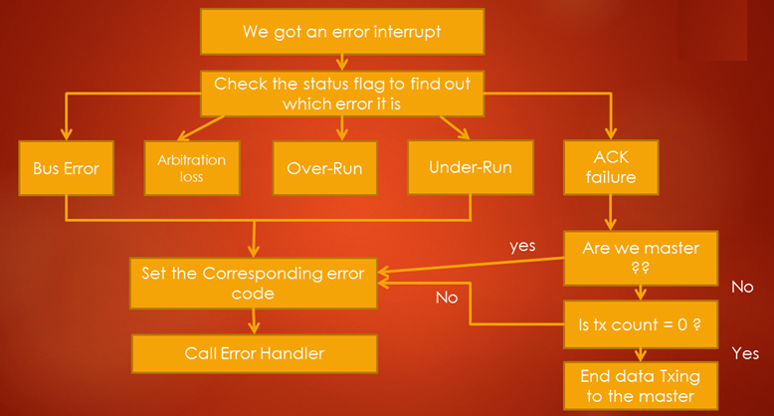
Handling of I2C Error Interrupt

Slide 134
Sample Application:
Master sending Data Stream to Slave
(Master Write Command)

Slide 135
(Master Write Command)
Master
Slave
Master Sending Write Cmd
ACK
Master Sending Write Len
ACK
Master sends Data Stream
Toggle RED led
ACK for every byte
fail
Toggle BLUE led
pass
Verify the data stream

Slide 136
Sample Application:
Slave sending Data Stream to Master
(Master Read Command)

Slide 137
(Master Read Command)
Master
Slave
Master Sending Read Cmd
ACK
Master Sending Read Len
ACK
Slave sends data bytes
Toggle RED led
Master ACKs for every byte
fail
Verify the data stream
pass
Toggle BLUE led

Slide 138
Connection Diagram
SCL(PB6)
SCL(PB6)
I2C1
I2C1
SDA(PB9)
SDA(PB9)
USER button
STM32F4 discovery
GND
GND
STM32F4 discovery
Master
Slave

Slide 139

Common Problems in I2C and
Debugging Tips

Slide 140
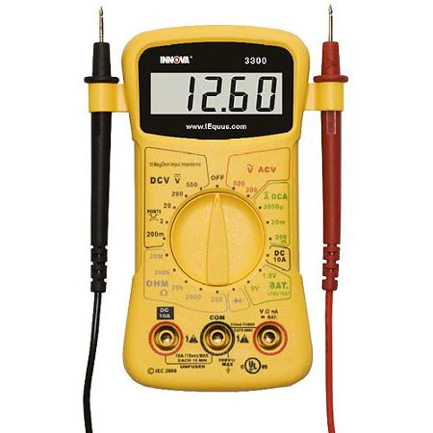
GND
SDA & SCL
Mandatory Tip
3.3V
Whenever you face problem in I2C , probe the SDA and SCL line after I2C initialization.
It must be held at HIGH Voltage.

Slide 141
Problem-1: SDA and SCL line not held HIGH Voltage after I2C pin initialization
Reason-1:
Not activating the pullup resistors if you are using the internal pull up resistor of an I/O line
Debug Tip:
worth checking the configuration register of an I/O line to see whether the pullups are really activated or not, best way is to dump the register contents.

Slide 142
Problem-2: ACK failure
Reason-1:
Generating the address phase with wrong slave address
Debug Tip:
verify the slave address appearing on the SDA line by using logic analyser.

Slide 143
Problem-2: ACK failure
Reason-2:
Not enabling the ACKing feature in the I2C control register
Debug Tip:
Cross check the I2C Control register ACK enable field

Slide 144
Problem-3: Master is not producing the clock
Debug Tip 1 :
First Check whether I2C peripheral clock is enabled and set to at least 2mhz to produce standard mode i2c serial clock frequency
Debug Tip 2 :
Check whether GPIOs which you used for SCL and SDA functionality are configured properly for the alternate functionality
Notes:
Debug Tip 2
Check whether gpios which you used for SCL and SDA functionality are configured properly for the alternate functionality . othere wise the i2c engine wont be able to produce the clock or data on those gpios

Slide 145
USB Logic analyzer
To PC
GND
CH1
CH0
SCL(PB6)
SCL(PB6)
I2C1
I2C1
SDA(PB9)
SDA(PB9)
USER button
STM32F4 discovery
GND
GND
STM32F4 discovery
Master
Slave

Slide 146
USB Logic analyzer
To PC
GND
CH1
CH0
SCL(PB6)
I2C1
SDA(PB9)
USER button
STM32F4 discovery
GND
Master
Slave

Slide 147
I2C Clock Stretching
Clock Stretching simply means that holding the clock to 0 or ground level.
The moment clock is held at low, then the whole I2C interface pauses until clock is given up to its normal operation level.

Slide 148
So, What is the use of clock stretching ?

Slide 149
I2C devices, either Master or Slave, uses this feature to slow down the communication by stretching SCL to low, which prevents the clock to Rise high again and the i2c communication stops for a while
There are situations where an I2C slave is not able to co-operate with the clock speed given by the master and needs to slow down a little.
If slave needs time, then it takes the advantage of clock stretching , and by holding clock at low, it momentary pauses the I2C operation.

