Slide 1
Clock Sources in the MCU
High Speed Internal (HSI) oscillator
High Speed External (HSE) oscillator
Phase Locked Loop (PLL)
Low Speed Internal (LSI) clock
Low Speed External (LSE) clock

Slide 2
Clock Sources in the MCU
HSI
PLLN
X
SysClk
AHB
16MHz
PLLM
PLLP
AHB
/
/
VCO
/
HSE
APB1
/
8 – 26 MHz
PLLQ
/
APB2
PLL
/
USB OTG,SDIO,etc

Slide 3
The HSI RC oscillator which is inside the MCU has the advantage of providing a clock source at low cost . Because there is no external components required to use this clock. It also has a faster start-up time than the external crystal oscillator however, the frequency is less accurate than an external crystal oscillator.

Slide 4
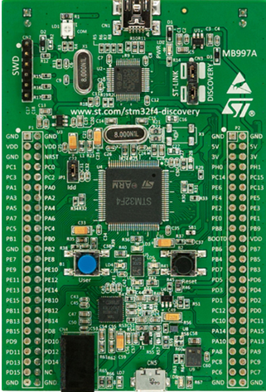
STM32F4xx Discovery board

Slide 5
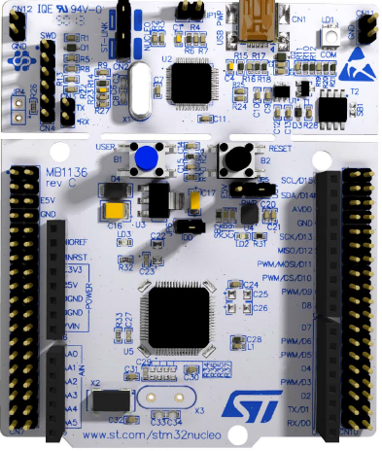
STM32F411RE Nucleo-64

Slide 6
How to enable the High Speed External Crystal Oscillator and use it as System Clock ?

Slide 7
Let’s measure the frequency of different clock sources like HSI,HSE,PLL by using USB logic Analyzer !

