Slide 1




Slide 2

TEST TIME ON REMAINDER THEOREM
URL: https://forms.gle/VR1E4L6Q92xy9LBU7
QR CODE:

Slide 3

TOGGLE THE SWITCH

Slide 4


TOPICS
Explanation
Coding
Test cases

Slide 5
Explanation
A Toggle Switch is a control that is very popular nowadays.
Especially on touch-based devices.
You can see it in Android check-box.
But for touch devices, it has one big advantage, when your finger is over the touch device it won’t obscure the control and so you can see instant feedback when you press it.

Slide 6
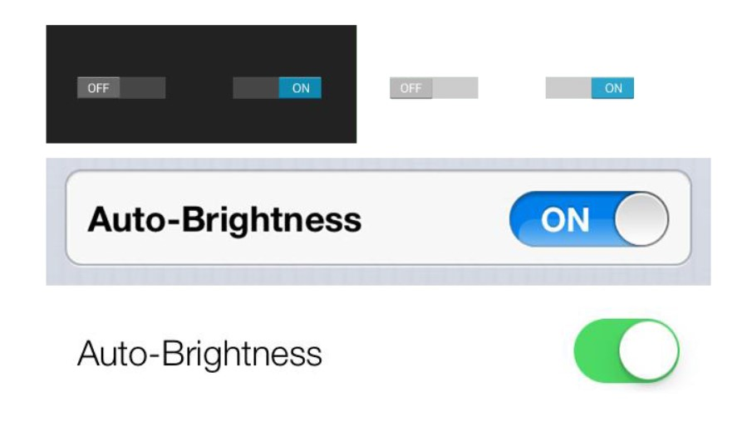
Toggle Switch allows you to change the text for the 'on' and 'off' state that appears right next to the toggle switch.

Slide 7
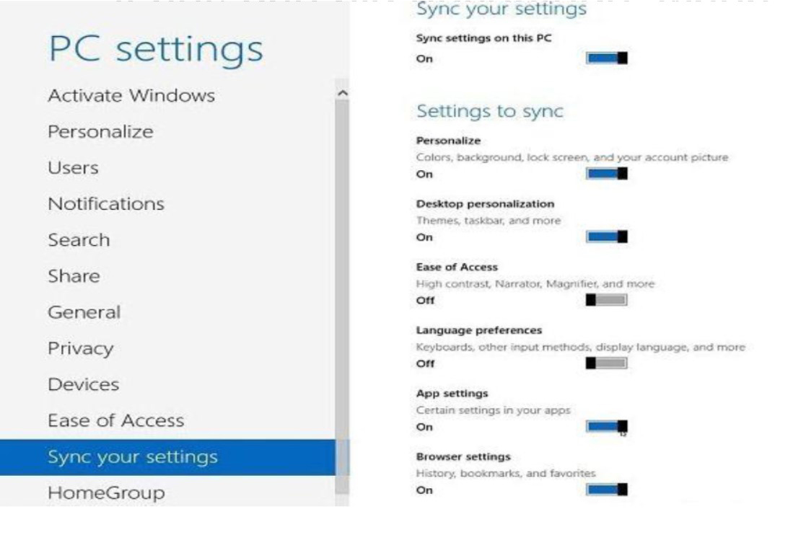

Slide 8
import javax.swing.*;
import java.awt.*;
import java.awt.event.*;
import javax.swing.JToggleButton;
class Toggle implements ItemListener
{
static JLabel text;
//Driver function
public static void main(String args[])
{

Slide 9
//Create a frame
JFrame frame = new JFrame("Toggle Button");
frame.setSize(500,500);
frame.setDefaultCloseOperation(JFrame.EXIT_ON_CLOSE);
frame.getContentPane().setBackground(Color.white);
frame.setLayout(null); //Create an object
Toggle obj = new Toggle();

Slide 10
//Create a Toggle Button
JToggleButton button = new JToggleButton("ToggleButton");
button.setBounds(150,100,200,100);
button.addItemListener(obj);
frame.add(button); //Create a label
text = new JLabel();
text.setBounds(150,250,300,100);
text.setText("Click on the Toggle Button");
frame.add(text);

Slide 11
//Display the frame
frame.setVisible(true);
}
public void itemStateChanged(ItemEvent e)
{
if(e.getStateChange()==ItemEvent.SELECTED)
text.setText("Status of Toggle Button :SELECTED");
else
text.setText("Status of Toggle Button :DESELECTED");
}
}

Slide 12
To create a toggle button use JToggleButton class.
Add ItemListener to the toggle button.
Use method getStateChange to get the state change of toggle button.
Here’s the run time test case to show the functioning of
toggle button.

Slide 13
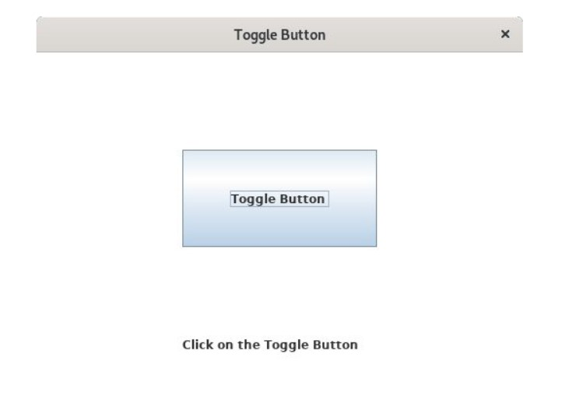
Test case 1 – To View the Toggle Button.

Slide 14
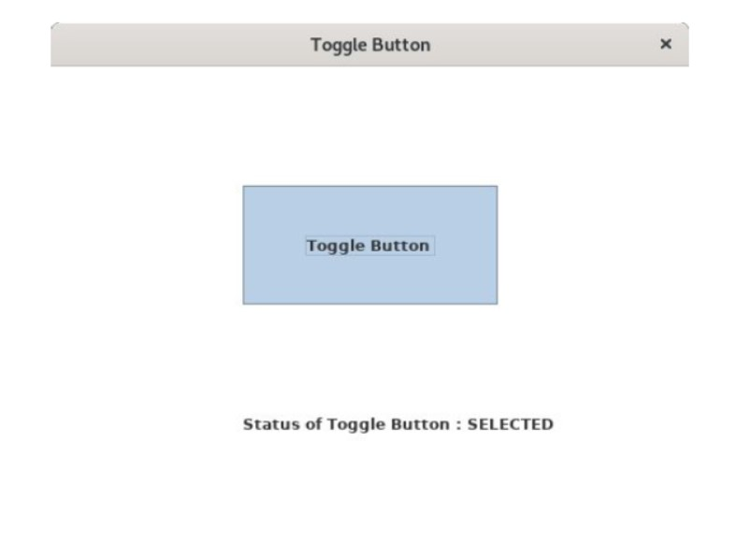
Test case 2 – To View the Selected status of Toggle Button.

Slide 15
ALICE APPLE TREE

Slide 16

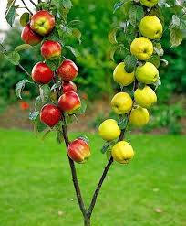

ALICE APPLE TREE
There are different kinds of apple trees in the four directions.
NORTH
WEST
EAST
SOUTH

Slide 17
They are...!
Does not have Red Apples.
NORTH
EAST
WEST
Have some Green Apples.
Has some Red Apples.
SOUTH
Does not have Green Apples.

Slide 18
However, the colors of apples cannot be distinguished outside the house.
So, the task is to find the minimum number of apples to be collected from the trees to guarantee M red apples.
If it is not possible, print -1.

Slide 19
Examples:
Input: M = 10, K = 15, N = 0, S = 1, W = 0, E = 0
Output: 10
Explanation: It simply gets 10 apples from the 1st south tree
Input: M = 10, K = 15, N = 3, S = 0, W = 1, E = 0
Output: -1
Explanation: There are no red apples in the South, North and East. But in the West there are at least 1 red apple and total tree is 1, So, total no. of guaranteed red apple is 1 * 1 = 1 which is less than M.

Slide 20
Approach: Every apple in the south ensures that it is red. So first, take an apple from the south.
In the East and West, there is at least 1 red apple in each tree.
That’s why for guaranteed it is considered that there is only 1 red apple on each tree in the east and west.
For the north there is no red apple, so, neglect that.
Follow the steps below to solve the problem:
If M is less than equal to S*K then print M.
Else if M is less than equal to S*K+E+W then print S*K + (M-S*K)
Else print -1.

Slide 21
import java.util.*; class Main { static int minApples(int M,int K,int N,int S,int W,int E) { if(M <= S * K) return M; else if(M <= S * K + E + W) return S * K + (M-S * K); else return -1; } public static void main(String[] args) { Scanner sc=new Scanner(System.in); System.out.print("Enter no of apples to be collected-"); | int M=sc.nextInt(); System.out.print("Enter no of apples in each tree-"); int K = sc.nextInt(); System.out.print("Enter no of trees in north-"); int N = sc.nextInt(); System.out.print("Enter no of trees in south-"); int S = sc.nextInt(); System.out.print("Enter no of trees in west-"); int W = sc.nextInt(); System.out.print("Enter no of trees in east-"); int E = sc.nextInt(); int ans = minApples(M,K,N,S,W,E); System.out.println(ans); }}
Notes:
Output
10
Time Complexity: O(1) // since no loop is used the algorithm takes constant space to execute Auxiliary Space: O(1) // since no extra array is used the solution takes up constant space.

Slide 22




THANK YOU
+91 78150 95095
codemithra@ethnus.com
www.codemithra.com

