Slide 1
ED
UNIT -2

Slide 2
What are Entrepreneurial Creativity and Innovation?
Entrepreneurial creativity is the ability to develop new ideas and solutions to problems. It is the ability to see into the future and generate ideas, solutions and innovations before they are needed. It is the ability to solve your customer's or client's problems before they even realize the problem exists.
Entrepreneurial innovation is the ability to turn an idea into reality. It is about finding new ways to do things and making them better. Entrepreneurial innovation is about creating new products or services, improving processes or finding new markets for existing products or services.

Slide 3
Necessity of Creativity in the Development of Entrepreneur
High overall success
There is a misconception that people only needs intelligence to achieve everything they need in life.
However, it takes time for aspiring entrepreneurs to realize that creativity plays an integral role as well.
Unfortunately, a lot of learning institutions stress more on intelligence than creative thinking. It could perhaps be because intellectual knowledge is measurable whereas creativity can be challenging to spot. Nonetheless, dynamics are changing, and entrepreneurs are beginning to realize the importance of bringing creative people on board. Creative workers can be a game changer in your company if you harness and shape their skills adequately.

Slide 4
Necessity of Creativity in the Development of Entrepreneur
Increase productivity
Creativity allows an entrepreneur to disconnect from the accustomed and move into uncharted territories with an aim to discern unique and useful solutions.
It has, therefore, become essential for both leaders and employees to develop creative skills.
Entrepreneurs are providing the necessary technological resources such as visual collaboration, which is often confused with video conferencing to help their workers discover innovative solutions and ideas.
In fact, this is an extremely cost-effective strategy to increase workplace productivity. Innovation and creativity bring an entrepreneur to the success path.

Slide 5
Necessity of Creativity in the Development of Entrepreneur
Exploit employee potential
You are probably utilizing only half of your employee’s potential by not encouraging workplace creativity.
Fortunately, entrepreneurs increasingly realize the ocean of creative ideas that remain untapped and dormant.
Tapping all these opportunities can result in improved financial strategies, increased profitability, and quick decision making. Creativity also enables an enterprise to stay ahead of the curve.

Slide 6
Necessity of Creativity in the Development of Entrepreneur
Transcend boundaries
Creativity enables entrepreneurs to find some of the path-breaking discoveries.
As such, it’s essential to allow collisions and blur to take place to transcend boundaries set by disciplines.
That way, it’s easier for an entrepreneur to get new perspectives towards solving a financial or operational problem.
Creativity lets an entrepreneur connect distinct aspects and extrapolate feasible solutions from unrelated concepts.

Slide 7
Necessity of Creativity in the Development of Entrepreneur
Encourage critical thinking
Creativity is slowly turning out to be one of the best ways to alleviate problems plaguing today’s enterprises.
Problem-solving works best when coupled with highly disciplined and focused thinking. Entrepreneurs can think in either divergent or convergent thinking mode.
Convergent thinking involves in-depth analysis and enables an entrepreneur to find the most feasible solution to a managerial or financial problem.
It allows entrepreneurs to use various data sources such as accounting software and computer systems.
In contrast, divergent thinking encourages creativity by enabling business owners to explore possible solutions for the same problem.
While entrepreneurs can combine both thinking modes, divergent thinking ensures an enterprise gets the best resolution.

Slide 8
Necessity of Creativity in the Development of Entrepreneur
Foster innovation
Manufacturers create unique products to not only meet customer expectations but exceed them as well.
As such, entrepreneurs need to be cautious to ensure their products are relevant and useful to the users.
While it may be hard to spot this from the beginning, things start to get more evident as your idea turns into a reality.
In fact, this is the time an entrepreneur begins to realize how innovation and invention differ. The invention refers to a new, unique concept while innovation is an idea which is as unique and useful as the original one.
You need to be creative and view an idea differently to be innovative. That way, it’s easier to turn a concept into a reality.

Slide 9
How to be more creative?
There are a few key things that you can do to develop your entrepreneurial creativity. To be creative, you need to have a mindset open to growth. Here are some practices to be more creative:
Have a growth mindset. A growth mindset is a belief that your abilities and intelligence can be developed through effort, good teaching and learning from mistakes. This belief leads to a love of learning and a willingness to take risks.
Be open to new ideas. Being open to new and different ideas is a must for innovation. So, be willing to experiment and try new things.
Practice creative thinking. To be creative, you need to be able to think outside the box. You need to be able to see things in new ways and make connections between seemingly disparate things. Practicing creative thinking regularly helps you become a creative thinker.

Slide 10
How to be more creative?
4. Take risks. Yes, taking risks is vital to being creative and innovative, but don't forget the importance of planning. A plan gives you a roadmap to follow and helps ensure you take the proper steps to reach your goals.
5. Think outside the box. You also need to be able to think outside the box and come up with new solutions to problems. Do not take the beaten path.
6. Be passionate about what you do. It shows in your work when you are passionate about what you do. In addition, passion helps you think creatively and outside the box, two main components of being an innovative entrepreneur.
7. Be willing to experiment. Try new things and see what works. Don't be afraid of failing. Failure is a part of the creative process and can lead to new and better ideas.

Slide 11
How to be more creative?
8. Practice freestyle writing regularly. Writing is a right-brain activity, especially creative writing. It helps you access the information that your left brain cannot.
9. Engage in right-brain activities regularly. These activities include but are not limited to drawing, painting, playing music, creating music, reading, singing, games that require imagination, etc. These activities help you use your right brain, making you more creative as you do these things often.
10. Last but not least, surround yourself with other creative and innovative people. This will help to stimulate your thinking and give you new ideas to work with.

Slide 12
Benefits of using creativity for innovation
Practicing creativity in your life can lead you to be a better entrepreneur and infusing creativity into your business makes you an innovative leader within your industry. Here are some of the benefits of being a creative and innovative entrepreneur.:
You will be able to create new products or services that solve problems for people.
You will be able to improve processes and make them more efficient.
You will be able to find new markets for existing products or services.
You will be able to create new jobs.
You will be able to make a positive impact on society.
You will be able to have a lot of fun and satisfaction in what you do.

Slide 13
Benefits of using creativity for innovation
1. It Accompanies Innovation: For something to be innovative, there are two requirements: It must be novel and useful. While creativity is crucial to generate ideas that are both unique and original, they’re not always inherently useful. Innovative solutions can’t exist, however, without a component of creativity.
2. It Increases Productivity: Creativity gives you the space to work smarter instead of harder, which can increase productivity and combat stagnation in the workplace. Routine and structure are incredibly important but shouldn’t be implemented at the expense of improvement and growth. When a creative and innovative environment is established, a business’s productivity level can spike upward.
3. It’s an In-Demand Skill: Creativity and innovation are skills commonly sought after in top industries, including health care and manufacturing. This is largely because every industry has complex challenges that require creative solutions.

Slide 14
Benefits of using creativity for innovation
4. It Allows for Adaptability: Sometimes events—both internal and external—can disrupt an organization’s structure. For example, the COVID-19 pandemic has dramatically changed how the present-day business world functions. In such instances, imaginative thinking and innovation are critical to maintaining business operations. Creatively approaching challenges requires adaptability but doesn’t always necessitate significantly adjusting your business model. For example, you might develop a new product or service or slightly modify the structure of your operations to improve efficiency. Big problems don’t always require big solutions, so don’t reject an idea because it doesn’t match a problem’s scale. Change is inevitable in the business world, and creative solutions are vital to adapting to it.
5. It’s Necessary for Growth: One of the main hindrances to a business’s growth is cognitive fixedness, or the idea that there’s only one way to interpret or approach a situation or challenge. Cognitive fixedness is an easy trap to fall into, as it can be tempting to approach every situation similar to how you have in the past. But every situation is different. If a business’s leaders don’t take the time to clearly understand the circumstances they face, encourage creative thinking, and act on findings, their company can stagnate—one of the biggest barriers to growth.

Slide 15
The five stages of the creative process
Preparation stage: As you begin the creative journey, the first stage involves prep work and idea generation. This is when you gather materials and conduct research that could spark an interesting idea. Brainstorm and let your mind wander, or write in a journal to foster divergent thinking; this will help you consider all possible approaches to building out your idea. In this first part of the process, your brain is using its memory bank to draw on knowledge and past experiences to generate original ideas.
Incubation stage: When you have finished actively thinking about your idea, the second stage is where you let it go. Part of creative thinking is taking a step away from your idea before you sit down to flesh it out. You might work on another project or take a break from the creative process altogether—regardless, you are not consciously trying to work on your idea. Walking away from your idea might seem counterproductive, but it’s an important stage of the process. During this time, your story or song or problem is incubating in the back of your mind.

Slide 16
The five stages of the creative process
3. Illumination stage: Sometimes called the insight stage, illumination is when the “aha” moment happens. The light bulb clicks on as spontaneous new connections are formed and all of that material you’ve gathered comes together to present the solution to your problem. In this third stage, the answer to your creative quest strikes you. For example, you overcome writer’s block by figuring out the ending to your story. It can take you by surprise but after the incubation stage, an idea has emerged.
4. Evaluation stage: During this stage, you consider the validity of your idea and weigh it against alternatives. This is also a time of reflection when you look back at your initial concept or problem to see if your solution aligns with your initial vision. Business professionals might do market research to test the viability of the idea. During this phase, you might go back to the drawing board or you might forge on, confident in what you’ve come up with.
5. Verification stage: This is the final stage of the creative process. It’s when the hard work happens. Your creative product might be a physical object, an advertising campaign, a song, a novel, an architectural design—any item or object that you set out to create, propelled by that initial idea that popped into your head. Now, you finalize your design, bring your idea to life, and share it with the world.

Slide 17
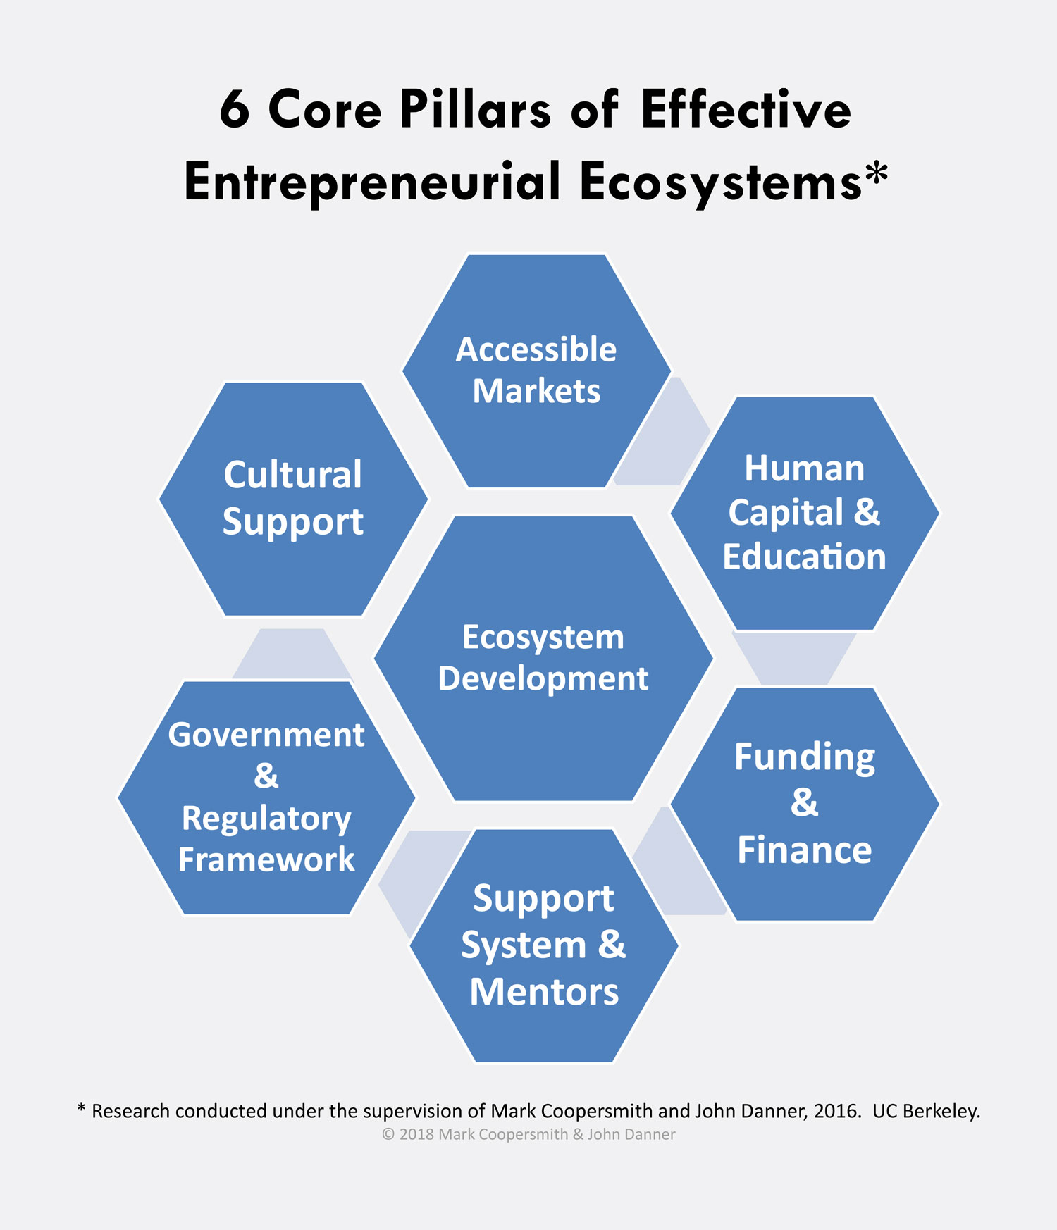
Entrepreneurial Eco-system

Slide 18
Entrepreneurship & Innovation
Entrepreneurs are innovators of the economy. It is not just the scientist who invents and comes up with the solutions.
The importance of innovation in entrepreneurship is shown by coming up with a new way to produce a product or a solution. A service industry can expand with another type of service to fulfill the ever-changing needs of its clients. Producers can come up with another product from the raw materials and by-products.
The importance of innovation in entrepreneurship is another key value for the longevity of a business. Entrepreneurs and businesses began with a need. They saw the need within the community and among themselves and they have come up with a solution. They seize the opportunity to innovate to make their lives more comfortable. And these solutions kept evolving to make them better, easier, and more useful. Entrepreneurs must keep themselves abreast of the current trends and demands. Manufacturers are constantly innovating to produce more without sacrificing quality.

Slide 19
Entrepreneurship & Innovation
Entrepreneurs, as innovators, see not just one solution to a need. They keep coming up with ideas and do not settle until they come up with multiple solutions.
Another factor that raises the importance of innovation in entrepreneurship is competition. It stimulates any entrepreneur to come up with something much better than their competition at a lower price, and still be cost-effective and qualitative.
Small businesses see the importance of innovation in entrepreneurship. They were able to compete with large industries and see their value in the economy. Small businesses are important as they are directly involved in the community and therefore, contribute to their financial and economic gain. These small businesses know exactly what the community needs and fulfill them. All things start small.
The innovation in entrepreneurship helped the country by changing with the times and producing new products and service from ones that already exist. And, being innovative has helped us become successful in all our endeavors.

Slide 20
Define Innovation
Innovation can be defined in many different ways, but at its core, it is the process of creating something new that has never been seen before. For example, it might involve developing a new product or service, finding a better way to do something existing, or coming up with an original idea.
Business innovation is the act of introducing something new to a company—whether it’s a new product, a new market strategy, a new method, and so on—in order to reinvigorate the company and promote new value and growth. Innovation is all about business leaders coming up with (or listening to) creative ideas, and then using strategic planning and decision-making to implement the new business ideas successfully. When a business innovates, it can either improve its existing products, processes, or methodologies, or it can create new ones from scratch.

Slide 21
What is the purpose of innovation?
The purpose of innovation is to create new products, services, or processes that improve the quality of life for people. This can be done in many ways, like providing better access to goods and services, making products more affordable or efficient, offering new opportunities for employment or education, and improving public health.

Slide 22
What are the benefits of innovation?
Innovation leads to faster growth, as customers respond well when companies consistently produce quality products and services that meet their needs. And it helps businesses secure long-term contracts by creating brand loyalty among consumers.
Some of the other benefits of innovation include: improved margins due to increased sales volumes, higher salaries due to greater competition in the marketplace, growth opportunities as technology advances rapidly, and increased consumer loyalty because you’re providing them with unique experiences that no one else has thought of yet.

Slide 23
What are the benefits of innovation?
Reasons Innovation Is Important for Businesses
Innovation is a key part of owning a successful business. It can help you:
Innovation grows your business. Business growth means, ultimately, increasing your profits. Successful innovation allows you to add value to your business so that you can increase your profits—if you don’t innovate well, your business will plateau.
Innovation helps you stay ahead of the competition. With globalization and a rapidly changing market, there are more competing businesses than ever before. Innovative thinking can help you predict the market and keep up with customer needs. If your business doesn’t innovate, you’ll watch innovative companies bring new ideas to the marketplace, and you’ll have to scramble to keep up.
Innovation helps you take advantage of new technologies. Technology (and especially artificial intelligence) is evolving faster than ever before, which means that there may be new, more efficient technologies to make better products, to offer your services, to market your business, or to track your performance with analytics. By taking advantage of these new technologies for process innovation, you’ll be able to optimize your business and gain a competitive advantage over your competitors.

Slide 24
Risks of Innovation
Innovation isn’t a guaranteed success. There are several factors that may prevent innovation from being successful, and you have to keep them in mind before taking the leap:
Expense: New technology, specialized employees, huge shifts in your business’s identity—innovation can be an extremely expensive undertaking, and because increased profits aren’t guaranteed, it can be risky. During the innovation process, you have to think about the costs weighed against the potential profits and make the best decision. Ask yourself the question: Will this create value?
Scheduling: Innovation takes time, and the time that you spend innovating is time that you’re not using to focus on your current products, marketing, and sales. If you can’t implement your innovations quickly and efficiently, you can risk failing to meet your quotas and falling behind on your schedule—losing profits and the trust of your customers and investors.
Instability: Innovative idea generation can be exciting, but if businesses are constantly making huge innovations, they may never find a stable identity or market—and it will be hard for customers, investors, and employees to keep up with their changes. It’s all about innovation management; a stable business identity is important for generating profits, so it’s vital that you choose your new innovations carefully and deliberately, rather than saying yes to every new thing that comes your way.

Slide 25
Opportunity Search and Identification
Opportunity refers to the extent to which possibilities for new ventures exist and the extent to which entrepreneurs have the leeway to influence their odds for success through their own actions. Simply put, opportunity is a perceived means of generating incomes that previously have not been exploited and are not currently being exploited by others. Opportunity identification can, in turn, be defined as the cognitive process or processes through which individuals conclude that they have identified an opportunity. It is important to note that opportunity identification is only the initial step in a continuing process, and is distinct both from detailed evaluation of the feasibility and potential economic value of identified opportunities and from active steps to develop them through new ventures.
It is essentially a situation in which new goods, raw materials, markets and organizational strategies can be introduced through the formation of new means, ends or means-ends relationships.
Searching for a business opportunity that is right for them is the major challenge would- be entrepreneurs face. New startups always focus on introducing a new product or service based on an unmet need, select an existing product or service from one market and offer it in another where they are not available; and sometimes the firm relies on a tried and tested formula that has worked elsewhere in a franchise setup.

Slide 26
Opportunity Analysis
An entrepreneur must identify business opportunity to do something new and to earn heavy profits. For example, Government may offer incentive to increase exports by reducing export duty on steel to U.S.A., Japan and Germany. Naturally the steel manufacturers and traders would like to take advantage if this chance by exporting steel to these countries in huge quantities and thus earn huge profits. Opportunities analysis means assessment of the strengths and weakness of the opportunities or chances in business so as to take advantage of a given situation. For example, Government decides to establish a sugar factory in Kolhapur you immediately purchase sugarcane in heavy quantity so as to sell the same to the sugar factory and thus earn huge profits

Slide 27
Sources of Opportunities Analysis
(1) Market Demand Analysis: The success of a business enterprise depends not on the amount of goods produced but on the amount of goods sold in the present competitive economy. Goods are produced not for own consumption but for marketing so that reasonable profit may be earned after providing satisfaction to the customers. The more is the demand of a product in the market, the more shall be the speed of the progress of a business unit. Even the size of the project and technology to be used depend very much upon the demand potential. Hence it is said that the modern entrepreneurs pay more attention on the creation of demand of goods as against the production of goods.
(2) Technical Analysis: Next step taken towards opportunities analysis is to ascertain the technical feasibility of the project. If the technical analysis indicates that project is not technically feasible, then there is no sense in pursuing the idea of establishing venture. For example, A intends to establish a computer manufacturing unit in Delhi. For this purpose necessary machinery and expertise is to be imported from Germany. Indian Government has imposed restricts on the import of computer machinery from Germany. In this case, there is no sense in persuing the idea of computer venture in Delhi. Ordinarily, for establishing a manufacturing unit technical feasibility report is prepared by an expert. It provides necessary information on various technical alternatives, methods of production available, nature and size of the plant, production process and size of the project etc.
(3) Financial Analysis: Financial analysis is undertaken to determine the profitability of the venture business and the financial resources covering the cost of the project, cost of raw-materials, technical cost and the cost of marketing the goods etc
(4) Resources Analysis: The entrepreneur has to see whether sufficient resources are available for the establishment of business venture. This covers procurement of land, construction of building, erection of machinery, equipment, technology, manpower, raw material, location and layout etc.

Slide 28
Sources of Opportunities Analysis
(5) Business Environment Analysis: A successful entrepreneur is always in search of new opportunities. But it is not an easy task. Before establishing any new venture, it is necessary to conduct, business environment analysis of that area. Main factors affecting business environment analysis are as follows: (i) Industrial Policy, (ii) Price Control Policy, (iii) Quality Controls, (iv) Essential Commodities Act. (v) Foreign Trade Policy (vi) Distribution System (vii) Tax Burden Evaluation (viii) Position of Existing Industries and their Profitability (ix) Incentives, Rebates, Grants, Subsidies, and Concessions (x) Economic and Social Tendencies (xi) Importance of the Business Venture in Government Economic Plans.
(6) Evaluation Analysis: In this stage, a final view on the proposed business venture is taken which is based on the combination of factors like technical financial, commercial, managerial and operational. Weakness or deficiency in any project does not prepare the ground for its rejection but care is taken to initiate suitable action to minimize its impact on the project. In order to overcome or minimize the impact of deficiencies on a project, entrepreneurs are advised to revamp the project or take necessary precautions.

Slide 29
Business Opportunity Identification Process
Opportunity identification is the collection of three main factors, which are the entrepreneur’s background, the business influence and the general business environment. Opportunity identification has five stages that lead to ‘recognition’. The five stages are discussed in relationship with the process of opportunity identification. These stages are: a. Preparation b. Incubation
c. Insight
d. Evaluation
e. Elaboration

Slide 30
Business Opportunity Identification Process
a. Preparation Preparation stage is that knowledge and experience exercised just before the opportunity discovery process. These knowledge and experience are not often deliberately acquired. However, preparation itself is usually a deliberate attempt to widen capability in an area and become sensitive to concerns in a field of interest. In an organized situation, the background of the business, the products or services or the technological knowledge must have majorly informed the main ideas of the successful venture. One cannot however, rule out the role of new ideas and expertise originating from individuals in the organization that will eventually result in a new business.
b. Incubation Incubation stage is the part of the opportunity identification process that involves the consideration of a concept or a specific problem ordinarily not subjected to conscious or formal analysis by a businessman or his team. It is usually not consciously done and therefore more often than not, an instinctive and unempirical approach for the consideration of several potential alternatives.

Slide 31
Business Opportunity Identification Process
c. Insight Insight stage occurs at the moment a fundamental solution suddenly becomes recognized unexpectedly. It is a particular moment that keeps occurring persistently right through the process of opportunity identification. Insights have been found to be extensive channels to the discovery of startup businesses and sometimes reveal additional knowledge for the development of a current process of discovery. In respect of a business venture, insight predictably encompasses the abrupt recognition of an opportunity in business, the answer to an adequately pondered crisis and the possession of a concept from social networks and associates.
d. Evaluation Evaluation stage is about investigating if the recognized and developed ideas are feasible, if the businessman has the required abilities to realize the ideas and if the idea is sufficiently innovative for prospects. It sometime involves full feasibility analysis of the ideas through all forms of research instruments and criticisms from relevant business acquaintances. It is fundamental to also investigate the prospect and viability of the new insight ideas as the spirit of entrepreneurship is to make satisfactory and sensible profits.

Slide 32
Business Opportunity Identification Process
e. Elaboration. Elaboration is that stage that exposes the opportunity/ideas to external analysis with the tedious and time–consuming options selection, choice decision and organization of resources. It is customarily in search of all legalities that could build confidence and guarantee the practicability of the business. Elaboration also reduces uncertainties by providing the detailed planning activities after the evaluation viability confirmation. This will eventually reveal the concept areas that still need further analysis and attention.

Slide 33
Entrepreneurial problem solving
It is the process of using innovation and creative solutions to close that gap by resolving societal, business, or technological problems. Sometimes, personal problems can lead to entrepreneurial opportunities if validated in the market. The entrepreneur visualizes the prospect of filling the gap with an innovative solution that might entail the revision of a product or the creation of an entirely new product. In any case, the entrepreneur approaches the problem-solving process in various ways. This chapter is more about problem solving as it pertains to the entrepreneur’s thought process and approach rather than on problem solving in the sense of opportunity recognition and filling those gaps with new products.
is an analytical method to identify potential solutions to a situation. It's a complex process and judgment calls, or decisions, may have to be made on the way. The primary goal is to find the best solution. Problem-solving involves identifying an issue, finding causes, asking questions and brainstorming solutions. Gathering facts helps make the solution more obvious.

Slide 34
Decision Making vs. Problem solving
Decision making is different from problem solving. A decision is needed to continue or smooth a process affecting the operation of a firm. It can be intuitive or might require research and a long period of consideration. Problem solving, however, is more direct. It entails the solution of some problem where a gap exists between a current state and a desired state. Entrepreneurs are problem solvers who offer solutions using creativity or innovative ventures that exploit opportunities.

Slide 35
Two Problem Solving Models: Adaptive and Innovative
The first and more conservative approach an entrepreneur may use to solve problems is the adaptive model. The adaptive model seeks solutions for problems in ways that are tested and known to be effective. An adaptive model accepts the problem definition and is concerned with resolving problems rather than finding them. This approach seeks greater efficiency while aiming at continuity and stability.
The second and more creative approach is the innovative model of entrepreneurial problem solving, which uses techniques that are unknown to the market and that bring advantage to an organization. An innovative problem-solving style challenges the problem definition, discovers problems and avenues for their solutions, and questions existing assumptions—in a nutshell, it does things differently. It uses outside-the-box thinking and searches for novel solutions. Novelty is a shared trait of creative entrepreneurship, and it’s why entrepreneurs gravitate toward this method of problem solving.

Slide 36
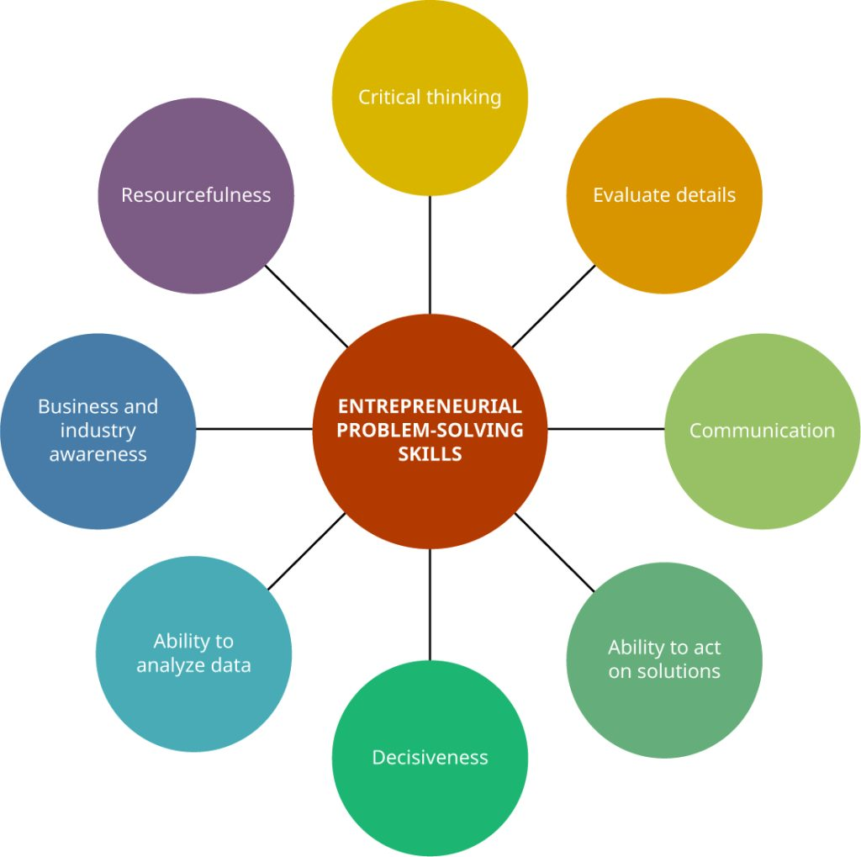
Skills that entrepreneurs possess that aid in solving problems
Problem-Solving Skills
While identifying problems is a necessary part of the origin of the entrepreneurial process, managing problems is an entirely different aspect once a venture is off the ground and running. An entrepreneur does not have the luxury of avoiding problems and is often responsible for all problem solving in a startup or other form of business. There are certain skills that entrepreneurs possess that make them particularly good problem solvers.

Slide 37
The Steps of the Creative Problem-Solving Process
Step 1: Clarify: To clarify is the critical step of recognizing the existence of a gap between the current state and a desired state. This can also be thought of as having need awareness, which occurs when the entrepreneur notes a gap between societal or customer needs and actual circumstances. Clarifying the problem by speaking with clients and developing a detailed description of the problem brings the specifics of a problem to light. Failure to identify the specifics of a problem leaves the entrepreneur with the impossible task of solving a ghost problem, a problem that is fully unknown or unseen. To establish and maintain credibility, an entrepreneur must clarify the problem by focusing on solving the problem itself, rather than solving a symptom of the problem.
For example, a farm could have polluted water, but it would not be enough to solve the problem only on that farm. Clarifying would involve identifying the source of the pollution to adequately tackle the problem. After gaining an understanding of a problem, the entrepreneur should begin to formulate plans for eliminating the gap.

Slide 38
The Steps of the Creative Problem-Solving Process
Step 2: Ideate: To ideate is the step of the creative problem-solving process that involves generating and detailing ideas by the entrepreneur. After collecting all information relevant to the problem, the entrepreneur lists as many causes of the problem as possible. This is the step in which the largest variety of ideas are put forth. Each idea must be evaluated for feasibility and cost as a solution to the problem. If a farm does not have clean water, for example, the entrepreneur must list causes of toxic water and eliminate as many of those causes as possible. The entrepreneur must then move forward investigating solutions to bring the water back to a safe state. If, say, nearby livestock are polluting the water, the livestock should be isolated from the water source.

Slide 39
The Steps of the Creative Problem-Solving Process
Step 3: Develop: To develop is the step in which the entrepreneur takes the list of ideas generated and tests each solution for feasibility. The entrepreneur must consider the cost of each idea and the obstacles to implementation. In the preceding example, adding a chemical to the water may not be a feasible solution to the farmer. Not every farmer wants additional chloride or fluoride added to the water due to the effect on both humans and livestock. These tradeoffs should be addressed in the feasibility assessment. The farmer might prefer a filtration system, but the cost of that solution might not be practicable. The entrepreneur should identify and assess alternative solutions to find one that is most cost-effective and feasible to the customer.

Slide 40
The Steps of the Creative Problem-Solving Process
Step 4: Implement: To implement is the step in which the solution to the problem is tested and evaluated. The entrepreneur walks through the planned implementation with the client and tests each part of the solution, if a service, or thoroughly tests a developed good. The entrepreneur implements the solution and goes through a structured system of follow-up to ensure the solution remains effective and viable. In the water example, the solution would be reducing runoff from toxic insecticides by adding prairie strips, buffers of grass, and vegetation along banks of streams.
Step 5: Evaluate: To evaluate is the step in which the final solution is assessed. This is a very important step that entrepreneurs often overlook. Any fallacy in the implementation of the product or service is reassessed, and new solutions are implemented. A continual testing process may be needed to find the final solution. The prairie strips, buffers of grass, and vegetation along banks of streams chosen in the farming water example should then be analyzed and tested to ensure the chosen solution changed the content of the water.

Slide 41
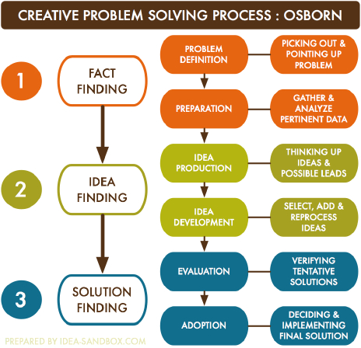
The Steps of the Creative Problem-Solving Process

Slide 42
Entrepreneurial Decision Making
It is the process of choosing a solution based on your judgment, situation, facts, knowledge or a combination of available data. The goal is to avoid potential difficulties. Identifying opportunity is an important part of the decision-making process. Making decisions is often a part of problem-solving.
The business decision-making process is a step-by-step process allowing professionals to solve problems by weighing evidence, examining alternatives, and choosing a path from there. This defined process also provides an opportunity, at the end, to review whether the decision was the right one.

Slide 43
Steps involved in Decision-Making Process
1. To diagnose the problem: The first step in decision-making is to understand the exact problem. Just as a disease cannot be cured without proper diagnosis, so also no decision-making is possible unless the problem is properly diagnosed or known. It is told that a disease is half cured if it is correctly diagnosed. Similarly, if the problem is correctly understood, its solution will be easier. For example, when a company is faced with declining profits, it shows the symptom and not the disease. The managers may decide to solve the problem through intensive sales effort. But if the real problem lies elsewhere which may need change or product lines, or reduction of price and improvement of quality, the intensified sales effort will not bring the desired result. So, correct assessment of the real problem is essential for decision-making. Diagnosing the real problem implies knowing the gap between what is and what ought to be, identifying the reasons for the gap, and understanding the problem in relation to higher objectives of the organisation.

Slide 44
Steps involved in Decision-Making Process
2. To analyse the problem: After correct diagnosis of the problem, the next task is to analyse the problem. This means splitting up of the problem into its different elements based on collection of facts, data and relevant information. For instance, if there is a declining trend in sales, it should analyse its extent in regard to market, price, product line, etc. So, all possible facts and data relating to the situation must be gathered to find out the revealing circumstances that may help the decision-maker to gain an insight into the problem. The whole approach of analysis of the problem should be based around the limiting or critical factors within minimum possible time and efforts.

Slide 45
Steps involved in Decision-Making Process
3. To search for alternative solutions: After ascertaining and analysing the problem, different possible alternatives are to be found out for its solution. A problem can be solved in several ways. However, all the ways cannot be equally satisfying. Further, if there is only one way of solving a problem, no question of decision-making arises. That particular way is to be accepted. Therefore, the decision-maker must try to find out the various alternatives available in order to get the most satisfactory result of a decision. However, it should be borne in mind that it may not be possible to consider all alternatives, because information about all alternatives may not be available, or some of the alternatives cannot be considered for selection due to the obvious limitation of the decision-maker. While determining alternatives, the concept of limiting factor should be applied. A limiting factor is one that stand in the way of accomplishing a desired objective. If these factors are identified, the managers will confine their search for alternatives to those which will overcome the limiting factors. For instance, if an enterprise has limitation in raising sizable finances, it cannot consider the projects involving high investment.

Slide 46
Steps involved in Decision-Making Process
4. To evaluate the alternatives: After the various alternatives are identified, the decision-maker will go for evaluating them to find out how each alternative may contribute towards the objectives supposed to be achieved by implementing the decision. In evaluating an alternative both tangible and intangible factors have to be taken into account. Tangible factors are those which can be quantified because they are quite obvious like the cost per unit, investment required, output to be received, etc. Such factors can be measured easily. As against these, intangible factors are mostly qualitative and cannot be measured in terms of quantity. For example, in a plant location, various non-economic factors like psychological problem arising out of displacement of persons from the plant site, ecological balance, etc. have to be considered which cannot be quantified.

Slide 47
Steps involved in Decision-Making Process
5. To select the best alternative: The evaluation of various alternatives presents a clear picture as to how each one of them contributes to the objectives under question. A comparison is made among the likely outcomes of various alternatives and the best one is chosen. Choice aspect of decision-making is related to deciding the most acceptable alternative which gives the greatest number of wanted consequences to fit with the organisational objectives. A manager with sound knowledge, long experience and considerable ability may choose the best course of action easily. When there is any confusion, some criteria may be useful for picking up the best solution.
These criteria are:
(i) Degree of risk against the expected gains;
(ii) Economy of effort;
(iii) Timing, and
(iv) Availability of resources.

Slide 48
Steps involved in Decision-Making Process
6. To make the decision effective: Once the alternative is selected, it is put into action. Truly speaking, the actual process of decision-making ends with the choice of the best alternative through which the objectives can be achieved. However, decision-making, being a continuous and on-going process, must ensure that the objectives have been achieved by the chosen alternative. Unless this is done, the managers will never know what result their choice has contributed. The decision, in order to be implemented must be communicated to the employees concerned in clear and simple language and their acceptance of the decision must be secured. All decisions affect the employees and their work. It is, therefore, necessary to secure their willing support and whole-hearted participation.

Slide 49
Steps involved in Decision-Making Process
7. To follow-up the decision: When the decision is put into action, it brings certain results. If a good decision is taken and implemented properly, its results should correspond with the objectives. So, results of the decision indicate whether decision-making and its implementation are proper. But all decisions cannot be said to be perfect and flawless. Decisions are not always based on facts, some guesswork may be necessary for this purpose. Moreover, there is the human limitation associated with each decision-making process. In order to provide safeguards against incorrect, bad and inappropriate decisions, it is desirable to introduce a system of follow-up in the light of feedback received from the results. This provides the scope of rectifying the wrong decisions and modifying similar future decisions to tune them up with environmental changes.

Slide 50
Entrepreneurship Decision Process | Decision Making
Decision making is the actual selection of the among alternatives. We have various available alternative options in the market. Entrepreneurs need to make various decisions for these business he/she needs good decision making skills because of the Market problem and defending the market situation. Entrepreneurs in decision making the identity alternative and then select the best course of action to solve specific problems in the business.

Slide 51
Entrepreneurship Decision Process | Decision Making
1. Identification of problem or opportunity (Entrepreneurship decision process): In entrepreneurship the first process of identifying opportunities or problems. The entrepreneurial decision process Both are equal to arising opportunity and Problem if you are firm under various arising problems then you identify a particular problem and opportunities as same.
2. Generate alternative solutions: Identify opportunities and problems. These first process are completed then the second decision process generates alternative solutions. You must be innovative to choose alternative ideas. That’s why we call this step an innovative step to make entrepreneurs’ decisions for particular taking decisions.
How to find innovative ideas in particular problems or opportunities. Here we are considering categories to choose alternative solutions.
Take solutions from the same decision made previously. It may be a good idea to use the work you have done in the past to make an existing decision. Note- especially if your decision does not require much change.

Slide 52
Entrepreneurship Decision Process | Decision Making
3 Analyse The Alternative Solutions: The second step is to generate ideas then analyze those ideas alternatively you choose for your particular purpose. You must analysis all areas of these ideas for beneficial in your organisation.
4. Selection of the best alternative: When you generate alternative solutions and analysis, Then Fourth steps of entrepreneurship in deciding the best alternative decision. When you choose the best alternative per requirement, it definitely benefits you.
5. Implementation of the alternative(Entrepreneurship decision process): Selection of the best alternative in the entrepreneurship decision process then the fifth process implements these alternatives in your purpose for getting more benefits.

