Slide 1
We will begin shortly…

Slide 2
Schdule
Story – Faulty gear detection using RCNN/Faster RCNN
Recap (10:30 AM) & Practical Advice for using Neural Networks
Types of solvers (10:40 AM)
Series vs DAG Nets (10:50 AM)
What are residual neural nets (ResNets)? (11:10 AM)
What are inception networks? (11:30 AM)
BREAK (11:45 AM)
EXERCISE 3: Transfer learning with Inception v3, ResNet50, GoogLeNet (1:00 PM)
LUNCH (2:00 PM)
Introduction to Object Detection
Region Proposals (RCNN)
YOLO Algorithm
DIY Playground: Image Classification with your own datasets (4:00 PM)
DISCUSSIONS, Q&A, TROUBLESHOOTING (5:00 PM)

Slide 3
Prerequisite: MATLAB 2019b or MATLAB 2020a

Slide 4
Story

Slide 5
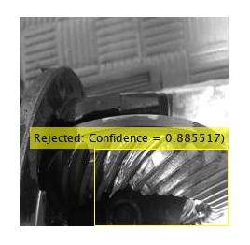
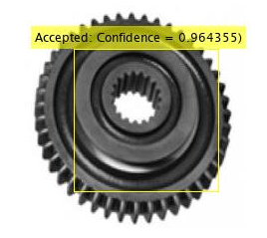
Story – Gear Fault Detection Algorithm
Fault detection of gears
Collecting custom datasets
Data pre-processing and dealing with small datasets
Predicting Bounding boxes
Result Visualization & Optimization

Slide 6
INTRODUCTION TO CNNs
WHY CONVOLUTIONS?
Inputs can be really big, especially for higher resolution images.
This will increase the number of parameters in the hidden layers
it will be difficult to get that much data to prevent the model from overfitting.
To not be stuck using very small images, we need to perform convolution.

Slide 7
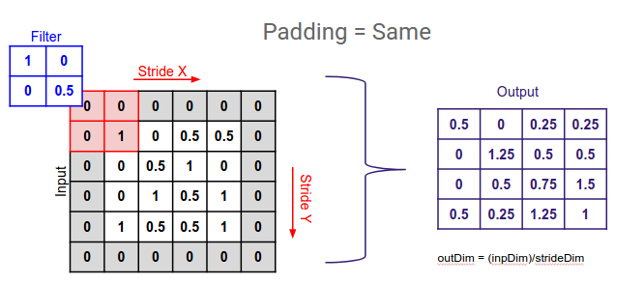
PADDING

Slide 8
STRIDED CONVOLUTIONS
In strided convolution, we stride over ‘s’ nodes while convolving as shown in the example below:

Slide 9
TYPES OF CV PROBLEMS
TYPES OF CV PROBLEMS
Image Classification: Classify what is contained in an image (e.g., cat, dog, person, truck, car)
Image Localization: Provide the exact location of a particular object in an image
Object Detection: Provide the exact locations of multiple objects in an image (you cannot infer the shape of an object, only its location)
Image Segmentation: Create a pixel-wise mask for each object in an image (you can infer the shape of the object)

Slide 10
Why Pooling?
Pooling layers are used to reduce the size of the representation to speed up computation as well as to make feature detection more robust.
Two types of pooling: Max pooling & average pooling (not used much anymore)

Slide 11
What is the function of FC layers?
Fully connected layers do the job of actually producing the output required from the activations obtained thus far
For example, a fully connected layer is the one which computes the probabilities that the object belongs to one of ‘n’ classes in a classification problem
It is also responsible for returning the coordinates of the object in a localization or detection problem
A flattened row vector is computed prior to being evaluated by an FC layer
In an FC layer, each neuron of the input is connected to the output fully

Slide 12
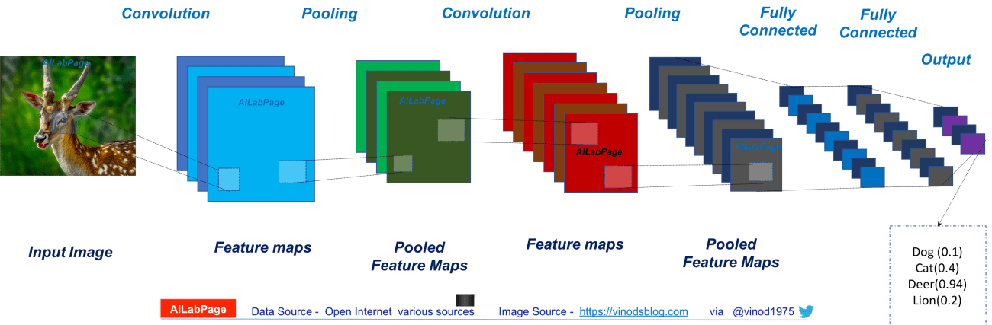
NEURAL NETWORKS
NEURAL NETWORK

Slide 13
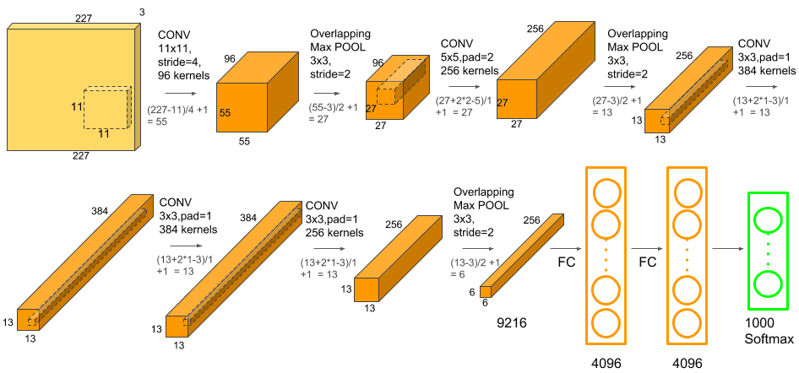
AlexNet
AlexNet is named after the original first author of the paper that introduced this architecture.
Won ImageNet challenge 2012. At the time of this paper, GPUs weren’t very powerful, so they devised a method to train nearly 60 million parameters of AlexNet with two GPUs communicating with each other

Slide 14
DISADVANTAGES OF CNNs
Large Datasets: For novel problems, huge amounts of data is required for each class
Class Imbalance: Not having same number of images for each class
Data sparsity: Difficult to find sufficient images for certain applications
Large training time: Consumes a large amount of computational power for training
Overfitting: Especially with smaller datasets, it tends to learn irrelevant details & overfits
Experience needed for hyperparameter tuning

Slide 15
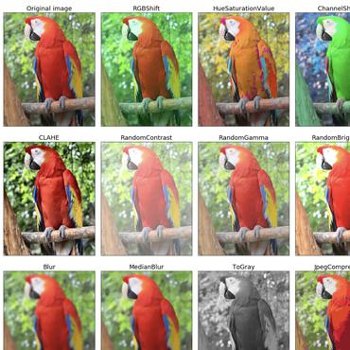
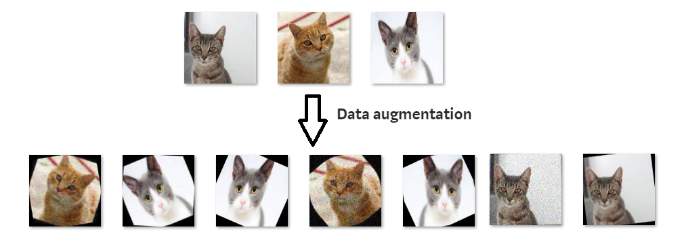
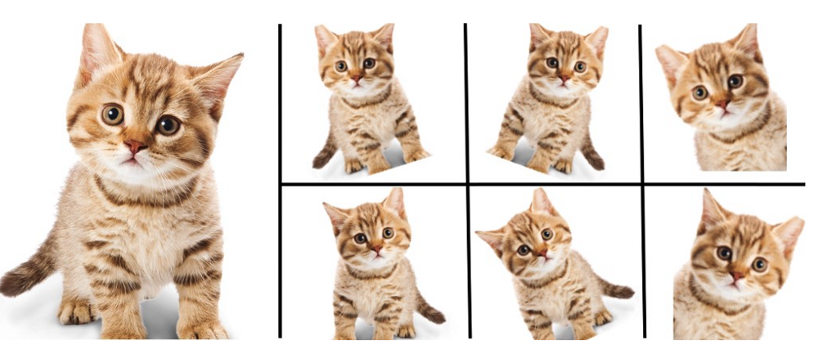
OVERCOMING OVERFITTING & UNBALANCED DATASETS DATA AUGMENTATION

Slide 16
TRANSFER LEARNING
The solution to large datasets issue

Slide 17
Practical Advice for using ConvNets
Small training set: Save computation and execution time, save the activations of all layers except the last softmax layer to the disk to train the parameters in the last layer.
If you have a larger training set: Save activations of a few layers before the output layer, not all of them.
Popular data augmentation methods used: mirroring, random cropping, shearing, rotation, colour shifting (using PCA [principle component analysis]
In general, in deep learning problems, when you don’t have enough data, a lot of hand engineering (manually hypertuning parameters, modifying the architecture etc) is required.
When you have more data, the algorithms become simpler and lesser hand engineering is required.

Slide 18
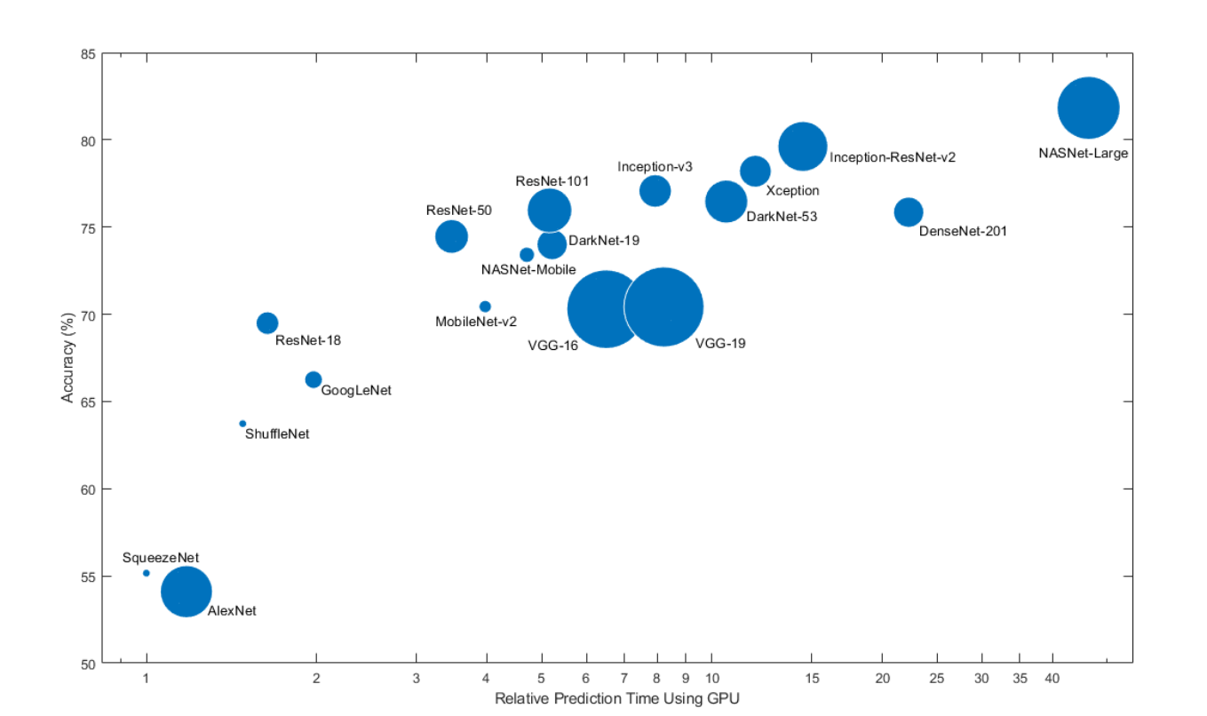
Comparison of pretrained models

Slide 19
ResNets
Its time for a deep dive

Slide 20
The problems of very deep neural nets…
Training time
Computational Costs
Exploding Gradients
Vanishing Gradients

Slide 21
Vanishing & Exploding Gradient Problem
Stochastic Gradient descent calculates the gradients of the loss wrt to the weights in the network
In vanishing gradients problems, the gradients wrt to weights in earlier layers become vanishingly small
Weight update becomes vanishingly small
Impairs ability of the network to learn
Earlier in the network the weight resides, more products are computed to calculate the gradient of the loss, and thus smaller it becomes
If you have gradients > 1, the opposite effect is exploding gradients

Slide 22
Introduction to ResNets
Why are ResNets useful in building very deep neural networks?

Slide 23
“Skipping” our way out of deep trouble

Slide 24
What are Skip Connections?
Reality: error will increase when the layer gets deeper than a certain value
Theory: error constantly needs to reduce with depth of the network
ResNets: Approaches theory
Skip connections take activations from one layer and feeds into another quite deep in the network
This enables the training of very deep networks having 100s of layers
ResNets are built out of residual blocks which are then stacked together

Slide 25
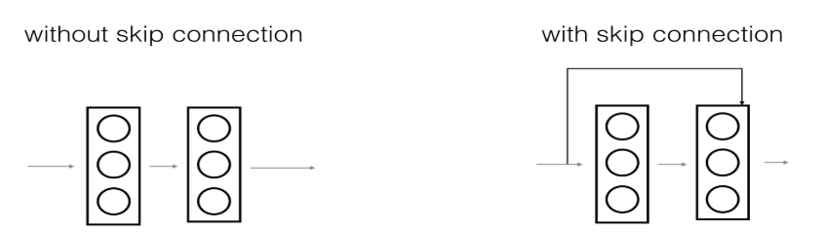
What are Skip Connections?
PLAIN NETWORK
RESIDUAL BLOCK

Slide 26
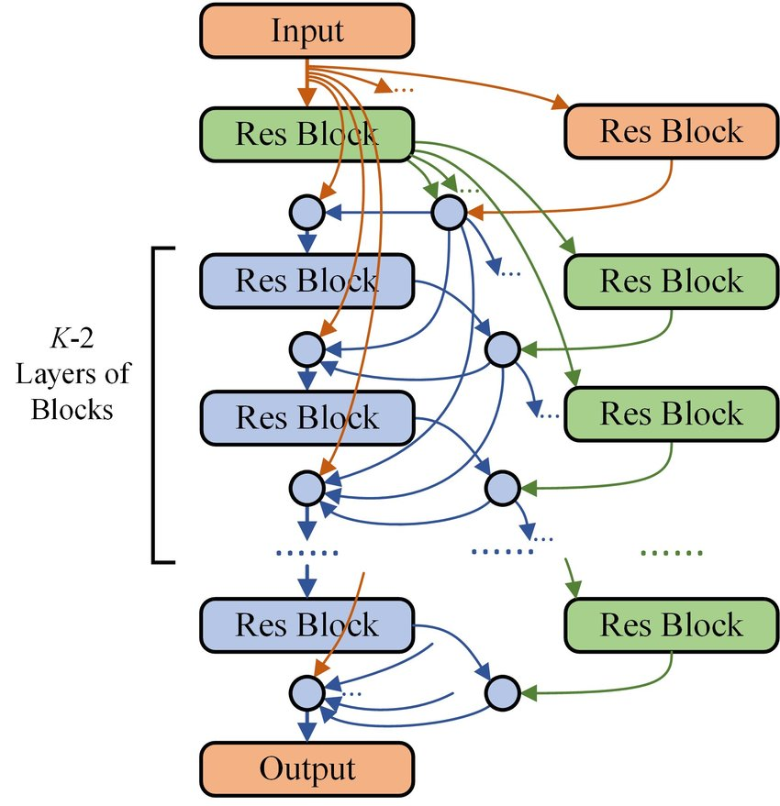
RESIDUAL NETWORK
Compose Residual network by stacking multiple residual blocks together

Slide 27
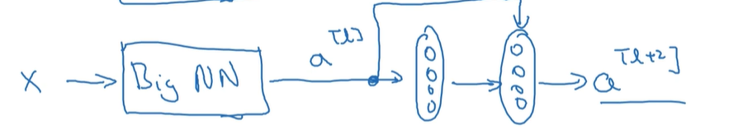
Why do ResNets work?
a ^{l + 2} = g(z ^{l + 2} + a ^{l} )
On applying L2 regularization (or weight decay), the z ^{l + 2} shrinks to 0
New activation is equal to a ^{l} because g(a ^{l} ) = a ^{l} if a ^{l} is positive
This is the identity function, and this is easier for ResNets to learn
By adding more layers, it does not hurt the performance because of ease in learning.
An important requirement for ResNets to work is that z ^{l + 2} and a ^{l} need to be of the same dimensions. Hence, in Resnets, we will see a lot of same convolutions being employed.
Stacking many of these residual blocks together results in the formation of ResNets

Slide 28
Inception Networks
We need to go deeper…

Slide 29
1x1 convolutions
1x1x32 filter: It takes the element wise product in each layer, and then a single number is the output after taking ReLU on that element wise product for each layer
Also called a Network in Network convolution
Using pooling layers decreases the height and width of the image
Using Nc 1x1xNc-1 convolutions, helps shrink the no. of channels of the image.
Reduces computation cost

Slide 30
How does CONV 1x1 reduce the computational cost?
WITHOUT 1X1 CONV
32*32*192 → CONV (5x5x192) x 28 → 32 x 32 x 28
Cost = 32 * 32 * 28 * 5 * 5 * 192 = 137M
WITH 1X1 CONV
32*32*192 → CONV (1x1x192) x 16 → 32 * 32 * 16 → CONV (5x5x16) x 28 → 32 x 32 x 28
Cost = (32*32*16*192) + (32*32*28*5*5*16) = 3.1M + 11.5 M = 14.6 M

Slide 31
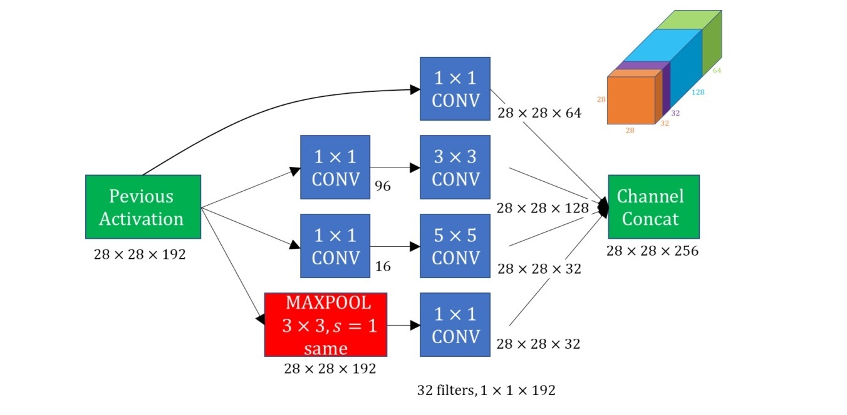
Inception Module
These inception modules/blocks that are stacked together one after the other form the inception layer
The only addition is that there are few side branches containing some softmax layers
Softmax layers takes the output of the hidden layers and tries to make a prediction – verifies intermediate results

Slide 32
Intuition: Inception Module
Instead of picking and choosing which filter to use for convolution and pooling, we use all our possible options (say 3x3, 5x5, 1x1 Conv & pooling) and stack the outputs together
Even a pooling layer is padded so that the output dimensions is the same as the input
The network then chooses which parameters to learn
The downside to this is that computational cost is very high. However be reduced by using a 1x1 convolution

Slide 33
MATLAB: ResNet-50 & Inception v3 for mask/no-mask classification

Slide 34
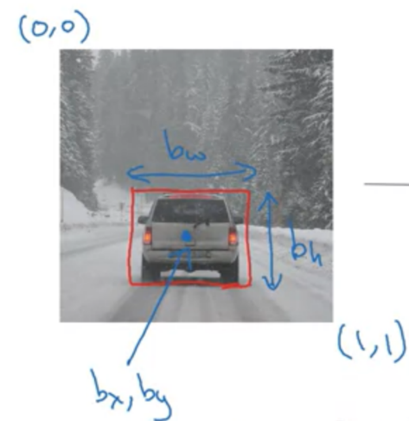
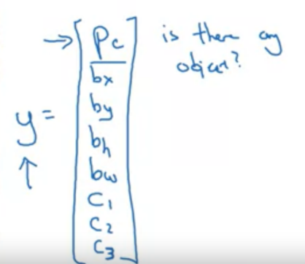
Object Detection

Slide 35
Object Detection
Object localization: In object localization problem, we have locate the position of a particular object in an image by drawing a bounding box around it.
In object detection, say for example, there are multiple cars in an image, we need to draw a bounding box around each car image.
It can even be multiple objects belonging to various classes.
In addition to classification, we need another softmax layer to give us the coordinates of the bounding box which contains the object of interest
Landmark detection: getting the coordinates of particular feature of an image, say the eyes of a person in an image, or the edges of their nose and mouth

Slide 36
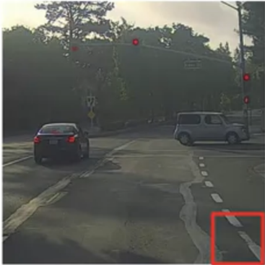
Sliding Window Detection
Once a ConvNet is trained to detect cars, we apply something called a sliding windows detection.
Define a window of a particular size and that window captures a certain portion of the input image
You then repeat this process with slightly larger windows each time and then combine the results.
Disadvantage: Computational Cost

Slide 37
Intersection over Unions (IoU)
A method to evaluate the object detection accuracy

Slide 38
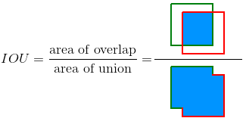
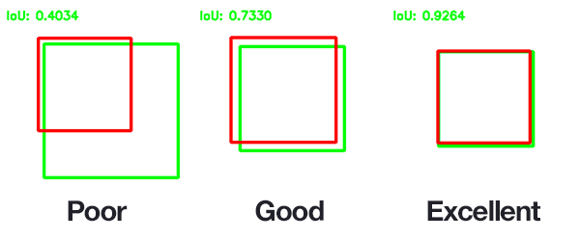
Computing IoU
Intersection – Area common to both the predicted bounding box and the ground truth bounding box
Union – Combined area of both predicted and ground truth bounding boxes
IoU = size of the intersection / size of the union. It is a measure of overlap between two bounding boxes
The localization is correct if the IoU is >= 0.5 as a convention
Higher the IoU, better the localization, highest being 1 when the predicted and ground truth bounding boxes overlap.

Slide 39
Non-max suppression
Retaining only what is truly important

Slide 40
Non-max suppression
In object detection, multiple grid cells might say that they have detected the object under consideration, even though the detections are of the same object (not to be confused with objects of the same class)
In this case, we need to make sure that only one bounding box is present for any given object
It suppresses the predictions whose probabilities are non-maximal
So only one bounding box with the highest Pc is retained, and all other bounding boxes, which have a high IoU with this bounding box are eliminated.

Slide 41
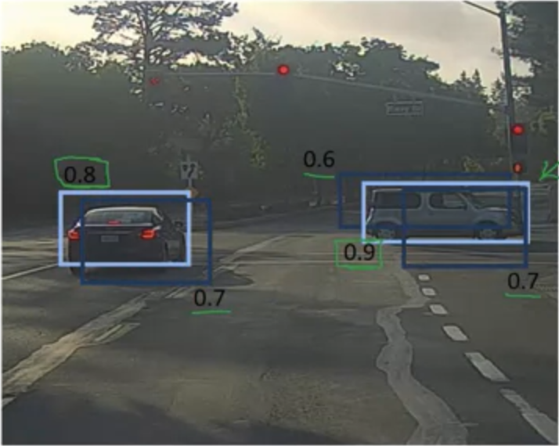
Non-max suppression

Slide 42
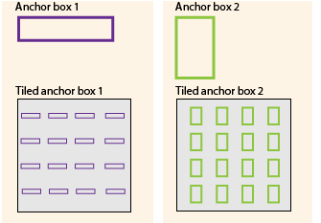
Anchor Boxes
One of the problems with what was described in object detection so far is that each box can only detect the presence of one object.
To solve this, we use the concept of anchor boxes, wherein, in addition to detecting an object, the detection is also associated with an anchor box.
The question of which detection belongs to which anchor box is answered by the IoU value between the predictions and the ground truth anchor box.
The detection assigned to the anchor box which has the highest overlap with the ground truth bounding box.

Slide 43
Region Proposals: RCNNs

Slide 44
Region Proposals: RCNNs
In region proposals, we do use send sections of the image where there is clearly no object into the ConvNet.
This is also called a segmentation algorithm, because you find blobs of pixels with similar values and only use those blobs to run into your ConvNet
R-CNN: Runs all the proposed blobs into the ConvNet one at a time
Fast R-CNN: Runs all the proposed blobs (using traditional CV) simultaneously using a convolution implementation
Faster R-CNN: Use a convolutional network to propose regions and identify blobs (i.e., image segmentation done using CNNs), and use a convolutional implementation to run those proposed regions on a ConvNet simultaneously

Slide 45
MATLAB: Image Labelling & Gear Detection with Faster RCNN

