Slide 1
Proposed Research Themes
Kaushik Balasundar
RIL, CPDM

Slide 2
Paper 1: One Shot Imitation Learning
Background of Researchers: Berkeley AI Research Lab, OpenAI
Year of publication: Dec., 2017
ABSTRACT
Goal is to make robots learn new tasks shown with one demonstration and quickly generalize to new situations of the same task using a meta-learning framework.
A neural network is trained such that after being given a demonstration, when given the state corresponding to the second demonstration, it should predict the necessary action.
Current systems require extensive feature engineering and lots of demonstrations.

Slide 3
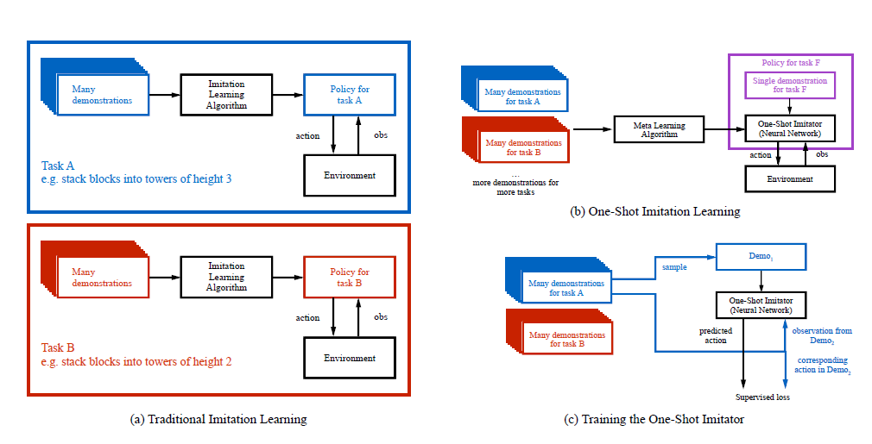
Paper 1: One Shot Imitation Learning
Why One Shot Imitation Learning?
Using reinforcement learning requires a large amount of time to learn from trial and error
Design of a reward function which is more difficult than actually showing a demonstration of the optimal task action required (as in Inverse Reinforcement Learning)
This approach relies heavily on ‘soft attention’ model.

Slide 4
Paper 1: One Shot Imitation Learning
Experiment Proposed
Equipment Used: 7DOF Fetch Robotic Arm
Task is to stack various alphabetical cube-shaped blocks into various configuration towers of varying heights using a single demonstration
In each configuration, the starting position might vary
This requires the learned policy to generalize within a given demonstration
Questions answered by experiments:
1. How does training with Behavioral cloning compare with DAGGER?
2. How does goal conditioning on the entire demonstration compare to conditioning on the final state, even when it already has enough information to fully specify the task? (Training on DAGGER)
3. How does goal conditioning on the entire demonstration compare to conditioning on a “snapshot” of the trajectory, which is a small subset of frames that are most informative? (Training on DAGGER)

Slide 5
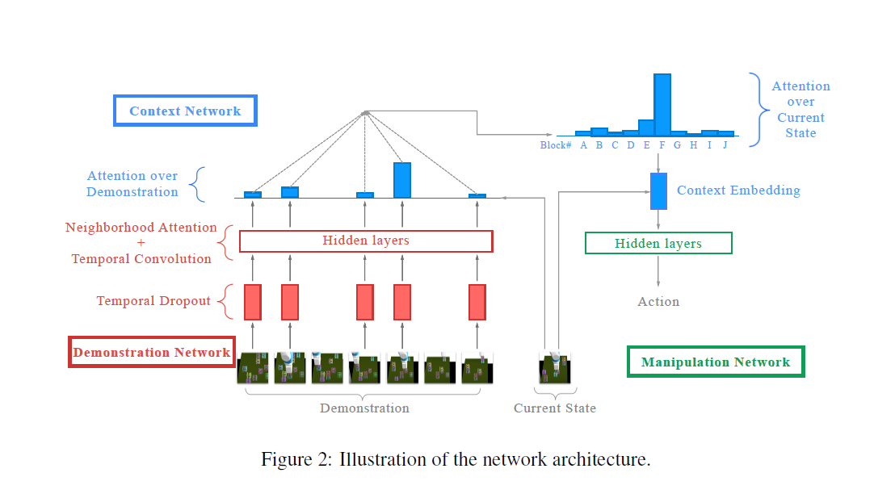
Paper 1: One Shot Imitation Learning

Slide 6
Paper 1: One Shot Imitation Learning
Directions for future work
Extend the framework to demonstrations in the form of image data, which will allow more end-to-end learning without requiring a separate perception module
Enabling the policy to condition on multiple demonstrations, in case where one demonstration does not fully resolve ambiguity in the objective
Scale up on a much larger and broader distribution of tasks, and explore its potential towards a general robotics imitation learning system

Slide 7
Paper 2: Creativity in Robot Manipulation with DRL
Background of Researchers: Carnegie Mellon University
Year of Publication: October, 2019
Abstract
In contrast to traditional control theory, DRL is more through in exploration of its environment, allowing the generation of human-like behaviour with creativity
They designed challenging manipulation tasks, to explore this capability

Slide 8
Paper 2: Creativity in Robot Manipulation with DRL
Why DRL over traditional control theory?
In traditional controls, robots depend heavily on human understanding of the task, the robot itself, and the environment
Robots assume perfect knowledge of the system’s description and the environment
DRL techniques enable robots to comprehensively explore the environment and learn appropriate solutions
Enables task generalization

Slide 9
Paper 2: Creativity in Robot Manipulation with DRL
Experiment
3 types of experiments that require the robot to move a box to the target location within the same table in a simulated environment
1. Ditch: The Robot and target are separated by a short ditch 2 cm deep and 2.5 cm wide, located at 26.25 cm from the origin
2. Wall: The Robot and target are separated by a short wall 3 cm high and 1 cm wide, located 28 cm from the origin, beyond reach of robot
3. TargetNear: The Robot and target are separated by a short wall 3 cm high and 1 cm wide, located 28 cm from the origin, not beyond reach by robot
Used negative sparse rewards as an incentive for quick exploration (Success: Score = 0; Failure: Score = -1)
Yet to be implemented on the real hardware

Slide 10
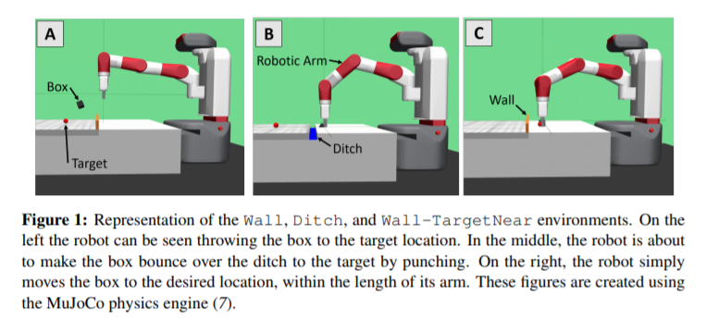
Paper 2: Creativity in Robot Manipulation with DRL
Demonstration of Creativity: Punching

Slide 11
Paper 2: Creativity in Robot Manipulation with DRL
Modified version of OpenAI’s Fetch-Slide environments
All experiments use the same Fetch robot that was used by OpenAI
Table has been modified to be bigger (82.5cm long and 65.0cm wide) and include either the ditch or the wall constraint
Powered by the MuJoCo physics engine
Architecture of DRL: Deep Deterministic Policy Gradients (DDPG) with Hindsight Experience Replay (HER)
Training system used: Intel Core i7-8700K CPU at 3.70GHz 12 cores server with a GeForce GTX 1080 Ti/PCIe/SSE2 GPU and 16 Gb of RAM, running Ubuntu 16.04

Slide 12
Paper 3: Zero Shot Visual Imitation
Background of Researchers: MIT, UC Berkeley
Publication: ICLR, 2018
Abstract
Imitation learning relies on strong supervision of expert actions.
Here, the agent first explores the world without any expert supervision and then distills its experience into a goal-conditioned skill policy. The role of the expert is NOT to train, only to communicate the goal.
Agent has no access to expert training data, and thus called ‘Zero-Shot’.

Slide 13
Paper 3: Zero Shot Visual Imitation (ZSVI)
Why Zero Shot Visual Imitation?
Traditional LfD requires the expert to either manually move the robot joints or teleoperate the robot to execute the desired task several times during training process
In ZSVI, agent explores the environment without any expert supervision or extrinsic rewards and distills this exploration data into goal-directed skills (actions to be taken to move robot from current state to goal) called Goal Conditioned Skill Policy (GSP)
Instead of learning by imitation, the proposed agent learns to imitate by acquiring skills during exploration
Can also be extended to robot navigation

Slide 14
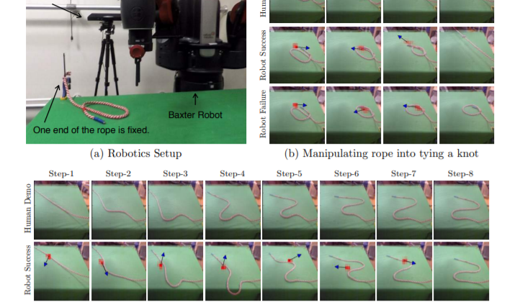
Paper 3: Zero Shot Visual Imitation
Experiment
Rope manipulation to tie a knot shown by the expert
Using Baxter robot
Policy extended to office navigation on a TurtleBot
There are multiple possible ways of going from one state to another, and not the only one shown by the demonstrator. To promote all possibilities, the novel ‘forward consistency loss’ function incentivizes reaching the goal and ignores how it is reached
Sometimes, the skills acquired are insufficient to directly transition from current to goal state. In such cases, the experts feed in an intermediate step before the goal can be attained.

Slide 15
Paper 4: Learning Synergies between Pushing and Grasping with Self-supervised Deep Reinforcement Learning
Background of Researchers: Princeton University, Google, MIT
Year of Publication: IROS, Sept., 2018 (Best Cognitive Robotics Paper)
SUMMARY:
In this work, they demonstrate that it is possible to discover and learn these synergies from scratch through model-free deep reinforcement learning
Involves training two fully convolutional networks that map from visual observations to actions: one for utility of pushes and another for utility of grasping
Both networks are trained jointly in a Q-learning framework and are entirely self-supervised by trial and error
Rewards are provided from successful grasps
Policy learns pushing motions that enable future grasps due to this reward
Qualitatively tested using V-Rep simulation and U5
During picking experiments in both simulation and real-world scenarios, their system quickly learns complex behaviors amid challenging cases of clutter

Slide 16
Paper 5: Deep Reinforcement Learning for Industrial Insertion Tasks with Visual Inputs and Natural Rewards
Background of Researchers: Siemens, UC Berkeley
Year of Publication: Aug., 2019
Abstract:
Traditional controllers in such tasks can be inaccurate and need to be manually tuned
Paper shows that complex insertion tasks can be solved with RL where the goal is natural sparse reward signals (+1 for successful electrical connectivity and 0 if not) and goal images

Slide 17
Paper 5: Deep Reinforcement Learning for Industrial Insertion Tasks with Visual Inputs and Natural Rewards
Approaches:
End-to-end approach that learns a policy from images (which serve as state representation and goal specification). Visual data also provides robustness to sensor and actuator noise
Using simple sparse rewards. Sample requirements are reduced by using the prior knowledge on the task. To handle this challenge, we extend the residual RL approach, which learns a parametric policy on top of a fixed, hand-specified controller, to the setting of vision-based manipulation.

Slide 18
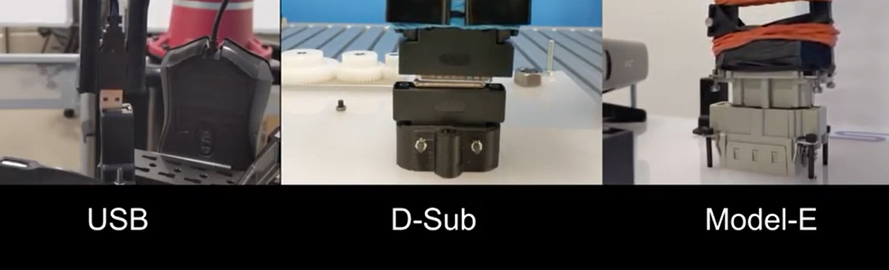
Paper 5: Deep Reinforcement Learning for Industrial Insertion Tasks with Visual Inputs and Natural Rewards
EXPERIMENTS:
Residual RL with easy-to-obtain reward signals
Two types of natural rewards that are intuitive for users to provide: an image directly specifying a goal and a binary sparse reward indicating success.
Questions to be answered:
(1) Can such trained policies provide comparable performance to policies that are trained with densely-shaped rewards?
(2) Are these trained policies robust to small variations and noise?

Slide 19
Paper 5: Deep Reinforcement Learning for Industrial Insertion Tasks with Visual Inputs and Natural Rewards
RESULTS:
Experiments show that a successful and consistent vision-based insertion policy can be learned from relatively few samples using residual RL.
All methods are able to achieve very high success rates in the sparse setting.
Results of the experiment with sparse rewards outperforms standard RL having perfect state information, with standard RL exhibiting only initial performance superiority.

Slide 20
Paper 5: Deep Reinforcement Learning for Industrial Insertion Tasks with Visual Inputs and Natural Rewards
Future Work
Focusing on multi-stage assembly tasks through vision for flexible manufacturing
Multi-step tasks involve adapting to previous mistakes or inaccuracies, which could be difficult but should be able to be handled by RL.

Slide 21
Proposed Research Topic
Implement zero-shot visual imitation on Multi-Object Manipulation & assembly
Reproduce these results using simulated model of Dobot Magician (ROS linked with OpenAI)
Intermediate action guidance through verbal commands from the expert as this can be more intuitive
Compare the results of path planning and collision avoidance with classical RRT based algorithms and test robustness against perturbations

