Slide 1
Nissan Aggregator
Solution Architecture
Jan, 2020

Slide 2


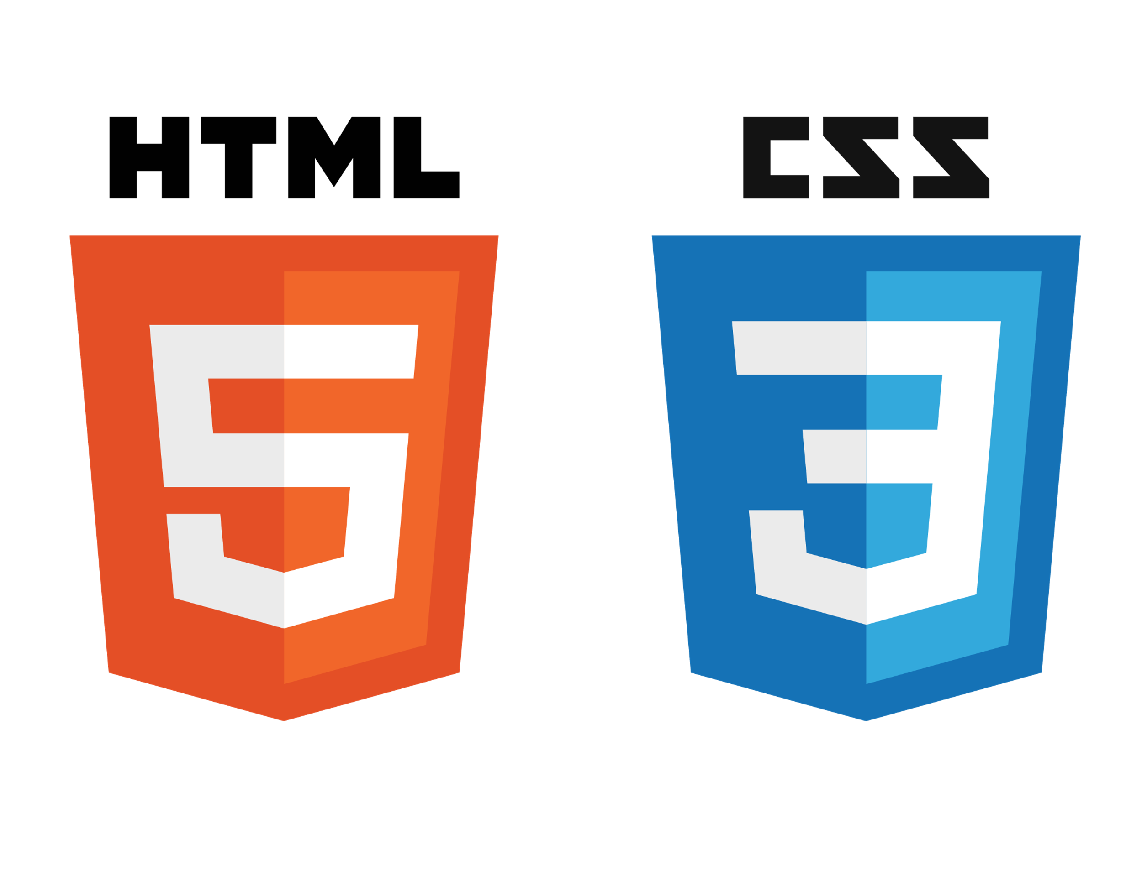




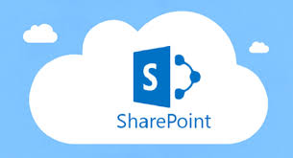
Technical Architecture
Command and Control- Deployment Diagram
Client/Browser
Identity Server
Web Server
Web Service Layer
<https>
Authorization
<https>
Business Layer
Authentication
Assessment
<https>
DAO Layer
<https>
Middleware Web Server
SMTP:25
User
Share point Metadata
Mail Server
Assessment
Database Server

Slide 3



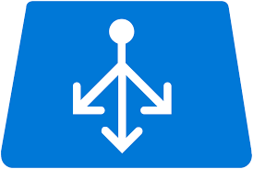

Deployment Architecture
Azure SQL
DB Server
Web Server
REST API
Azure Web Server 1
REST API
Client/Browser
Azure
Load Balancer
Azure Web Server 2
REST API
REST API

Slide 4
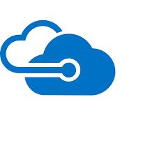



Security Architecture Diagram
Azure SQL
DB Server
Web Server
https:443
https:443
Azure Web Server 1
https:443
https:443
Client/Browser
Azure
Load Balancer
Azure Web Server 2
https:443
All other traffic blocked except 443
Azure Virtual Net

Slide 5
Nissan Aggregator – Components with License details
Component Name | License Type | License Under | Used For
PostGreSQL v12.1 | Open source |  | Data storage
Sharepoint File Storage |  |  | File Storage
React JS v16.10.2 | Open source | MIT | UI Framework
Bootstrap v4.0.0 | Open source | MIT | CSS Framework
Swagger v1.5.8 | Open source | Apache License 2.0 | API documentation framework
JDK 1.8 | Open Source | Oracle Binary Code License | Java App

Slide 6
Nissan Aggregator- Deployment Options
Artifact | Location | IaaS | Azure PaaS
Web Server | Genpact/Customer Cloud | A2 ( 2 Core, 3.5 GB Ram, 60 GB storage, Linux, CentOS) | Web App Standard Plan
Database Server | Genpact/Customer Cloud |  | PostGreSQL Server

Slide 7
Thank You

