Slide 1
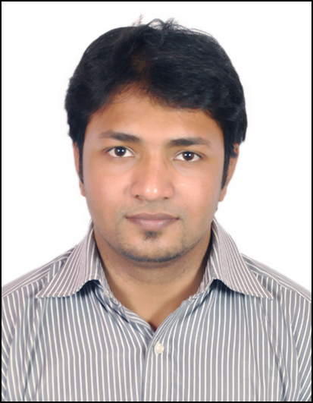
Kaushik Das– Senior Manager– Genpact Digital
Background
Currently working as Lead Full stack Developer and part of Technology Competency Group team - Genpact Digital, which leads technology, innovation and delivery acceleration.
Kaushik has 7+ years of solid experience in design and development for Product & Services. He has worked across the software product and professional services industry in various segments like Web application development, Cloud based SAAS & PAAS platforms, Technology Consulting and Cloud architecture & operations. In these 7+ years he has worked mostly in the design and development projects for Investment Banks.
Summary of recent experience
Employment History
Genpact: Senior Manager, Digital Consulting
Morgan Stanley : Manager
Citicorp India: Assistant Manager
Sony India Software Center : Senior Software Engineer
Skills
Full stack Lead Developer with experience on Java 1.8, React JS 16.x, Mongo DB, Kafka streams .
Web Techs: Spring boot, Microservices, SOAP, RESTful Services
Frameworks: Hibernate, JMS, Kafka, Drools, Lucene, Solr, Nutch, Elastic Search, EhCache, Hystrix, Jbehave, Apache Camel
Cloud: Amazon AWS –S3, EC2, ELB
Databases: Mongo DB, Redis MySQL
Tools: Git, Jenkins, Teamcity, Sonarqube, Splunk, Maven, Gradle
Agile Methodologies
Roles and Responsibilities:
Designed and Developed web based applications for Capital Markets, Credit Risk and Market Risk.
Worked on projects starting from scratch involving requirements gathering, design and development.
Extensive experience in developing backend applications in Java and React JS
Experienced in performance tuning of Java based web applications.
Experience:
Kaushik has worked extensively on Web technologies, developing products for Equities/Fixed Income/Mutual Funds, Rest based API development, SOA and Microservices, React JS and Redux, Rule Engine, Text based Search Engines etc. Kaushik has previously worked with Morgan Stanley, Citicorp Services India Pvt. Ltd, Pune and Sony India Software Center, Bangalore.
Added value for the customer
Create and execute customer centric tech strategy with end to end ownership from development, deployment and non functional requirements.
Provide technology consultancy and best practices in Web tech and Cloud operations for customers.
Evaluation and adoption new technology practices and leverage it with cost optimization for customers.
Roles
Lead Backend Developer
Full stack developer
Technology Consulting
Industries
Banking
E-Commerce
Education
B.Tech – NIT Silchar(7.53 CGPA)
Electronics and Communication Engineering
2008-2012

