Slide 1
Nissan Aggregator
Solution Architecture
Jan, 2020

Slide 2


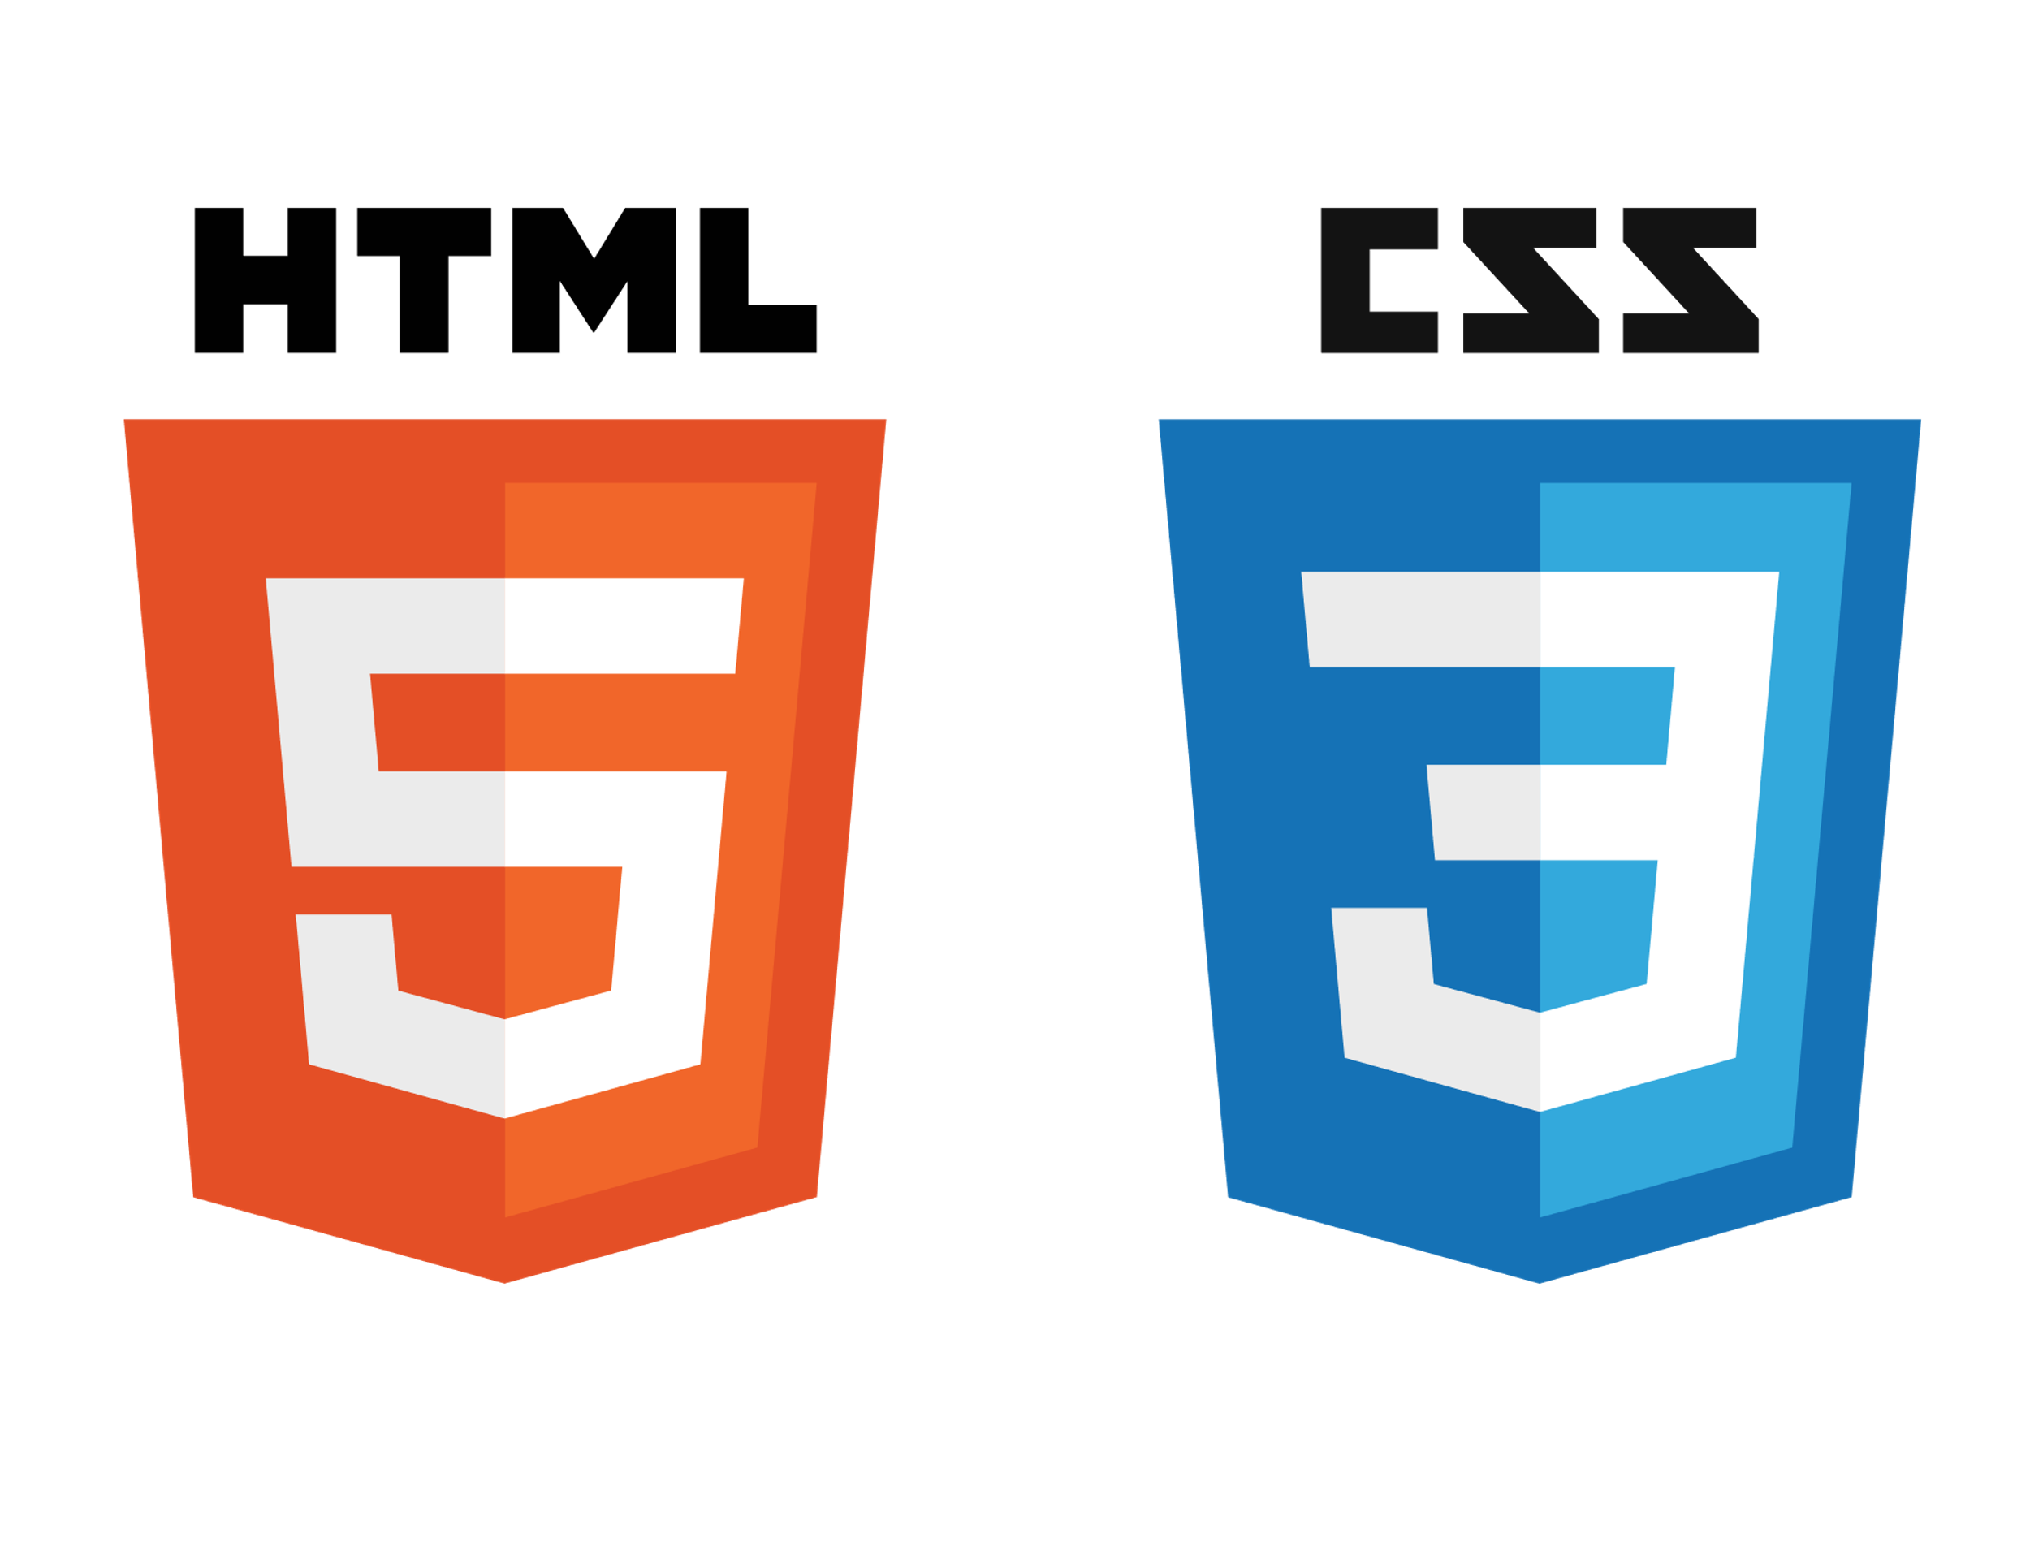





Technical Architecture
Command and Control- Deployment Diagram
Client/Browser
Identity Server
Web Server
Web Service Layer
<https>
Authorization
<https>
Business Layer
Authentication
Assessment
<https>
DAO Layer
<https>
Middleware Web Server
SMTP:25
User
Share point Metadata
Mail Server
Assessment
Database Server

Slide 3



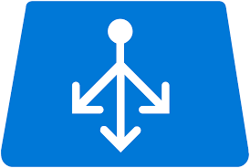

Deployment Architecture
Azure SQL
DB Server
Web Server
REST API
Azure Web Server 1
REST API
Client/Browser
Azure
Load Balancer
Azure Web Server 2
REST API
REST API

Slide 4
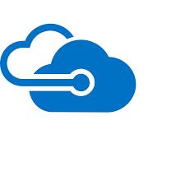



Security Architecture Diagram
Azure SQL
DB Server
Web Server
https:443
https:443
Azure Web Server 1
https:443
https:443
Client/Browser
Azure
Load Balancer
Azure Web Server 2
https:443
All other traffic blocked except 443
Azure Virtual Net

Slide 5
Appendix

Slide 6
Thank You

