Slide 1
Challenge 5 : Configuration Stack Driver Monitor on Kubernetes

Slide 2
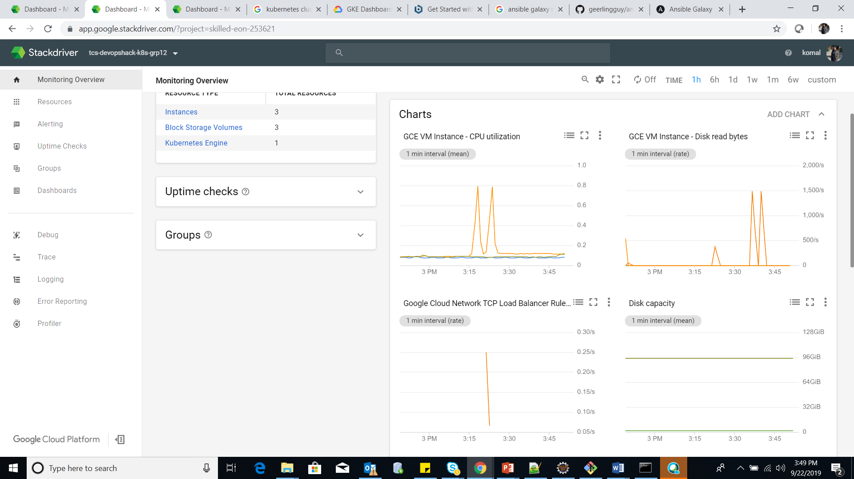

Slide 3
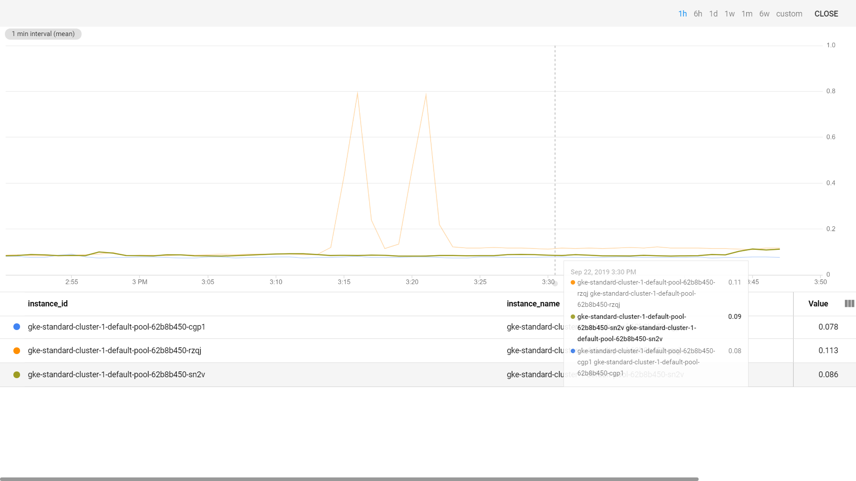

Slide 4
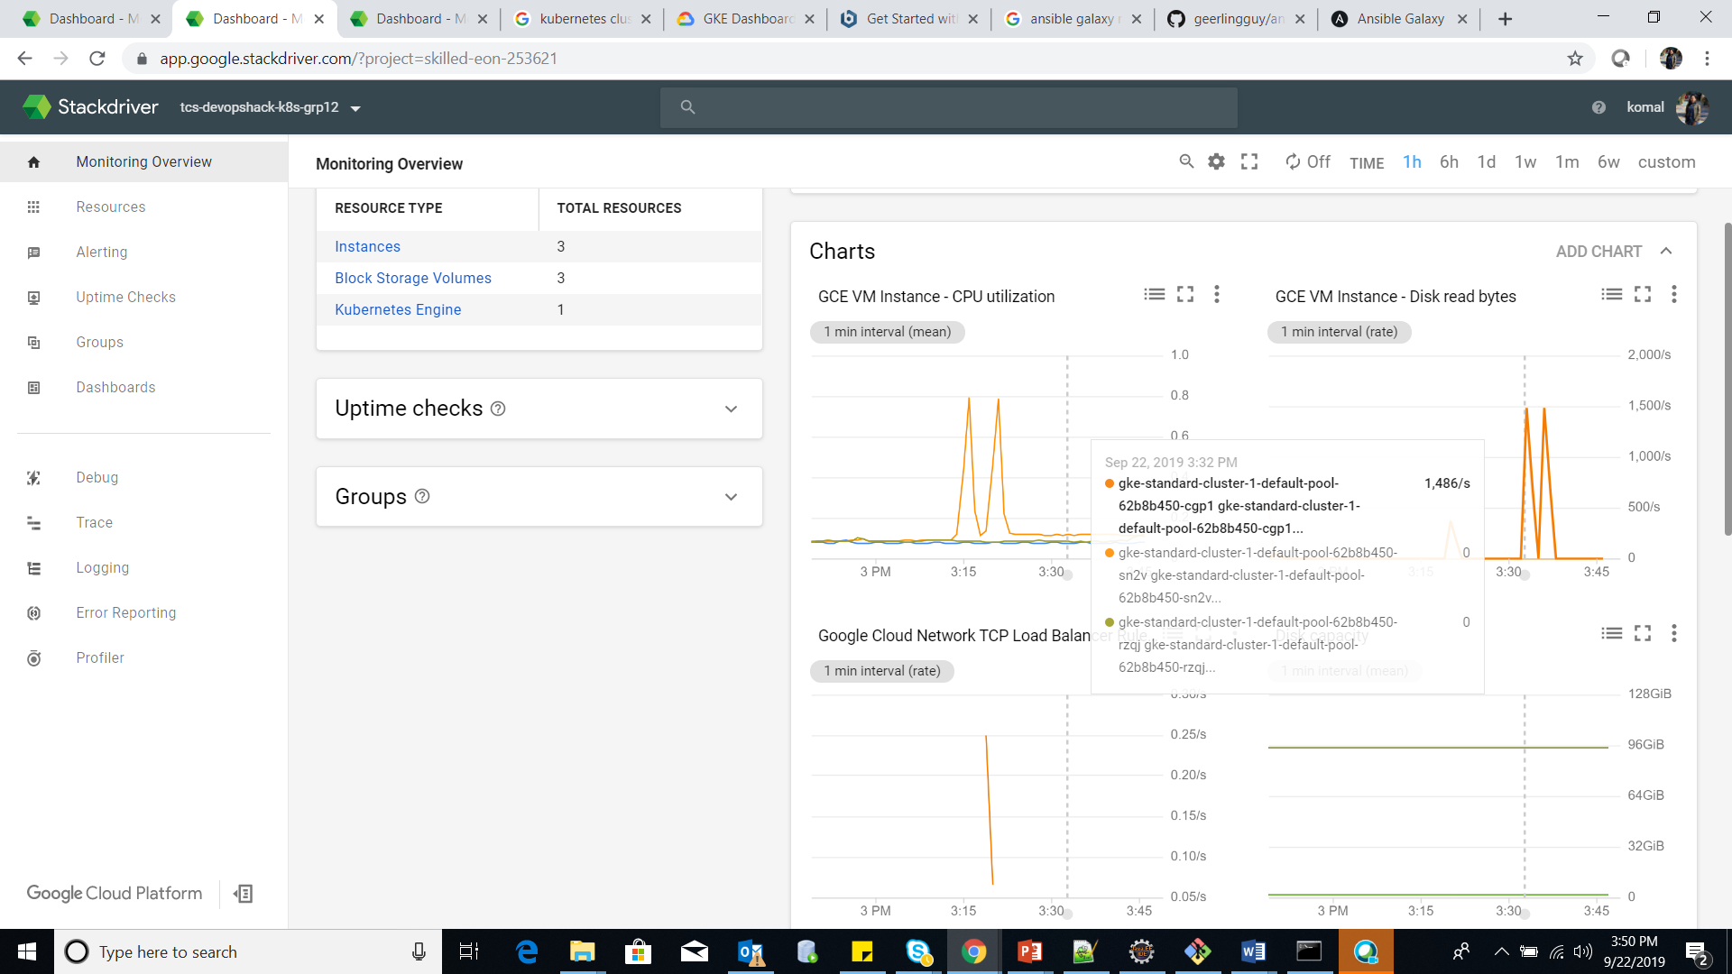

Slide 5
