Slide 1

Predicting Risk category of restaurant
By, 11 December 2020
Kaushiki Chauhan supervised by: Dr. Anthony breitzman

Slide 2
Table of content
Introduction
Objective
Steps for analysis
Intro to dataset
Data preparation and workflow
Different models
Results
References and acknowledgment

Slide 3
Statement of problem
Health Department in San Francisco has developed an inspection report and scoring system. After conducting an inspection of the facility, the Health Inspector calculates a score based on the violation observed.
Violations done by the restaurant fall into three category:
High Risk
Medium Risk
Low Risk
High risk may include food adulteration, contamination of food-contact surfaces or transmission of food borne illness.

Slide 4
Objective of this project
Collected a Live Score data from DataSF site to build a predictive model which will classify the risk category of the restaurants.
Data cleaning and preprocessing of Raw data collected.
Finding a best prediction model
Predicting the number of restaurants fall into category of low, medium and high.

Slide 5
Steps in Analysis
Data Collection
Data Preprocessing
Building Different Models
Best model based on accuracy

Slide 6
introduction to dataset
Column Name | Data type
business_id | Numeric
business_postal_code | String
business_latitude | Numeric
business_longitude | Numeric
inspection_date | String
inspection_score | Numeric
inspection_type | String
violation_id | Numeric
violation_description | String
risk_category | String

Slide 7
Data Preparation and workflow
4 years of restaurant inspection report data are collected(Source: Data San Francisco Health and Safety Services)
Due to redundant variables such as business city, business state, business address, business location, etc., dropped these columns from dataset.
Selected only a set of 10 important variables.
Handled missing values and excluded some of the data with more missing values from the initial dataset.

Slide 8
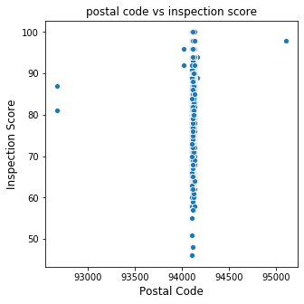
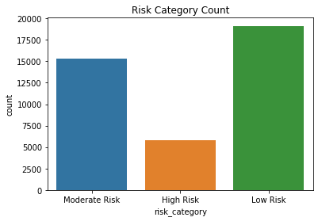
Graphical representation
First graph shows the number of predicting variable before splitting.
Second graph shows the postal code where more inspections being conducted.

Slide 9
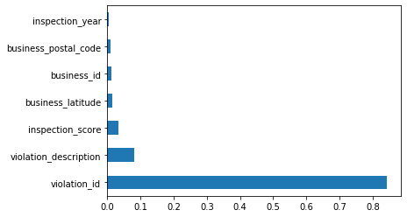
Feature Selection and scaling
Before building a predictive model, the best features are selected.
Also, applied feature scaling to improve the training performance.

Slide 10
Models Build for predictions
K-Nearest Neighbors
Support Vector Machine
Kernel SVM
Logistic Regression
Neural Network

Slide 11
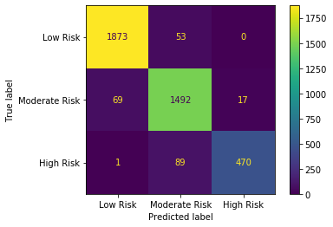
prediction table : K-Nearest neighbors
Prediction Accuracy = 94.3%
 | Precision | Recall | F1 Score
Low | 0.96 | 0.97 | 0.96
Medium | 0.91 | 0.94 | 0.92
High | 0.96 | 0.83 | 0.89

Slide 12

prediction table – Support Vector machine
Accuracy improved after feature scaling
Prediction Accuracy = 99.8%
 | Precision | Recall | F1 Score
Low | 0.99 | 0.99 | 0.99
Medium | 0.99 | 1.0 | 0.99
High | 1.0 | 0.99 | 0.99

Slide 13
Conclusion
SVM model has the best accuracy and KNN has the least accuracy
High accuracy is obtained by using feature scaling before splitting the dataset.
The final model shows that the restaurant which is at high-risk is less.
The restaurants which are identified as high-risk category can be inspected on a regular basis.

Slide 14
Thank You !

