Slide 1

Diabetic patient Readmission rate
By: Kaushiki Chauhan
Date: 05/03/2021
Supervised by: dr. Umashanger thayasivam

Slide 2
Agenda
Abstract
Introduction
Approach
Data Description
Exploratory Data Analysis
Data Preprocessing
Problem Statement
Methodology
Discussions and Results
Conclusion

Slide 3
Abstract
High risk of diabetic patient readmission in the US.
Goal: finding the major factors contributing to hospitals readmission.
Methods: Principal Component Analysis, Logistic Regression, Random Forest
Results: Change in medication occurs most frequently
Conclusion: prediction rate on patient readmission help hospitals to identify and provide treatment to patients at higher risk.

Slide 4
Problem Statement
Identify the major factors that mainly contribute to hospital readmission of diabetic patients within 30 days.
Measure the influence of each factors on readmission.
Compare accuracy of model.

Slide 5
Introduction
Diabetes Readmission Prediction Rate
Readmission Rate ?
Patient hospitalization that occurs within 30 days after the discharge.
By predicting the rate of readmission will reduce the cost of care and medical disputes.
Also, it will help in improving patient’s safety and health.

Slide 6
Approach
To understand factors affecting diabetes readmission and applying best possible model.
Data Pre-Processing
Exploratory Analysis
PCA and Correlation Analysis
Modelling
Performance Evaluation

Slide 7
Data Description
Attribute | Description
Race | one out of five categorical values
Age | Grouped in 10-year intervals: [0, 10), [10, 20), . . ., [90, 100)
Admission type | Integer identifier corresponding to 9 distinct values, for example, emergency, urgent, elective, newborn
Discharge disposition | Integer identifier corresponding to 29 distinct values, for example, discharged to home, expired, and not available
Time in hospital | in days
Glucose serum test result | >200, >300, normal or none
A1C test result | >7%, >8%, normal or none
23 diabetic medications | with values of no, up, down, and steady
Diabetic Medication | Whether there was any diabetic medication prescribed or not
Readmitted | Days to readmission
Data source: The data is from the Center for clinical and Translational Research, Virginia University
The dataset represents 10 years of clinical care at 130 US hospitals. It includes 101,766 instances and 55 variables representing patient and hospital outcomes

Slide 8
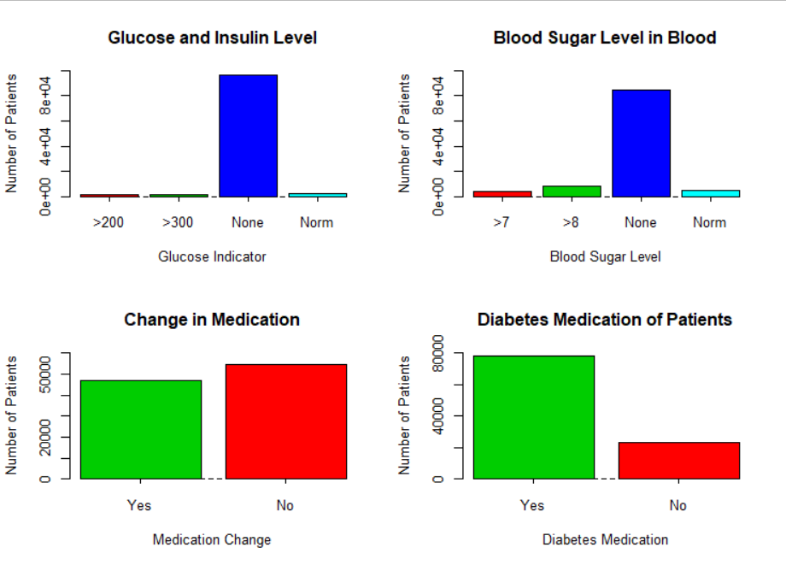
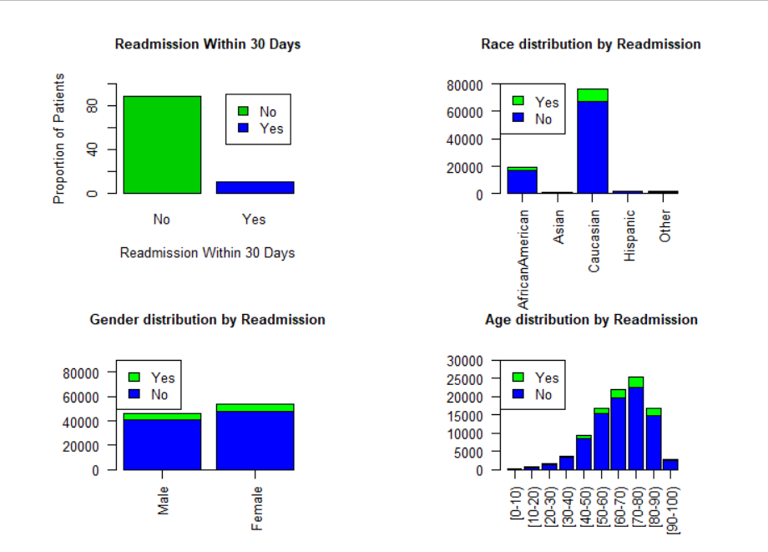
Exploratory Data Analysis

Slide 9
Data Preparation
Some of the variables in dataset are removed like
Variables having around 97% missing values
Identifiers of each records
Removed irrelevant variables like payer code, citoglipton, examide(NO values)
Dependent variable has changed to numeric value
Readmission < 30, then 1
Readmission > 30 or NO, 0
PCA and Correlation Analysis was done to find most influential variables.

Slide 10
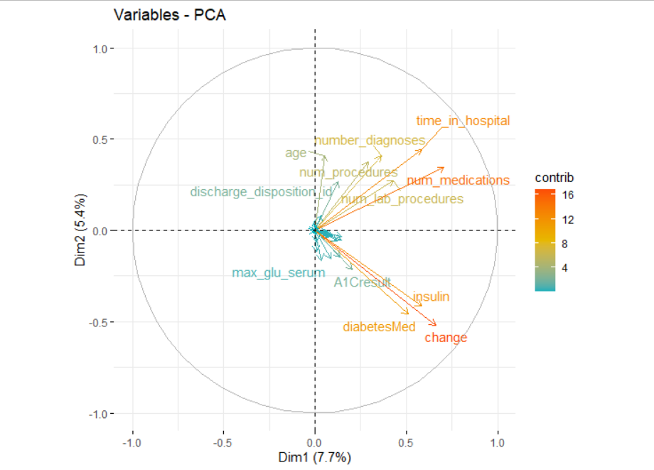
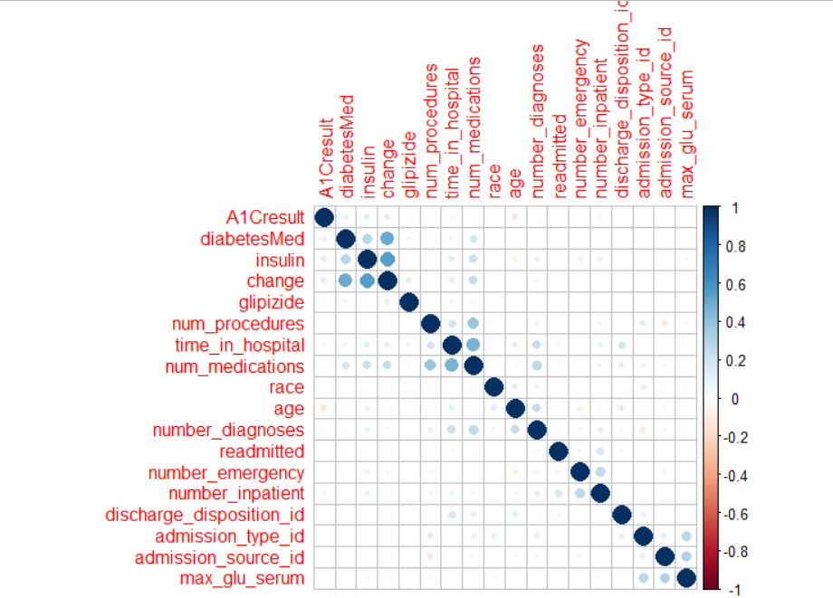
PCA and Correlation Analysis

Slide 11
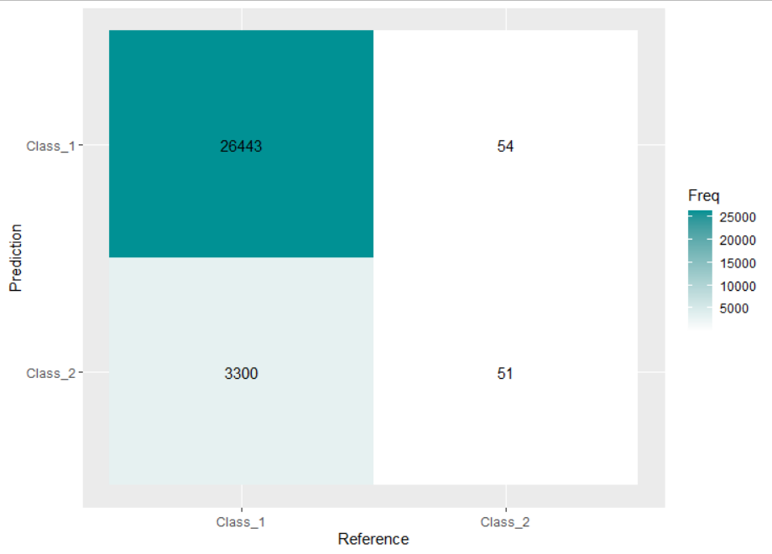
Discussion and Result
Partition: 70% training and 30% validation data
Used Logistic Regression and Random Forest for Readmission classification.
Logistic Regression Accuracy - 88.76%
Random Forest Accuracy – 82.62%

Slide 12
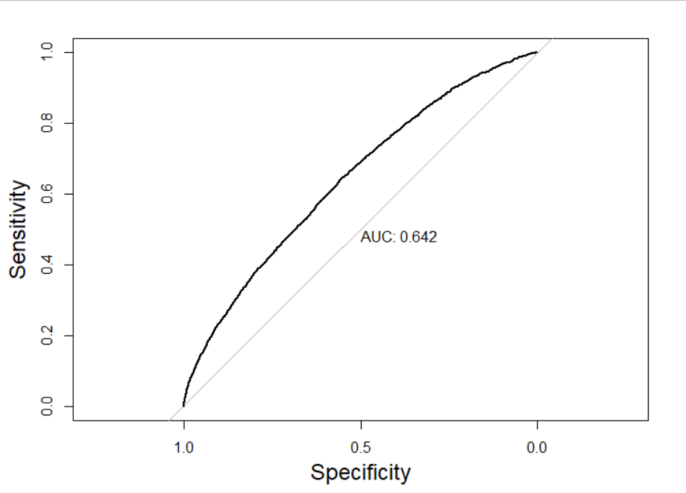
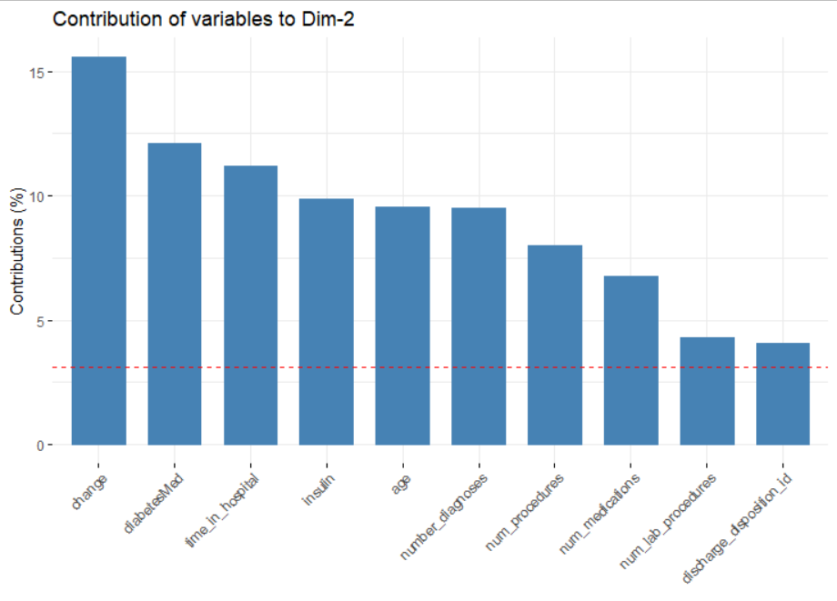
Significant Variables

Slide 13
Limitations & Conclusion
Logistic Regression gives better accuracy than Random Forest.
Random Forest took a long time to work hence would be future work.
Instead of tracking all 50 attributes, hospitals are suggested to focus on number of patient’s change in medicine, diabetes medication, age, insulin, number of diagnosis, lab procedure, discharge disposition
Computation time was the major challenge because of multivariate large dataset.

Slide 14
THANK YOU

