Slide 1

IDC Classification in Breast Cancer Histopathology using Transfer Learning
Team ID: Team 4
Members:
Kaushik Arvind Jadhav (kajadhav)
Ajith Kumar V Patchaimayil (avinaya)
Aditya Srivastava (asrivas7)
Course: CSC 591-071 - Neural Networks & Deep Learning
Instructor: Dr. Edgar Lobaton

Slide 2
01
Introduction
02
The Dataset
03
Data Pre-processing
04
Handling Imbalanced Data
05
Train Test Split
06
Image Augmentation
Contents
07
Regularization
08
The Baseline Model
09
Baseline model Results
10
Transfer Learning Model (VGG16)
11
Transfer Learning Results
12
Hyperparameter Tuning
13
Future Work
14
References

Slide 3

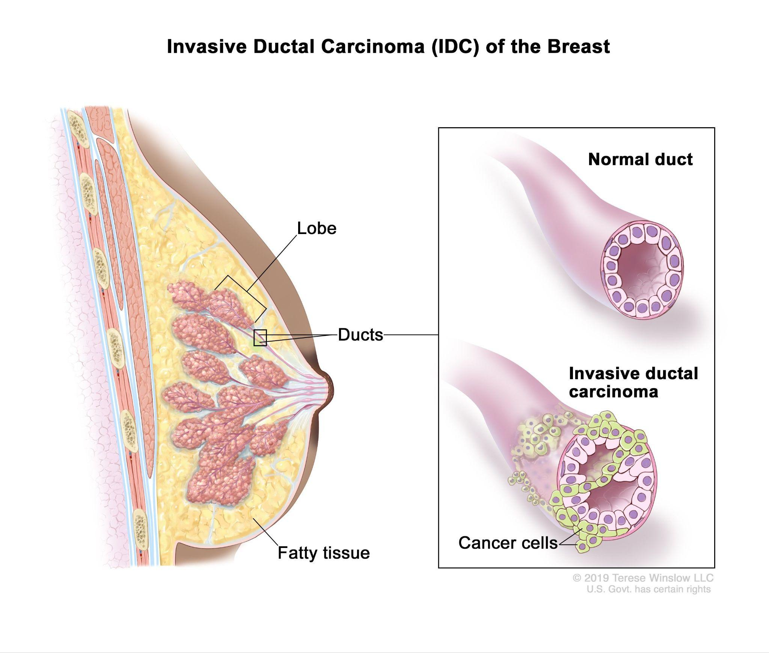
Introduction
Breast cancer forms in breast cells and is considered as the second most common type of cancer in women [4]. According to WHO, an estimated 9.6 million women passed away in 2018 due to this [1]. In 2023, it is predicted that 42,000 women in the United States alone will die from this disease [4]. Early detection of breast cancer seemingly increases a patient's chances of survival and previous studies have shown the successful application of Convolutional Neural Network (CNN) to classify Invasive Ductal Carcinoma (IDC) type cancer from Breast Histopathology images [2], [3], [4].
In this project, we aim to further enhance the classification performance of CNNs using transfer learning model of VGG16. We also employ techniques like Regularization, Early Stopping, Data Augmentation, Cross Validation and Hyperparameter Optimization during various phases of the project.

Slide 4
The Dataset
The dataset is the IDC type Breast Histopathology Images dataset made available on Kaggle by Paul Mooney. The inputs are 277,524 patches of size 50x50 extracted from 162 whole mount slide images of Breast Cancer (BCa) specimens [1]. The output will be in the form of class labels 0 and 1 where 0 is non-IDC, that is benign and 1 is IDC, that is malignant.
Data Collection

Slide 5
Challenges
In the first phase of the project we faced challenges like the data was not being properly formatted and also the class labels were imbalanced. The challenges and their respective solutions are discussed in more detail in next sections
In the second phase, we faced the challenges of not being a generalized model. we tackled this in using Stratified K-fold cross validation and then also improved model accuracy using hyperparameter tuning
Data Collection

Slide 6
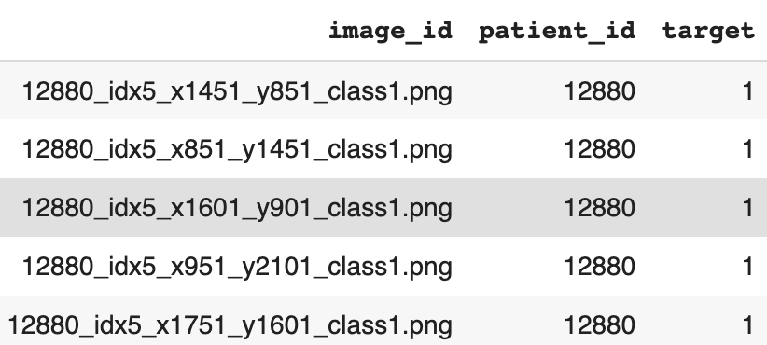
Data Pe-Processing
Data Pre-Processing
The dataset contains images stored in directory structure format of: IDC_regular_ps50_idx5/<patient_id>/<class_label>/<image_name>.png
The data in this directory structure would be difficult to process. So we store it in the format of: train_dir/<class_label>/<image_name>.png
Further, we load the data using pandas and perform a few numpy operations after which the data looks like:
Data Pre-processing
Data Collection
Finally, we read the images using openCV functions and visualize it.

Slide 7
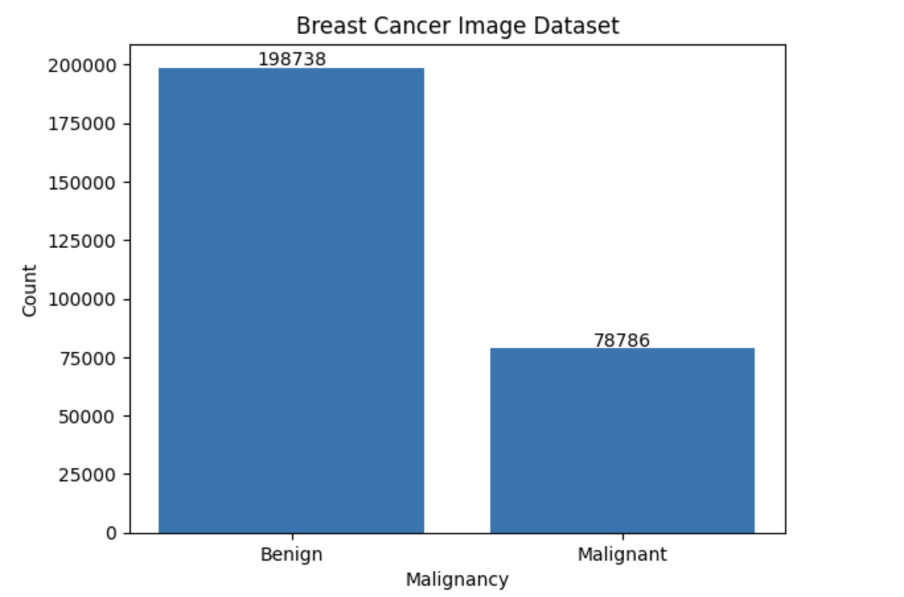
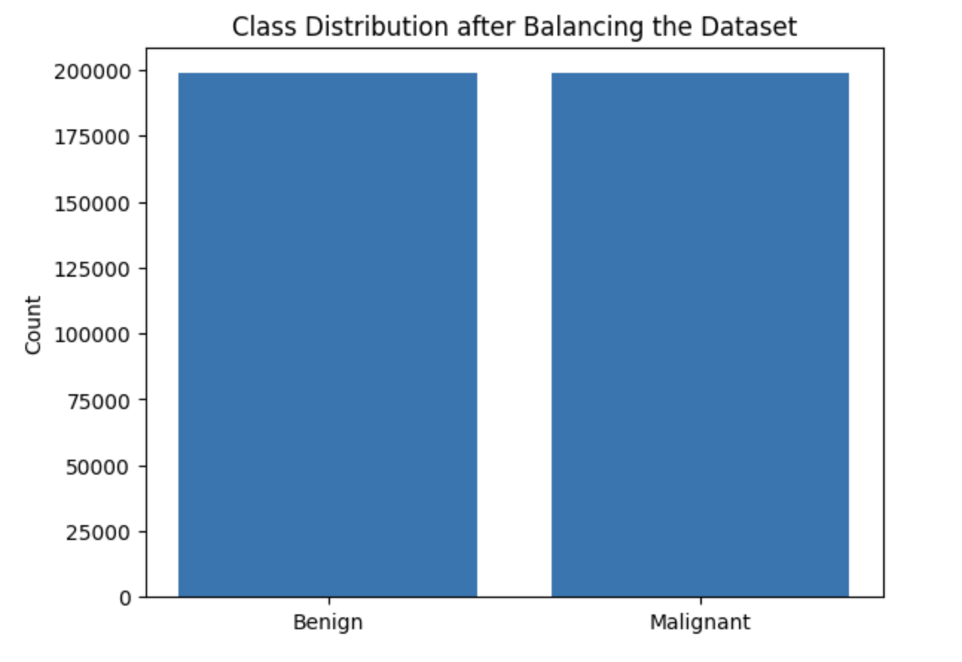
Handling Imbalanced Data
After visualizing initial data, we see that it is highly imbalanced as it has many more class 0 rows than class 1 rows as shown in Fig 1 alongside.
To balance the dataset, we make use of RandomOverSampler after which the data looks as shown in Fig2.
Data Pre-processing
Data Collection
Balancing Data

Slide 8
Train Test Split
Once the dataset is balanced, we split the data into train, test and validation datasets.
85% data is kept for training and 15% for testing. The 85% data is further split into 75% training dataset and 15% validation dataset:
from sklearn.model_selection import train_test_split
X_train, X_test, y_train, y_test = train_test_split(X_resampled, Y_resampled, test_size=0.15, random_state=42)
X_train, X_val, y_train, y_val = train_test_split(X_train, y_train, test_size=0.15, random_state=42)
Data Pre-processing
Train Test Split
Data Collection
Balancing Data

Slide 9
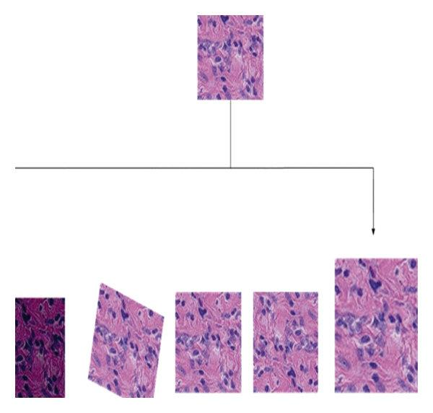
Image Augmentation
We perform image augmentation to generate new transformed versions of images from the given image dataset to increase its diversity.
We consider multiple combinations of images, like at different
Zoom, Rotations or Angles as depicted in the figure alongside.
Regularization
Furthermore, after training we apply L2 Regularization with a lambda value of 0.0001. Also, we add Dropouts with 0.5 threshold after Dense layers to avoid overfitting.
Data Pre-processing
Train Test Split
Data Collection
Balancing Data
Image Augmentation & Regularization

Slide 10
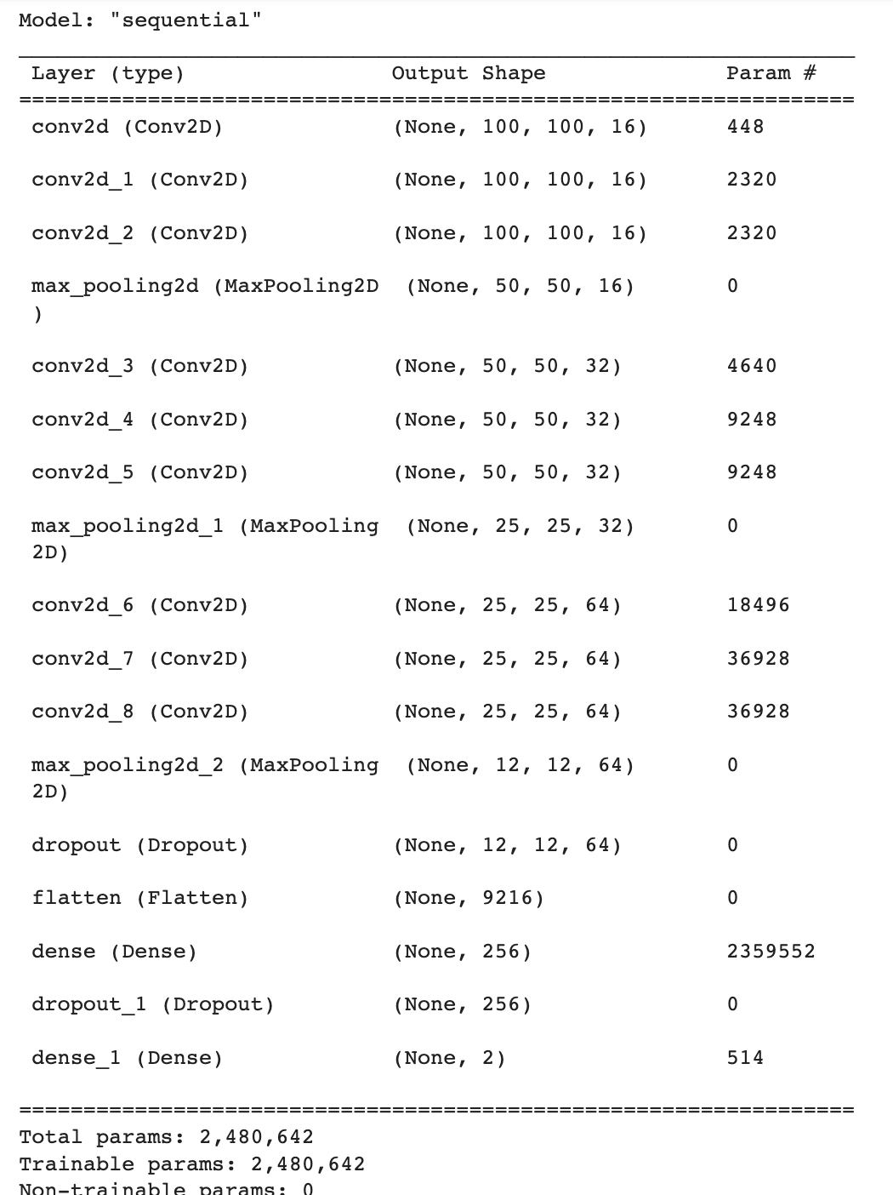
The Baseline Model
There have been previous successful attempts to classify IDC type Breast Histopathology images using a Convolutional Neural Network (CNN).
So, we use a CNN with 3 sets of 3 convolution layers followed by a Max Pooling layer. After this we add a few Dropout and Flatten layers and finally the final output layer.
We compile the model with binary_crossentropy and adam optimizer.
Data Pre-processing
Train Test Split
Data Collection
Balancing Data
Image Augmentation & Regularization

Slide 11
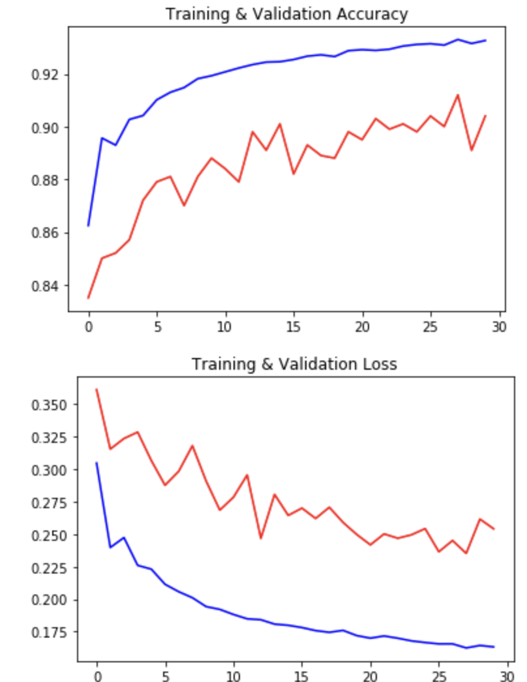
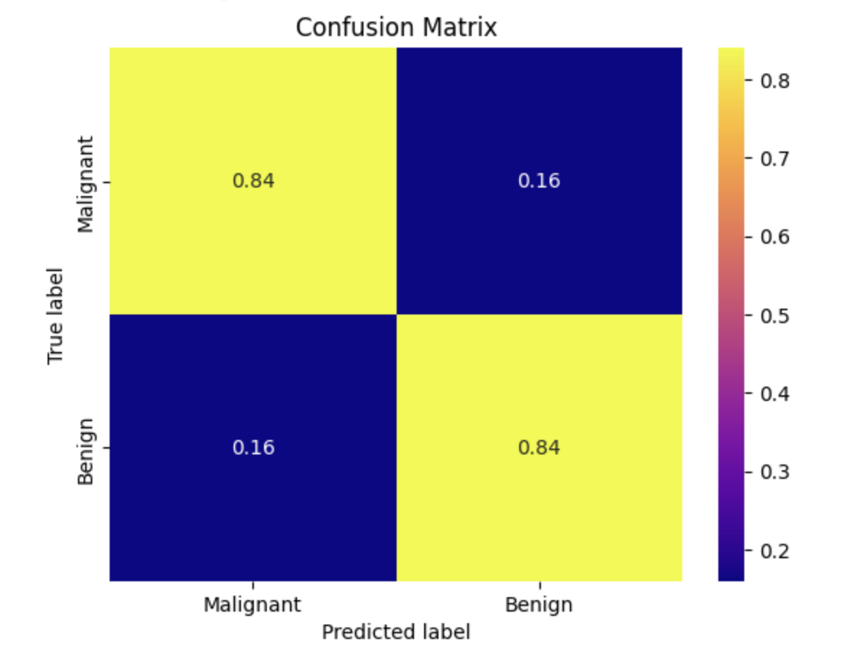
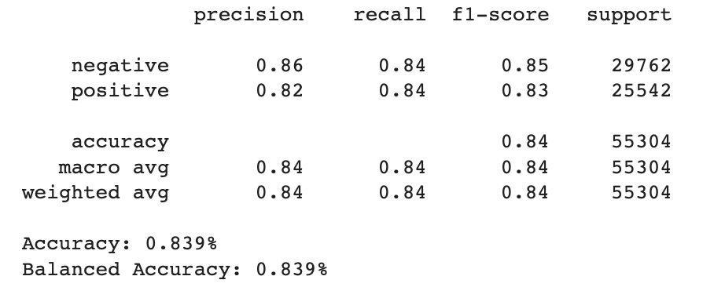
Baseline Model Results
Data Pre-processing
Train Test Split
Baseline Model
Data Collection
Balancing Data
Image Augmentation & Regularization

Slide 12
Transfer Learning Model (VGG16)
The baseline model had a low metrics like accuracy and precision score. So for our transfer learning model, the goal is to improve these metrics and come up with a more efficient model.
We use transfer learning by combining the baseline CNN with a VGG16 model.
We compile the model with binary_crossentropy and adam optimizer.
Data Pre-processing
Train Test Split
Baseline Model
Data Collection
Balancing Data
Image Augmentation & Regularization
Transfer Learning

Slide 13
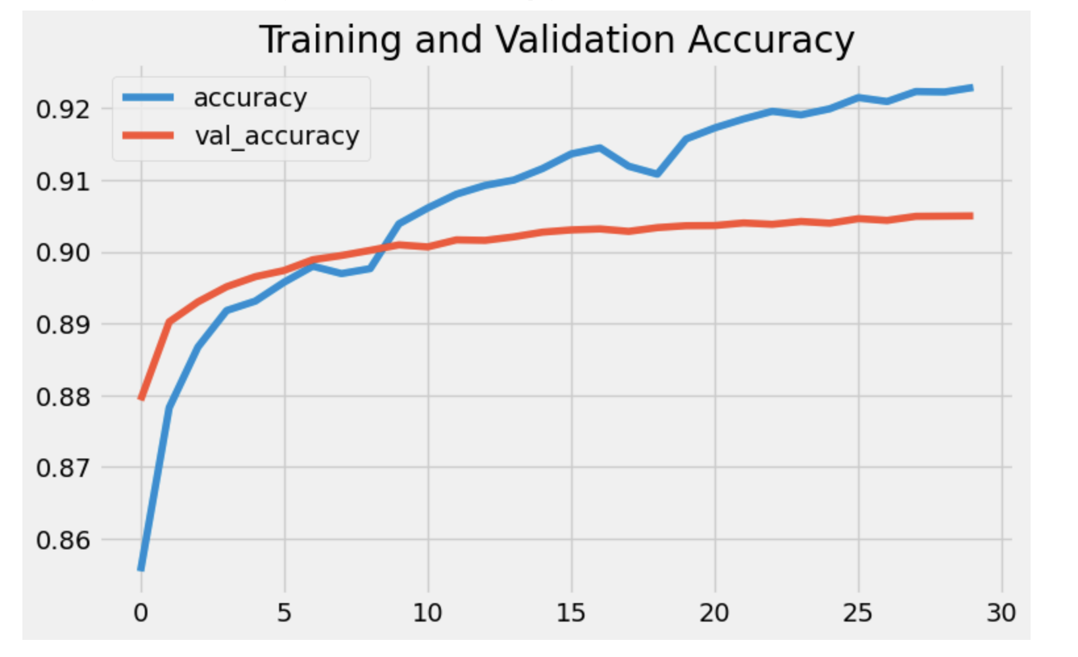
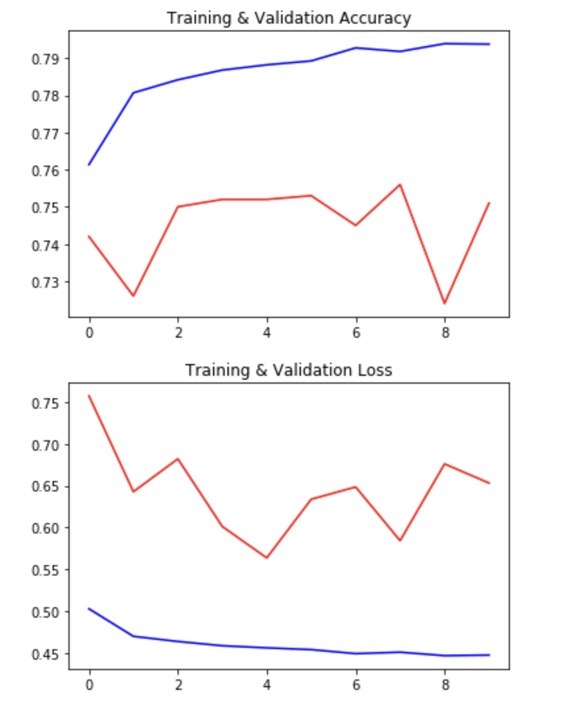
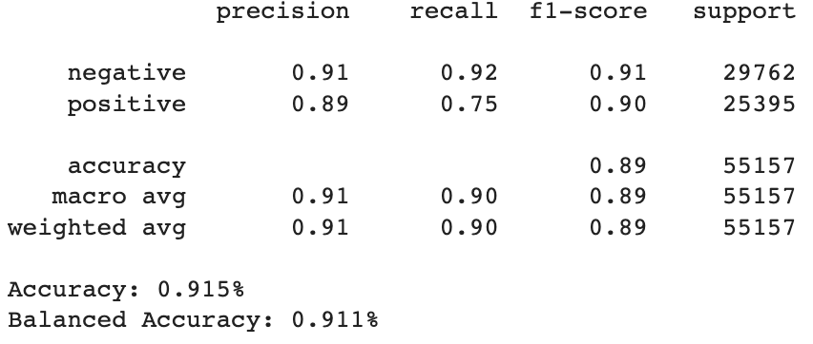
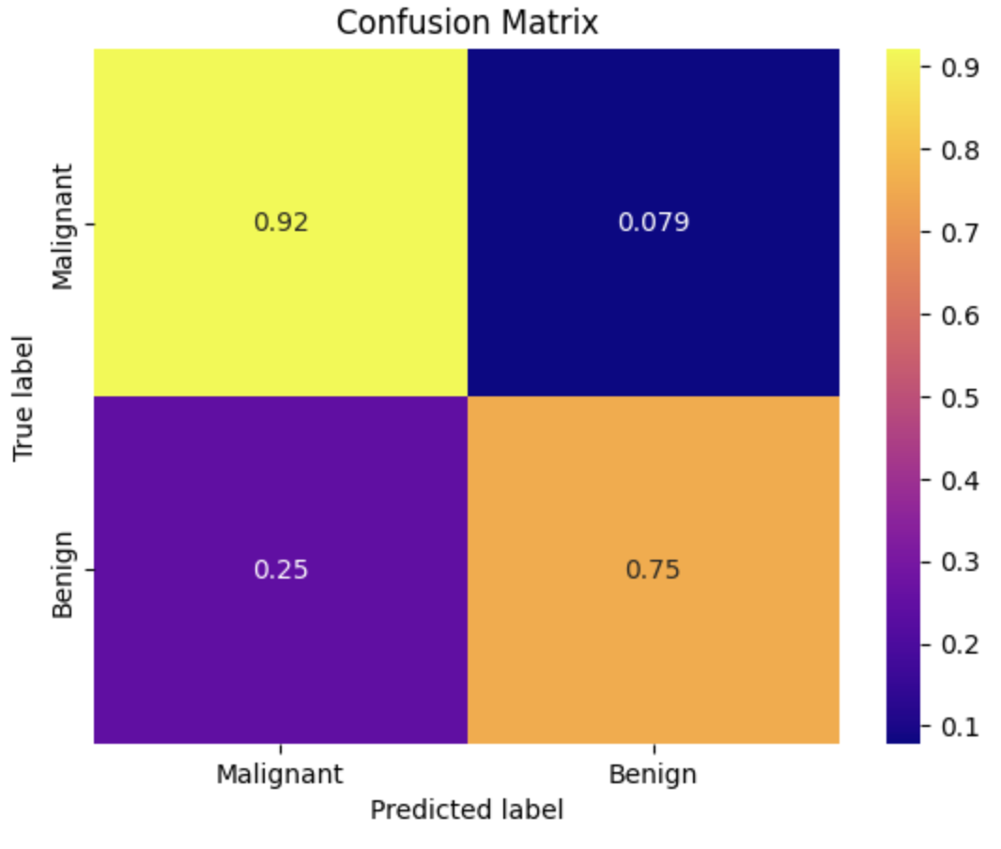
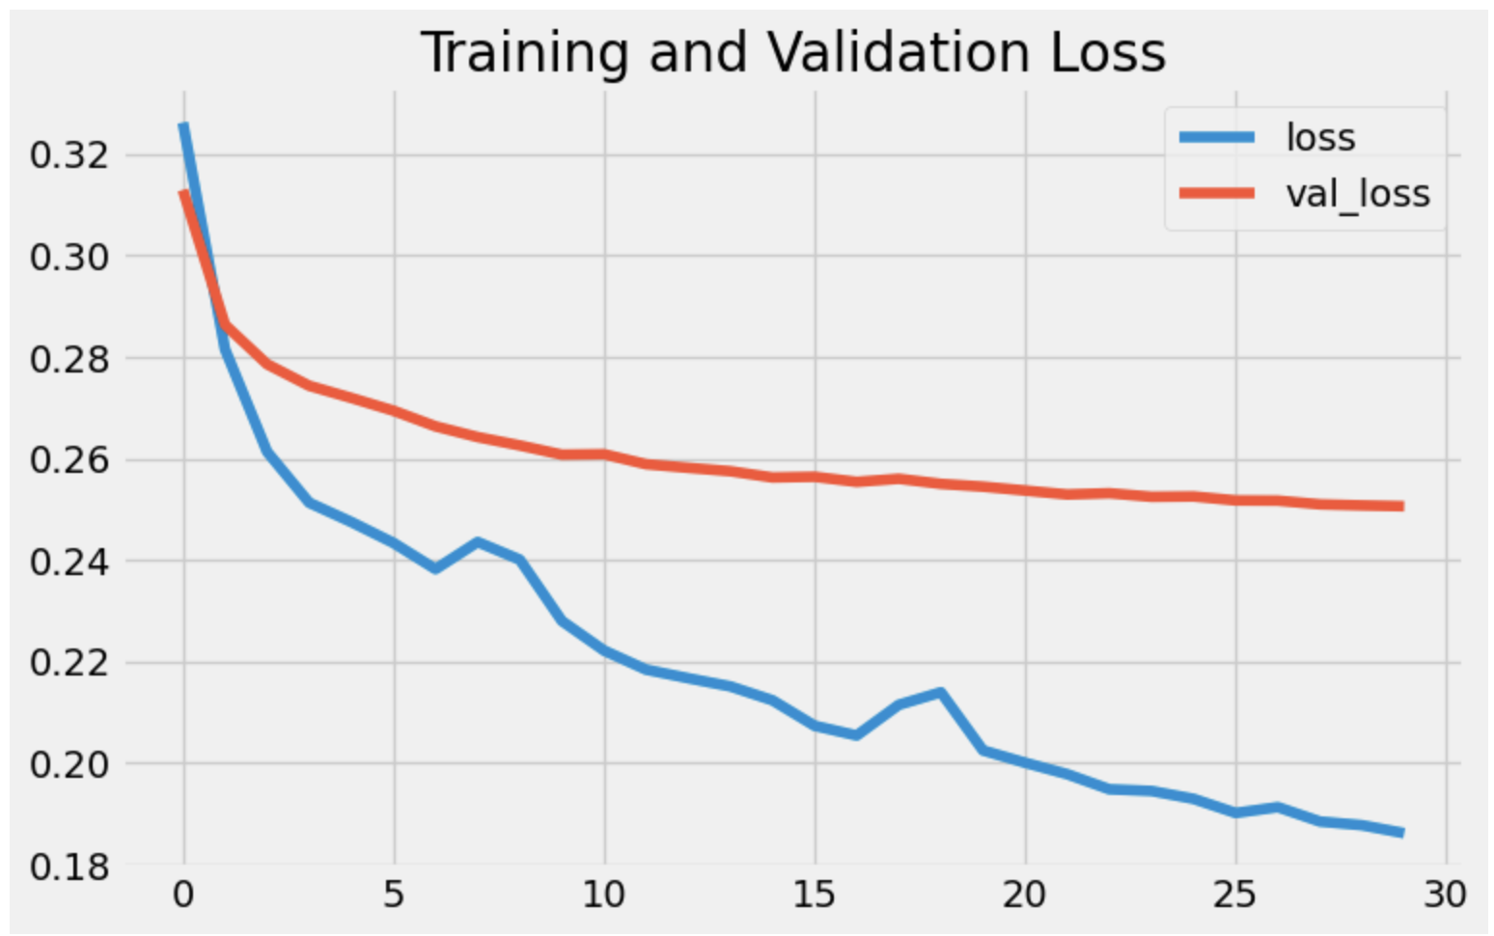
Transfer Learning Results
Data Pre-processing
Train Test Split
Baseline Model
Data Collection
Balancing Data
Image Augmentation & Regularization
Transfer Learning

Slide 14
Hyperparameter Tuning
Lastly, we performed Hyperparameter Tuning using BayesianOptimization and train the model again with the best params we get.
The final accuracy we get for the VGG16 Transfer Learning model is 91% on unseen data, a significant improvement over the baseline accuracy of just 83%.
Data Pre-processing
Baseline Model
Hyperparameter Tuning
Train Test Split
Data Collection
Balancing Data
Image Augmentation & Regularization
Transfer Learning

Slide 15
Future Work
Our final transfer learning model of VGG16 got an accuracy of 91%. In future, it would be interesting to see if other Transfer Learning models like InceptionV3 or Xception further outperform VGG16.
This project was about detecting IDC type cancer in breast histopathology images. It would be nice to study if the VGG16 classifier we trained in this study would also work well for other types of cancers in breast scan images.
References
[1] https://www.kaggle.com/datasets/paultimothymooney/breast-histopathology-images
[2] https://www.analyticsvidhya.com/blog/2021/06/breast-cancer-classification-using-deep-learning/
[3] https://engineering.case.edu/centers/ccipd/sites/ccipd.case.edu/files/Automatic_detection_of_invasive_ductal_carcinoma_in_whole.pdf
[4] Saad Awadh Alanazi, M. M. Kamruzzaman, Md Nazirul Islam Sarker, Madallah Alruwaili, Yousef Alhwaiti, Nasser Alshammari, Muhammad Hameed Siddiqi, "Boosting Breast Cancer Detection Using Convolutional Neural Network", Journal of Healthcare Engineering, vol. 2021, Article ID 5528622, 11 pages, 2021. https://doi.org/10.1155/2021/5528622
[5] Kittusamy, Kousalya & Saranya, T.. (2021). Improved the detection and classification of breast cancer using hyper parameter tuning. Materials Today: Proceedings. 10.1016/j.matpr.2021.03.707.
[6] https://www.analyticsvidhya.com/blog/2018/04/fundamentals-deep-learning-regularization-techniques/

Slide 16
Thanks!

