Slide 1
Workflow vs Agent
Example: Leave Management portal

Slide 2
How workflow works?
Step 1: employee submits a request (mentioning type of leave and dates)
Step 2: checks for availibility of leaves and checks who their manager is (database check involved)
Step 3: Mail sent to manager (tool used– Gmail/outlook etc..)
Step 4: Leave request made
Step 5: Manager accepts/declines the request
Step 6: Mail sent to the employee (tool used – Gmail/outlook etc..)

Slide 3
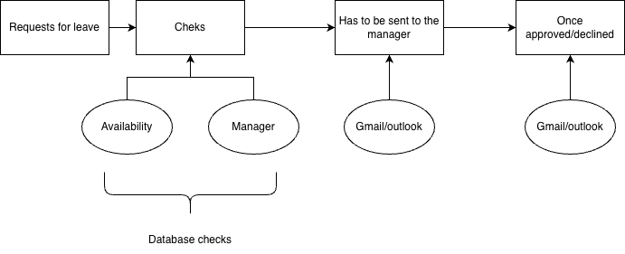

Slide 4
How agent works?
First let us imagine the agent to be a bot
Employee types in a prompt requesting leave “I am availing sick leave on xx/yy/zzzz”
Agent first checks with the available leaves for the employee, then it has to identify who the manager is. So it queries the database.
Since it is a sick leave the agent has to auto approve and notify the manager, if not it has to notify the manager for approval.
After approval, sends a response mail to the employee and has to schedule out of office in calendar tool.

Slide 5
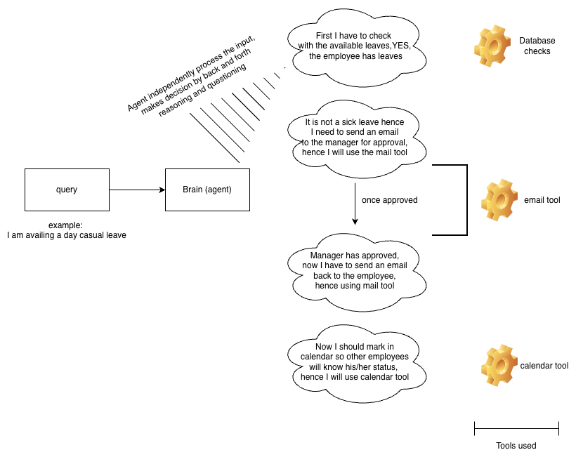

Slide 6
When to go for workflows and agents
The process is static, standardized and has to follow a series of steps in order to complete the function accordingly
Works for processes that are mundane, typical, which doesn’t involve much decision making
Vs agents:
The process is dynamic, not following a series of steps, decision driven. AI agent hence makes the decision when are where to use appropriate tools and completes the task.

