Slide 1
STAX Business Intelligence System
SUSHMITA SINHA
ASOK KAUSHIK
LODUGU NITHESH REDDY

Slide 2
Technology Architecture
Database
Cloud Heroku
PostgreSQL
SQL Alchemy
Frontend
HTML + Bootstrap 5 + Chart JS
Backend
Flask + Python

Slide 3
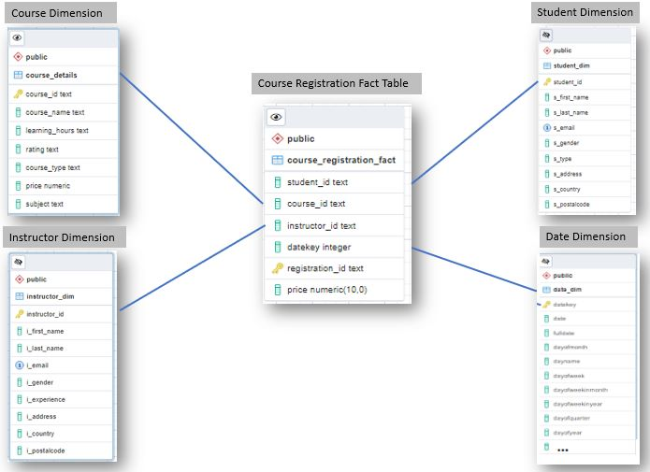
STAR SCHEMA

Slide 4
DATA GENERATION

Slide 5

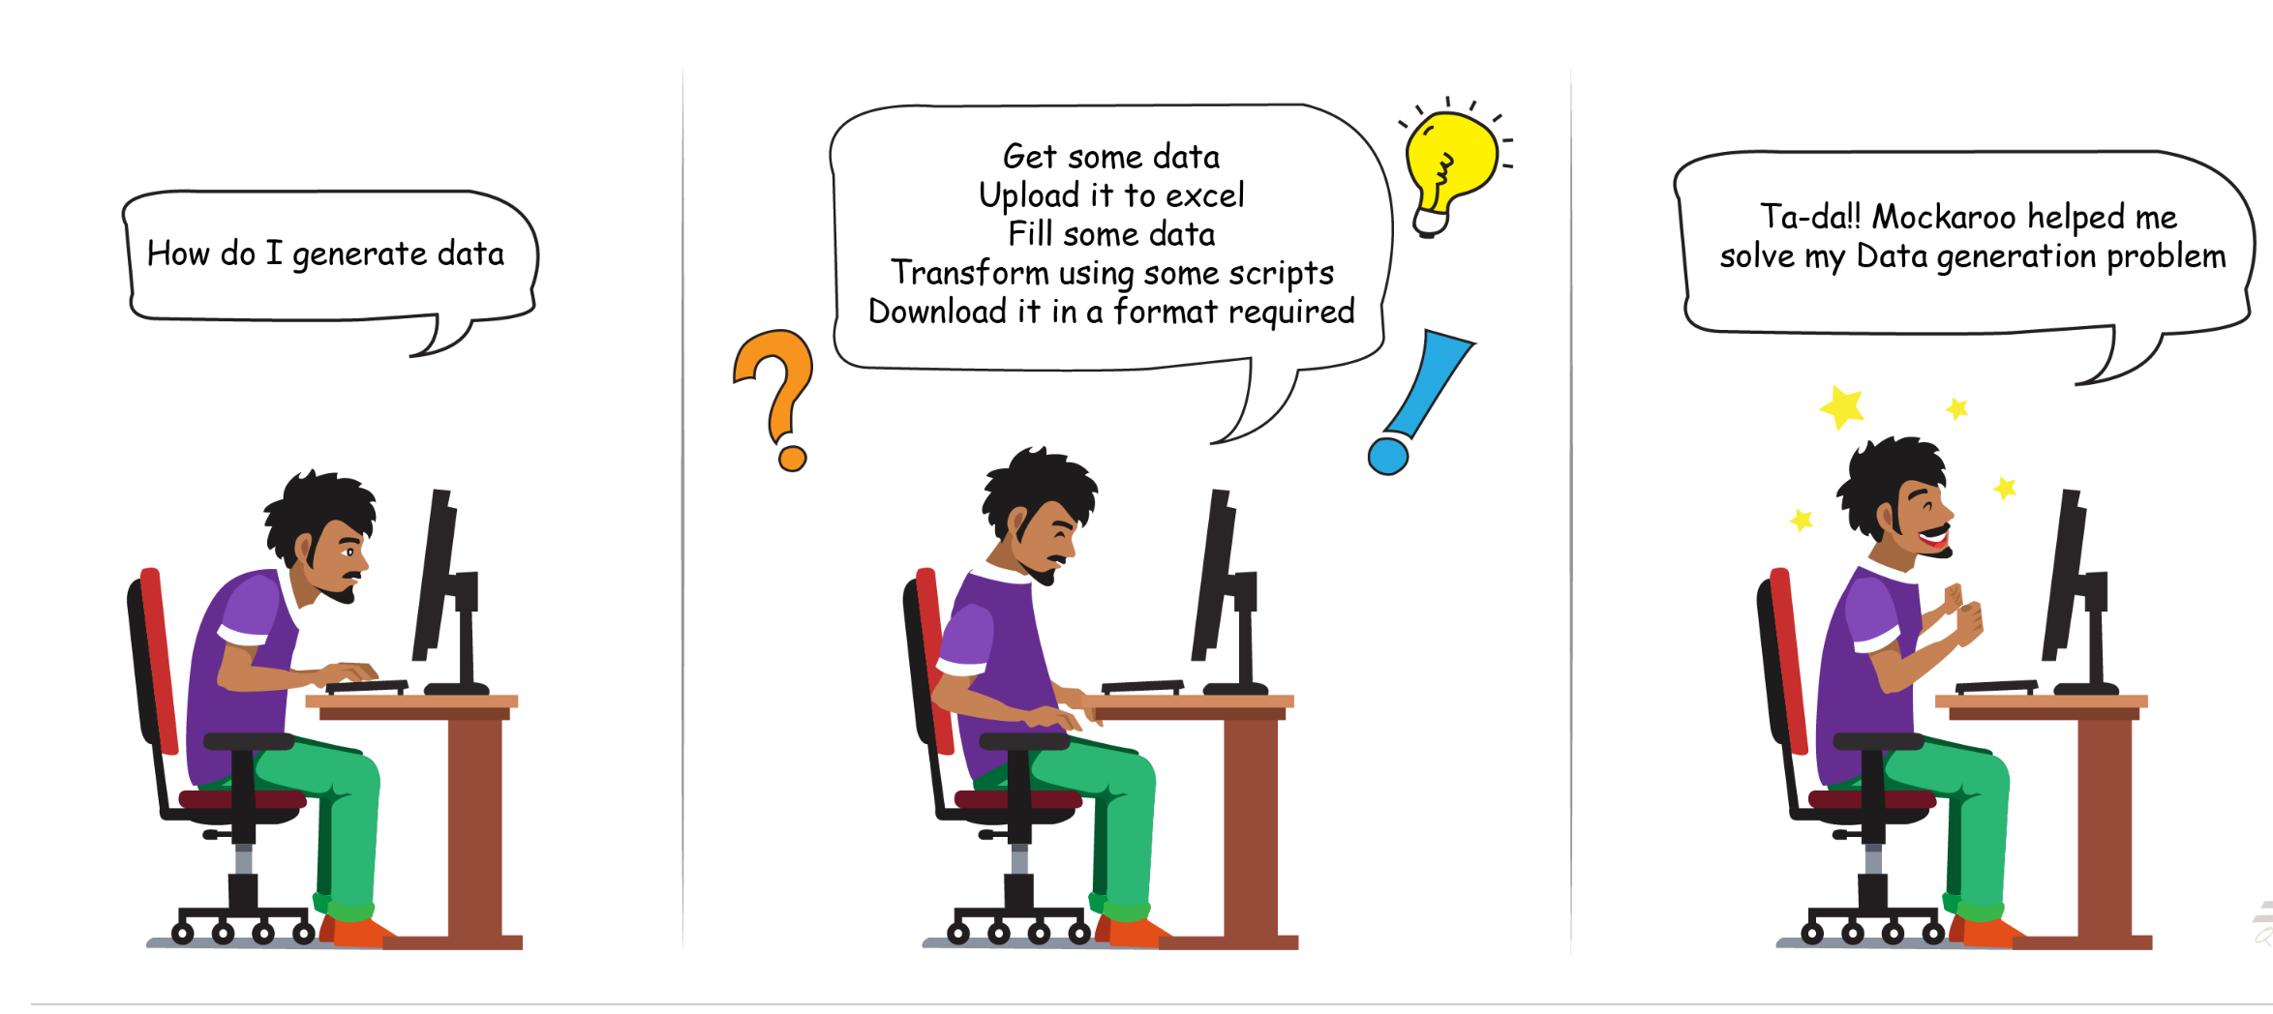

Slide 6
SQL Queries
Delete
CREATE
Courses are deleted as per the constraints Implemented.
Administrators can Sign Up, New Courses can be added
Aggregate/Joins
The data tables and metrics representaion are obtained using Aggregate functions
READ
Table information are displayed
Windows Function
Determines the Rank of the Instructor depending upon the total number of students enrolled in their cousres.
UPDATE
Course details can be Updated

Slide 7
01
Home Page with popular course Information
HTML + BootStrap
02
Forms implemented for Add and Update Information
03
DataTables displaying available Courses and Enrolled Courses
04
Chart Js Implemented for graph Visualisation

Slide 8
Technology Infographics
https://starapp32.herokuapp.com/

