Slide 1
Job Card to Invoicing Flow
A clear end-to-end view of how a job moves from entry to delivery, implementation, and final billing.
What this presentation covers
Job card creation and line-item capture
Estimate sharing and customer approval
Operational handoffs through production, delivery, and implementation
Invoice preparation and reporting
Production MIS
Prepared for internal walkthroughs and team presentations

Slide 2
Presentation Description
This deck explains how a job moves from creation to invoice generation inside Production MIS.
Purpose
Audience
Outcome
Show the full operational flow in a simple order so teams can understand where each action happens and why the job card matters.
Useful for CS, job entry, production, implementation, billing, and management teams during training or process review.
Everyone gets a shared view of handoffs, required checks, and the point where invoicing should begin.
How to read the flow
Start with the job card, check whether an estimate is needed, then follow the work through design, printing, finishing, delivery, implementation, and finally billing. Each stage depends on clean data from the previous step, especially billing location, dimensions, charges, and proof of execution.
This slide gives the audience the context they need before the detailed process slides begin.

Slide 3
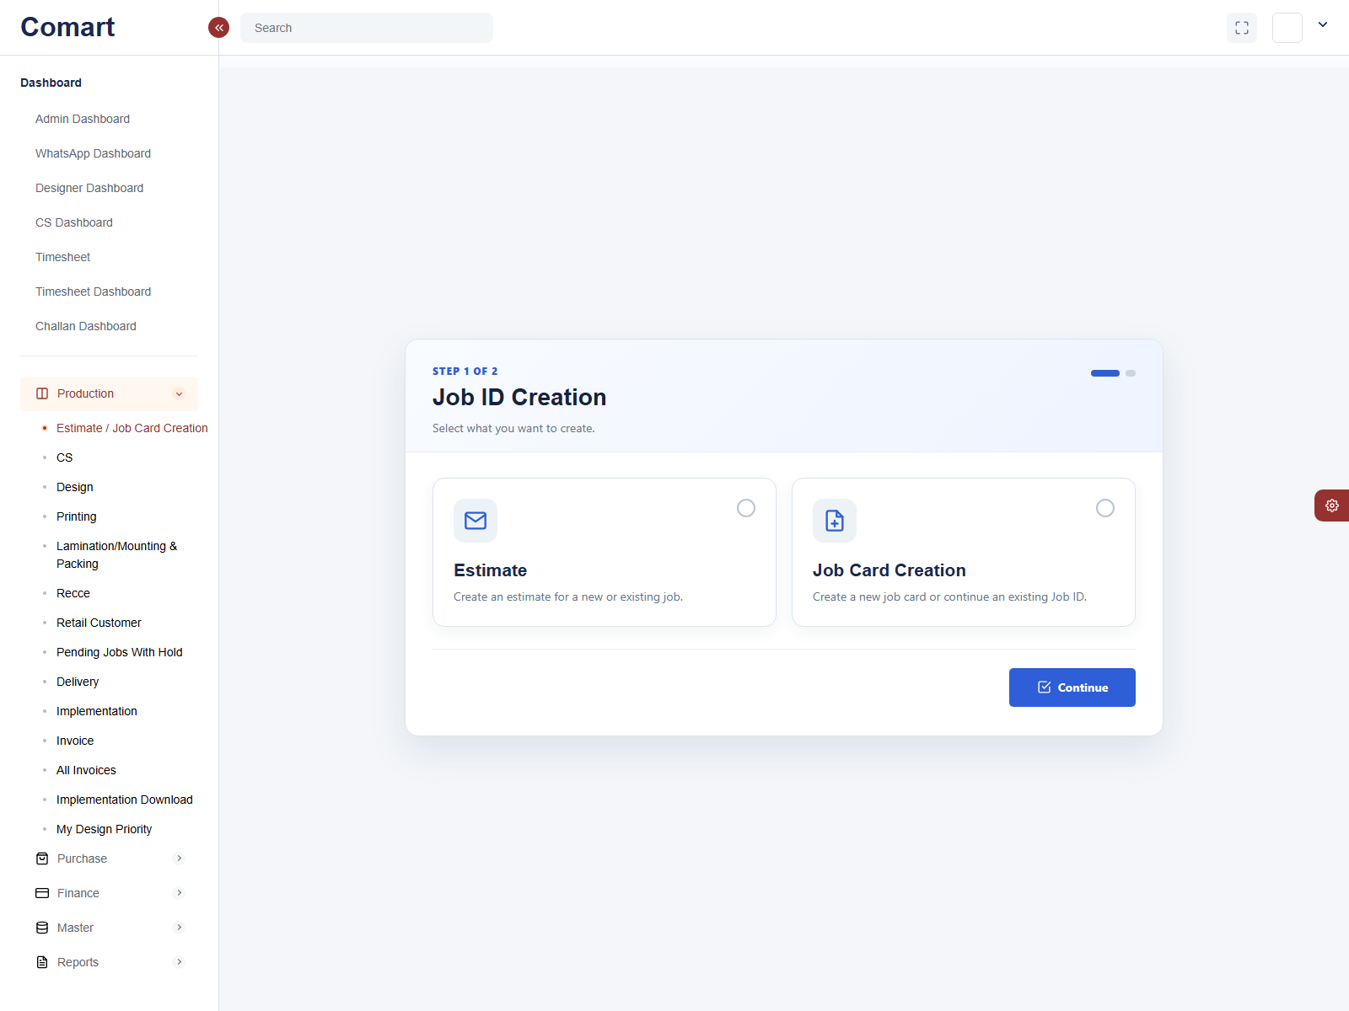
Job ID Creation
Start here to choose the creation path for a job card or estimate.
Key points
Choose Estimate when you want to prepare a quotation first.
Choose Job Card Creation when you want to open a job directly.
Click Continue after selecting the workflow type.

Slide 4
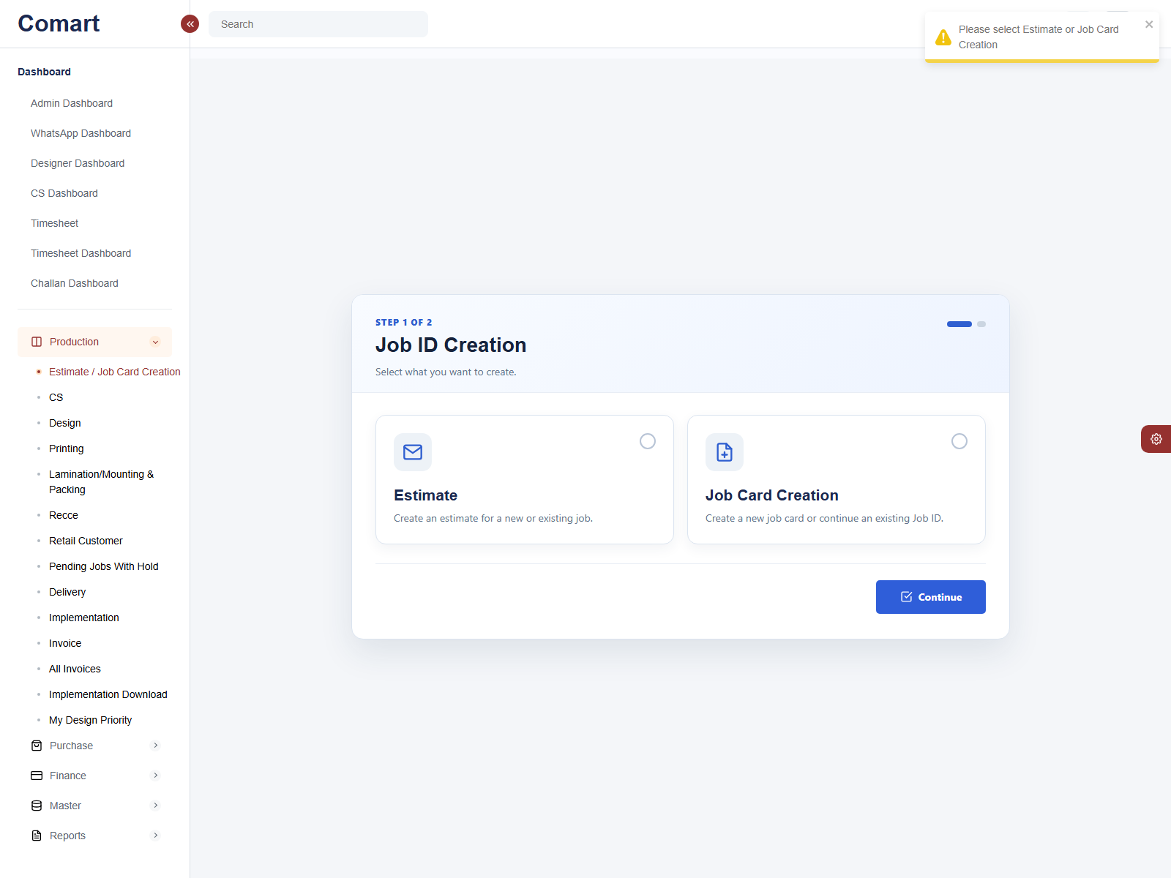
Estimate Setup
Use this path when the team needs a new estimate or wants to continue an estimate flow.
Key points
Select Estimate and move to the second step.
Choose New for a blank estimate or Existing to continue a saved job.
Use Send Estimate when the estimate is ready to share.

Slide 5

Estimate Existing
The existing estimate path is used when you continue from a saved job or estimate list.
Key points
Use Existing to search the Job ID list for an already-started estimate.
This helps continue work instead of starting from scratch.
The same estimate screen supports mail, PDF, and save actions.

Slide 6
Job Card Creation
Use this path to open a new job-card form or continue an existing Job ID.
Key points
Select Job Card Creation and continue to the second step.
Choose New to open a blank job-card form or Existing to continue an old job.
Job card data is the source for all downstream production and billing steps.

Slide 7
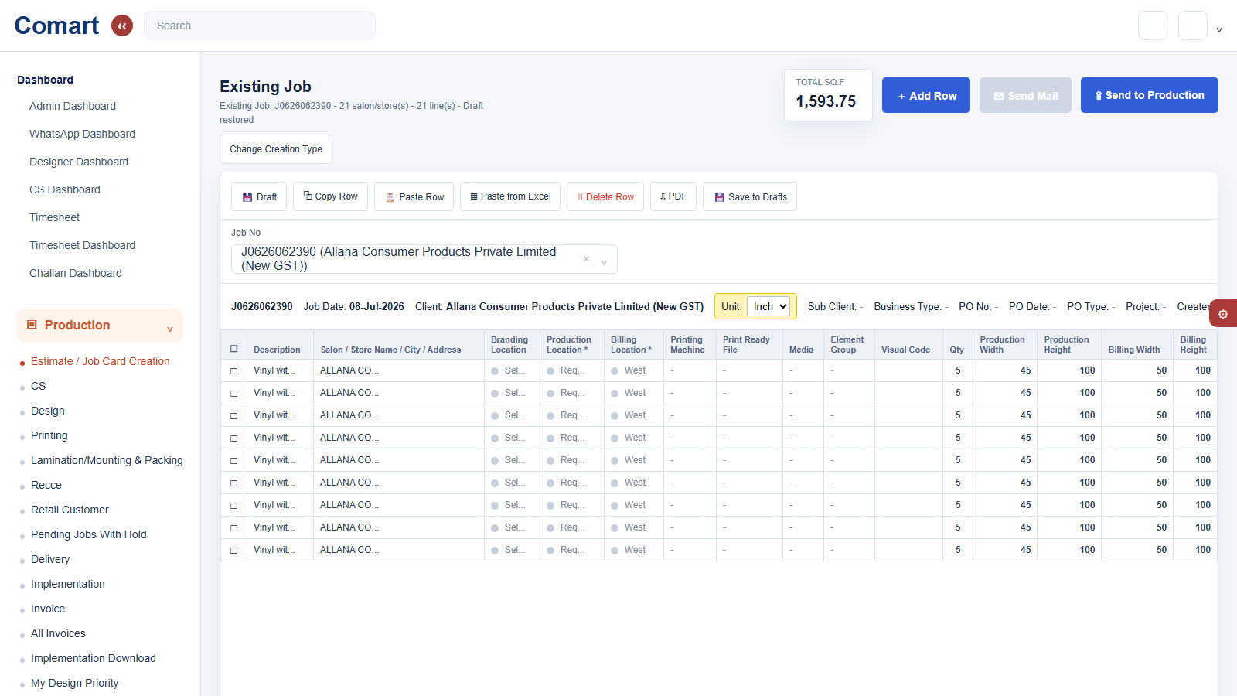
Existing Job
This screen opens after choosing Existing from Estimate or Job Card Creation.
Key points
Step 1 selects Estimate or Job Card Creation, then step 2 selects Existing.
Change Creation Type takes you back to the first step if you picked the wrong flow.
Use Add Row, Draft, Copy Row, PDF, and Save to Drafts to continue the job entry.
Send to Production passes the completed job to the next team.

Slide 8
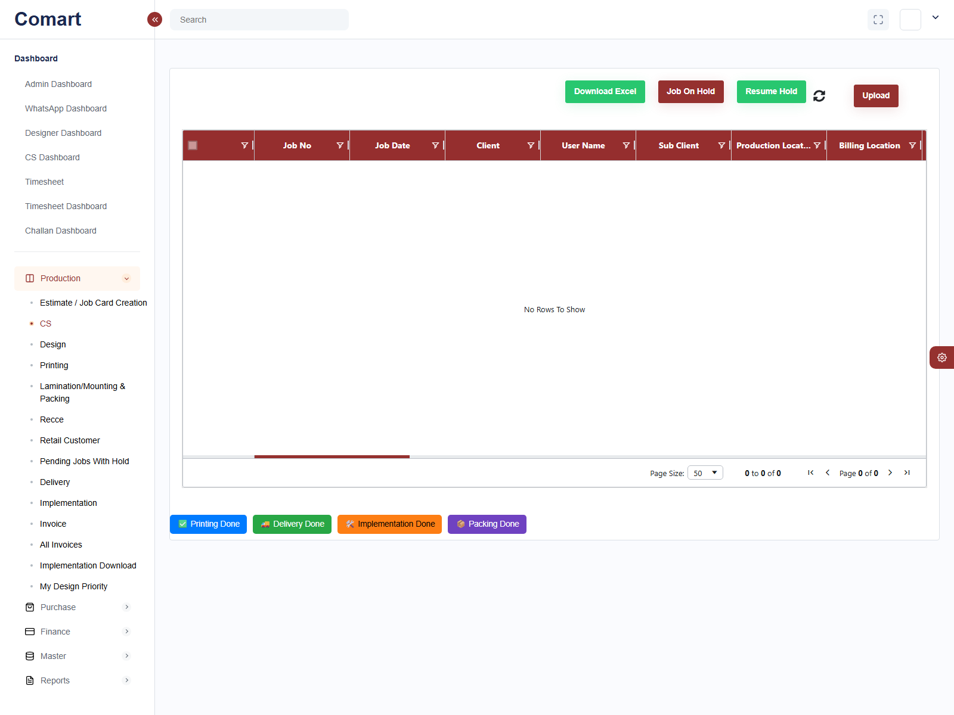
CS Screen
CS tracks job status, hold state, and row-level progress.
Key points
Review job no, client, location, and current production status.
Use this screen to monitor hold, pending, and completed rows.
CS is the control point before work moves deeper into production.

Slide 9
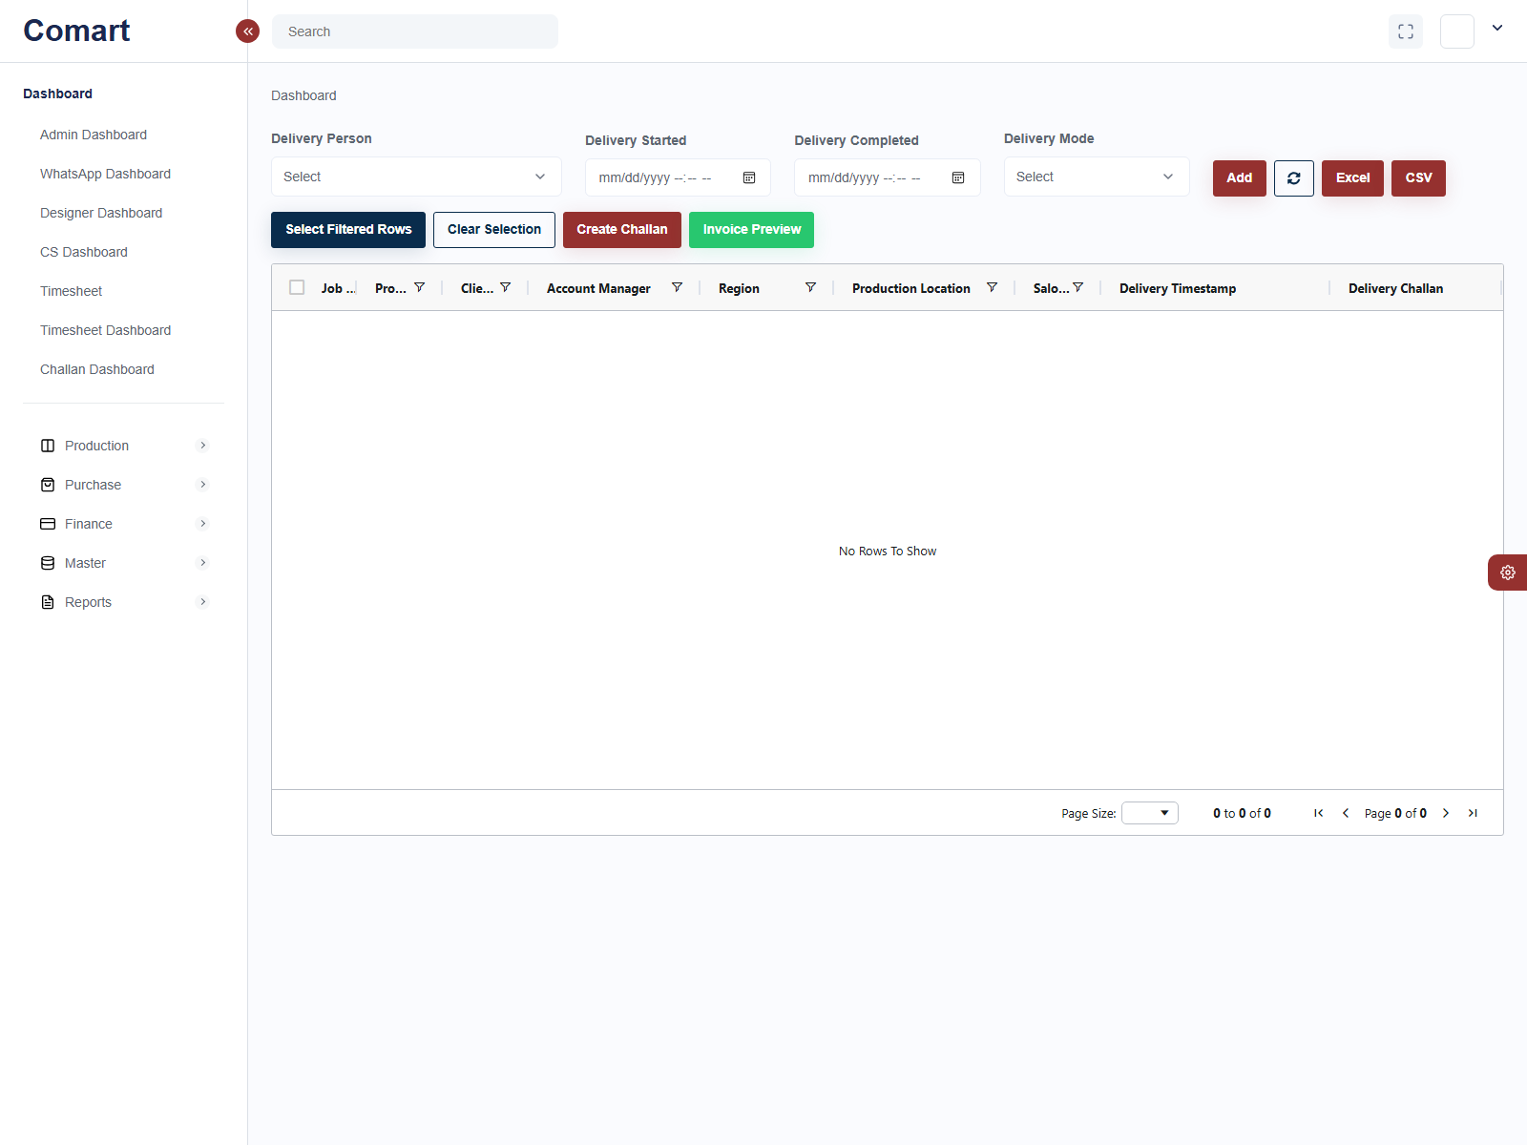
Delivery
Capture dispatch details and create the delivery challan.
Key points
Enter delivery person, delivery start, delivery completed time, and mode.
Click Add to save the delivery detail row.
Create Challan to generate the delivery record for billing and proof.

Slide 10
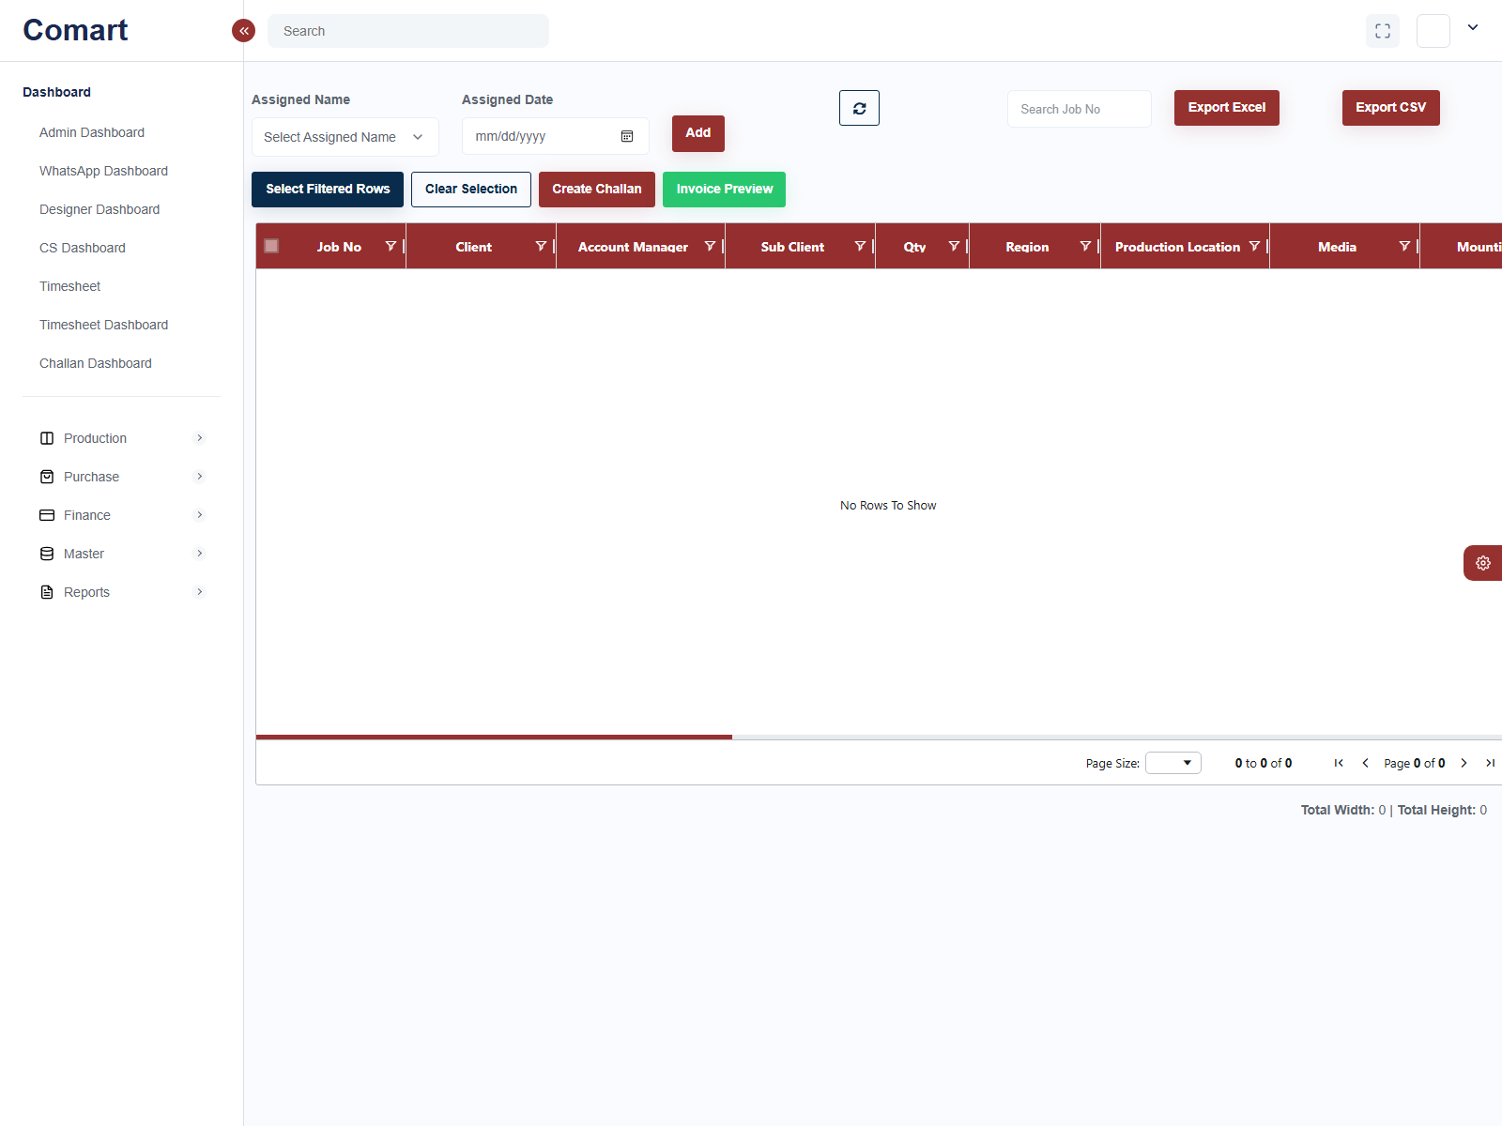
Implementation
Record on-site execution and upload proof media.
Key points
Select the implemented rows and create the implementation challan.
Upload media or proof photos for verification.
Implementation proof is the final operational checkpoint before invoicing.

Slide 11
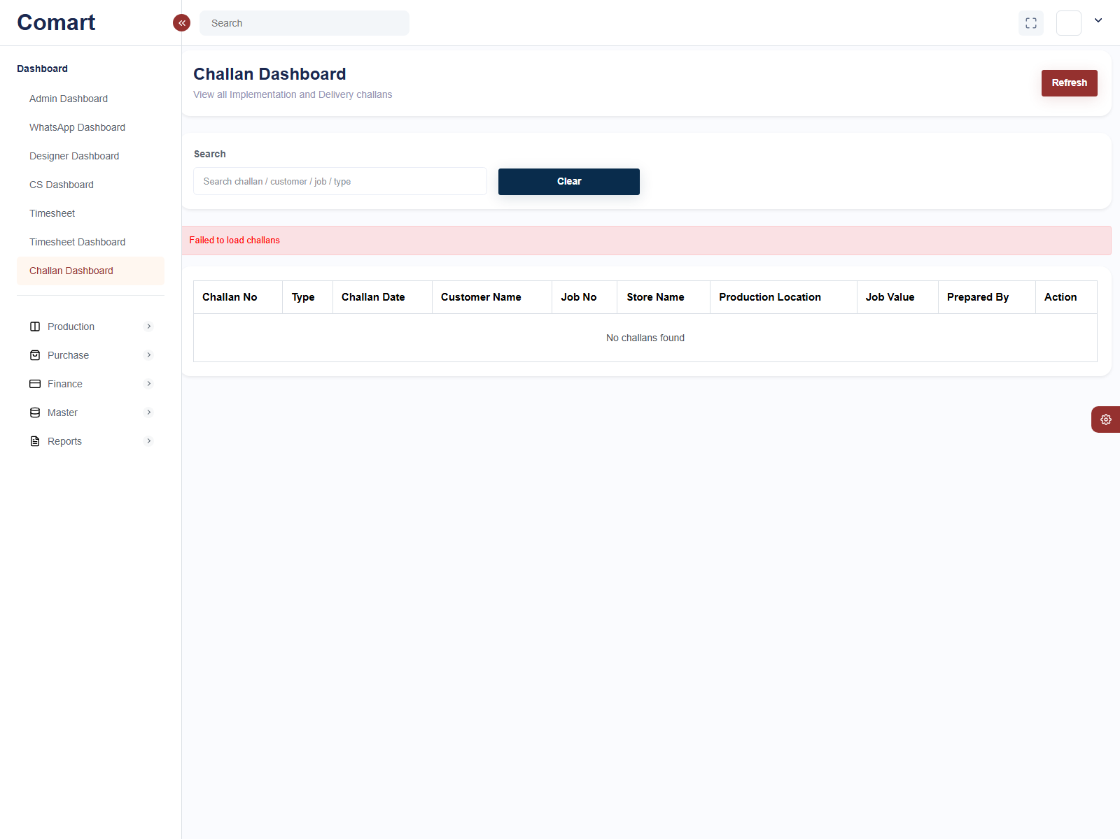
Challan Dashboard
View all delivery and implementation challans in one place.
Key points
Search challans by customer, job, or challan type.
Use this dashboard to review delivery and implementation records together.
This is useful when billing or operations need a quick verification point.

Slide 12
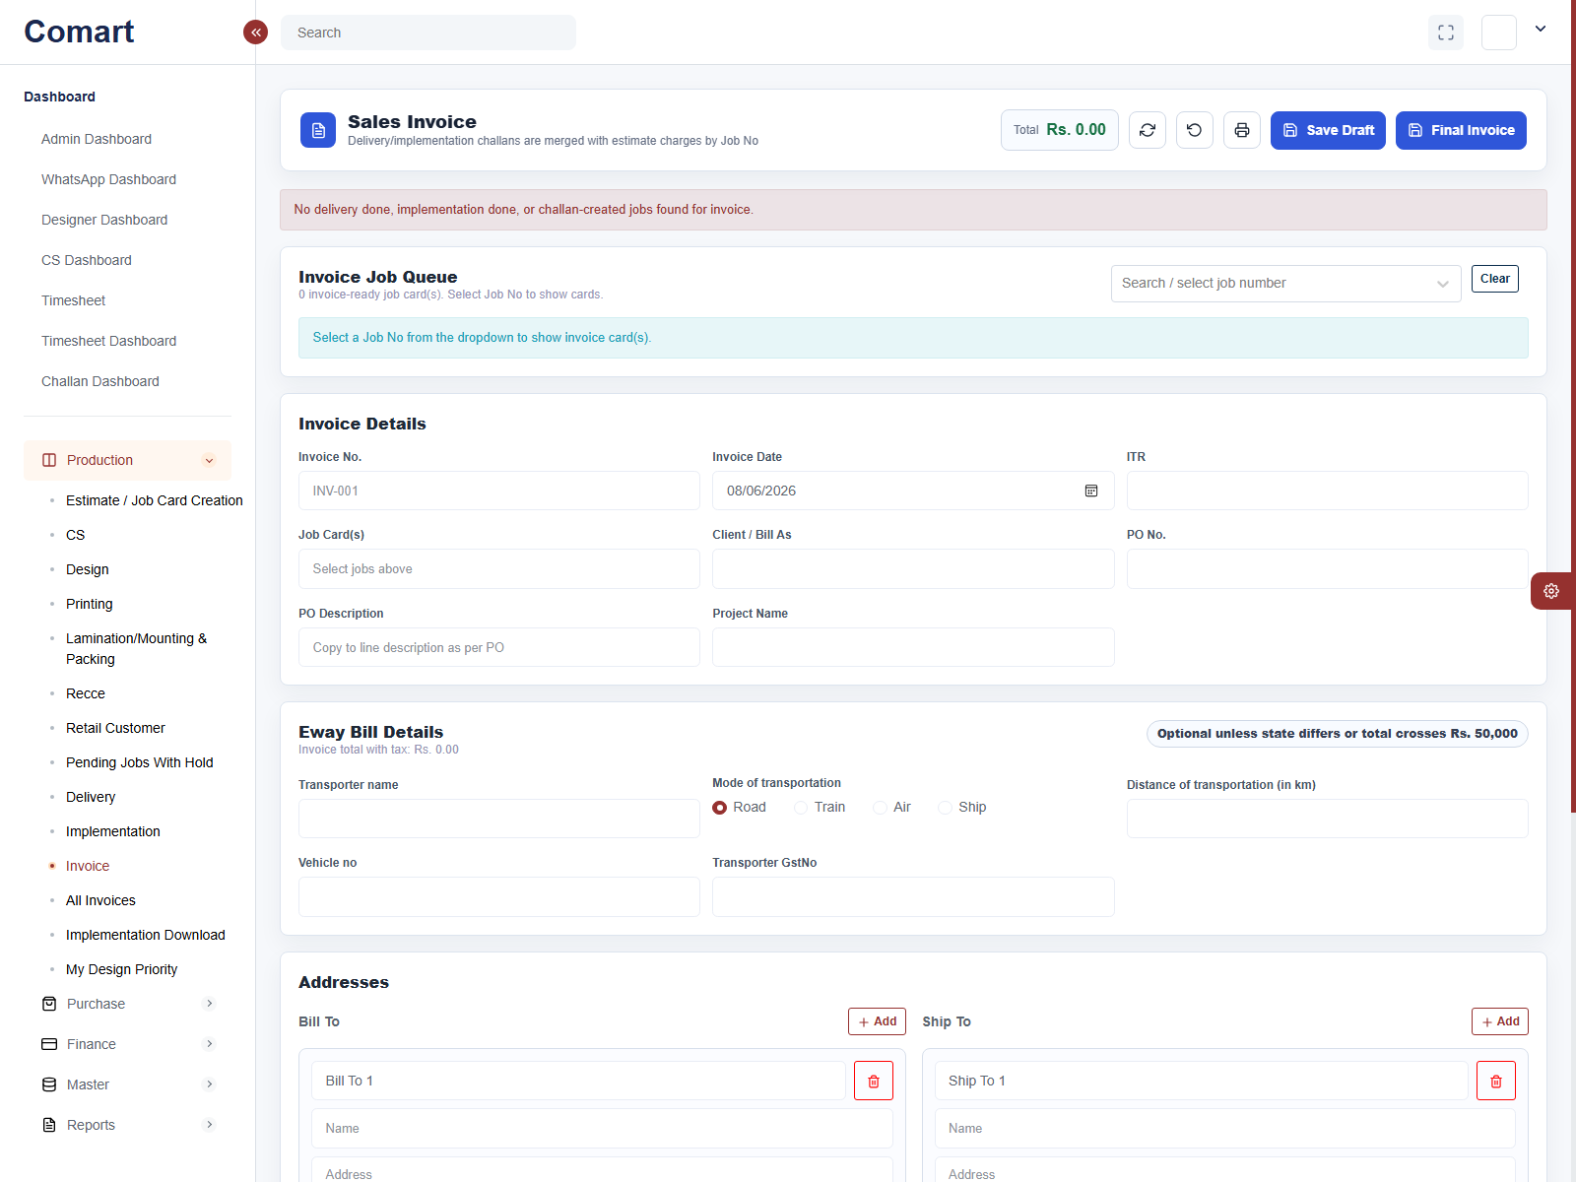
Invoice Preview
Prepare the invoice after delivery and implementation are complete.
Key points
Select the job from the invoice queue and review invoice details.
Confirm bill-to, PO, E-way details, and address fields.
Save Draft or Final Invoice when everything is correct.

Slide 13
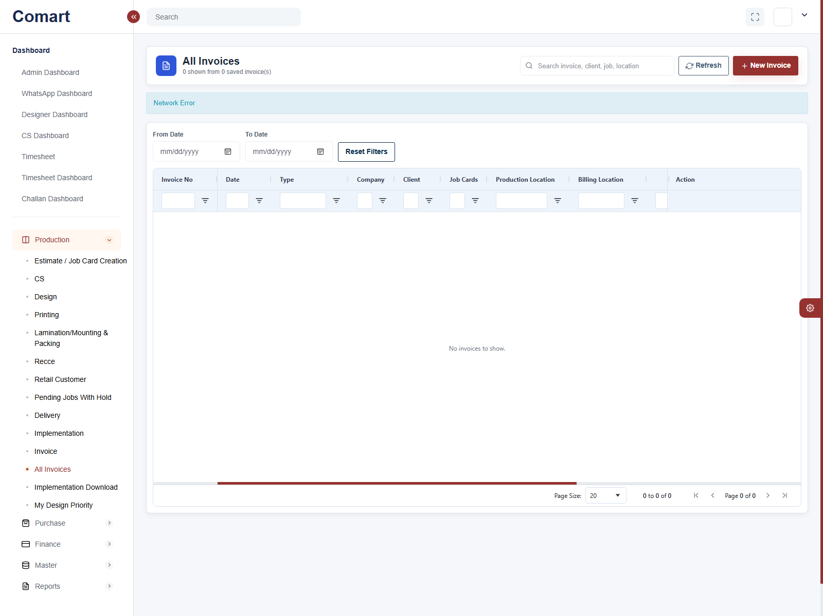
All Invoices
See saved invoices and filter them by date or invoice number.
Key points
Search and filter invoices by client, job, location, or invoice number.
Use this screen to review existing billing records.
This acts as the invoice register for the billing team.

Slide 14
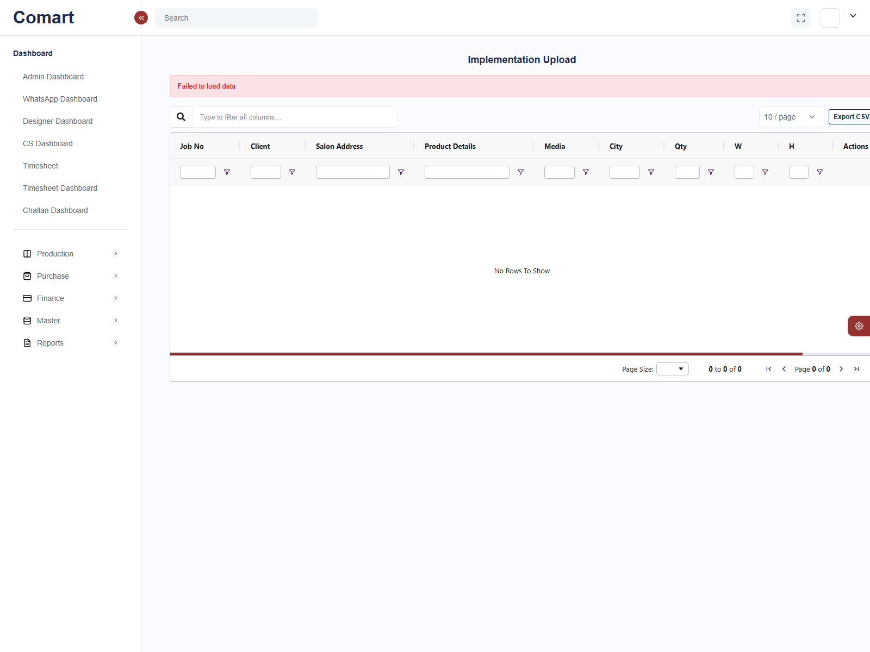
Implementation Download
Review or export implementation upload records.
Key points
Use this screen to inspect implementation upload data.
It is helpful when rechecking proof, size, or site execution details.
Export or filter the records when the billing team needs supporting evidence.

