Slide 1
IBM University Engagement Project Submission
“Exploring the Power of Agentic AI with IBM Granite and IBM Bob”

Slide 2
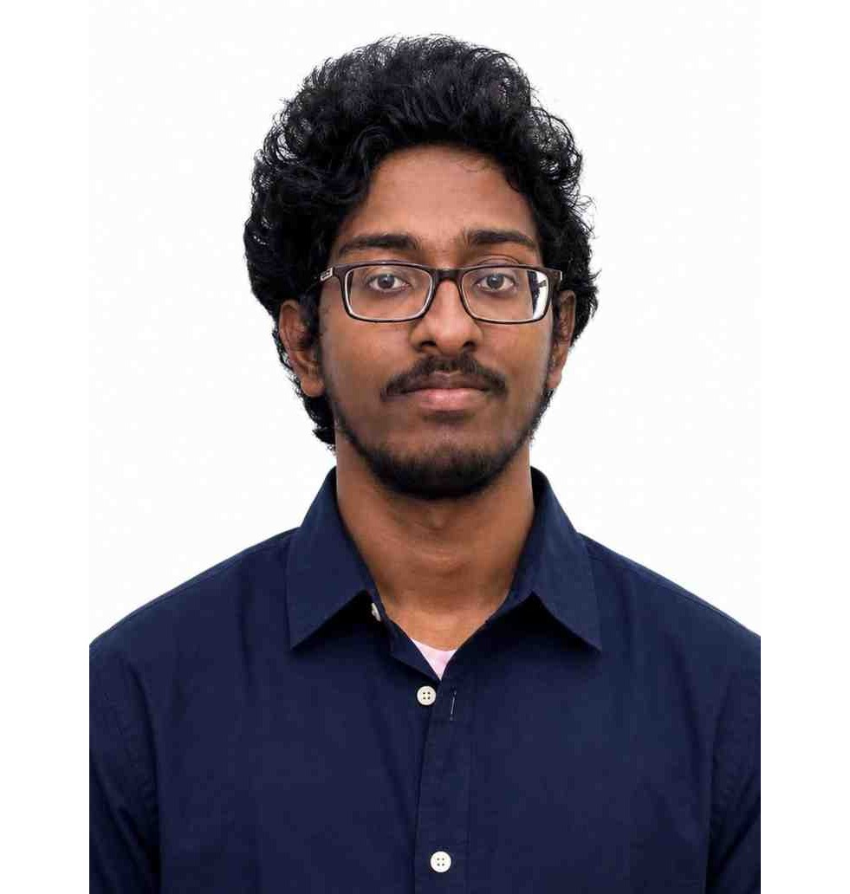
Project Tile – TikZFlow — Agentic AI-Powered LaTeX Diagram Generator for Academic Research
Domain of Project – Education & Academic Research Tools
Student Name | Recent Passport Photo | Email ID | Mobile number [WhatsApp]
Kaushik M |  | kaushikmanivezh@gmail.com | 6381778427
Recommended font style and size: Font Style: Arial Font Size (Heading): 28
Font Size (Content): 20

Slide 3
Problem Statement -
Problem Statement No.26 : AI-Powered LaTeX Diagram Generator for Academic Research
The Challenge
Writing TikZ/LaTeX diagrams by hand is slow and error-prone: a single missing semicolon or malformed coordinate silently produces a fatal compile error, and even code that compiles can render blank or with overlapping labels. Researchers and students routinely burn significant time on trial-and-error diagram debugging instead of on the actual content.
The Objective
Build an agentic system that converts natural-language descriptions (and, as a future extension, sketches) into compilable, publication-ready TikZ code, and that autonomously verifies and corrects its own output rather than returning a single generate-and-hope response. The solution should:
Natural Language to TikZ – Convert plain-English diagram descriptions into a compilable TikZ/LaTeX body.
Autonomous Compile & Fix – Compile every attempt against a real LaTeX toolchain and self-correct using the exact compiler error, with no manual intervention.
Visual Correctness Checking – Go beyond “does it compile” to catch blank renders and overlapping node labels.
Iterative Refinement – Accept natural-language follow-up edits on top of an already-generated diagram.
Pipeline Stages –
Pattern Retrieval (keyword-matched TikZ skeleton library)
Generation (IBM Granite via watsonx.ai, grounded by the retrieved skeleton)
Compile + Visual Validation (pdflatex, plus blank-canvas and node-overlap detection)
Self-Correction (error-grounded retry, up to 4 attempts)
Streamlit Dashboard – Live diagram preview, full agent trace, and a token-usage panel.

Slide 4
Proposed Solution -
Proposed Solution: TikZFlow
The proposed solution is a retrieval-grounded, self-correcting agentic pipeline built using IBM Bob, IBM watsonx.ai, and Granite Models, converting natural-language diagram descriptions into compilable, publication-ready TikZ/LaTeX. It addresses the unreliability of pure LLM code generation for PGF/TikZ syntax through a multi-stage autonomous correction loop.
At its core, the solution retrieves the closest-matching pattern from a curated TikZ template library before generation, rather than asking Granite to invent PGF syntax on a blank page. This retrieval-before-generation step applies the same principle behind RAG to code synthesis instead of conversation, and is what keeps first-try compile rates high.
The system consists of four cooperating stages:
Pattern Retrieval Agent matches the request against six verified TikZ diagram families (neural nets, flowcharts, automata, sequence diagrams, circuits, org charts).
Generation Agent adapts the retrieved skeleton (or generates from scratch) using IBM Granite on watsonx.ai.
Compile & Visual-Validation Agent runs pdflatex and inspects the rendered pixels for blank canvases and coordinate-level node overlaps.
Self-Correction Agent feeds the exact compiler error or visual finding back into Granite and retries, up to 4 attempts.
The solution includes a Streamlit dashboard that shows the live rendered diagram, the full multi-attempt agent trace, and a running token-usage counter for every session.
IBM Bob is used to build and verify this pipeline end to end, while watsonx.ai hosts Granite for generation and self-correction. A fully offline pattern-fallback mode keeps the whole system testable without live cloud credentials.
Overall, this solution trades a blank-page LLM gamble for a grounded, self-checking pipeline — producing diagrams that are verified to compile and look right, not diagrams that were merely generated.

Slide 5
Technology Used
IBM Bob platform – Used to build, verify, and iterate on the full TikZFlow pipeline (retrieval, generation, compile, validation, self-correction).
IBM Granite model – ibm/granite-3-8b-instruct via watsonx.ai – for TikZ generation and error-grounded self-correction
IBM Cloud – Hosts the watsonx.ai project and provides the Lite-tier infrastructure the pipeline runs on.
Retrieval-grounded generation – A curated TikZ pattern library is retrieved by keyword match and handed to Granite as a skeleton to adapt, instead of generating PGF syntax from a blank page.
IBM Watsonx.ai - For Granite model hosting and inference.
LaTeX / TeX Live (pdflatex + circuitikz) – the ground-truth compiler every generated diagram is verified against.

Slide 6
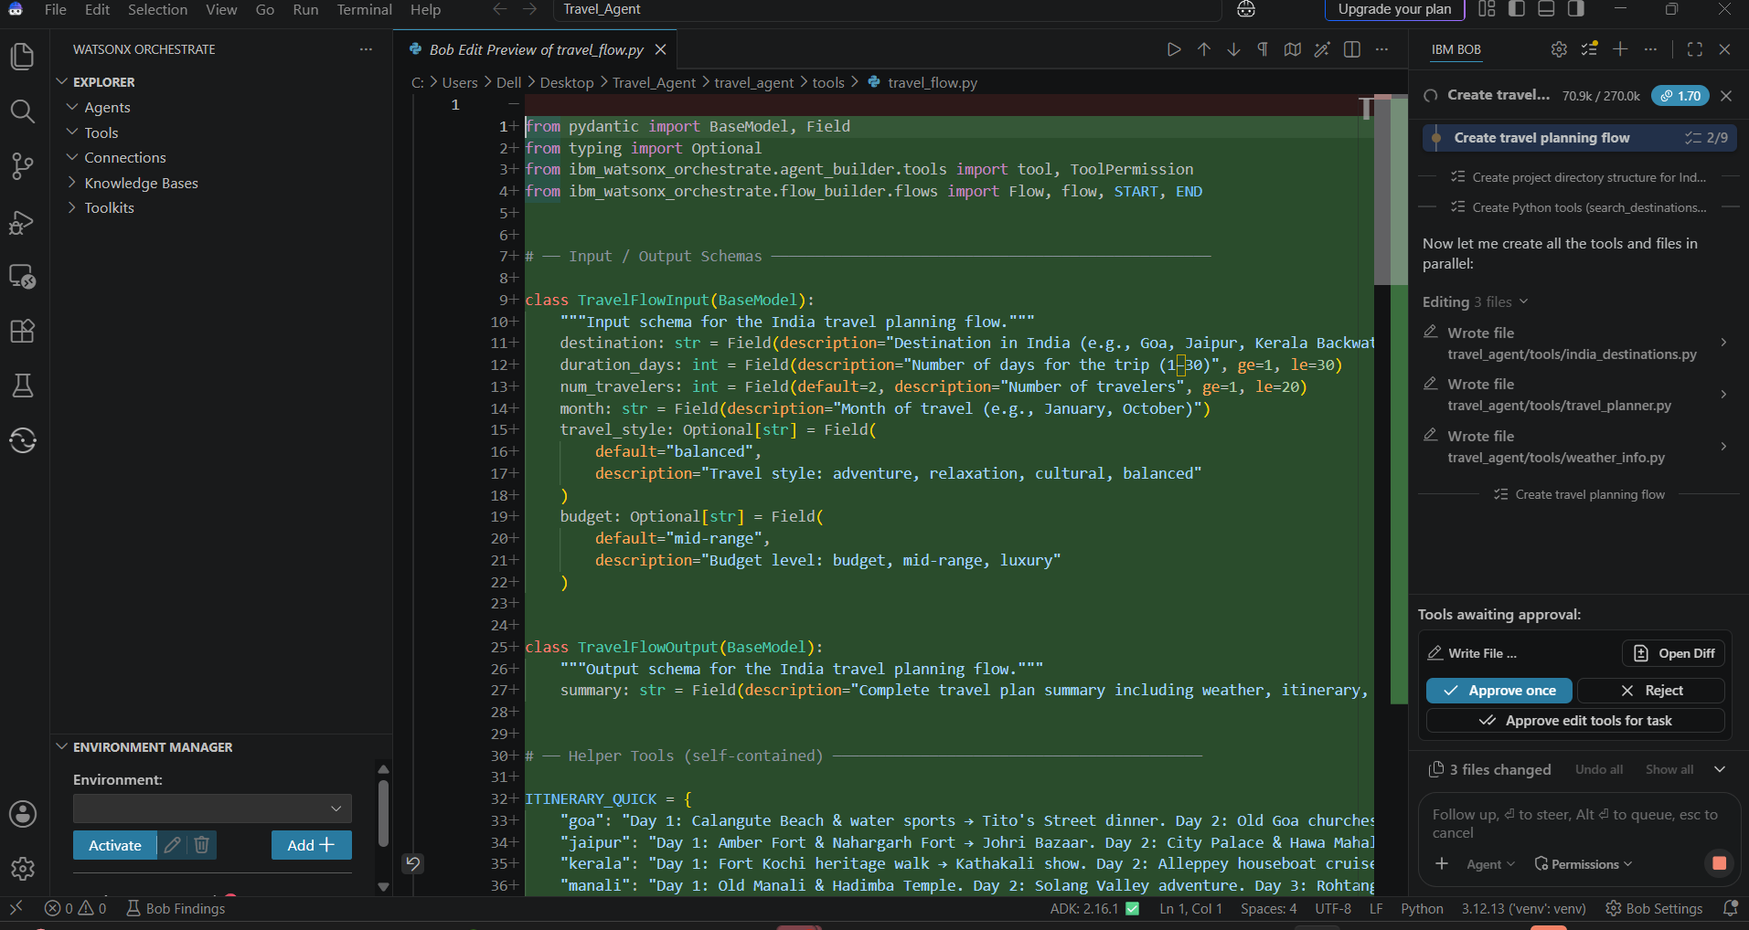
Required Files created using IBM bob -

Slide 7
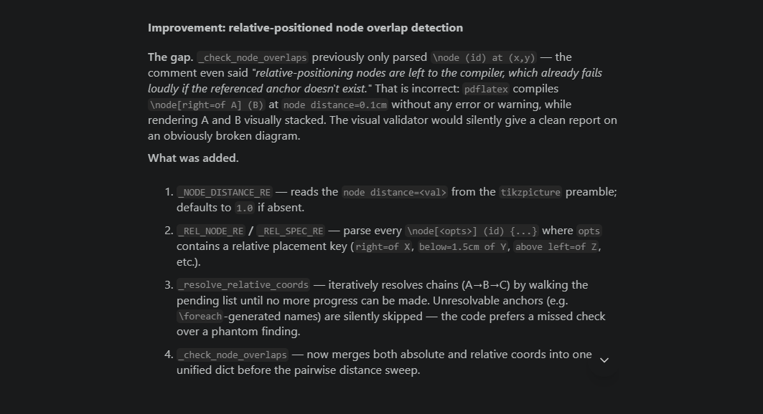
IBM Bob Screenshots:

Slide 8
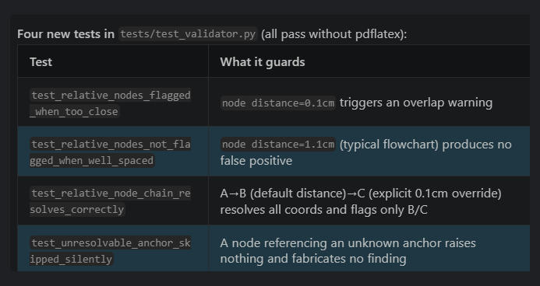

Slide 9
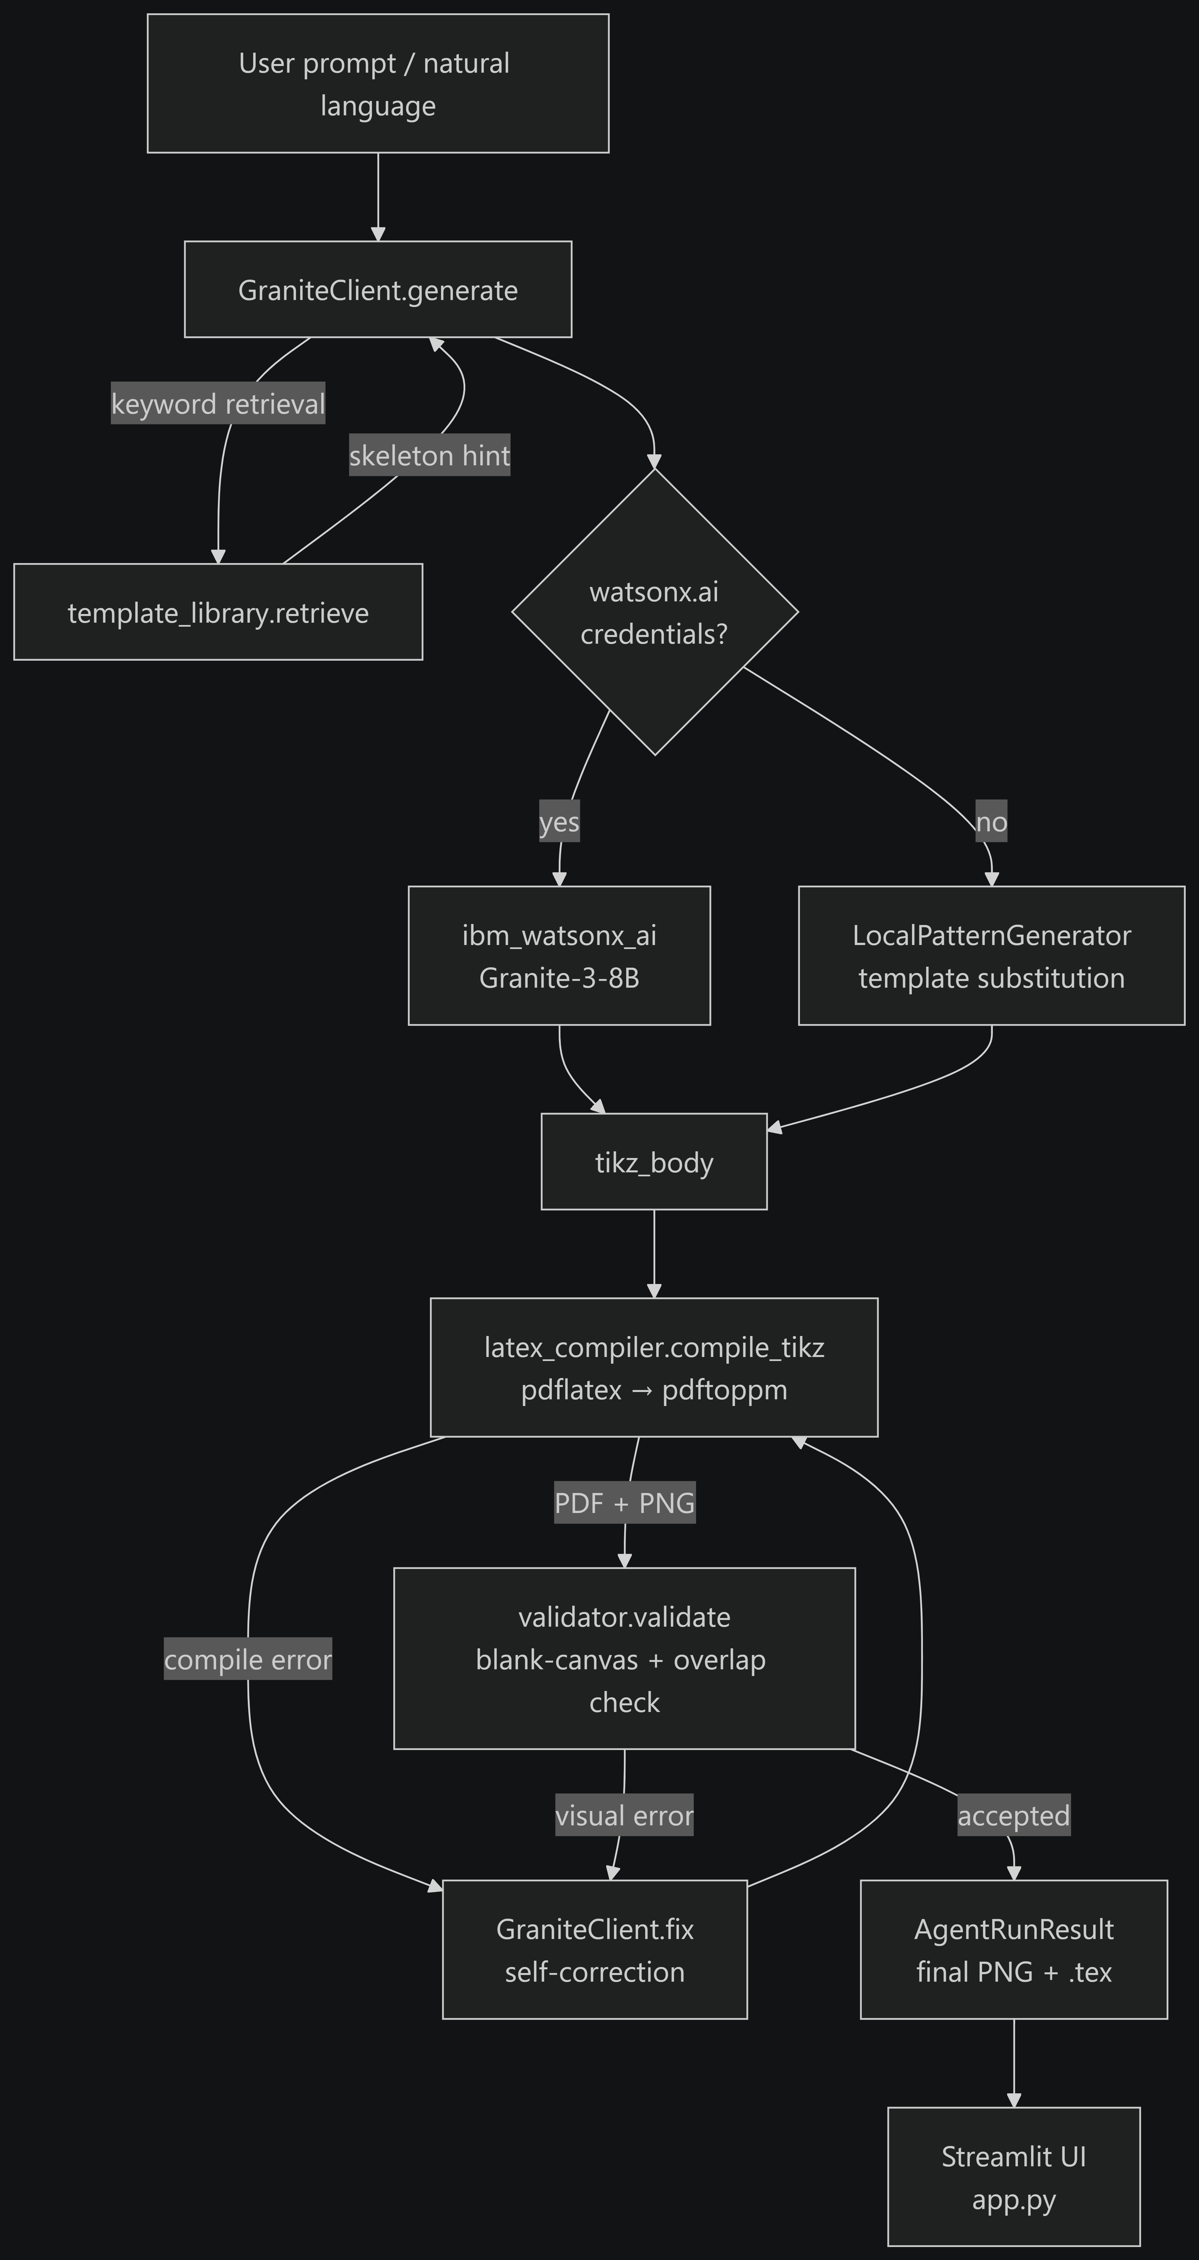
Architecture blueprint for IBM bob:

Slide 10

Role of Agentic AI in the solution
Role of Agentic AI in TikZFlow
Agentic AI enables TikZFlow to autonomously judge and improve its own output rather than returning a single LLM response. Using IBM watsonx.ai and IBM Granite models, the system perceives (compiles and visually inspects), decides (accept, or retry with a specific reason), and acts (regenerates) without human intervention.
Each stage performs a distinct role — retrieving a verified pattern, generating or adapting TikZ code, compiling it against a real LaTeX toolchain, and visually inspecting the render — while feeding results forward. This multi-stage approach is what lets the system recover from failures a single-shot generation call cannot detect.
Agentic AI also brings grounded self-correction: retries carry the exact compiler error or visual defect as context, converging on a working diagram within a bounded number of attempts. It supports real-time refinement, regenerating the diagram against new natural-language feedback on top of the current code.
Every attempt — accepted or rejected — is logged with its backend, its errors, and its token cost, so the full autonomous correction trace is inspectable rather than hidden behind a single final answer.
Overall, Agentic AI makes TikZFlow self-checking and reliability-driven, acting like a diagram co-author that verifies its own work before handing it back — not just a text generator.

Slide 11
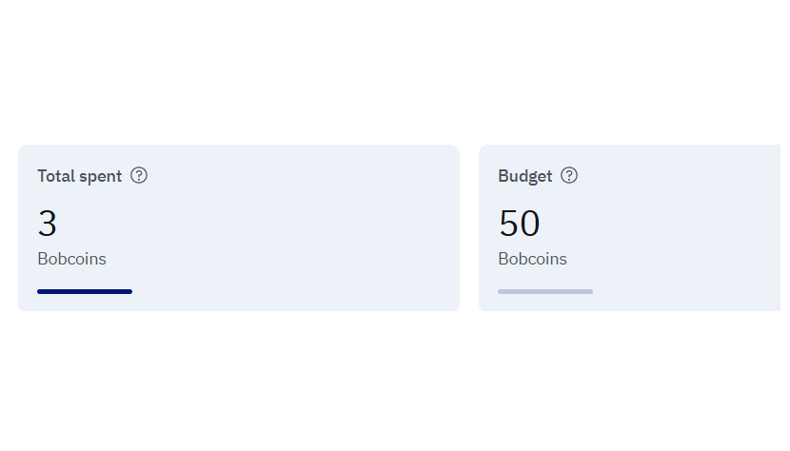
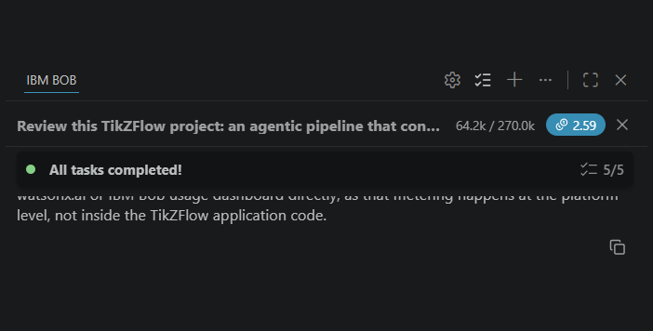
Token Usage
64.2k / 270.0k tokens used for this review+fix task (2.59 Bobcoins)
Total Session Spend
This Task's Usage
·
·
·

Slide 12
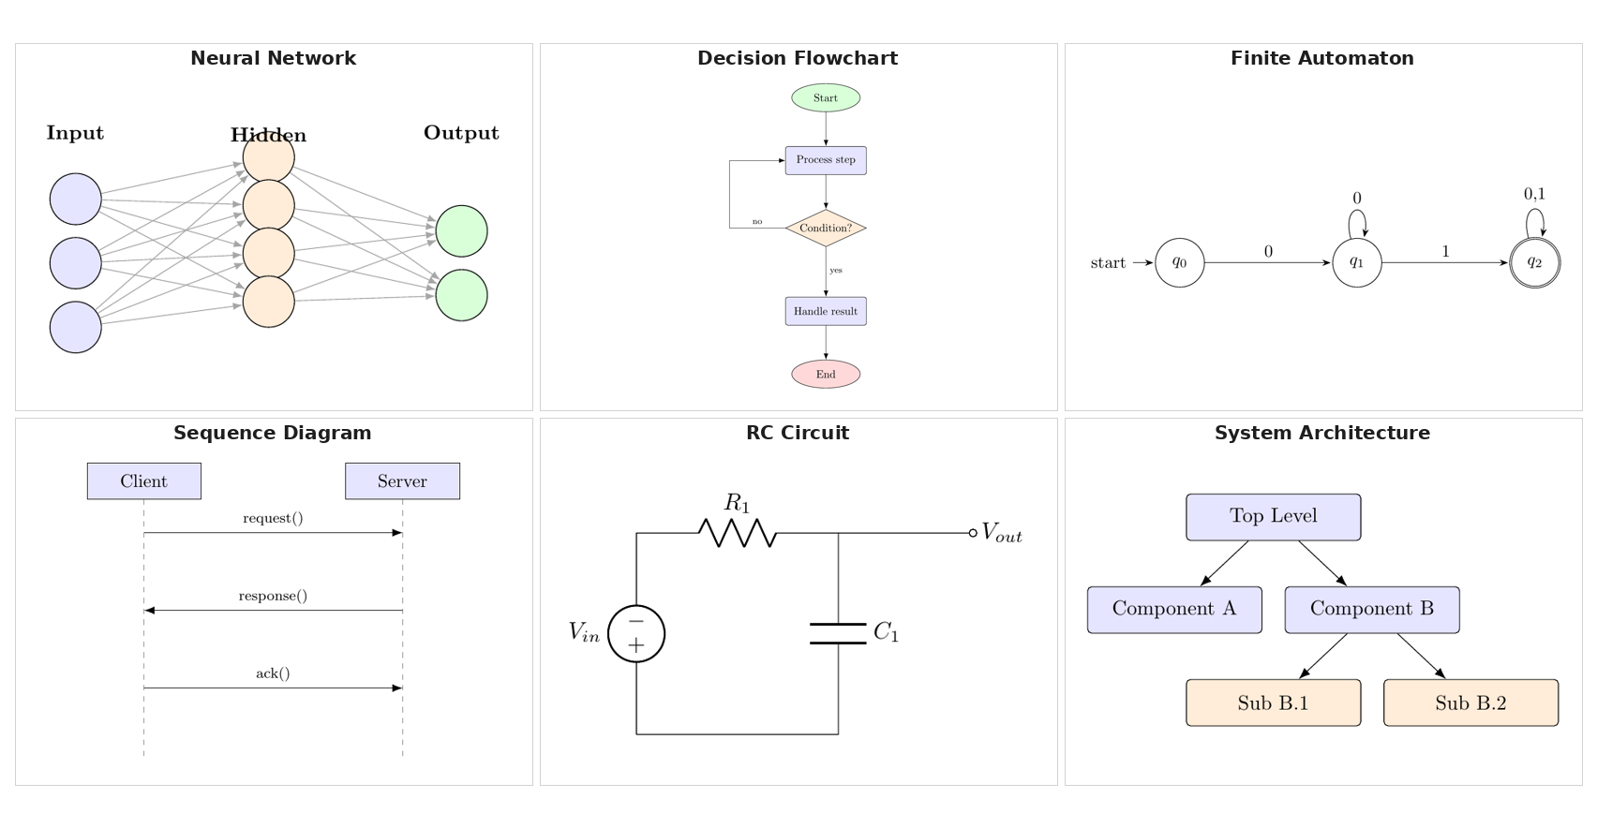
Project Output Screenshot
Please put IBM Bob output screenshots with 2-3 prompts.
You can take 2-3 more slides for each screenshot
·
·
·

Slide 13
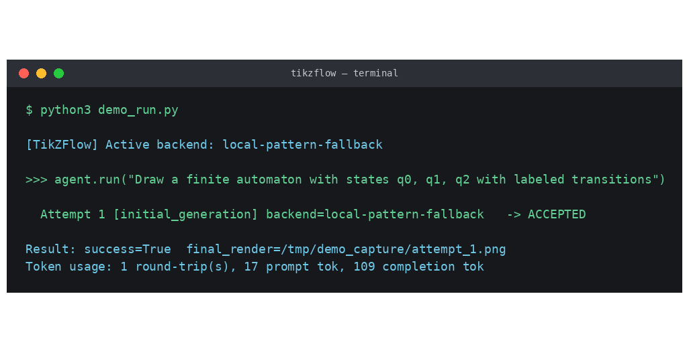
Project Output Screenshot
Please put IBM Bob output screenshots with 2-3 prompts.
You can take 2-3 more slides for each screenshot
·
·
·

Slide 14
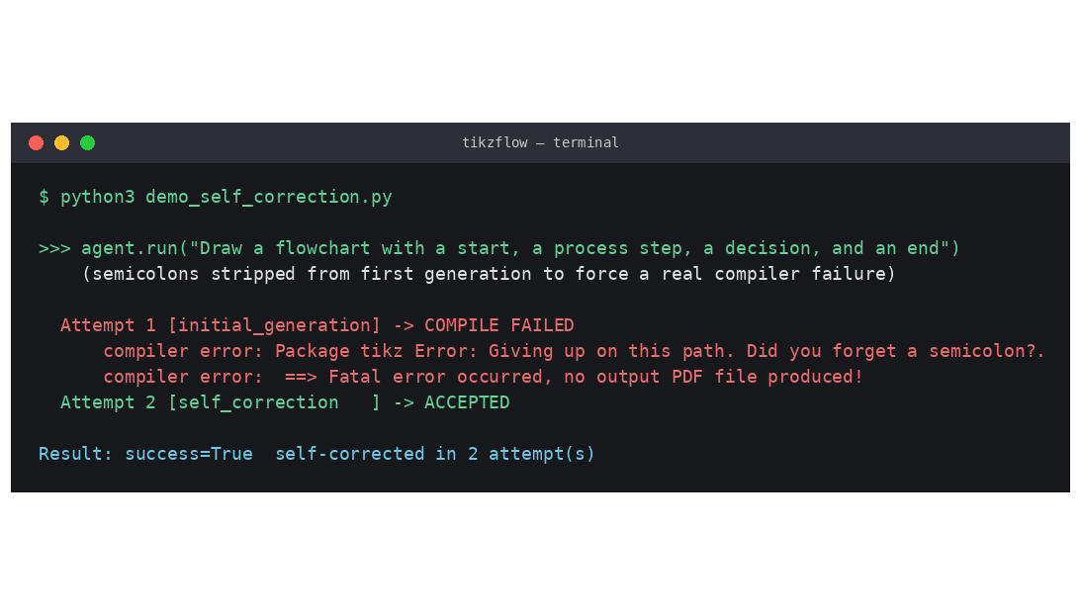
Project Output Screenshot
Please put IBM Bob output screenshots with 2-3 prompts.
You can take 2-3 more slides for each screenshot
·
·
·

Slide 15
Novelty and Uniqueness
TikZFlow stands out by combining retrieval-grounded generation and pixel-level visual validation into a single self-correcting pipeline.
Retrieval-Before-Generation – A verified TikZ pattern library is retrieved by keyword match and adapted, instead of asking an LLM to invent PGF syntax from scratch — RAG applied to code, not conversation.
Visual Validation, Not Just Compile Validation – Inspects rendered pixels and node coordinates, catching the “compiles but wrong” failures that compile-only pipelines miss.
Grounded, Fully-Traced Self-Correction – Retries are seeded with the exact compiler error or visual finding, and every attempt — accepted or rejected — is logged with its backend and token cost.
Fully Offline-Testable – Every example and test here was produced with zero IBM Cloud credentials via a transparent local fallback; the same call sites run live Granite once credentials are set.
This makes the solution a diagram-generation system that verifies its own correctness before responding — not just a chatbot wrapped around an LLM call.

Slide 16
Git Hub Link
· Please create public github repository (Enable Add README button while creating repository) with format –
GitHub URL: https://github.com/kaushikm2706-tech/tikzflow
Make sure you have Uploaded following three files into your github repository 1) All Agent relevant files of IBM Cloud , 2) yourproblemstatement.pdf file 3) your projectpresntation.pptx file 4)any other files
·
·
·

Slide 17
Future Scope
1. Sketch Input Support –
The problem statement explicitly calls for descriptions and sketches. The generation interface is already structured so a vision-capable Granite call (image → structural description → pattern retrieval) slots into the same pipeline without touching the compile/validate/fix loop.
2.Relative-Positioning Overlap Detection –
The current visual validator only catches overlaps between nodes with explicit (x,y) coordinates. Extending the coordinate parser to TikZ's relative-positioning syntax (right=of X) would close the one gap the validator is currently honest about not covering.
·
·
·

Slide 18
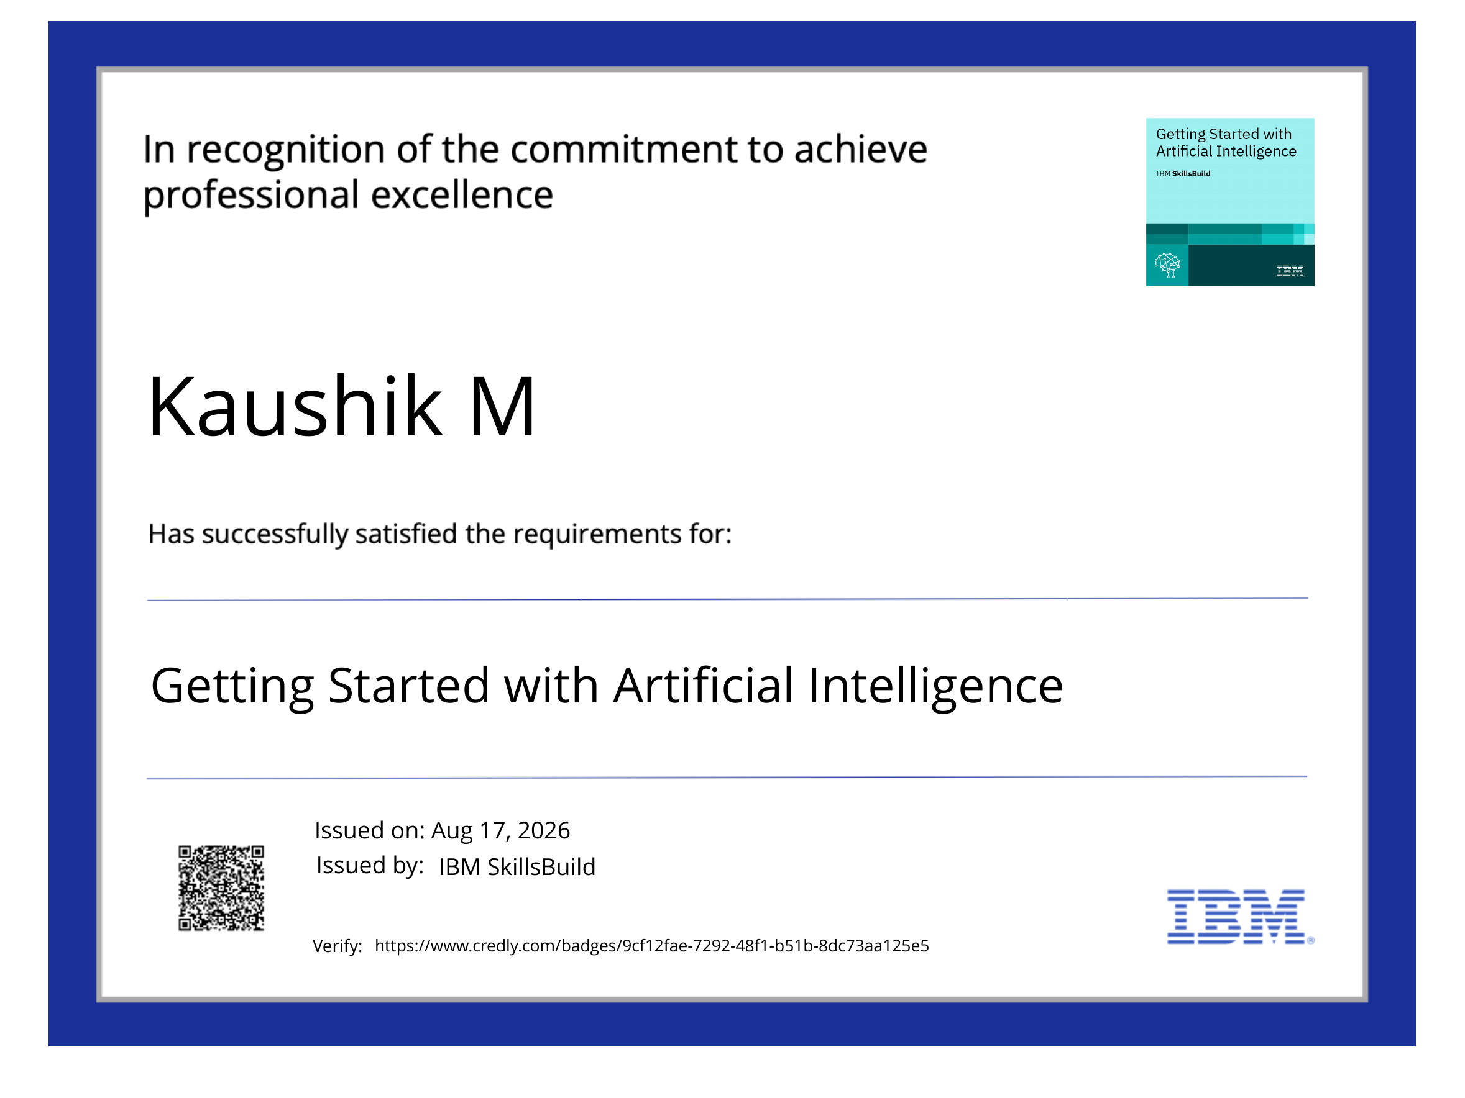
Certificates Earned:
Please add your credly certificate(Getting Started with Artificial Intelligence)

Slide 19
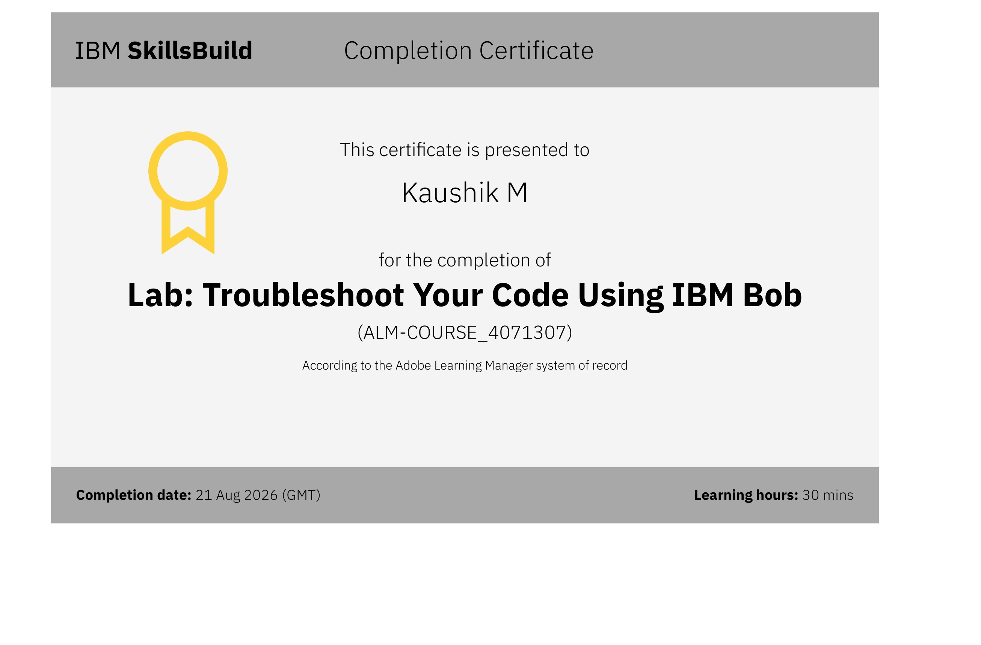
Certificates Earned:​
Add your IBM BOB Certificate

Slide 20


