Slide 1



Analysis of US College Scorecard Data
Kaushik
Shuo
Rohan
Wenqiuli
Analytics with big data

Slide 2






Agenda
1
Methodology
2
Speed Comparison
3
Analyses
4
Conclusions

Slide 3
Methodology
Data Preprocessing
Spark Implementation
Clustering with Mahout

Slide 4
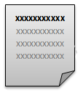
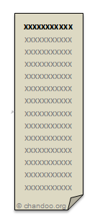
Data Preprocessing
Merge Files
Format Columns
Remove NULLS
Remove Noise

Slide 5



Data Preprocessing
CREATE TABLE Generator

Slide 6
Hive vs Impala vs Spark SQL
Whose performance is fastest ?

Slide 7
Hive vs Impala vs Spark SQL
Whose performance is fastest ?
Time in seconds
Notes:
https://amplab.cs.berkeley.edu/benchmark/
https://www.quora.com/How-does-Cloudera-Impala-compare-to-Shark-now-part-of-Spark

Slide 8
Spark implementation
Create SQL Context
Create HiveQL Context
Load data in RDD
Transform/Filter/Group Data
Extract Year-wise Data
Extract State-wise Data
Extract Data for Trend Analysis

Slide 9
Spark implementation
Create SQL Context
Create HiveQL Context
Load data in RDD
Hive on Spark
Transform/Filter/Group Data
Extract Year-wise Data
Extract State-wise Data
Extract Data for Trend Analysis

Slide 10
Spark implementation
Create SQL Context
Create HiveQL Context
Load data in RDD
Transform/Filter/Group Data
Extract Year-wise Data
Extract State-wise Data
Extract Data for Trend Analysis

Slide 11
Spark implementation
Create SQL Context
Create HiveQL Context
Load data in RDD
Transform/Filter/Group Data
Extract Year-wise Data
Extract State-wise Data
Extract Data for Trend Analysis

Slide 12
Spark implementation
Create SQL Context
Create HiveQL Context
Load data in RDD
Transform/Filter/Group Data
Extract Year-wise Data
Extract State-wise Data
Extract Data for Trend Analysis

Slide 13

Spark implementation
Create SQL Context
Create HiveQL Context
Load data in RDD
spark-csv
Transform/Filter/Group Data
Extract Year-wise Data
Extract State-wise Data
Extract Data for Trend Analysis

Slide 14

Workflow
Dataset
Hive on Spark
Extract Data
Data Preprocessing
Spark SQL
Data Analysis
Clustering Results

Slide 15
Mahout Clustering Process
Local
Create Dataset by Impala
HDFS
Mahout
Clustering analysis
Field delimiter = ‘ ’
Change into sequential file

Slide 16
Clusters formed
Cluster of Best Schools:
Average SAT score of students admitted
Completion rate for all white, black, and hispanic students
Tuition fee
Average faculty salary
Admission rate
454
260
566

Slide 17
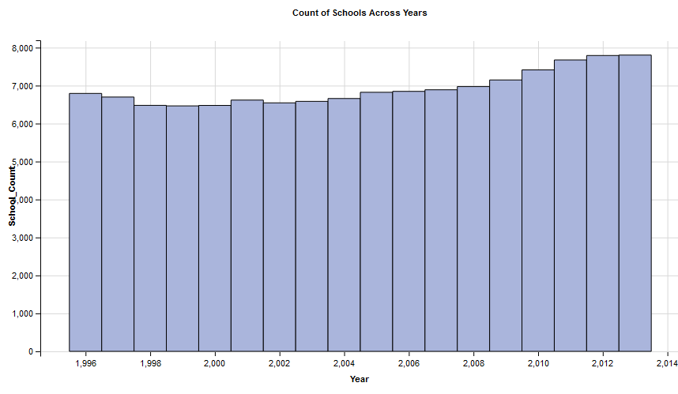
Number of schools over years

Slide 18
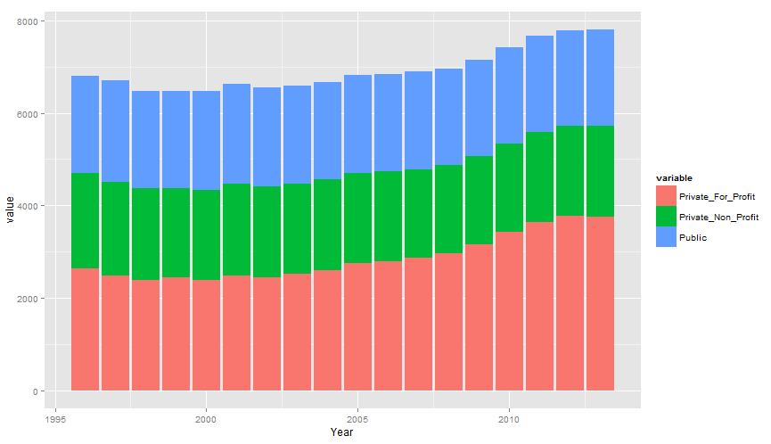
Count of colleges by control

Slide 19
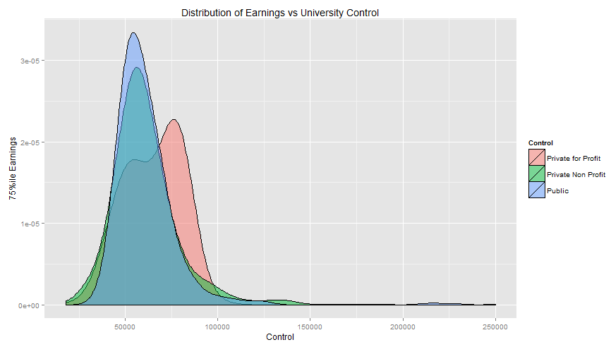
Distribution of Earnings vs Control
75%ile Earnings 10 years after matriculation

Slide 20
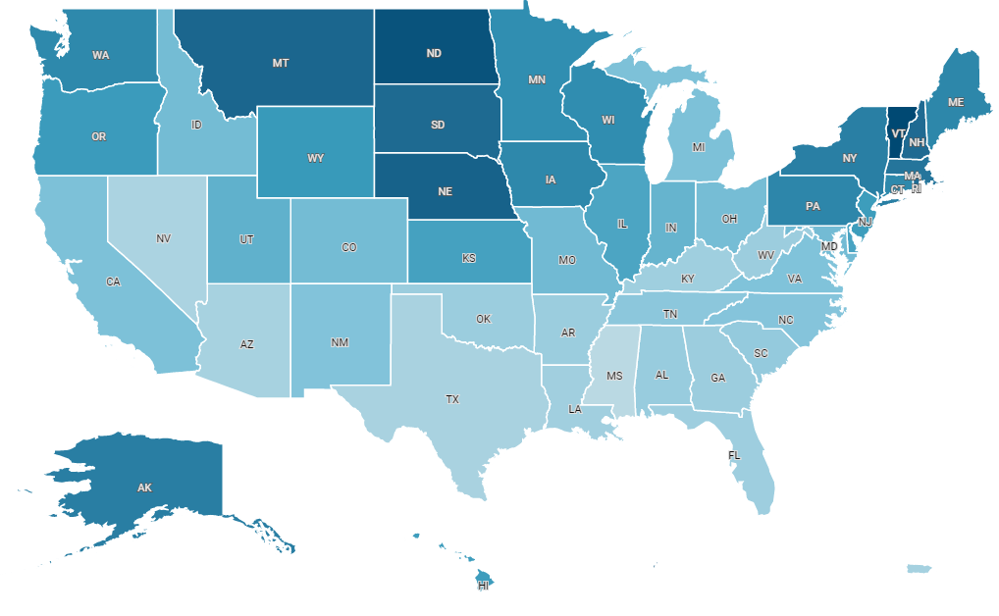
Repayment rates across states
Notes:
Vermont North Dakota and Nebraska

Slide 21
Conclusion and Learnings
Impala has competitive performance with respect to Spark SQL
+
Combining techniques to support our functionality
+
We identified the top 3 states which have the highest repayment rate
+
From our cluster analysis using Mahout, we identified a set “best” colleges

Slide 22

Dilbert, our data has 2000 attributes and we don’t know which tool can handle it
Huh, just 2000? Attend Prof. De’s big data class, you will learn a million tools
Hmm…sounds like a plan
Thank you!

Slide 23
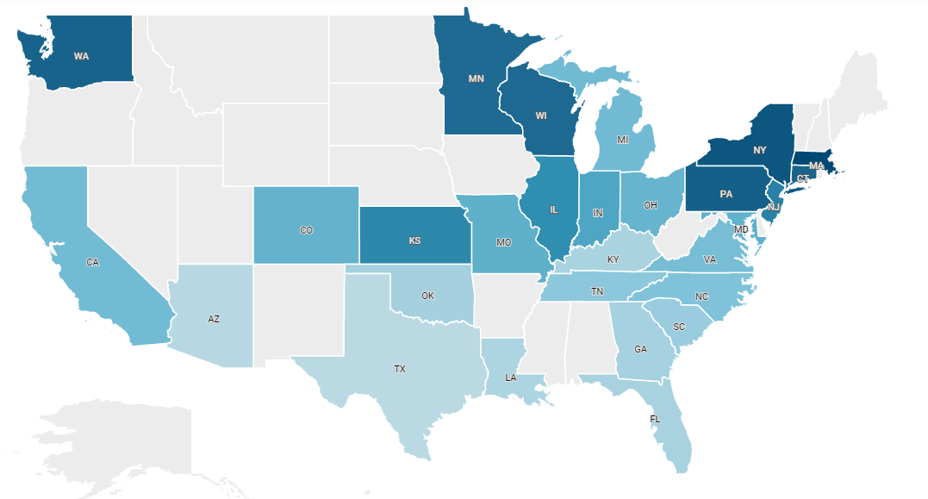
Repayment rates across states
Schools in state > 100 (Median # of schools across states)

