Slide 1

Simple Input: Sophisticated Suggestions for Major League Baseball
Use what you already know
Focus your efforts
Find the best
Kaushik , Adharsh, Deepika, Richard, Srinivas, Yueying
December 10th 2015
Notes:
Richard

Slide 2
Agenda
Problem Definition
Finding similar players
Identifying patterns among batters/fielders/pitchers
Next Steps
Notes:
Richard

Slide 3
Major League Baseball Data
2014 Major League Baseball
Notes:
Richard

Slide 4
Major League Baseball Data
2014 Major League Baseball
1,320 players
Notes:
Richard

Slide 5
Major League Baseball Data
2014 Major League Baseball
1,320 players × 15+ metrics per player
Notes:
Richard

Slide 6
Major League Baseball Data
2014 Major League Baseball
1,320 players × 15+ metrics per player × 162+ games per season =
Notes:
Richard

Slide 7
Major League Baseball Data
2014 Major League Baseball
1,320 players × 15+ metrics per player × 162+ games per season =
Information overload!
Notes:
Richard

Slide 8
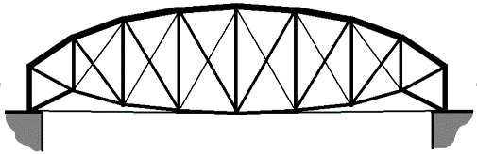
Gap Analysis
Gap
Lack of clarity on how to find similarity among players
Identifying groups of players
Current State
Future State
The manager of a baseball team has difficulty in identifying similarity/trends among players
The manager would like to have a solid technique to identify prospects for old-fashioned scouting
1,320 players made 2014 MLB appearances. No one can keep track of them all
By leveraging analytics the team manager is able to evaluate 1300+ players
For any player, a similar performer can be found and salaries can be compared
Describe a hole in your team, and find a player to fill it in
Key Questions
What your team needs
What the available budget is
Notes:
Richard

Slide 9
Use-case: Player Replacement
Name a player you’d like to replace
Find the top 5 players with similar outcomes
Evaluate by age, salary, and summary performance metrics
Notes:
Adharsh

Slide 10
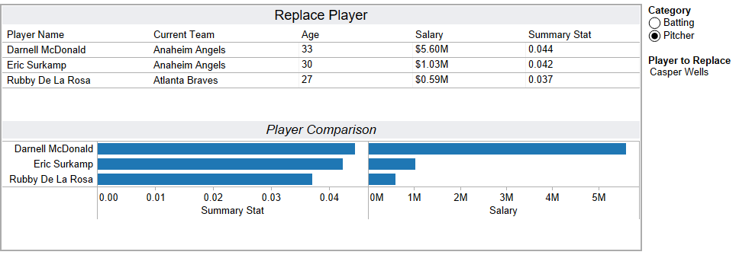
Sophisticated Suggestions
Notes:
Adharsh

Slide 11
Use What You Already Know
A simple set of questions you already know the answer to:
Gets you the information you need to focus on:
1
What position do you need?
Player name
Player age
2
What can you pay?
Summary performance metric
3
What sort of player are you interested in?
Salary (where available)
Notes:
Deepika

Slide 12
Use-case: Fill a hole
Requirement
I need an outfielder
How much can you pay?
I can pay $14M
What do you want to emphasize?
Batting performance
Notes:
Deepika

Slide 13
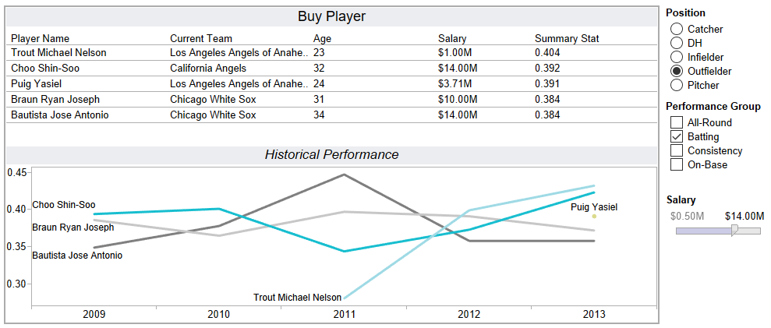
Sophisticated Suggestions
Notes:
Deepika

Slide 14
Under the hood
Found groups of players based on simple performance metrics
Grouped players into position categories
Pitchers
Hits
Errors
Outfielders
Stolen Bases etc.
Data Source
Infielders
Lahman’s Baseball Database
Catchers
Designated Hitters
Notes:
5 years data
Kaushik team, player level and manager level

Slide 15
Next Steps
Improvement
Refine performance inputs (combine, weight, or remove metrics)
In depth analyses
Implement more granular searches: Player availability?
Include more leagues
Expand to include minor league players
Notes:
Performance metrics: equal weight , on field performance metrics, physical characteristics,
Displaying the top 5players: Novelty and diversity: best player turns out in the results

Slide 16
Thank You

Slide 17
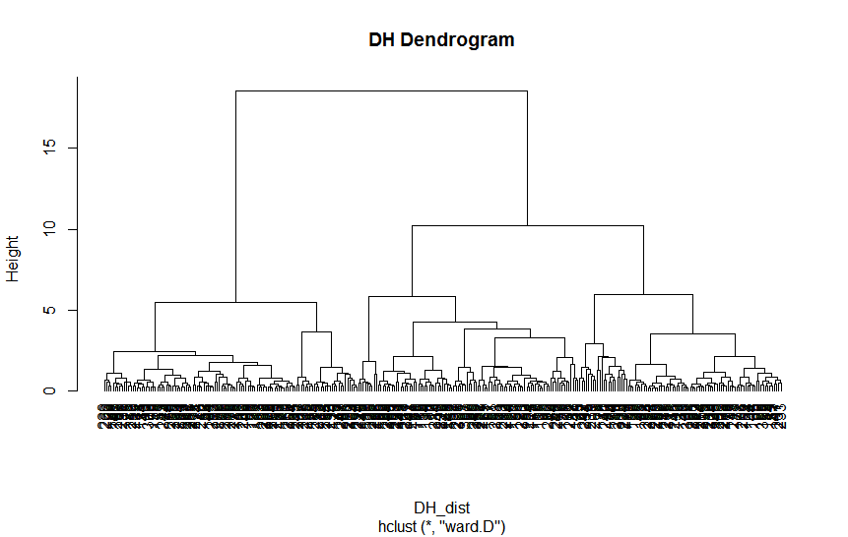
Appendix A: Simple Clustering Example
Designated Hitter: A player that bats in place of the pitcher
Only present on American League teams
Only bats, so only batting statistics are present
Express all stats as a ratio with At-Bats, and then normalize

Slide 18
Two or three clusters? Prioritize Interpretability
cluster | R | H | X2B | X3B | HR | RBI | SB | CS | BB | SO | IBB | HBP | SH | SF | GIDP
1 | 0.116499 | 0.252142 | 0.051058 | 0.004807 | 0.021991 | 0.112137 | 0.014252 | 0.006324 | 0.089313 | 0.192674 | 0.006069 | 0.01034 | 0.005437 | 0.008403 | 0.024573
2 | 0.133313 | 0.249521 | 0.051245 | 0.002902 | 0.045083 | 0.152946 | 0.006154 | 0.003213 | 0.115275 | 0.250168 | 0.008893 | 0.010132 | 0.001179 | 0.008524 | 0.024769
These clusters show one group swinging at the ball (Home Runs, Strike Outs), and another acting to score runs when on-base, or with a teammate on-base (Stolen Bases, Sacrifice Hits).
cluster | R | H | X2B | X3B | HR | RBI | SB | CS | BB | SO | IBB | HBP | SH | SF | GIDP
1 | 0.125511 | 0.254096 | 0.050459 | 0.007473 | 0.019166 | 0.106171 | 0.022868 | 0.009847 | 0.09595 | 0.203093 | 0.005079 | 0.009853 | 0.007656 | 0.007595 | 0.019049
2 | 0.106703 | 0.250018 | 0.05171 | 0.001909 | 0.025062 | 0.118621 | 0.004885 | 0.002495 | 0.082099 | 0.181349 | 0.007145 | 0.010868 | 0.003024 | 0.009282 | 0.030577
3 | 0.133313 | 0.249521 | 0.051245 | 0.002902 | 0.045083 | 0.152946 | 0.006154 | 0.003213 | 0.115275 | 0.250168 | 0.008893 | 0.010132 | 0.001179 | 0.008524 | 0.024769
These clusters find large differences in rare metrics, such as Triple and Grounded Into Double Play.

Slide 19
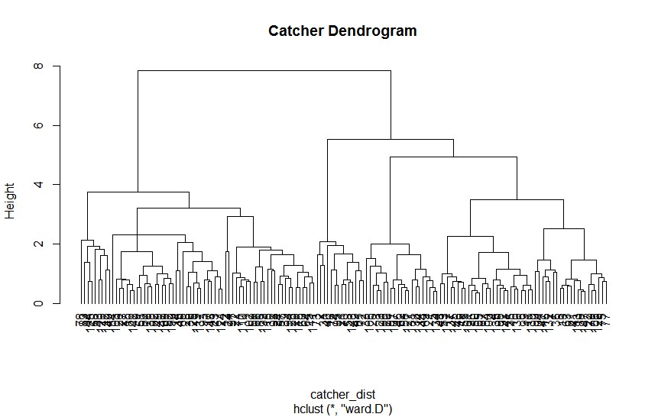
Appendix B: Complex Clustering Example
Catcher
Batting: same as all other players
Fielding is different from other players, with several rare outcomes tracked
Collect fielding data only from games played as catcher
Measure as ratio with games played
Join with all batting outcome ratios

Slide 20
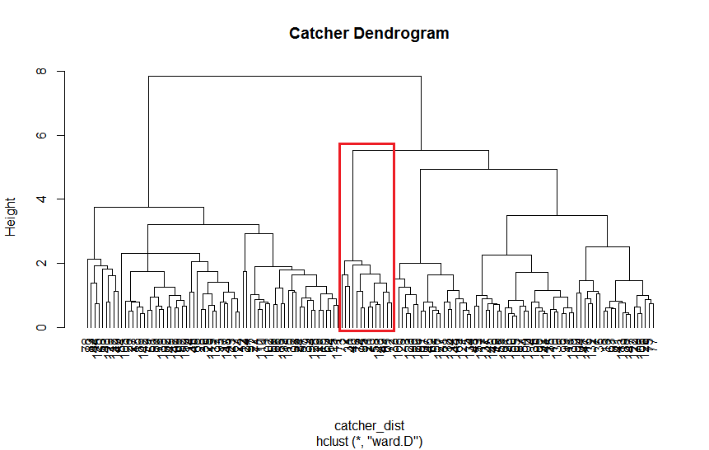
Two or four clusters? Is the outlier cluster useful?
Filtering out inactive players, the four clusters have sizes: 27, 5, 15, and 29.
A 5-player cluster is not much use, so we use two clusters instead.

Slide 21

Appendix C: Player similarity
The performance metric for batting and pitching is calculated
Batting:
Pitching¹:
Using this, the similarity matrix is computed using Euclidian distance
For each player, the 3 most similar players are selected (who aren’t in the same team)
1: Lower the ERA, the better
Baseball glossary: http://baseball.about.com/od/termstatglossar1/a/statsglossary.htm

Slide 22
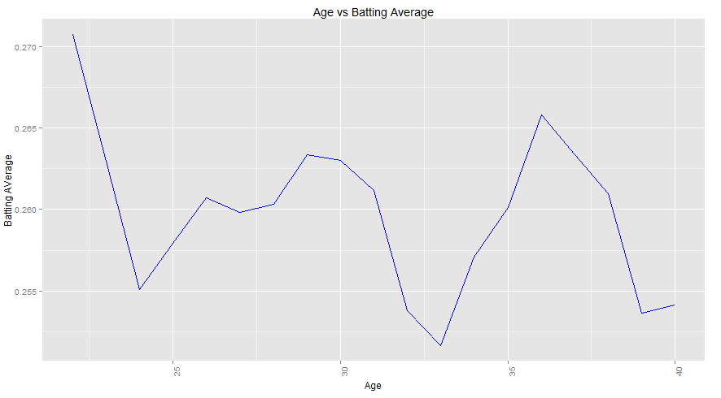
Appendix D: Age vs Batting Average
Notes:
We chose not incorporate age into our clusters, but still wondered what it might represent to a manager. We compared player age to two important statistics (Batting Average and ERA), and found that age and each outcome was at best weakly correlated. We do believe that it conveys useful information to a manager about a player’s maturity, attitude, and performance potential, which is why it is included in the application’s output.

Slide 23
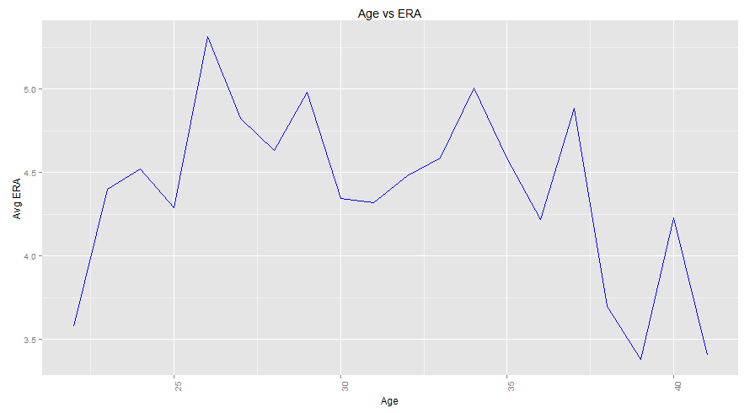
Appendix E: Age vs ERA

