Slide 1

Funding Club 2011 Competitive Analysis
Team 8
Kaushik Nuvvula ,Ameeta Japtiwale, Manikandan Kuppuswamy, Fu Lin, John Tong

Slide 2
Agenda
Company Background and Goals
Data
ETL Strategy
Dimension Modeling
SSIS Implementation
Competitive Analysis
Conclusion

Slide 3







Funding Club – online marketplace connecting borrowers to investors
Ameeta
Mani
Kaushik
Fu
John

Slide 4


To compete against Lending Club, we are willing to take on a riskier portfolio
Consider borrowers who were declined by LC
Target qualified candidates with lower base interest rate
Next Step: To analyze Lending Club’s client data to support our go-to market strategy

Slide 5
Data
Lending Club Data
FRED Data
Approved loan data (2007 – 2011) : Loan Application data for all loans issued through the time period (2007-2011)
Declined loan data (2007 – 2012) : Loan applications that did not meet Lending Club's credit underwriting policy
FRED economic data : The consumer price index for all urban customers on a month level
FRED GDP : Gross Domestic Product on a quarterly level
FRED loan rate : Rate posted by a majority of top 25 (by assets in domestic offices) insured U.S.-chartered commercial banks on a daily level

Slide 6
Business Context
Determine what type of customers are qualified for a loan at Lending Club
What are the different interest rates offered to borrowers of different grades?
How much money (NPV & ROI) does Lending Club make off their customers of each grade?
Percentage of loans charged off for customers of each grade

Slide 7
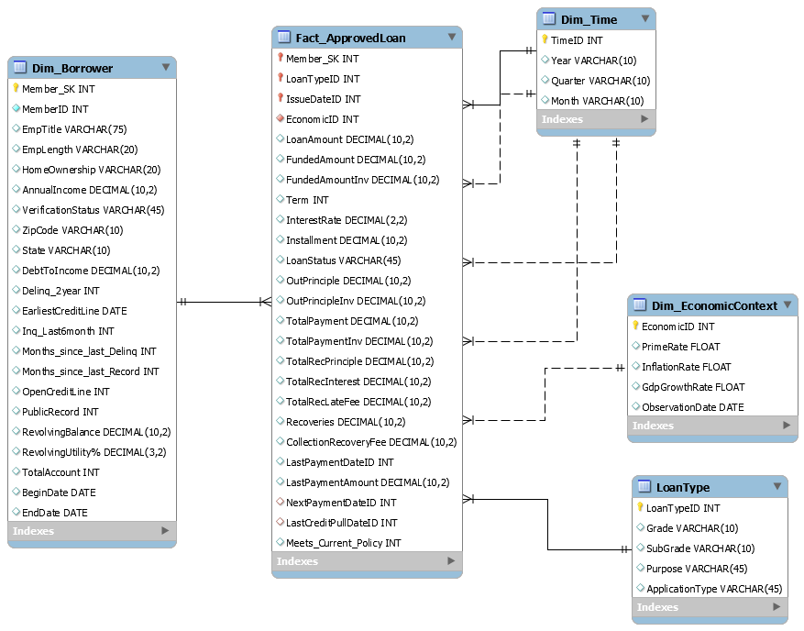
Dimensional Model
Grain : One row per approved loan application for the borrower
Dimensions : Borrower, Time, EconomicContext, LoanType
Fact: ApprovedLoan
Accumulating Snapshot
Slowly Changing Dimensions

Slide 8
ETL Strategy
Agenda
Extract data
Transform Data
Load Data
Source Data : Excel files
Change date format
Missing value treatment
Recode attributes
Dimensions
Facts

Slide 9
ETL Implementation
Time
Economic
Loan Type
Borrower
Fact_Loan
Loading Order
Key Issues
Time inconformity
Before 2000: mm-yyyy
After 2000: yyyy-mm
2. Decimal and integer data type
Decimal in SQL server Numeric
INT in SQL server Four-byte singed integer

Slide 10
Slowly Changing Dimensions
Type 1 SCD
DebtToIncome Ratio
Employment Title
Employment Length
AnnualIncome
Borrower dimension: Track History
Type 2 SCD
LastPaymentAmount
LastPaymentDate
Outstanding Principle
NextPaymentDate
Fact table: Update current milestone

Slide 11
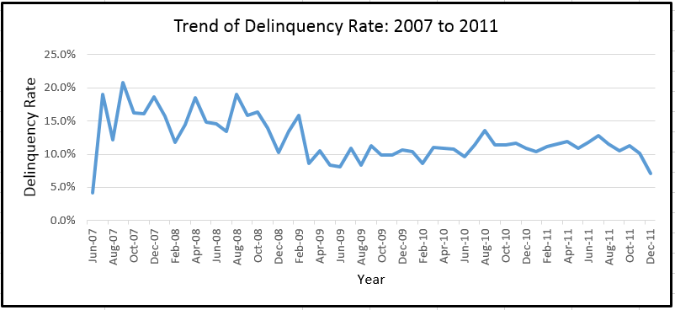
Trend Analysis of Delinquency Rate
Lots of fluctuations in delinquency rate in the initial years
From 2009, Lending club is more cautious in approving loans

Slide 12
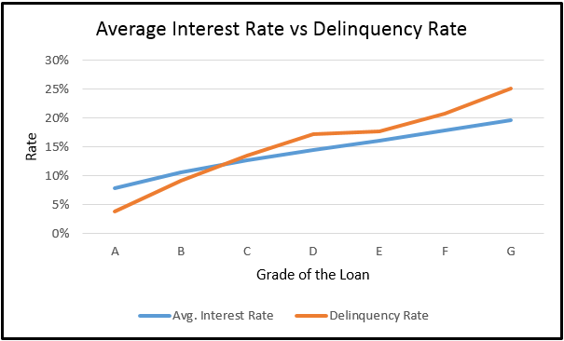
Interest Rate Vs. Loan Grade
Interest rate increases as loan grade varies from A to G
This might be due to the increase in delinquency rate from A to G

Slide 13
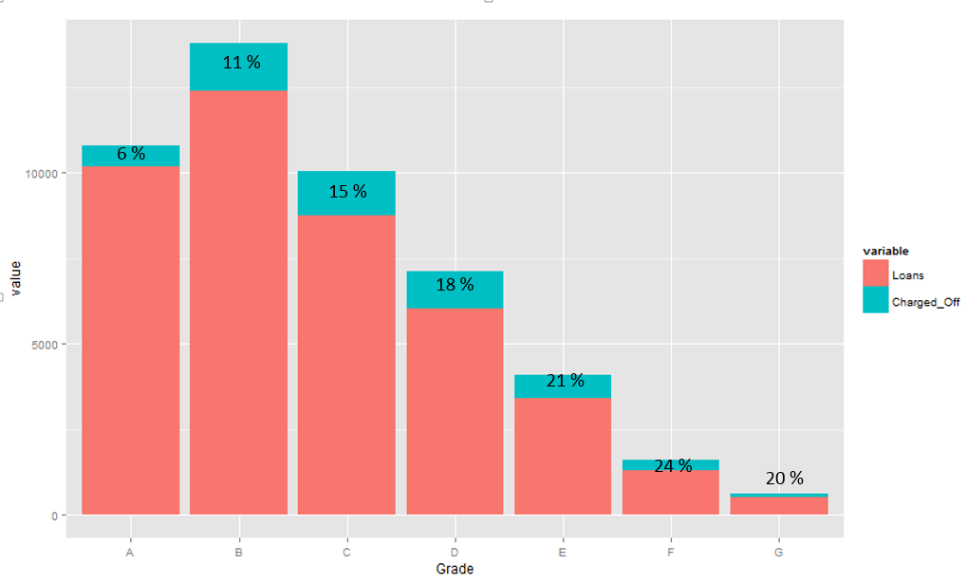
Loans across Grades
Percentage of loans charged off increases as the loan grade varies from A to G
Percentage loans charged off = Number of loans charged off/Number of loans

Slide 14
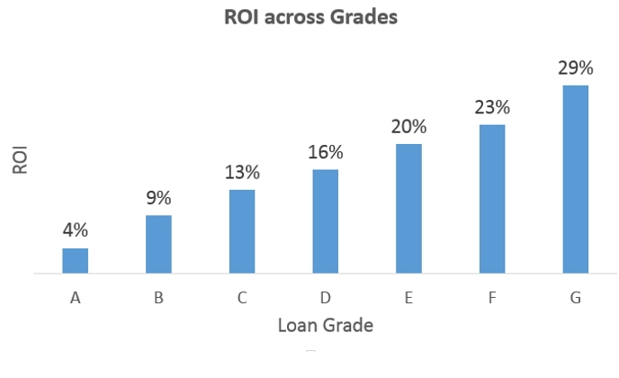
ROI across Grades
Loan grade G has the highest ROI as they are charged at a much higher interest rate
ROI = Net Present Value/Funded Amount

Slide 15
Conclusions
As a new start-up, Funding Club:
Extracted and stored Lending Club loan data from 2007 – 2011
Analyzed Lending Club customers and their qualifications
Created model to predict approval and declined customers, consider top 5% declined customers
Borrowers of all grades are profitable, target with a lower interest rate

