Slide 1

Analysis of Top US Restaurants on Yelp.com
MSBA 6330 Kaushik, Rohan, Shuo, Wenqiuli

Slide 2


What is Yelp?
Yelp is a website (and mobile app) that can be used by:
Everyday Individuals
Business Owners
Notes:
Yelp is a website and mobile app that can be used by both everyday individuals, like ourselves, and small business owners or business professionals.

Slide 3
Agenda
Harvesting Data: Methodology
Approach/Findings
State/City level analysis
Defining Popular Restaurants
Identifying Suggested Reviews
Conclusions

Slide 4
Yelp API
What is Yelp API?
Provides information about businesses (restaurants in our case) in a particular region
Features:
Can fetch up to 40 restaurants in a particular region.
Restaurant preferences can be sorted by highest rating, by distance or best match(random)

Slide 5
Methodology: Data Scraping
City Name
Call YelpAPI
Highest rated restaurants in that city
Input
Scrapper
Output
High Level Overview of our Approach

Slide 6
Methodology: Data Scraping
City Name
Call YelpAPI
Highest rated restaurants in that city
Input
Scrapper
Output
Seem Simple?

Slide 7
Methodology: Data Scraping
City Name
Call YelpAPI
Highest rated restaurants in that city
Input
Scrapper
Output
Issue:
For each city, API returns only 40 highest rated restaurants.
Total cities (Yelp API supported) = 55
Dataset size = 55*40 = 2200 -> Too small for any analysis
Can significantly deviate findings

Slide 8
Methodology: Data Scraping
For each Neighborhood in a City
Call YelpAPI
Highest rated restaurants in that neighborhood
Input
Scrapper
Output
Solution:
Divide the city into Neighborhoods.
Get restaurant data for each neighborhood.
Example:
Minneapolis has 19 neighborhoods.
Thus, restaurant data collected for Minneapolis = 40 * 19 = 760 records

Slide 9
Methodology: Data Scraping
For each Neighborhood in a City
Call YelpAPI
Highest rated restaurants in that neighborhood
Input
Scrapper
Output
Issue:
Yelp API can search by location name, but not quite efficiently.
If two cities have same name, which one will Yelp choose?
example- Madison in Wisconsin and Madison in Illinois

Slide 10
Methodology: Data Scraping
For each Neighborhood in a City
Call YelpAPI
Highest rated restaurants in that neighborhood
Longitude
Latitude
Scrapper
Output
Location
name
Google Geocoding API

Slide 11
Methodology: Data Scraping
For each Neighborhood in a City
Google Geocoding API
Location
name
Longitude
Latitude
Call YelpAPI
JSON
response
CSV file
Highest rated restaurants in that neighborhood
write
data

Slide 12
Methodology: Data Scraping
For each Neighborhood in a City
Google Geocoding API
Location
name
Longitude
Latitude
Call YelpAPI
Repeat this process for all the cities
JSON
response
CSV file
Highest rated restaurants in that neighborhood
write
data
Time taken – up to 30 hours
Records generated ~132,000

Slide 13
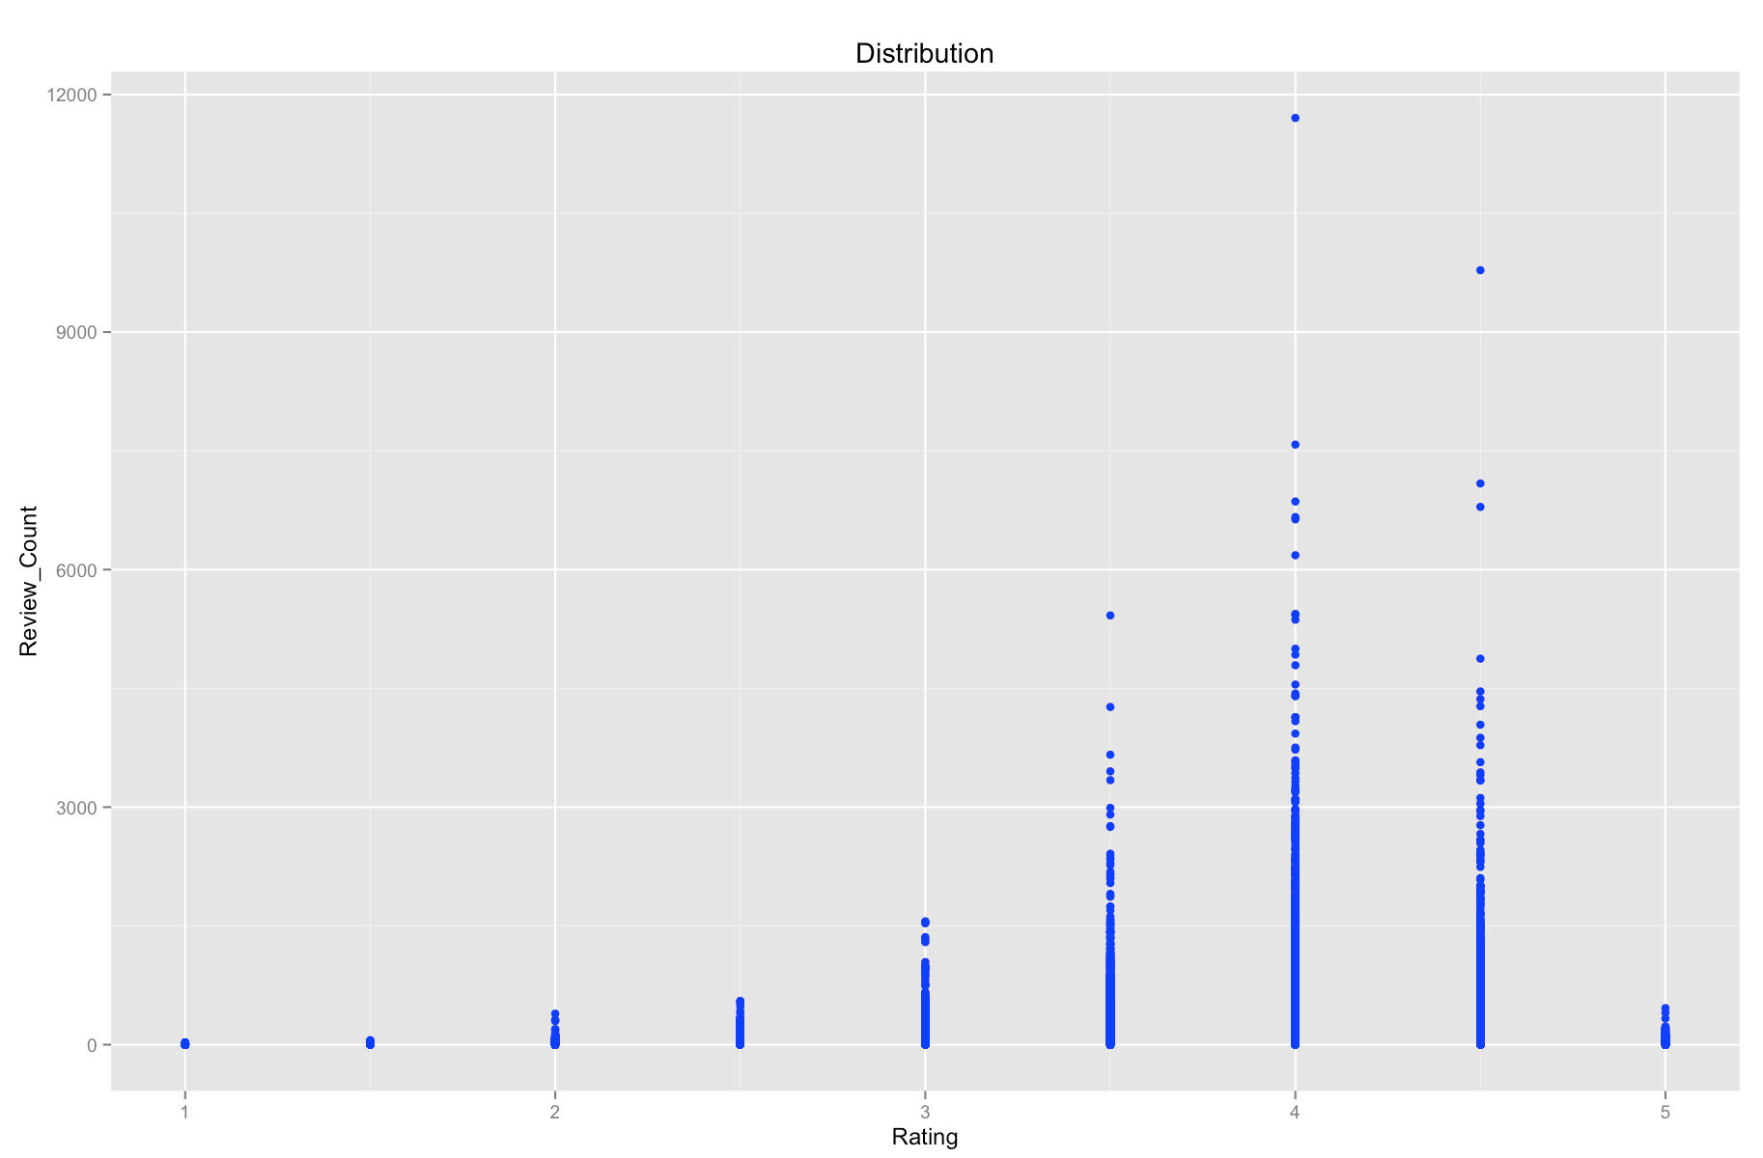
Review count distribution across Rating

Slide 14
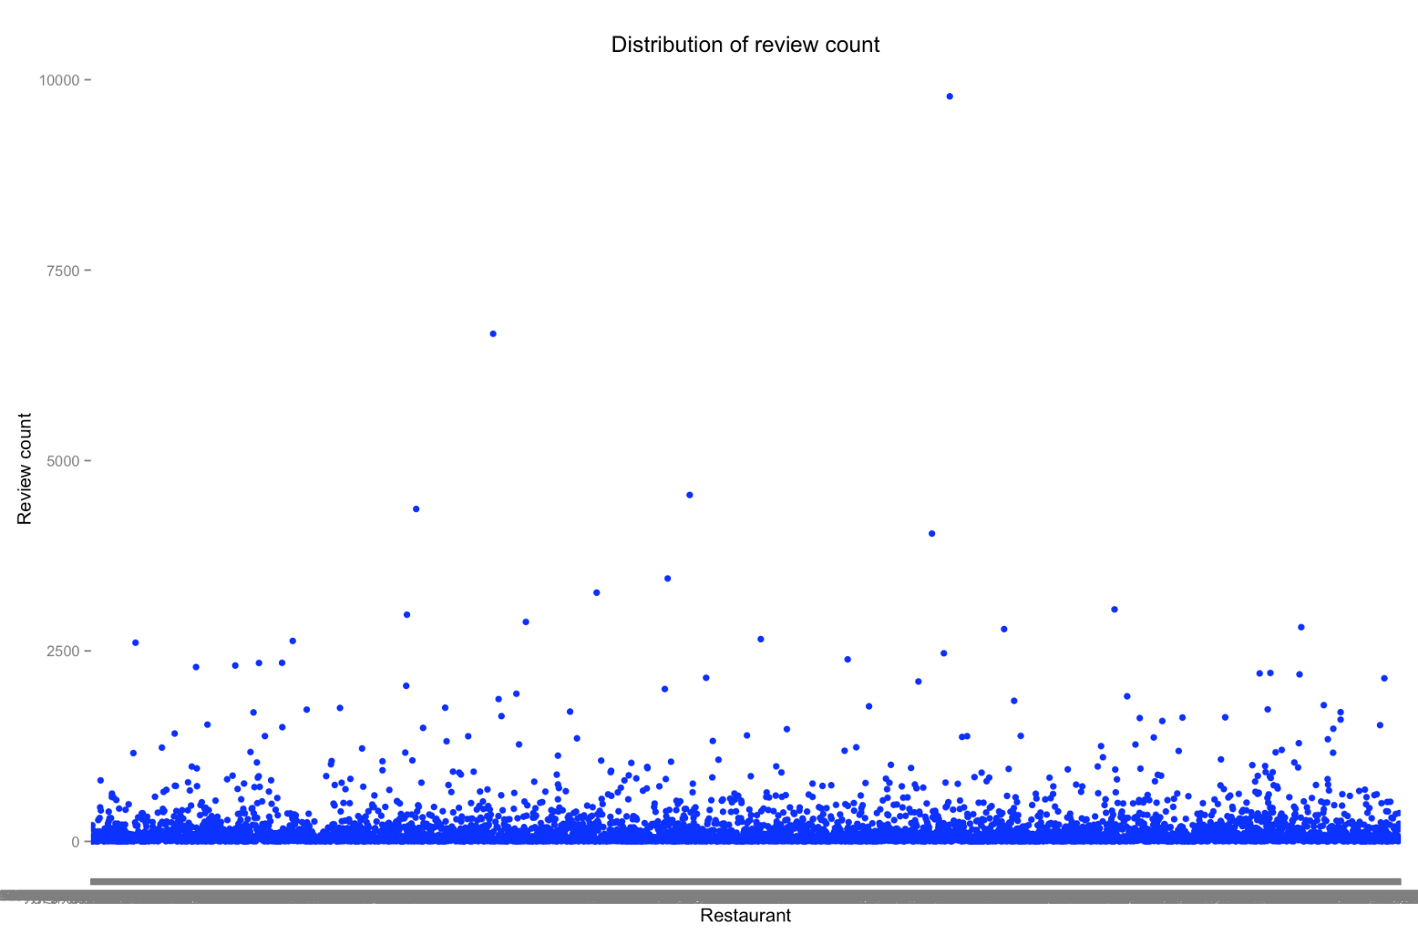
Review count distribution across restaurant

Slide 15
Approach
Number of Restaurants
Stage 1 → 60, 395 Restaurants
Cities > 100 Restaurants
Stage 2 → 47, 174 Restaurants
Rev Cnt > 100
Rating > 4
Stage 3 → 2, 692 Popular Restaurants
Rating > Median
Review Count > 70%ile

Slide 16
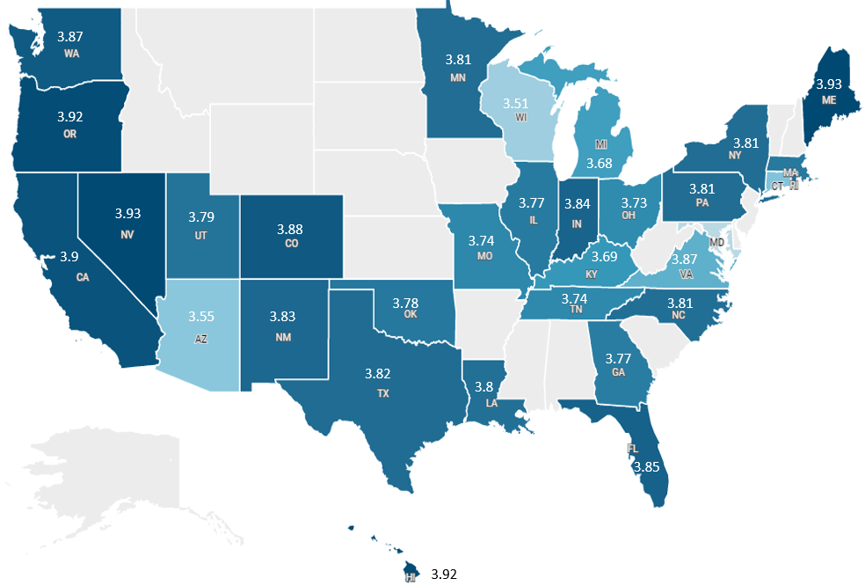
Findings: Average rating across states (Stage 2)

Slide 17
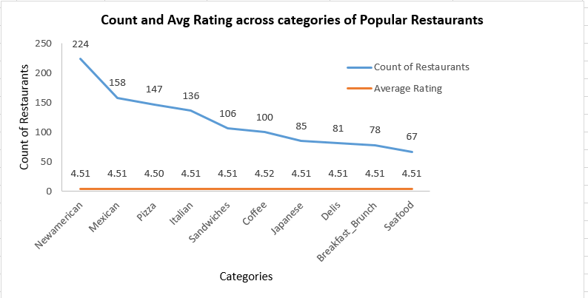
Categories served by popular restaurants
New American, Mexican and Pizza are the top 3 categories served by popular restaurants

Slide 18
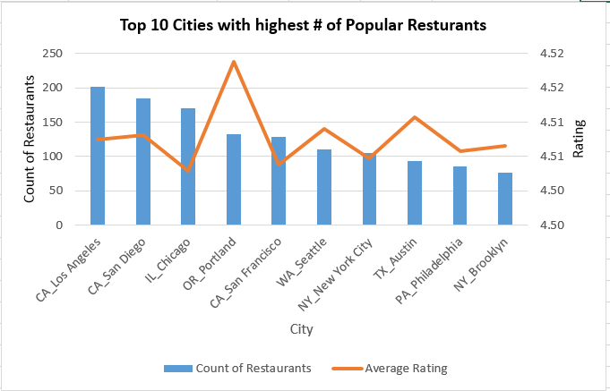
Top 10 Cities with most number of popular restaurants
Los Angeles, San Diego and Chicago – Top 3 cities

Slide 19
Text Analysis
Top 20 Chinese Restaurants in Minneapolis
Dragon House | Luis Chow Mein
Hot Wok Delivery | Xin Wong
Fresh Wok | Szechuan Spice
Kowloon | Kinhdo Vietnamese
Evergreen | Shuang Cheng
Chin Dian Cafe | Keefer Court Bakery and Cafe
Que Viet Village House One | Tea House
China Express | Kims Vietnamese
Camdi, Mei Inn | Hong Kong Noodle

Slide 20
Text Analysis
Web Scrapping — 1,389 reviews, 469 low-rating
Text analysis — Dictionary based approach
— 69 suggested reviews

Slide 21
Conclusion
All US restaurants
Highest average rating by state: — Maine and Nevada
Most number of restaurants: — Chicago, LA, Houston
Popular restaurants
Most popular cuisines: New American, Mexican, Pizza
Most number of popular restaurants: LA and San Diego
California has the highest number of popular restaurants
Top 20 Chinese restaurants in Minneapolis
Suggested reviews

Slide 22
THANK YOU!

Slide 23
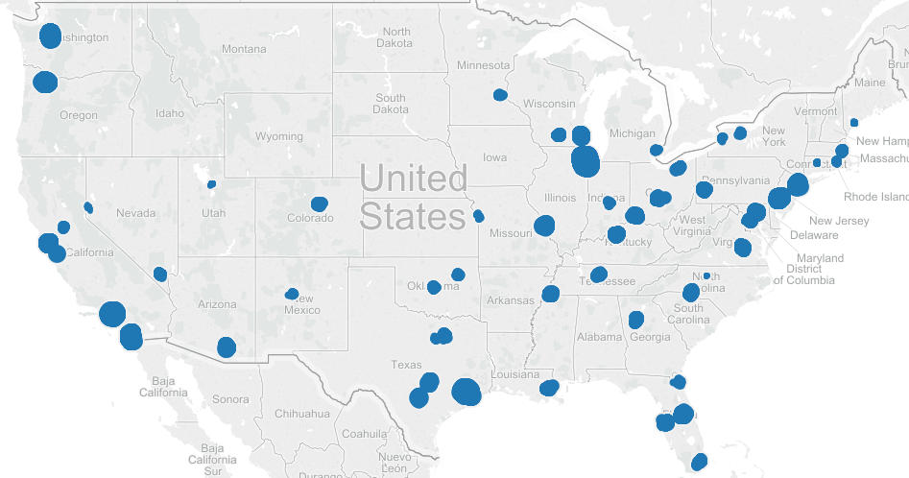
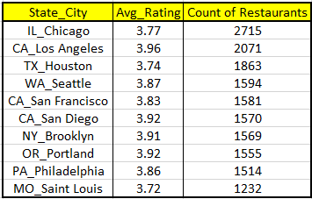
Ratings of restaurants vary across cities

Slide 24
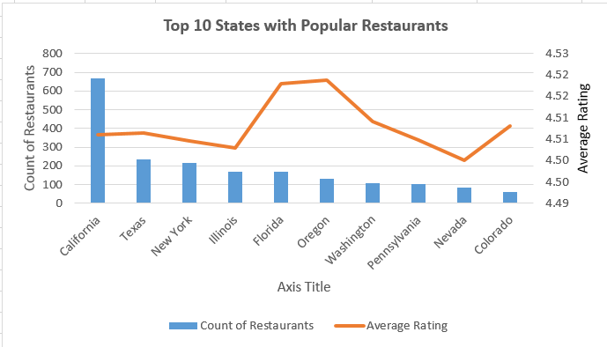
Top 10 states with highest number of Popular Restaurants
California has the highest number of popular restaurants

