Slide 1
Online Book shopping store using blazor

Slide 2
Technologies used
Blazor (WebAssembly for C#)
ASP.Net Core 2.1
Blazor is a web UI framework based on C#, Razor, and HTML that runs in the web browsers via WebAssembly. Blazor was designed to simplify the task of building fast single-page applications that run in any browser.
Because of blazor, we can completely eliminate the use of Javascript on the client-side.

Slide 3
About our project
We have created a simple online bookstore where there is an admin who can add, delete, update book details(CRUD).
And there is also a user who can buy books. The User can also view his orders that he has placed.
We are carrying out all the operations using MSSQL and all the activities that are being taken place in the website are stored on the database in the respective entities or tables.

Slide 4
Online Book shopping store using blazor

Slide 5
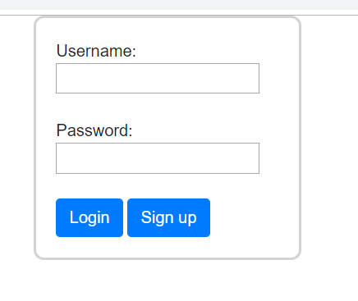
Login Page
Here the User or the Admin can enter their specific username and password to enter
We have made sure that when the user enters his credentials he is redirected to User Home and when it is an admin, he is redirected to an admin home page.
We also have an option to signUp for a user

Slide 6
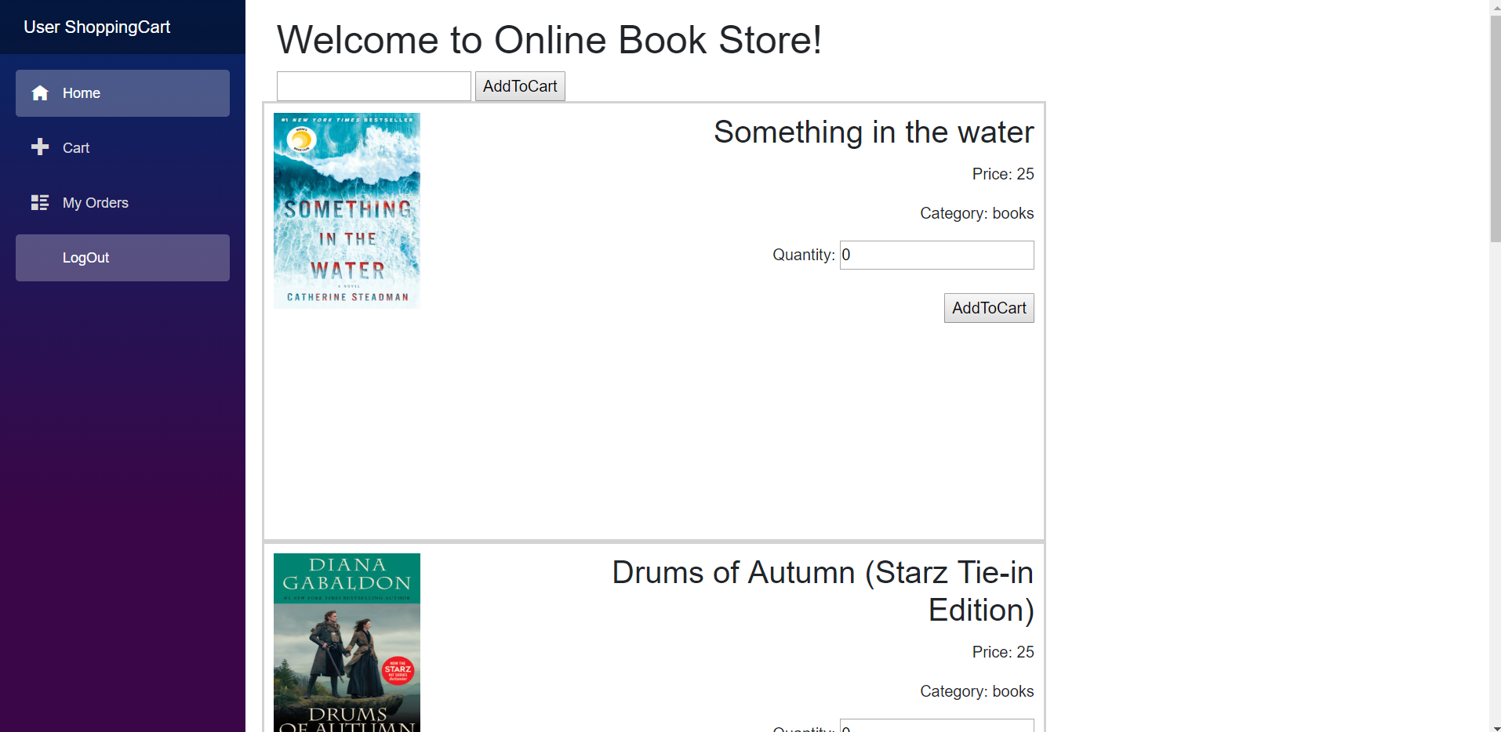
User View
This the User view that we have created where the user can see the books available in the online store. He can choose the quantity and add the item to the cart.
To view the cart, the user can click on cart in the left hand side navigation menu.
To view the previous order history, the user can click on My Orders option

