Slide 1
Beauty & Hygiene
Product Sales

Slide 2

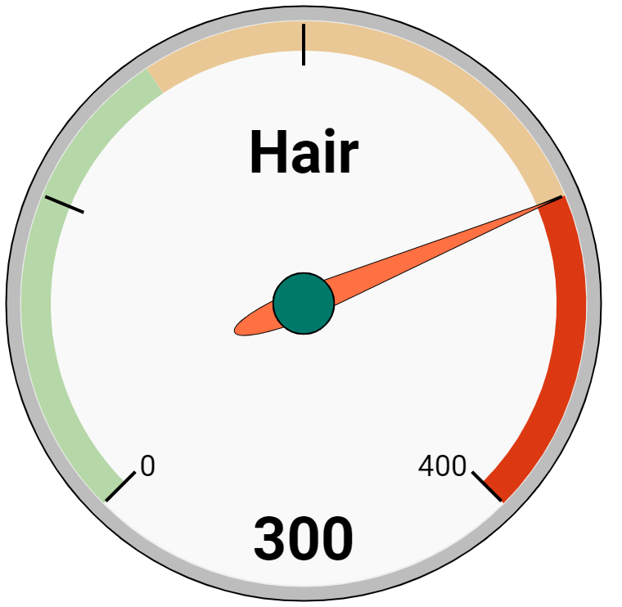
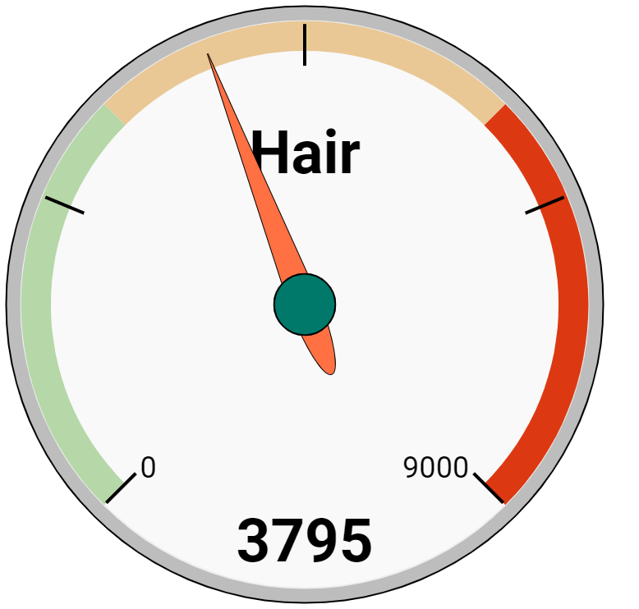


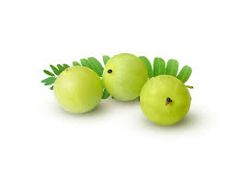
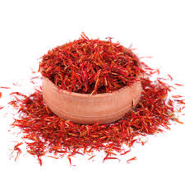

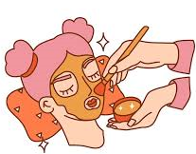
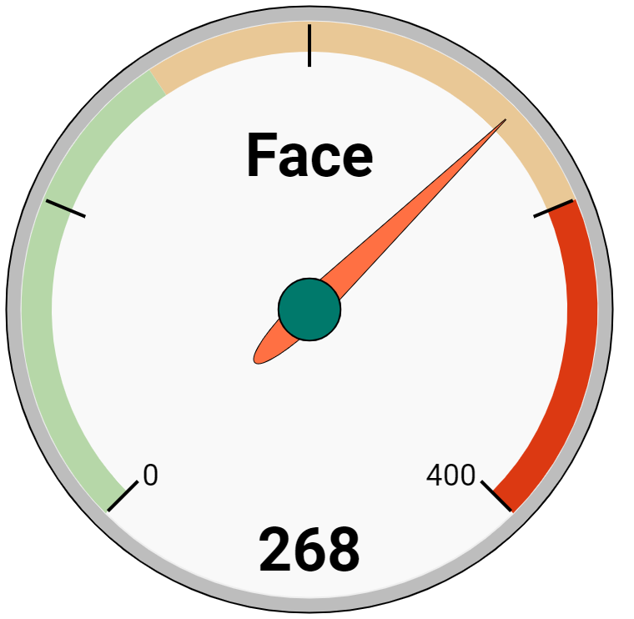
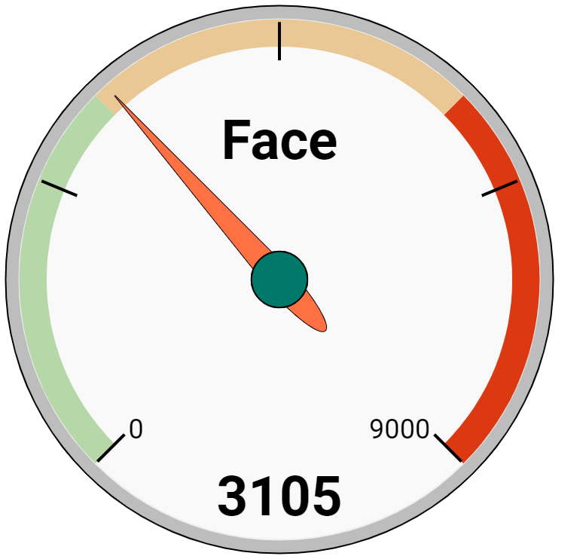




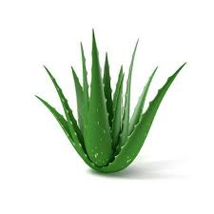

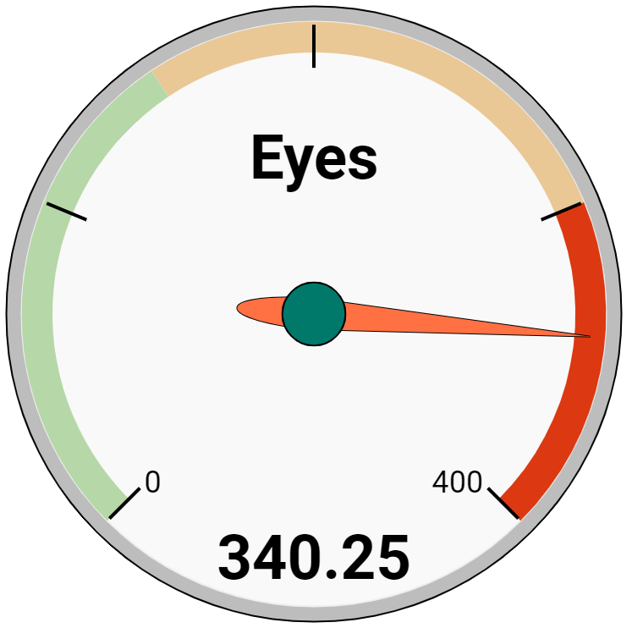
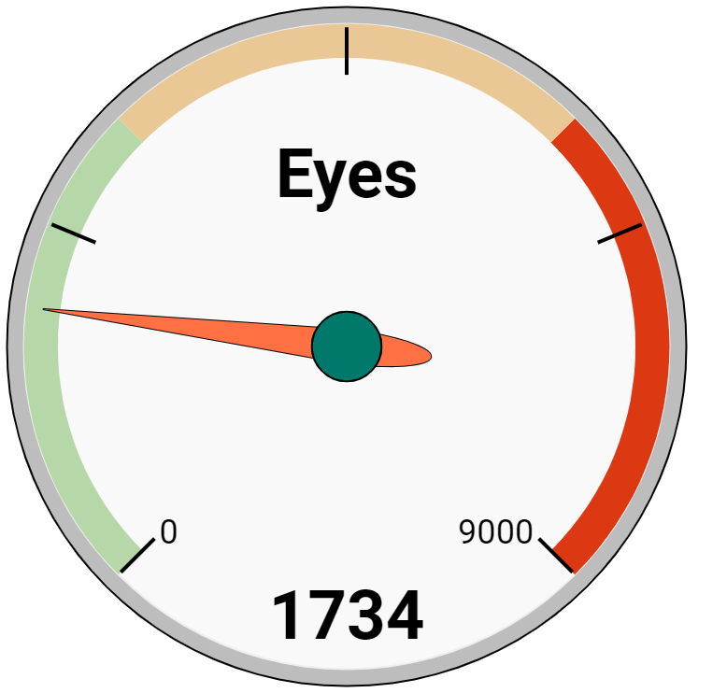


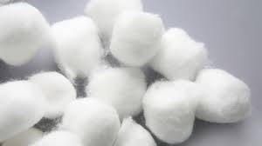

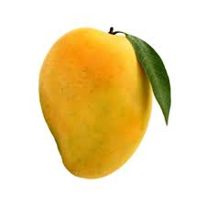
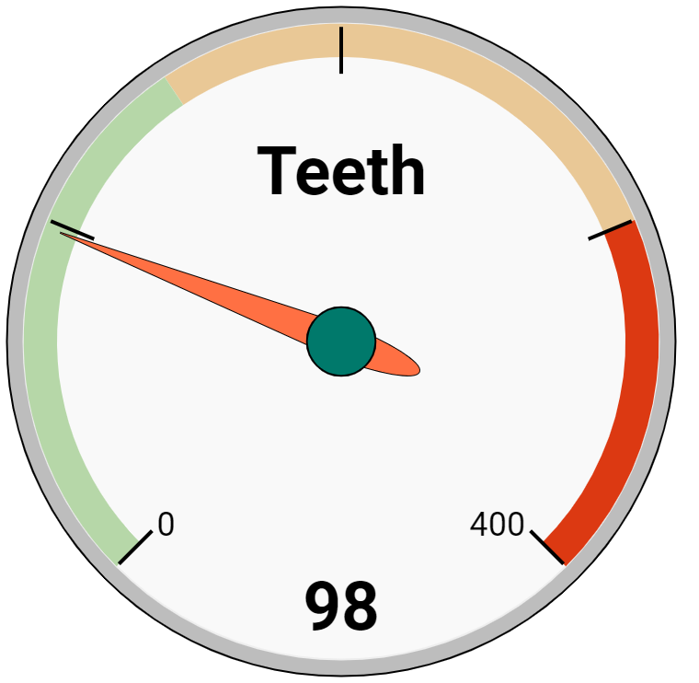
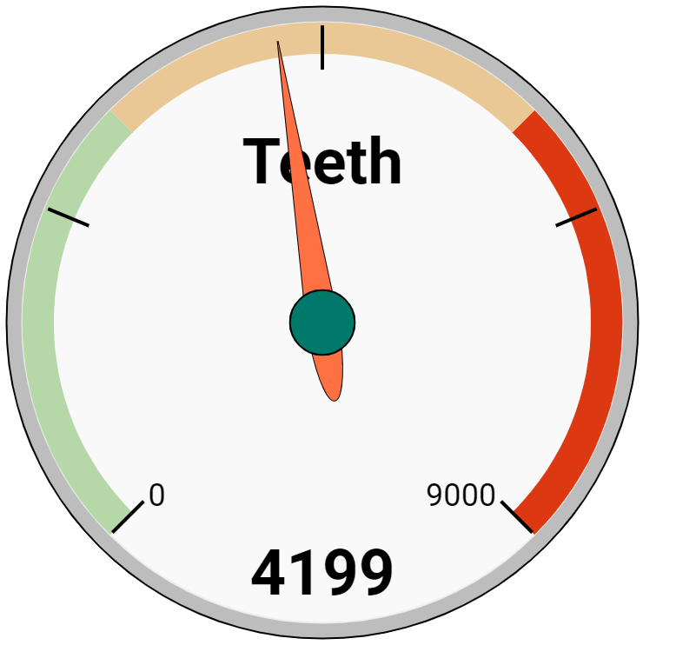

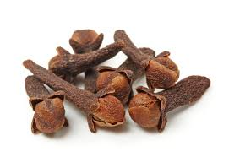
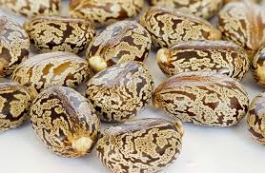




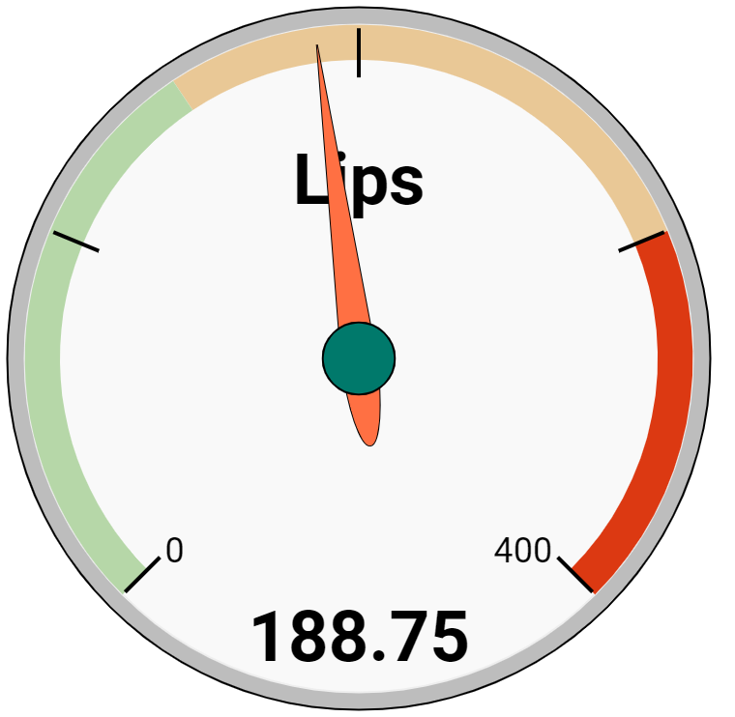
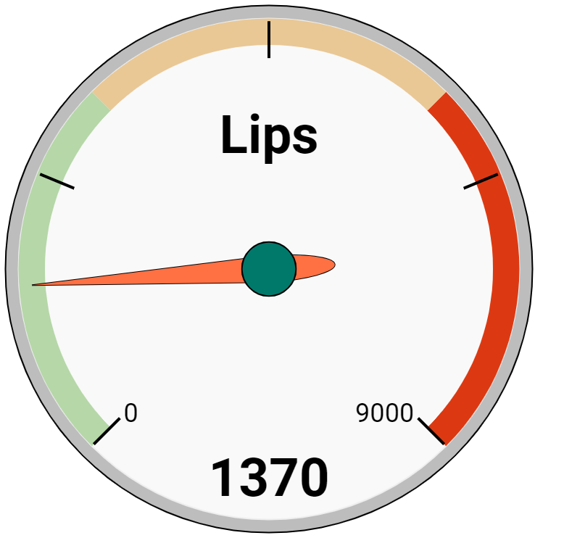


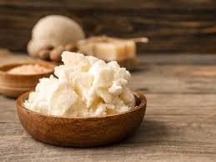
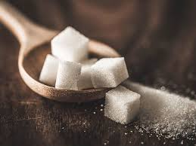


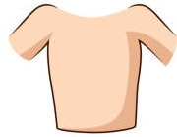
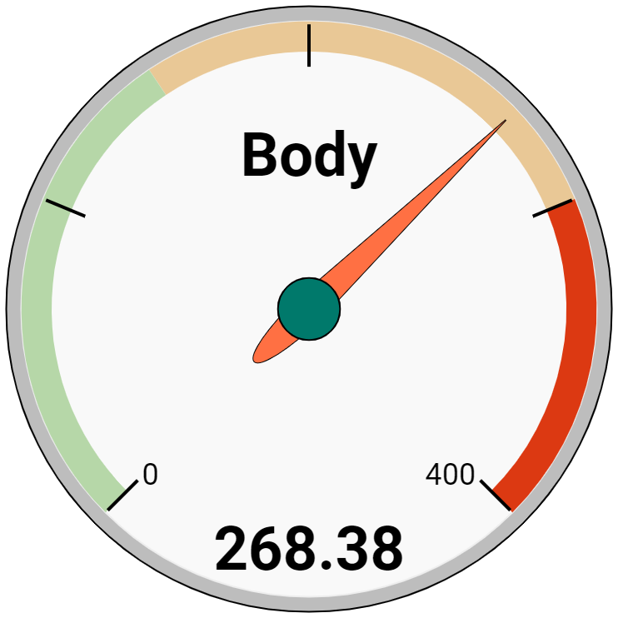
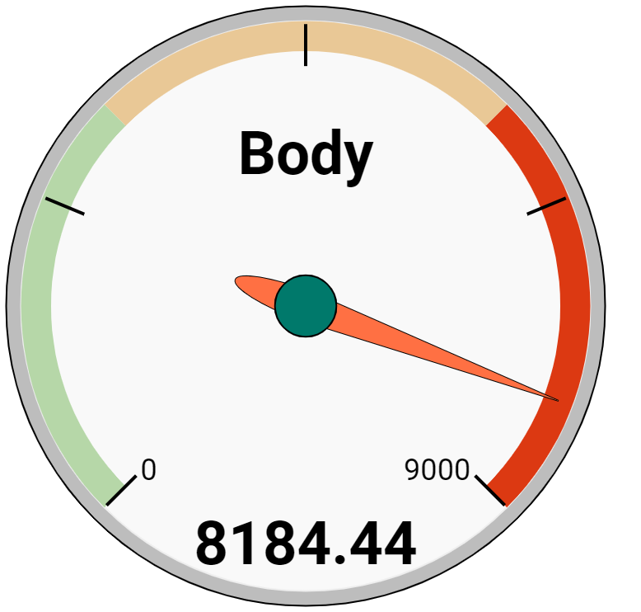


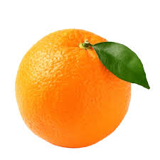

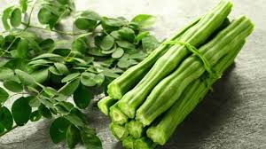

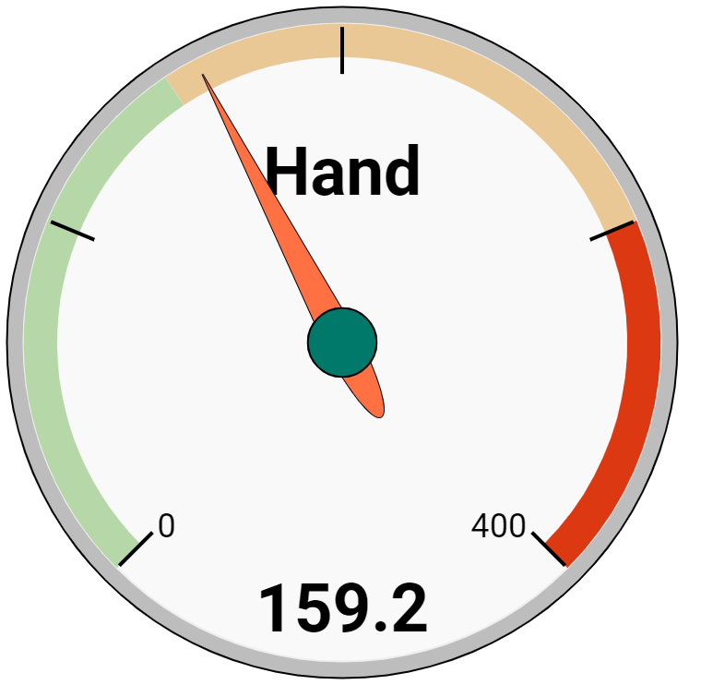
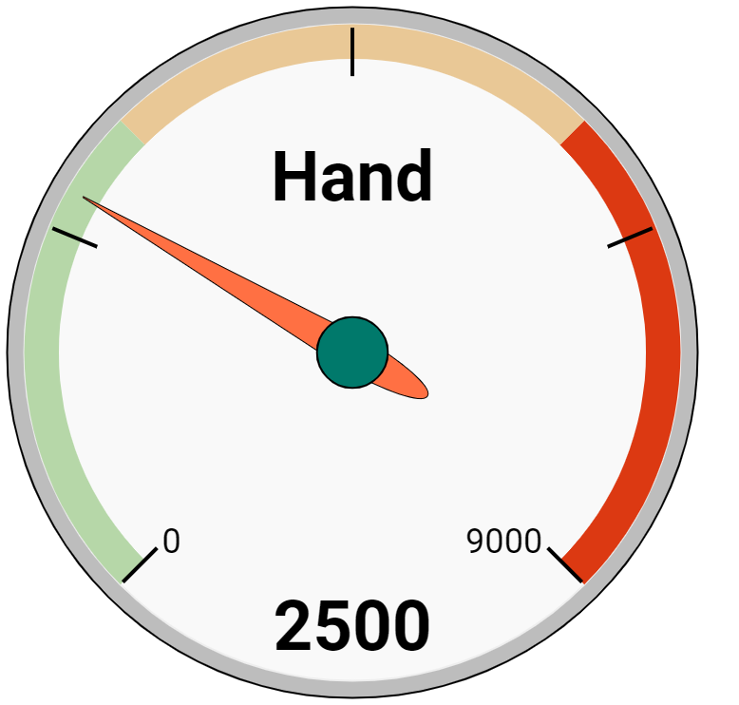


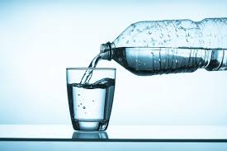
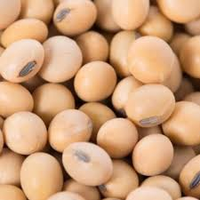


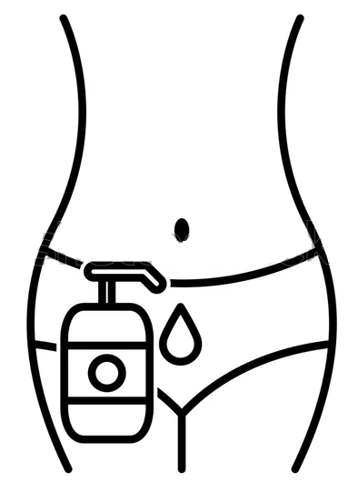
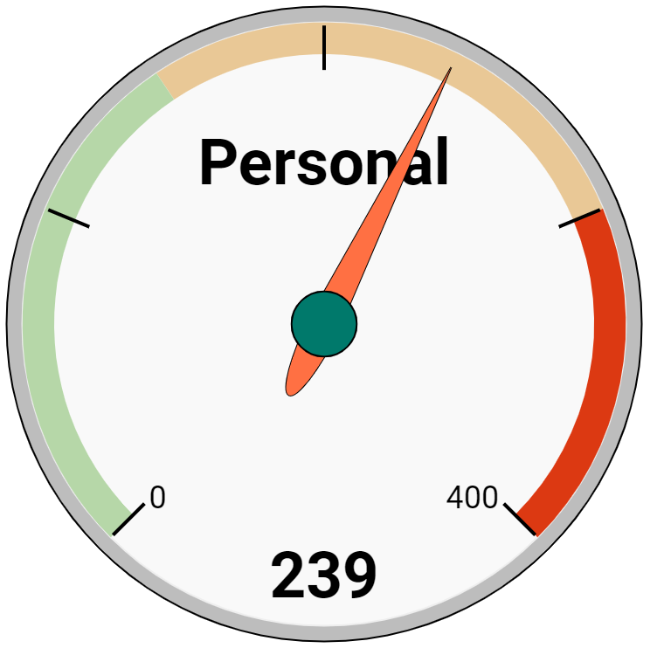
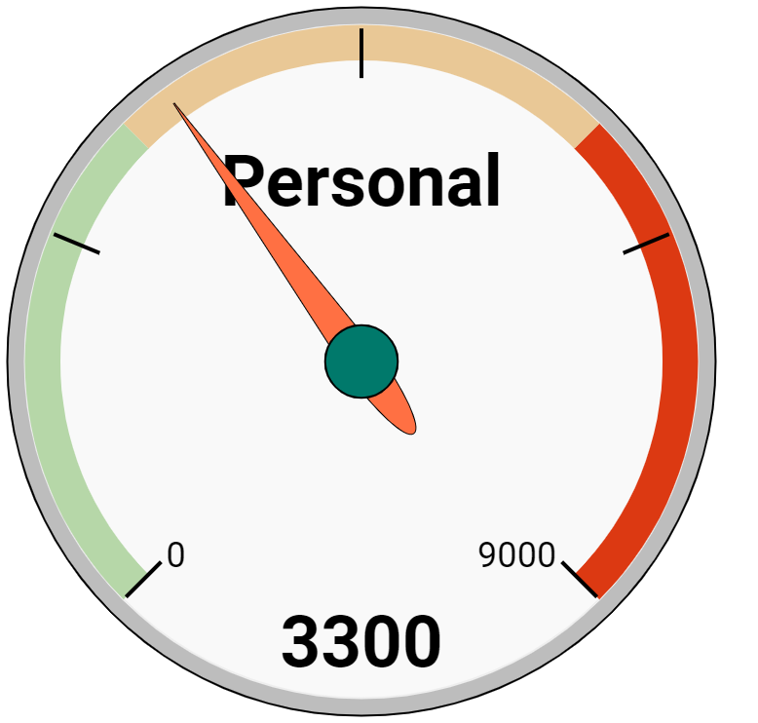

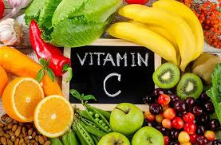




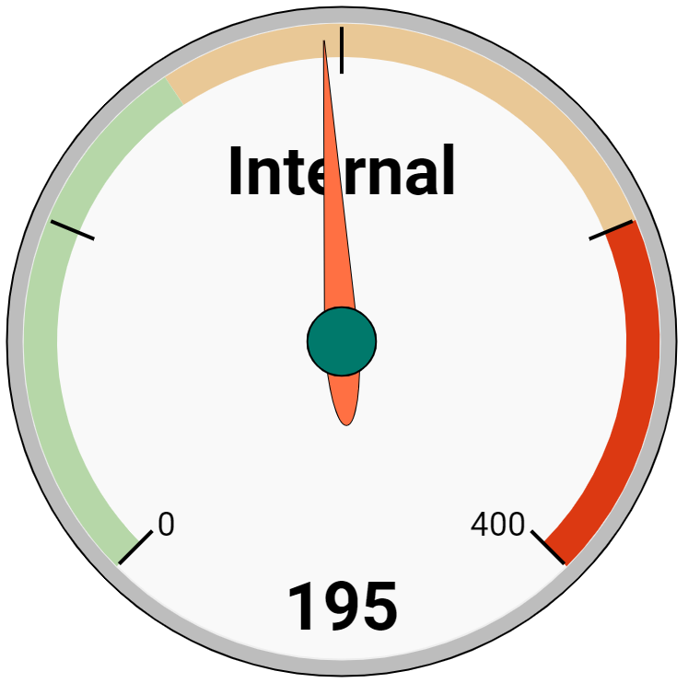
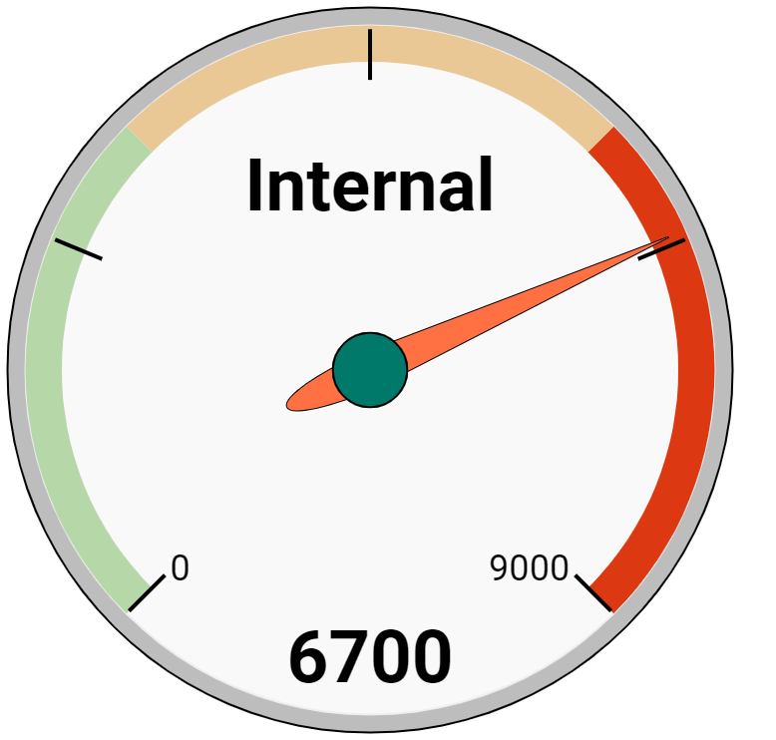


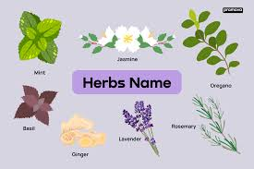
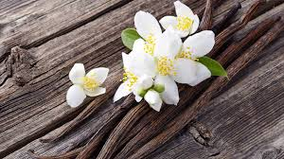

Rs 21.2 mio.
Cleanse - 40%
Grooming- 13%
Cleanse
TreSemme
Amazon
Inatur
Nourish
Aloe Veda
BbHunt
The Mom’s
Hair
13.0%
Nourish- 41%
52%
1139 items
6.3%
6.1%
Amla
Saffron
Rs 43.4 mio.
Cleanse - 31%
Protect - 8%
Enhance
Face Shop
It’s Skin
Shankara
Cleanse
Gillette
Shankara
RichFeel
Face
26.5%
Enhance - 51%
57%
2167 items
4.9%
4.3%
Aloe
Keratin
Rs 2.8 mio.
Cleanse - 9%
Essentials - 2%
Enhance
St Botanica
LOreal
Inatur
Eyes
1.7%
Enhance - 88%
65%
118 items
12.8%
9.1%
Cotton
Mango
Rs 3 mio.
Cleanse
Colgate
Oral-B
Dabur
Mouth
1.8%
Cleanse - 98%
57%
297 items
33.1%
29.8%
Clove
Castor
Rs 1 mio.
Enhance
Milani
The Face shop
Vegetal
Lips
0.6%
Enhance - 71%
Cleanse - 19%
Wellness - 7%
55%
96 items
8.0%
7.2%
Butter
Sugar
Rs 64.9 mio.
Enhance - 14%
Cleanse - 8%
Perfume
DKNY
Ajmal
Liberty
Body
39.6%
Perfume - 77%
46%
2355 items
7.1%
6.5%
Citrus
Moringa
Rs 6.8 mio.
Enhance - 9%
Nourish - 5%
Cleanse
TreSemme
Amazon
Morpheme Remedies
Hands
4.1%
Cleanse - 82%
51%
515 items
7.4%
5.9%
Water
Soya
Private
Hygiene
Rs 5.5 mio.
Essentials
Seni
Everteen
Sirona
3.4%
Essentials - 92%
Sexual Health - 8%
49%
329 items
17.6%
9.4%
Cotton
Vit. C
Rs 15.3 mio.
Wellness - 96%
Pain Relief - 3%
Wellness
Fit Whey
BTN Sports
The Mom’s Co
Wellness
9.3%
60%
851 items
6.6%
6.3%
Herbs
Vanilla

Slide 3
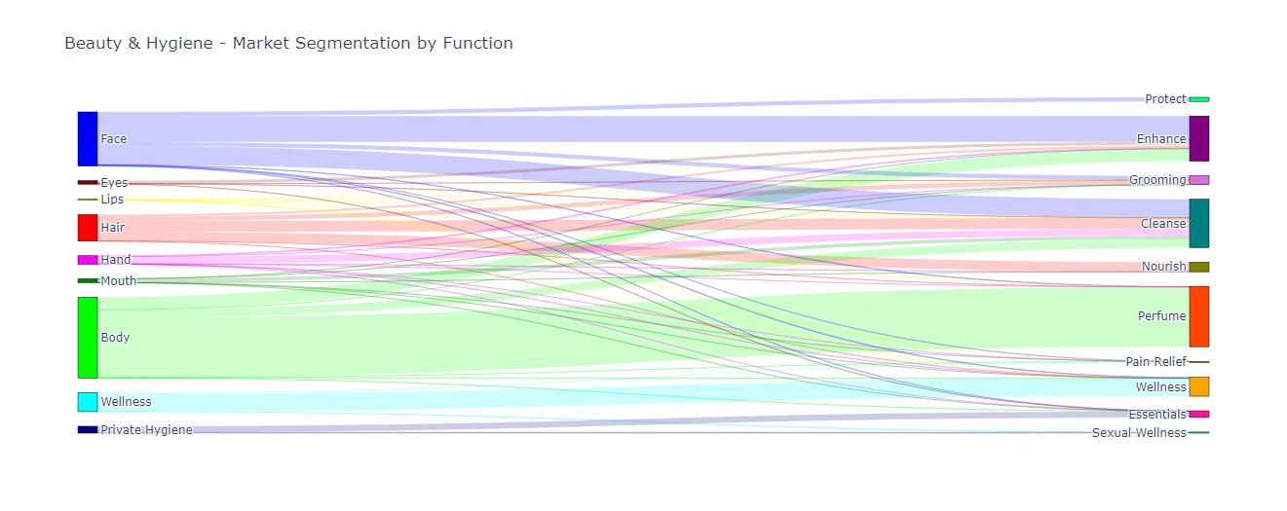
Segment by uses
Back

Slide 4
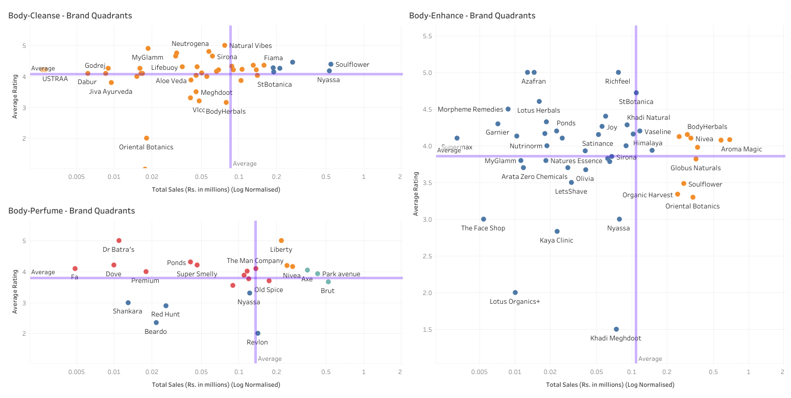
Brand Quadrants - Body
Back

Slide 5
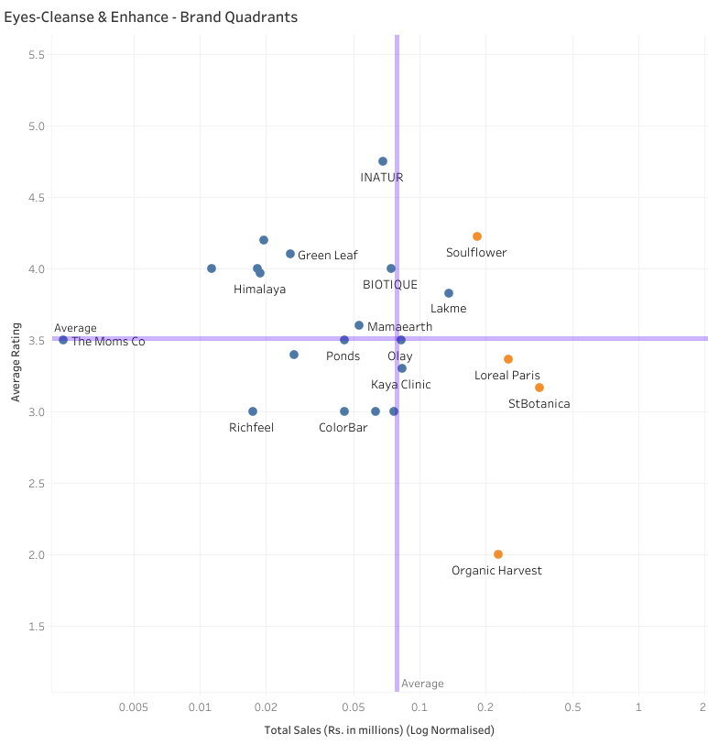
Brand Quadrants - Eyes
Back

Slide 6
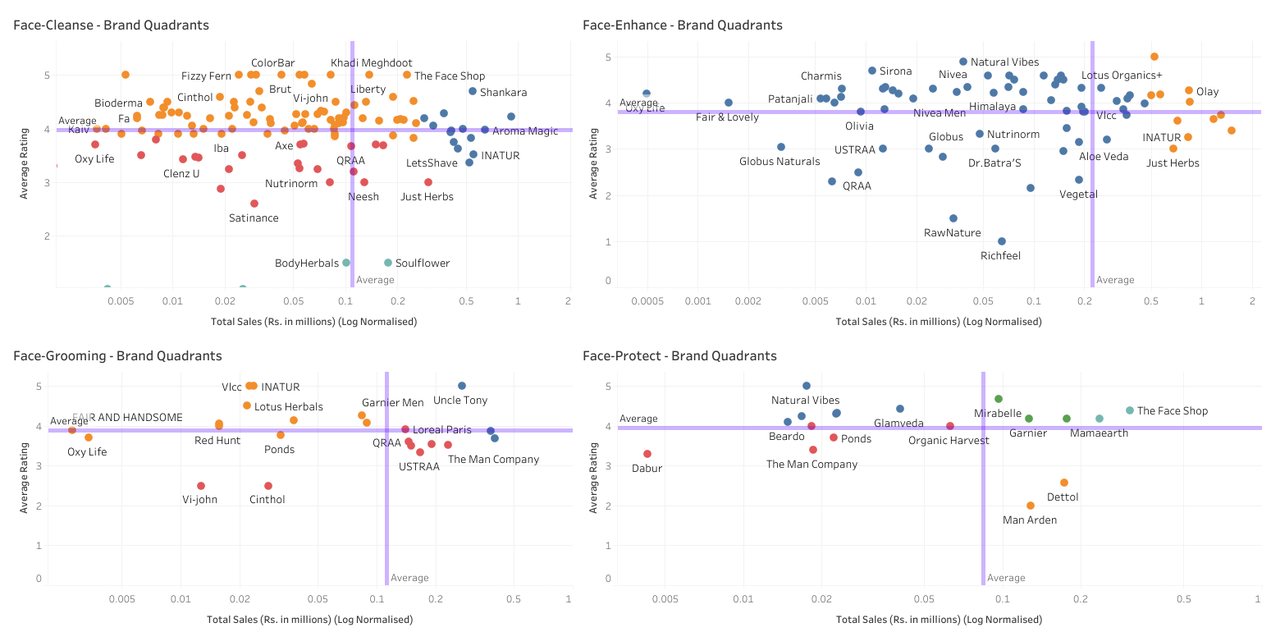
Brand Quadrants - Face
Back

Slide 7
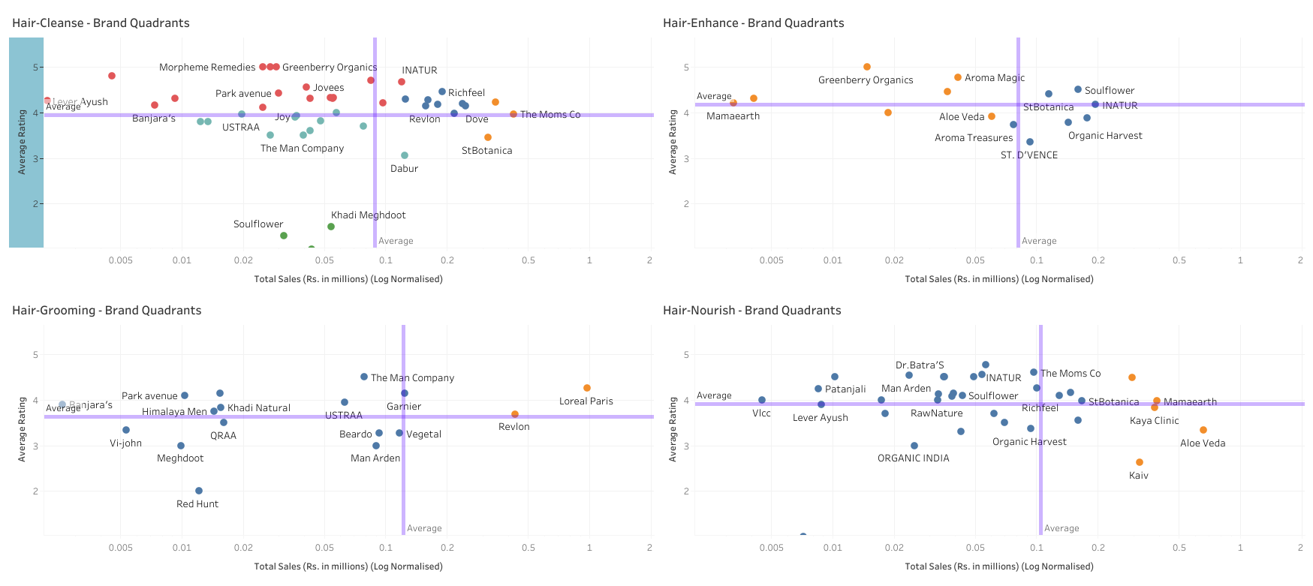
Brand Quadrants - Hair
Back

Slide 8
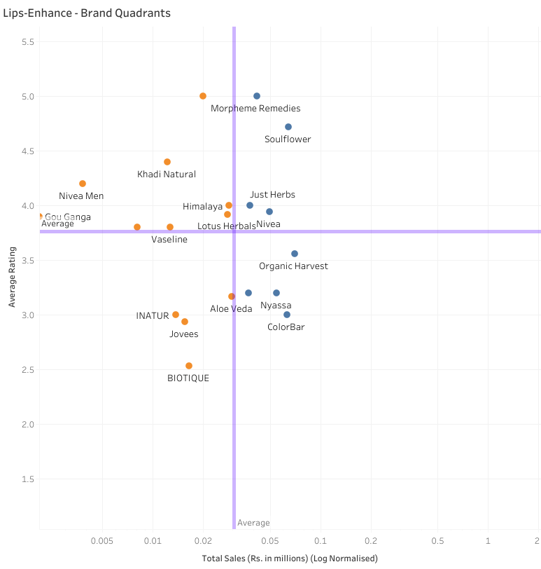
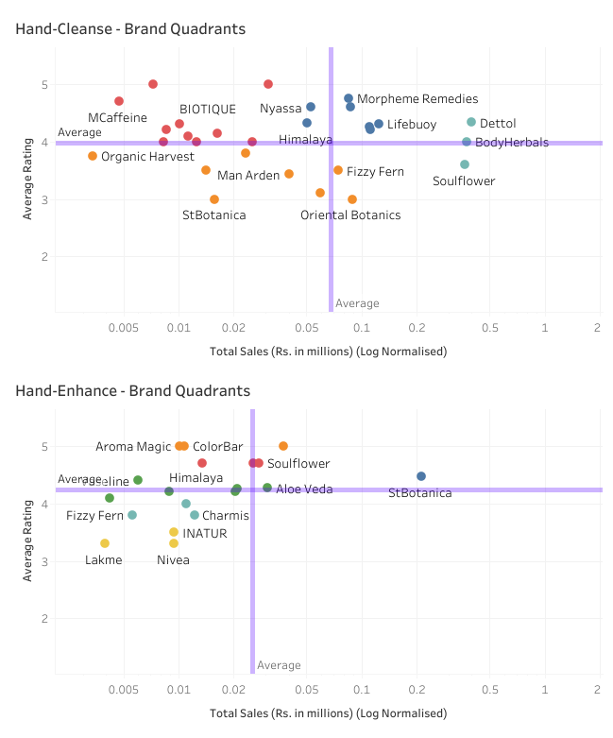
Brand Quadrants - Lips & Hands
Back

Slide 9
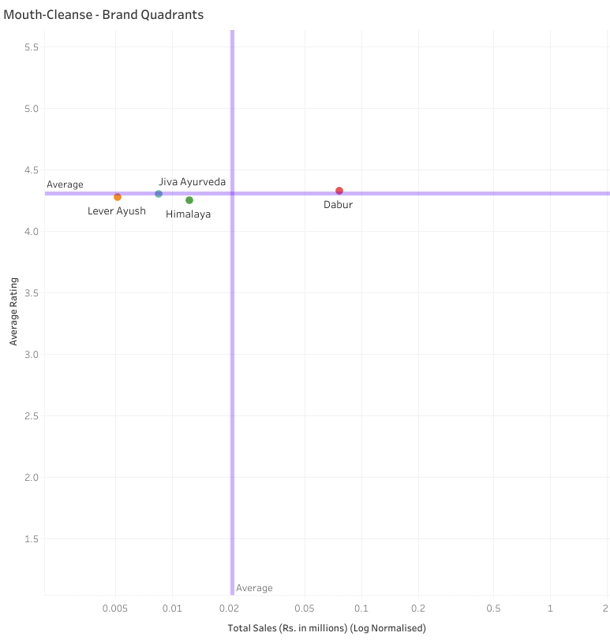
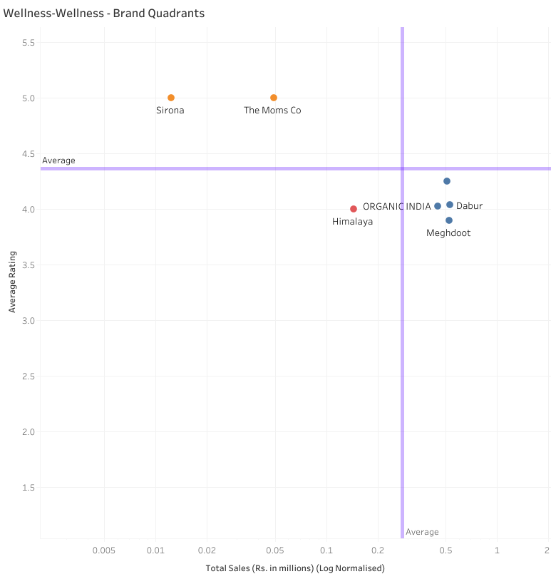
Brand Quadrants - Mouth & Wellness
Back

Slide 10
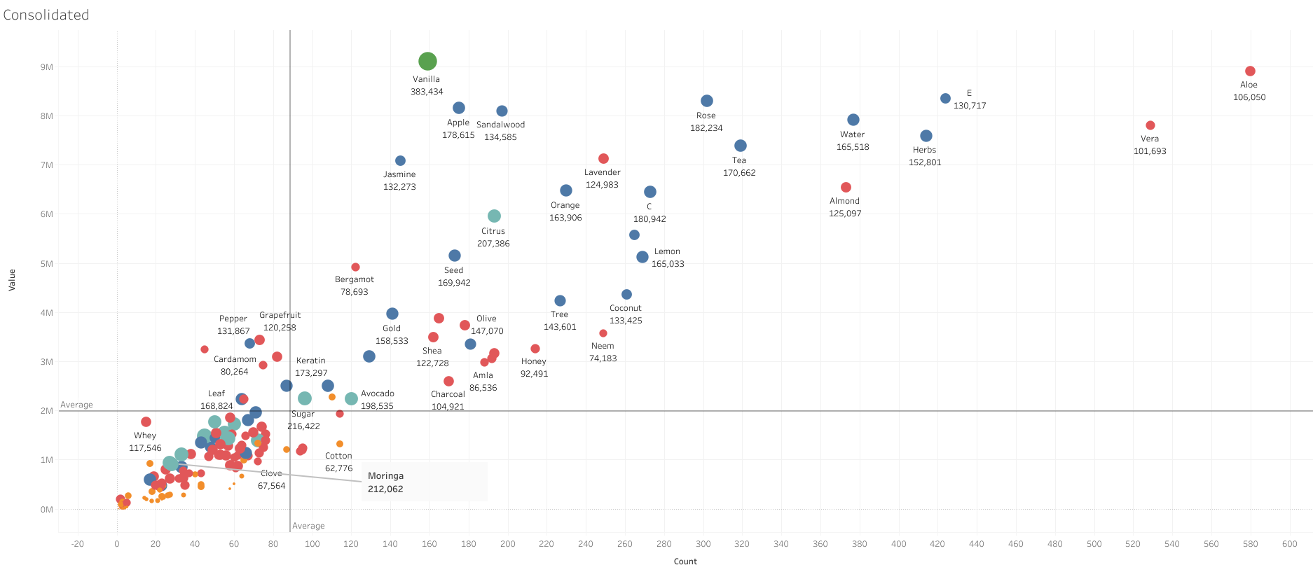
Consolidated - Ingredient Realisation View
Back

Slide 11
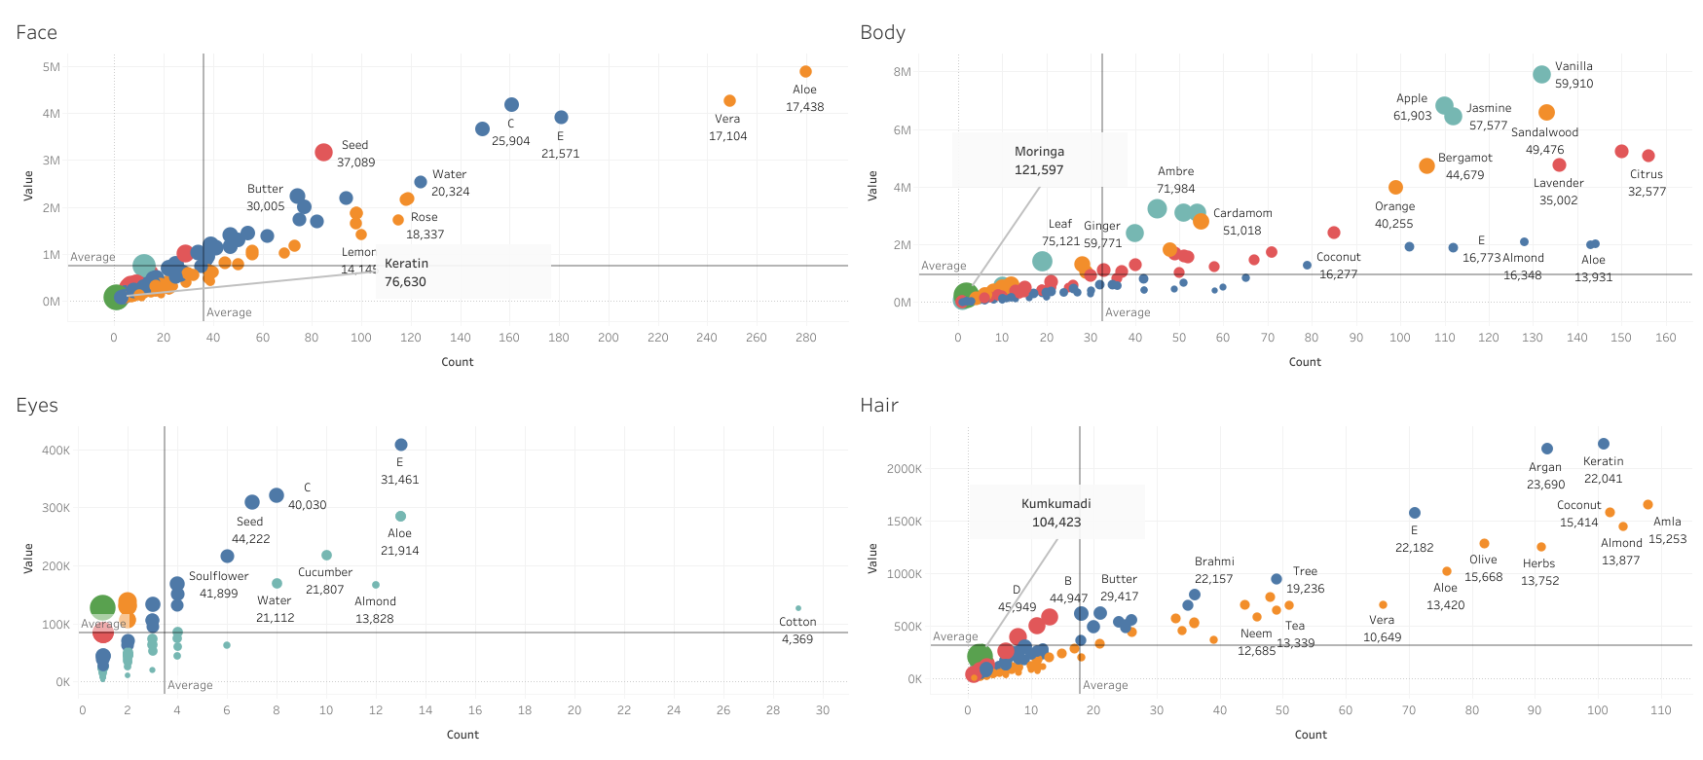
Ingredient Realisation View - 1
Back

Slide 12
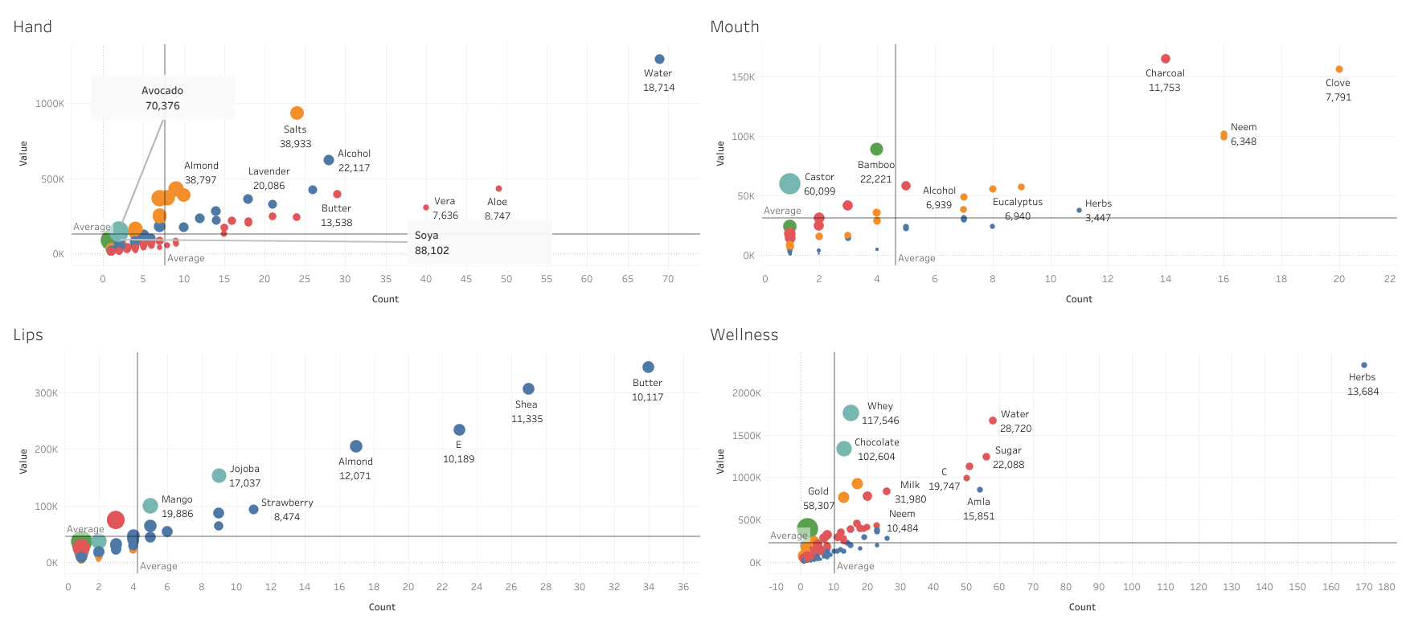
Ingredient Realisation View - 2
Back

Slide 13
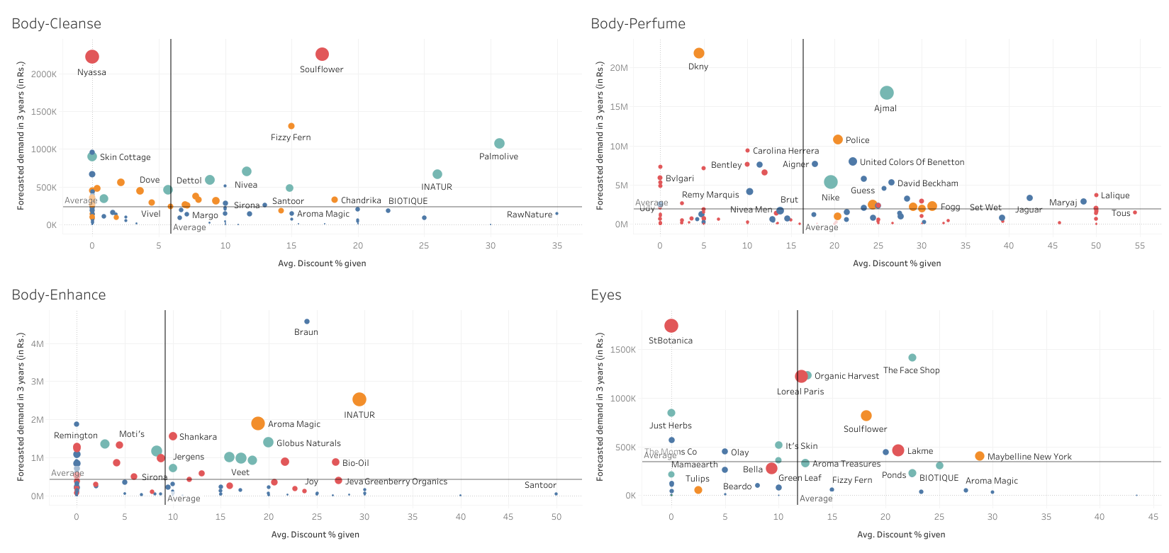
Promotion Effectiveness - Body & Eyes
Back

Slide 14

Promotion Effectiveness - Face & Lips
Back

Slide 15

Promotion Effectiveness - Hair & Mouth
Back

Slide 16

Promotion Effectiveness - Hand, Wellness & Hygiene
Back

