Slide 1

Bank customer churn
By :
Kaushik Ramabhotla
Juhi Kumari
Vishnu Pappu Mentor: U.Chandrasekhar

Slide 2
Problem description
To develop a model which predicts the customers who may discontinue their further relationship with the bank
Dataset contains details of customer and our target variable “CHURN” which is binary class reflecting the fact whether or not the customer left the bank or not.
No. of records : 48079
No of columns: 28

Slide 3

Features in the dataset.
churn : churn, is the rate at which customers stop doing business with an entity(0 : not left & 1 : left the bank)
age : age of the customer
rent_or_own : do the customer rent's or owns a place
has_used_mobile : whether the customer has used mobile or not.
has_used_web : whether customer has used internet banking or not.
used_android : whether the user is using an android device or not.
used_ios : whether the user is using an IOS device or not.
more_than_one_mobile_device : if the user has more than one mobile phone.
payfreq : payment frequency of the particular user.
loan_pending : whether the user's loan is pending or not.
zodiac_sign : sun signs of the users.
un_linked_account : whether they have linked accounts or not.
withdrawn_application : whether they have taken back the application or not.
paid_off_loan : did they pay the loan or not.
did_not_accept_funding : self explanatory.
re_linked_account : re-linked or not.
cash_back_engagement : IDK
has_referred : did they refer somebody or not.
TOTAL 8 COLUMNS ARE UNCLEAR.

Slide 4
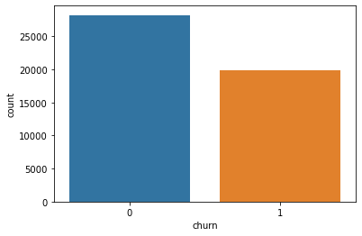
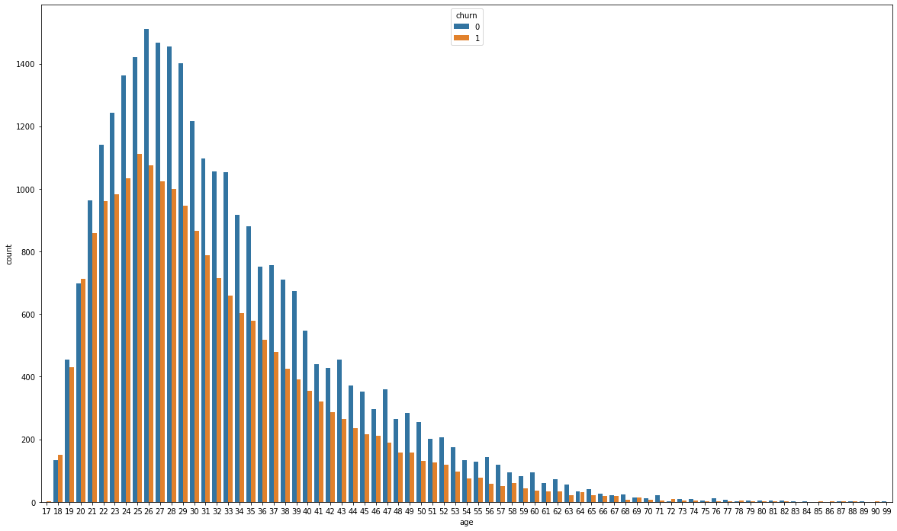
Data description
Almost 28000 people have stayed in the bank and nearly 20000 people have churned. Hence it’s a balanced dataset.
In the age group of 20-30,almost 1300-1400 people have remained and almost 1000 people have churned in each of the age factor.

Slide 5
Data description
There were few columns namely : “user_id”,”using_iOS”,”using_android”,”zodiac_sign” etc. which are completely useless in the dataset. We can safely remove them.
There are many columns named after the word : “trivia” which were completely meaningless, but they are highly impacting on the output.
MISSING VALUES..
There are missing values in the dataset, represented as “na”. So, we have used the filter command in the excel sheet to filter out and check for the missing values.
So, there were two columns which are “rent_or_own” &”payfreq” having 48% and 15% missing values respectively.

Slide 6

Sem-supervised learning model
For covering up the missing values, create a separate random forest classifier model to predict the missing values of the column “payfreq” .
After predicting the missing values of payfreq, delete the rows which contain “na ” values according to the column “rent_or_own”.
Do not try to predict the “rent_or_own” because the missing value percentage was high and neither do not delete the column because it may contribute towards the output.

Slide 7
Dimensionality reduction :
As there were 28 columns in total, keep only the important columns contributing to the model.
Apply the low variance filter to remove the
columns which are unwanted. Remove the
columns : “cards_helpful” & “cards_share”.
Apply the correlation method to impute the
the columns which were highly correlated with
other independent variables.
After dimensionality reduction, the total columns
remaining are19/28 .

Slide 8
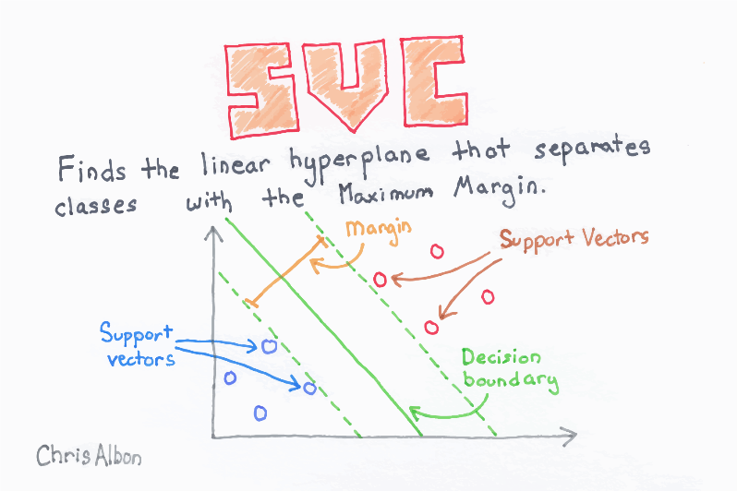
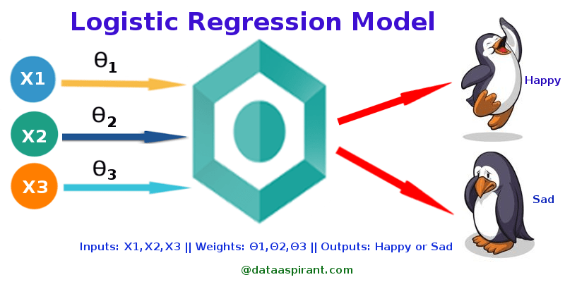
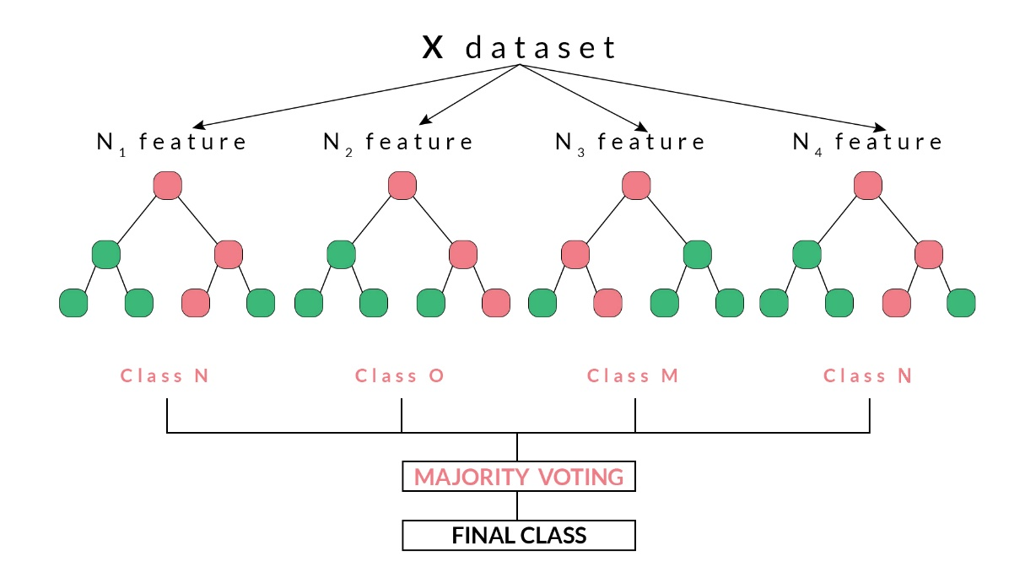
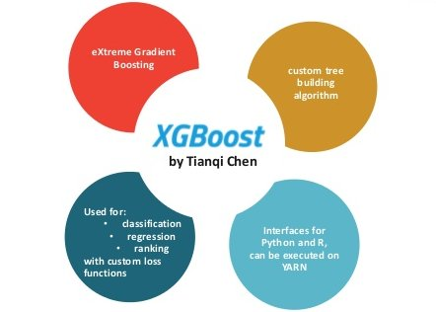
Prediction methodologies :

Slide 9
Model Comparison
Random Forest
SVC | precision | recall | F1-score | support
0 | 0.73 | 0.82 | 0.77 | 2942
1 | 0.61 | 0.47 | 0.53 | 1721
Accuracy | - | - | 0.69 | 4663
Macro avg | 0.67 | 0.65 | 0.65 | 4663
Weighted avg | 0.68 | 0.69 | 0.68 | 4663
RF | precision | recall | F1-score | support
0 | 0.75 | 0.85 | 0.80 | 2900
1 | 0.69 | 0.53 | 0.60 | 1763
Accuracy | - | - | 0.73 | 4663
Macro Avg | 0.72 | 0.69 | 0.70 | 4663
Weighted Avg | 0.73 | 0.73 | 0.72 | 4663
LR | precision | recall | F1-score | support
0 | 0.70 | 0.83 | 0.76 | 2900
1 | 0.59 | 0.41 | 0.49 | 1763
Accuracy |  |  | 0.67 | 4663
Macro Avg | 0.64 | 0.62 | 0.62 | 4663
Weighted Avg | 0.66 | 0.67 | 0.65 | 4663
XGBoost
Best Score | 74%

Slide 10

Recommendation
The F score, also called the F1 score or F measure, is a measure of a test’s accuracy. The F score is defined as the weighted harmonic mean of the test’s precision and recall.
Choose f1 score here in this case into account because this isn’t a balanced dataset.
As in the previous slide, one can clearly see that, the recall and f1 score are higher in the RANDOMFORESTCLASSIFIER rather than other classifiers which are 80 and 60 % which are pretty good when compared to others.
Finally, the f1 scores recommends to use Random forest algo.
For greater accuracy, play with the parameters!

Slide 11

Future work :
Try other models as MLP classifier
Try other packages as Keras and Pytorch to implement MLP classifier
Do some more feature transformations (feature engineering)

Slide 12


