Slide 1
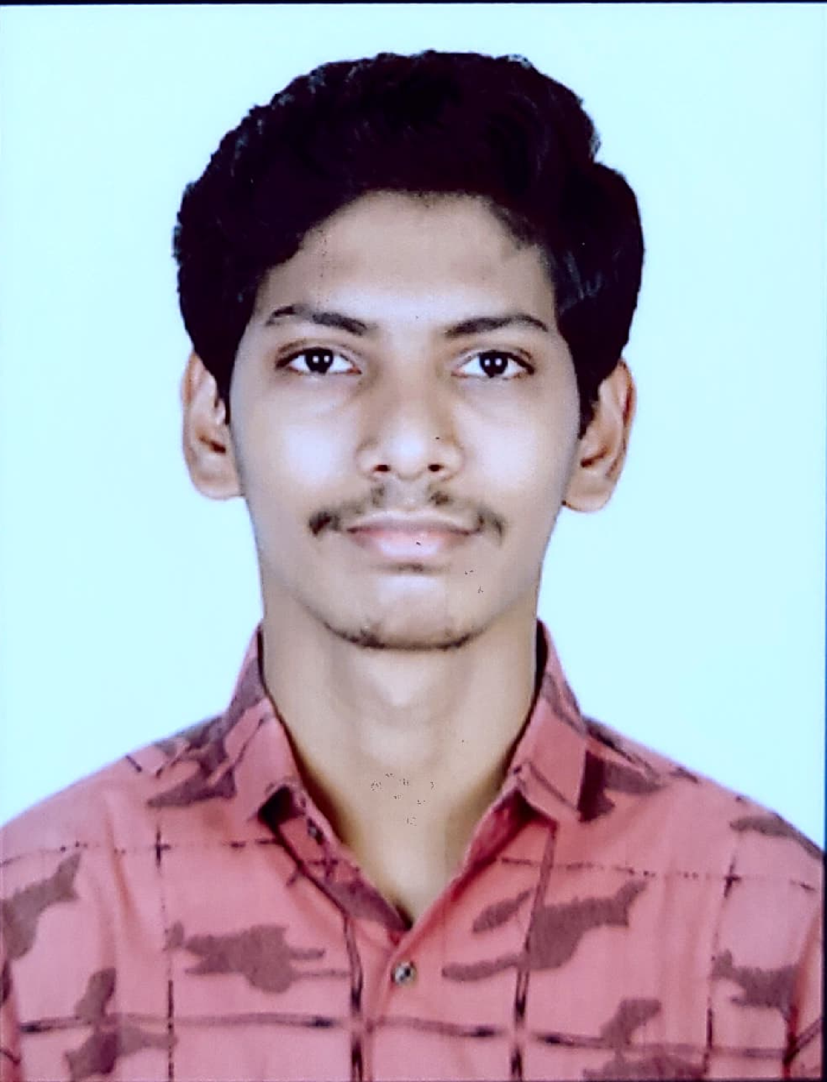
Kaushik Rane | Analyst
Name Kaushik Rane
Title Analyst
Location Mumbai, India
Professional Experience
Developing Entities and services in spring boot.
Developing spring boot microservices.
Worked on understanding the existing CIF in spring MVC and redeveloping it on spring boot framework.
Worked and implemented a procedure to create a backup for database.
Currently working on a case study(Pharmacy Management System).
Technical Skills: Java, spring-boot, SQL.
Tools: STS, MySQL Workbench, PgAdmin, Eclipse, Postman.
Skills & Experience Summary
Analyst at Capgemini, working on CIF.
Developing application based on the spring-boot technology.
Competencies
Having Knowledge on Spring framework as well as MySQL, PostgreSQL databases.
Worked on redevelopment of CIF framework.
Certifications
Migration Ambassador Foundation AWS.
Agile Software Development.

