Slide 1

Human resources slide 1
CodeX
Marketing Insights
Food & Beverage Industry
Simran Kaushik

Slide 2
AGENDA
CodeX is a German beverage company that is aiming to make its mark in the Indian market. A few months ago, they launched their energy drink in 10 cities of India.
The agenda is to use that survey data and give company some primary and secondary insights to help the company grow their business.
The agenda is to use that survey data and give company some primary and secondary insights to help the company grow their business.
This presentation includes the following insights:
Demographic Insights
Consumer Preferences
Competition Analysis
Marketing Channels and Brand Awareness
Brand Penetration
Purchase Behavior
Product Development
Recommendations for CodeX

Slide 3
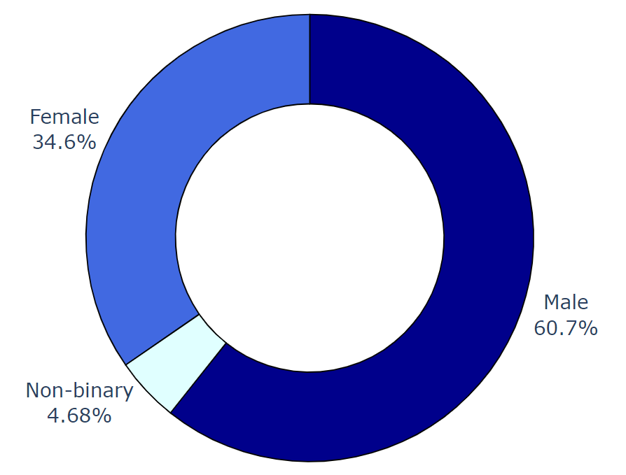
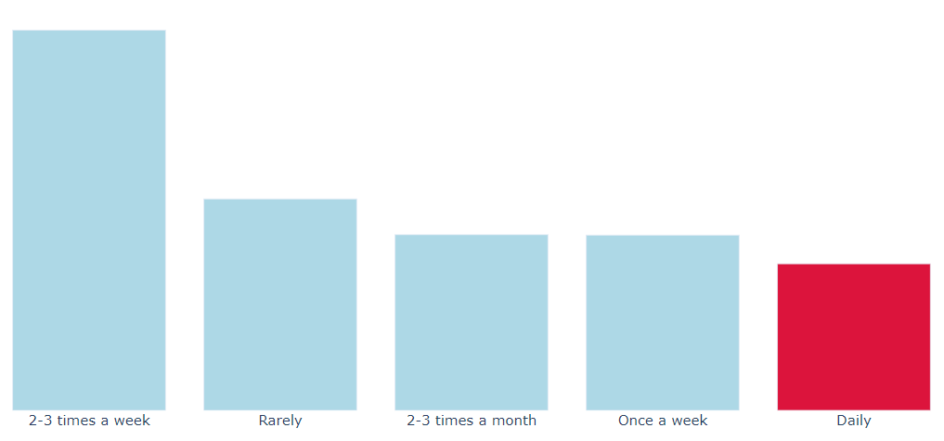
Demographic Insights
a. Who prefers energy drink more? (male/female/non-binary?)
Out of 10,000 the people
1346
people tends to take energy drink on the
daily basis.
60.7%
MALES

Slide 4
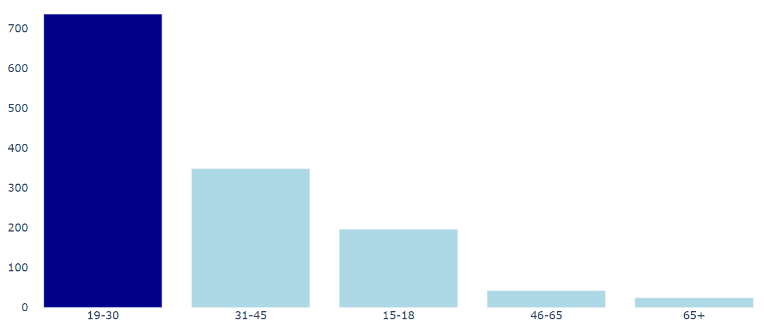
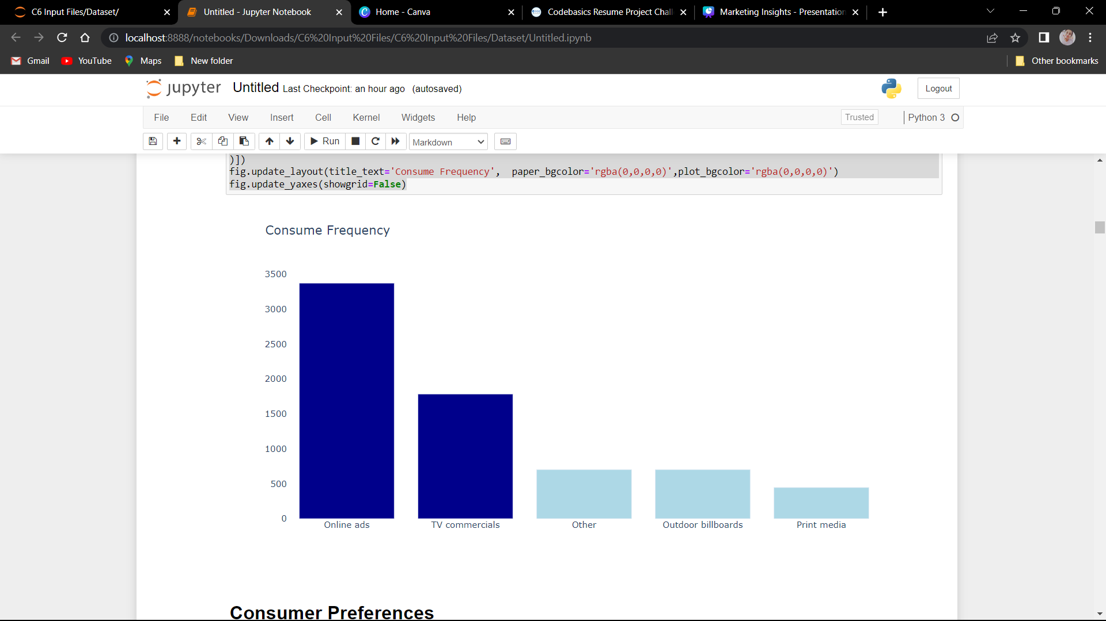
b. Which age group prefers energy drinks?
More then
50%
Of people belongs to 19-30 age group!
c. Which type of marketing reaches the most Youth (15-30)?
Online Ads and TV commercials are taking lead in marketing sector by producing
70%
Results!

Slide 5
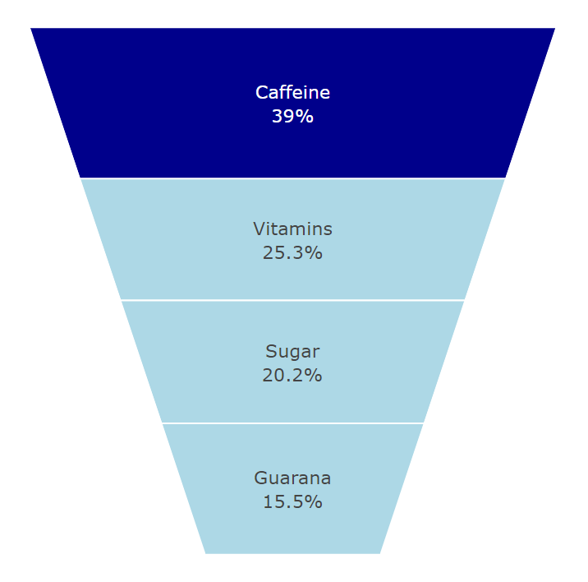
Consumer Preferences
a. What are the preferred ingredients of energy drinks among respondents?
3000+
Respondents preferred
Caffeine!
Caffeine is a stimulant, which means it increases activity in your brain and nervous system. It also increases the circulation of chemicals such as cortisol and adrenaline in the body. In small doses, caffeine can make you feel refreshed and focused.

Slide 6
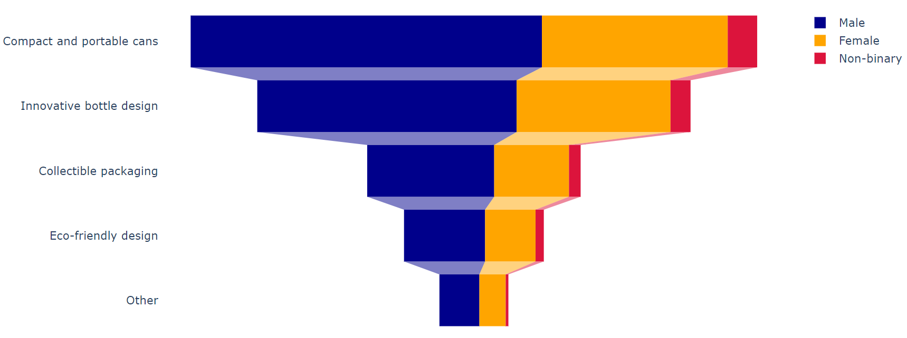
Consumer Preferences
b. What packaging preferences do respondents have for energy drinks?

Slide 7
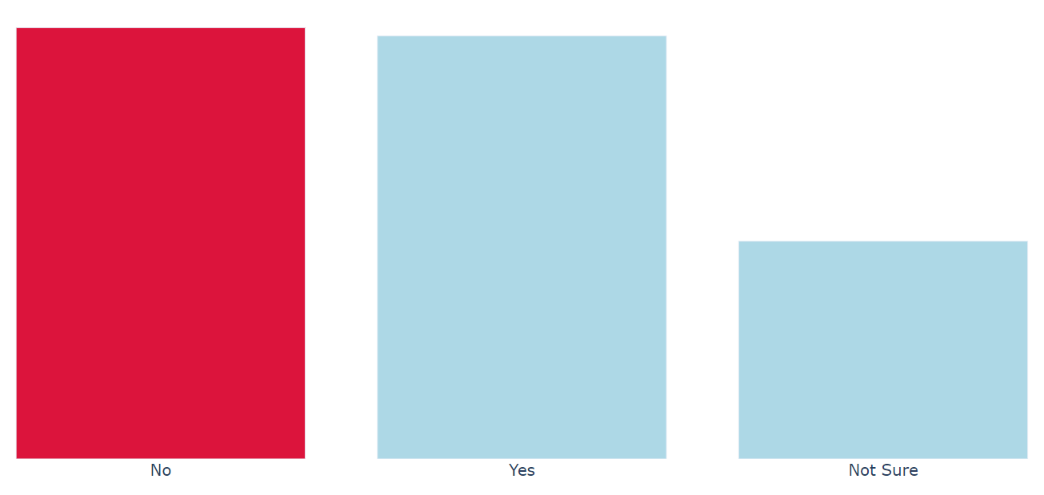
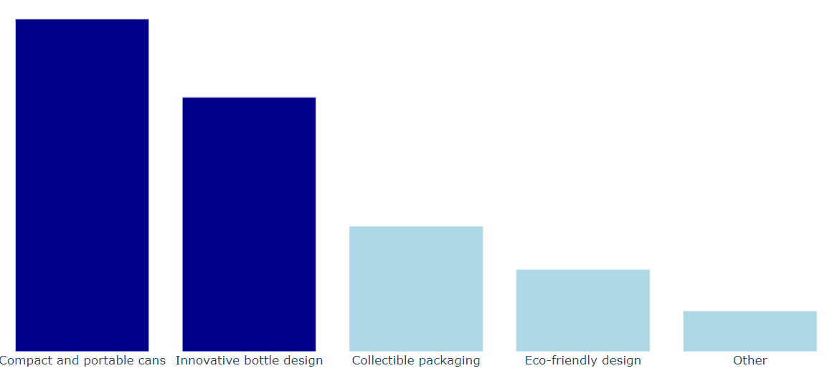
Consumer Preferences
More then 39% people preferred Compact, portable and innovative bottle/cans design!
More then
40%
people don’t want
Limited Edition Packaging!

Slide 8
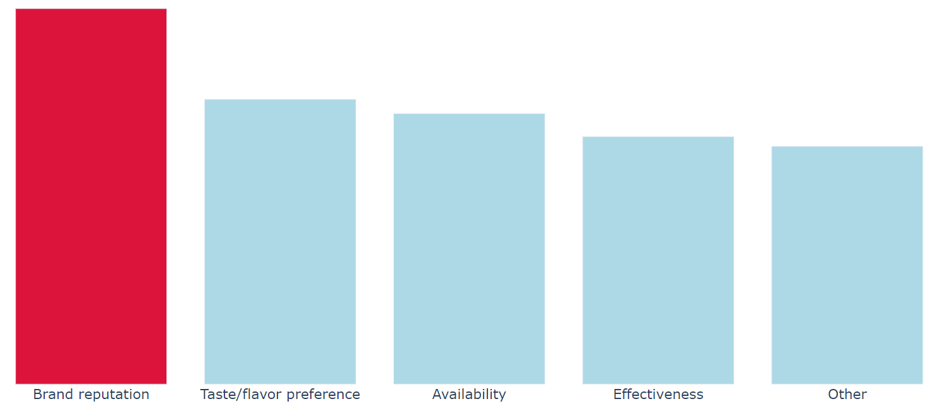
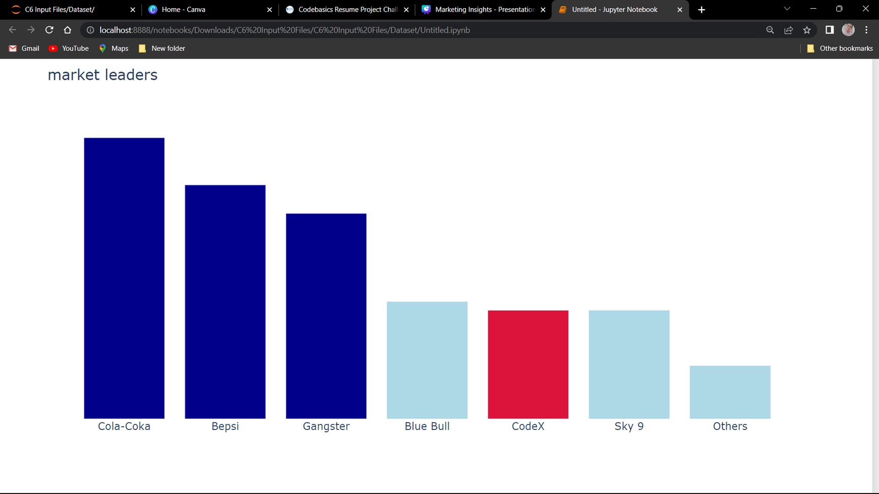



Competition Analysis
a. Who are the current market leaders?
b. What are the primary reasons consumers prefer those brands over ours?
And only 17% people think of Effectiveness while choosing a drink!
Current Market Leaders
Cola-Coka
Bepsi
Gangster
CodeX stands 5th in the lead!
More then
26%
people have chosen their drink based on Brand Reputation!

Slide 9
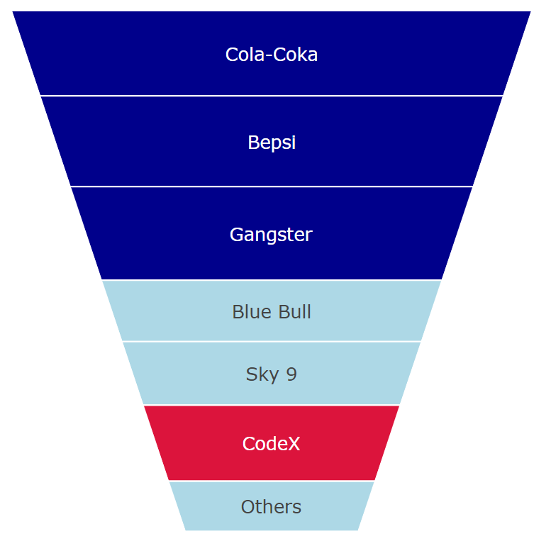
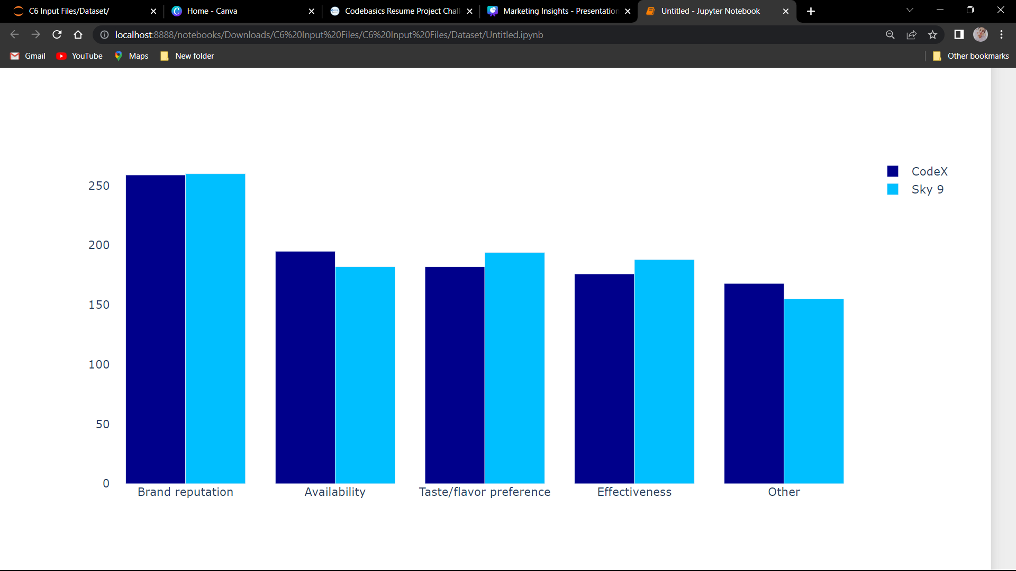
The main reason for selecting other brand over CodeX is Brand Reputation.
Also, sky 9 is among the least preference of the user but still it has more Brand Reputation, Taste/flavor preference and Effectiveness than CodeX.
alarming
CodeX stands
6th
in the Brand Reputation!

Slide 10
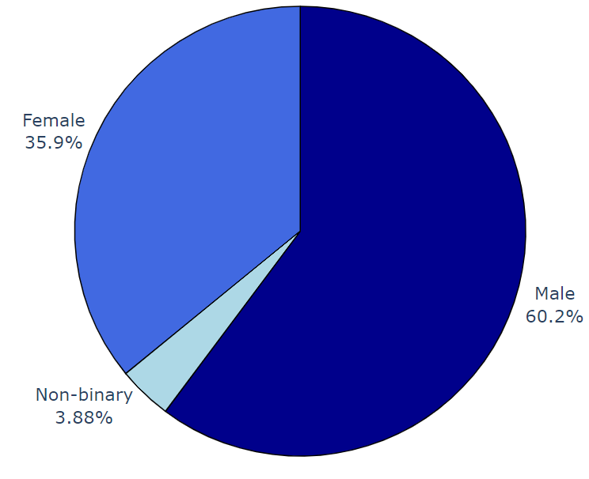
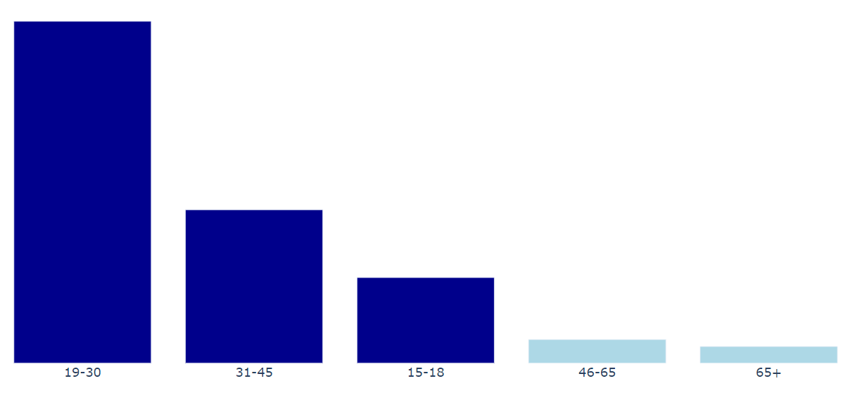
CodeX customers
More then
93%
of CodeX customers
belongs to 15-45 age group!
60.2%
of CodeX customers
are Males!

Slide 11
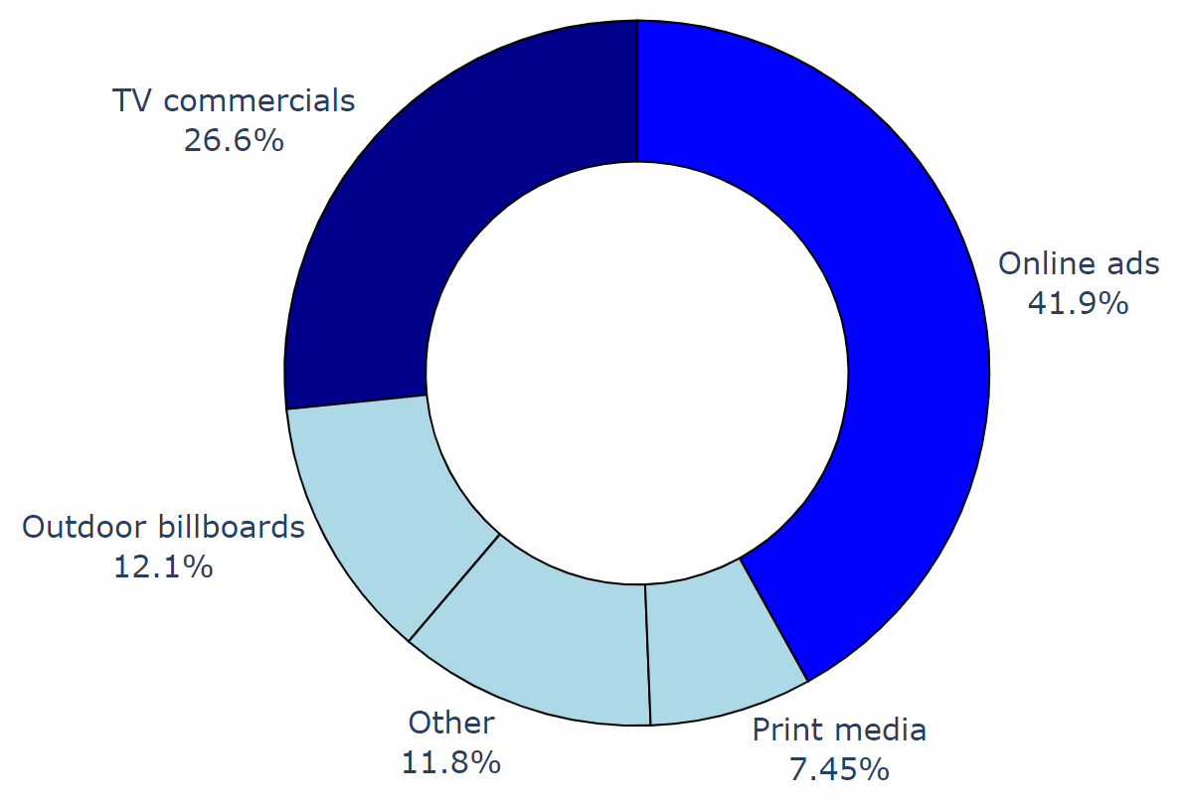
Marketing Channels
a. Which marketing channel can be used to reach more customers?
b. How effective are different marketing strategies and channels in reaching our customers?
Online Ads and TV commercials reached
65%
Of the customers in general!
More then
68%
of customers got to know about
CodeX through Online Ads and TV commercials!

Slide 12
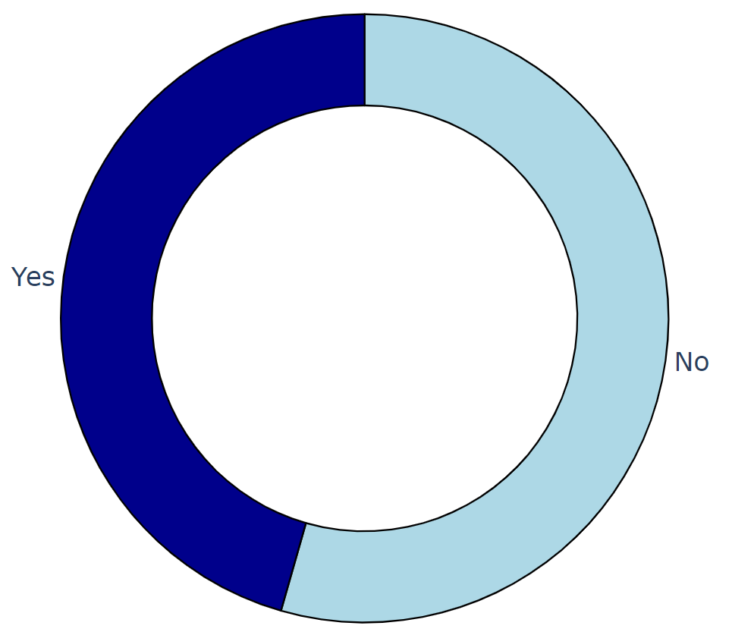
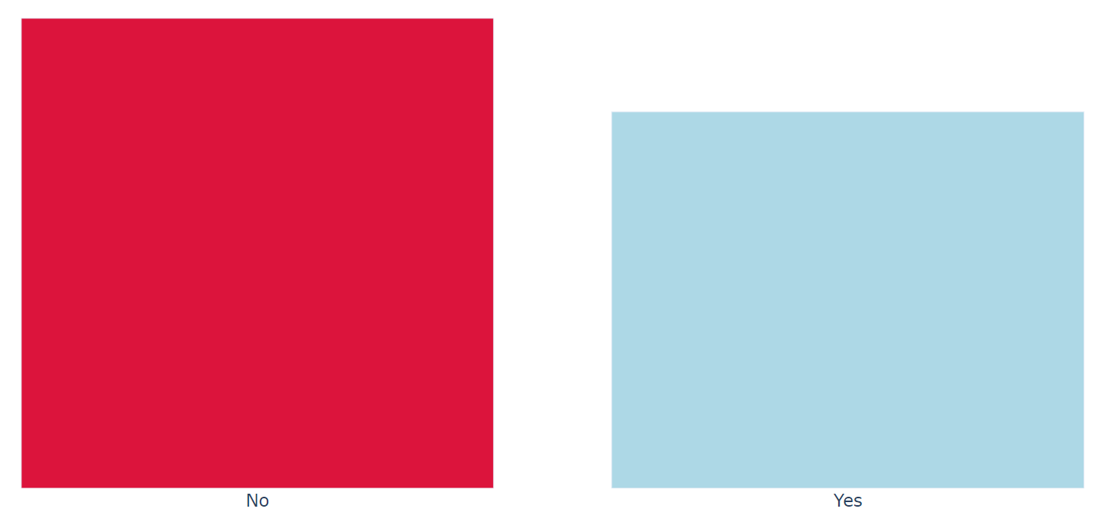
Brand Awareness
Out of 4447 people heard
45%
of the people tried CodeX!
More then
50%
did not even heard about CodeX!
Rest of the people did not tried because of Health concerns and unavailability!

Slide 13
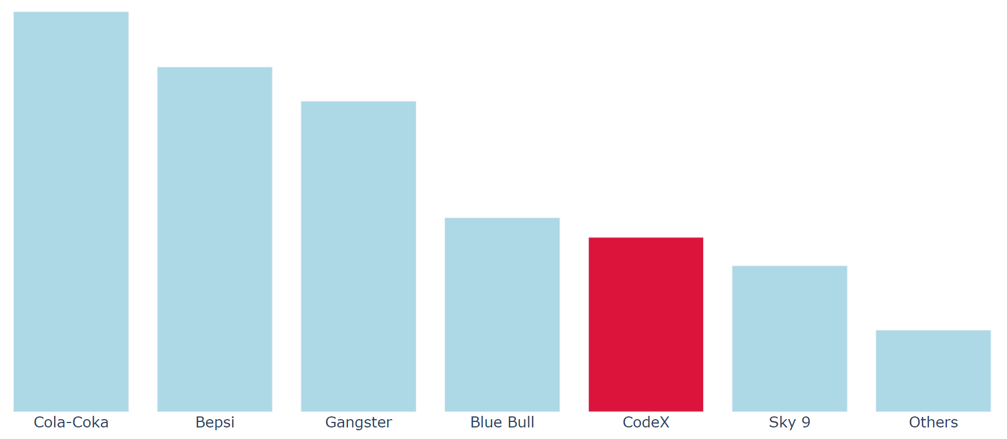
Brand Awareness
Rest of the people selected other brands because of Brand Reputation and Unavailability!
Out of 2026 people who tried
10%
made CodeX their current brand!

Slide 14
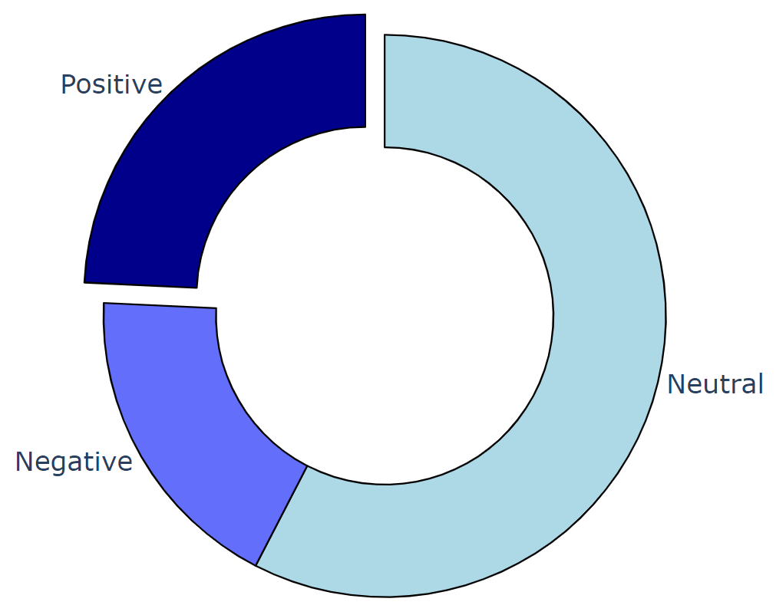
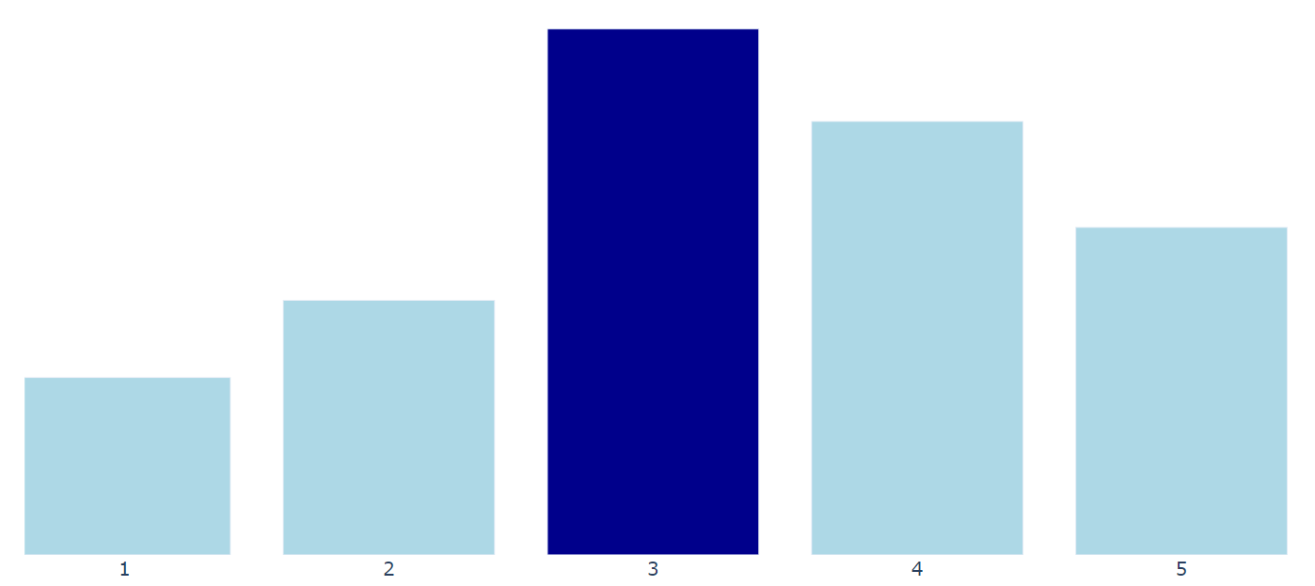
Brand Penetration
44%
people liked it!
a. What do people think about our brand? (overall rating)
Out of 2026 people who tried CodeX
30%
people found it average!
24%
have a positive perception for CodeX!

Slide 15
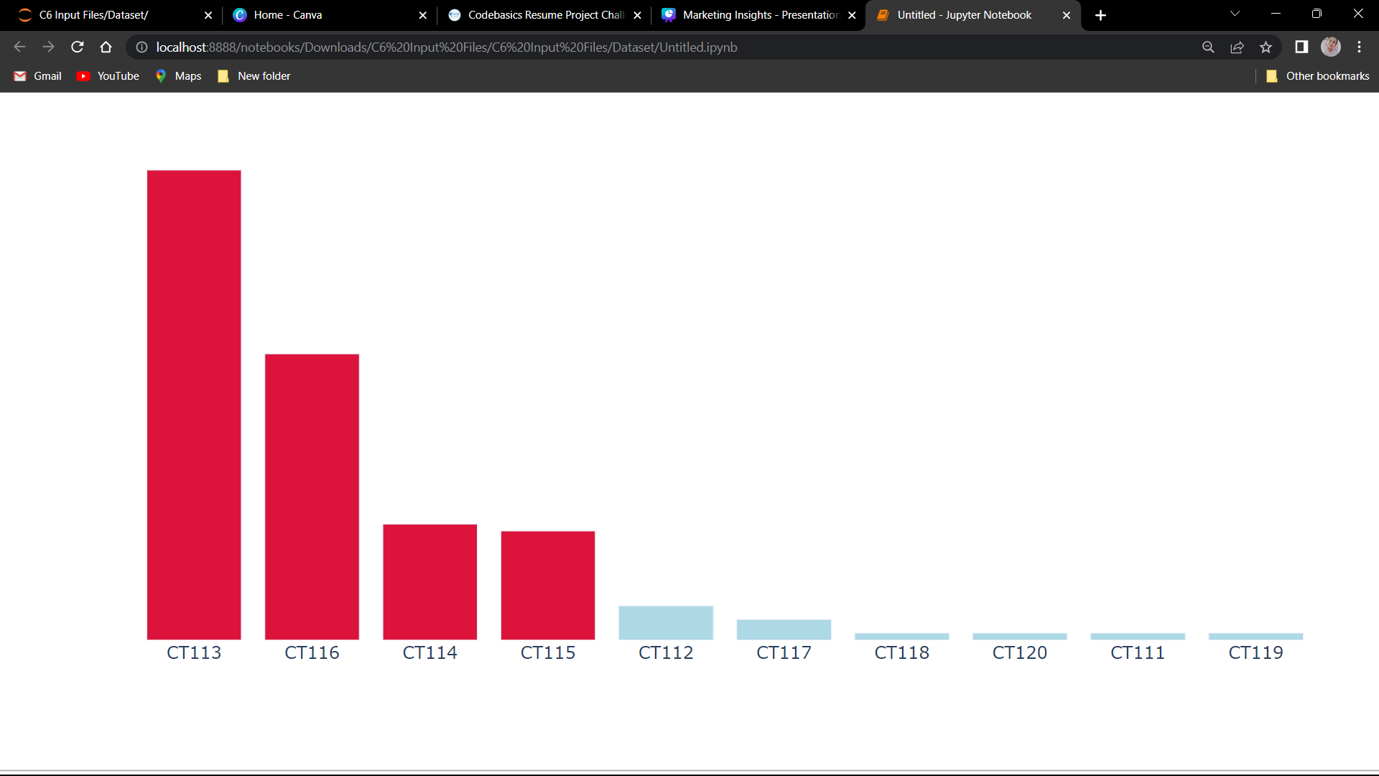
Brand Penetration
b. Which cities do we need to focus more on?
Out of all the 10 cities, CodeX should primarily focus on :
Bangalore
Hyderabad
Chennai
Kolkata
As people here liked the drink but due to unavailability of the product, there current brand is not CodeX.

Slide 16
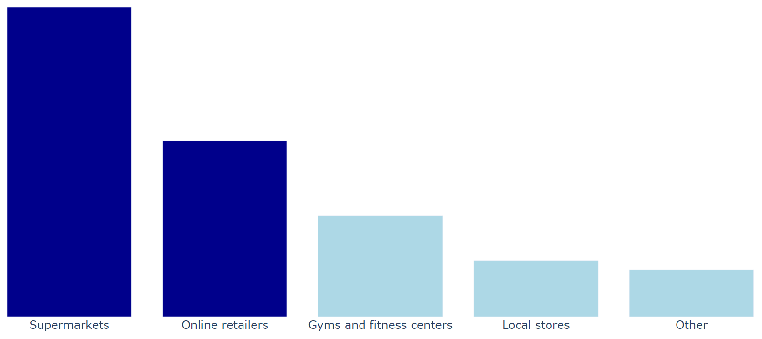
Purchase Behavior
a. Where do respondents prefer to purchase energy drinks?
More then
70%
preferred purchasing energy drinks
from Supermarkets and Online Retailers!

Slide 17
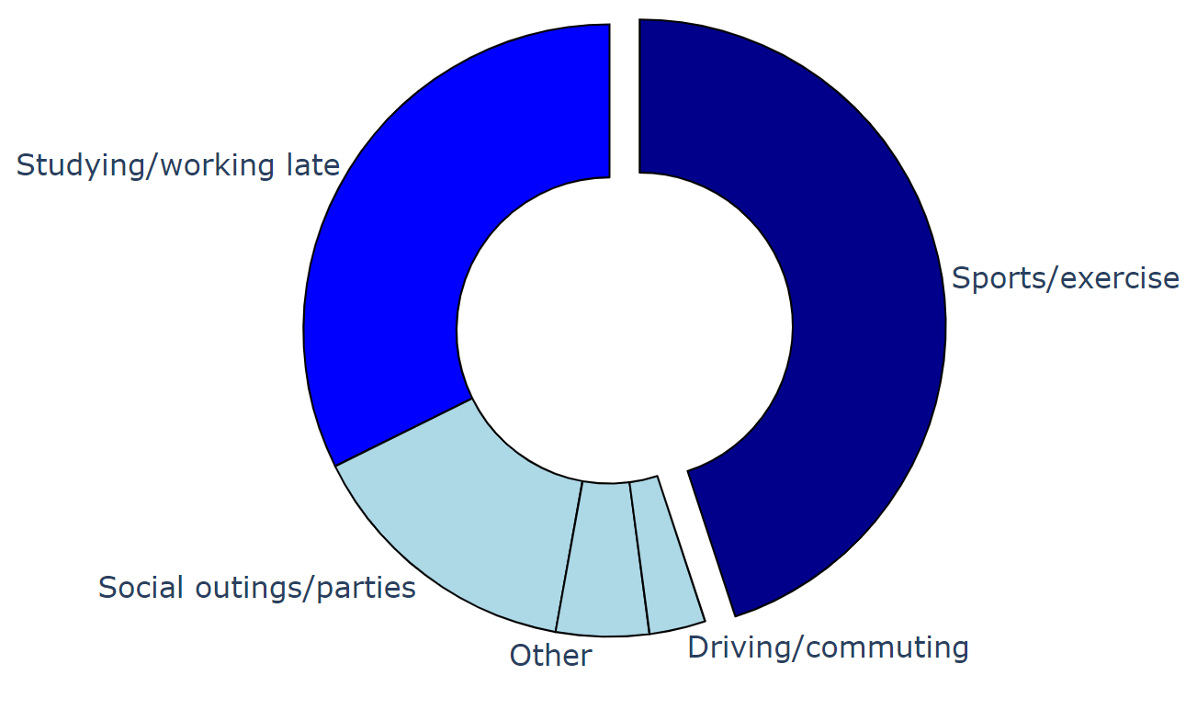
Purchase Behavior
b. What are the typical consumption situations for energy drinks among respondents?
More then
32%
More then
44%

Slide 18
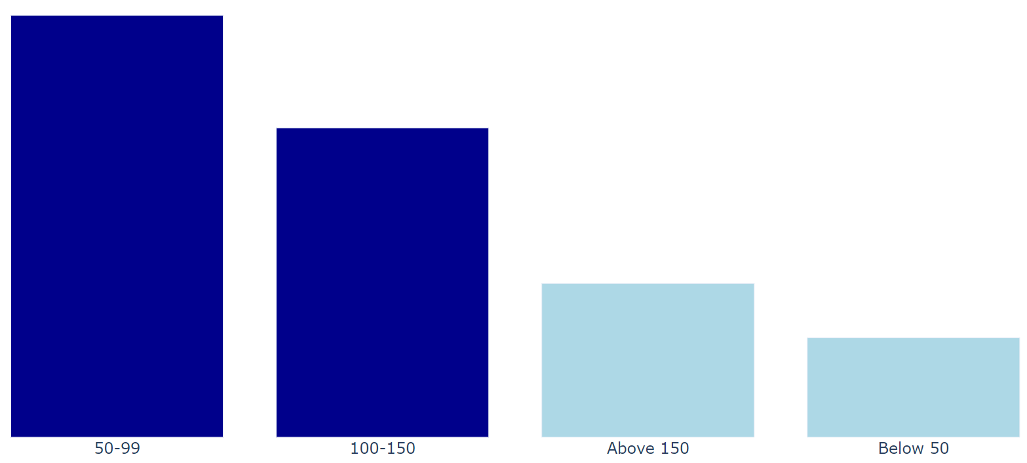
Purchase Behavior
c. What factors influence respondents' purchase decisions, such as price range and limited edition packaging?
42% people thinks the ideal price to be between Rs. 50-99!
39% are in the favor of Limited Edition Packaging!

Slide 19
Product Development
a. Which area of business should we focus more on our product development? (Branding/taste/availability)
As of now, CodeX should focus on Branding Reputation and Availability.
Bangalore
Hyderabad
Chennai
Kolkata
Unavailability in these 4 cities.
CodeX stands
6th
in the Brand Reputation!

Slide 20
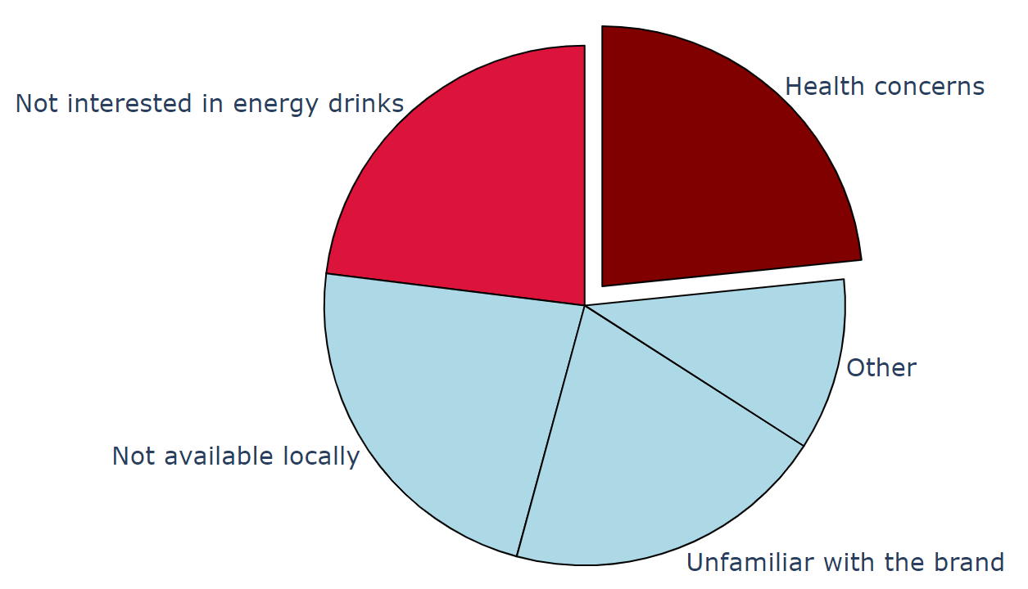
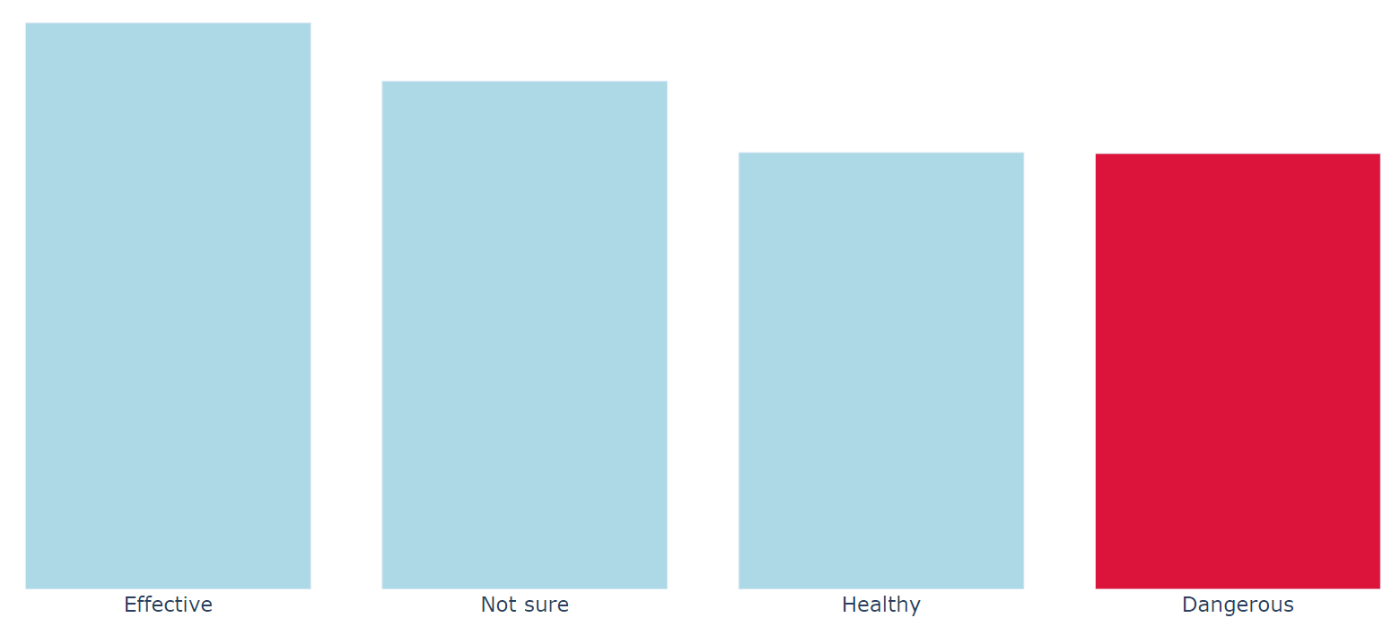
Recommendations for CodeX
a. What immediate improvements can we bring to the product?
Out of 10,000 people, 22% (2238) of the people thinks that energy drinks are dangerous.
One of the reason for not trying CodeX is Health Concern!

Slide 21
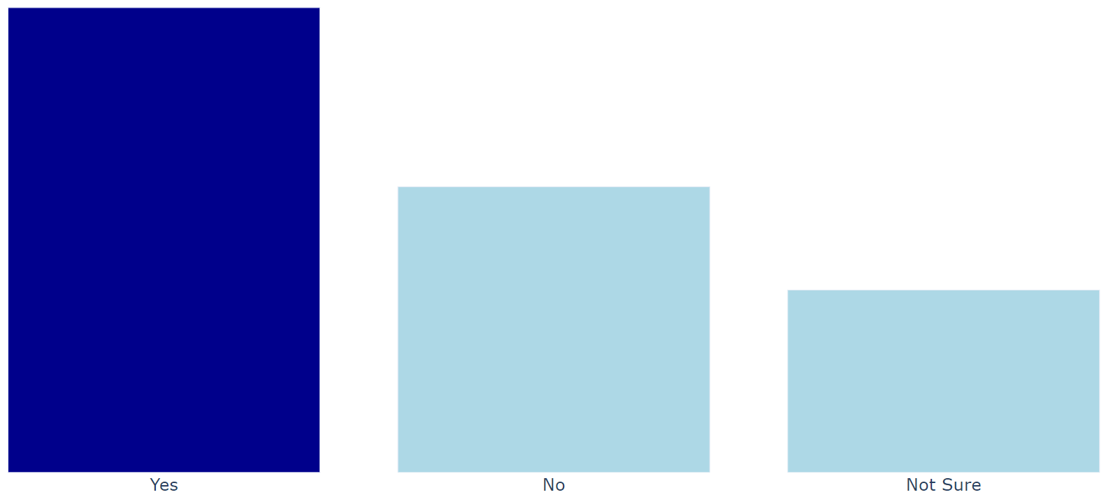
Recommendations for CodeX
More then
49%
respondents are in the favor of adding natural/organic content!
Therefore, taking all the things into consideration, CodeX should try adding some natural/organic ingredient in the drinks!

Slide 22
Recommendations for CodeX
b. What should be the ideal price of our product?
The 19-35 is the age group that prefers taking energy drinks.
Ideal price should be Rs. 50-60.
Also, they should try different quantities for packaging like 500ml, 300ml and so on with the max price between Rs. 50-60.

Slide 23

Recommendations for CodeX
c. What kind of marketing campaigns, offers, and discounts we can run?
Company should try sponsorship deals for the sports events and body building events especially cricket and IBBFF for India and should advertise as much as possible.
Since Online Ads and TV commercials are the most known marketing channels, Facebook (Online Ads) and Star or Sony Entertainment Channels(TV commercials) can be used to increase the marketing.
Different flavors such as orange, grape, apple, and lemon are all popular choices, and different combinations of citrus and tropical flavors like Mango Essence Natural and Guava Flavor Natural can produce fresh, sweet, and light flavors that create the right mood for an energy drink meant to help energize a consumer.
Ownership of teams, sports events and stunt events or bike racing can be organized.
Also, should try for some slogan which tends to attract many customers, like “red bull gives you wings” slogan.
Sports such as mountain biking, wind surfing, snowboarding or skateboarding, etc., can be used to campaigning the product.

Slide 24
Recommendations for CodeX
d. Who can be a brand ambassador, and why?
Bollywood: Mr. Shah Rukh Khan (actor), Ms. Kangana Ranaut (actress)
Sports: Mr. Sunil Chhetri (Football), Mr. Pardeep Narwal (Kabaddi)
Social Media Influencer: Mr. Gaurav Taneja (The Flying Beast), Mr. Ranveer Allahbadia
With millions of subscribers on YouTube, he leads his way among the Top 50 Indian Health and fitness Youtuber.
He is an entrepreneur, social media Influencer, motivational speaker, leadership coach. He has many YouTube channels and a podcast, ‘The Ranvir Show’. Mainly the channel focuses on self-improvement and entrepreneurship.

Slide 25
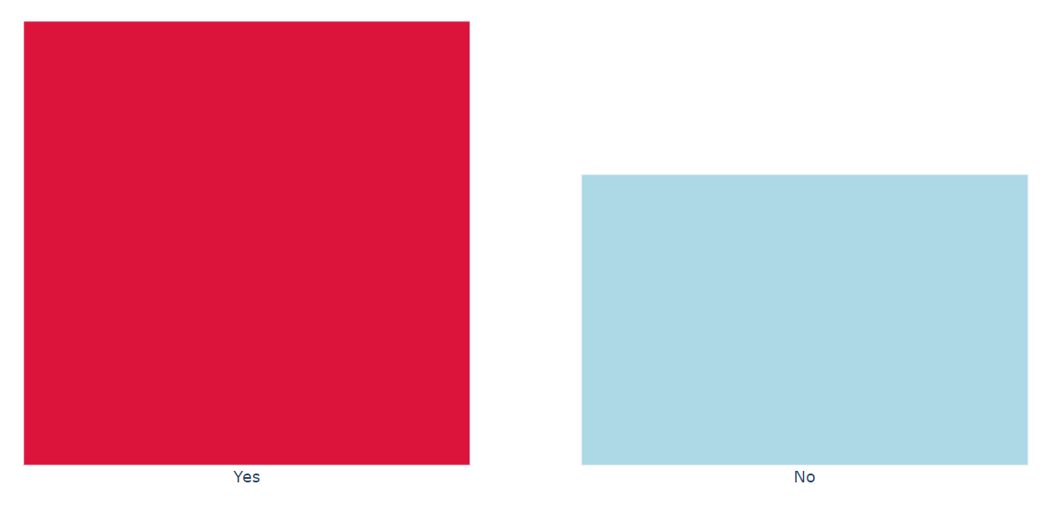
Recommendations for CodeX
e. Who should be our target audience, and why?
Target audience should be between 24-45 and not less then this, since more then 60% of the people are concerned about health and so the people of age <24 will try to keep themselves away from external energy booster drinks for better health. Also, they tends to have more energy level than ever and people more then 45 years should also focus more on healthy diets rather than these external energy booster.
This can act as a message for CodeX audience where company promotes drinks only for certain age group and give some health advices for rest of the age groups. This will act as a trust builder in the audience and also will allow the company to stand out as most of the companies starts their target audience with the people of age of 18 or even less. 24-45 should be the ideal target audience range as this age group is mature and they are also indulge in more manual and mental work.
Health campaigns should be organized taking the above into consideration where CodeX can promote organic ingredients in the drinks as people are getting more concerned about health and this can act as advantage for the company if consider suggestions and comments.
More then
60%
respondents are concerned about the health impact of energy drinks!

Slide 26


Dhaval Patel Sir
Hemanand Vadivel Sir

