Slide 1
Extension Of DSVM with Data Lake Store and Hdinsights

Slide 2
DS Team real pains
Since they cannot add on HDInsight the python visualization libraries they need, they use mainly their laptops
No structured way of sharing data between them (usb keys)
Since they use their laptop each DS has his own environment and code is not always portable because needs libraries that are available only on the laptop of the DS.
Other departments of the company are using Databricks that is really a complete E2E Data Science environment for Spark workloads where data, visualizations, code, versioning, clusters and scheduling is managed all at once in very simple and elegant way
Risks
Enterprise IT sponsors Azure but if DS team moves to AWS with Databricks other workloads can move to AWS with the potential risk of losing all Azure revenues

Slide 3
Solution
?
?
?
?

Slide 4
How we addressed the pain points
Assign to each DS member a Linux DS VM with a local Jupiter notebook server and a local Spark installation (the OOB image that we offer from marketplace)
Add to the OOB Linux DS VM the possibility to connect , via local spark, to azure blob storage (adding libraries, conf files and settings)
Add to the OOB Linux DS VM spark magic (adding libraries, conf files and settings) to connect from local Jupyter notebook to the HDInsight cluster using Livy
Tuning of the local spark parameters to overcome write speed bottlenecks on Azure Blob
Leveraging , thanks to the ADF PG, the new Spark Activity on ADF to schedule PySpark jobs with custom modules loading
Setup the HDInsight Azure Blob Storage as the “de facto” area where each DS finds input data and puts the outputs of his jobs with a clear and shared taxonomy and folder structure
Setup of the git control version on the notebooks and python libraries on each DS VM

Slide 5
Results
Common data area where all the DS collaborate together
Structured and easy way to schedule Spark jobs
Version control of notebooks (previously hosted on the cluster itself)
Ability to run all the custom, needed external libraries on their own jupyter server on the linux DS VM

Slide 6
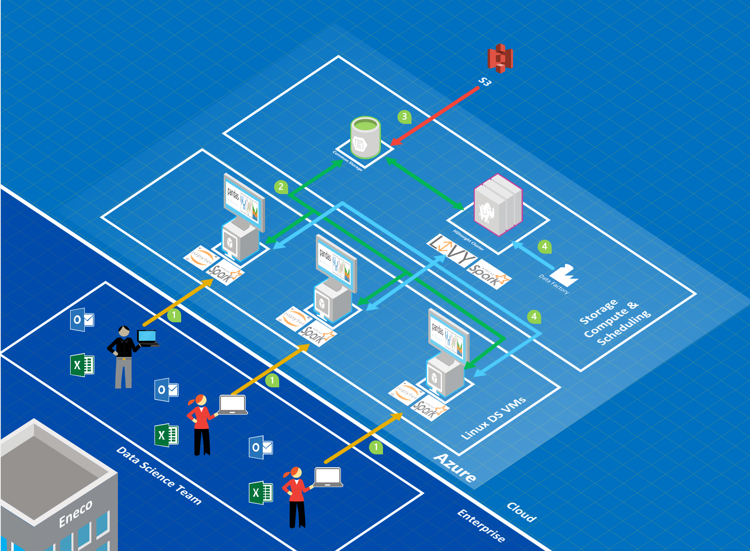
Our solution
Data scientist operate with standardized Linux DS VM
Transformed Data elaborated with Linux DS VM is read/written to Azure Blob Storage
New telemetry data from external sources comes to Azure Blob Storage
Heavy Spark computations are pushed/scheduled to the HDInsight Cluster that read/writes on the same storage blob

Slide 7





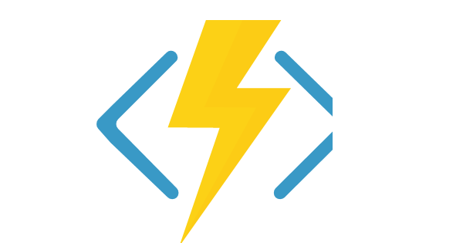
The Whole Picture
Dev/Test Environment
HDInsight
DSVM
Azure Data Factory
VSTS
Git
Azure Functions
Data Lake Store

Slide 8
Thank you
?
?
?
?

