Slide 1
Jeevan Jagadeesh

Slide 2
Agenda
Introduction to Node JS
How to Install
Simple Examples
NPM
Q & A

Slide 3
What is node.js
Node.js is a JavaScript runtime built on Chrome's V8 JavaScript engine
Node.js uses an event-driven, non-blocking I/O model that makes it lightweight and efficient

Slide 4
Why Node.JS
Asynchronous and Event Driven – many connections can be handled concurrently
Lightweight and Very Fast
Notes:
Most regular Web Servers like Apache uses OS threads for request handling. That means that every request the server handles will spawn a OS thread and the web server won't release the thread until the request finish.
Most of the time OS threads wait till some I/O operation finish:
var result = query("select * from users");
for(user in result){
//You get the idea // In this case the OS thread just sits and waits the I/O operation returns to resume the flow.
}
Every OS thread takes some memory, so regular servers can't handle many simultaneous connections without penalizing the system performance

Slide 5
Where all NODE.js
I/O bound Applications
Data Streaming Applications
JSON APIs based Applications
Note - It is not advisable to use Node.js for CPU intensive applications.

Slide 6
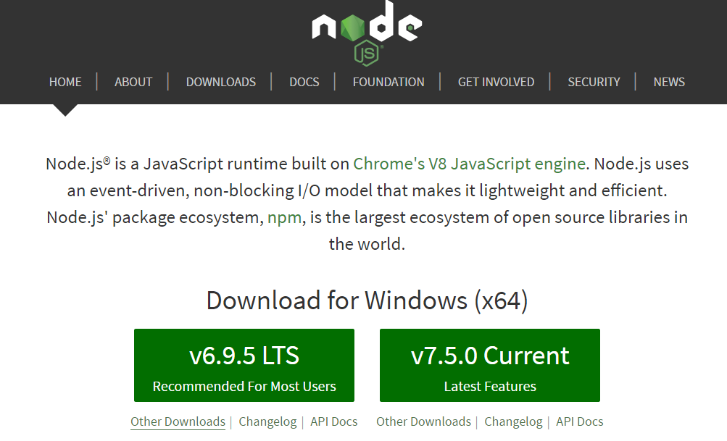
How to install NodeJS
Download latest nodejs.exe from - https://nodejs.org/en/
Execute the exe

Slide 7

Validate NodeJs installation
Command prompt, node --version

Slide 8
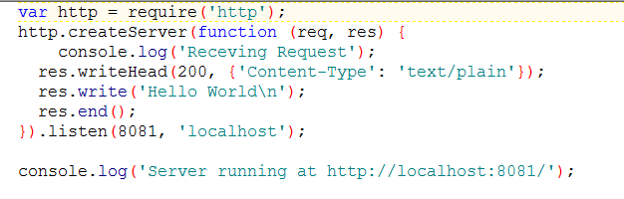
Hello WorLD

Slide 9
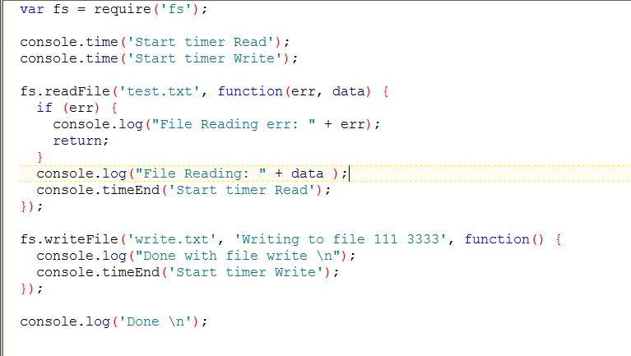
Async I/O

Slide 10
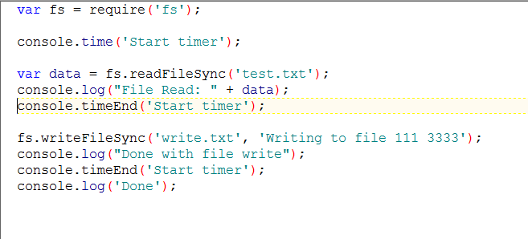
sync I/O

Slide 11
NODE Package manager (npm)
Node.js supports modularity. Each modules can be bundled under a single package.
NPM is used to install, update, uninstall and configure Node JS Platform modules/packages very easily.

Slide 12
Installing third party modules
NPM Install
npm install <options> <package unique name>
Eg - npm install express --save

Slide 13
Node.js “require”
The modules/packages available can be imported in .js file using “require” function.
Ex – require(“http”);
This helps in loading “http” package in current .js file.

Slide 14
Modules export n import
A module in node.js can be exported, by which it can be imported in other files.
The “require” function helps in importing modules.
Exporting -
module.exports{<module to be exported>}
Importing –
var <varName> = require(<module name>);

Slide 15
References
https://nodejs.org/en/
http://www.journaldev.com/7462/node-js-architecture-single-threaded-event-loop
https://www.npmjs.com

Slide 16


Slide 17


