Slide 1
DIPLOMA PROJECT · VIVA PRESENTATION
E-WASTE MANAGEMENT & RECYCLING SYSTEM
An Object-Oriented Approach to Sustainable E-Waste Management
C++17
OBJECT-ORIENTED PROGRAMMING
DIPLOMA ENGINEERING PROJECT
Students: Kaushik B. Topale
Nachiket Mane
Viraj Durgoli
Samarth Thorva
Waleed Khan
SYSTEM STATUS: ONLINE
Diploma Electronics & Computer Engineering

Slide 2
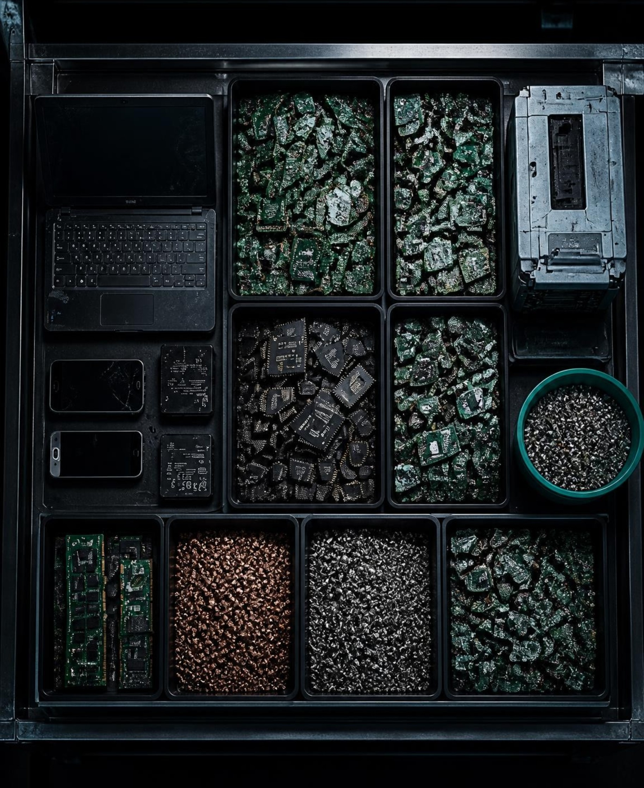
ANALYSIS · CURRENT CHALLENGES
MISSION 01 — THE PROBLEM
Unorganized E-Waste: Electronic waste is often recorded and handled without a structured system.
01
Incorrect Classification: Different electronic items require different handling and recycling processes.
02
No Condition-Based Decision: Working, partially working and non-working devices need different treatment.
03
Poor Tracking: Collection and recycling status can be difficult to monitor.
04
SYSTEM LIFECYCLE TARGET
Problem → Classification → Decision → Collection → Recycling

Slide 3
TARGET CAPABILITIES · SYSTEM PIPELINE
MISSION 02 — SYSTEM OBJECTIVES
MISSION COMPLETION: 100%
OBJ 01
OBJ 02
OBJ 03
1. Register E-Waste
2. Classify Automatically
3. Recommend Action
Record owner, item, type, condition and weight.
Assign the correct e-waste category.
Reuse → Repair → Recycling based on condition.
OBJ 04
OBJ 05
OBJ 06
4. Reward Responsible Disposal
5. Track Collection
6. Generate Reports
Calculate reward points according to type, weight and condition.
Registered → Scheduled → Collected → Sorted → Recycled.
Analyze categories, conditions, status, weight and rewards.

Slide 4
SYSTEM ARCHITECTURE · C++17 IMPLEMENTATION
VECTOR<EWASTEITEM*> → RUNTIME POLYMORPHISM
CORE ENGINE — OBJECT-ORIENTED DESIGN
CLASS HIERARCHY TREE
Class hierarchy: EWasteItem << ABSTRACT >> → Mobile, Laptop, Battery, Printer, Television.
Mobile
Derived Class
Laptop
Derived Class
Battery
Derived Class
Printer
Derived Class
Television
Derived Class
PILLAR 1
PILLAR 2
PILLAR 3
PILLAR 4
Encapsulation
Abstraction
Inheritance
Polymorphism
Encapsulation: Private data + controlled access.
Abstraction: Abstract EWasteItem + pure virtual functions.
Inheritance: Specialized e-waste classes inherit common behaviour.
Polymorphism: Base-class pointers call derived-class implementations at runtime.

Slide 5
ALGORITHMIC LOGIC · DECISION ENGINE
CORE ENGINE — SMART DECISION FLOW
PIPELINE EXECUTION STEP 1
1. USER → REGISTER E-WASTE → IDENTIFY TYPE → CHECK CONDITION → CALCULATE REWARD
PIPELINE EXECUTION STEP 2
2. SMART RECOMMENDATION: Working → REUSE / RESALE; Partial → REPAIR / REFURBISH; Non-working → RECYCLING.
PIPELINE EXECUTION STEP 3
3. SCHEDULE COLLECTION → COLLECTED → SORTED → RECYCLED
RUNTIME TEST EXECUTION TRACE
Example: Laptop | 2.5 kg | Non-Working → Computer Equipment → Recycling Recommended → 46 Reward Points

Slide 6
FUNCTIONAL SPECIFICATION · CAPABILITIES
8 CORE MODULES | C++17 | OFFLINE SYSTEM
SYSTEM MODULES — AVAILABLE FEATURES
E-Waste Registration: Generate unique E-Waste ID such as EW1001.
Condition Assessment: Working / Partially Working / Non-Working.
Reward Engine: Type rate × weight × condition multiplier.
Collection Manager: Schedule and track collection lifecycle.
Search System: Search by ID, owner or category.
Report Generator: Category, condition, status, weight and reward statistics.
Exception Handling: Custom exceptions for invalid input, ID, weight and missing records.
File Management: Persistent data + transaction logging.

Slide 7
CLI INTERFACE & BATCH ANALYTICS
MISSION COMPLETE — SYSTEM OUTPUT
AGGREGATE SYSTEM AUDIT
Total Items: 05
Total Weight: 18.70 KG
TERMINAL SESSION: /BIN/EWASTE_CLI
Actual C++ console menu: 1. Register E-Waste; 2. View All E-Waste; 3. Search E-Waste; 4. Assess Condition; 5. Get Recycling Recommendation; 6. Calculate Reward; 7. Schedule Collection; 8. Update Status; 9. Generate Reports; 10. Update E-Waste; 11. Delete E-Waste; 12. View Transaction Log; 13. Save & Exit.
Reward Points: 312
Hazardous Items: 01
Recycled Items: 03

Slide 8
EVALUATION & ROADMAP
FINAL STATUS — PROJECT SUMMARY
SYSTEM STATUS: OPERATIONAL
WHAT WE ACHIEVED
FUTURE UPGRADES
• Practical e-waste management system
Database Integration: Replace text storage with MySQL/database.
• Strong OOP implementation
• Runtime polymorphism
Authentication: Add user/admin login.
• Exception handling
• File persistence
Analytics Dashboard: Visualize recycling statistics.
• STL-based data management
Mobile/Web Interface: Connect the C++ backend with a modern interface.
• Collection lifecycle tracking
• Reward and recommendation engine
THANK YOU · QUESTIONS & VIVA

