Slide 1
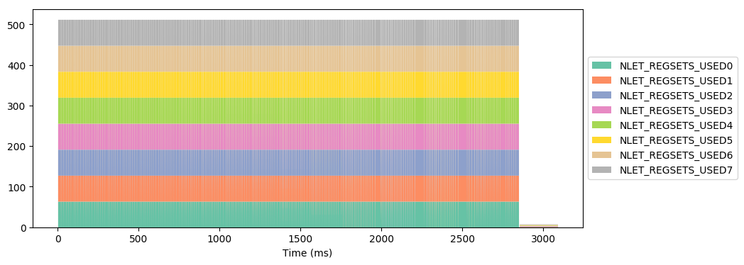
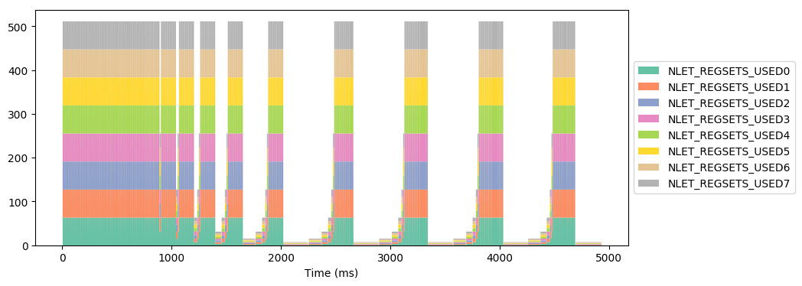
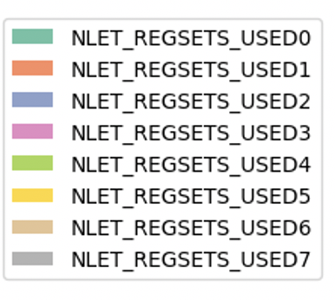
Bitonc Sort WITH Adaptive Loop Parallelism
Active Threads per Nodelet
Bitonc Sort WITHOUT Adaptive Loop Parallelism
Active Threads per Nodelet
active threads
Nodelet 0
Nodelet 2
Nodelet 4
Nodelet 6
Nodelet 1
Nodelet 3
Nodelet 5
Nodelet 7

Slide 3
Nodelet 0
Nodelet 2
Nodelet 4
Nodelet 6
Nodelet 1
Nodelet 3
Nodelet 5
Nodelet 7

